Slide 1
Computer Arch. & AI Chip Lecture 2: Pipeline Hazard + Reorder Buffer
Prof. Zeke Wang
Zhejiang University
09 March 2026

Slide 2
Recall: Axiom
To achieve the highest energy efficiency and performance:
we must take the expanded view
of LLM system
Problem
Algorithm
Co-design across the hierarchy:
Algorithms to devices
Program/Language
System Software
SW/HW Interface
Specialize as much as possible
within the design goals
Micro-architecture
Logic
Devices
Electrons

Slide 3
Recall: Amdahl’s Law
Amdahl’s Law
f: Parallelizable fraction of a program
N: Number of processors
Serial bottleneck of Amdahl’s Law:
Maximum speedup (1/(1-f)) limited by serial portion (1 - f)
Parallel portion (f) is usually not perfectly parallel
Synchronization overhead (e.g., updates to shared data)
Load imbalance overhead (imperfect parallelization)
Resource sharing overhead (contention among N processors)
1
Speedup =
1 - f
+
f
N
Amdahl, “Validity of the single processor approach to achieving large scale computing capabilities,” 1967.

Slide 4
Recall: Key Term in Roofline Model
Arithmetic intensity (AI)
Definition: AI = Total Flops / Total Memory Bytes
Arithmetic intensity describes the characteristics of a compute kernel running on a given processor
Large AI → Compute-bound
Small AI → Memory-bound
9
Williams, Waterman, Patterson, “Roofline: An Insightful Visual Performance Model for Multicore Architectures”, CACM, 2009
Notes:
All these works rely on many different methodology's to identify memory bottlenecks in a system. Often, such methodologies are intuitively used as a indication of NDP suitability for a given application
[CLICK] However, as I will show next, none of those models are comprehensive enough to identify memory bottlenecks and NDP suitability. This happens because these models are built targeting to identify specific sources of data movement bottlenecks, and often their definitions of compute and memory bound are not enough to indicate NDP suitability.
[CLICK] For that, we will analyze two commonly used approaches: the roofline model, which correlates the arithmetic intensity of an application with performance,
[CLICK] and identifying application that has high misses-per-kilo instructions or MPKI.
[NEXT]

Slide 5
Recall: Roofline Model’s 3 Steps
Roofline model’s 3 Steps:
1, Machine characterization:
Memory bandwidth,
Peak compute;
2, Application Characterization:
Arithmetic intensity;
3, Application execution monitoring:
Real Throughput
9
Williams, Waterman, Patterson, “Roofline: An Insightful Visual Performance Model for Multicore Architectures”, CACM, 2009
Notes:
All these works rely on many different methodology's to identify memory bottlenecks in a system. Often, such methodologies are intuitively used as a indication of NDP suitability for a given application
[CLICK] However, as I will show next, none of those models are comprehensive enough to identify memory bottlenecks and NDP suitability. This happens because these models are built targeting to identify specific sources of data movement bottlenecks, and often their definitions of compute and memory bound are not enough to indicate NDP suitability.
[CLICK] For that, we will analyze two commonly used approaches: the roofline model, which correlates the arithmetic intensity of an application with performance,
[CLICK] and identifying application that has high misses-per-kilo instructions or MPKI.
[NEXT]

Slide 6

Recall: Little’s Law：Intuition
Average service time: 6 mins
Arrival rate: one person/min
How many Counters?
Image the services provided by counters in the bank.
Arrival rate: one customer/min;
Counter’s average serve time: 6 mins;
Question: how many counters are needed for people who need the service? (Cond: The customer will leave if no counter is available. )
Answer: 6 counters (one slot for one person, then no customer will leave).
Notes:
这里server不太合理

Slide 7
Recall: Little’s Law Used in Memory Subsystem
Latency: ~100ns
Buffer
Memory
Throughput: 12GB/s
Little’s law is widely used in hardware design whose latency is larger than one cycle, e.g., memory subsystem:
Throughput: 12GB/s;
Latency: 100ns;
Buffer Size (concurrency):
100ns * 12GB/s = 1200B
Concurrency = Latency * Throughput

Slide 8
Recall von Neumann Model: Key Properties
Von Neumann model is also called stored program computer (instructions in memory).
von Neumann Model has two key properties:
1，Stored program
Instructions stored in a linear memory array
Memory is unified between instructions and data
The interpretation of a stored value depends on the control signals
2，Sequential instruction processing
One instruction processed (fetched, executed, completed) at a time
Program counter (instruction pointer) identifies the current instruction
Program counter is advanced sequentially except for control transfer instructions
Notes:
Every application can be descripted by this complete design von Neumann

Slide 9
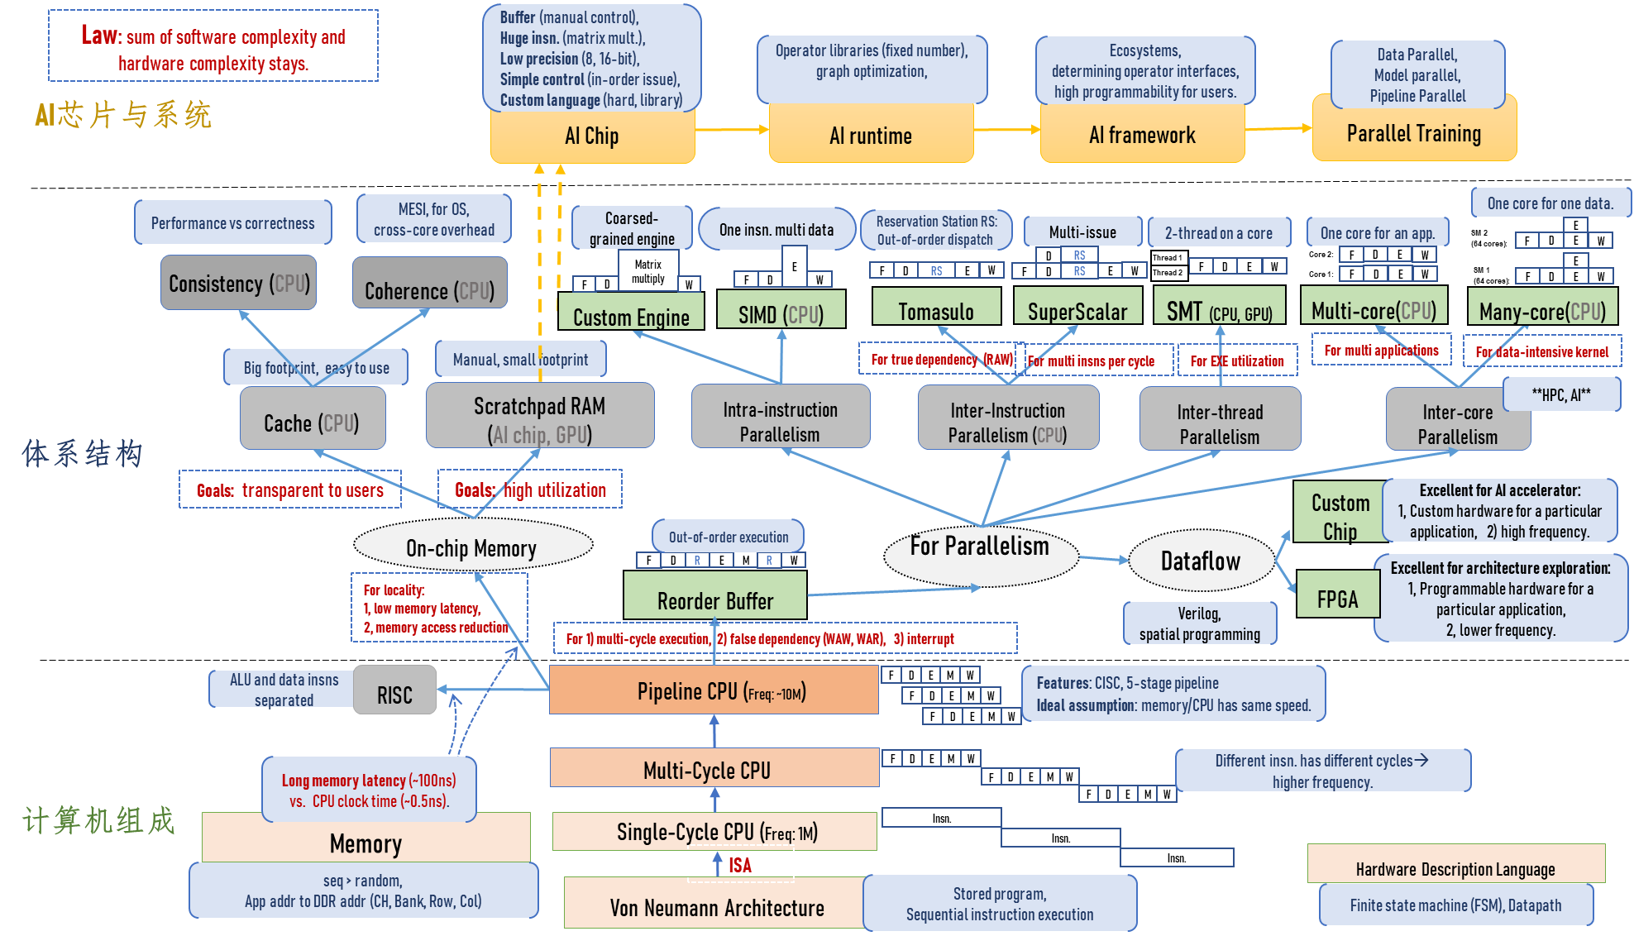
Where Are We?

Slide 10
Outline
Pipeline Hazard
Structural Hazard
Data Hazard (Dependencies)
Control Hazard
Reorder Buffer
For Multi-cycle Execution
For Exception and Interrupt
For False Dependencies (WAW & WAR)
Definition of Reorder Buffer

Slide 11
Pipeline hazards
A hazard is a condition that prevents an instruction in the pipeline from executing its next scheduled pipeline stage.
Taxonomy of hazard:
Structural hazards
Conflict due to limited hardware resources
Data hazards
Instruction depends on result of a prior instruction which is not ready (computed or stored) yet
Control hazards
Not able to fetch the next instruction for the next clock due to unsolved branch condition or unavailable branch.

Slide 12
Outline
Pipeline Hazard
Structural Hazard
Data Hazard (Dependencies)
Control Hazard
Reorder Buffer
For Multi-cycle Execution
For Exception and Interrupt
For False Dependencies (WAW & WAR)
Definition of Reorder Buffer

Slide 13
Structural hazard
Structural hazard
Reason: Occurs when two or more instructions try to use the same hardware resource in the same cycle.
Outcome: Causes bubble (stall) in a pipelined CPU.
Solution: Can be overcome by replicating hardware resources
Multiple accesses to the register file
Multiple accesses to memory
Fully pipeline the functional unit

Slide 14
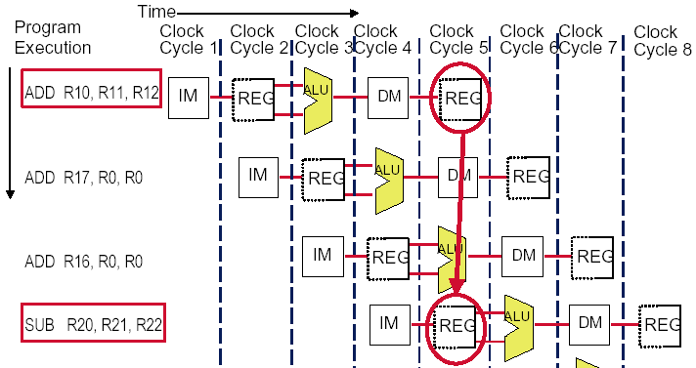
Structural Hazard: Multi Ports of Register File
Condition of Register file to avoid structural hazard?
Allows concurrently two reads and one write to avoid structural hazard regarding register file.
Notes:
下面，从寄存器文件来说结构冲突：多少个读口，多少个写口才能解决冲突？
答案：两个读口 一个写口
Generalization：硬件设计需要满足最坏的情况

Slide 15
Instruction and Data Memory Ports Split
Structural hazard regarding memory?
Solution: Split instruction and data memory
Fetch the instruction and data using different memory ports, rather than contenting for the same port.
Time (clock cycles)
I
n
s
t
r.
O
r
d
e
r
Ld/St
IM
Reg
ALU
DM
Reg
Instr 1
IM
Reg
ALU
DM
Reg
Instr 2
IM
Reg
ALU
DM
Reg
Instr 3
IM
Reg
ALU
DM
Reg

Slide 16
Outline
Pipeline Hazard
Structural Hazard
Data Hazard (Dependencies)
Control Hazard
Reorder Buffer
For Multi-cycle Execution
For Exception and Interrupt
For False Dependencies (WAW & WAR)
Definition of Reorder Buffer

Slide 17
Data Dependences
Three Types of data dependences
Flow dependence (read after write – true data dependence)
Output dependence (write after write)
Anti dependence (write after read)
Which ones cause stalls in a pipelined machine?
Assumption: we need to ensure semantics of the program is correct.
Flow dependences always need to be obeyed because they constitute true dependence on a register
Anti and output dependences exist due to limited number of architectural registers.
Essentially, insns are dependent on a name, not a value.

Slide 18
Data Dependence Types
Flow dependence
r₃ ← r₁ op r₂ Read-after-Write
r₅ ← r₃ op r₄ (RAW)
Anti dependence
r₃ ← r₁ op r₂ Write-after-Read
r₁ ← r₄ op r₅ (WAR)
Output-dependence
r₃ ← r₁ op r₂ Write-after-Write
r₅ ← r₃ op r₄ (WAW)
r₃ ← r₆ op r₇

Slide 19
How to Handle Data Dependences
Anti and output dependences
They are easier to handle.
Write to the destination only in last stage and in program order
Handling flow dependences:
Hardware Pipeline Stall:
Detect and wait until value is available in register file
Software Pipeline Stall:
Detect and eliminate the dependence at the software level
No need for the hardware to detect dependence
Data Forward/Bypass:
Detect and forward/bypass data to dependent instruction

Slide 20
Outline
Pipeline Hazard
Structural Hazard
Data Hazard (Dependencies)
RAW
WAW
WAR
Control Hazard
Reorder Buffer
For Multi-cycle Execution
For Exception and Interrupt
For False Dependencies (WAW & WAR)
Definition of Reorder Buffer

Slide 21
Remember: Data Dependence Types
Flow dependence
r₃ ← r₁ op r₂ Read-after-Write
r₅ ← r₃ op r₄ (RAW)
Anti dependence
r₃ ← r₁ op r₂ Write-after-Read
r₁ ← r₄ op r₅ (WAR)
Output-dependence
r₃ ← r₁ op r₂ Write-after-Write
r₅ ← r₃ op r₄ (WAW)
r₃ ← r₆ op r₇

Slide 22
RAW Data Dependence: Example
One instruction writes a register ($s0) and next instructions read this register => read after write (RAW) dependence.
add writes into $s0 in the first half of cycle 5
and reads $s0 on cycle 3, obtaining the wrong value
or reads $s0 on cycle 4, again obtaining the wrong value
sub reads $s0 in 2nd half of cycle 5, getting the correct value
subsequent instructions read the correct value of $s0
Only if the pipeline handles
data dependences incorrectly!

Slide 23
How to Handle Data Dependences
Anti and output dependences
They are easier to handle.
Write to the destination only in last stage and in program order
Handling flow dependences:
Hardware Pipeline Stall:
Detect and wait until value is available in register file
Software Pipeline Stall:
Detect and eliminate the dependence at the software level
No need for the hardware to detect dependence
Data Forward/Bypass:
Detect and forward/bypass data to dependent instruction

Slide 24
Hardware Pipeline Stall for Flow Dependency
The simplest way to "fix" flow dependency is to stall the pipeline.
A pipeline stall, called a pipeline bubble or simply bubble.
What does a pipeline stall do to:
Previous instructions: go on proceeding in the pipeline.
Following instructions: stalled in the pipeline by one or more clock cycles until the waiting register is ready.
New instructions: Not fetched during a pipeline stall.

Slide 25
Hardware Pipeline Stall: An Example
Issue: dependency regarding register ra
Solution: hardware pipeline stalls the second insn until the first insn. writes the latest value of ra back.
addi ra r- -
IF
ID
EX
MEM
WB
subi r- ra -
IF
ID
EX
MEM
WB
subi r- ra -
IF
ID
EX
MEM
subi r- ra -
IF
ID
EX
IF
?
subi r- ra -
ID
subi r- ra -
IF

Slide 26
Pipeline Stall: Resolving Data Dependence
t₀
t₀
t₀
t₀
t₁
t₁
t₁
t₁
t₂
t₂
t₂
t₂
t₃
t₃
t₃
t₃
t₄
t₄
t₄
t₄
t₅
t₅
t₅
t₅
Inst_{h}
Inst_{h}
Inst_{h}
Inst_{h}
IF
IF
IF
IF
ID
ID
ID
ID
ALU
ALU
ALU
ALU
MEM
MEM
MEM
MEM
WB
WB
WB
WB
i
i
i
Inst_{i}
i
Inst_{i}
Inst_{i}
Inst_{i}
IF
IF
IF
IF
ID
ID
ID
ID
ALU
ALU
ALU
ALU
MEM
MEM
MEM
MEM
WB
WB
WB
WB
j
j
j
Inst_{j}
j
Inst_{j}
Inst_{j}
Inst_{j}
IF
IF
IF
IF
ID
ID
ID
ID
ALU
ID
ID
ID
MEM
ALU
ID
ID
WB
MEM
ALU
ID
WB
MEM
ALU
Inst_{k}
Inst_{k}
Inst_{k}
Inst_{k}
IF
IF
IF
IF
ID
IF
IF
IF
ALU
ID
IF
IF
MEM
ALU
ID
IF
WB
MEM
ALU
ID
Inst_{l}
Inst_{l}
Inst_{l}
Inst_{l}
IF
ID
IF
ALU
ID
IF
MEM
ALU
ID
IF
IF
ID
IF
ALU
ID
IF
i: r_{x} ← _
j: _ ← r_{x} dist(i,j)=1
i: r_{x} ← _
bubble
j: _ ← r_{x} dist(i,j)=2
i: r_{x} ← _
bubble
bubble
j: _ ← r_{x} dist(i,j)=3
i: r_{x} ← _
bubble
bubble
bubble
j: _ ← r_{x} dist(i,j)=4
IF
ID
IF
Pipeline stall = make the dependent instruction
wait until its source data value is available.
1. stop all up-stream stages,
2. drain all down-stream stages.
IF

Slide 27
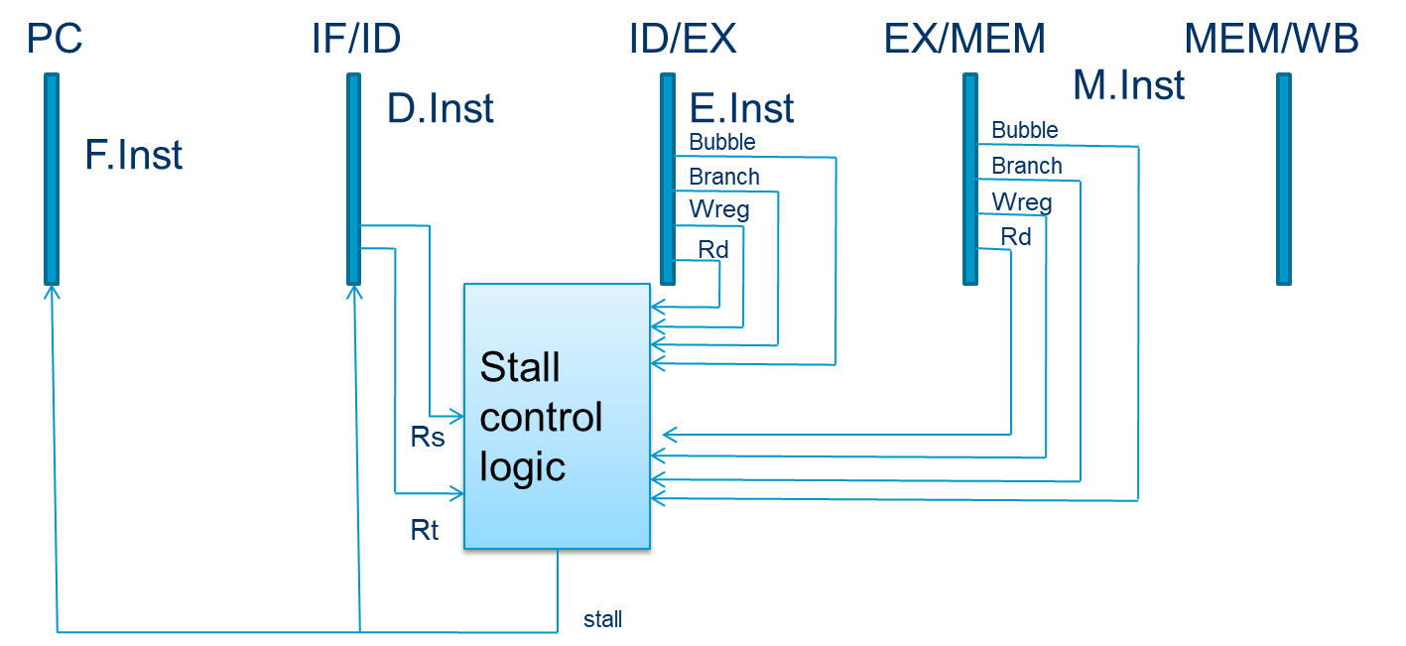
How to Implement Stalling in Pipeline?
Pipeline stalling:
Disables PC and IF/ID latching; ensure stalled instruction stays in its stage
Pushs a bubble into next stage: Bubble = 1 and disables control signal Wreg and Wmem; Puch a nop forward into ID/EX.
Based on original figure from [P&H CO&D, COPYRIGHT 2004 Elsevier. ALL RIGHTS RESERVED.]

Slide 28
Hardware Needed for Stalling
Stalls are supported by the following hardware:
adding enable inputs (EN) to the Fetch and Decode pipeline registers
and a synchronous reset/clear (CLR) input to the Execute pipeline register
or an INV bit associated with each pipeline register, indicating that contents are INValid
When a lw stall occurs
StallD and StallF are asserted to force the Decode and Fetch stage pipeline registers to hold their old values.
FlushE is also asserted to clear the contents of the Execute stage pipeline register, introducing a bubble

Slide 29
Stalling and Dependence Detection Hardware

Slide 30
How to Handle Data Dependences
Anti and output dependences
They are easier to handle.
Write to the destination only in last stage and in program order
Handling flow dependences:
Hardware Pipeline Stall:
Detect and wait until value is available in register file
Software Pipeline Stall:
Detect and eliminate the dependence at the software level
No need for the hardware to detect dependence
Data Forward/Bypass:
Detect and forward/bypass data to dependent instruction

Slide 31
Compile-Time Detection and Elimination
Insert enough NOPs for the required result to be ready
Or (if you can) move independent useful instructions up
Reorder/reschedule instructions at the compiler level

Slide 32
What is the issue of issuing NOPs from the compiler?
Insn’s latency varies, based on the context.
Notes:
The majority of you will not work on Systems.
But you should know the key principles that help you understand the system on which your AI task runs.
Our course has to include both computer architecture and AI chip courses.

Slide 33
More on Software vs. Hardware
Software based scheduling of instructions → static scheduling
Compiler orders the instructions, hardware executes them in that order
Contrast this with dynamic scheduling (in which hardware can execute instructions out of the compiler-specified order)
How does the compiler know the latency of each instruction?
What information does the compiler not know that makes static scheduling difficult?
Answer: Anything that is determined at run time
Variable-length operation latency, memory addr, branch direction
How can the compiler alleviate this (i.e., estimate the unknown)?
Answer: Profiling

Slide 34
How to Handle Data Dependences
Anti and output dependences
They are easier to handle.
Write to the destination only in last stage and in program order
Handling flow dependences:
Hardware Pipeline Stall:
Detect and wait until value is available in register file
Software Pipeline Stall:
Detect and eliminate the dependence at the software level
No need for the hardware to detect dependence
Data Forward/Bypass:
Detect and forward/bypass data to dependent instruction

Slide 35
Data Forwarding
Data Forwarding (called Data Bypassing)
Forwards the result value to the dependent instruction as soon as the value is available.
Act like Dataflow?
Data value supplied to dependent instruction as soon as it is available.
Instruction executes when all its operands are available.
Data forwarding brings a pipeline closer to dataflow execution principles.

Slide 36
Data Forwarding
Notes:
关于s0 有依赖。。。第一条写，后面读。。。

Slide 37
Data Forwarding
Notes:
Rse rte 是对应的读寄存器，
regwriteM memory stage
regwriteW write back stage

Slide 38
Data Forwarding
Forward to Execute stage from either:
Memory stage or
Writeback stage
When should we forward from either Memory or Writeback stage?
Answer：If that stage will write to a destination register and the destination register matches the source register.
If both the Memory and Writeback stages contain matching destination registers?
Answer： The Memory stage should have priority, because it contains the more recently executed instruction.

Slide 39
Data Forwarding (in Pseudocode)
Forward to Execute stage from either:
Memory stage or
Writeback stage
Forwarding logic for ForwardAE (pseudo code):
if ((rsE != 0) AND (rsE == WriteRegM) AND RegWriteM) then ForwardAE = 10 # forward from Memory stage else if ((rsE != 0) AND (rsE == WriteRegW) AND RegWriteW) then ForwardAE = 01 # forward from Writeback stage else ForwardAE = 00 # no forwarding
Forwarding logic for ForwardBE same, but replace rsE with rtE
Notes:
A B是两个不同操作数

Slide 40
Forwarding Is Not Always Possible
Forwarding is sufficient to resolve RAW data dependences
Unfortunately, there are cases when forwarding is not possible
Due to pipeline design and instruction latencies
The lw instruction does not finish reading data until the end of the Memory stage
→ its result cannot be forwarded to the Execute stage of the next instruction
Notes:
本质上：把一个周期变成两个部分，第一部分结束 --》第二部分开始。

Slide 41
Outline
Pipeline Hazard
Structural Hazard
Data Hazard (Dependencies)
RAW
WAW
WAR
Control Hazard
Reorder Buffer
For Multi-cycle Execution
For Exception and Interrupt
For False Dependencies (WAW & WAR)
Definition of Reorder Buffer

Slide 42
Control Dependence
Control dependence
Data dependence on the Instruction Pointer / Program Counter

Slide 43
Outline
Pipeline Hazard
Structural Hazard
Data Hazard (Dependencies)
RAW
WAW
WAR
Control Hazard
Reorder Buffer
For Multi-cycle Execution
For Exception and Interrupt
For False Dependencies (WAW & WAR)
Definition of Reorder Buffer

Slide 44
Where Are We?

Slide 45
Review: Single-Cycle MIPS FSM
Single-cycle machine
AS’
AS
Sequential
Logic
(State)
Combinational
Logic
AS: Architectural State

Slide 46
Review: Multi-Cycle MIPS FSM
What is the shortcoming of
this design?
What does
this design
assume
about memory?

Slide 47
Recall: Illustrating Pipeline Operation
 | t₀ | t₁ | t₂ | t₃ | t₄ | t₅ | t₆ | t₇ | t₈ | t₉ | t₁₀
IF
ID
EX
MEM
WB
I₀
I₁
I₂
I₃
I₄
I₅
I₆
I₇
I₈
I₉
I₁₀
I₀
I₁
I₂
I₃
I₄
I₅
I₆
I₇
I₈
I₉
I₀
I₁
I₂
I₃
I₄
I₅
I₆
I₇
I₈
I₀
I₁
I₂
I₃
I₄
I₅
I₆
I₇
I₀
I₁
I₂
I₃
I₄
I₅
I₆

Slide 48
Recall: Pipelined Control
Same control unit as single-cycle processor Control delayed to proper pipeline stage

Slide 49
Recall: Data Dependence Types
Flow dependence
r₃ ← r₁ op r₂ Read-after-Write
r₅ ← r₃ op r₄ (RAW)
Anti dependence
r₃ ← r₁ op r₂ Write-after-Read
r₁ ← r₄ op r₅ (WAR)
Output-dependence
r₃ ← r₁ op r₂ Write-after-Write
r₅ ← r₃ op r₄ (WAW)
r₃ ← r₆ op r₇

Slide 50
Recall: How to Handle Data Dependences
Anti and output dependences
They are easier to handle.
Write to the destination only in last stage and in program order
Handling flow dependences:
Hardware Pipeline Stall:
Detect and wait until value is available in register file
Software Pipeline Stall:
Detect and eliminate the dependence at the software level
No need for the hardware to detect dependence
Data Forward/Bypass:
Detect and forward/bypass data to dependent instruction

Slide 51
Pipelined CPU: Ideal vs. Realistic
Ideal pipelined CPU has：
One pipeline
Fixed latency
Dependency is known at compiler time
no support for exception/interrupt
Realistic Pipelined CPU has:
Multiple pipelines with different latencies
Unpredictable latency
Unknown dependency at compiler time
Support for exception/interrupt

Slide 52
Outline
Pipeline Hazard
Structural Hazard
Data Hazard (Dependencies)
RAW
WAW
WAR
Control Hazard
Reorder Buffer
For Multi-cycle Execution
For Exception and Interrupt
For False Dependencies (WAW & WAR)
Definition of Reorder Buffer

Slide 53
Multi-Cycle Execution
Multi-Cycle Execution： Not all instructions take the same amount of time for “execution”.
Question: How to address multi-cycle execution issue?
Answer: Have multiple different functional units that take different number of cycles
Can let independent instructions start execution on a different functional unit before a previous long-latency instruction finishes execution
E
Integer add
Integer mul
E
E
E
E
?
F
D
FP mul
E
E
E
E
E
E
E
E
. . .
E
E
E
E
E
E
E
E
Load/store

Slide 54
Example of Multi-Cycle Execution
Instructions take different number of cycles in EXECUTE stage
Integer ADD (1 cycle) versus Integer DIVide (8 cycles)
What is wrong with this picture in a Von Neumann architecture?
Sequential semantics of the ISA NOT preserved!
DIV R4 ← R1, R2
ADD R3 ← R1, R2
F
D
E
E
E
E
E
E
E
E
W
F
D
E
W
……
F
D
E
W
F
D
E
W
DIV R2 ← R5, R6
ADD R7 ← R5, R6
F
D
E
E
E
E
E
E
E
E
W
F
D
E
W
F
D
E
W

Slide 55
Outline
Pipeline Hazard
Structural Hazard
Data Hazard (Dependencies)
RAW
WAW
WAR
Control Hazard
Reorder Buffer
For Multi-cycle Execution
For Exception and Interrupt
For False Dependencies (WAW & WAR)
Definition of Reorder Buffer

Slide 56
Exceptions and Interrupts
“Unplanned” changes or interruptions in program execution
Exceptions: Due to internal problems in execution of the program
Interrupts: Due to external events that need to be handled by the processor
Both exceptions and interrupts require
1, stopping of the current program
2, saving the architectural state
3, handling the exception/interrupt → switch to handler
4, return back to program execution (if possible and makes sense)

Slide 57
Exceptions vs. Interrupts
Cause
Exceptions: internal to the running thread
Interrupts: external to the running thread
When to Handle
Exceptions: when detected (and known to be non-speculative)
Interrupts: when convenient
Except for very high priority ones
Power failure
Machine check (error)
Notes:
Interrupt: machine check

Slide 58
Precise Exceptions/Interrupts
The architectural state should be consistent (precise) when the exception/interrupt is ready to be handled
1. All previous instructions should be completely retired.
2. No later instruction should be retired.
Retire = commit = finish execution and update arch. state
Notes:
意外、中断处理：之前的指令完成，后面的指令还未更新到寄存器等系统状态内。

Slide 59
Checking for and Handling Exceptions in Pipelining
When the oldest instruction ready-to-be-retired is detected to have caused an exception, the control logic
1，Ensures architectural state is precise (register file, PC, memory)
2，Flushes all younger instructions in the pipeline
3，Saves PC and registers (as specified by the ISA)
4，Redirects the fetch engine to the appropriate exception handling routine

Slide 60
Why Do We Want Precise Exceptions?
Four Goals of Precise Exception:
1. Keeps the semantics of the von Neumann model
2. Aids software debugging
3. Enables (easy) recovery from exceptions
4. Enables traps into software (e.g., software implemented opcodes)
Notes:
Trap: opcode not software emulate the opcode…

Slide 61
Ensuring Precise Exceptions
Easy to do in single-cycle and multi-cycle machines
Single-cycle
Instruction boundaries == Cycle boundaries
Multi-cycle
Add special states in the control FSM that lead to the exception or interrupt handlers
Switch to the handler only at a precise state → before fetching the next instruction
See H&H Section 7.7 for a treatment of exceptions in multi-cycle uarch

Slide 62
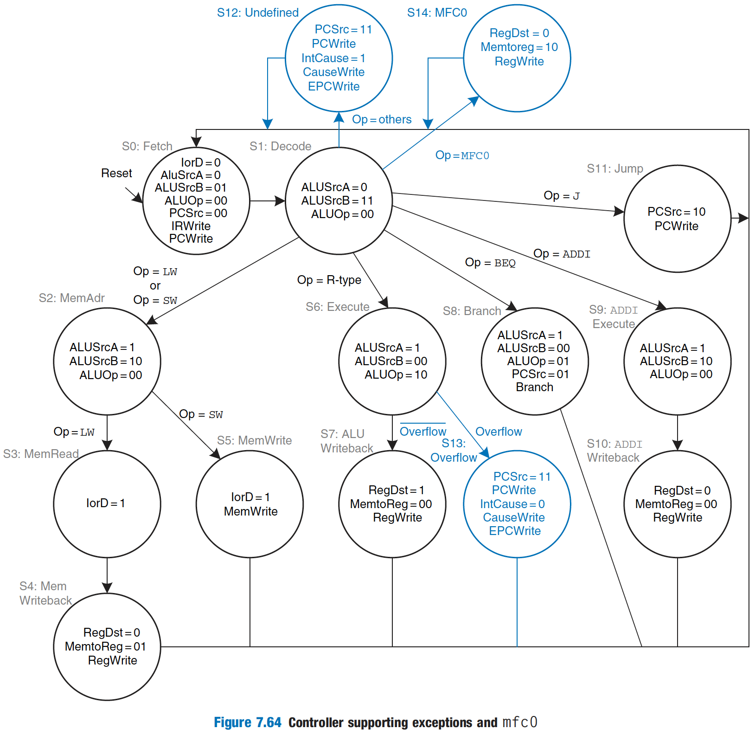
Precise Exceptions in Multi-Cycle FSM
Notes:
S1

Slide 63
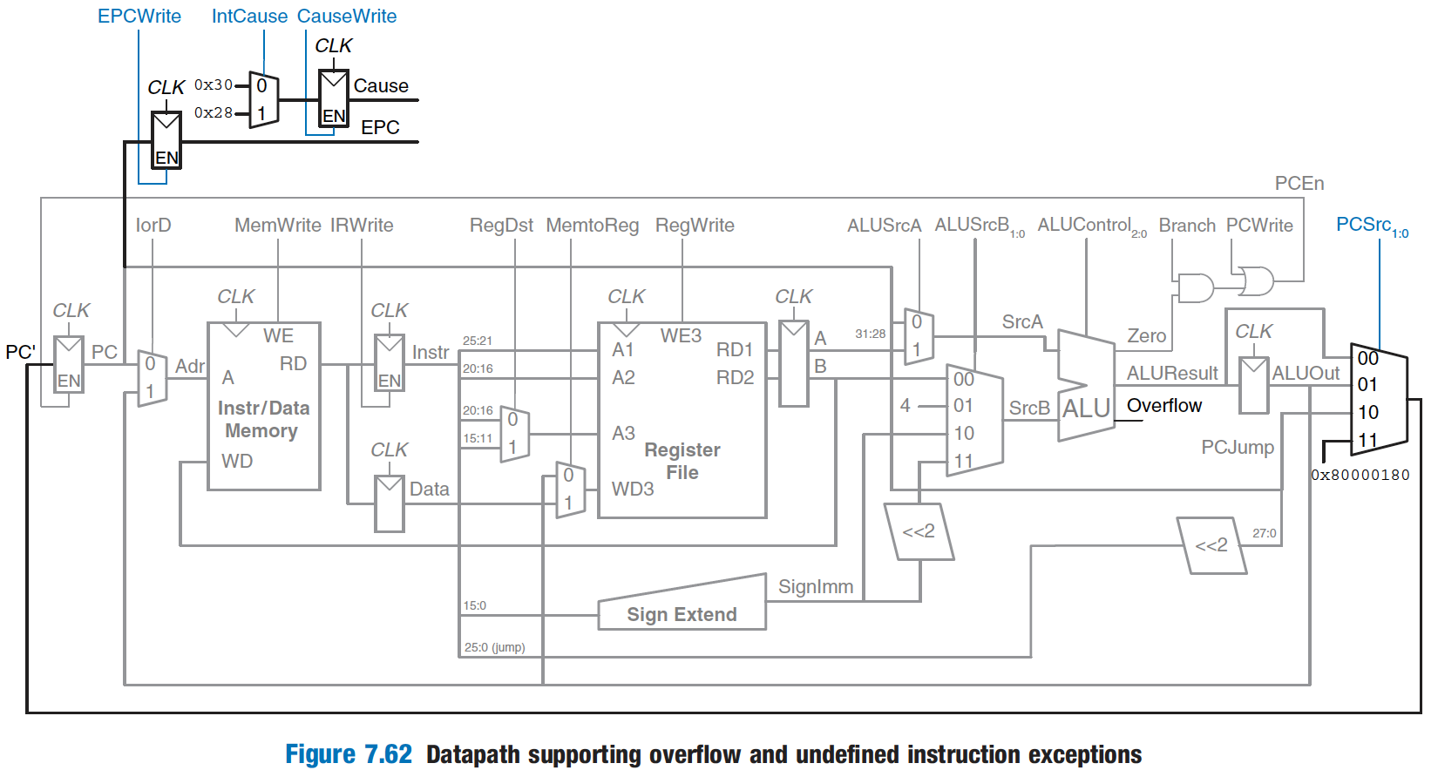
Precise Exceptions in Multi-Cycle Datapath
See H&H Section 7.7 for a treatment of exceptions in multi-cycle uarch

Slide 64
Ensuring Precise Exceptions in Pipelining
Idea: Make each operation take the same amount of time
Downside:
Worst-case instruction latency determines all instructions’ latency
What about memory operations?
Each functional unit takes worst-case number of cycles?
DIV R3 ← R1, R2
ADD R4 ← R1, R2
F
D
E
E
E
E
E
E
E
E
W
F
D
E
E
E
E
E
E
E
E
W
F
D
E
E
E
E
E
E
E
E
W
F
D
E
E
E
E
E
E
E
E
W
F
D
E
E
E
E
E
E
E
E
W
F
D
E
E
E
E
E
E
E
E
W
F
D
E
E
E
E
E
E
E
E
W
Notes:
第一种：摆烂

Slide 65
Outline
Pipeline Hazard
Structural Hazard
Data Hazard (Dependencies)
RAW
WAW
WAR
Control Hazard
Reorder Buffer
For Multi-cycle Execution
For Exception and Interrupt
For False Dependencies (WAW & WAR)
Definition of Reorder Buffer

Slide 66
False Dependencies: Lack of registers
Flow dependence
r₃ ← r₁ op r₂ Read-after-Write
r₅ ← r₃ op r₄ (RAW)
Anti dependence
r₃ ← r₁ op r₂ Write-after-Read
r₁ ← r₄ op r₅ (WAR)
Output-dependence
r₃ ← r₁ op r₂ Write-after-Write
r₅ ← r₃ op r₄ (WAW)
r₃ ← r₆ op r₇

Slide 67
Pipelining and Precise Exceptions: Preserving Sequential Semantics

Slide 68
Outline
Pipeline Hazard
Structural Hazard
Data Hazard (Dependencies)
RAW
WAW
WAR
Control Hazard
Reorder Buffer
For Multi-cycle Execution
For Exception and Interrupt
For False Dependencies (WAW & WAR)
Definition of Reorder Buffer

Slide 69
Reorder Buffer
Reorder buffer
For false dependencies
For exception and interrupt
For multi-cycle execute
Suggested reading
Smith and Plezskun, “Implementing Precise Interrupts in Pipelined Processors,” IEEE Trans on Computers 1988 and ISCA 1985.

Slide 70
Reorder Buffer (ROB)
Key Idea: Complete instructions out-of-order, but reorder them before writing results to architectural state (Commit).
1, When instruction is decoded in order, it reserves the next-sequential entry in the ROB, rename the destination register.
2, When instruction completes out-of-order, it writes result into ROB entry.
3, When instruction oldest in ROB and it has completed without exceptions, its result writes to reg. file or memory (In order commitment)
Register
File
Func Unit
Instruction
Cache
Decoded
in order
Commit
in order
Func Unit
Reorder
Buffer
Func Unit
Complete out-of-order
Notes:
Need the animation here…
Rob index, write, read…

Slide 71
Reorder buffer类似临时工，没编制。
出问题就怪临时工。
Notes:
The majority of you will not work on Systems.
But you should know the key principles that help you understand the system on which your AI task runs.
Our course has to include both computer architecture and AI chip courses.

Slide 72
What’s in a ROB Entry?
ROBs need to:
1, correctly reorder instructions back into the program order
2, update the architectural state with the instruction’s result(s), if instruction can retire without any issues
3, handle an exception/interrupt precisely, if an exception/interrupt needs to be handled before retiring the instruction
4, use valid bits to keep track of readiness of the result(s) and find out if the instruction has completed execution
V
DestRegID
DestRegVal
StoreAddr
StoreData
PC
Valid bits for reg/data + control bits
Exception?

Slide 73
Reorder Buffer: Independent Operations
Indirection:
1, Result first written to ROB on instruction completion
2, Result written to register file at commit time
What if a later instruction needs a value in the reorder buffer?
One option: stall the operation → stall the pipeline
Better: Read the value from the reorder buffer. How?
F
D
E
E
E
E
E
E
E
E
R
W
F
D
E
R
W
F
D
E
R
W
F
D
E
R
W
F
D
E
E
E
E
E
E
E
E
R
W
F
D
E
R
W
F
D
E
R
W
Notes:
Use
bypass

Slide 74
Reorder Buffer: Where to put?
A register value can be in the register file, reorder buffer.
Instruction
Cache
Register
File
Func Unit
Func Unit
Reorder
Buffer
Func Unit

Slide 75
Simplifying Reorder Buffer Access
Idea: Use indirection
1, Access register file first (check if the register is valid)
If register not valid, register file stores the ID of the reorder buffer entry that contains (or will contain) the value of the register
Mapping of the register to a ROB entry: Register file maps the register to a reorder buffer entry if there is an in-flight instruction writing to the register
2, Access reorder buffer next
Notes:
Access ROB first

Slide 76
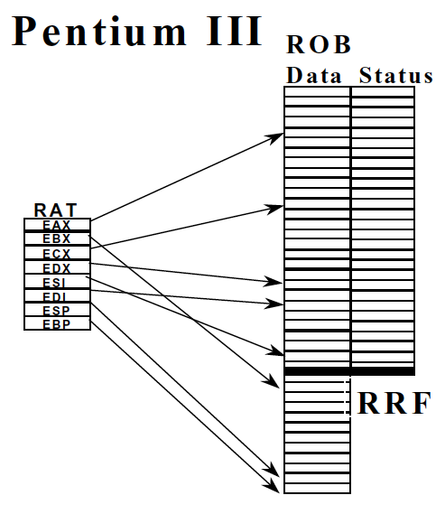
Reorder Buffer in Intel Pentium III
Boggs et al., “The Microarchitecture of the Pentium 4 Processor,” Intel Technology Journal, 2001.

Slide 77
Reorder Buffer: For False Dependencies
Output and anti dependences are not true dependences
WHY? The same register refers to values that have nothing to do with each other
They exist due to lack of register ID’s (i.e. names) in the ISA
RB eliminates anti and output dependences
Gives the illusion that there are a large number of registers
HOW: The register ID is renamed to the reorder buffer entry that will hold the register’s value
Register ID → ROB entry ID
Architectural register ID → Physical register ID
After renaming, ROB entry ID used to refer to the register
Notes:
ROB 临时工，临时工多，有编制的少

Slide 78
Reorder Buffer: For False Dependencies
Flow dependence
r₃ ← r₁ op r₂ Read-after-Write
r₅ ← r₃ op r₄ (RAW)
Anti dependence
r₃ ← r₁ op r₂ Write-after-Read
r₁ ← r₄ op r₅ (WAR)
Output-dependence
r₃ ← r₁ op r₂ Write-after-Write
r₅ ← r₃ op r₄ (WAW)
r₃ ← r₆ op r₇
RB₁₀₀
RB₁₀₀
RB₁₀₁
RB₁₀₂

Slide 79
To address false dependency,
number of registers > number of ROB entries?
NO.
Notes:
The majority of you will not work on Systems.
But you should know the key principles that help you understand the system on which your AI task runs.
Our course has to include both computer architecture and AI chip courses.

Slide 80
In-Order Pipeline with Reorder Buffer
In-order dispatch/execution, out-of-order completion, in-order retirement
Decode (D): Access regfile/ROB, allocate entry in ROB, check if instruction can execute, if so dispatch instruction
Execute (E): Instructions can complete out-of-order
Completion (R): Write result to reorder buffer
Retirement/Commit (W): Check for exceptions; if none, write result to architectural register file or memory; else, flush pipeline and start from exception handler
Integer add
Out of Order
E
Integer mul
E
E
E
E
R
W
F
D
FP mul
E
E
E
E
E
E
E
E
In order
R
. . .
E
E
E
E
E
E
E
E
Load/store

Slide 81
Reorder Buffer Tradeoffs
Advantages
Conceptually simple for supporting precise exceptions
Can eliminate false dependences
Disadvantages
Reorder buffer needs to be accessed to get the results that are yet to be written to the register file
Indirection → increased latency and complexity

Slide 82
Can Reorder Buffer Change This Map?
Notes:
NO

