Slide 1
Computer Arch. & AI Chip Lecture 3: Tomasula
Prof. Zeke Wang
Zhejiang University
22 March 2026

Slide 2
Recall: Reorder Buffer (ROB)
Key Idea: Complete instructions out-of-order, but reorder them before writing results to architectural state (Commit).
1, When instruction is decoded in order, it reserves the next-sequential entry in the ROB, rename the destination register.
2, When instruction completes out-of-order, it writes result into ROB entry.
3, When instruction oldest in ROB and it has completed without exceptions, its result writes to reg. file or memory (In order commitment)
Register
File
Func Unit
Instruction
Cache
Decoded
in order
Commit
in order
Func Unit
Reorder
Buffer
Func Unit
Complete out-of-order
Notes:
Need the animation here…
Rob index, write, read…

Slide 3
Recall: Reorder Buffer: For False Dependencies
Output and anti dependences are not true dependences
WHY? The same register refers to values that have nothing to do with each other
They exist due to lack of register ID’s (i.e. names) in the ISA
This eliminates anti and output dependences
Gives the illusion that there are a large number of registers
HOW: The register ID is renamed to the reorder buffer entry that will hold the register’s value.
Register ID → ROB entry ID
Architectural register ID → Physical register ID
After renaming, ROB entry ID used to refer to the register

Slide 4
Reorder Buffer: For False Dependencies
Flow dependence
r₃ ← r₁ op r₂ Read-after-Write
r₅ ← r₃ op r₄ (RAW)
Anti dependence
r₃ ← r₁ op r₂ Write-after-Read
r₁ ← r₄ op r₅ (WAR)
Output-dependence
r₃ ← r₁ op r₂ Write-after-Write
r₅ ← r₃ op r₄ (WAW)
r₃ ← r₆ op r₇
RB₁₀₀
RB₁₀₀
RB₁₀₁
RB₁₀₀
RB₁₀₂

Slide 5
Recall: Reorder Buffer for Multi-cycle Execution and Interrupt
Indirection:
1, Result first written to ROB on instruction completion
2, Result written to register file at commit time
F
D
E
E
E
E
E
E
E
E
R
W
F
D
E
R
W
F
D
E
R
W
F
D
E
R
W
F
D
E
E
E
E
E
E
E
E
R
W
F
D
E
R
W
F
D
E
R
W
Notes:
Use
bypass

Slide 6
Out-of-Order Execution (Dynamic Instruction Scheduling)

Slide 7
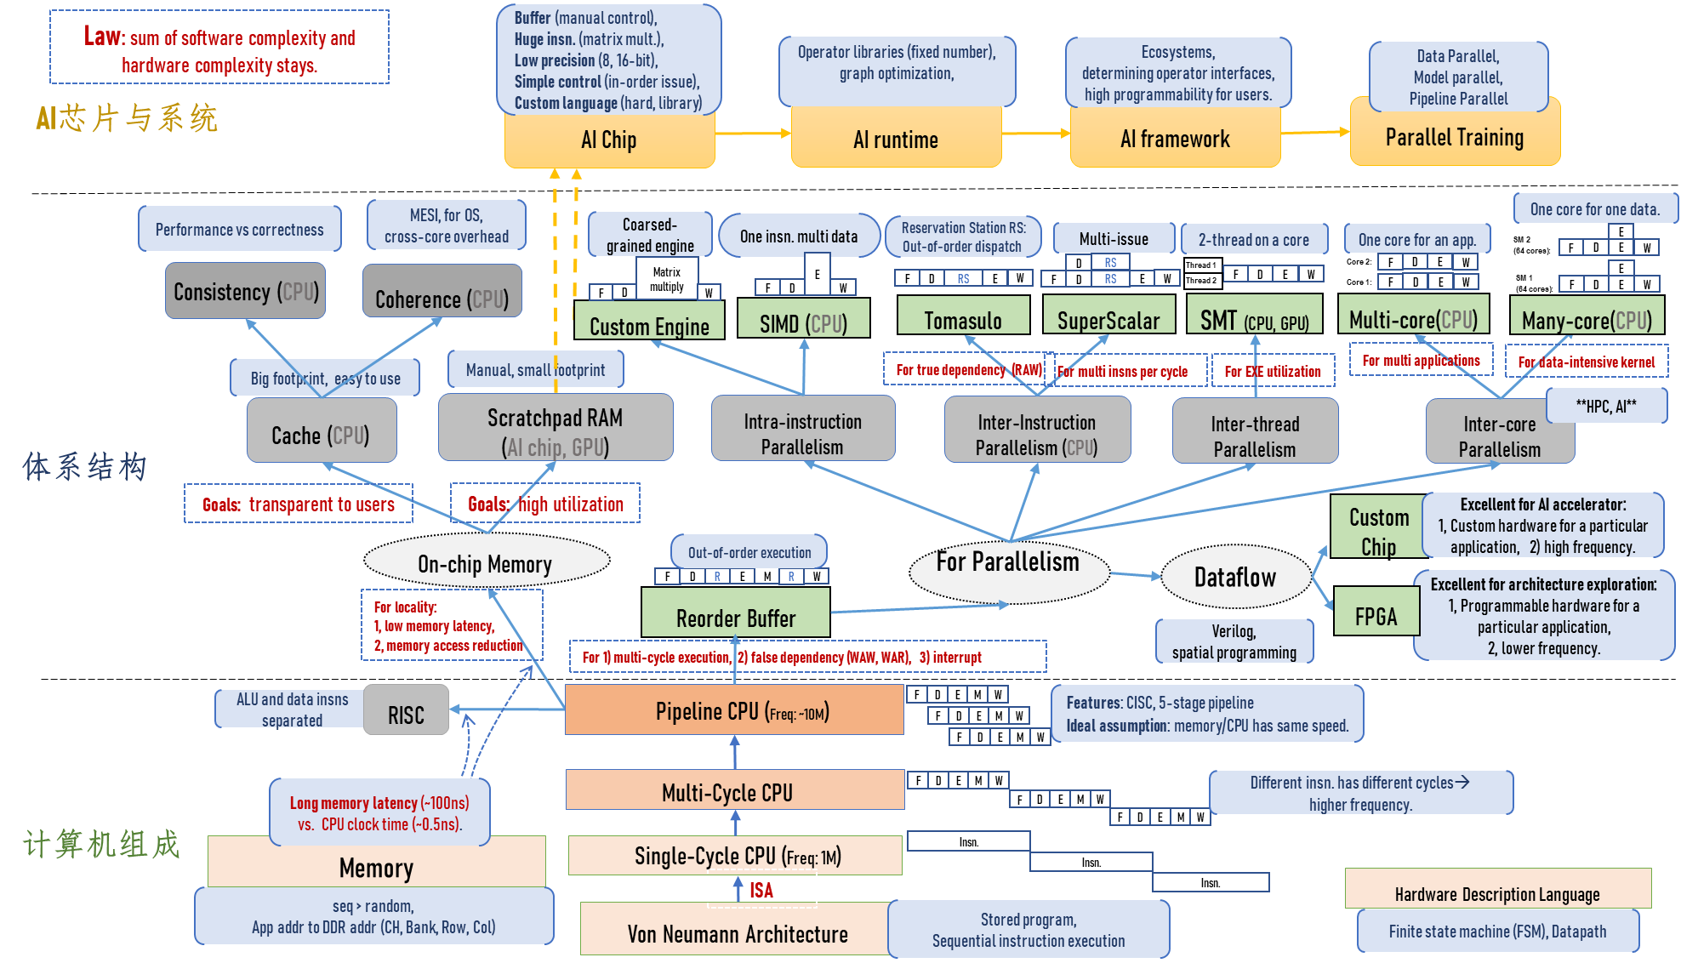
Where Are We?

Slide 8
An In-order Pipeline with only ROB
In order dispatch
Out of order
In order
Integer add
E
Integer mul
E
E
E
E
R
W
F
D
FP mul
E
E
E
E
E
E
E
E
. . .
E
E
E
E
E
E
E
E
Cache miss
Dispatch: Act of sending an instruction to a functional unit
Renaming with ROB
eliminates stalls due to false dependences
Problem: A true data dependence stalls dispatch of younger instructions into functional (execution) units
Notes:
In-order issue, in-order dispaatch, out-of-order completion, in-order retirement.

Slide 9
Issue of In-order Dispatch
In order dispatch + precise exceptions:
IO: 16
IMUL R3 ← R1, R2
ADD R3 ← R3, R1
ADD R1 ← R6, R7
IMUL R5 ← R6, R8
ADD R7 ← R3, R5
F
D
E
E
E
E
R
W
F
D
STALL
E
R
W
F
STALL
D
E
R
W
F
D
E
E
E
E
E
R
W
F
D
STALL
E
R
W
IMUL: 4 cycles, ADD： 1 cycle
Notes:
假设有forward，IMUL 4 cycles, ADD 1 cycle.

Slide 10
Can We Do Better?

Slide 11
How Can We Do Better?
What do the following two pieces of code have in common (with respect to execution in the previous design)?
Answer: First ADD stalls the whole pipeline!
ADD cannot dispatch because its source register R3 is unavailable
Later independent instructions cannot get executed
How are the above code portions different?
Answer: Load latency is variable (unknown until runtime)
IMUL R3 ← R1, R2
ADD R3 ← R3, R1
ADD R4 ← R6, R7
IMUL R5 ← R6, R8
ADD R7 ← R9, R9
LD R3 ← R1 (0)
ADD R3 ← R3, R1
ADD R4 ← R6, R7
IMUL R5 ← R6, R8
ADD R7 ← R9, R9

Slide 12
Preventing Dispatch Stalls
Problem: in-order dispatch (scheduling, or execution)
Solution: out-of-order dispatch (scheduling, or execution)
Goal of out-of-order dispatch:
Like Dataflow, “fire” an instruction only when its inputs are ready
LD R3 ← R1 (0)
ADD R3 ← R3, R1
ADD R4 ← R6, R7
IMUL R5 ← R6, R8
ADD R7 ← R9, R9
The insn “ADD R3…” will not impede insns “ADD R4…, IMUL R5…, ADD R7…”.

Slide 13
Reservation Station: Out-of-order Execution
Key idea of reservation station: Move the dependent instructions out of the way of independent ones (s.t. independent ones can execute)
Rest areas for dependent instructions: Reservation Stations
Function of Reservation Station:
Monitors the source “values” of each instruction in the resting area
“Fires” (i.e. dispatch) the instruction, when all source “values” of an instruction are available
Instructions dispatched in dataflow (not control-flow) order
Benefit of Reservation Station:
Latency tolerance: Allows independent instructions to execute and complete in the presence of a long-latency operation
Notes:
One road with multiple ways…
高速路上的

Slide 14
In-order vs. Out-of-order Dispatch
In order dispatch + precise exceptions:
Out-of-order dispatch + precise exceptions:
IO: 16 vs. OoO:12 cycles
IMUL R3 ← R1, R2
ADD R3 ← R3, R1
ADD R1 ← R6, R7
IMUL R5 ← R6, R8
ADD R7 ← R3, R5
F
D
E
E
E
E
R
W
F
D
STALL
E
R
W
F
STALL
D
E
R
W
F
D
E
E
E
E
E
R
W
F
D
STALL
E
R
W
IMUL R3 ← R1, R2
ADD R3 ← R3, R1
ADD R1 ← R6, R7
IMUL R5 ← R6, R8
ADD R7 ← R3, R5
F
D
E
E
E
E
R
W
F
D
WAIT
E
R
W
F
D
E
R
W
F
D
E
E
E
E
R
W
F
D
WAIT
E
R
W
IMUL: 4 cycles, ADD： 1 cycle
Notes:
假设有forward，IMUL 4 cycles, ADD 1 cycle.

Slide 15
Tomasulo’s Algorithm for OoO Execution
OoO with register renaming invented by Robert Tomasulo
Used in IBM 360/91 Floating Point Units
Read: Tomasulo, “An Efficient Algorithm for Exploiting Multiple Arithmetic Units,” IBM Journal of R&D, Jan. 1967.
OoO variants are used in most high-performance processors
Initially in Intel Pentium Pro, AMD K5
Alpha 21264, MIPS R10000, IBM POWER5, IBM z196, Oracle UltraSPARC T4, ARM Cortex A15, Apple M1, …
Notes:
360 is not commercially suceesful, without precious exception

Slide 16
Two Humps in a Modern Pipeline
Hump 1: Reservation stations (enabling in-order issue and out-of-order dispatch/execution)
Hump 2: Reorder buffer (enabling OoO completion, in-order commitment)
TAG and VALUE Broadcast Bus
Integer add
R
E
O
R
D
E
R
E
Integer mul
Reservation Station
E
E
E
E
F
D
W
FP mul
E
E
E
E
E
E
E
E
. . .
E
E
E
E
E
E
E
E
Load/store
In order issue
OoO dispatch
OoO execution
In order commitment

Slide 17
Two Humps in a Modern Pipeline
Hump 1: Reservation stations (scheduling window)
Hump 2: Reordering (reorder buffer, aka instruction window or active window)
TAG and VALUE Broadcast Bus
S
C
H
E
D
U
L
E
R
E
O
R
D
E
R
E
Integer add
Integer mul
F
D
E
E
E
E
W
FP mul
E
E
E
E
E
E
E
E
. . .
E
E
E
E
E
E
E
E
Load/store
in order
out of order
in order
Photo credit: http://true-wildlife.blogspot.ch/2010/10/bactrian-camel.html

Slide 18
Enabling OoO Execution
1. Need to link the consumer of a value to the producer
Register renaming: Associate a “tag” with each data value
2. Need to buffer instructions until they are ready to execute
Insert instruction into reservation stations after renaming
3. Instructions need to keep track of readiness of source values
Broadcast the “tag” when the value is produced
Instructions compare their “source tags” to the broadcast tag → if match, source value becomes ready
4. When all source values of an instruction are ready, need to dispatch the instruction to its functional unit (FU)
Instruction wakes up if all sources are ready
If multiple instructions are awake, need to select one per FU

Slide 19
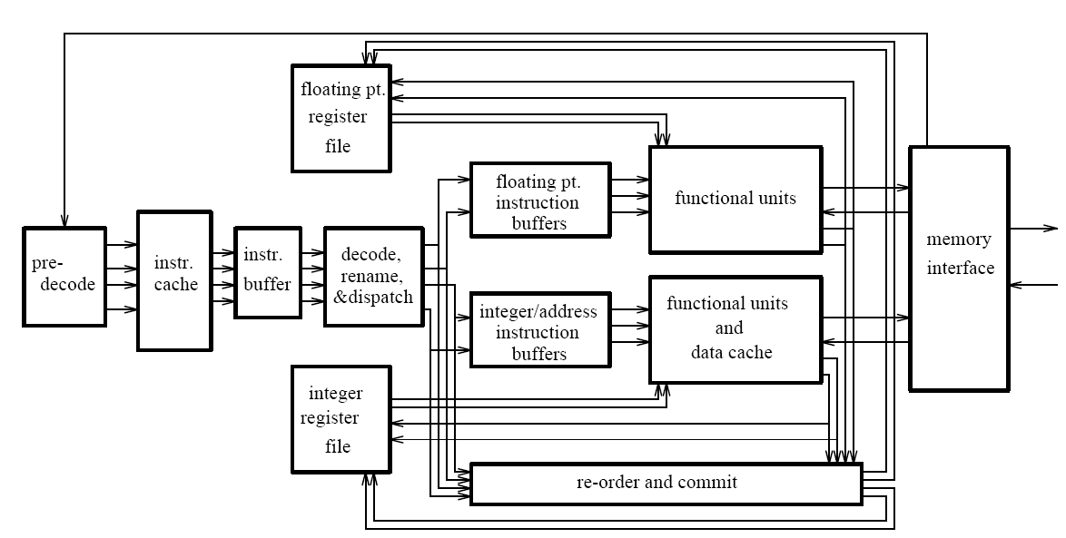
General Organization of an OOO Processor
Smith and Sohi, “The Microarchitecture of Superscalar Processors,” Proc. IEEE, Dec. 1995.
Notes:
Instruction buffer: reservation station.

Slide 20
Tomasulo’s Machine: IBM 360/91
FP registers
from memory
from instruction unit
load
buffers
store buffers
operation bus
reservation
stations
to memory
FP FU
FP FU
Common data bus

Slide 21
Recall Once More: Register Renaming
Output and anti dependences are not true dependences
WHY? The same register refers to values that have nothing to do with each other
They exist because not enough register ID’s (i.e. names) in the ISA
The dest. register ID is renamed to the reservation station entry
Destination register ID → RS entry ID
After renaming, RS entry ID used to refer to the register for the following instructions before updating the register.
This eliminates anti- and output- dependences
Approximates the performance effect of a large number of registers even though ISA has a small number.
Notes:
Destination id

Slide 22
Tomasulo’s Algorithm: Three Components
Register Rename Table (register alias table)
Reservation Station
 | Source 1 |  |  | Source 2
 | V | Tag | Value | V | Tag | Value
a
b
c
d
rs.tag
tag
value
valid?
R0
1
R1
1
R2
1
R3
1
R4
1
Common Data Bus:
Broadcasts the tag and result to all FUs
Updates the RF using the tag and result
R5
1
R6
1
R7
1
R8
1
R9
1
IF
ID
RS
W
E
Notes:
RRT:
Tag: reservation station entry ID
Valid: 1 means the register is readable, 0 means the new value exists in a reservation station entry.
Value: value in RF
RS:
V: valid bit of this operand
Tag: RS ID
Value: value of this operand

Slide 23
Tomasulo’s Algorithm
ID: If reservation station entry available before renaming dest. register
Occupy a RS entry for the instruction
For each source register in the RS entry: if the valid bit of source register in RF is 1, RS.source.v = 1 and RS.source.value=source register; else RS.source.v = 0 and RS.source.tag = source register.tag.
For dest. register in RF: Rename to the tag of the corresponding RS entry, set the valid bit to 0.
Else stall
RS: While in reservation station, each instruction:
Update: Watches common data bus (CDB) for tag of its sources. When tag seen, grab value for the source and keep it in the reservation station (.v = 1).
Issue: When both operands available, instruction ready to be dispatched to FU
EXE: Execute the instruction in FU, produce its broadcast tag and value
WB: After instruction finishes in the Functional Unit
a, Arbitrate for CDB
b, Put broadcast tag and its broadcast value onto CDB (tag broadcast)
c, Update register file connected to the CDB
If the tag in the RF matches the broadcast tag, write broadcast value into register (and set valid bit)
d, Update reservation station connected to the CDB
If the broadcast tag matches the tag of any source in a RS entry, write the broadcast value to the source and set the valid bit of the source.
Notes:
d, Reclaim rename tag
no valid copy of tag in system!

Slide 24
Our First OoO Machine Simulation
Program We Will Simulate
MUL | R1, R2 | → | R3
ADD | R3, R4 | → | R5
ADD | R2, R6 | → | R7
ADD | R8, R9 | → | R10
MUL | R7, R10 | → | R11
ADD | R5, R11 | → | R5
Initially:
RS’s are all Invalid (Empty)
All Registers are Valid
RS for ADD Unit
RS for MUL Unit
Register | Valid | Tag | Value
R1 | 1 |  | 1
R2 | 1 |  | 2
R3 | 1 |  | 3
R4 | 1 |  | 4
R5 | 1 |  | 5
R6 | 1 |  | 6
R7 | 1 |  | 7
R8 | 1 |  | 8
R9 | 1 |  | 9
R10 | 1 |  | 10
R11 | 1 |  | 11
 | Source 1 |  |  | Source 2
 | V | Tag | Value | V | Tag | Value
a
b
c
d
 | Source 1 |  |  | Source 2
 | V | Tag | Value | V | Tag | Value
x
y
z
t
+
∗
Tag
Value
Tag
Value
Register Rename Table
ADD and MUL Execution Units
have separate common data buses
MUL: 6 cycles, ADD： 4 cycle

Slide 25
Cycle 0
Cycle
MUL | R1, R2 | → | R3
ADD | R3, R4 | → | R5
ADD | R2, R6 | → | R7
ADD | R8, R9 | → | R10
MUL | R7, R10 | → | R11
ADD | R5, R11 | → | R5
Register | Valid | Tag | Value
R1 | 1 |  | 1
R2 | 1 |  | 2
R3 | 1 |  | 3
R4 | 1 |  | 4
R5 | 1 |  | 5
R6 | 1 |  | 6
R7 | 1 |  | 7
R8 | 1 |  | 8
R9 | 1 |  | 9
R10 | 1 |  | 10
R11 | 1 |  | 11
 | Source 1 |  |  | Source 2
 | V | Tag | Value | V | Tag | Value
a
b
c
d
 | Source 1 |  |  | Source 2
 | V | Tag | Value | V | Tag | Value
x
y
z
t
+
∗
MUL: 6 cycles, ADD： 4 cycle

Slide 26
Cycle 1
Cycle
1
MUL | R1, R2 | → | R3
ADD | R3, R4 | → | R5
ADD | R2, R6 | → | R7
ADD | R8, R9 | → | R10
MUL | R7, R10 | → | R11
ADD | R5, R11 | → | R5
F
Register | Valid | Tag | Value
R1 | 1 |  | 1
R2 | 1 |  | 2
R3 | 1 |  | 3
R4 | 1 |  | 4
R5 | 1 |  | 5
R6 | 1 |  | 6
R7 | 1 |  | 7
R8 | 1 |  | 8
R9 | 1 |  | 9
R10 | 1 |  | 10
R11 | 1 |  | 11
 | Source 1 |  |  | Source 2
 | V | Tag | Value | V | Tag | Value
a
b
c
d
 | Source 1 |  |  | Source 2
 | V | Tag | Value | V | Tag | Value
x
y
z
t
+
∗
MUL: 6 cycles, ADD： 4 cycle

Slide 27
Cycle 2
MUL gets decoded and allocated into RS x
Step 1: Check if reservation station available. Yes: x
Cycle
1
2
Step 2: Access the Register Alias Table
MUL | R1, R2 | → | R3
ADD | R3, R4 | → | R5
ADD | R2, R6 | → | R7
ADD | R8, R9 | → | R10
MUL | R7, R10 | → | R11
ADD | R5, R11 | → | R5
F
D
Step 3: Put source registers into reservation station x.
F
Step 4: Rename destination register R3 → x
R3 is now renamed to x.
Its new value will produced by the reservation station
that is identified by tag x.
Register | Valid | Tag | Value
R1 | 1 |  | 1
R2 | 1 |  | 2
R3 | 1 |  | 3
R4 | 1 |  | 4
R5 | 1 |  | 5
R6 | 1 |  | 6
R7 | 1 |  | 7
R8 | 1 |  | 8
R9 | 1 |  | 9
R10 | 1 |  | 10
R11 | 1 |  | 11
1
1
 | Source 1 |  |  | Source 2
 | V | Tag | Value | V | Tag | Value
a
b
c
d
 | Source 1 |  |  | Source 2
 | V | Tag | Value | V | Tag | Value
x
y
z
t
1
2
0
x
~
~
+
∗
MUL in RS x is ready to execute in the next cycle!
MUL: 6 cycles, ADD： 4 cycle

Slide 28

Cycle 3
1. MUL in RS x starts executing
2. ADD gets decoded and allocated into RS a
Cycle
1
2
3
Check readiness (Both sources ready?) → Wakeup
MUL | R1, R2 | → | R3
ADD | R3, R4 | → | R5
ADD | R2, R6 | → | R7
ADD | R8, R9 | → | R10
MUL | R7, R10 | → | R11
ADD | R5, R11 | → | R5
F
D
E₁
Ready → Dispatch the instruction to the MUL unit
F
D
Same Steps 1-4 for ADD… Rename R5 → a
F
Register | Valid | Tag | Value
R1 | 1 |  | 1
R2 | 1 |  | 2
R3 | 0 | x
R4 | 1 |  | 4
R5 | 1 |  | 5
R6 | 1 |  | 6
R7 | 1 |  | 7
R8 | 1 |  | 8
R9 | 1 |  | 9
R10 | 1 |  | 10
R11 | 1 |  | 11
 | Source 1 |  |  | Source 2
 | V | Tag | Value | V | Tag | Value
a
b
c
d
 | Source 1 |  |  | Source 2
 | V | Tag | Value | V | Tag | Value
x | 1 | ~ | 1 | 1 | ~ | 2
y
z
t
0
x
~
1
4
0
a
+
∗
6
Cycles
ADD in RS a cannot execute in the next cycle: one source is not valid
MUL: 6 cycles, ADD： 4 cycle

Slide 29
Cycle 4
Cycle
1
2
3
4
ADD in RS a waits because one source is not valid.
MUL | R1, R2 | → | R3
ADD | R3, R4 | → | R5
ADD | R2, R6 | → | R7
ADD | R8, R9 | → | R10
MUL | R7, R10 | → | R11
ADD | R5, R11 | → | R5
F
D
E₁
E₂
Rename R7 → b
F
D
-
F
D
F
Register | Valid | Tag | Value
R1 | 1 |  | 1
R2 | 1 |  | 2
R3 | 0 | x
R4 | 1 |  | 4
R5 | 0 | a
R6 | 1 |  | 6
R7 | 1 |  | 7
R8 | 1 |  | 8
R9 | 1 |  | 9
R10 | 1 |  | 10
R11 | 1 |  | 11
 | Source 1 |  |  | Source 2
 | V | Tag | Value | V | Tag | Value
a | 0 | x |  | 1 | ~ | 4
b
c
d
 | Source 1 |  |  | Source 2
 | V | Tag | Value | V | Tag | Value
x | 1 | ~ | 1 | 1 | ~ | 2
y
z
t
1
2
~
~
1
6
0
b
+
∗
ADD in RS b is ready to execute in the next cycle!
It will be executed out of order in the next cycle.

Slide 30
Cycle 5
Cycle
1
2
3
4
5
MUL | R1, R2 | → | R3
ADD | R3, R4 | → | R5
ADD | R2, R6 | → | R7
ADD | R8, R9 | → | R10
MUL | R7, R10 | → | R11
ADD | R5, R11 | → | R5
F
D
E₁
E₂
E₃
F
D
-
-
F
D
E₁
F
D
F
Register | Valid | Tag | Value
R1 | 1 |  | 1
R2 | 1 |  | 2
R3 | 0 | x
R4 | 1 |  | 4
R5 | 0 | a
R6 | 1 |  | 6
R7 | 0 | b
R8 | 1 |  | 8
R9 | 1 |  | 9
R10 | 1 |  | 10
R11 | 1 |  | 11
 | Source 1 |  |  | Source 2
 | V | Tag | Value | V | Tag | Value
a | 0 | x |  | 1 | ~ | 4
b | 1 | ~ | 2 | 1 | ~ | 6
c
d
 | Source 1 |  |  | Source 2
 | V | Tag | Value | V | Tag | Value
x | 1 | ~ | 1 | 1 | ~ | 2
y
z
t
1
~
8
1
~
9
+
4
Cycles
∗
0
c
ADD in RS c is ready to execute in the next cycle!
MUL: 6 cycles, ADD： 4 cycle

Slide 31
Cycle 6
Cycle
1
2
3
4
5
6
MUL | R1, R2 | → | R3
ADD | R3, R4 | → | R5
ADD | R2, R6 | → | R7
ADD | R8, R9 | → | R10
MUL | R7, R10 | → | R11
ADD | R5, R11 | → | R5
F
D
E₁
E₂
E₃
E₄
F
D
-
-
-
F
D
E₁
E₂
F
D
E₁
F
D
F
Register | Valid | Tag | Value
R1 | 1 |  | 1
R2 | 1 |  | 2
R3 | 0 | x
R4 | 1 |  | 4
R5 | 0 | a
R6 | 1 |  | 6
R7 | 0 | b
R8 | 1 |  | 8
R9 | 1 |  | 9
R10 | 0 | c
R11 | 1 |  | 11
 | Source 1 |  |  | Source 2
 | V | Tag | Value | V | Tag | Value
a | 0 | x |  | 1 | ~ | 4
b | 1 | ~ | 2 | 1 | ~ | 6
c | 1 | ~ | 8 | 1 | ~ | 9
d
 | Source 1 |  |  | Source 2
 | V | Tag | Value | V | Tag | Value
x | 1 | ~ | 1 | 1 | ~ | 2
y
z
t
0
b
0
c
+
∗
0
y
MUL: 6 cycles, ADD： 4 cycle

Slide 32
Cycle 7
All 6 instructions are now decoded and renamed
Note what happened to R5!
Cycle
1
2
3
4
5
6
7
MUL | R1, R2 | → | R3
ADD | R3, R4 | → | R5
ADD | R2, R6 | → | R7
ADD | R8, R9 | → | R10
MUL | R7, R10 | → | R11
ADD | R5, R11 | → | R5
F
D
E₁
E₂
E₃
E₄
E₅
F
D
-
-
-
-
F
D
E₁
E₂
E₃
F
D
E₁
E₂
F
D
-
F
D
Register | Valid | Tag | Value
R1 | 1 |  | 1
R2 | 1 |  | 2
R3 | 0 | x
R4 | 1 |  | 4
R5 | 0 | a
R6 | 1 |  | 6
R7 | 0 | b
R8 | 1 |  | 8
R9 | 1 |  | 9
R10 | 0 | c
R11 | 0 | y
 | Source 1 |  |  | Source 2
 | V | Tag | Value | V | Tag | Value
a | 0 | x |  | 1 | ~ | 4
b | 1 | ~ | 2 | 1 | ~ | 6
c | 1 | ~ | 8 | 1 | ~ | 9
d
 | Source 1 |  |  | Source 2
 | V | Tag | Value | V | Tag | Value
x | 1 | ~ | 1 | 1 | ~ | 2
y | 0 | b |  | 0 | c
z
t
0
d
0
a
0
y
+
∗
MUL: 6 cycles, ADD： 4 cycle

Slide 33
Cycle 8 (First Slide)
Cycle
1
2
3
4
5
6
7
8
MUL in RS x is done
MUL | R1, R2 | → | R3
ADD | R3, R4 | → | R5
ADD | R2, R6 | → | R7
ADD | R8, R9 | → | R10
MUL | R7, R10 | → | R11
ADD | R5, R11 | → | R5
F
D
E₁
E₂
E₃
E₄
E₅
E₆
Broadcast MUL’s tag (x)
F
D
-
-
-
-
F
D
E₁
E₂
E₃
Check tag
F
D
E₁
E₂
Check for invalidity
F
D
-
Broadcast MUL’s result (2)
F
D
Register | Valid | Tag | Value
R1 | 1 |  | 1
R2 | 1 |  | 2
R3 | 0 | x
R4 | 1 |  | 4
R5 | 0 | d
R6 | 1 |  | 6
R7 | 0 | b
R8 | 1 |  | 8
R9 | 1 |  | 9
R10 | 0 | c
R11 | 0 | y
 | Source 1 |  |  | Source 2
 | V | Tag | Value | V | Tag | Value
a | 0 | x |  | 1 | ~ | 4
b | 1 | ~ | 2 | 1 | ~ | 6
c | 1 | ~ | 8 | 1 | ~ | 9
d | 0 | a |  | 0 | y
 | Source 1 |  |  | Source 2
 | V | Tag | Value | V | Tag | Value
x | 1 | ~ | 1 | 1 | ~ | 2
y | 0 | b |  | 0 | c
z
t
1
2
1
2
+
∗
x
2
x
2
ADD in RS a is ready to execute in the next cycle!

Slide 34
Cycle 8 (Second Slide)
Cycle
1
2
3
4
5
6
7
8
ADD in RS b is also done
MUL | R1, R2 | → | R3
ADD | R3, R4 | → | R5
ADD | R2, R6 | → | R7
ADD | R8, R9 | → | R10
MUL | R7, R10 | → | R11
ADD | R5, R11 | → | R5
F
D
E₁
E₂
E₃
E₄
E₅
E₆
Broadcast ADD’s tag (b)
F
D
-
-
-
-
-
F
D
E₁
E₂
E₃
E₄
Check tag
F
D
E₁
E₂
Check for invalidity
F
D
-
Broadcast ADD’s result (8)
F
D
Register | Valid | Tag | Value
R1 | 1 |  | 1
R2 | 1 |  | 2
R3 | 1 |  | 2
R4 | 1 |  | 4
R5 | 0 | d
R6 | 1 |  | 6
R7 | 0 | b
R8 | 1 |  | 8
R9 | 1 |  | 9
R10 | 0 | c
R11 | 0 | y
 | Source 1 |  |  | Source 2
 | V | Tag | Value | V | Tag | Value
a | 1 | ~ | 2 | 1 | ~ | 4
b | 1 | ~ | 2 | 1 | ~ | 6
c | 1 | ~ | 8 | 1 | ~ | 9
d | 0 | a |  | 0 | y
 | Source 1 |  |  | Source 2
 | V | Tag | Value | V | Tag | Value
x | 1 | ~ | 1 | 1 | ~ | 2
y | 0 | b |  | 0 | c
z
t
1
8
1
8
+
∗
b
8
b
8
MUL in RS y is still NOT ready to execute in the next cycle!

Slide 35
Cycle 8 (Third Slide)
Cycle
1
2
3
4
5
6
7
8
MUL | R1, R2 | → | R3
ADD | R3, R4 | → | R5
ADD | R2, R6 | → | R7
ADD | R8, R9 | → | R10
MUL | R7, R10 | → | R11
ADD | R5, R11 | → | R5
F
D
E₁
E₂
E₃
E₄
E₅
E₆
F
D
-
-
-
-
-
F
D
E₁
E₂
E₃
E₄
F
D
E₁
E₂
E₃
F
D
-
-
F
D
-
Register | Valid | Tag | Value
R1 | 1 |  | 1
R2 | 1 |  | 2
R3 | 1 |  | 2
R4 | 1 |  | 4
R5 | 0 | d
R6 | 1 |  | 6
R7 | 1 | b | 8
R8 | 1 |  | 8
R9 | 1 |  | 9
R10 | 0 | c
R11 | 0 | y
 | Source 1 |  |  | Source 2
 | V | Tag | Value | V | Tag | Value
a | 1 | ~ | 2 | 1 | ~ | 4
b | 1 | ~ | 2 | 1 | ~ | 6
c | 1 | ~ | 8 | 1 | ~ | 9
d | 0 | a |  | 0 | y
 | Source 1 |  |  | Source 2
 | V | Tag | Value | V | Tag | Value
x | 1 | ~ | 1 | 1 | ~ | 2
y | 1 | ~ | 8 | 0 | c
z
t
+
∗
MUL: 6 cycles, ADD： 4 cycle

Slide 36
Cycle 9
Cycle
1
2
3
4
5
6
7
8
9
MUL | R1, R2 | → | R3
ADD | R3, R4 | → | R5
ADD | R2, R6 | → | R7
ADD | R8, R9 | → | R10
MUL | R7, R10 | → | R11
ADD | R5, R11 | → | R5
F
D
E₁
E₂
E₃
E₄
E₅
E₆
W
F
D
-
-
-
-
-
E₁
F
D
E₁
E₂
E₃
E₄
W
Broadcast and Update
F
D
E₁
E₂
E₃
E₄
F
D
-
-
-
F
D
-
-
Register | Valid | Tag | Value
R1 | 1 |  | 1
R2 | 1 |  | 2
R3 | 1 |  | 2
R4 | 1 |  | 4
R5 | 0 | d
R6 | 1 |  | 6
R7 | 1 |  | 8
R8 | 1 |  | 8
R9 | 1 |  | 9
R10 | 0 | c
R11 | 0 | y
 | Source 1 |  |  | Source 2
 | V | Tag | Value | V | Tag | Value
a | 1 | ~ | 2 | 1 | ~ | 4
b | 1 | ~ | 2 | 1 | ~ | 6
c | 1 | ~ | 8 | 1 | ~ | 9
d | 0 | a |  | 0 | y
 | Source 1 |  |  | Source 2
 | V | Tag | Value | V | Tag | Value
x | 1 | ~ | 1 | 1 | ~ | 2
y | 1 | ~ | 8 | 0 | c
z
t
1
~
17
+
∗
1
17
c
17
MUL in RS y is ready to execute in the next cycle!
MUL: 6 cycles, ADD： 4 cycle

Slide 37
Cycle 10
Cycle
1
2
3
4
5
6
7
8
9
10
MUL | R1, R2 | → | R3
ADD | R3, R4 | → | R5
ADD | R2, R6 | → | R7
ADD | R8, R9 | → | R10
MUL | R7, R10 | → | R11
ADD | R5, R11 | → | R5
F
D
E₁
E₂
E₃
E₄
E₅
E₆
W
F
D
-
-
-
-
-
E₁
E₂
F
D
E₁
E₂
E₃
E₄
W
F
D
E₁
E₂
E₃
E₄
W
F
D
-
-
-
E₁
F
D
-
-
-
Register | Valid | Tag | Value
R1 | 1 |  | 1
R2 | 1 |  | 2
R3 | 1 |  | 2
R4 | 1 |  | 4
R5 | 0 | d
R6 | 1 |  | 6
R7 | 1 |  | 8
R8 | 1 |  | 8
R9 | 1 |  | 9
R10 | 1 |  | 17
R11 | 0 | y
 | Source 1 |  |  | Source 2
 | V | Tag | Value | V | Tag | Value
a | 1 | ~ | 2 | 1 | ~ | 4
b | 1 | ~ | 2 | 1 | ~ | 6
c | 1 | ~ | 8 | 1 | ~ | 9
d | 0 | a |  | 0 | y
 | Source 1 |  |  | Source 2
 | V | Tag | Value | V | Tag | Value
x | 1 | ~ | 1 | 1 | ~ | 2
y | 1 | ~ | 8 | 1 | ~ | 17
z
t
+
∗
MUL: 6 cycles, ADD： 4 cycle

Slide 38
Cycle 11
Cycle
1
2
3
4
5
6
7
8
9
10
11
MUL | R1, R2 | → | R3
ADD | R3, R4 | → | R5
ADD | R2, R6 | → | R7
ADD | R8, R9 | → | R10
MUL | R7, R10 | → | R11
ADD | R5, R11 | → | R5
F
D
E₁
E₂
E₃
E₄
E₅
E₆
W
F
D
-
-
-
-
-
E₁
E₂
E₃
F
D
E₁
E₂
E₃
E₄
W
F
D
E₁
E₂
E₃
E₄
W
F
D
-
-
-
E₁
E₂
F
D
-
-
-
-
Register | Valid | Tag | Value
R1 | 1 |  | 1
R2 | 1 |  | 2
R3 | 1 |  | 2
R4 | 1 |  | 4
R5 | 0 | d
R6 | 1 |  | 6
R7 | 1 |  | 8
R8 | 1 |  | 8
R9 | 1 |  | 9
R10 | 1 |  | 17
R11 | 0 | y
 | Source 1 |  |  | Source 2
 | V | Tag | Value | V | Tag | Value
a | 1 | ~ | 2 | 1 | ~ | 4
b | 1 | ~ | 2 | 1 | ~ | 6
c | 1 | ~ | 8 | 1 | ~ | 9
d | 0 | a |  | 0 | y
 | Source 1 |  |  | Source 2
 | V | Tag | Value | V | Tag | Value
x | 1 | ~ | 1 | 1 | ~ | 2
y | 1 | ~ | 8 | 1 | ~ | 17
z
t
+
∗
MUL: 6 cycles, ADD： 4 cycle

Slide 39
Cycle 12
Cycle
1
2
3
4
5
6
7
8
9
10
11
12
MUL | R1, R2 | → | R3
ADD | R3, R4 | → | R5
ADD | R2, R6 | → | R7
ADD | R8, R9 | → | R10
MUL | R7, R10 | → | R11
ADD | R5, R11 | → | R5
F
D
E₁
E₂
E₃
E₄
E₅
E₆
W
Broadcast and Update
F
D
-
-
-
-
-
E₁
E₂
E₃
E₄
F
D
E₁
E₂
E₃
E₄
W
F
D
E₁
E₂
E₃
E₄
W
F
D
-
-
-
E₁
E₂
E₃
F
D
-
-
-
-
-
Register | Valid | Tag | Value
R1 | 1 |  | 1
R2 | 1 |  | 2
R3 | 1 |  | 2
R4 | 1 |  | 4
R5 | 0 | d
R6 | 1 |  | 6
R7 | 1 |  | 8
R8 | 1 |  | 8
R9 | 1 |  | 9
R10 | 1 |  | 17
R11 | 0 | y
 | Source 1 |  |  | Source 2
 | V | Tag | Value | V | Tag | Value
a | 1 | ~ | 2 | 1 | ~ | 4
b | 1 | ~ | 2 | 1 | ~ | 6
c | 1 | ~ | 8 | 1 | ~ | 9
d | 0 | a |  | 0 | y
 | Source 1 |  |  | Source 2
 | V | Tag | Value | V | Tag | Value
x | 1 | ~ | 1 | 1 | ~ | 2
y | 1 | ~ | 8 | 1 | ~ | 17
z
t
1
~
6
+
∗
a
6
MUL: 6 cycles, ADD： 4 cycle

Slide 40
Cycle 13
Cycle
1
2
3
4
5
6
7
8
9
10
11
12
13
MUL | R1, R2 | → | R3
ADD | R3, R4 | → | R5
ADD | R2, R6 | → | R7
ADD | R8, R9 | → | R10
MUL | R7, R10 | → | R11
ADD | R5, R11 | → | R5
F
D
E₁
E₂
E₃
E₄
E₅
E₆
W
F
D
-
-
-
-
-
E₁
E₂
E₃
E₄
W
F
D
E₁
E₂
E₃
E₄
W
F
D
E₁
E₂
E₃
E₄
W
F
D
-
-
-
E₁
E₂
E₃
E₄
F
D
-
-
-
-
-
-
Register | Valid | Tag | Value
R1 | 1 |  | 1
R2 | 1 |  | 2
R3 | 1 |  | 2
R4 | 1 |  | 4
R5 | 0 | d
R6 | 1 |  | 6
R7 | 1 |  | 8
R8 | 1 |  | 8
R9 | 1 |  | 9
R10 | 1 |  | 17
R11 | 0 | y
 | Source 1 |  |  | Source 2
 | V | Tag | Value | V | Tag | Value
a | 1 | ~ | 2 | 1 | ~ | 4
b | 1 | ~ | 2 | 1 | ~ | 6
c | 1 | ~ | 8 | 1 | ~ | 9
d | 1 | ~ | 6 | 0 | y
 | Source 1 |  |  | Source 2
 | V | Tag | Value | V | Tag | Value
x | 1 | ~ | 1 | 1 | ~ | 2
y | 1 | ~ | 8 | 1 | ~ | 17
z
t
+
∗
MUL: 6 cycles, ADD： 4 cycle

Slide 41
Cycle 14
Cycle
1
2
3
4
5
6
7
8
9
10
11
12
13
14
MUL | R1, R2 | → | R3
ADD | R3, R4 | → | R5
ADD | R2, R6 | → | R7
ADD | R8, R9 | → | R10
MUL | R7, R10 | → | R11
ADD | R5, R11 | → | R5
F
D
E₁
E₂
E₃
E₄
E₅
E₆
W
F
D
-
-
-
-
-
E₁
E₂
E₃
E₄
W
F
D
E₁
E₂
E₃
E₄
W
F
D
E₁
E₂
E₃
E₄
W
F
D
-
-
-
E₁
E₂
E₃
E₄
E₅
F
D
-
-
-
-
-
-
-
Register | Valid | Tag | Value
R1 | 1 |  | 1
R2 | 1 |  | 2
R3 | 1 |  | 2
R4 | 1 |  | 4
R5 | 0 | d
R6 | 1 |  | 6
R7 | 1 |  | 8
R8 | 1 |  | 8
R9 | 1 |  | 9
R10 | 1 |  | 17
R11 | 0 | y
 | Source 1 |  |  | Source 2
 | V | Tag | Value | V | Tag | Value
a | 1 | ~ | 2 | 1 | ~ | 4
b | 1 | ~ | 2 | 1 | ~ | 6
c | 1 | ~ | 8 | 1 | ~ | 9
d | 1 | ~ | 6 | 0 | y
 | Source 1 |  |  | Source 2
 | V | Tag | Value | V | Tag | Value
x | 1 | ~ | 1 | 1 | ~ | 2
y | 1 | ~ | 8 | 1 | ~ | 17
z
t
+
∗
MUL: 6 cycles, ADD： 4 cycle

Slide 42
Cycle 15
Cycle
1
2
3
4
5
6
7
8
9
10
11
12
13
14
15
MUL | R1, R2 | → | R3
ADD | R3, R4 | → | R5
ADD | R2, R6 | → | R7
ADD | R8, R9 | → | R10
MUL | R7, R10 | → | R11
ADD | R5, R11 | → | R5
F
D
E₁
E₂
E₃
E₄
E₅
E₆
W
F
D
-
-
-
-
-
E₁
E₂
E₃
E₄
W
F
D
E₁
E₂
E₃
E₄
W
F
D
E₁
E₂
E₃
E₄
W
Broadcast and Update
F
D
-
-
-
E₁
E₂
E₃
E₄
E₅
E₆
F
D
-
-
-
-
-
-
-
-
Register | Valid | Tag | Value
R1 | 1 |  | 1
R2 | 1 |  | 2
R3 | 1 |  | 2
R4 | 1 |  | 4
R5 | 0 | d
R6 | 1 |  | 6
R7 | 1 |  | 8
R8 | 1 |  | 8
R9 | 1 |  | 9
R10 | 1 |  | 17
R11 | 0 | y
 | Source 1 |  |  | Source 2
 | V | Tag | Value | V | Tag | Value
a | 1 | ~ | 2 | 1 | ~ | 4
b | 1 | ~ | 2 | 1 | ~ | 6
c | 1 | ~ | 8 | 1 | ~ | 9
d | 1 | ~ | 6 | 0 | y
 | Source 1 |  |  | Source 2
 | V | Tag | Value | V | Tag | Value
x | 1 | ~ | 1 | 1 | ~ | 2
y | 1 | ~ | 8 | 1 | ~ | 17
z
t
1
~
136
+
∗
1
136
y
136
ADD in RS d is ready to execute in the next cycle!
MUL: 6 cycles, ADD： 4 cycle

Slide 43
Cycle 16
Cycle
1
2
3
4
5
6
7
8
9
10
11
12
13
14
15
16
MUL | R1, R2 | → | R3
ADD | R3, R4 | → | R5
ADD | R2, R6 | → | R7
ADD | R8, R9 | → | R10
MUL | R7, R10 | → | R11
ADD | R5, R11 | → | R5
F
D
E₁
E₂
E₃
E₄
E₅
E₆
W
F
D
-
-
-
-
-
E₁
E₂
E₃
E₄
W
F
D
E₁
E₂
E₃
E₄
W
F
D
E₁
E₂
E₃
E₄
W
F
D
-
-
-
E₁
E₂
E₃
E₄
E₅
E₆
W
F
D
-
-
-
-
-
-
-
-
E₁
Register | Valid | Tag | Value
R1 | 1 |  | 1
R2 | 1 |  | 2
R3 | 1 |  | 2
R4 | 1 |  | 4
R5 | 0 | d
R6 | 1 |  | 6
R7 | 1 |  | 8
R8 | 1 |  | 8
R9 | 1 |  | 9
R10 | 1 |  | 17
R11 | 1 |  | 136
 | Source 1 |  |  | Source 2
 | V | Tag | Value | V | Tag | Value
a | 1 | ~ | 2 | 1 | ~ | 4
b | 1 | ~ | 2 | 1 | ~ | 6
c | 1 | ~ | 8 | 1 | ~ | 9
d | 1 | ~ | 6 | 1 | ~ | 136
 | Source 1 |  |  | Source 2
 | V | Tag | Value | V | Tag | Value
x | 1 | ~ | 1 | 1 | ~ | 2
y | 1 | ~ | 8 | 1 | ~ | 17
z
t
+
∗
MUL: 6 cycles, ADD： 4 cycle

Slide 44
Cycle 17
Cycle
1
2
3
4
5
6
7
8
9
10
11
12
13
14
15
16
17
MUL | R1, R2 | → | R3
ADD | R3, R4 | → | R5
ADD | R2, R6 | → | R7
ADD | R8, R9 | → | R10
MUL | R7, R10 | → | R11
ADD | R5, R11 | → | R5
F
D
E₁
E₂
E₃
E₄
E₅
E₆
W
F
D
-
-
-
-
-
E₁
E₂
E₃
E₄
W
F
D
E₁
E₂
E₃
E₄
W
F
D
E₁
E₂
E₃
E₄
W
F
D
-
-
-
E₁
E₂
E₃
E₄
E₅
E₆
W
F
D
-
-
-
-
-
-
-
-
E₁
E₂
Register | Valid | Tag | Value
R1 | 1 |  | 1
R2 | 1 |  | 2
R3 | 1 |  | 2
R4 | 1 |  | 4
R5 | 0 | d
R6 | 1 |  | 6
R7 | 1 |  | 8
R8 | 1 |  | 8
R9 | 1 |  | 9
R10 | 1 |  | 17
R11 | 1 |  | 136
 | Source 1 |  |  | Source 2
 | V | Tag | Value | V | Tag | Value
a | 1 | ~ | 2 | 1 | ~ | 4
b | 1 | ~ | 2 | 1 | ~ | 6
c | 1 | ~ | 8 | 1 | ~ | 9
d | 1 | ~ | 6 | 1 | ~ | 136
 | Source 1 |  |  | Source 2
 | V | Tag | Value | V | Tag | Value
x | 1 | ~ | 1 | 1 | ~ | 2
y | 1 | ~ | 8 | 1 | ~ | 17
z
t
+
∗
MUL: 6 cycles, ADD： 4 cycle

Slide 45
Cycle 18
Cycle
1
2
3
4
5
6
7
8
9
10
11
12
13
14
15
16
17
18
MUL | R1, R2 | → | R3
ADD | R3, R4 | → | R5
ADD | R2, R6 | → | R7
ADD | R8, R9 | → | R10
MUL | R7, R10 | → | R11
ADD | R5, R11 | → | R5
F
D
E₁
E₂
E₃
E₄
E₅
E₆
W
F
D
-
-
-
-
-
E₁
E₂
E₃
E₄
W
F
D
E₁
E₂
E₃
E₄
W
F
D
E₁
E₂
E₃
E₄
W
F
D
-
-
-
E₁
E₂
E₃
E₄
E₅
E₆
W
F
D
-
-
-
-
-
-
-
-
E₁
E₂
E₃
Register | Valid | Tag | Value
R1 | 1 |  | 1
R2 | 1 |  | 2
R3 | 1 |  | 2
R4 | 1 |  | 4
R5 | 0 | d
R6 | 1 |  | 6
R7 | 1 |  | 8
R8 | 1 |  | 8
R9 | 1 |  | 9
R10 | 1 |  | 17
R11 | 1 |  | 136
 | Source 1 |  |  | Source 2
 | V | Tag | Value | V | Tag | Value
a | 1 | ~ | 2 | 1 | ~ | 4
b | 1 | ~ | 2 | 1 | ~ | 6
c | 1 | ~ | 8 | 1 | ~ | 9
d | 1 | ~ | 6 | 1 | ~ | 136
 | Source 1 |  |  | Source 2
 | V | Tag | Value | V | Tag | Value
x | 1 | ~ | 1 | 1 | ~ | 2
y | 1 | ~ | 8 | 1 | ~ | 17
z
t
+
∗
MUL: 6 cycles, ADD： 4 cycle

Slide 46
Cycle 19
Cycle
1
2
3
4
5
6
7
8
9
10
11
12
13
14
15
16
17
18
19
MUL | R1, R2 | → | R3
ADD | R3, R4 | → | R5
ADD | R2, R6 | → | R7
ADD | R8, R9 | → | R10
MUL | R7, R10 | → | R11
ADD | R5, R11 | → | R5
F
D
E₁
E₂
E₃
E₄
E₅
E₆
W
F
D
-
-
-
-
-
E₁
E₂
E₃
E₄
W
F
D
E₁
E₂
E₃
E₄
W
F
D
E₁
E₂
E₃
E₄
W
F
D
-
-
-
E₁
E₂
E₃
E₄
E₅
E₆
W
F
D
-
-
-
-
-
-
-
-
E₁
E₂
E₃
E₄
Broadcast and Update
Register | Valid | Tag | Value
R1 | 1 |  | 1
R2 | 1 |  | 2
R3 | 1 |  | 2
R4 | 1 |  | 4
R5 | 0 | d
R6 | 1 |  | 6
R7 | 1 |  | 8
R8 | 1 |  | 8
R9 | 1 |  | 9
R10 | 1 |  | 17
R11 | 1 |  | 136
 | Source 1 |  |  | Source 2
 | V | Tag | Value | V | Tag | Value
a | 1 | ~ | 2 | 1 | ~ | 4
b | 1 | ~ | 2 | 1 | ~ | 6
c | 1 | ~ | 8 | 1 | ~ | 9
d | 1 | ~ | 6 | 1 | ~ | 136
 | Source 1 |  |  | Source 2
 | V | Tag | Value | V | Tag | Value
x | 1 | ~ | 1 | 1 | ~ | 2
y | 1 | ~ | 8 | 1 | ~ | 17
z
t
1
142
+
∗
d
142
MUL: 6 cycles, ADD： 4 cycle

Slide 47
Cycle 20
Cycle
1
2
3
4
5
6
7
8
9
10
11
12
13
14
15
16
17
18
19
20
MUL | R1, R2 | → | R3
ADD | R3, R4 | → | R5
ADD | R2, R6 | → | R7
ADD | R8, R9 | → | R10
MUL | R7, R10 | → | R11
ADD | R5, R11 | → | R5
F
D
E₁
E₂
E₃
E₄
E₅
E₆
W
F
D
-
-
-
-
-
E₁
E₂
E₃
E₄
W
F
D
E₁
E₂
E₃
E₄
W
F
D
E₁
E₂
E₃
E₄
W
F
D
-
-
-
E₁
E₂
E₃
E₄
E₅
E₆
W
F
D
-
-
-
-
-
-
-
-
E₁
E₂
E₃
E₄
W
Register | Valid | Tag | Value
R1 | 1 |  | 1
R2 | 1 |  | 2
R3 | 1 |  | 2
R4 | 1 |  | 4
R5 | 1 |  | 142
R6 | 1 |  | 6
R7 | 1 |  | 8
R8 | 1 |  | 8
R9 | 1 |  | 9
R10 | 1 |  | 17
R11 | 1 |  | 136
 | Source 1 |  |  | Source 2
 | V | Tag | Value | V | Tag | Value
a | 1 | ~ | 2 | 1 | ~ | 4
b | 1 | ~ | 2 | 1 | ~ | 6
c | 1 | ~ | 8 | 1 | ~ | 9
d | 1 | ~ | 6 | 1 | ~ | 136
 | Source 1 |  |  | Source 2
 | V | Tag | Value | V | Tag | Value
x | 1 | ~ | 1 | 1 | ~ | 2
y | 1 | ~ | 8 | 1 | ~ | 17
z
t
+
∗
MUL: 6 cycles, ADD： 4 cycle

Slide 48
Tomasulo’s Algorithm
ID: If reservation station entry available before renaming dest. register
Occupy a RS entry for the instruction
For each source register in the RS entry: if the valid bit of source register in RF is 1, RS.source.v = 1 and RS.source.value=source register; else RS.source.v = 0 and RS.source.tag = source register.tag.
For dest. register in RF: Rename to the tag of the corresponding RS entry, set the valid bit to 0.
Else stall
RS: While in reservation station, each instruction:
Update: Watches common data bus (CDB) for tag of its sources. When tag seen, grab value for the source and keep it in the reservation station (.v = 1).
Issue: When both operands available, instruction ready to be dispatched to FU
EXE: Execute the instruction in FU, produce its broadcast tag and value
WB: After instruction finishes in the Functional Unit
a, Arbitrate for CDB
b, Put broadcast tag and its broadcast value onto CDB (tag broadcast)
c, Update register file connected to the CDB
If the tag in the RF matches the broadcast tag, write broadcast value into register (and set valid bit)
d, Update reservation station connected to the CDB
If the broadcast tag matches the tag of any source in a RS entry, write the broadcast value to the source and set the valid bit of the source.
Notes:
d, Reclaim rename tag
no valid copy of tag in system!

Slide 49
Some Questions
What can potentially become the critical path?
Tag broadcast → value capture → instruction wake up
How can you reduce the potential critical paths?
Break down the critical path

Slide 50
Dataflow Graph for Our Example
MUL R3 ← R1, R2
ADD R5 ← R3, R4
ADD R7 ← R2, R6
ADD R10 ← R8, R9
MUL R11 ← R7, R10
ADD R5 ← R5, R11

Slide 51
State of RAT and RS in Cycle 7
Cycle
1
2
3
4
5
6
7
MUL | R1, R2 | → | R3
ADD | R3, R4 | → | R5
ADD | R2, R6 | → | R7
ADD | R8, R9 | → | R10
MUL | R7, R10 | → | R11
ADD | R5, R11 | → | R5
F
D
E₁
E₂
E₃
E₄
E₅
F
D
-
-
-
-
F
D
E₁
E₂
E₃
F
D
E₁
E₂
F
D
-
F
D
Register | Valid | Tag | Value
R1 | 1 |  | 1
R2 | 1 |  | 2
R3 | 0 | x
R4 | 1 |  | 4
R5 | 0 | a
R6 | 1 |  | 6
R7 | 0 | b
R8 | 1 |  | 8
R9 | 1 |  | 9
R10 | 0 | c
R11 | 0 | y
 | Source 1 |  |  | Source 2
 | V | Tag | Value | V | Tag | Value
a | 0 | x |  | 1 | ~ | 4
b | 1 | ~ | 2 | 1 | ~ | 6
c | 1 | ~ | 8 | 1 | ~ | 9
d
 | Source 1 |  |  | Source 2
 | V | Tag | Value | V | Tag | Value
x | 1 | ~ | 1 | 1 | ~ | 2
y | 0 | b |  | 0 | c
z
t
0
d
0
a
0
y
+
∗

Slide 52
Corresponding Dataflow Graph (Reverse Engineered)
R1
R2
R6
R8
R9
MUL R3 ← R1, R2
ADD R5 ← R3, R4
ADD R7 ← R2, R6
ADD R10 ← R8, R9
MUL R11 ← R7, R10
ADD R5 ← R5, R11
*
+
+
R3 (x)
R7 (b)
R10 (c)
R4
+
*
R5 (a)
R11 (y)
+
R5 (d)

Slide 53
Summary of OOO Execution Concepts
Register renaming eliminates false dependences, enables linking of producer to consumers
Buffering in reservation stations enables the pipeline to move for independent instructions
Tag broadcast enables communication (of readiness of produced value) between instructions
Wakeup and select enables out-of-order dispatch

Slide 54
For You: An Exercise, wo/ Precise Exceptions
Assume
ADD (4 cycle execute), MUL (6 cycle execute)
One adder and one multiplier
How many cycles
in an in-order-dispatch pipelined machine wo reorder buffer (no forwarding and full forwarding)?
in an out-of-order dispatch pipelined machine wo reorder buffer (full forwarding)?
MUL R3 ← R1, R3
ADD R5 ← R3, R4
ADD R7 ← R2, R6
ADD R10 ← R8, R9
MUL R11 ← R5, R6
ADD R5 ← R5, R3
F
D
E
W
Notes:
任务。。。

Slide 55
Out-of-Order Execution with Precise Exceptions
Hump 1: Reservation stations (scheduling window)
Hump 2: Reordering (reorder buffer, aka instruction window or active window)
TAG and VALUE Broadcast Bus
Integer add
R
E
O
R
D
E
R
E
Integer mul
Reservation
Station
E
E
E
E
F
D
W
FP mul
E
E
E
E
E
E
E
E
. . .
E
E
E
E
E
E
E
E
Load/store
in order
out of order
in order

Slide 56
Two Humps in a Modern Pipeline
Hump 1: Reservation stations (scheduling window)
Hump 2: Reordering (reorder buffer, aka instruction window or active window)
TAG and VALUE Broadcast Bus
S
C
H
E
D
U
L
E
R
E
O
R
D
E
R
E
Integer add
Integer mul
F
D
E
E
E
E
W
FP mul
E
E
E
E
E
E
E
E
. . .
E
E
E
E
E
E
E
E
Load/store
in order
out of order
in order
Photo credit: http://true-wildlife.blogspot.ch/2010/10/bactrian-camel.html

Slide 57
Modern OoO Execution w/ Precise Exceptions
Most modern processors use the following
Reorder buffer to support in-order retirement of instructions
A single register file to store all registers
Both speculative and architectural registers
INT and FP are still separate
Two register maps
Future/frontend register map → used for renaming
Architectural register map → used for maintaining precise state

Slide 58
Out-of-Order Execution with Precise Exceptions
Idea: Use a reorder buffer to reorder instructions before committing them to architectural state
An instruction updates the RAT when it completes execution
Also called frontend register file
An instruction updates a separate architectural register file when it retires
i.e., when it is the oldest in the machine and has completed execution
In other words, the architectural register file is always updated in program order
On an exception: flush pipeline, copy architectural register file into frontend register file

Slide 59
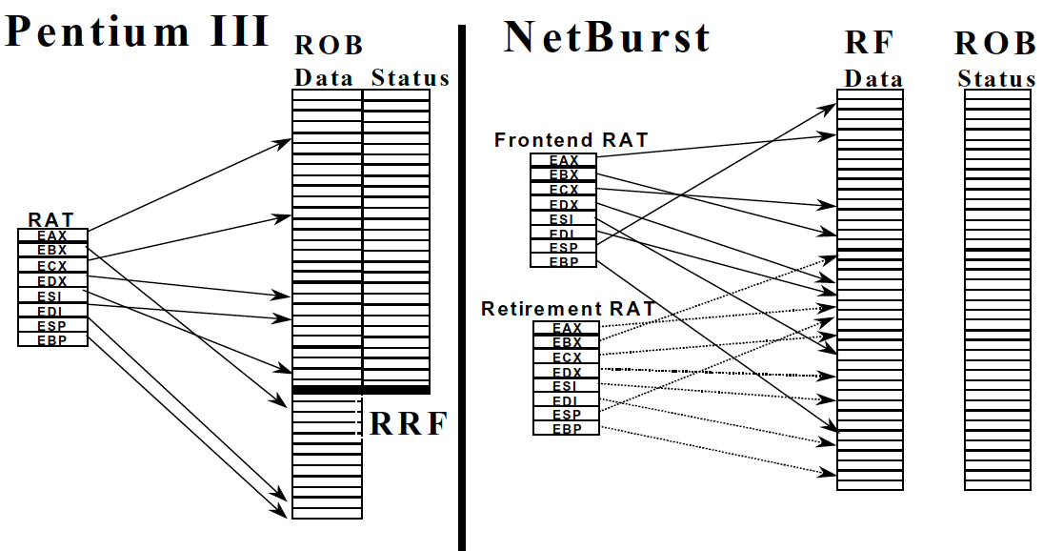
An Example from Modern Processors
Boggs et al., “The Microarchitecture of the Pentium 4 Processor,” Intel Technology Journal, 2001.

Slide 60
OOO Execution: Restricted Dataflow
An out-of-order engine dynamically builds the dataflow graph of a piece of the program
which piece?
The dataflow graph is limited to the instruction window
Instruction window: all decoded but not yet retired instructions
Can we do it for the whole program?
Why would we like to?
In other words, how can we have a large instruction window?
Can we do it efficiently with Tomasulo’s algorithm?

Slide 61
Questions to Ponder
Why is OoO execution beneficial?
What if all operations take a single cycle?
Latency tolerance: OoO execution tolerates the latency of multi-cycle operations by executing independent operations concurrently
What if an instruction takes 1000 cycles?
How large of an instruction window do we need to continue decoding?
How many cycles of latency can OoO tolerate?
What limits the latency tolerance scalability of Tomasulo’s algorithm?
Instruction window size: how many decoded but not yet retired instructions you can keep in the machine.

Slide 62
General Organization of an OOO Processor
Smith and Sohi, “The Microarchitecture of Superscalar Processors,” Proc. IEEE, Dec. 1995.

Slide 63
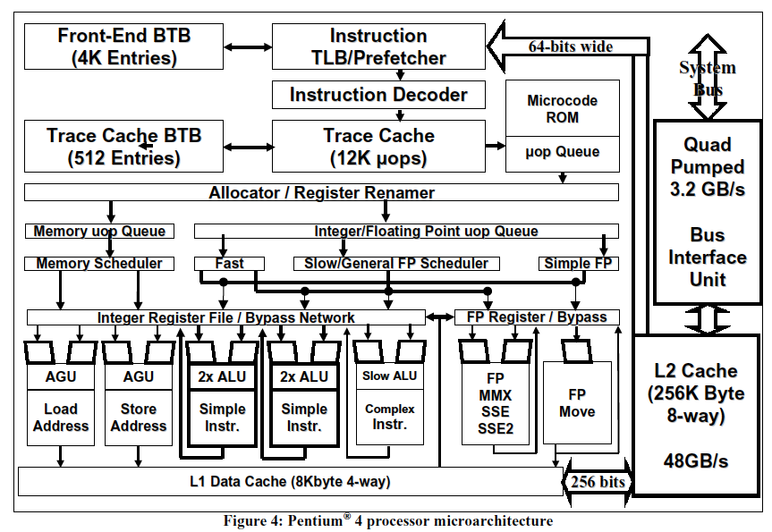
A Modern OoO Design: Intel Pentium 4
Boggs et al., “The Microarchitecture of the Pentium 4 Processor,” Intel Technology Journal, 2001.

Slide 64
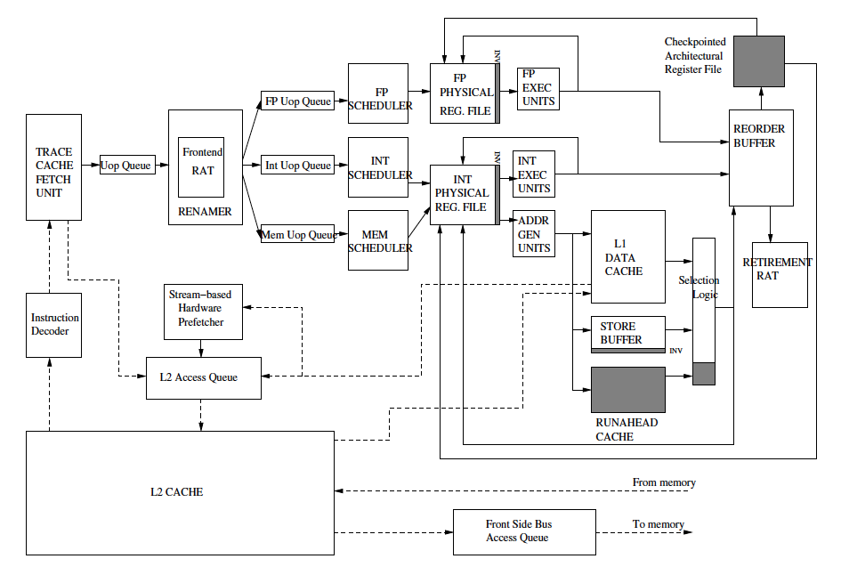
Intel Pentium 4 Simplified
Mutlu+, “Runahead Execution,”
HPCA 2003.

Slide 65
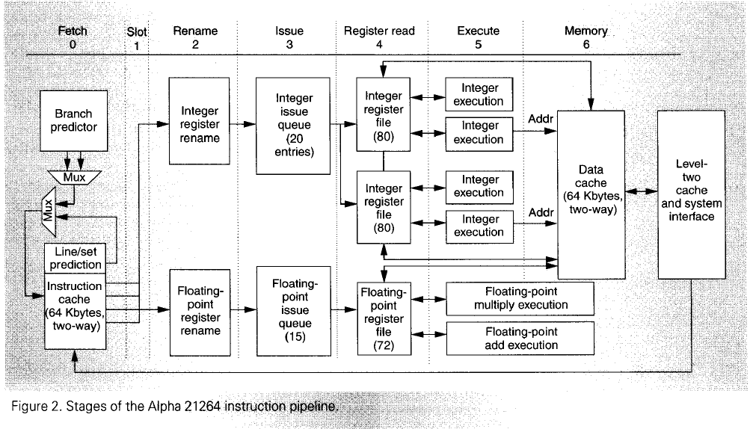
Alpha 21264
Kessler, “The Alpha 21264 Microprocessor,” IEEE Micro, March-April 1999.

Slide 66
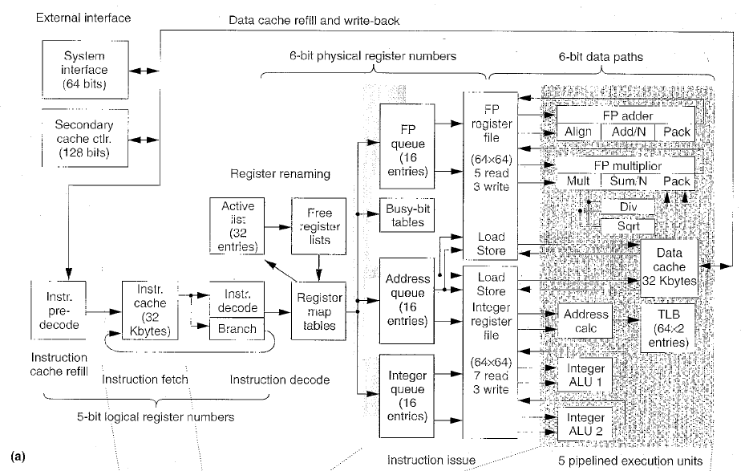
MIPS R10000
Yeager, “The MIPS R10000 Superscalar Microprocessor,” IEEE Micro, April 1996

Slide 67
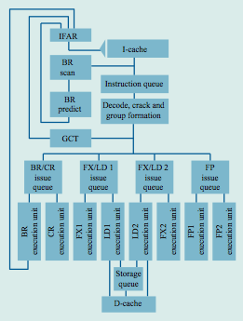
IBM POWER4
Tendler et al., “POWER4 system microarchitecture,” IBM J R&D, 2002.

Slide 68
IBM POWER4
2 cores, out-of-order execution
100-entry instruction window in each core
8-wide instruction fetch, issue, execute
Large, local+global hybrid branch predictor
1.5MB, 8-way L2 cache
Aggressive stream based prefetching

Slide 69
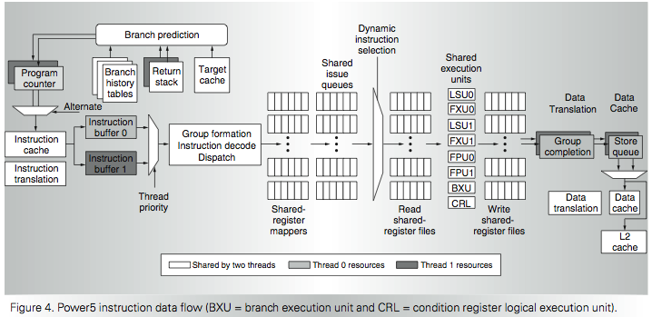
IBM POWER5
Kalla et al., “IBM Power5 Chip: A Dual-Core Multithreaded Processor,” IEEE Micro 2004.

Slide 70
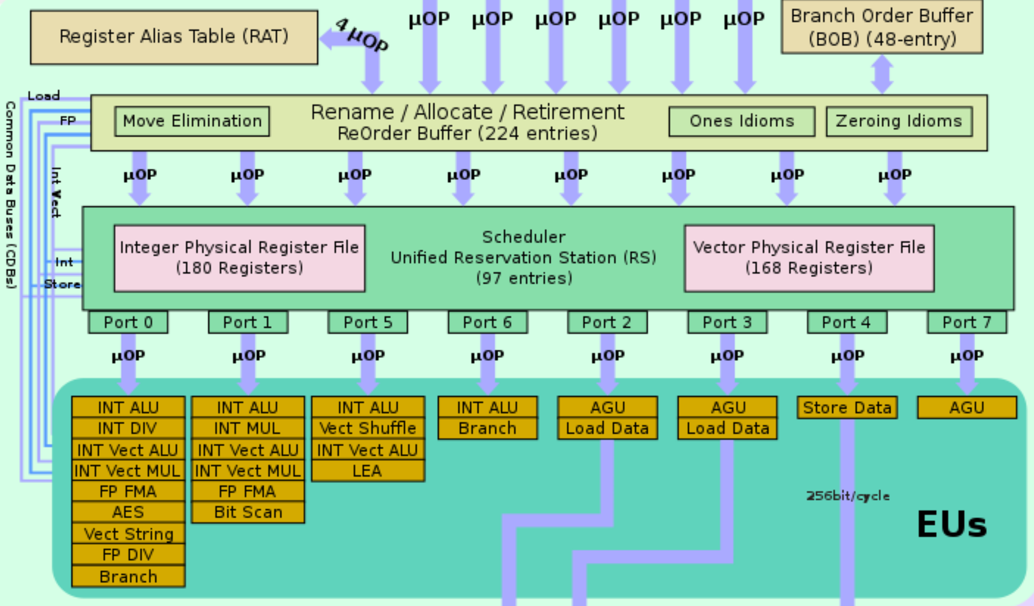
Intel Skylake (3rd Xeon)
Notes:
Intel gold CPU…
4rd Xeon Sapphire Rapids

Slide 71
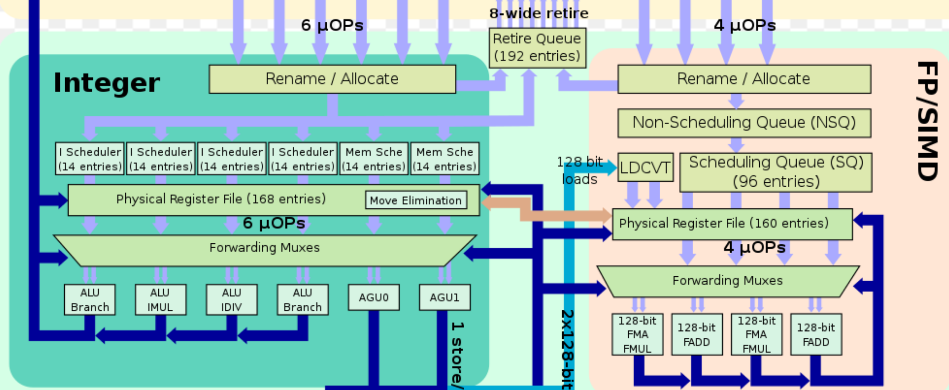
AMD Zen
Notes:
Intel gold CPU…

Slide 72
Approaches to Dependence Detection (I)
Scoreboarding
Each register in register file has a Valid bit associated with it
An instruction that is writing to the register resets the Valid bit
An instruction in Decode stage checks if all its source and destination registers are Valid
Yes: No need to stall… No dependence
No: Stall the instruction
Advantage:
Simple. 1 bit per register
Disadvantage:
Need to stall for all types of dependences, not only flow dep.

