Slide 1
Computer Arch. & AI Chip Lecture 4: Superscalar + SIMD + Multi-core
Prof. Zeke Wang
Zhejiang University
26 March 2026

Slide 2
Recall: Reorder Buffer (ROB)
Key Idea: Complete instructions out-of-order, but reorder them before writing results to architectural state (Commit).
1, When instruction is decoded in order, it reserves the next-sequential entry in the ROB, rename the destination register.
2, When instruction completes out-of-order, it writes result into ROB entry.
3, When instruction oldest in ROB and it has completed without exceptions, its result writes to reg. file or memory (In order commitment)
Register
File
Func Unit
Instruction
Cache
Decoded
in order
Commit
in order
Func Unit
Reorder
Buffer
Func Unit
Complete out-of-order
Notes:
Need the animation here…
Rob index, write, read…

Slide 3
Recall: Effect of Out-of-order Dispatch
In order dispatch + precise exceptions:
Out-of-order dispatch + precise exceptions:
IO: 16 vs. OoO:12 cycles
IMUL R3 ← R1, R2
ADD R3 ← R3, R1
ADD R1 ← R6, R7
IMUL R5 ← R6, R8
ADD R7 ← R3, R5
F
D
E
E
E
E
R
W
F
D
STALL
E
R
W
F
STALL
D
E
R
W
F
D
E
E
E
E
E
R
W
F
D
STALL
E
R
W
IMUL R3 ← R1, R2
ADD R3 ← R3, R1
ADD R1 ← R6, R7
IMUL R5 ← R6, R8
ADD R7 ← R3, R5
F
D
E
E
E
E
R
W
F
D
WAIT
E
R
W
F
D
E
R
W
F
D
E
E
E
E
R
W
F
D
WAIT
E
R
W
IMUL: 4 cycles, ADD： 1 cycle
Notes:
假设有forward，IMUL 4 cycles, ADD 1 cycle.

Slide 4
Recall: Two Humps in a Modern Pipeline
Hump 1: Reservation stations (enabling in-order issue and out-of-order dispatch/execution)
Hump 2: Reorder buffer (enabling OoO completion, in-order commitment)
TAG and VALUE Broadcast Bus
Integer add
R
E
O
R
D
E
R
E
Integer mul
Reservation Station
E
E
E
E
F
D
W
FP mul
E
E
E
E
E
E
E
E
. . .
E
E
E
E
E
E
E
E
Load/store
In order issue
OoO dispatch
OoO execution
In order commitment

Slide 5
Recall: Tomasulo’s Algorithm: Components
Register rename table (register alias table)
Reservation station
 | Source 1 |  |  | Source 2
 | V | Tag | Value | V | Tag | Value
a
b
c
d
rs.tag
tag
value
valid?
R0
1
R1
1
R2
1
R3
1
R4
1
Common Data Bus:
Broadcasts the tag and result to all RSs
Updates the RF using the tag and result
R5
1
R6
1
R7
1
R8
1
R9
1
IF
ID
RS
W
E
Notes:
Tag: reservation station entry ID
Valid: 1 means the register is readable, 0 means the new value exists in a reservation station entry.

Slide 6
Recall: Tomasulo’s Algorithm
ID: If reservation station entry available before renaming dest. register
Occupy a RS entry for the instruction
For each source register in the RS entry: if the valid bit of source register in RF is 1, RS.source.v = 1 and RS.source.value=source register; else RS.source.v = 0 and RS.source.tag = source register.tag.
For dest. register in RF: Rename to the tag of the corresponding RS entry, set the valid bit to 0.
Else stall
RS: While in reservation station, each instruction:
Update: Watches common data bus (CDB) for tag of its sources. When tag seen, grab value for the source and keep it in the reservation station.
Issue: When both operands available, instruction ready to be dispatched to FU
EXE: Execute the instruction in FU, produce its broadcast tag and value
WB: After instruction finishes in the Functional Unit
a, Arbitrate for CDB
b, Put broadcast tag and its broadcast value onto CDB (tag broadcast)
c, Update register file connected to the CDB
If the tag in the register file matches the broadcast tag, write broadcast value into register (and set valid bit)
d, Update reservation station connected to the CDB
If the broadcast tag matches the tag of any source in a RS entry, write the broadcast value to the source and set the valid bit of the source.
Notes:
d, Reclaim rename tag
no valid copy of tag in system!

Slide 7
Outline
Superscalar
Vector Insn
Multithreading
Multi-core

Slide 8
Superscalar Execution

Slide 9
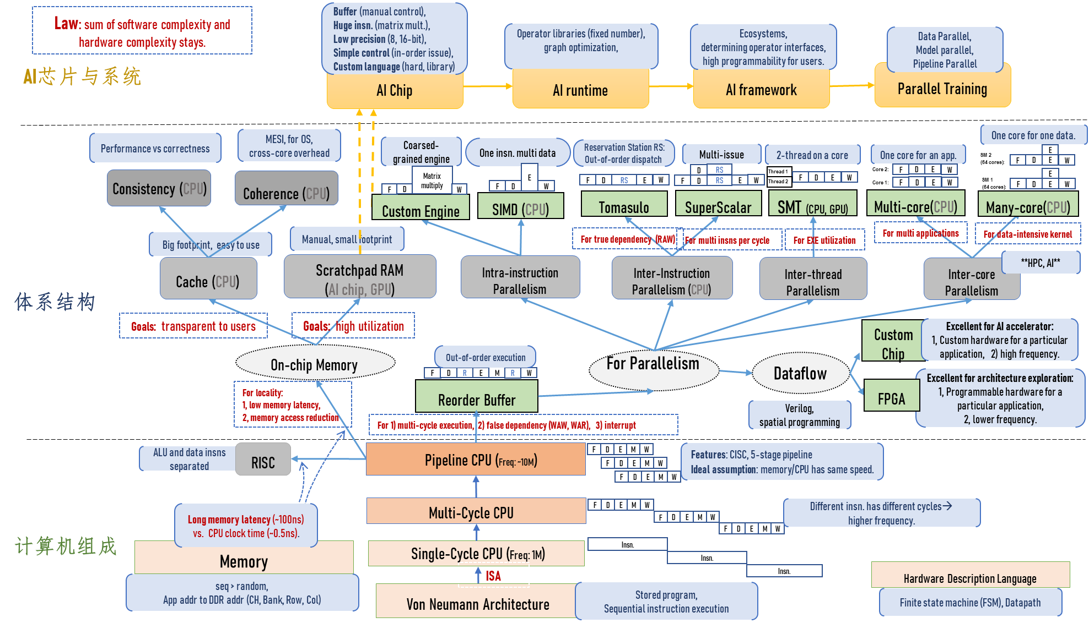
Where Are We?

Slide 10
Superscalar Execution
Idea: Fetch, decode, execute, retire multiple instructions per cycle
N-wide superscalar → N instructions per cycle
Issues:
Need to add the hardware resources for doing so
Hardware performs the dependence checking between concurrently-fetched instructions
Superscalar execution and out-of-order execution are orthogonal concepts
Can have all four combinations of processors:
[in-order, out-of-order] x [scalar, superscalar]

Slide 11
In-Order Superscalar Processor Example
Idea: Multiple copies of data-path: Can fetch/decode/execute multiple instructions per cycle.
Issue: Dependences make it tricky to dispatch multiple instructions in the same cycle.
Need dependence detection between concurrently-fetched instructions.
Here: Ideal IPC = 2

Slide 12
In-Order Superscalar: Ideal
lw $t0, 40($s0)
add $t1, $s1, $s2
sub $t2, $s1, $s3 and $t3, $s3, $s4 or $t4, $s1, $s5
sw $s5, 80($s0)
Ideal IPC = 2
Actual IPC = 2 (6 instructions issued in 3 cycles)

Slide 13
In-Order Superscalar: Dependences
lw $t0, 40($s0)
add $t1, $t0, $s1
sub $t0, $s2, $s3 and $t2, $s4, $t0 or $t3, $s5, $s6
sw $s7, 80($t3)
Ideal IPC = 2
Actual IPC = 1.2
(6 instructions issued in 5 cycles)
Notes:
Pointer chasing

Slide 14
Superscalar Execution Tradeoffs
Advantages
Higher instruction throughput
Higher IPC: instructions per cycle (i.e., lower CPI)
Disadvantages
Higher complexity for dependence checking
Require checking within a pipeline stage
Register renaming becomes more complex in an OoO processor
Potentially lengthens critical path delay → clock cycle time
More hardware resources needed

Slide 15
Can superscalar tech affect the result in Roofline model?
Notes:
不太行

Slide 16
Outline
Superscalar
Vector Insn
Multithreading
Multi-core

Slide 17
Where Are We?

Slide 18
Flynn’s Taxonomy of Computers
SISD: Single instruction operates on single data element
SIMD: Single instruction operates on multiple data elements
Array processor
Vector processor
MISD: Multiple instructions operate on single data element
Closest form: systolic array processor, streaming processor
MIMD: Multiple instructions operate on multiple data elements (multiple instruction streams)
Multiprocessor
Multithreaded processor
Mike Flynn, “Very High-Speed Computing Systems,” Proc. of IEEE, 1966
Notes:
Flynn:弗林

Slide 19
Single-Instruction/Single-Data Stream (SISD)
Instruction Pool
PU
Data Pool
SISD computer that exploits no parallelism in either the instruction or data streams.
Examples of SISD：
traditional uniprocessor machines, e.g. our trusted RISC-V pipeline

Slide 20
Single-Instruction/Multiple-Data (SIMD or “sim-dee”)
Instruction Pool
PU
PU
Data Pool
PU
PU
SIMD computer exploits multiple data streams against a single instruction stream to operations that are naturally parallelized.
Examples of SIMD:
Intel SIMD instruction extensions
AMD, PowerPC

Slide 21
Multi-Instruction/Multiple-Data (MIMD or “mim-dee”)
Instruction Pool
PU
PU
Data Pool
PU
PU
MIMD computer exploits a number of processors that function asynchronously and independently for parallelism. At any time, different processors may be executing different instructions on different pieces of data.
Example of MIMD:
Intel Xeon Phi

Slide 22
Multiple-Instruction/Single-Data Stream (MISD)
Instruction Pool
PU
Data Pool
PU
MISD computer exploits multiple instruction streams against a single data stream.
Example of MISD:
Historical significance,
Systolic array processor,
Streaming processor

Slide 23
SIMD Applications & Implementations
Applications:
Scientific computing
Matlab, NumPy
Graphics and video processing
Photoshop, …
Big Data
Deep learning
Gaming
…
Implementations:
x86
ARM
RISC-V vector extensions

Slide 24
Intuition of SIMD Capability
Computing task (A[6:0] + B[6:0])
Scalar: one addition per cycle
SIMD : Multiple additions per cycle
t6
A[6]
B[6]
t5
A[5]
B[5]
t4
A[4]
B[4]
t3
A[3]
B[3]
t2
A[2]
B[2]
t1
A[1]
B[1]
t1
A[4]
B[4]
A[5]
B[5]
A[6]
B[6]
t0
A[0]
B[0]
t0
A[0]
B[0]
A[1]
B[1]
A[2]
B[2]
A[3]
B[3]
+
+
+
+
+
Scalar
SIMD

Slide 25
SIMD in Intel CPU：
1, 256-bit AVX2 (8个32-bit float)
2, 512-bit AVX512 (16个32-bit float)
Linus Torvalds: “I hope AVX512 dies a painful death, and that Intel starts fixing real problems instead of trying to create magic instructions to then create benchmarks that they can look good on…”
Notes:
现在的计算世界往三个方向发展

Slide 26
Recall: Amdahl’s Law
Amdahl’s Law
f: Parallelizable fraction of a program
N: Number of processors
Maximum speedup limited by serial portion: Serial bottleneck
All parallel machines “suffer from” the serial bottleneck
1
Speedup =
1 - f
+
f
N
Amdahl, “Validity of the single processor approach to achieving large scale computing capabilities,” AFIPS 1967.

Slide 27
Vector Processor Limitations
-- Memory (bandwidth) can easily become a bottleneck, especially if
1. compute/memory operation balance is not maintained
2. data is not mapped appropriately to memory banks

Slide 28
What needs us to do to support SIMD instructions?
Notes:
现在的计算世界往三个方向发展

Slide 29
Recall: MIPS State Elements
Program counter:
32-bit register
Instruction memory:
Takes input 32-bit address A and reads the 32-bit data (i.e., instruction) from that address to the read data output RD.
Register file:
The 32-element, 32-bit register file has 2 read ports and 1 write port
Data memory:
If the write enable, WE, is 1, it writes 32-bit data WD into memory location at 32-bit address A on the rising edge of the clock.
If the write enable is 0, it reads 32-bit data from address A onto RD.
This notation is used in H&H single-cycle MIPS implementation (H&H Chapter 7.3)

Slide 30
Recall: The Full MIPS Datapath
JAL, JR, JALR omitted
**Based on original figure from [P&H CO&D, COPYRIGHT 2004 Elsevier. ALL RIGHTS RESERVED.]

Slide 31
MIPS State Elements When Enabling SIMD
Program counter:
32-bit register
Instruction memory:
Takes input 32-bit address A and reads the 32-bit data (i.e., instruction) from that address to the read data output RD.
Register file (s):
The 32-element, 32-bit register file has 2 read ports and 1 write port
The 32-element, 128-bit register file has 2 read ports and 1 write port
Data memory:
If WE is 1, it writes 32-bit data WD into memory location at 32-bit address A. If WE1 = 1, writes 128-bit data WD1 to A1 address.
What else parts needs to add?
This notation is used in H&H single-cycle MIPS implementation (H&H Chapter 7.3)
Notes:
EXE

Slide 32
What will This Graph Be to Support Vector Insns?
VRF VALU VMemory

Slide 33
Programmer Visible (Architectural) States
Memory:
1, array of storage locations
indexed by an address;
2, Multiple bank design.
Registers:
General purpose register file
Vector register file
M[0]
M[1]
M[2]
M[3]
M[4]
Program Counter
Program Counter:
memory address
of the current (or next) instruction
M[N-1]

Slide 34
Roofline Model for SIMD CPU
Notes:
KB MB GB TB
K M B T
1B=10亿

Slide 35
Outline
Superscalar
Vector Insn
Multithreading
Multi-core

Slide 36
Fine-Grained Multithreading

Slide 37
Where Are We?

Slide 38
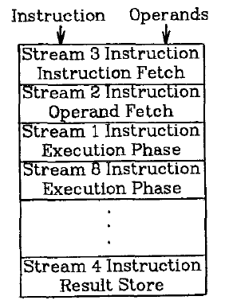
Fine-Grained Multithreading
Idea: Hardware has multiple thread contexts (PC+registers). Each cycle, fetch engine fetches from a different thread.
By the time the fetched branch/instruction resolves, no instruction is fetched from the same thread
Branch/instruction resolution latency overlapped with execution of other threads’ instructions
+ No logic needed for handling control and
data dependences within a thread
-- Single thread performance suffers
-- Extra logic for keeping thread contexts
-- Does not overlap latency if not enough
threads to cover the whole pipeline
Notes:
Latency overlap/hiding

Slide 39
Fine-Grained Multithreading (II)
Idea: Switch to another thread every cycle such that no two instructions from a thread are in the pipeline concurrently
Advantages：
Tolerates the control and data dependency latencies by overlapping the latency with useful work from other threads
Improves pipeline utilization by taking advantage of multiple threads
Thornton, “Parallel Operation in the Control Data 6600,” AFIPS 1964.
Smith, “A pipelined, shared resource MIMD computer,” ICPP 1978.

Slide 40
Fine-Grained Multithreading: History
CDC 6600’s peripheral processing unit is fine-grained multithreaded
Thornton, “Parallel Operation in the Control Data 6600,” AFIPS 1964.
Processor executes a different I/O thread every cycle
An operation from the same thread is executed every 10 cycles
Denelcor HEP (Heterogeneous Element Processor)
Smith, “A pipelined, shared resource MIMD computer,” ICPP 1978.
120 threads/processor
Available queue vs. unavailable (waiting) queue for threads
Each thread can have only 1 instruction in the processor pipeline; each thread independent
For each thread, processor looks like a non-pipelined machine
System throughput vs. single thread performance tradeoff

Slide 41
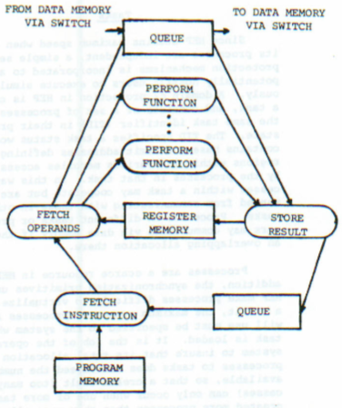
Fine-Grained Multithreading in HEP
Cycle time: 100ns
8 stages → 800 ns to complete an instruction
assuming no memory access
No control and data dependency checking
Burton Smith
(1941-2018)

Slide 42
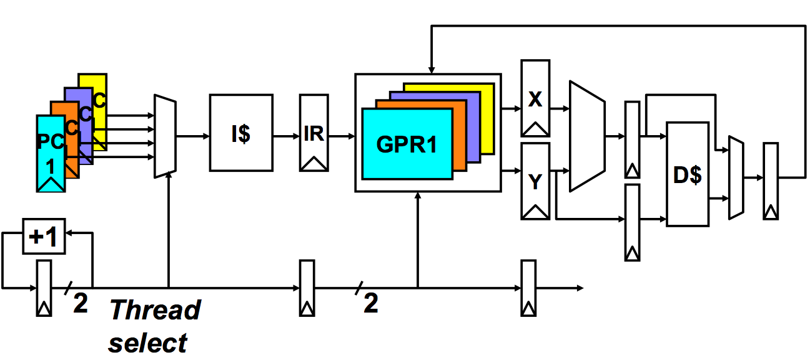
Multithreaded Pipeline Example
Slide credit: Joel Emer

Slide 43
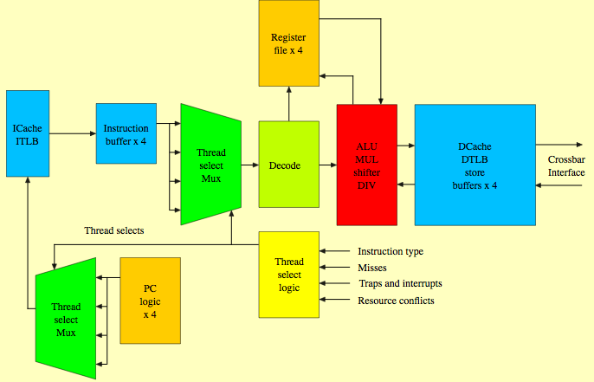
Sun Niagara Multithreaded Pipeline
Kongetira et al., “Niagara: A 32-Way Multithreaded Sparc Processor,” IEEE Micro 2005.

Slide 44
Fine-grained Multithreading
Advantages
+ No need for dependency checking between instructions
(only one instruction in pipeline from a single thread)
+ No need for branch prediction logic
+ Otherwise-bubble cycles used for executing useful instructions from different threads
+ Improved system throughput, latency tolerance, utilization
Disadvantages
- Extra hardware complexity: multiple hardware contexts (PCs, register files, …), thread selection logic
- Reduced single thread performance (one instruction fetched every N cycles from the same thread)
- Resource contention between threads in caches and memory
- Some dependency checking logic between threads remains (load/store)

Slide 45
Can multithreading tech affect the result in Roofline model?
Notes:
现在的计算世界往三个方向发展

Slide 46
Outline
Superscalar
Vector Insn
Multithreading
Multi-core

Slide 47
Where Are We?

Slide 48
Multi-Core Processors

Slide 49
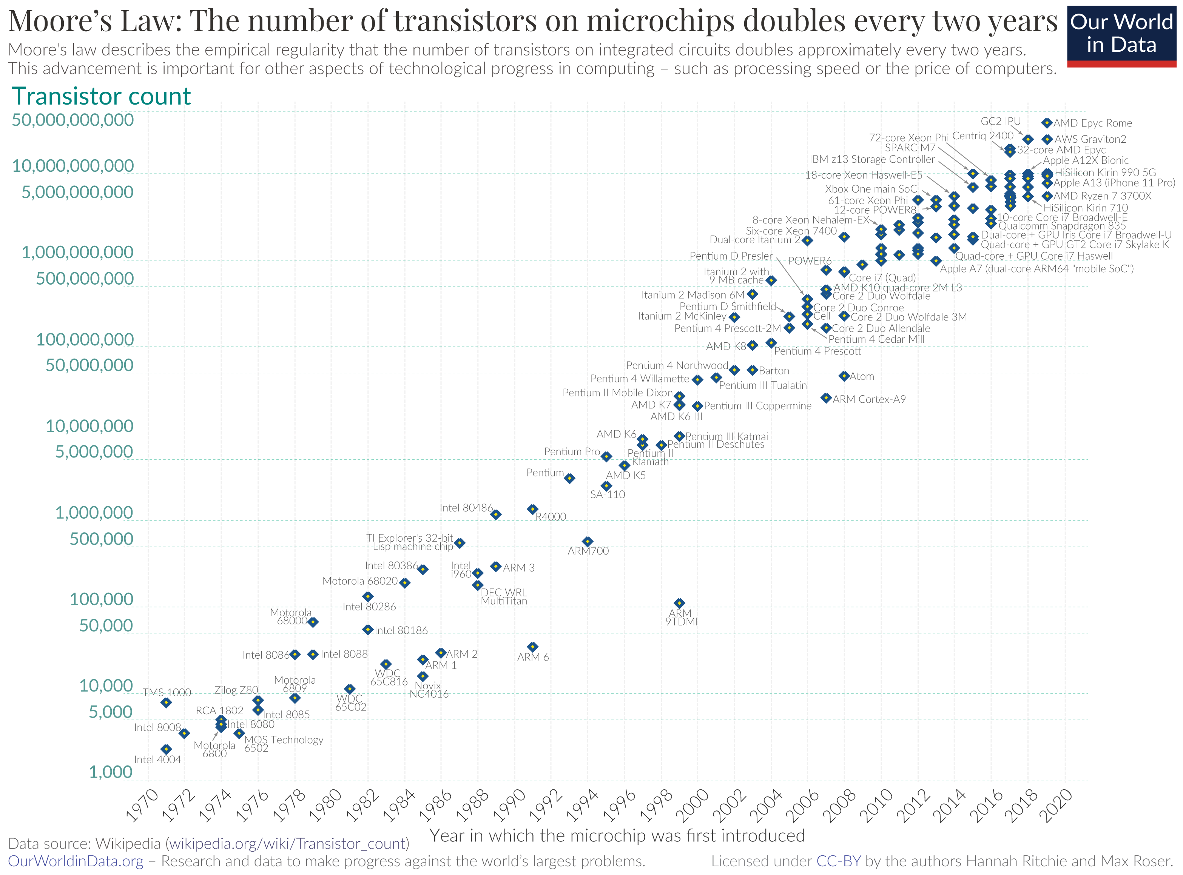
Moore’s Law
Notes:
晶体管数量两年翻倍

Slide 50
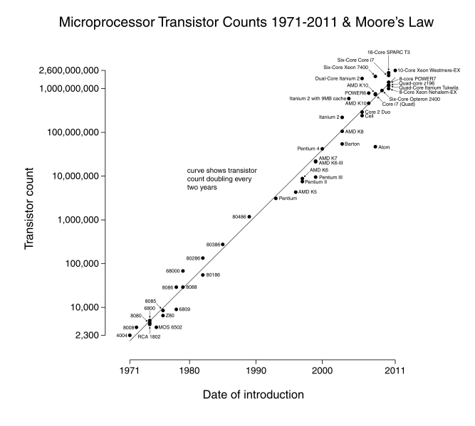

Slide 51

Gordon E. Moore Dies at 94
Intel and the Gordon and Betty Moore Foundation announce that company co-founder Gordon Moore died on March 24, 2023, at the age of 94.

Slide 52
Multi-Core
Idea: Put multiple cores on the same die.
Technology scaling (Moore’s Law) enables more transistors to be placed on the same die area
What else could you do with the die area you dedicate to multiple processors?
Have a bigger, more powerful core
Have larger caches in the memory hierarchy
Simultaneous multithreading
Integrate platform components on chip (e.g., network interface, memory controllers)

Slide 53
Why Multi-Core?
Alternative: Bigger, more powerful single core
Larger superscalar issue width, larger instruction window, more execution units, large trace caches, large branch predictors, etc
+ Improves single-thread performance transparently to programmer, compiler;
- Very difficult to design (Scalable algorithms for improving single-thread performance elusive);
- Power hungry – many out-of-order execution structures consume significant power/area when scaled. Why?
- Diminishing returns on performance;
- Does not significantly help memory-bound application performance (Scalable algorithms for this elusive).

Slide 54
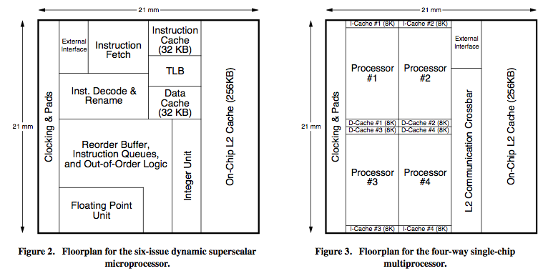
Large Superscalar vs. Multi-Core
Large Superscalar
Multi-Core
Vs.
Olukotun et al., “The Case for a Single-Chip Multiprocessor,” ASPLOS 1996.

Slide 55
Multi-Core vs. Large Superscalar
Multi-core advantages
+ Simpler cores → more power efficient, lower complexity, easier to design and replicate, higher frequency (shorter wires, smaller structures)
+ Higher system throughput on multiprogrammed workloads → reduced context switches
+ Higher system throughput in parallel applications
Multi-core disadvantages
- Requires parallel tasks/threads to improve performance (parallel programming)
- Resource sharing can reduce single-thread performance
- Shared hardware resources need to be managed
- Number of pins limits data supply for increased demand

Slide 56
Why Multi-Core over Large Superscalar
Technology push
Instruction issue queue size limits the cycle time of the superscalar, OoO processor → diminishing performance
Quadratic increase in complexity with issue width
Large, multi-ported register files to support large instruction windows and issue widths → more resources, reduced frequency or longer RF access, diminishing performance
Application pull
Multiple applications run on your CPU
Olukotun et al., “The Case for a Single-Chip Multiprocessor,” ASPLOS 1996.
Notes:
What does application pull mean?
Cell phone use multiple cores…

Slide 57
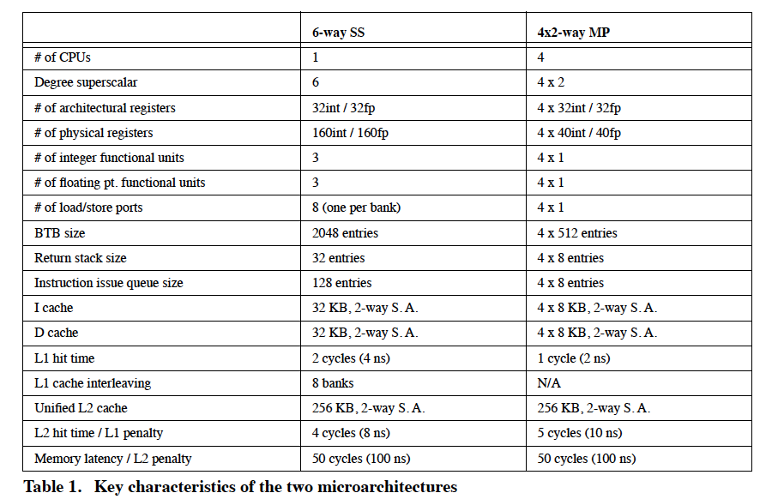
Comparison Points…

Slide 58
Can multi-core tech affect the result in Roofline model?
Notes:
现在的计算世界往三个方向发展

Slide 59
Can Multi-core CPU Increase Throughput?
Notes:
KB MB GB TB
K M B T
1B=10亿

Slide 60
Multi-Core Evolution (An Early History)

Slide 61
Piranha Chip Multiprocessor
Barroso et al., “Piranha: A Scalable Architecture Based on Single-Chip Multiprocessing,” ISCA 2000.
An early example of a symmetric multi-core processor
Large-scale server based on CMP nodes
Designed for commercial workloads
Read:
Barroso et al., “Memory System Characterization of Commercial Workloads,” ISCA 1998.
Ranganathan et al., “Performance of Database Workloads on Shared-Memory Systems with Out-of-Order Processors,” ASPLOS 1998.

Slide 62
Commercial Workload Characteristics
Memory system is the main bottleneck
Very high CPI
Execution time dominated by memory stall times
Instruction stalls as important as data stalls
Fast/large L2 caches are critical
Very poor Instruction Level Parallelism (ILP) with existing techniques
Frequent hard-to-predict branches
Large L1 miss ratios
Small gains from wide-issue out-of-order techniques
No need for floating point and multimedia units

Slide 63

Piranha Processing Node
Alpha core:
1-issue, in-order,
500MHz
CPU
Next few slides from
Luiz Barroso’s ISCA 2000 presentation of
Piranha: A Scalable Architecture Based on Single-Chip Multiprocessing

Slide 64
Piranha Processing Node
Alpha core:
1-issue, in-order,
500MHz
L1 caches:
I&D, 64KB, 2-way
CPU
I$
D$

Slide 65
Piranha Processing Node
Alpha core:
1-issue, in-order,
500MHz
L1 caches:
I&D, 64KB, 2-way
Intra-chip switch (ICS)
32GB/sec, 1-cycle delay
CPU
CPU
CPU
CPU
I$
D$
I$
D$
I$
D$
I$
D$
ICS
I$
D$
I$
D$
I$
D$
I$
D$
CPU
CPU
CPU
CPU

Slide 66
Piranha Processing Node
Alpha core:
1-issue, in-order,
500MHz
L1 caches:
I&D, 64KB, 2-way
Intra-chip switch (ICS)
32GB/sec, 1-cycle delay
L2 cache:
shared, 1MB, 8-way
CPU
L2$
CPU
L2$
CPU
L2$
CPU
L2$
I$
D$
I$
D$
I$
D$
I$
D$
ICS
L2$
I$
D$
L2$
I$
D$
L2$
I$
D$
L2$
I$
D$
CPU
CPU
CPU
CPU

Slide 67
Piranha Processing Node
Alpha core:
1-issue, in-order,
500MHz
L1 caches:
I&D, 64KB, 2-way
Intra-chip switch (ICS)
32GB/sec, 1-cycle delay
L2 cache:
shared, 1MB, 8-way
Memory Controller (MC)
RDRAM, 12.8GB/sec
MEM-CTL
MEM-CTL
MEM-CTL
MEM-CTL
CPU
L2$
CPU
L2$
CPU
L2$
CPU
L2$
I$
D$
I$
D$
I$
D$
I$
D$
ICS
L2$
I$
D$
L2$
I$
D$
L2$
I$
D$
L2$
I$
D$
CPU
CPU
CPU
CPU
MEM-CTL
MEM-CTL
MEM-CTL
MEM-CTL
8 banks
@1.6GB/sec

Slide 68
Piranha Processing Node
Alpha core:
1-issue, in-order,
500MHz
L1 caches:
I&D, 64KB, 2-way
Intra-chip switch (ICS)
32GB/sec, 1-cycle delay
L2 cache:
shared, 1MB, 8-way
Memory Controller (MC)
RDRAM, 12.8GB/sec
Protocol Engines (HE & RE)
μprog., 1K μinstr.,
even/odd interleaving
MEM-CTL
MEM-CTL
MEM-CTL
MEM-CTL
HE
CPU
L2$
CPU
L2$
CPU
L2$
CPU
L2$
I$
D$
I$
D$
I$
D$
I$
D$
ICS
RE
L2$
I$
D$
L2$
I$
D$
L2$
I$
D$
L2$
I$
D$
CPU
CPU
CPU
CPU
MEM-CTL
MEM-CTL
MEM-CTL
MEM-CTL

Slide 69
Piranha Processing Node
Alpha core:
1-issue, in-order,
500MHz
L1 caches:
I&D, 64KB, 2-way
Intra-chip switch (ICS)
32GB/sec, 1-cycle delay
L2 cache:
shared, 1MB, 8-way
Memory Controller (MC)
RDRAM, 12.8GB/sec
Protocol Engines (HE & RE):
μprog., 1K μinstr.,
even/odd interleaving
System Interconnect:
4-port Xbar router
topology independent
32GB/sec total bandwidth
4 Links
@ 8GB/s
MEM-CTL
MEM-CTL
MEM-CTL
MEM-CTL
HE
CPU
L2$
CPU
L2$
CPU
L2$
CPU
L2$
I$
D$
I$
D$
I$
D$
I$
D$
Router
ICS
RE
L2$
I$
D$
L2$
I$
D$
L2$
I$
D$
L2$
I$
D$
CPU
CPU
CPU
CPU
MEM-CTL
MEM-CTL
MEM-CTL
MEM-CTL

Slide 70

Piranha Processing Node
Alpha core:
1-issue, in-order,
500MHz
L1 caches:
I&D, 64KB, 2-way
Intra-chip switch (ICS)
32GB/sec, 1-cycle delay
L2 cache:
shared, 1MB, 8-way
Memory Controller (MC)
RDRAM, 12.8GB/sec
Protocol Engines (HE & RE):
μprog., 1K μinstr.,
even/odd interleaving
System Interconnect:
4-port Xbar router
topology independent
32GB/sec total bandwidth
MEM-CTL
MEM-CTL
MEM-CTL
MEM-CTL
HE
CPU
L2$
CPU
L2$
CPU
L2$
CPU
L2$
I$
D$
I$
D$
I$
D$
I$
D$
Router
ICS
RE
L2$
I$
D$
L2$
I$
D$
L2$
I$
D$
L2$
I$
D$
CPU
CPU
CPU
CPU
MEM-CTL
MEM-CTL
MEM-CTL
MEM-CTL
Single Chip

Slide 71
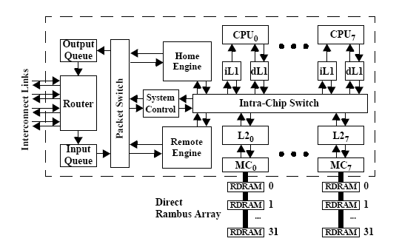
Piranha Processing Node

Slide 72
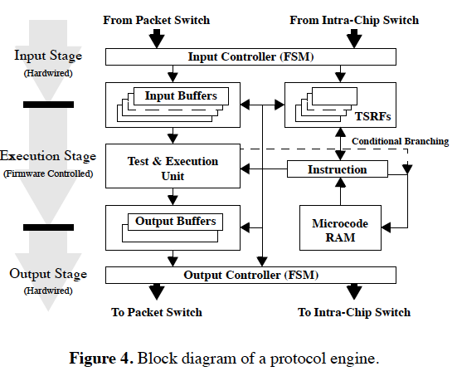
Inter-Node Coherence Protocol Engine

Slide 73
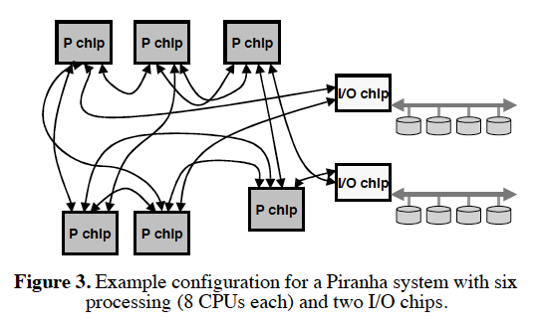
Piranha System

Slide 74
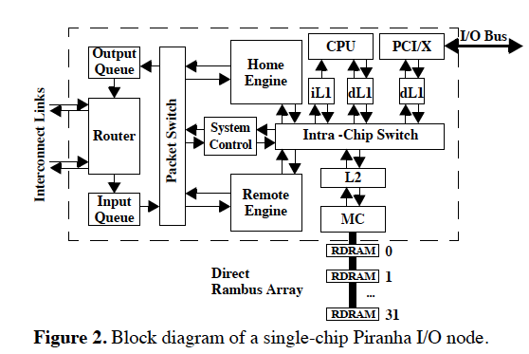
Piranha I/O Node

Slide 75
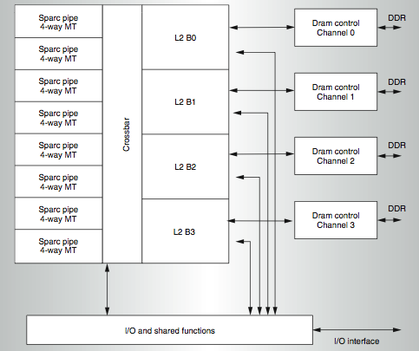
Sun Niagara (UltraSPARC T1)
Kongetira et al., “Niagara: A 32-Way Multithreaded SPARC Processor,” IEEE Micro 2005.

Slide 76
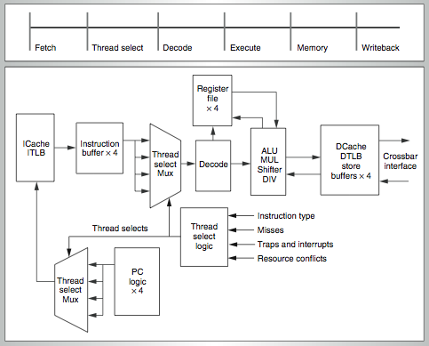
Niagara Core
4-way fine-grain multithreaded, 6-stage, dual-issue in-order
Round robin thread selection (unless cache miss)
Shared FP unit among cores

Slide 77
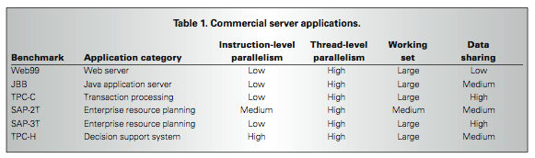
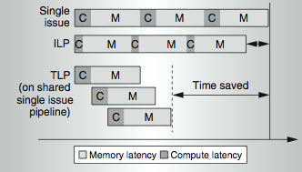
Niagara Design Point
Also designed for commercial applications

Slide 78
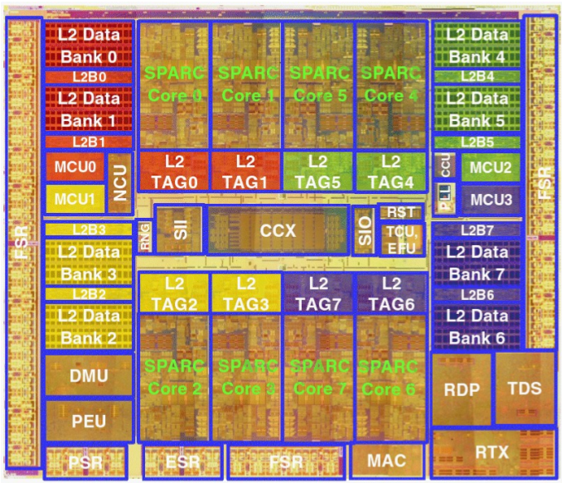
Sun Niagara II (UltraSPARC T2)
8 SPARC cores, 8 threads/core. 8 stages. 16 KB I$ per Core. 8 KB D$ per Core. FP, Graphics, Crypto, units per Core.
4 MB Shared L2, 8 banks, 16-way set associative.
4 dual-channel FBDIMM memory controllers.
X8 PCI-Express @ 2.5 Gb/s.
Two 10G Ethernet ports @ 3.125 Gb/s.

Slide 79
Chip Multithreading (CMT)
Spracklen and Abraham, “Chip Multithreading: Opportunities and Challenges,” HPCA Industrial Session, 2005.
Idea: Chip multiprocessor where each core is multithreaded
Niagara 1/2: fine grained multithreading
IBM POWER5: simultaneous multithreading
Motivation: Tolerate memory latency better
A simple core stays idle on a cache miss
Multithreading enables tolerating cache miss latency when there is TLP

Slide 80
CMT (CMP + MT) vs. CMP
Advantages of adding multithreading to each core
+ Better memory latency tolerance when there are enough threads
+ Fine grained multithreading can simplify core design (no need for branch prediction, dependency checking)
+ Potentially better utilization of core, cache, memory resources
+ Shared instructions and data among threads not replicated
+ When one thread is not using a resource, another can
Disadvantages
- Reduced single-thread performance (a thread does not have the core and L1 caches to itself)
- More pressure on the shared resources (cache, off-chip bandwidth) → more resource contention
- Applications with limited TLP do not benefit

Slide 81
Sun ROCK
Chaudhry et al., “Rock: A High-Performance Sparc CMT Processor,” IEEE Micro, 2009.
Chaudhry et al., “Simultaneous Speculative Threading: A Novel Pipeline Architecture Implemented in Sun's ROCK Processor,” ISCA 2009
Goals:
Maximize throughput when threads are available
Boost single-thread performance when threads are not available and on cache misses
Ideas:
Runahead on a cache miss → ahead thread executes miss-independent instructions, behind thread executes dependent instructions
Branch prediction (gshare)

Slide 82
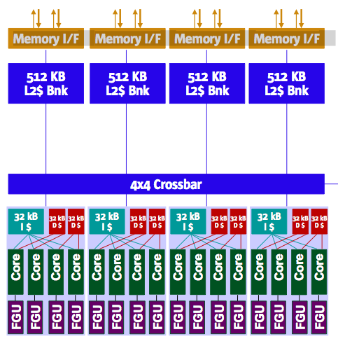
Sun ROCK
16 cores, 2 threads per core (fewer threads than Niagara 2)
4 cores share a 32KB instruction cache
2 cores share a 32KB data cache
2MB L2 cache (smaller than Niagara 2)

Slide 83
Sun ROCK Cores
Load miss in L1 cache starts parallelization using 2 HW threads
Ahead thread
Checkpoints state and executes speculatively
Instructions independent of load miss are speculatively executed
Load miss(es) and dependent instructions are deferred to behind thread
Behind thread
Executes deferred instructions and re-defers them if necessary
Memory-Level Parallelism (MLP)
Run ahead on load miss and generate additional load misses
Instruction-Level Parallelism (ILP)
Ahead and behind threads execute independent instructions from different points in program in parallel

Slide 84
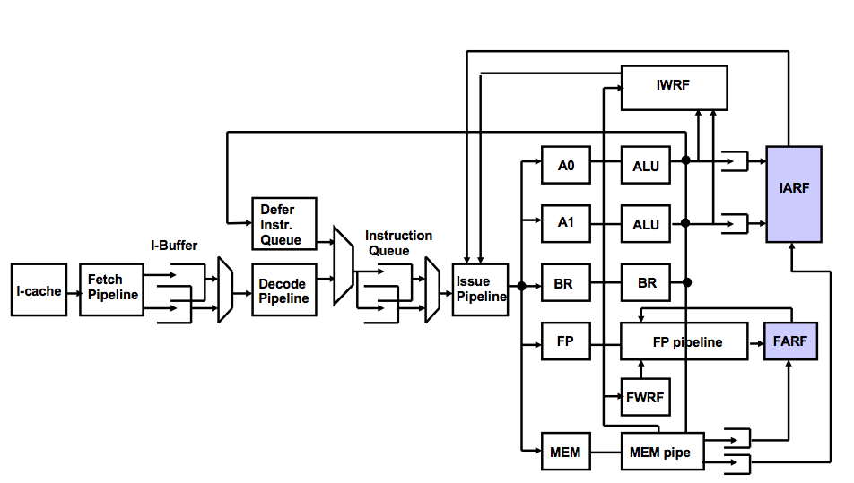
ROCK Pipeline

Slide 85
More Powerful Cores in Sun ROCK
Advantages
+ Higher single-thread performance (MLP + ILP)
+ Better cache miss tolerance → Can reduce on-chip cache sizes
Disadvantages
- Bigger cores → Fewer cores → Lower parallel throughput (in terms of threads).
How about each thread’s response time?
- More complex than Niagara cores (but simpler than conventional out-of-order execution) → Longer design time?

Slide 86
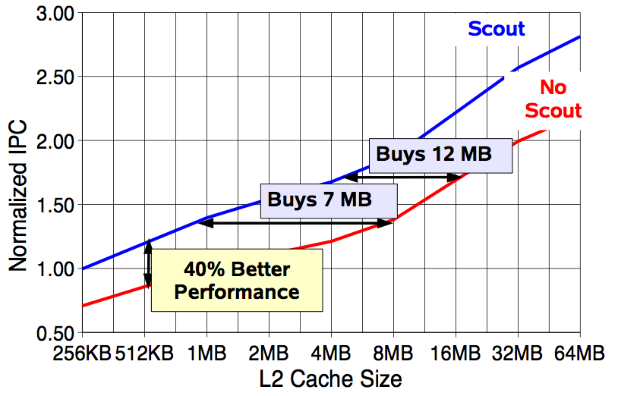
More Powerful Cores in Sun ROCK
Chaudhry talk, Aug 2008.

Slide 87
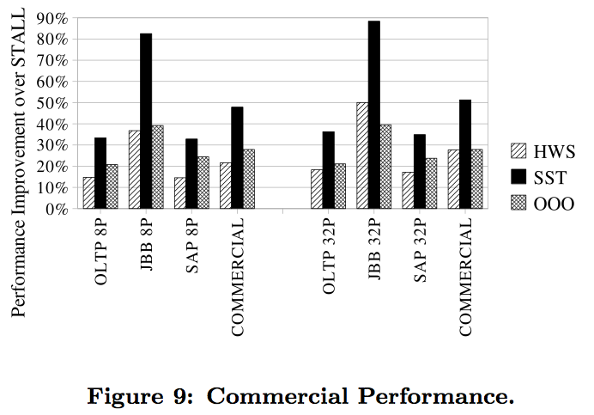
More Powerful Cores in Sun ROCK
Chaudhry et al., “Simultaneous Speculative Threading: A Novel Pipeline Architecture Implemented in Sun's ROCK Processor,” ISCA 2009

Slide 88
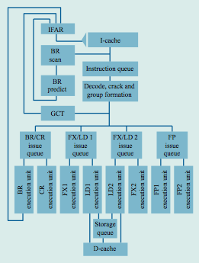
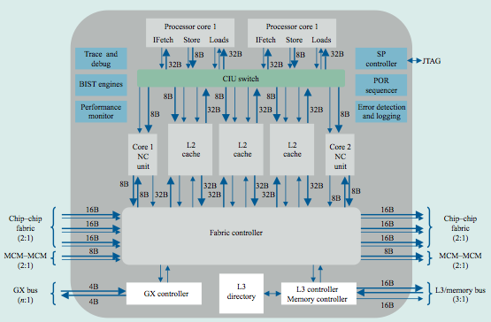
IBM POWER4
Tendler et al., “POWER4 system microarchitecture,” IBM J R&D, 2002.
Another symmetric multi-core chip…
But, fewer and more powerful cores

Slide 89
IBM POWER4
2 cores, out-of-order execution
100-entry instruction window in each core
8-wide instruction fetch, issue, execute
Large, local+global hybrid branch predictor
1.5MB, 8-way L2 cache
Aggressive stream based prefetching

Slide 90
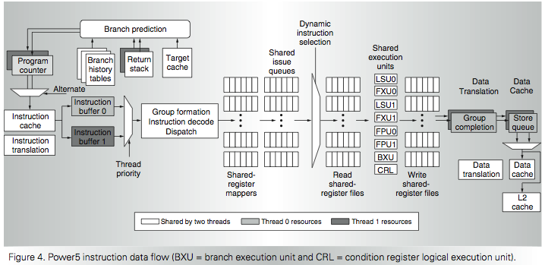
IBM POWER5
Kalla et al., “IBM Power5 Chip: A Dual-Core Multithreaded Processor,” IEEE Micro 2004.

Slide 91
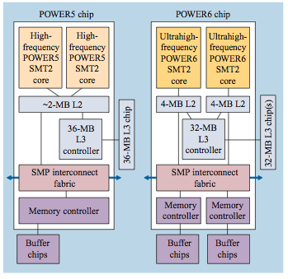
IBM POWER6
Le et al., “IBM POWER6 microarchitecture,” IBM J R&D, 2007.
2 cores, in order, high frequency (4.7 GHz)
8 wide fetch
Simultaneous multithreading in each core
Runahead execution in each core
Similar to Sun ROCK

Slide 92
IBM POWER7
Kalla et al., “Power7: IBM’s Next-Generation Server Processor,” IEEE Micro 2010.
8 out-of-order cores, 4-way SMT in each core
TurboCore mode
Can turn off cores so that other cores can be run at higher frequency

Slide 93
Large vs. Small Cores
Large Core
Small Core
Out-of-order
Wide fetch e.g. 4-wide
Deeper pipeline
Aggressive branch predictor (e.g. hybrid)
Multiple functional units
Trace cache
Memory dependence speculation
In-order
Narrow Fetch e.g. 2-wide
Shallow pipeline
Simple branch predictor (e.g. Gshare)
Few functional units
Large Cores are power inefficient: e.g., 2x performance for 4x area (power)

Slide 94
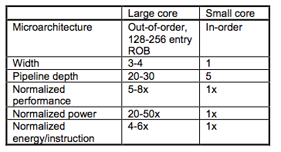
Large vs. Small Cores
Grochowski et al., “Best of both Latency and Throughput,” ICCD 2004.

Slide 95
Tile-Large Approach
Tile a few large cores
IBM Power 5, AMD Barcelona, Intel Core2Quad, Intel Nehalem
+ High performance on single thread, serial code sections (2 units)
- Low throughput on parallel program portions (8 units)
Large
core
Large core
Large core
Large core
“Tile-Large”

Slide 96
Tile-Small Approach
Tile many small cores
Sun Niagara, Intel Larrabee, Tilera TILE (tile ultra-small)
+ High throughput on the parallel part (16 units)
- Low performance on the serial part, single thread (1 unit)
Small core
Small core
Small core
Small core
Small core
Small core
Small core
Small core
Small core
Small core
Small core
Small core
Small core
Small core
Small core
Small core
“Tile-Small”

Slide 97
Can We Get the Best of Both worlds?
Tile Large
+ High performance on single thread, serial code sections (2 units)
- Low throughput on parallel program portions (8 units)
Tile Small
+ High throughput on the parallel part (16 units)
- Low performance on the serial part, single thread (1 unit), reduced single-thread performance compared to existing single thread processors
Idea: Have both large and small on the same chip → Performance asymmetry

Slide 98
Asymmetric Chip Multiprocessor (ACMP)
Provide one large core and many small cores
+ Accelerate serial part using the large core (2 units)
+ Execute parallel part on all cores for high throughput (14 units)
Large
core
Large core
Small core
Small core
Small core
Small core
Large
core
Small core
Small core
Small core
Small core
Small core
Small core
Small core
Small core
Large core
Large core
Small core
Small core
Small core
Small core
Small core
Small core
Small core
Small core
Small core
Small core
Small core
Small core
Small core
Small core
Small core
Small core
“Tile-Large”
“Tile-Small”
ACMP

