Slide 1
AI Chip & Systems. Lecture 6: Graphics Processing Units
Prof. Zeke Wang
Zhejiang University
April 9 2026

Slide 2
Recall: Comparison of Memories
Capacity
Bandwidth
Latency
SRAM
~10MB
SRAM
~1TB/s
SRAM
~1ns
HBM
~10GB
HBM
~100GB/s
HBM
~100ns
DDR
~100GB
DDR
~10GB/s
DDR
~100ns
SSD
~1TB
SSD
~1GB/s
SSD
~1us
DISK
~10TB
DISK
~10MB/s
DISK
~1ms

Slide 3
Recall: FF vs. SRAM vs. DRAM vs. SSD
Flip-Flops (~K)
Very fast, parallel access
Very expensive (one bit costs tens of transistors)
Static RAM (~M)
Relatively fast, only one data word at a time
Expensive (one bit costs 6+ transistors)
Dynamic RAM (~G)
Slower, one data word at a time, reading destroys content (refresh), needs special process for manufacturing
Cheap (one bit costs only one transistor plus one capacitor)
Flash Memory (~T)
Much slower, access takes a long time, non-volatile
Very cheap (one transistor stores 16 bits or no transistors involved)

Slide 4
Recall: SRAM Summary
SRAM
Goal: buffering data on chip to reduce external memory traffic
Advantage: random access still keeps high performance
Disadvantage: low capacity (multiple MBs)
Where to Use SRAM?
Cache in CPU
Shared memory in GPU
On-chip buffer in AI accelerator
How to Use SRAM?
Multiple small separate SRAMs: low latency and high throughput
Banked design: wide access ports

Slide 5
Recall: A Large Fraction of CPU is SRAM
SRAM (Cache) in a CPU
Half chip area is occupied by cache
10MB (2.5MB/core * 4 cores)

Slide 6
Recall: DRAM Capacity, Bandwidth & Latency
128x
20x
1.3x

Slide 7
Recall: Key Messages behind Memory
Memory Optimizations aim at size, bandwidth, not latency.
A memory read/write may need a few DDR operations, e.g., ACTIVATE, Column, Prechange, within a memory chip…
Different access sequence leads to different throughput, sequential (mainly row buffer hit) > random (mainly row buffer miss).
Random access is slow due to low row buffer miss rate.

Slide 8
Recall: DRAM vs. SRAM
DRAM
Slower access (capacitor)
Higher density (1T 1C cell)
Lower cost
Requires refresh (power, performance, circuitry)
Manufacturing requires putting capacitor and logic together
SRAM
Faster access (no capacitor)
Lower density (6T cell)
Higher cost
No need for refresh
Manufacturing compatible with logic process (no capacitor)

Slide 9
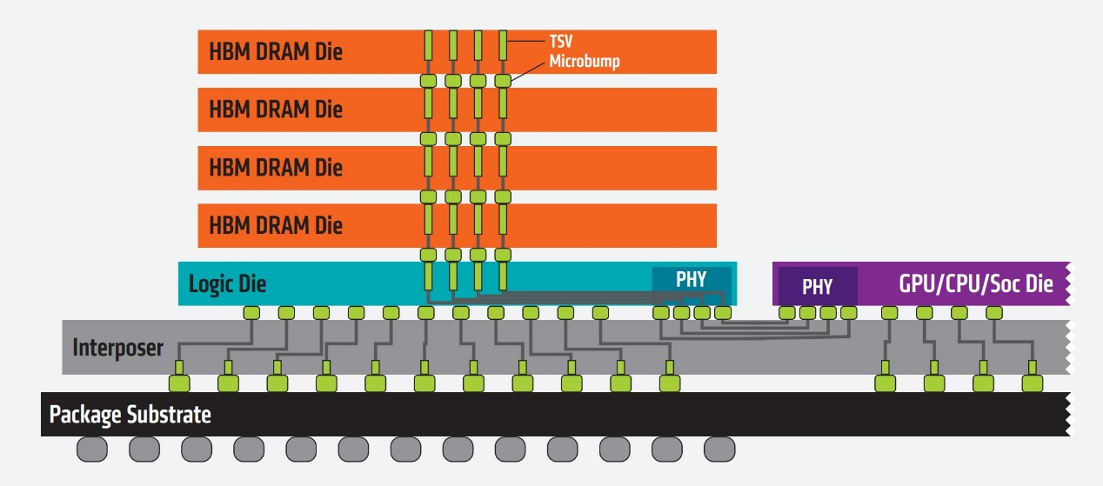
Recall: HBM
HBM stack:
It is used in conjunction with high-end GPUs, AI ASICs and FPGAs.
Each stack has 4/8 DRAM dies and a logic die.
Notes:
Substrate: 底座
Interposer: 插入式选样

Slide 10
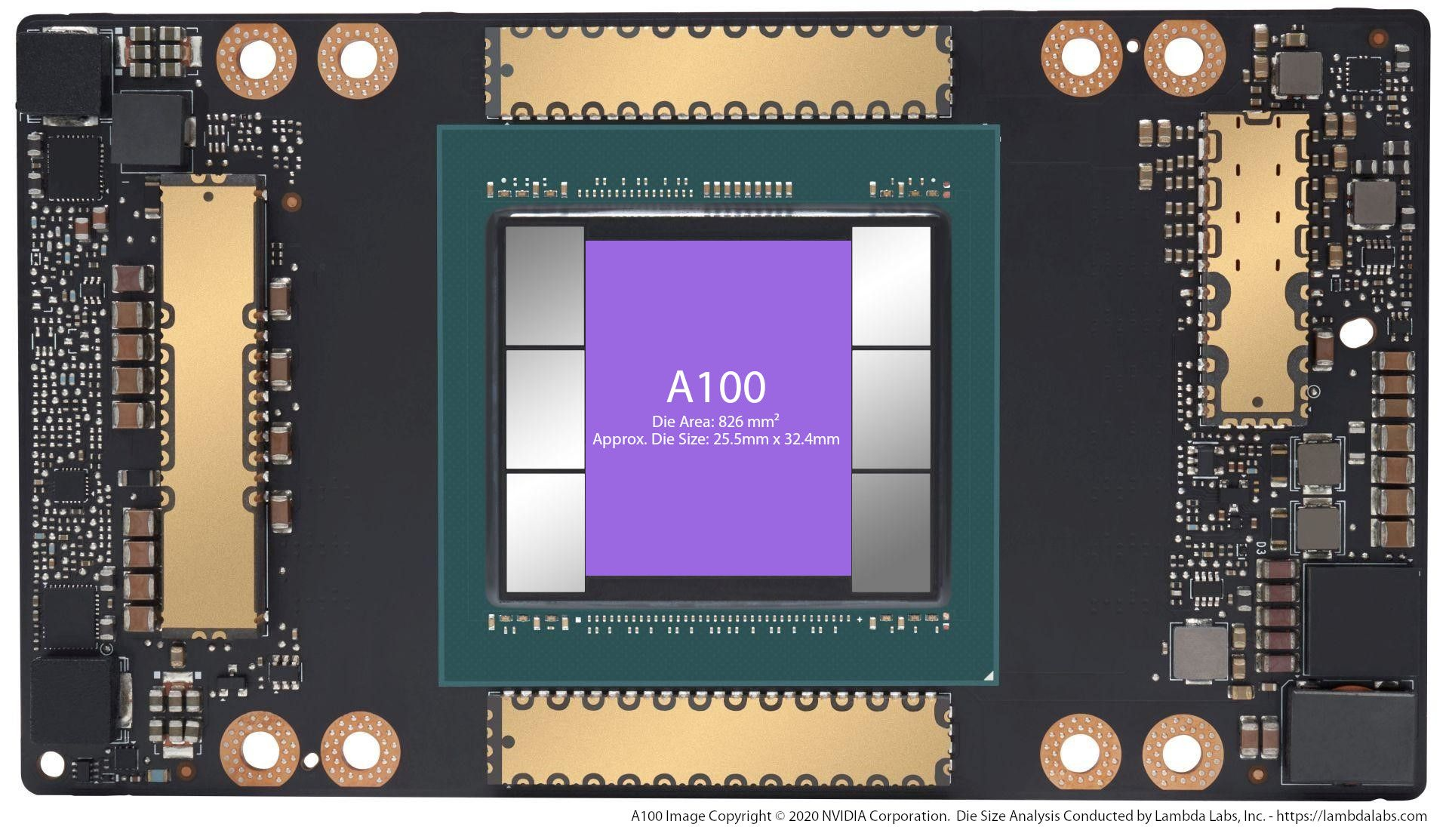
Recall: HBM in Nvidia A100
A100 GPU: 6 HBM2 stacks at the left/right side.

Slide 11
Recall: Advantage and Disadvantage of HBM
Advantage of HBM:
High bandwidth: ~500GB/s per stack.
Low power consumption: due to running without termination.
Disadvantage of HBM:
Less flexibility: fixed, in the same package with compute chip.
Low capacity: really close to compute chip.
High cost: strict condition.
Notes:
Termination is needed when CPU is long away from memory. However, HBM is close to accelerator, so termination is not needed.

Slide 12
Recall: NVME SSD
0.001×1,024 = 1 GB
8×128 GB = 1 TB
SSD Controller
LPDDR DRAM
NAND Packages
Core
Core
Core
HW
Flash Ctrl.
HW
Flash Ctrl.
HW
Flash Ctrl.
HW
Flash Ctrl.
Request Handler
ECC/Randomizer
Encryption Engine
Samsung PM853T 960GB Enterprise SSD (from https://www.tweaktown.com/reviews/6695/samsung-pm853t-960gb-enterprise-ssd-review/index.html)
Advantage: Large memory size, e.g., 16TB per SSD
Disadvantage: Low throughput, high latency, hard to use

Slide 13
Recall: Comparison of Memories
Capacity
Bandwidth
Latency
SRAM
~10MB
SRAM
~1TB/s
SRAM
~1ns
HBM
~10GB
HBM
~100GB/s
HBM
~100ns
DDR
~100GB
DDR
~10GB/s
DDR
~100ns
SSD
~1TB
SSD
~1GB/s
SSD
~1us
DISK
~10TB
DISK
~10MB/s
DISK
~1ms

Slide 14
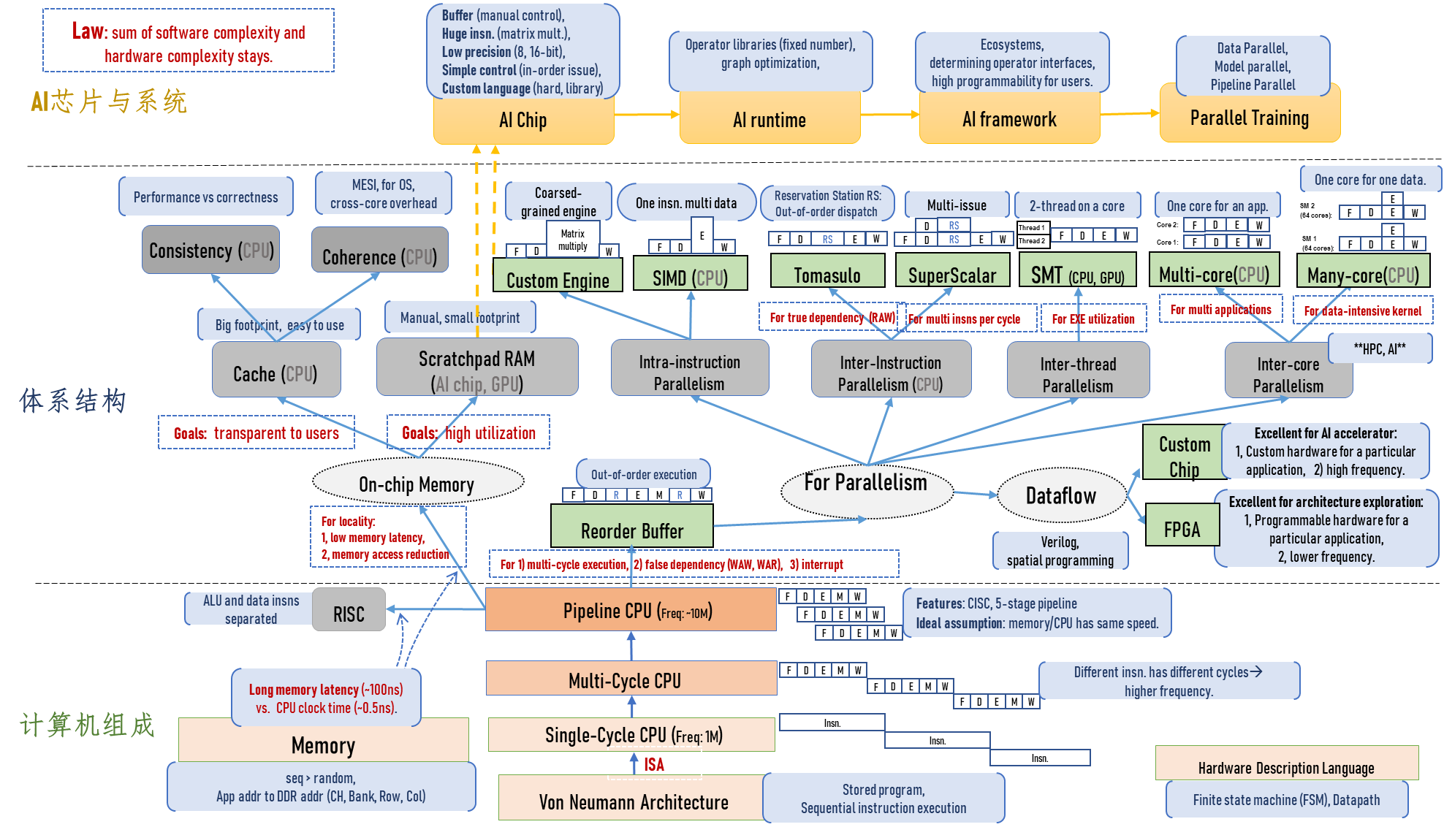
Where Are We?

Slide 15
Agenda for Today
Why GPU?
Hardware Execution Model
Programming Model
SISD vs. SIMD vs. SPMD
GPU Programming Example
Advance
SIMT (Hardware) & Warp (Software)

Slide 16
Motivation of In-network Computing
Why GPU?
Need More Computing Power.

Slide 17
OpenAI: Compute Power Needed by NN Model
Model | Model Size | Compute/iteration (OPs)
VGG 19 | 114M | ~19.6 B
“GPT-3” | 175B | ~250 T
One Forward Pass of Model:
Notes:
KB MB GB TB
K M B T
1B=10亿

Slide 18
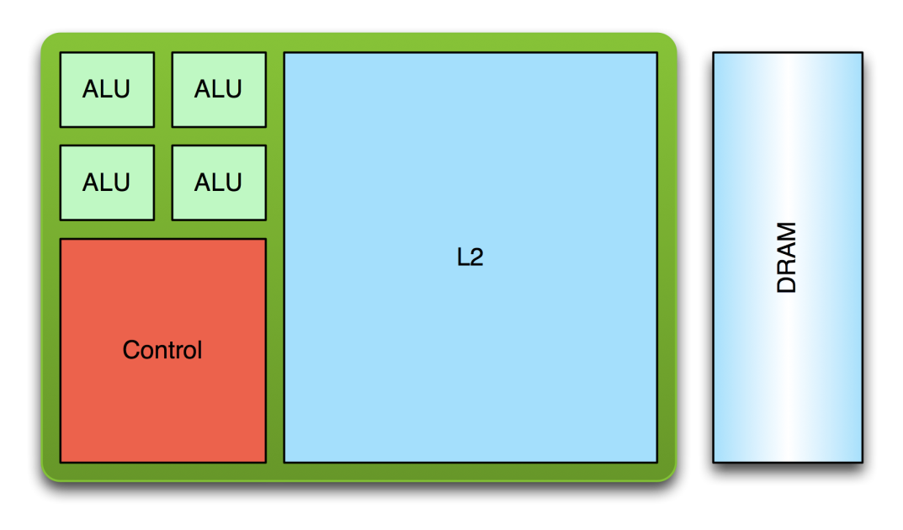
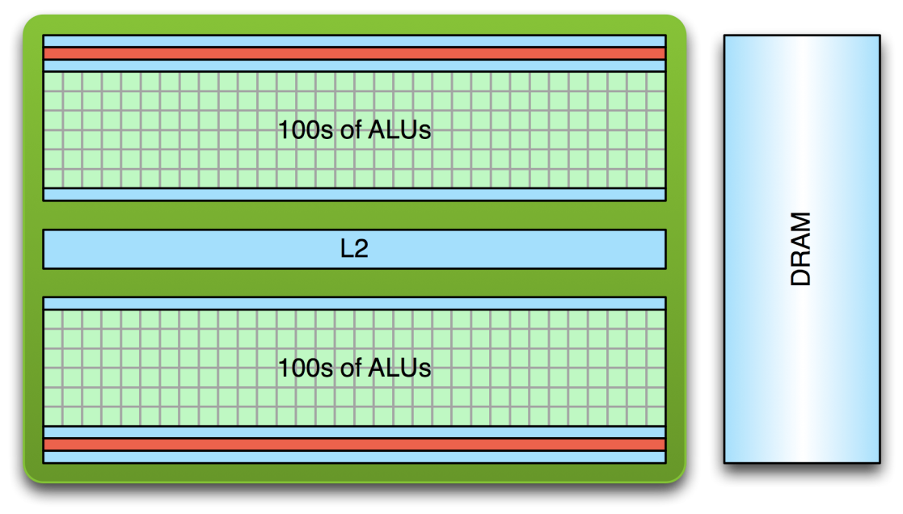
CPU vs GPU： Compute Perspective
CPU:
Few complex cores
Larger cache for low memory latency
Large and slow memory
GPU:
Lots of simple cores
Small cache for low memory latency
Small and fast memory

Slide 19
State-of-the-art CPU GPU and FPGA
 | Cores (Threads) | TFLOPS | Memory Size (Bandwidth) | PCIe | Network
CPU (AMD Threadripper 3995WX) | 64 (128) | 2.8 (FP32), 1.4 (FP64) | 512GB (80GB/s) | 32.0GB/s (PCIe 4.0 X16) | No
GPU (Nvidia H100) | 18432 (128K) | 67 (FP32), 34 (FP64), 989 (FP32, Tensor), 1979 (FP16, Tensor) | 80GB (3350GB/s) | 64.0GB/s (PCIe 5.0 X16) | No
FPGA (U280) | 9,024 (25x18 MULs) | 1.8 (FP32) | 40GB (460GB/s) | 16.0GB/s (PCIe 4.0 X8) | Yes
Notes:
KB MB GB TB
K M B T E P
1B=10亿

Slide 20
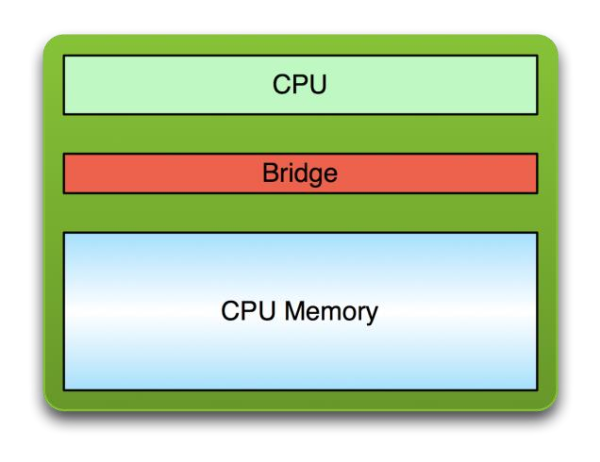
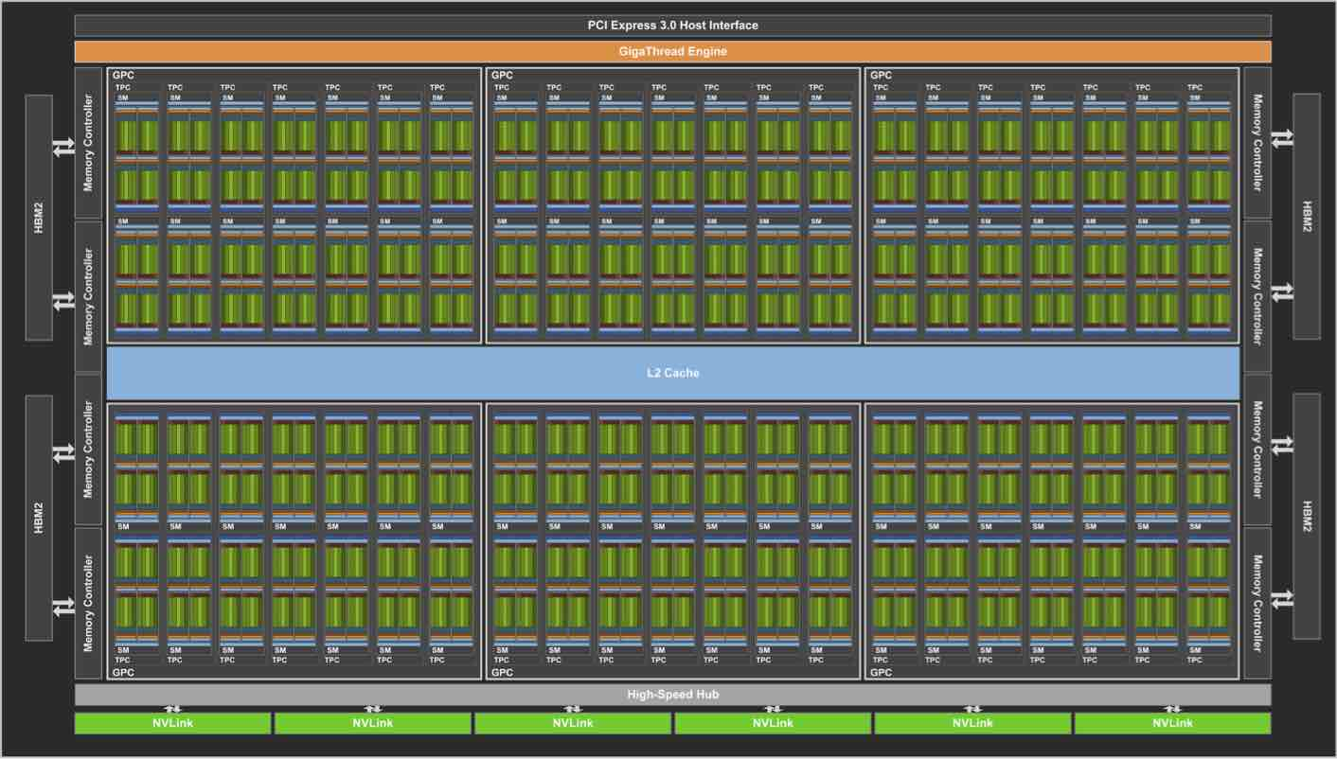
Relationship between CPU and GPU
CPU
GPU
PCI Bus

Slide 21
Motivation of In-network Computing
More cores → More trouble
Challenge: How to manipulate them?
Notes:
之前千核项目 很多，只活了英伟达。

Slide 22
GPU Computing
Key Idea:
Computation is offloaded to the GPU
Three steps:
CPU-GPU data transfer (1)
GPU kernel execution (2)
GPU-CPU data transfer (3)

Slide 23
Programming Model: CPU and GPU
CPU-GPU Co-processing:
CPU: Sequential or modestly parallel sections
GPU: Massively parallel sections
Serial Code (CPU):
Parallel Kernel (GPU):
KernelA<<<nBlk, nThr>>>(args);
. . .
Serial Code (CPU):
Parallel Kernel (GPU):
KernelB<<<nBlk, nThr>>>(args);
. . .

Slide 24
Recall: Amdahl’s Law
Amdahl’s Law
f: Parallelizable fraction of a program
N: Number of processors
Serial bottleneck of Amdahl’s Law:
Maximum speedup (1/(1-f)) limited by serial portion (1 - f)
Parallel portion (f) is usually not perfectly parallel
Synchronization overhead (e.g., updates to shared data)
Load imbalance overhead (imperfect parallelization)
Resource sharing overhead (contention among N processors)
1
Speedup =
1 - f
+
f
N
Amdahl, “Validity of the single processor approach to achieving large scale computing capabilities,” 1967.

Slide 25
GPUs are SIMD Engines Underneath
The instruction pipeline operates like a SIMD pipeline (e.g., an array processor)
However, the programming is done using threads, NOT SIMD instructions
To understand this, let’s go back to our parallelizable code example
But, before that, let’s distinguish between
Programming Model (Software)
vs.
Execution Model (Hardware)

Slide 26
Programming Model vs. Hardware Execution Model
Programming Model： how the programmer expresses the code
E.g., Sequential (von Neumann), Data Parallel (SIMD), Dataflow, Multi-threaded (MIMD, SPMD), …
Hardware Execution Model： how the hardware executes the code underneath
E.g., Out-of-order execution, Vector processor, Array processor, Dataflow processor, Multiprocessor, Multithreaded processor, …
Discussion: Execution Model can be very different from Programming Model
E.g., von Neumann model implemented by an OoO processor
E.g., SPMD model implemented by a SIMD processor (a GPU)

Slide 27






GPU: Programming Model vs. Hardware Execution Model
Hardware Execution Model
CUDA Programming Model
GPU
Grid
...
Streaming
Multi-processor
Thread block
CUDA core
Thread

Slide 28
Agenda for Today
Where is GPU? & Key Message
Hardware Execution Model
Programming Model
SISD vs. SIMD vs. SPMD
GPU Programming Example
Advance
SIMT (Hardware) & Warp (Software)

Slide 29
A Many-core GPU (Hardware Execution Model)

Slide 30
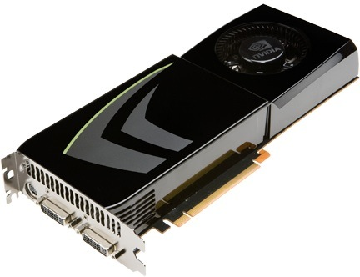
NVIDIA GeForce GTX 285
NVIDIA-speak:
240 stream processors (CUDA cores)
“SIMT execution”
Generic speak:
30 cores
8 SIMD functional units per core
NVIDIA, “NVIDIA GeForce GTX 200 GPU. Architectural Overview. White Paper,” 2008.
Slide credit: Kayvon Fatahalian
Notes:
Link to the GTX 200 series white paper:
https://www.nvidia.com/docs/IO/55506/GeForce_GTX_200_GPU_Technical_Brief.pdf
The NVIDIA GeForce GTX 285 was launched on January 2009.

Slide 31
NVIDIA GeForce GTX 285 “core”(SM)
64 KB of storage
for thread contexts (registers)
…
= SIMD functional unit, control
shared across 8 units
= instruction stream decode
= multiply-add
= execution context storage
= multiply
Slide credit: Kayvon Fatahalian
Notes:
30 * 32 * 32 = 30 * 1024 = 30K fragments
64KB register file = 16 32-bit registers per thread = 64B (1/32 that of LRB)
16KB of shared scratch
80KB / core available to software

Slide 32
NVIDIA GeForce GTX 285
Tex
Tex
…
…
…
…
…
…
Tex
Tex
…
…
…
…
…
…
Tex
Tex
…
…
…
…
…
…
Tex
Tex
…
…
…
…
…
…
Tex
Tex
…
…
…
…
…
…
30 cores on the GTX 285: 30K threads
Slide credit: Kayvon Fatahalian
Notes:
If you’re running a CUDA program, and your not launching 30K threads, you are certainly not getting full latency hiding, and you might not be using the GPU well

Slide 33
Evolution of NVIDIA GPUs: Compute

Slide 34
NVIDIA V100
NVIDIA-speak:
5120 stream processors (CUDA cores)
“SIMT execution”
Generic speak:
80 cores
64 SIMD functional units per core
Tensor cores for Machine Learning
NVIDIA, “NVIDIA Tesla V100 GPU Architecture. White Paper,” 2017.
Notes:
CUDA core： stream processor

Slide 35
NVIDIA V100 Block Diagram
https://devblogs.nvidia.com/inside-volta/
80 cores on the V100

Slide 36
NVIDIA A100
NVIDIA-speak:
6912 stream processors (CUDA cores)
“SIMT execution”
Generic speak:
108 cores
64 SIMD functional units per core
Tensor cores for Machine Learning
Support for sparsity
New floating point data type (TF32)
https://developer.nvidia.com/blog/nvidia-ampere-architecture-in-depth/
Notes:
5 HBM2 stacks, 10 512-bit memory controllers
Sparsity is possible in deep learning because the importance of individual weights evolves during the learning process, and by the end of network training, only a subset of weights have acquired a meaningful purpose in determining the learned output. The remaining weights are no longer needed (see https://developer.nvidia.com/blog/nvidia-ampere-architecture-in-depth/).
TensorFloat-32 (TF32) uses 8 bit for exponent and 10 bits for mantissa. This way, TF32 provides the range of FP32 with the precision of FP16 (see https://developer.nvidia.com/blog/nvidia-ampere-architecture-in-depth/).

Slide 37
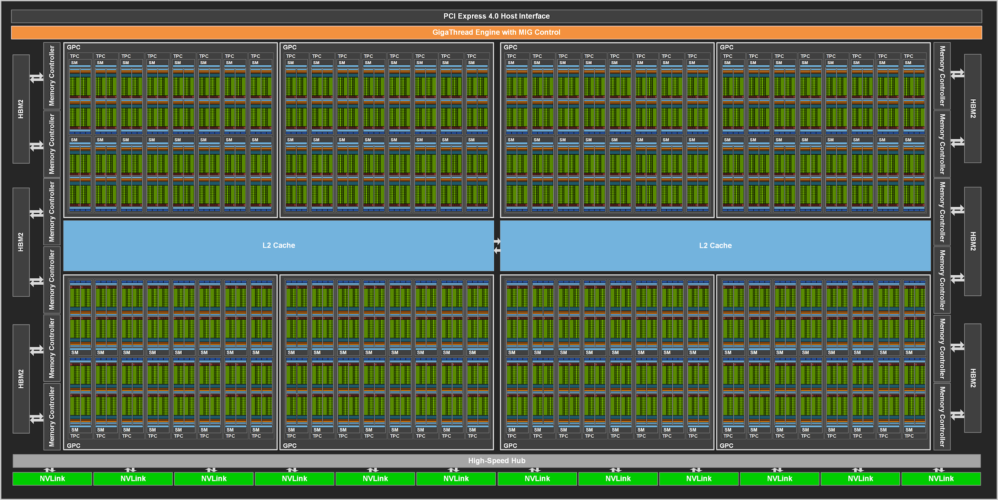
NVIDIA A100 Block Diagram
https://developer.nvidia.com/blog/nvidia-ampere-architecture-in-depth/
108 cores on the A100
(Up to 128 cores in the full-blown chip)
40MB L2 cache
Notes:
The A100 GPU includes 40 MB of L2 cache, which is 6.7x larger than V100 L2 cache.The L2 cache is divided into two partitions to enable higher bandwidth and lower latency memory access. Each L2 partition localizes and caches data for memory accesses from SMs in the GPCs directly connected to the partition. This structure enables A100 to deliver a 2.3x L2 bandwidth increase over V100 (see https://developer.nvidia.com/blog/nvidia-ampere-architecture-in-depth/).

Slide 38
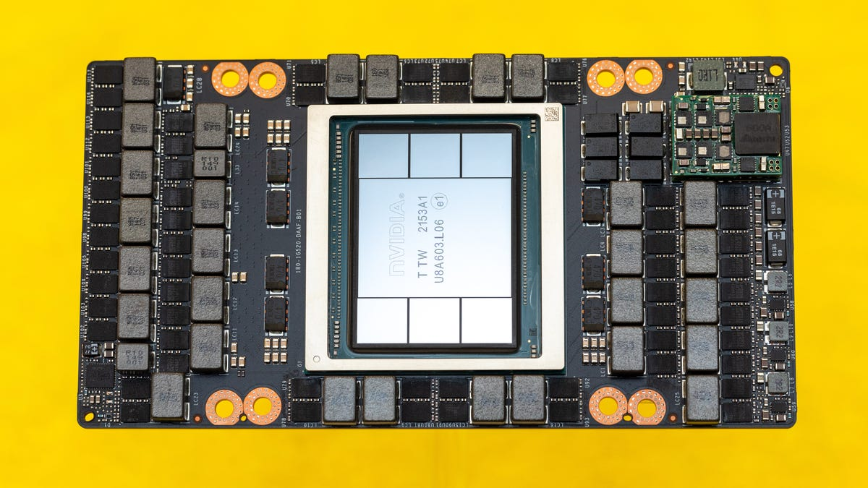
NVIDIA H100
NVIDIA-speak:
8448 stream processors (CUDA cores)
“SIMT execution”
Generic speak:
132 cores
64 SIMD functional units per core
Tensor cores for Machine Learning
Support for sparsity
Support for transformer
https://developer.nvidia.com/blog/nvidia-hopper-architecture-in-depth/
Notes:
5 HBM2 stacks, 10 512-bit memory controllers
Sparsity is possible in deep learning because the importance of individual weights evolves during the learning process, and by the end of network training, only a subset of weights have acquired a meaningful purpose in determining the learned output. The remaining weights are no longer needed (see https://developer.nvidia.com/blog/nvidia-ampere-architecture-in-depth/).
TensorFloat-32 (TF32) uses 8 bit for exponent and 10 bits for mantissa. This way, TF32 provides the range of FP32 with the precision of FP16 (see https://developer.nvidia.com/blog/nvidia-ampere-architecture-in-depth/).

Slide 39
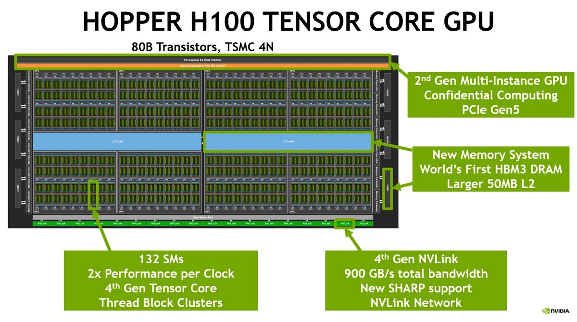
NVIDIA H100 Block Diagram
https://developer.nvidia.com/blog/nvidia-ampere-architecture-in-depth/
Notes:
The A100 GPU includes 40 MB of L2 cache, which is 6.7x larger than V100 L2 cache.The L2 cache is divided into two partitions to enable higher bandwidth and lower latency memory access. Each L2 partition localizes and caches data for memory accesses from SMs in the GPCs directly connected to the partition. This structure enables A100 to deliver a 2.3x L2 bandwidth increase over V100 (see https://developer.nvidia.com/blog/nvidia-ampere-architecture-in-depth/).

Slide 40
GPU Trend: H100 vs. A100
 | FP8 | FP16 | FP32 | FP64 | Memory bandwidth | Memory capacity
H100 | 4000T | 2000T | 1000T | 60T | 3TB/s | 80GB
A100 | 666T | 666T | 333T | 20T | 2TB/s | 80GB
Compute power scales well.
GPU memory capacity does not scale well.
Notes:
军迷：
算力：武器 坦克等
内存：后勤

Slide 41
Agenda for Today
Where is GPU? & Key Message
Hardware Execution Model
Programming Model
SISD vs. SIMD vs. SPMD
GPU Programming Example
Advance
SIMT (Hardware) & Warp (Software)

Slide 42
How Can You Exploit Parallelism Here?
Let’s examine three programming options to exploit instruction-level parallelism present in this sequential code:
1. Sequential (SISD)
2. Data-Parallel (SIMD)
3. Multithreaded (SPMD)
Scalar Sequential Code
for (i=0; i < N; i++)
C[i] = A[i] + B[i];
load
Iter. 1
load
add
store
load
load
Iter. 2
add
store

Slide 43
Prog. Model 1: Sequential (SISD)
for (i=0; i < N; i++)
C[i] = A[i] + B[i];
Can be executed on thee processors:
1, Pipelined processor
2, Out-of-order execution processor
Independent instructions executed when ready
Different iterations are present in the instruction window and can execute in parallel in multiple functional units
3, Superscalar or VLIW processor
Can fetch and execute multiple instructions per cycle
Scalar Sequential Code
load
Iter. 1
load
add
store
load
Iter. 2
load
add
store

Slide 44
Prog. Model 2: Data Parallel (SIMD)
for (i=0; i < N; i++)
C[i] = A[i] + B[i];
Scalar Sequential Code
Vector Instruction
Vectorized Code
load
load
VLD A → V1
load
load
Iter. 1
load
load
VLD B → V2
add
VADD V1 + V2 → V3
add
add
store
store
store
VST V3 → C
load
Iter. 1
Iter. 2
Iter. 2
load
Motivation: Each iteration is independent
Idea: Programmer or compiler generates a SIMD instruction to execute the same instruction from all iterations across different data
add
store

Slide 45
Prog. Model 3: Multithreaded
for (i=0; i < N; i++)
C[i] = A[i] + B[i];
Scalar Sequential Code
load
load
load
load
Iter. 1
load
load
add
add
add
store
store
store
load
Iter. 1
Iter. 2
Iter. 2
load
Motivation: Each iteration is independent
Idea: Programmer or compiler generates a thread to execute each iteration. Each thread does the same thing (but on different data)
add
store

Slide 46
Prog. Model 3: Multithreaded
for (i=0; i < N; i++)
C[i] = A[i] + B[i];
load
load
load
load
add
add
store
store
Iter. 1
Iter. 2
Realization: Each iteration is independent
Idea: Programmer or compiler generates a thread to execute each iteration. Each thread does the same thing (but on different data)
This programming model (software) is called:
SPMD: Single Program Multiple Data

Slide 47
SPMD
SPMD: Single procedure/program, multiple data
This is a programming model rather than computer organization
Each processing element executes the same procedure, except on different data elements
Procedures can synchronize at certain points in program, e.g. barriers
Key Idea of SPMD: multiple instruction streams execute the same program
Each program/procedure 1) works on different data, 2) can execute a different control-flow path, at run-time
Many scientific applications are programmed this way and run on MIMD hardware (multiprocessors)
Modern GPUs programmed in a similar way on a SIMD hardware

Slide 48
Agenda for Today
Where is GPU? & Key Message
Hardware Execution Model
Programming Model
SISD vs. SIMD vs. SPMD
GPU Programming Example
Advance
SIMT (Hardware) & Warp (Software)

Slide 49
CUDA/OpenCL Programming Model
Single Program Multiple Data (SPMD), e.g., CUDA
Bulk synchronous programming: Global (coarse-grain) synchronization between kernels
The device (typically GPU) executes CUDA kernels
Grid
Thread Block
CUDA runtime schedules at granularity of thread block.
A thread block is a programming abstraction that represents a group of threads that can be executed in parallel.
Within a block, shared memory, and synchronization.
Thread
A thread corresponds to an iteration.

Slide 50
GPU: Programming Model vs. Hardware Execution Model
Hardware Execution Model
CUDA Programming Model
GPU
Grid
...
Streaming
Multi-processor
Thread block
CUDA core
Thread
Notes:
Wrap

Slide 51
CUDA: Memory Hierarchy

Slide 52
Traditional Program Structure in CUDA
Function prototypes
float serialFunction(…);
__global__ void kernel(…);
main()
1) Allocate memory space on the device – cudaMalloc(&d_in, bytes);
2) Transfer data from host to device – cudaMemCpy(d_in, h_in, …);
3) Execution configuration setup: #blocks and #threads
4) Kernel call – kernel<<<execution configuration>>>(args…);
5) Transfer results from device to host – cudaMemCpy(h_out, d_out, …);
Kernel – __global__ void kernel(type args,…)
Automatic variables transparently assigned to registers
Shared memory: __shared__
Intra-block synchronization: __syncthreads();
Repeat as needed
Slide credit: Hwu & Kirk

Slide 53
CUDA Programming Language
Memory allocation
cudaMalloc((void**)&d_in, #bytes);
Memory copy
cudaMemcpy(d_in, h_in, #bytes, cudaMemcpyHostToDevice);
Kernel launch
kernel<<< #blocks, #threads >>>(args);
Memory deallocation
cudaFree(d_in);
Explicit synchronization
cudaDeviceSynchronize();

Slide 54
First GPU Example: Vector Addition (I)
Key Idea: one GPU thread to each element-wise addition

Slide 55
First GPU Example: Vector Addition (II)
A grid: the whole set of threads
We need a way to assign threads to GPU cores

Slide 56
First GPU Example: Vector Addition (III)
We group threads into blocks
blockDim = 4
blockIdx = 0
blockIdx = 1
blockIdx = 2
blockIdx = 3
Block 0
Block 1
Block 2
Block 3
threadIdx = 0
threadIdx = 1
threadIdx = 2
threadIdx = 2
Notes:
每个block有四个threads。
blockIdx = 0

Slide 57
GPU: Programming Model vs. Hardware Execution Model
Hardware Execution Model
CUDA Programming Model
GPU
Grid
...
Streaming
Multi-processor
Thread block
CUDA core
Thread
Notes:
Wrap

Slide 58
Host Code Example: Vector Addition
void vecadd(float* A, float* B, float* C, int N) {
//1, Allocate GPU memory
float *A_d, *B_d, *C_d;
cudaMalloc((void**) &A_d, N*sizeof(float));
cudaMalloc((void**) &B_d, N*sizeof(float));
cudaMalloc((void**) &C_d, N*sizeof(float));
//2, Copy data to GPU memory
cudaMemcpy(A_d, A, N*sizeof(float), cudaMemcpyHostToDevice);
cudaMemcpy(B_d, B, N*sizeof(float), cudaMemcpyHostToDevice);
//3, Perform computation on GPU
...
//4, Copy data from GPU memory
cudaMemcpy(C, C_d, N*sizeof(float), cudaMemcpyDeviceToHost);
//5, Deallocate GPU memory
cudaFree(A_d);
cudaFree(B_d);
cudaFree(C_d);
}
const unsigned int numThreadsPerBlock = 512;
const unsigned int numBlocks = N/numThreadsPerBlock;
vecadd_kernel<<<numBlocks, numThreadsPerBlock>>>(A_d, B_d, C_d, N);
Slide credit: Izzat El Hajj

Slide 59
Kernel Code Example: Vector Addition
__global__ void vecadd_kernel(float* A, float* B, float* C, int N) {
int i = blockDim.x*blockIdx.x + threadIdx.x;
C[i] = A[i] + B[i];
}
blockDim: block dimension
blockIdx: block index within a grid
threadIdx: thread index within a block
Slide credit: Izzat El Hajj

Slide 60
Boundary Conditions
Question: What if the size of the input is not a multiple of the number of threads per block?
Solution: use the ceiling to launch extra threads then omit the threads after the boundary
Host code:
Kernel code:
const unsigned int numBlocks = (N +numThreadsPerBlock – 1)/numThreadsPerBlock;
vecadd_kernel<<<numBlocks, numThreadsPerBlock>>>(A_d, B_d, C_d, N);
__global__ void vecadd_kernel(float* A, float* B, float* C, int N) {
int i = blockDim.x*blockIdx.x + threadIdx.x;
if(i < N) {
C[i] = A[i] + B[i]; }
}

Slide 61
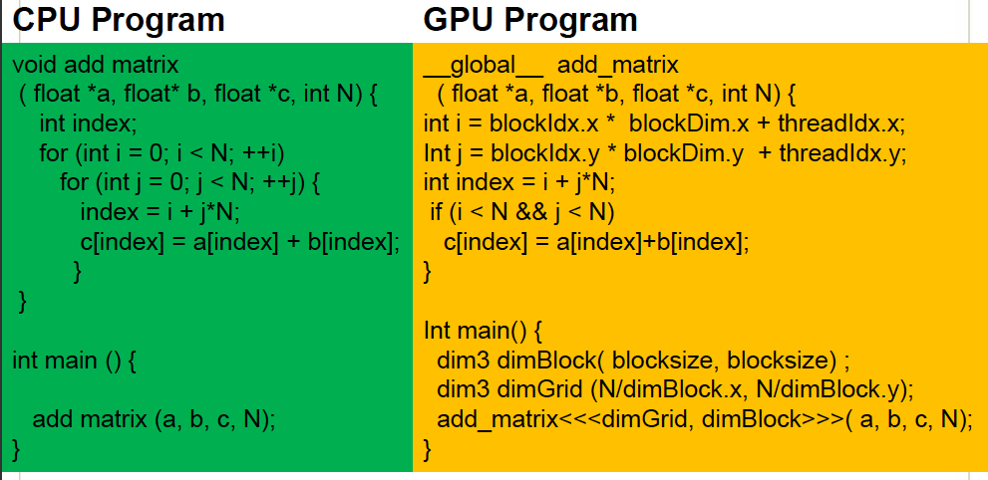
Sample GPU Program: Matrix Multiplication
Slide credit: Hyesoon Kim

Slide 62
Indexing and Memory Access
Images are 2D data structures
height x width
Image[j][i], where 0 ≤ j < height, and 0 ≤ i < width
Image[0][1]
0
1
2
3
4
5
6
7
Image[1][2]
0
1
2
3
4
5
6
7

Slide 63
Image Layout in Memory
Row-major layout
Image[j][i] = Image[j x width + i]
Image[0][1] = Image[0 x 8 + 1]
Stride = width
Image[1][2] = Image[1 x 8 + 2]

Slide 64
Indexing and Memory Access: 1D Grid
One GPU thread per pixel
Grid of Blocks of Threads
gridDim.x, blockDim.x
blockIdx.x, threadIdx.x
Thread 0
Thread 1
Thread 2
Thread 3
blockIdx.x
Block 0
threadIdx.x
Block 0
6 * 4 + 1 = 25
blockIdx.x * blockDim.x + threadIdx.x

Slide 65
Agenda for Today
Where is GPU? & Key Message
Hardware Execution Model
Programming Model
SISD vs. SIMD vs. SPMD
GPU Programming Example
Advance
SIMT (Hardware) & Warp (Software)

Slide 66
GPU: Programming Model vs. Hardware Execution Model
Hardware Execution Model
CUDA Programming Model
GPU
Grid
...
Streaming
Multi-processor
Thread block
Wrap
SIMT
CUDA core
Thread
Notes:
SIMD Wrap

Slide 67
SIMT (Hardware) & Warp (Software)
SIMT: Single Instruction Multiple Thread
Key Feature: 16 CUDA cores in a SM are executed in a lock step.
Warp:
A warp, a basic execution unit, consists of 32 consecutive threads
A thread block is divided into warps for SIMT execution.
Block 0’s warps
Block 1’s warps
Block 2’s warps
…
…
…
…
…
…
t0 t1 t2 … t31
t0 t1 t2 … t31
t0 t1 t2 … t31

Slide 68
Motivation of In-network Computing
Why SIMT and Warp?
Reduce GPU scheduling overhead

Slide 69
How to Form Warps?
for (i=0; i < N; i++)
C[i] = A[i] + B[i];
load
load
Warp 0 at PC X
load
load
Warp 0 at PC X+1
add
add
Warp 0 at PC X+2
store
store
Warp 0 at PC X+3
Iter. 1
Iter. 2
Iter. 32
Warp: A set of threads that execute
the same instruction (i.e., at the same PC)

Slide 70
Mapping Warps on a SIMT Hardware
Warp:
A thread block is divided into warps.
A warp executes the same instruction on different data elements
SIMT Pipeline:
16 CUDA cores are executed in a lock step to serve each warp.
Thread Warp
Common PC
Thread Warp 0
Scalar
Scalar
Scalar
Scalar
Thread Warp 8
Thread
Thread
Thread
Thread
0
1
2
31
Thread Warp 7
SIMT Pipeline
Lindholm et al., "NVIDIA Tesla: A Unified Graphics and Computing Architecture," IEEE Micro 2008.
Notes:
In SIMD, you need to specify the data array + an instruction (on which to operate the data on) + THE INSTRUCTION WIDTH. Eg: You might want to add 2 integer arrays of length 16, then a SIMD instruction would look like (the instruction has been cooked-up by me for demo) add.16 arr1 arr2 However, SIMT doesn't bother about the instruction width. So, essentially, you could write the above example as: arr1[i] + arr2[i] and then launch as many threads as the length of the array, as you want. Note that, if the array size was, let us say, 32, then SIMD EXPECTS you to explicitly call two such 'add.16' instructions! Whereas, this is not the case with SIMT.

Slide 71
GPU Execution with Warps
for (i=0; i < N; i++)
C[i] = A[i] + B[i];
Assume: a warp consists of 32 threads
If you have 32K iterations, and 1 iteration/thread → 1K warps
Warps can be interleaved on the same pipeline → Fine grained multithreading of warps.
load
load
Warp 0 at PC X
Warp 1 at PC X
load
load
add
add
Warp 20 at PC X+2
store
store
Iter. 1
Iter. 2
Iter. 33
Iter. 34
Iter.
20*32 + 1
Iter.
20*32 + 2

Slide 72
Warp Instruction Level Parallelism
Can overlap execution of multiple instructions
Example machine has 32 threads per warp and 8 lanes
Completes 24 operations/cycle while issuing 1 warp/cycle
Load Unit
Multiply Unit
Add Unit
W0
W1
W2
time
W3
W4
W5
Warp issue
Slide credit: Krste Asanovic

Slide 73
Motivation of In-network Computing
SIMT is not SIMD!

Slide 74
SIMD vs. SIMT Execution Model
SIMD: A single sequential instruction stream of SIMD instructions → each instruction specifies multiple data inputs
[VLD, VLD, VADD, VST], VLEN
SIMT: Multiple instruction streams of scalar instructions → threads grouped dynamically into warps
[LD, LD, ADD, ST], NumThreads
Two Major SIMT Advantages:
Can treat each thread separately → i.e., can execute each thread independently on any type of scalar pipeline → MIMD processing
Can group threads into warps flexibly → i.e., can group threads that are supposed to truly execute the same instruction → dynamically obtain and maximize benefits of SIMD processing

Slide 75
SPMD: Genius Abstraction
GPUs were invented and gpus are a kind vector computer which is really wild because while gpus have big vectors they essentially run scalar programs on each element and you can think of them as running a vector of scalar programs which by the way was a genius abstraction because everybody can write a scalar program almost nobody can write a vector program but suddenly we had all kinds of people doing vector programs on GPUs”
--- Jim Keller @DAC’24
Slide credit: Hyesoon Kim

Slide 76
SIMT Code vs. SIMD Code
CPU scalar code
for (ii = 0; ii < 100000; ++ii) {
C[ii] = A[ii] + B[ii];
}
// there are 25000 loops with SIMD=4
…
v_A = vec_load (A);
v_B = vec_load (B);
v_C = vec_add(v_A, v_B);
Vec_store(v_C, C)
…
}
// there are 100000 threads
__global__ void KernelFunction(…) {
int tid = blockDim.x * blockIdx.x + threadIdx.x;
int varA = aa[tid];
int varB = bb[tid];
C[tid] = varA + varB;
}
CUDA code
CPU vector code
Slide credit: Hyesoon Kim

Slide 77
Warp-based SIMD vs. Traditional SIMD
Traditional SIMD contains a single thread
Sequential instruction execution; lock-step operations in a SIMD instruction
Programming model is SIMD (no extra threads) → SW needs to know vector length
ISA contains vector/SIMD instructions
Warp-based SIMD consists of multiple scalar threads executing in a SIMD manner (i.e., same instruction executed by all threads)
Does not have to be lock step
Each thread can be treated individually (i.e., placed in a different warp) → programming model not SIMD
SW does not need to know vector length
Enables multithreading and flexible dynamic grouping of threads
ISA is scalar → SIMD operations can be formed dynamically
Essentially, it is SPMD programming model implemented on SIMD hardware

Slide 78
Threads Can Take Different Paths in Warp-based SIMD
Each thread can have conditional control flow instructions
Threads can execute different control flow paths
A
Thread Warp
Common PC
B
Thread
1
Thread
2
Thread
3
Thread
4
C
D
F
E
G
Slide credit: Tor Aamodt

Slide 79
Control Flow Problem in GPUs/SIMT
A GPU uses a SIMD pipeline to save area on control logic
Groups scalar threads into warps
Branch divergence occurs when threads inside warps branch to different execution paths
Branch
Branch
Path A
Path A
Path B
Path B
Slide credit: Tor Aamodt

Slide 80
SIMD Utilization
Intra-warp divergence
Compute(threadIdx.x);
if (threadIdx.x % 2 == 0){
Do_this(threadIdx.x);
}
else{
Do_that(threadIdx.x);
}

Slide 81
Increasing SIMD Utilization
Divergence-free execution
Compute(threadIdx.x);
if (threadIdx.x < 32){
Do_this(threadIdx.x * 2);
}
else{
Do_that((threadIdx.x%32)*2+1);
}

Slide 82
Vector Reduction: Naïve Mapping (I)
Thread 0
Thread 2
Thread 4
Thread 6
Thread 8
Thread 10
0
1
2
3
4
5
6
7
8
9
10
11
…
1
0+1
2+3
4+5
6+7
8+9
10+11
2
0...3
4..7
8..11
iterations
3
0..7
8..15
Slide credit: Hwu & Kirk

Slide 83
Vector Reduction: Naïve Mapping (II)
Program with low SIMD utilization
__shared__ float partialSum[]
unsigned int t = threadIdx.x;
for (int stride = 1; stride < blockDim.x; stride *= 2) {
__syncthreads();
if (t % (2*stride) == 0)
partialSum[t] += partialSum[t + stride];
}

Slide 84
Divergence-Free Mapping (I)
All active threads belong to the same warp
Thread 0
Thread 1
Thread 2
…
Thread 14
Thread 15
0
1
2
3
…
13
14
15
16
17
18
19
1
0+16
15+31
2
iterations
3
Slide credit: Hwu & Kirk

Slide 85
Divergence-Free Mapping (II)
Program with high SIMD utilization
__shared__ float partialSum[]
unsigned int t = threadIdx.x;
for (int stride = blockDim.x; stride > 0; stride >> 1){
__syncthreads();
if (t < stride)
partialSum[t] += partialSum[t + stride];
}

Slide 86
Programming Model vs. Hardware Execution Model
Hardware Programming Model
Programming Model
GPU
Thread blocks
Streaming
Multi-processor
Thread block (s)
Wrap
CUDA core:
Core
Thread

Slide 87
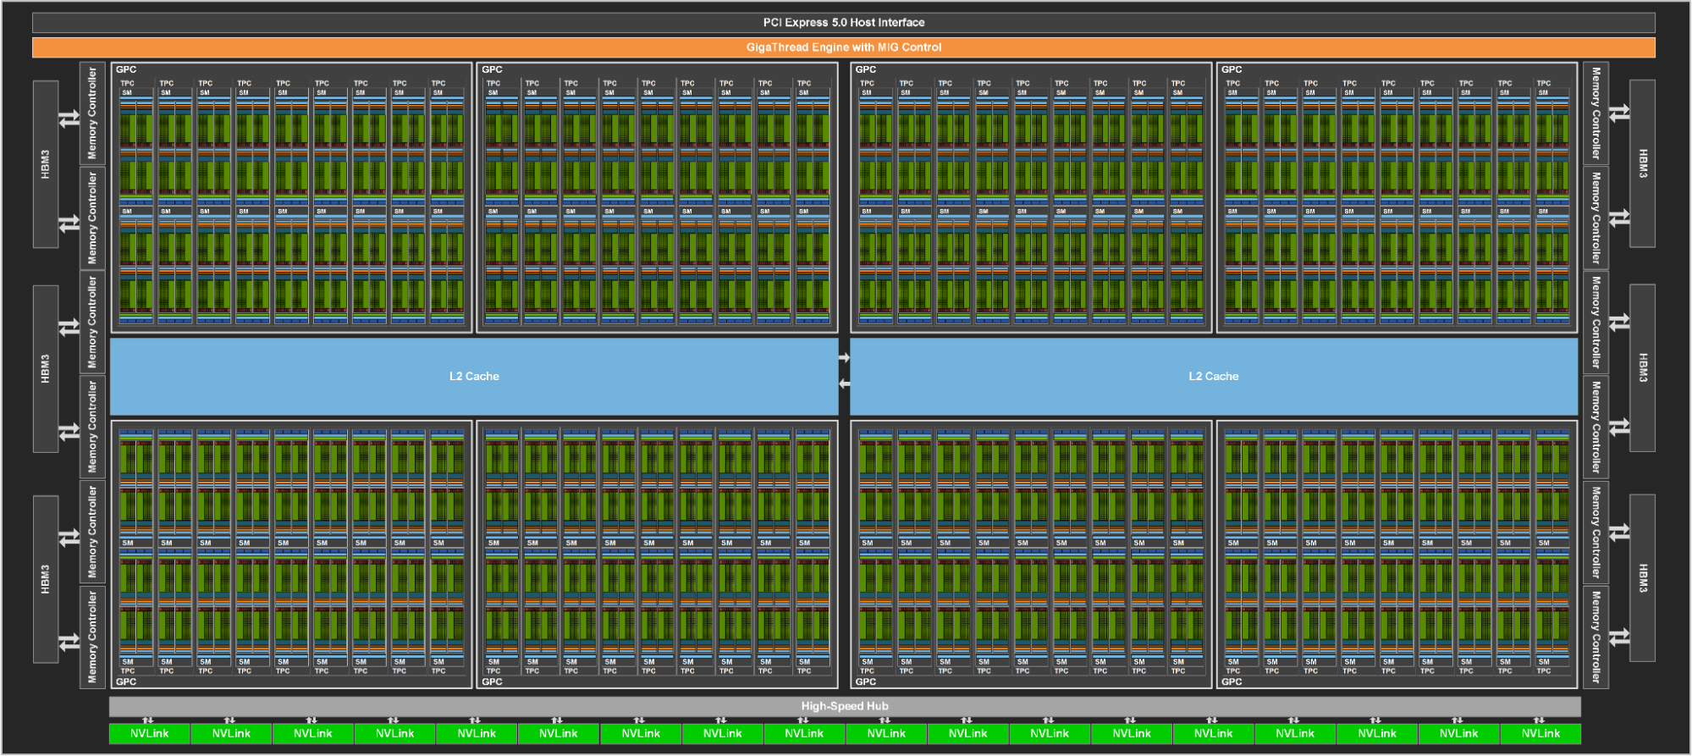
NVIDIA H100 Block Diagram
https://developer.nvidia.com/blog/nvidia-hopper-architecture-in-depth/
144 cores on the full GH100
60MB L2 cache

Slide 88
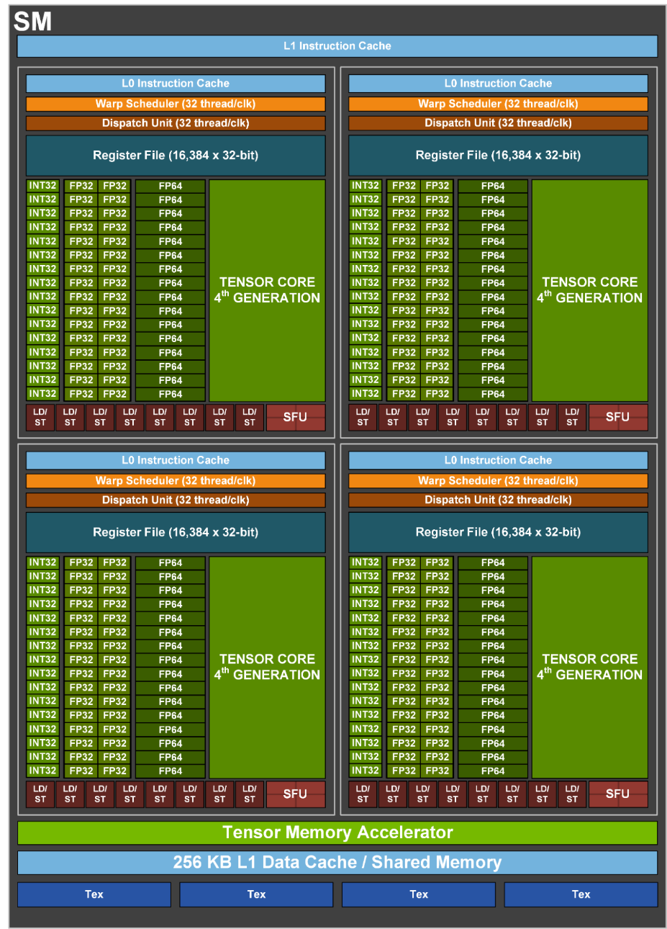
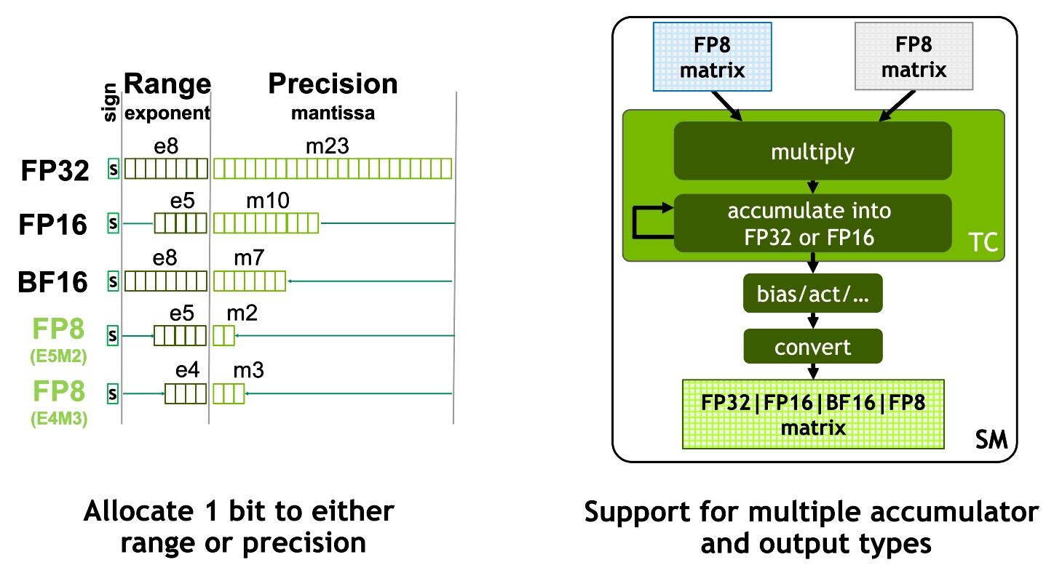
NVIDIA H100 Core
48 TFLOPS Single Precision*
24 TFLOPS Double Precision*
800 TFLOPS (FP16, Tensor Cores)*
https://developer.nvidia.com/blog/nvidia-hopper-architecture-in-depth/
* Preliminary performance estimates

Slide 89
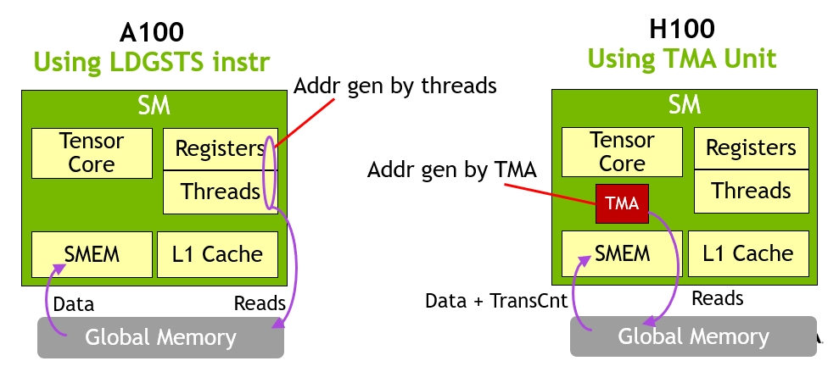
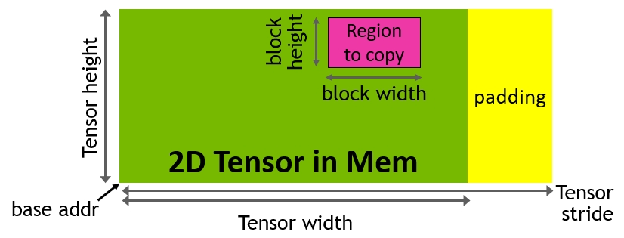
NVIDIA H100 Tensor Memory Accelerator
Asynchronous memory copy with LDGSTS instruction vs. TMA
TMA unit reduces addressing overhead
A single thread per warp issues the TMA operation
Support for different tensor layouts (1D-5D)
https://developer.nvidia.com/blog/nvidia-hopper-architecture-in-depth/
Notes:
New asynchronous execution features include a new Tensor Memory Accelerator (TMA) unit that can transfer large blocks of data efficiently between global memory and shared memory. TMA also supports asynchronous copies between thread blocks in a cluster. There is also a new asynchronous transaction barrier for doing atomic data movement and synchronization.
New asynchronous execution features include a new Tensor Memory Accelerator (TMA) unit that can efficiently transfer large blocks of data between global memory and shared memory. TMA also supports asynchronous copies between thread blocks in a cluster. There is also a new asynchronous transaction barrier for doing atomic data movement and synchronization.

Slide 90
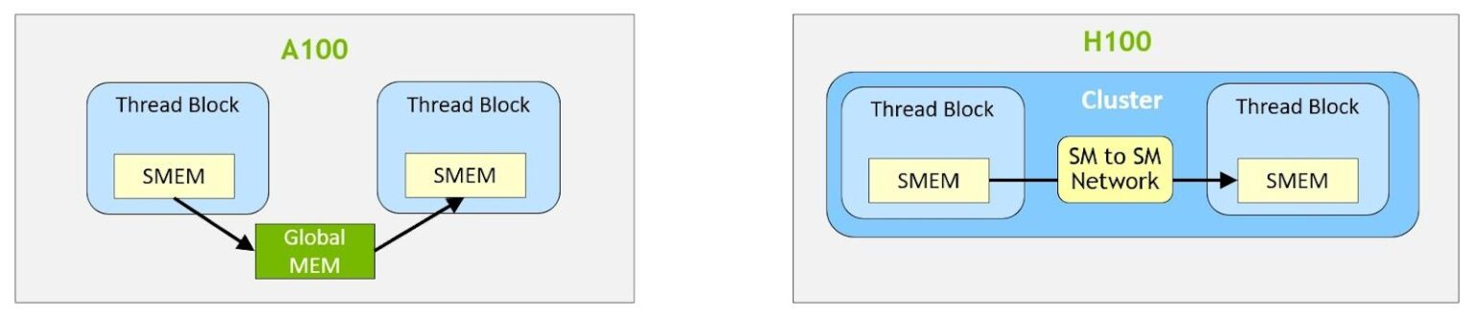
NVIDIA H100 Distributed Shared Memory
Shared memory virtual address space distributed across the blocks of a cluster
Load, store, and atomic operations to other SM’s shared memory
Thread block clusters and distributed shared memory (DSMEM) are leveraged via cooperative_groups API
TMA unit supports copies across thread blocks in a cluster
Asynchronous transaction barriers
https://developer.nvidia.com/blog/nvidia-hopper-architecture-in-depth/
Notes:
Distributed shared memory allows direct SM-to-SM communications for loads, stores, and atomics across multiple SM shared memory blocks.
Distributed shared memory enables direct SM-to-SM communications for loads, stores, and atomics across multiple SM shared memory blocks

Slide 91
NVIDIA GeForce GTX 285 “core”
64 KB of storage
for thread contexts (registers)
…
Groups of 32 threads share instruction stream (each group is a Warp)
Up to 32 warps are simultaneously interleaved
Up to 1024 thread contexts can be stored
Slide credit: Kayvon Fatahalian
Notes:
To get maximal latency hiding:
Run 1/32 of the time
16 words per thread = 64B

