Slide 1
AI Chip & Systems. Lecture 7: GPU Optimization
Prof. Zeke Wang
Zhejiang University
April 20 2026

Slide 2
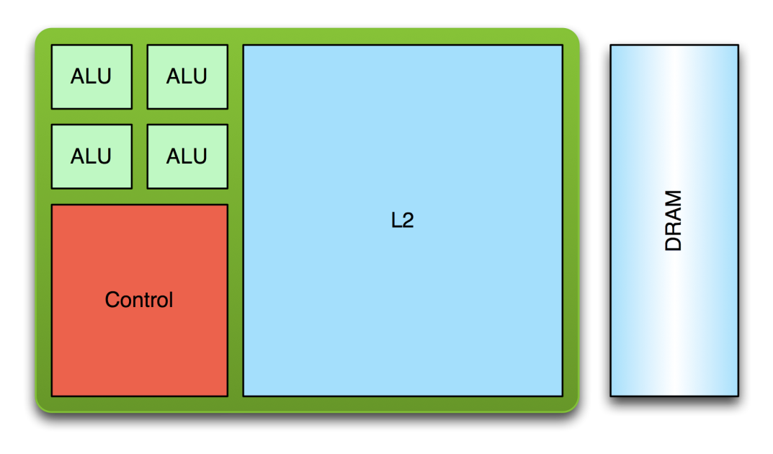
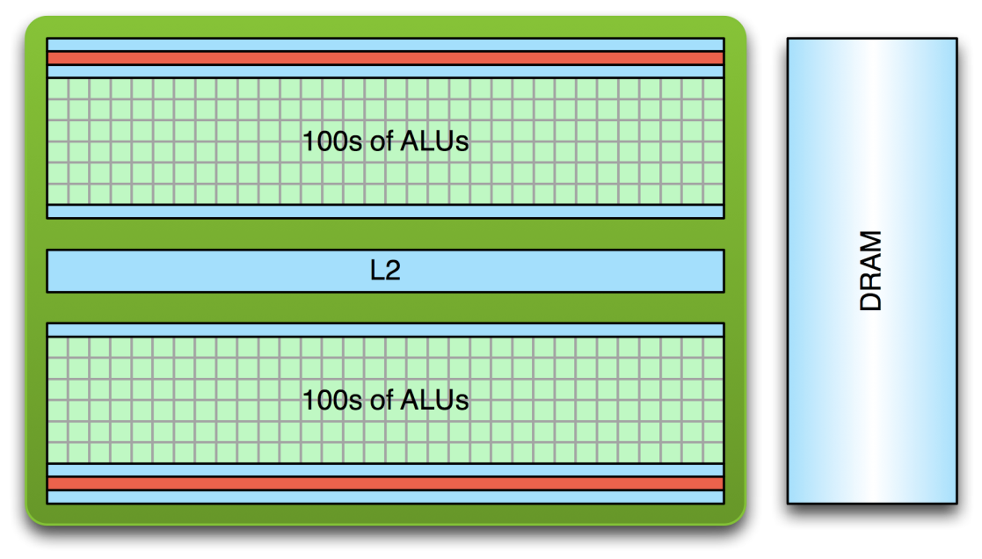
Recall: CPU vs GPU： Compute Perspective
CPU:
Few complex cores
Larger cache for low memory latency
Large and slow memory
GPU:
Lots of simple cores
Small cache for low memory latency
Small and fast memory

Slide 3
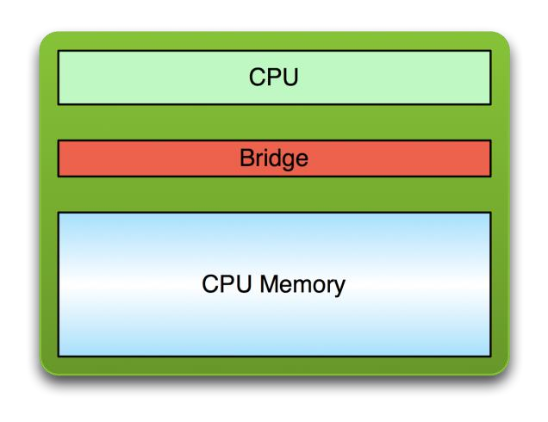
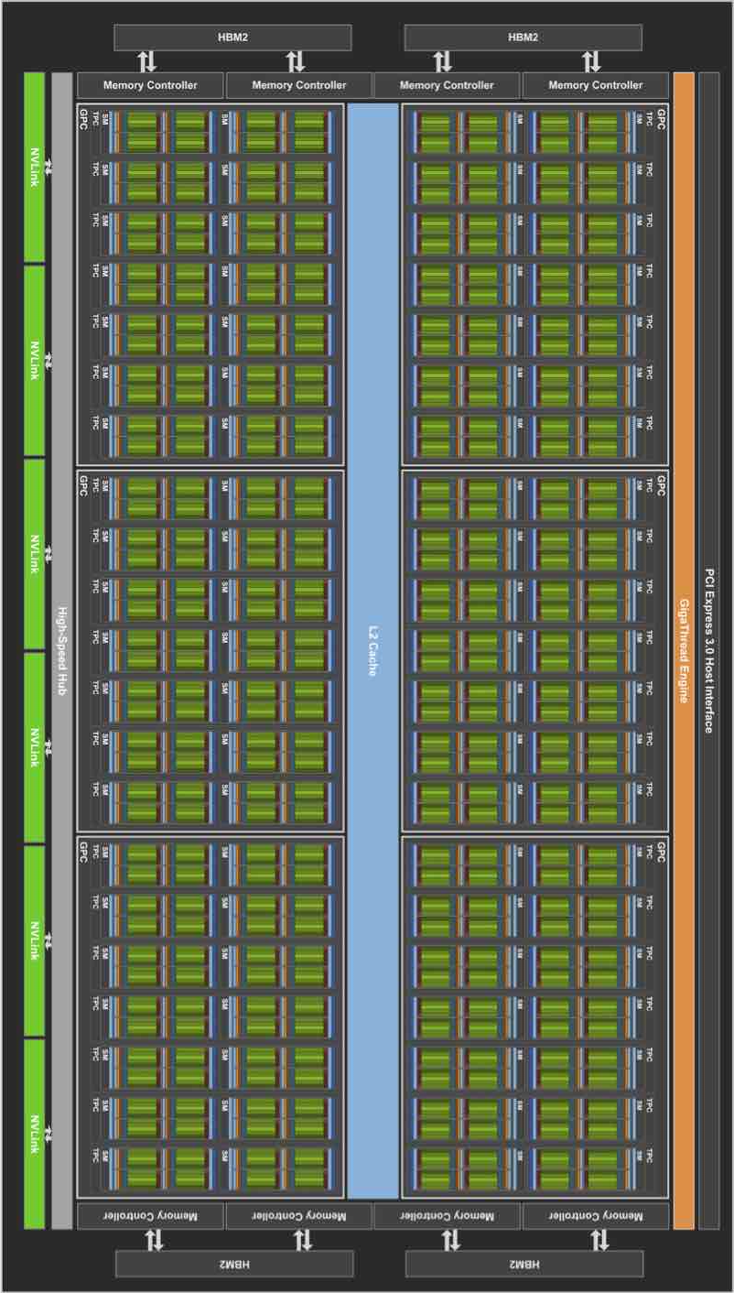
Recall: Relationship between CPU and GPU
CPU
GPU
PCI Bus

Slide 4
Recall: SPMD
SPMD: Single procedure/program, multiple data
This is a programming model rather than computer organization
Each processing element executes the same procedure, except on different data elements
Procedures can synchronize at certain points in program, e.g. barriers
Key Idea of SPMD: multiple instruction streams execute the same program
Each program/procedure 1) works on different data, 2) can execute a different control-flow path, at run-time
Many scientific applications are programmed this way and run on MIMD hardware (multiprocessors)
Modern GPUs programmed in a similar way on a SIMD hardware

Slide 5






Recall Programming Model vs. Hardware Execution Model
Hardware Execution Model
CUDA Programming Model
GPU
Grid
...
Streaming
Multi-processor
Thread block
Warp
SIMT
CUDA core
Thread
Notes:
SIMD Wrap

Slide 6
Recall: SIMT (Hardware) & Warp (Software)
SIMT: Single Instruction Multiple Thread
More precisely, SIMD (Single Instruction Multiple Data)
Key Feature: 16 CUDA cores in a SM are executed in a lock step.
Warp:
A warp, a basic execution unit, consists of 32 consecutive threads
A thread block is divided into warps for SIMT execution.
Block 0’s warps
Block 1’s warps
Block 2’s warps
…
…
…
…
…
…
t0 t1 t2 … t31
t0 t1 t2 … t31
t0 t1 t2 … t31

Slide 7
Motivation of In-network Computing
Why SIMT and Warp?
Reduce GPU scheduling overhead

Slide 8
Recall: Mapping Warps on a SIMT Hardware
Warp:
A thread block is divided into warps.
A warp executes the same instruction on different data elements
SIMT Pipeline:
16 CUDA cores are executed in a lock step to serve each warp.
Thread Warp
Common PC
Thread Warp 0
Scalar
Scalar
Scalar
Scalar
Thread Warp 8
Thread
Thread
Thread
Thread
0
1
2
31
Thread Warp 7
SIMT Pipeline
Lindholm et al., "NVIDIA Tesla: A Unified Graphics and Computing Architecture," IEEE Micro 2008.
Notes:
In SIMD, you need to specify the data array + an instruction (on which to operate the data on) + THE INSTRUCTION WIDTH. Eg: You might want to add 2 integer arrays of length 16, then a SIMD instruction would look like (the instruction has been cooked-up by me for demo) add.16 arr1 arr2 However, SIMT doesn't bother about the instruction width. So, essentially, you could write the above example as: arr1[i] + arr2[i] and then launch as many threads as the length of the array, as you want. Note that, if the array size was, let us say, 32, then SIMD EXPECTS you to explicitly call two such 'add.16' instructions! Whereas, this is not the case with SIMT.

Slide 9
Recall: GPU Execution with Warps
for (i=0; i < N; i++)
C[i] = A[i] + B[i];
Assume: a warp consists of 32 threads
If you have 32K iterations, and 1 iteration/thread → 1K warps
Warps can be interleaved on the same pipeline → Fine grained multithreading of warps.
load
load
Warp 0 at PC X
Warp 1 at PC X
load
load
add
add
Warp 20 at PC X+2
store
store
Iter. 1
Iter. 2
Iter. 33
Iter. 34
Iter.
20*32 + 1
Iter.
20*32 + 2

Slide 10
Recall: Warp Instruction Level Parallelism
Can overlap execution of multiple instructions
Example machine has 32 threads per warp and 8 lanes
Completes 24 operations/cycle while issuing 1 warp/cycle
Load Unit
Multiply Unit
Add Unit
W0
W1
W2
time
W3
W4
W5
Warp issue
Slide credit: Krste Asanovic

Slide 11
Motivation of In-network Computing
SIMT is not SIMD!

Slide 12
Recall: SIMT Code vs. SIMD Code
CPU scalar code
for (ii = 0; ii < 100000; ++ii) {
C[ii] = A[ii] + B[ii];
}
// there are 25000 loops with SIMD=4
…
v_A = vec_load (A);
v_B = vec_load (B);
v_C = vec_add(v_A, v_B);
Vec_store(v_C, C)
…
}
// there are 100000 threads
__global__ void KernelFunction(…) {
int tid = blockDim.x * blockIdx.x + threadIdx.x;
int varA = aa[tid];
int varB = bb[tid];
C[tid] = varA + varB;
}
CUDA code
CPU vector code
Slide credit: Hyesoon Kim

Slide 13
Agenda for Today
SIMT (Hardware) & Warp (Software)
Optimization of Memory System
Multi-threading
Memory Coalescing
Shared Memory
SIMT Efficiency
Divergency
Atomic
CPU-GPU Transfer

Slide 14
GPU Memories

Slide 15
Memory in the GPU Architecture
SM
SM
SM
Control
Control
Control
≈1 cycle
Registers
Registers
Registers
Core
Core
Core
Core
Core
Core
Core
Core
…
Core
Core
Core
Core
Core
Core
Core
Core
Core
Core
Core
Core
Core
Core
Core
Core
≈5 cycles
Constant Cache
Constant Cache
Constant Cache
Shared Memory
L1 Cache
Shared Memory
L1 Cache
Shared Memory
L1 Cache
≈5 cycles
L2 Cache
≈500 cycles
Global Memory
Slide credit: Izzat El Hajj

Slide 16
Memory in the GPU Architecture
SM
SM
SM
Control
Control
Control
≈1 cycle
Registers
Registers
Registers
Core
Core
Core
Core
Core
Core
Core
Core
…
Core
Core
Core
Core
Core
Core
Core
Core
Core
Core
Core
Core
Core
Core
Core
Core
≈5 cycles
Constant Cache
Constant Cache
Constant Cache
Shared Memory
L1 Cache
Shared Memory
L1 Cache
Shared Memory
L1 Cache
≈5 cycles
Direct copy
L2 Cache
50 MB
Global Memory
≈500 cycles
3 TB/s
80 GB
Slide credit: Izzat El Hajj
Notes:
HBM3 memory subsystem provides nearly a 2x bandwidth increase over the previous generation. The H100 SXM5 GPU is the world’s first GPU with HBM3 memory delivering a class-leading 3 TB/sec of memory bandwidth.
50 MB L2 cache architecture caches large portions of models and datasets for repeated access, reducing trips to HBM3.
SM： streaming multiprocessor

Slide 17
NVIDIA V100 & A100 Memory Hierarchy
Example of data movement between GPU global memory (DRAM) and GPU cores.
A100 feature:
Direct copy from L2 to scratchpad, bypassing L1 and register file.
https://images.nvidia.com/aem-dam/en-zz/Solutions/data-center/nvidia-ampere-architecture-whitepaper.pdf
Notes:
A100: New load instruction that copies from global memory (DRAM) to shared memory (scratchpad) directly, without having to use registers (i.e., no need to copy from global memory to register and then from register to shared memory).

Slide 18
CUDA Variable Type Qualifiers
Variable declaration | Memory | Scope | Lifetime
int LocalVar; | register | thread | thread
int localArr[N]; | global | thread | thread
__device__ __shared__ int SharedVar; | shared | block | block
__device__ int GlobalVar; | global | grid | application
__device__ __constant__ int ConstantVar; | constant | grid | application
__device__ is optional when used with __shared__, or __constant__
Recall cudaMalloc(…) allocates memory from the host
Constant memory can also be allocated and initialized from the host
Automatic variables without any qualifier reside in a register
Except arrays that reside in global memory

Slide 19
Memory Hierarchy in CUDA Programs

Slide 20
Recall: Comparison of Memories
Capacity
Bandwidth
Latency
SRAM
~10MB
SRAM
~1TB/s
SRAM
~1ns
HBM
~10GB
HBM
~100GB/s
HBM
~100ns
DDR
~100GB
DDR
~10GB/s
DDR
~100ns
SSD
~1TB
SSD
~1GB/s
SSD
~1us
DISK
~10TB
DISK
~10MB/s
DISK
~1ms

Slide 21
The DRAM Subsystem The Top-Down View

Slide 22
DRAM Subsystem Organization
Channel
DIMM
Rank
Chip
Bank
Row/Column

Slide 23
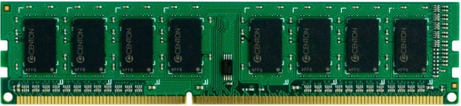
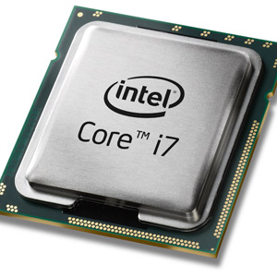
The DRAM Subsystem
“Channel”
DIMM (Dual in-line memory module)
Processor
Memory channel
Memory channel

Slide 24
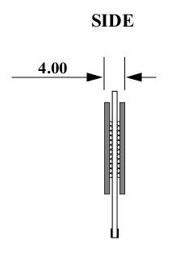
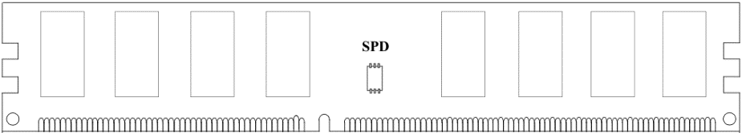
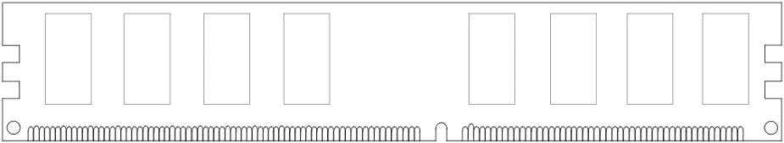
Breaking down a DIMM (module)
DIMM (Dual in-line memory module)
Side view
Front of DIMM
Back of DIMM
Rank 0: collection of 8 chips
Rank 1

Slide 25
Breaking down a Rank
. . .
Chip 0
Chip 1
Chip 7
Rank 0
<0:63>
<0:7>
<8:15>
<56:63>
Data <0:63>

Slide 26
Breaking down a Chip
8 banks
Chip 0
Bank 0
<0:7>
<0:7>
<0:7>
...
<0:7>
<0:7>

Slide 27

Inside a DRAM Chip
Bitline
Wordline
Subarray
(2D Array of DRAM Cells)
DRAM Cells
Wordline
Access
Transistor
Bitline
Sense Amplifiers
Row Buffer
Storage
Capacitor
DRAM Bank
DRAM Chips
DRAM Module
8

Slide 28
DRAM Bank Operation
Access Address:
(Row 0, Column 0)
Columns
(Row 0, Column 1)
(Row 0, Column 85)
(Row 1, Column 0)
Row address 0
Row address 1
Row decoder
Rows
Row Buffer
CONFLICT !
HIT
Row 1
HIT
Row 0
Empty
Column address 0
Column mux
Column address 0
Column address 1
Column address 85
Data

Slide 29
Long Global Memory Access Latency

Slide 30
Motivation of In-network Computing
How to optimize global memory access?
Multithreading
Memory Coalescing
Shared Memory

Slide 31
Agenda for Today
SIMT (Hardware) & Warp (Software)
Optimization of Memory System
Multi-threading
Memory Coalescing
Shared Memory
SIMT Efficiency
Divergency
Atomic
CPU-GPU Transfer

Slide 32
Latency Hiding via Warp-Level FGMT
Warp: A set of threads that execute the same instruction (on different data elements)
Fine-grained multithreading
One instruction per thread in pipeline at a time (No interlocking)
Interleaving warp execution to hide latencies
Register values of all threads stay in register file
FGMT enables long latency tolerance
Millions of pixels
Thread Warp 3
Warps available
Thread Warp 8
for scheduling
Thread Warp 7
SIMD Pipeline
I-Fetch
Decode
R
R
R
F
F
F
Warps accessing
A
A
A
memory hierarchy
L
L
L
U
U
U
Miss?
D-Cache
Thread Warp 1
All Hit?
Data
Thread Warp 2
Writeback
Thread Warp 6
Slide credit: Tor Aamodt
Notes:
With a large number of shader threads multiplexed on the same execution re- sources, our architecture employs fine-grained multithreading where individual threads are interleaved by the fetch unit to proactively hide the potential latency of stalls before they occur. As illustrated by Figure, warps are issued fairly in a round-robin queue. When a thread is blocked by a memory request, shader core simply removes that thread’s warp from the pool of “ready” warps and thereby allows other threads to proceed while the memory system processes its request.
With a large number of threads (1024 per shader core) interleaved on the same pipeline, FGMT effectively hides the latency of most memory operations since the pipeline is occupied with instructions from other threads while memory operations complete. also hides the pipeline latency so that data bypassing logic can potentially be omitted to save area with minimal impact on performance. simplify the dependency check logic design by restricting each thread to have at most one instruction running in the pipeline at any time.

Slide 33
Latency Hiding and Occupancy
FGMT can hide long latency operations (e.g., memory accesses)
Occupancy: ratio of active warps to the maximum number of warps per GPU core
4 active warps
2 active warps

Slide 34
Agenda for Today
SIMT (Hardware) & Warp (Software)
Optimization of Memory System
Multi-threading
Memory Coalescing
Shared Memory
SIMT Efficiency
Divergency
Atomic
CPU-GPU Transfer

Slide 35
Memory Coalescing (I)
Memory Coalescing：
When threads in the same warp access consecutive memory locations in the same burst, the accesses can be combined and served by one burst
Only one DRAM transaction is needed.
Memory Divergence：
If threads in the same warp access locations not in the same burst, accesses cannot be combined
Multiple memory transactions are needed
Takes longer to service data to the warp
Slide credit: Izzat El Hajj

Slide 36
Memory Coalescing (II)
Memory Coalescing:
When accessing global memory, memory coalescing makes sure that concurrent threads access nearby memory locations
Peak bandwidth utilization occurs when all threads in a warp access one cache line (or several consecutive cache lines)
Not coalesced
Coalesced
Md
Nd
Thread 1
H
T
D
Thread 2
I
W
WIDTH
Slide credit: Hwu & Kirk

Slide 37
Uncoalesced Memory Accesses
Access direction of each thread
M_{0,0}
M_{1,0}
M_{2,0}
M_{3,0}
M_{0,1}
M_{1,1}
M_{2,1}
M_{3,1}
M_{0,2}
M_{1,2}
M_{2,2}
M_{3,2}
M_{0,3}
M_{1,3}
M_{2,3}
M_{3,3}
Warp 2
…
T₁
T₂
T₃
T₄
Warp 1
T₁
T₂
T₃
T₄
M
M_{0,0}
M_{1,0}
M_{2,0}
M_{3,0}
M_{0,1}
M_{1,1}
M_{2,1}
M_{3,1}
M_{0,2}
M_{1,2}
M_{2,2}
M_{3,2}
M_{0,3}
M_{1,3}
M_{2,3}
M_{3,3}
Slide credit: Hwu & Kirk

Slide 38
Coalesced Memory Accesses
Access direction of each thread
M_{0,0}
M_{1,0}
M_{2,0}
M_{3,0}
M_{0,1}
M_{1,1}
M_{2,1}
M_{3,1}
M_{0,2}
M_{1,2}
M_{2,2}
M_{3,2}
M_{0,3}
M_{1,3}
M_{2,3}
M_{3,3}
Warp 1
Warp 2
…
T₁
T₂
T₃
T₄
T₁
T₂
T₃
T₄
M
M_{0,0}
M_{1,0}
M_{2,0}
M_{3,0}
M_{0,1}
M_{1,1}
M_{2,1}
M_{3,1}
M_{0,2}
M_{1,2}
M_{2,2}
M_{3,2}
M_{0,3}
M_{1,3}
M_{2,3}
M_{3,3}
Slide credit: Hwu & Kirk

Slide 39
SIMT Memory Access
Same instruction in different threads uses thread id to index and access different data elements
Let’s assume N=16, 4 threads per warp → 4 warps
0
1
2
3
4
5
6
7
8
9
10
11
12
13
14
15
Threads
+
0
1
2
3
4
5
6
7
8
9
10
11
12
13
14
15
Data elements
+
+
+
+
Warp 0
Warp 1
Warp 2
Warp 3
Slide credit: Hyesoon Kim

Slide 40
Agenda for Today
SIMT (Hardware) & Warp (Software)
Optimization of Memory System
Multi-threading
Memory Coalescing
Shared Memory
SIMT Efficiency
Divergency
Atomic
CPU-GPU Transfer

Slide 41
Shared Memory
Shared memory is an interleaved (banked) memory
Each bank can service one address per cycle
Typically, 32 banks in NVIDIA GPUs
Successive 32-bit words are assigned to successive banks
Bank = Address % 32
Bank conflicts are only possible within a warp
No bank conflicts between different warps

Slide 42
Shared Memory Bank Conflicts (I)
Bank conflict free
Thread 0
Bank 0
Thread 0
Bank 0
Thread 1
Bank 1
Thread 1
Bank 1
Thread 2
Bank 2
Thread 2
Bank 2
Thread 3
Bank 3
Thread 3
Bank 3
Thread 4
Bank 4
Thread 4
Bank 4
Thread 5
Bank 5
Thread 5
Bank 5
Thread 6
Bank 6
Thread 6
Bank 6
Thread 7
Bank 7
Thread 7
Bank 7
Thread 15
Bank 15
Thread 15
Bank 15
Linear addressing: stride = 1
Random addressing 1:1
Slide credit: Hwu & Kirk

Slide 43
Shared Memory Bank Conflicts (II)
N-way bank conflicts
Thread 0
Bank 0
Thread 0
x8
Bank 0
Thread 1
Bank 1
Thread 1
Bank 1
Thread 2
Bank 2
Thread 2
Bank 2
Thread 3
Bank 3
Thread 3
Thread 4
Bank 4
Thread 4
Bank 5
Thread 5
Bank 7
Bank 6
Thread 6
Bank 8
Bank 7
Thread 7
Bank 9
Thread 8
x8
Thread 9
Thread 10
Thread 11
Bank 15
Thread 15
Bank 15
2-way bank conflict: stride = 2
8-way bank conflict: stride = 8
Slide credit: Hwu & Kirk

Slide 44
Use Shared Memory to Improve Coalescing
Md
Nd
Original
H
Access
T
D
I
Pattern
W
WIDTH
Copy into
scratchpad
memory
Md
Nd
Tiled
Access
Pattern
Perform
multiplication
with scratchpad
values
Slide credit: Hwu & Kirk

Slide 45
Reducing Shared Memory Bank Conflicts
Bank conflicts are only possible within a warp
No bank conflicts between different warps
If strided accesses are needed, some optimization techniques can help
Padding
Randomized mapping
Rau, “Pseudo-randomly interleaved memory,” ISCA 1991
Hash functions
V.d.Braak+, “Configurable XOR Hash Functions for Banked Scratchpad Memories in GPUs,” IEEE TC, 2016

Slide 46
No Data Reuse
No Data reuse:
Each thread reads its only elements.
Loading Amount:
9 elements per thread
for (int i = 0; i < 3; i++){
for (int j = 0; j < 3; j++){
sum += gauss[i][j] * Image[(i+row-1)*width + (j+col-1)];
}
}
Notes:
对每一个row，col,计算一个sum。

Slide 47
Data Reuse: Tiling
For data reuse, we divide the input into tiles, each of which loads L_SIZE chunks together into shared memory, then compute together
Compute Amount:
The same
Loading Amount:
(L_SIZE+2)²/L_SIZE²
elements per thread
__shared__ int l_data[(L_SIZE+2)*(L_SIZE+2)];
…
Load tile into shared memory l_data
__syncthreads();
for (int i = 0; i < 3; i++){
for (int j = 0; j < 3; j++){
sum += gauss[i][j] * l_data[(i+l_row-1)*(L_SIZE+2)+j+l_col-1];
}
}
Notes:
L_SIZE: number of points together…

Slide 48
Synchronization Function
void __syncthreads();
Synchronizes all threads in a block
Once all threads in a block have reached this point, execution resumes normally
Used to avoid RAW / WAR / WAW hazards when accessing shared or global memory

Slide 49
Tiling/Blocking in On-chip Memories
Tiling or Blocking
Divide loops operating on arrays into computation chunks so that each chunk can hold its data in the on-chip RAM (or other on-chip memory, e.g., scratchpad)
Avoids on-chip RAM conflicts between different chunks of computation
Essentially: Divide the working set so that each piece fits in the on-chip RAMs

Slide 50
CPU: Naïve Matrix Multiplication (I)
Matrix multiplication: C = A x B
Consider two input matrices A and B in row-major layout
A size is M x P
B size is P x N
C size is M x N
B
k
P
A
C
i
j
M
k
P
N

Slide 51
CPU: Naïve Matrix Multiplication (II)
Naïve implementation of matrix multiplication
Poor access locality
#define A(i,j) matrix_A[i * P + j]
#define B(i,j) matrix_B[i * N + j]
#define C(i,j) matrix_C[i * N + j]
for (i = 0; i < M; i++){ // i = row index
for (j = 0; j < N; j++){ // j = column index
C(i, j) = 0; // Set to zero
for (k = 0; k < P; k++) // Row x Col
C(i, j) += A(i, k) * B(k, j);
}
}
B
k
P
A
C
Consecutive accesses to B are far from each other, in different memory lines.
Every access to B is likely to cause a row buffer miss
i
j
M
k
P
N

Slide 52
CPU: Tiled Matrix Multiplication (I)
Tiled Matrix Multiplication:
Achieve better on-chip RAM locality by computing on smaller tiles or blocks that fit in the RAMs
B
k
P
A
C
i
tile_dim
j
M
k
tile_dim
P
N
Lam+, "The cache performance and optimizations of blocked algorithms," ASPLOS 1991. https://doi.org/10.1145/106972.106981
Bansal+, "Chapter 15 - Fast Matrix Computations on Heterogeneous Streams," in "High Performance Parallelism Pearls", 2015. https://doi.org/10.1016/B978-0-12-803819-2.00011-2
Kirk & Hwu, "Chapter 5 - Performance considerations," in "Programming Massively Parallel Processors (Third Edition)", 2017. https://doi.org/10.1016/B978-0-12-811986-0.00005-4

Slide 53
CPU: Tiled Matrix Multiplication (II)
Tiled implementation operates on submatrices (tiles or blocks) that fit fast RAMs (cache, scratchpad, RF)
#define A(i,j) matrix_A[i * P + j]
#define B(i,j) matrix_B[i * N + j]
#define C(i,j) matrix_C[i * N + j]
for (I = 0; I < M; I += tile_dim){
for (J = 0; J < N; J += tile_dim){
Set_to_zero(&C(I, J)); // Set to zero
for (K = 0; K < P; K += tile_dim)
Multiply_tiles(&C(I, J), &A(I, K), &B(K, J));
}
}
B
k
P
A
C
Multiply small submatrices (tiles or blocks) of size tile_dim x tile_dim
i
tile_dim
j
M
k
tile_dim
P
N
Lam+, "The cache performance and optimizations of blocked algorithms," ASPLOS 1991. https://doi.org/10.1145/106972.106981
Bansal+, "Chapter 15 - Fast Matrix Computations on Heterogeneous Streams," in "High Performance Parallelism Pearls", 2015. https://doi.org/10.1016/B978-0-12-803819-2.00011-2
Kirk & Hwu, "Chapter 5 - Performance considerations," in "Programming Massively Parallel Processors (Third Edition)", 2017. https://doi.org/10.1016/B978-0-12-811986-0.00005-4

Slide 54
GPU: Matrix-Matrix Multiplication (I)
N
C = A x B
B
N
N
N
A
C
N
N
Slide credit: Izzat El Hajj

Slide 55
GPU: Matrix-Matrix Multiplication (II)
Parallelization approach: assign one thread to each element in the output matrix (C)
N
C = A x B
B
N
N
N
A
C
N
N
Slide credit: Izzat El Hajj

Slide 56
GPU: Matrix-Matrix Multiplication (III)
__global__ void mm_kernel(float* A, float* B, float* C, unsigned int N) {
unsigned int row = blockIdx.y*blockDim.y + threadIdx.y;
unsigned int col = blockIdx.x*blockDim.x + threadIdx.x;
float sum = 0.0f;
for(unsigned int i = 0; i < N; ++i) {
sum += A[row*N + i]*B[i*N + col];
}
C[row*N + col] = sum;
}
Slide credit: Izzat El Hajj

Slide 57
GPU: Reuse in Matrix-Matrix Multiplication (I)
N
C = A x B
B
N
Some of the threads in the same thread block use the same input data
N
N
A
C
N
N
Slide credit: Izzat El Hajj

Slide 58
GPU: Reuse in Matrix-Matrix Multiplication (II)
N
C = A x B
B
N
Some of the threads in the same thread block use the same input data
N
N
A
C
N
N
Slide credit: Izzat El Hajj

Slide 59
GPU: Tiled Matrix-Matrix Multiplication (I)
N
C_{tile} = A_{tile1} x B_{tile1}
B
N
Step 1: Load the first tile of each input matrix to shared memory (each thread loads one element)
N
N
A
C
N
N
Slide credit: Izzat El Hajj

Slide 60
GPU: Tiled Matrix-Matrix Multiplication (II)
B_{tile2}
C_{tile} += A_{tile2} x B_{tile2}
Step 2: Each thread computes its partial sum from the tiles in shared memory (threads wait for each other to finish)
A_{tile2}
C_{tile}
Slide credit: Izzat El Hajj

Slide 61
GPU: Tiled Matrix-Matrix Multiplication (III)
N
C_{tile} += A_{tile2} x B_{tile2}
B
N
…accumulate the second tile
N
N
A
C
N
N
Slide credit: Izzat El Hajj

Slide 62
GPU: Tiled Matrix-Matrix Multiplication (IV)
N
C_{tile} += A_{tile3} x B_{tile3}
B
N
…and accumulate the third tile
N
N
A
C
N
N
Slide credit: Izzat El Hajj

Slide 63
GPU: Tiled Matrix-Matrix Multiplication (V)
__shared__ float A_s[TILE_DIM][TILE_DIM];
__shared__ float B_s[TILE_DIM][TILE_DIM];
unsigned int row = blockIdx.y*blockDim.y + threadIdx.y;
unsigned int col = blockIdx.x*blockDim.x + threadIdx.x;
float sum = 0.0f;
for(unsigned int tile = 0; tile < N/TILE_DIM; ++tile) {
// Load tile to shared memory
A_s[threadIdx.y][threadIdx.x] = A[row*N + tile*TILE_DIM + threadIdx.x];
B_s[threadIdx.y][threadIdx.x] = B[(tile*TILE_DIM + threadIdx.y)*N + col];
__syncthreads();
// Compute with tile
for(unsigned int i = 0; i < TILE_DIM; ++i) {
sum += A_s[threadIdx.y][i]*B_s[i][threadIdx.x];
}
__syncthreads();
}
C[row*N + col] = sum;
Declare arrays in shared memory
Threads wait for each other to finish loading before computing
Threads wait for each other to finish computing before loading
Slide credit: Izzat El Hajj

Slide 64
Agenda for Today
SIMT (Hardware) & Warp (Software)
Optimization of Memory System
Multi-threading
Memory Coalescing
Shared Memory
SIMT Efficiency
Divergency
Atomic
CPU-GPU Transfer

Slide 65
Threads Can Take Different Paths in Warp-based SIMT
Each thread can have conditional control flow instructions
Threads can execute different control flow paths
A
Thread Warp
Common PC
B
Thread
1
Thread
2
Thread
3
Thread
4
C
D
F
E
G
Slide credit: Tor Aamodt

Slide 66
Control Flow Problem in GPUs/SIMT
A GPU uses a SIMT pipeline to save area on control logic
Groups scalar threads into warps
Branch divergence occurs when threads inside warps branch to different execution paths
Branch
Branch
Path A
Path A
Path B
Path B
Slide credit: Tor Aamodt

Slide 67
SIMT Utilization
Intra-warp divergence
Compute(threadIdx.x);
if (threadIdx.x % 2 == 0){
Do_this(threadIdx.x);
}
else{
Do_that(threadIdx.x);
}

Slide 68
Increasing SIMT Utilization
Divergence-free execution
Compute(threadIdx.x);
if (threadIdx.x < 32){
Do_this(threadIdx.x * 2);
}
else{
Do_that((threadIdx.x%32)*2+1);
}

Slide 69
Vector Reduction: Naïve Mapping (I)
Thread 0
Thread 2
Thread 4
Thread 6
Thread 8
Thread 10
0
1
2
3
4
5
6
7
8
9
10
11
…
1
0+1
2+3
4+5
6+7
8+9
10+11
2
0...3
4..7
8..11
iterations
3
0..7
8..15
Slide credit: Hwu & Kirk

Slide 70
Vector Reduction: Naïve Mapping (II)
Program with low SIMD utilization
__shared__ float partialSum[]
unsigned int t = threadIdx.x;
for (int stride = 1; stride < blockDim.x; stride *= 2) {
__syncthreads();
if (t % (2*stride) == 0)
partialSum[t] += partialSum[t + stride];
}

Slide 71
Divergence-Free Mapping (I)
All active threads belong to the same warp
Thread 0
Thread 1
Thread 2
…
Thread 14
Thread 15
0
1
2
3
…
13
14
15
16
17
18
19
1
0+16
15+31
2
iterations
3
Slide credit: Hwu & Kirk

Slide 72
Divergence-Free Mapping (II)
Program with high SIMD utilization
__shared__ float partialSum[]
unsigned int t = threadIdx.x;
for (int stride = blockDim.x; stride > 0; stride >> 1){
__syncthreads();
if (t < stride)
partialSum[t] += partialSum[t + stride];
}

Slide 73
Agenda for Today
SIMT (Hardware) & Warp (Software)
Optimization of Memory System
Multi-threading
Memory Coalescing
Shared Memory
SIMT Efficiency
Divergency
Atomic
CPU-GPU Transfer

Slide 74
Atomic Operations

Slide 75
Atomic Operations (I)
CUDA provides atomic instructions on shared memory and global memory
They perform read-modify-write operations atomically
Arithmetic functions
Add, sub, max, min, exch, inc, dec, CAS
int atomicAdd(int*, int);
Bitwise functions
And, or, xor
Datatypes: int, uint, ull, float (half, single, double)*
Return value (old value)
Pointer to shared memory or global memory
Value to add
* Datatypes for different atomic operations in https://docs.nvidia.com/cuda/cuda-c-programming-guide/index.html#atomic-functions

Slide 76
Atomic Operations (II)
Atomic operations serialize the execution if there are atomic conflicts
t_{conflict}
t_{base}
t_{base}
No atomic conflict = concurrent updates
Atomic conflict = serialized updates
Shared memory
Shared memory

Slide 77
Uses of Atomic Operations
Use atomic operations to prevent data races when more than one thread need to update the same memory location
Computation
Atomics on an array that will be the output of the kernel
Example
Histogram, reduction
Synchronization
Atomics on memory locations that are used for synchronization or coordination
Example
Counters, locks, flags…

Slide 78
Image Histogram
Histograms are widely used in image processing
Some computation before voting in the histogram may be needed
Parallel threads frequently incur atomic conflicts in image histogram computation
For (each pixel i in image I){
Pixel = I[i] // Read pixel
Pixel’ = Computation(Pixel) // Optional computation
Histogram[Pixel’]++ // Vote in histogram bin
}

Slide 79
Agenda for Today
SIMT (Hardware) & Warp (Software)
Optimization of Memory System
Multi-threading
Memory Coalescing
Shared Memory
SIMT Efficiency
Divergency
Atomic
CPU-GPU Transfer

Slide 80
Asynchronous Data Transfers between CPU and GPU

Slide 81
CUDA Streams
CUDA streams (command queues in OpenCL)
Sequence of operations that are performed in order
1. Data transfer CPU-GPU
2. Kernel execution
D input data instances, B blocks
#Streams: (D / #Streams) data instances, (B / #Streams) blocks
3. Data transfer GPU-CPU
Notes:
Computation is divided such that if D data instances need B blocks to be processed… The kernel is therefore #Streams times launched.
CUDA literature gives only two rough estimates, but does not give any hint of the optimal number of streams in which a given data set should be preferably divided.

Slide 82
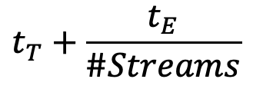
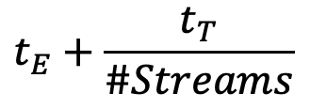
Asynchronous Transfers between CPU & GPU
Computation divided into #Streams
D input data instances, B blocks
#Streams
D/#Streams data instances
B/#Streams blocks
Estimates
Default stream
Several streams
$$t_{E}+\frac{t_{T}}{\#Streams}$$
$$t_{T}+\frac{t_{E}}{\#Streams}$$
t_{E} >= t_{T} (dominant kernel)
t_{T} > t_{E} (dominant transfers)
Notes:
Computation is divided such that if D data instances need B blocks to be processed… The kernel is therefore #Streams times launched.
CUDA literature gives only two rough estimates, but does not give any hint of the optimal number of streams in which a given data set should be preferably divided.

Slide 83
Overlap of Data Transfers and Kernel Execution
Code for devices that do not support concurrent data transfers
// Create streams
int number_of_streams = 32;
cudaStream_t stream[number_of_streams]; // Stream declaration
for(int i = 0; i < number_of_streams; ++i)
cudaStreamCreate(&stream[i]); // Stream creation
// CPU-GPU data transfers
for (int i = 0; i < number_of_streams; ++i)
cudaMemcpyAsync(inputDevPtr + i * size, hostPtr + i * size, size,
cudaMemcpyHostToDevice, stream[i]);
// Kernel launches
for (int i = 0; i < number_of_streams; ++i)
MyKernel<<<num_blocks / number_of_streams, num_threads, 0, stream[i]>>>
(outputDevPtr + i * size, inputDevPtr + i * size, size);
// GPU-CPU data transfers
for (int i = 0; i < number_of_streams; ++i)
cudaMemcpyAsync(hostPtr + i * size, outputDevPtr + i * size, size,
cudaMemcpyDeviceToHost, stream[i]);
cudaDeviceSynchronize(); // Explicit synchronization
// Destroy streams
for (int i = 0; i < number_of_streams; ++i)
cudaStreamDestroy(stream[i]); // Stream destruction
Check CUDA programming guide
https://docs.nvidia.com/cuda/cuda-c-programming-guide/index.html#streams
Gomez-Luna+, “Performance Models for Asynchronous Data Transfers on Consumer Graphics Processing Units,”
JPDC, 2012

Slide 84
Use Case: Video Processing
Applications with independent computation on different data instances can benefit from asynchronous transfers
For instance, video processing
Gomez-Luna+, “Performance Models for Asynchronous Data Transfers on Consumer Graphics Processing Units,”
JPDC, 2012
Notes:
A number b of blocks per frame executes.
Data transfers are overlapped with computation. Thus, some time can be saved.

Slide 85
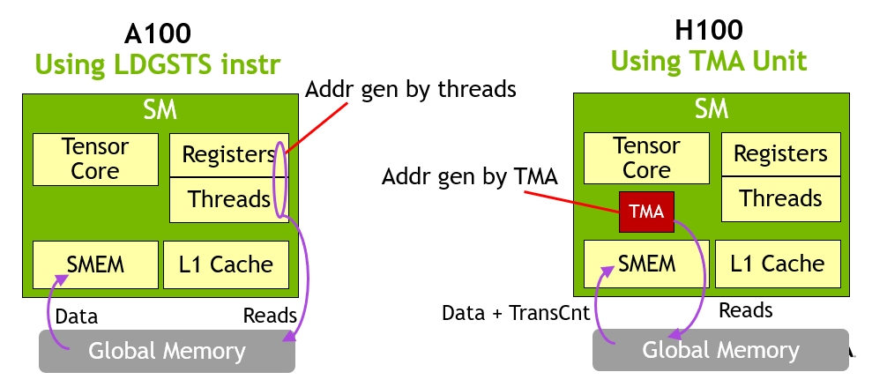
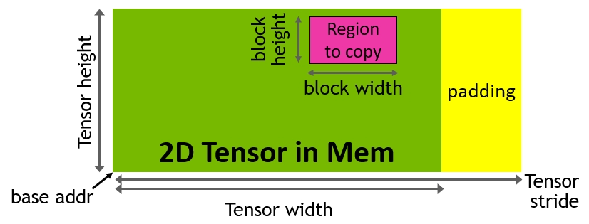
NVIDIA H100 Tensor Memory Accelerator
Asynchronous memory copy with LDGSTS instruction vs. TMA
TMA unit reduces addressing overhead
A single thread per warp issues the TMA operation
Support for different tensor layouts (1D-5D)
https://developer.nvidia.com/blog/nvidia-hopper-architecture-in-depth/
Notes:
New asynchronous execution features include a new Tensor Memory Accelerator (TMA) unit that can transfer large blocks of data efficiently between global memory and shared memory. TMA also supports asynchronous copies between thread blocks in a cluster. There is also a new asynchronous transaction barrier for doing atomic data movement and synchronization.
New asynchronous execution features include a new Tensor Memory Accelerator (TMA) unit that can efficiently transfer large blocks of data between global memory and shared memory. TMA also supports asynchronous copies between thread blocks in a cluster. There is also a new asynchronous transaction barrier for doing atomic data movement and synchronization.

Slide 86
State-of-the-art CPU GPU and FPGA
 | Cores (Threads) | TFLOPS | Memory Size (Bandwidth) | PCIe | Network
CPU (AMD Threadripper 3995WX) | 64 (128) | 2.8 (FP32), 1.4 (FP64) | 512GB (80GB/s) | 32.0GB/s (PCIe 4.0 X16) | No
GPU (Nvidia A100) | 8192 (128K) | 19.5 (FP32), 9.7 (FP64), 156 (FP32, Tensor), 312 (FP16, Tensor) | 40/80GB (1935GB/s) | 32.0GB/s (PCIe 4.0 X16) | No
FPGA (U280) | 9,024 (25x18 MULs) | 1.8 (FP32) | 40GB (460GB/s) | 16.0GB/s (PCIe 4.0 X8) | Yes
Notes:
KB MB GB TB
K M B T E P
1B=10亿

Slide 87
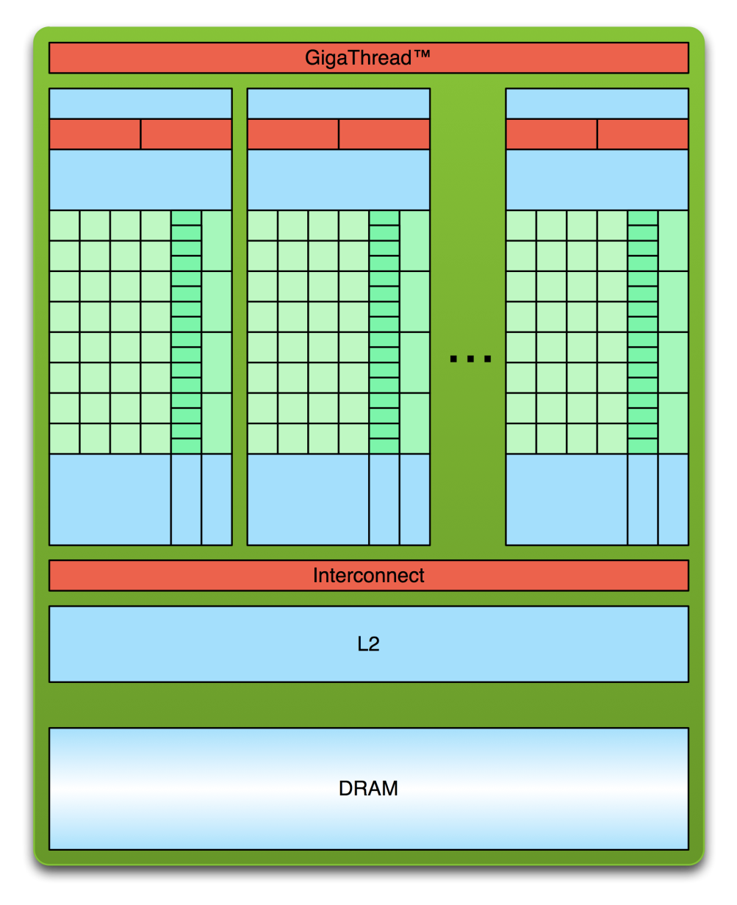
Limitation of GPU
GPU
CPU
PCIe
32.0GB/s
1935GB/s

Slide 88
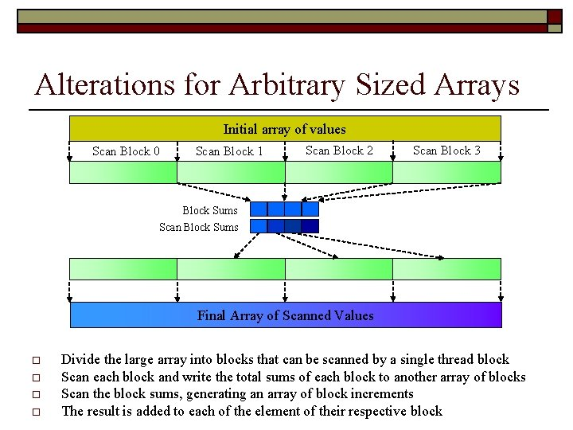
Limitation of GPU
// Fills prefix sum array
void fillPrefixSum(int arr[], int n, int prefixSum[])
{ prefixSum[0] = arr[0];
// Adding present element
for (int i = 1; i < n; i++)
prefixSum[i] = prefixSum[i-1] + arr[i]; }
Serial Code of Prefix sum:
GPU Code of Prefix sum:
Multi-pass (ISSUE)

Slide 89
Nvidia’s Success: Transparent Scalability
Hardware is free to schedule thread blocks
Gen 1
Gen 2
Device
Kernel grid
Block 0
Block 1
Device
Block 2
Block 3
time
Block 0
Block 1
Block 4
Block 5
Block 6
Block 7
time
Block 0
Block 1
Block 2
Block 3
Block 2
Block 3
Block 4
Block 5
Block 6
Block 7
Block 4
Block 5
Each block can execute in any order relative to other blocks.
Block 6
Block 7
The CUDA code stays the same and enjoys performance improvement while GPU hardware evolves.
Slide credit: Hwu & Kirk
Notes:
Thread block is the key innovation to scale-up GPU architecture. The software code stays the same and enjoys performance speedup while GPU hardware evolves.

Slide 90
Key Messages:
Programming model is the key success of Nvidia, rather than the GPU itself.
GPU has an order of magnitude higher memory bandwidth and compute power than CPU.
Offloading a task to GPU pays off only when the task has enough compute intensity.
AI task needs compute-intensive accelerators, e.g., GPU and AI processor.

Slide 91
Prog. Model 3: Multithreaded
for (i=0; i < N; i++)
C[i] = A[i] + B[i];
load
load
load
load
add
add
store
store
Iter. 1
Iter. 2
Realization: Each iteration is independent
Idea: Programmer or compiler generates a thread to execute each iteration. Each thread does the same thing (but on different data)
This programming model (software) is called:
SPMD: Single Program Multiple Data
Executed on a SIMT machine (hardware)
Single Instruction Multiple Thread

Slide 92
A GPU is a SIMD (SIMT) Machine
Except it is not programmed using SIMD instructions
It is programmed using threads (SPMD programming model)
Each thread executes the same code but operates a different piece of data
Each thread has its own context (i.e., can be treated/restarted/executed independently)
A set of threads executing the same instruction are dynamically grouped into a warp (wavefront) by the hardware
A warp is essentially a SIMD operation formed by hardware!

Slide 93
SIMD vs. SIMT Execution Model
SIMD: A single sequential instruction stream of SIMD instructions → each instruction specifies multiple data inputs
[VLD, VLD, VADD, VST], VLEN
SIMT: Multiple instruction streams of scalar instructions → threads grouped dynamically into warps
[LD, LD, ADD, ST], NumThreads
Two Major SIMT Advantages:
Can treat each thread separately → i.e., can execute each thread independently on any type of scalar pipeline
Can group threads into warps flexibly → i.e., can group threads that are supposed to truly execute the same instruction → dynamically obtain and maximize benefits of SIMD processing

Slide 94
Brief Review of GPU Architecture (I)
Streaming Processor Array
Tesla architecture (G80/GT200)

Slide 95
Brief Review of GPU Architecture (II)
Streaming Multiprocessors (SM)
Streaming Processors (SP)
Blocks are divided into warps
SIMD unit (32 threads)
Block 0’s warps
Block 1’s warps
Block 2’s warps
…
…
…
…
…
…
t0 t1 t2 … t31
t0 t1 t2 … t31
t0 t1 t2 … t31
NVIDIA Fermi architecture

Slide 96
Brief Review of GPU Architecture (III)
Streaming Multiprocessors (SM) or Compute Units (CU)
SIMD pipelines
Streaming Processors (SP) or CUDA ”cores”
Vector lanes
Number of SMs x SPs across generations
Tesla (2007): 30 x 8
Fermi (2010): 16 x 32
Kepler (2012): 15 x 192
Maxwell (2014): 24 x 128
Pascal (2016): 56 x 64
Volta (2017): 80 x 64

Slide 97
Graphics Processing Units SIMD not Exposed to Programmer (SIMT)

Slide 98
SIMD vs. SIMT Execution Model
SIMD: A single sequential instruction stream of SIMD instructions → each instruction specifies multiple data inputs
[VLD, VLD, VADD, VST], VLEN
SIMT: Multiple instruction streams of scalar instructions → threads grouped dynamically into warps
[LD, LD, ADD, ST], NumThreads
Two Major SIMT Advantages:
Can treat each thread separately → i.e., can execute each thread independently (on any type of scalar pipeline) → MIMD processing
Can group threads into warps flexibly → i.e., can group threads that are supposed to truly execute the same instruction → dynamically obtain and maximize benefits of SIMD processing

Slide 99
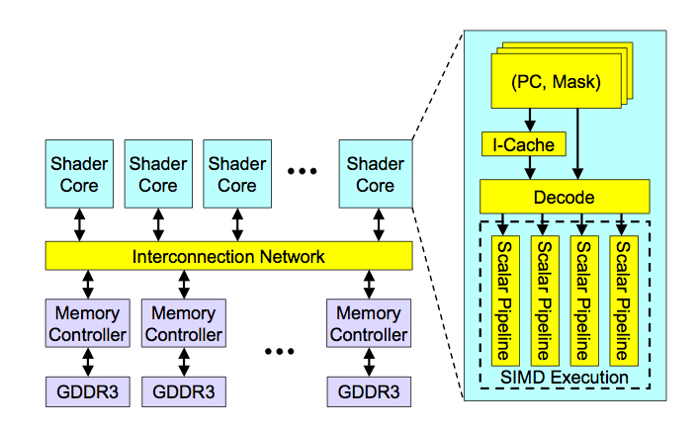
High-Level View of a GPU
Lindholm et al., "NVIDIA Tesla: A Unified Graphics and Computing Architecture," IEEE Micro 2008.

Slide 100
Latency Hiding via Warp-Level FGMT
Warp: A set of threads that execute the same instruction (on different data elements)
Fine-grained multithreading
No interlocking: One instruction per thread in pipeline at a time.
Interleave warp execution to hide latencies
Register values of all threads stay in register file
FGMT enables long latency tolerance
Millions of pixels
Thread Warp 3
Warps available
Thread Warp 8
for scheduling
Thread Warp 7
SIMD Pipeline
I-Fetch
Decode
R
R
R
F
F
F
Warps accessing
A
A
A
memory hierarchy
L
L
L
U
U
U
Miss?
D-Cache
Thread Warp 1
All Hit?
Data
Thread Warp 2
Writeback
Thread Warp 6
Slide credit: Tor Aamodt
Notes:
With a large number of shader threads multiplexed on the same execution re- sources, our architecture employs fine-grained multithreading where individual threads are interleaved by the fetch unit to proactively hide the potential latency of stalls before they occur. As illustrated by Figure, warps are issued fairly in a round-robin queue. When a thread is blocked by a memory request, shader core simply removes that thread’s warp from the pool of “ready” warps and thereby allows other threads to proceed while the memory system processes its request.
With a large number of threads (1024 per shader core) interleaved on the same pipeline, FGMT effectively hides the latency of most memory operations since the pipeline is occupied with instructions from other threads while memory operations complete. also hides the pipeline latency so that data bypassing logic can potentially be omitted to save area with minimal impact on performance. simplify the dependency check logic design by restricting each thread to have at most one instruction running in the pipeline at any time.

Slide 101
Warp Execution (Recall the Slide)
32-thread warp executing ADD A[tid],B[tid] → C[tid]
Execution using one pipelined functional unit
Execution using four pipelined functional units
A[6]
B[6]
A[24]
B[24]
A[25]
B[25]
A[26]
B[26]
A[27]
B[27]
A[5]
B[5]
A[20]
B[20]
A[21]
B[21]
A[22]
B[22]
A[23]
B[23]
A[4]
B[4]
A[16]
B[16]
A[17]
B[17]
A[18]
B[18]
A[19]
B[19]
A[3]
B[3]
A[12]
B[12]
A[13]
B[13]
A[14]
B[14]
A[15]
B[15]
C[2]
C[8]
C[9]
C[10]
C[11]
C[1]
C[4]
C[5]
C[6]
C[7]
Time
Time
C[0]
C[0]
C[1]
C[2]
C[3]
Space
Slide credit: Krste Asanovic

Slide 102
SIMD Execution Unit Structure
Functional Unit
Registers
for each
Thread
Registers for thread IDs
0, 4, 8, …
Registers for thread IDs
1, 5, 9, …
Registers for thread IDs
2, 6, 10, …
Registers for thread IDs
3, 7, 11, …
Lane
Memory Subsystem
Slide credit: Krste Asanovic

Slide 103
Warps not Exposed to GPU Programmers
CPU threads and GPU kernels
Sequential or modestly parallel sections on CPU
Massively parallel sections on GPU: Blocks of threads
Serial Code (host)
Parallel Kernel (device)
KernelA<<<nBlk, nThr>>>(args);
. . .
Serial Code (host)
Parallel Kernel (device)
KernelB<<<nBlk, nThr>>>(args);
. . .
Slide credit: Hwu & Kirk

Slide 104
From Blocks to Warps
GPU cores: SIMD pipelines
Streaming Multiprocessors (SM)
Streaming Processors (SP)
Blocks are divided into warps
SIMD unit (32 threads)
Block 0’s warps
Block 1’s warps
Block 2’s warps
…
…
…
…
…
…
t0 t1 t2 … t31
t0 t1 t2 … t31
t0 t1 t2 … t31
NVIDIA Fermi architecture

Slide 105
SPMD
Single procedure/program, multiple data
This is a programming model rather than computer organization
Each processing element executes the same procedure, except on different data elements
Procedures can synchronize at certain points in program, e.g. barriers
Essentially, multiple instruction streams execute the same program
Each program/procedure 1) works on different data, 2) can execute a different control-flow path, at run-time
Many scientific applications are programmed this way and run on MIMD hardware (multiprocessors)
Modern GPUs programmed in a similar way on a SIMD hardware

Slide 106
Dynamic Warp Formation/Merging
Idea: Dynamically merge threads executing the same instruction (after branch divergence)
Form new warps from warps that are waiting
Enough threads branching to each path enables the creation of full new warps
Warp X
Warp Z
Warp Y

Slide 107
Dynamic Warp Formation/Merging
Idea: Dynamically merge threads executing the same instruction (after branch divergence)
Fung et al., “Dynamic Warp Formation and Scheduling for Efficient GPU Control Flow,” MICRO 2007.
Branch
Branch
Path A
Path A
Path B

Slide 108
Dynamic Warp Formation Example
A
x/1111
y/1111
Legend
B
A
A
x/1110
y/0011
Execution of Warp x
Execution of Warp y
at Basic Block A
at Basic Block A
C
x/1000
D
x/0110
F
x/0001
y/0010
y/0001
y/1100
D
E
A new warp created from scalar threads of both Warp x and y executing at Basic Block D
x/1110
y/0011
G
x/1111
y/1111
A
A
B
B
C
C
D
D
E
E
F
F
G
G
A
A
Baseline
Time
Dynamic
Warp
Formation
A
A
B
B
C
D
E
E
F
G
G
A
A
Time
Slide credit: Tor Aamodt

Slide 109
Hardware Constraints Limit Flexibility of Warp Grouping
Functional Unit
Registers
for each
Thread
Registers for thread IDs
0, 4, 8, …
Registers for thread IDs
1, 5, 9, …
Registers for thread IDs
2, 6, 10, …
Registers for thread IDs
3, 7, 11, …
Lane
Memory Subsystem
Slide credit: Krste Asanovic

Slide 110
Clarification of Some GPU Terms
Generic Term | NVIDIA Term | AMD Term | Comments
Vector length | Warp size | Wavefront size | Number of threads that run in parallel (lock-step) on a SIMD functional unit
Pipelined functional unit / Scalar pipeline | Streaming processor / CUDA core | - | Functional unit that executes instructions for one GPU thread
SIMD functional unit / SIMD pipeline | Group of N streaming processors (e.g., N=8 in GTX 285, N=16 in Fermi) | Vector ALU | SIMD functional unit that executes instructions for an entire warp
GPU core | Streaming multiprocessor | Compute unit | It contains one or more warp schedulers and one or several SIMD pipelines

Slide 111
Programming Model vs. Hardware Execution Model
Hardware Programming Model
Programming Model
GPU
Thread blocks
Streaming
Multi-processor
Thread block (s)
Wrap
CUDA core:
Core
Thread

Slide 112
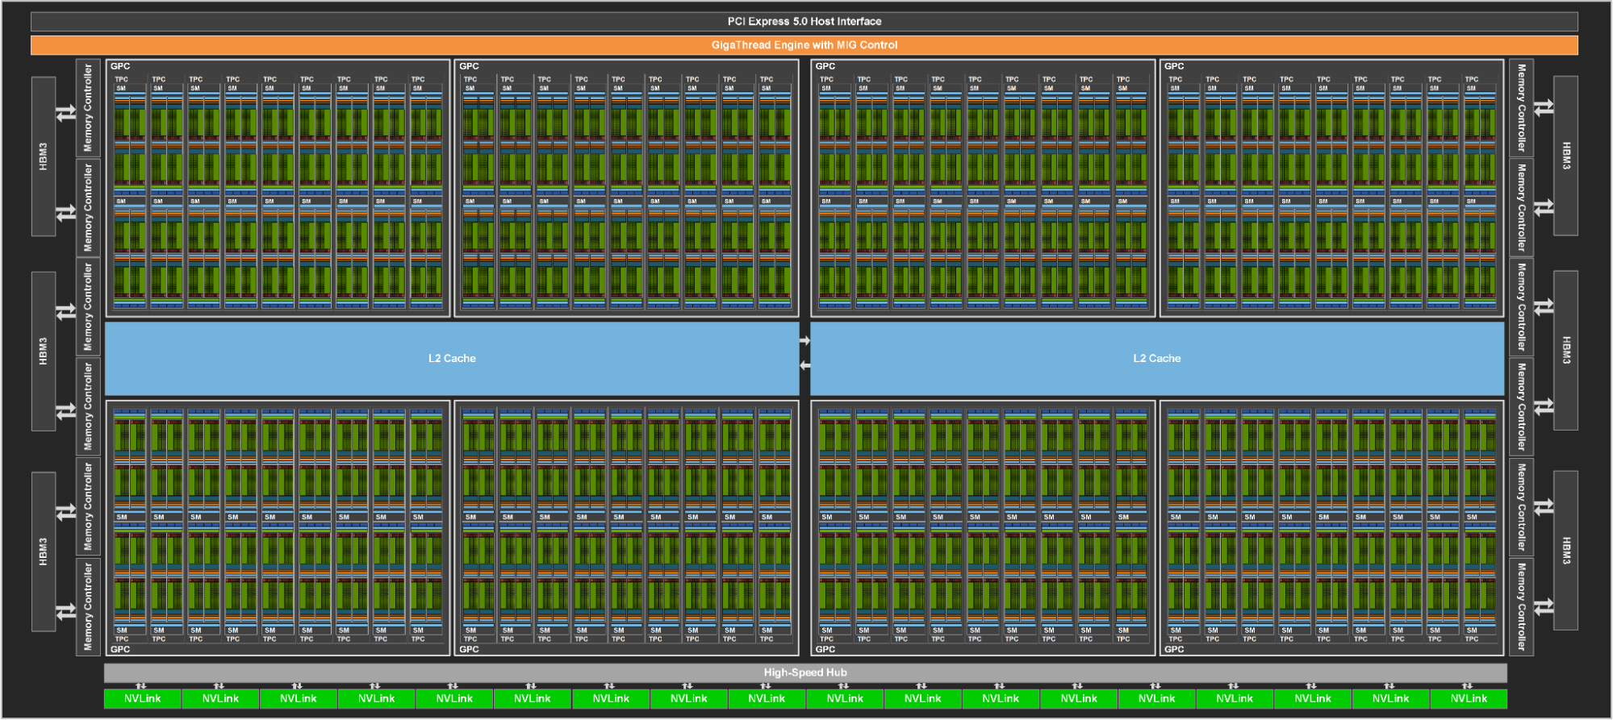
NVIDIA H100 Block Diagram
https://developer.nvidia.com/blog/nvidia-hopper-architecture-in-depth/
144 cores on the full GH100
60MB L2 cache

Slide 113
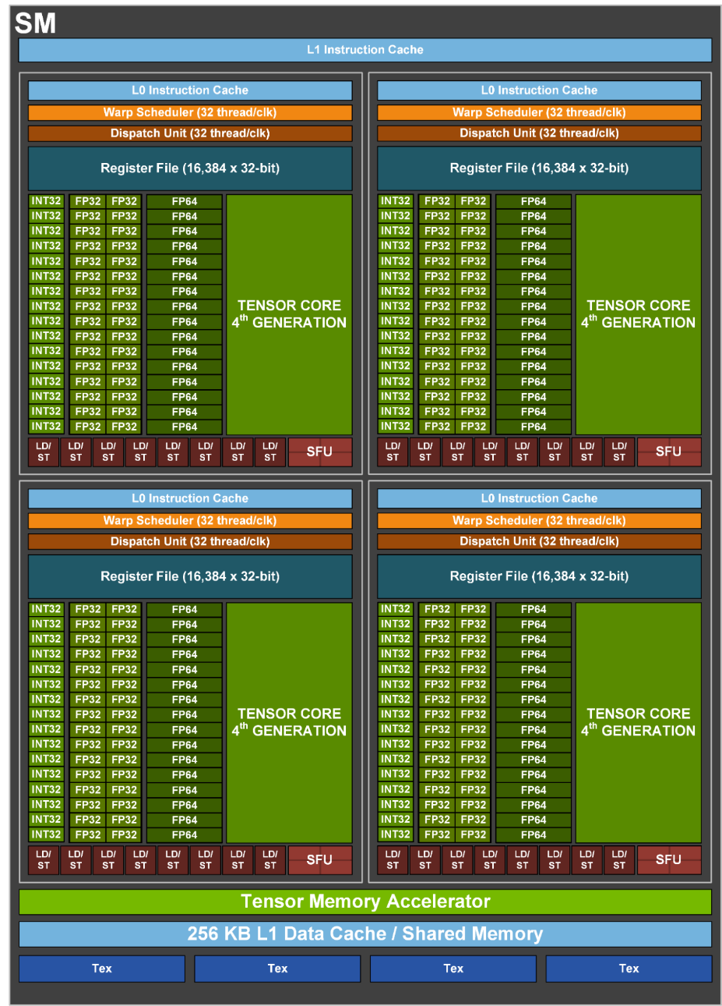
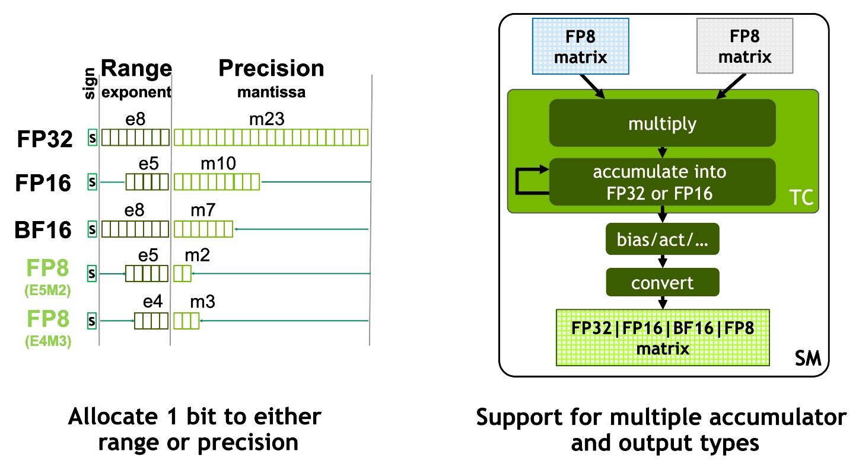
NVIDIA H100 Core
48 TFLOPS Single Precision*
24 TFLOPS Double Precision*
800 TFLOPS (FP16, Tensor Cores)*
https://developer.nvidia.com/blog/nvidia-hopper-architecture-in-depth/
* Preliminary performance estimates

Slide 114
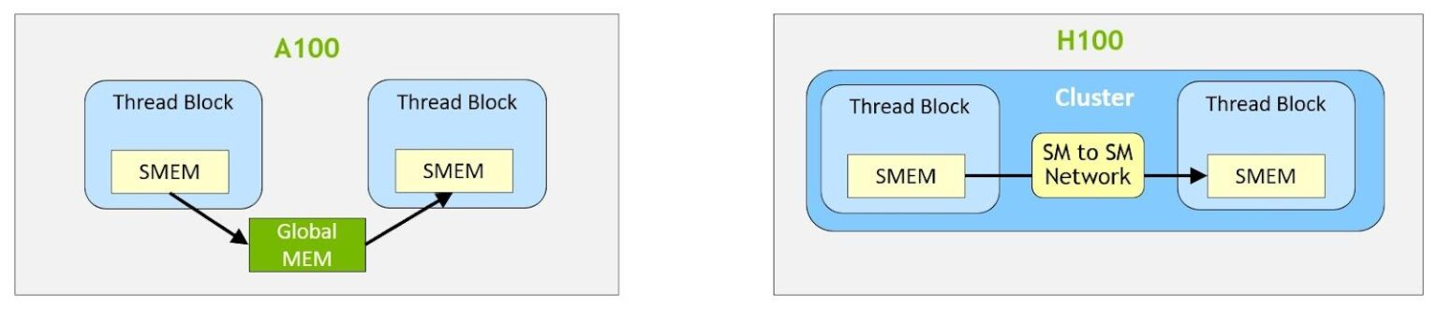
NVIDIA H100 Distributed Shared Memory
Shared memory virtual address space distributed across the blocks of a cluster
Load, store, and atomic operations to other SM’s shared memory
Thread block clusters and distributed shared memory (DSMEM) are leveraged via cooperative_groups API
TMA unit supports copies across thread blocks in a cluster
Asynchronous transaction barriers
https://developer.nvidia.com/blog/nvidia-hopper-architecture-in-depth/
Notes:
Distributed shared memory allows direct SM-to-SM communications for loads, stores, and atomics across multiple SM shared memory blocks.
Distributed shared memory enables direct SM-to-SM communications for loads, stores, and atomics across multiple SM shared memory blocks

Slide 115
Optimized Parallel Reduction
7 versions in CUDA samples: Tree-based reduction in shared memory
Version 0: No whole warps active
Version 1: Contiguous threads, but many bank conflicts
Version 2: No bank conflicts
Version 3: First level of reduction when reading from global memory
Version 4: Warp shuffle or unrolling of final warp
Version 5: Warp shuffle or complete unrolling
Version 6: Multiple elements per thread sequentially
https://docs.nvidia.com/cuda/cuda-samples/index.html#cuda-parallel-reduction
Harris, “Optimizing Parallel Reduction in CUDA,” https://developer.download.nvidia.com/assets/cuda/files/reduction.pdf

Slide 116
Reduction with Atomic Operations
3 new versions of reduction based on 3 previous versions
Version 0: No whole warps active
Version 3: First level of reduction when reading from global memory
Version 6: Multiple elements per thread sequentially
New versions 7, 8, and 9
Replace the for loop (tree-based reduction) with one shared memory atomic operation per thread

Slide 117
Video Processing: Performance Results (I)
256-bin histogram calculation
21%
44%
Gomez-Luna+, “Performance Models for Asynchronous Data Transfers on Consumer Graphics Processing Units,”
JPDC, 2012

Slide 118
Video Processing: Performance Results (II)
RGB-to-grayscale conversion
63%
18%
Gomez-Luna+, “Performance Models for Asynchronous Data Transfers on Consumer Graphics Processing Units,”
JPDC, 2012

Slide 119
Performance Considerations
Main bottlenecks
CPU-GPU data transfers
Global memory access
Memory access
Latency hiding
Occupancy
Memory coalescing
Data reuse
Shared memory usage
SIMD (Warp) Utilization: Divergence
Other considerations
Atomic operations: Serialization
Data transfers between CPU and GPU
Overlap of communication and computation

Slide 120
Recommended Readings
Hwu and Kirk, “Programming Massively Parallel Processors,” Third Edition, 2017
Chapter 5: Performance considerations
Chapter 18 - Programming
a heterogeneous computing cluster,
Section 18.5

