Slide 1
Computer Arch. & AI Chip Lecture 8: Memory Hierarchy and Caches
Prof. Zeke Wang
Zhejiang University
23 April 2026

Slide 2






Recall: GPU Programming Model vs. Hardware Execution Model
Hardware Execution Model
CUDA Programming Model
GPU
Grid
...
Streaming
Multi-processor
Thread block
Warp
SIMT
CUDA core
Thread
Notes:
SIMD Wrap

Slide 3
Motivation of In-network Computing
How to deal with long-latency global memory access?
Multithreading
Memory Coalescing
Shared Memory

Slide 4
Recall: Latency Hiding and Occupancy
FGMT can hide long latency operations (e.g., memory accesses)
Occupancy: ratio of active warps to the maximum number of warps per GPU core
4 active warps
2 active warps

Slide 5
Recall: SIMT Memory Access
Same instruction in different threads uses thread id to index and access different data elements
Let’s assume N=16, 4 threads per warp → 4 warps
0
1
2
3
4
5
6
7
8
9
10
11
12
13
14
15
Threads
+
0
1
2
3
4
5
6
7
8
9
10
11
12
13
14
15
Data elements
+
+
+
+
Warp 0
Warp 1
Warp 2
Warp 3
Slide credit: Hyesoon Kim

Slide 6
Recall: Naïve Matrix-Matrix Multiplication
N
C = A x B
B
N
N
N
A
C
N
N
Slide credit: Izzat El Hajj

Slide 7
Recall: GPU Tiled Matrix-Matrix Multiplication
N
C += A_{tile} x B_{tile}
B
N
N
N
A
C
N
N
Slide credit: Izzat El Hajj

Slide 8
Recall: Tiled Matrix-Matrix Multiplication with Shared Memory
__shared__ float A_s[TILE_DIM][TILE_DIM];
__shared__ float B_s[TILE_DIM][TILE_DIM];
unsigned int row = blockIdx.y*blockDim.y + threadIdx.y;
unsigned int col = blockIdx.x*blockDim.x + threadIdx.x;
float sum = 0.0f;
for(unsigned int tile = 0; tile < N/TILE_DIM; ++tile) {
// Load tile to shared memory
A_s[threadIdx.y][threadIdx.x] = A[row*N + tile*TILE_DIM + threadIdx.x];
B_s[threadIdx.y][threadIdx.x] = B[(tile*TILE_DIM + threadIdx.y)*N + col];
__syncthreads();
// Compute with tile
for(unsigned int i = 0; i < TILE_DIM; ++i) {
sum += A_s[threadIdx.y][i]*B_s[i][threadIdx.x];
}
__syncthreads();
}
C[row*N + col] = sum;
Declare arrays in shared memory
Threads wait for each other to finish loading before computing
Threads wait for each other to finish computing before loading
Slide credit: Izzat El Hajj

Slide 9
Issue of Shared Memory Mechanism
Issue of Shared Memory:
Manual: Programmer manages data movement across levels
-- too painful for programmers on substantial programs
Done in on-chip scratchpad SRAM: GPUs (called “shared memory”), ML accelerators, …
Cache: Hardware manages data movement across levels, Automatic: transparently to the programmer
++ programmer’s life is easier
The average programmer doesn’t need to know about caches
You don’t need to know how big the cache is and how it works to write a “correct” program! (What if you want a “fast” program?)

Slide 10
Recall: Data Movement vs. Computation
32-bit Operation | Energy (pJ) | ADD (int) Relative Cost
ADD (int) | 0.1 | 1
ADD (float) | 0.9 | 9
Register File | 1 | 10
MULT (int) | 3.1 | 31
MULT (float) | 3.7 | 37
SRAM Cache | 5 | 50
DRAM | 640 | 6400
A memory access consumes ~6400X
the energy of an integer addition
Han+, “EIE: Efficient Inference Engine on Compressed Deep Neural Network,” ISCA 2016.

Slide 11
Recall: Idealism
Pipeline
(Instruction
execution)
Instruction
Supply
Data
Supply
- Zero latency access
- Infinite capacity
- Zero cost
- Perfect control flow
No pipeline stalls
Perfect data flow
(reg/memory dependencies)
Zero-cycle interconnect
(operand communication)
Enough functional units
Zero latency compute
Zero latency access
Infinite capacity
- Infinite bandwidth
Zero cost

Slide 12
Recall: DRAM Capacity, Bandwidth & Latency
128x
20x
1.3x

Slide 13
Recall: FF vs. SRAM vs. DRAM vs. Flash
Flip-Flops
Very fast, parallel access
Very expensive (one bit costs tens of transistors)
Static RAM
Relatively fast, only one data word at a time
Expensive (one bit costs 6+ transistors)
Dynamic RAM
Slower, one data word at a time, reading destroys content (refresh), needs special process for manufacturing
Cheap (one bit costs only one transistor plus one capacitor)
Flash Memory
Much slower, access takes a long time, non-volatile
Very cheap (one transistor stores 16 bits or no transistors involved)

Slide 14
Recall: Memory Address Mapping
App address to memory address: channel, DIMM, rank, row, column
Sequential: column, column
Random: pre-charge previous row, activate new row, column
Sequential > Random:
Row buffer hit vs. Row buffer miss.
2kB
1B (column)
row 32k-1
...
row 0
Row-buffer
1B
1B
1B
...
<0:7>

Slide 15
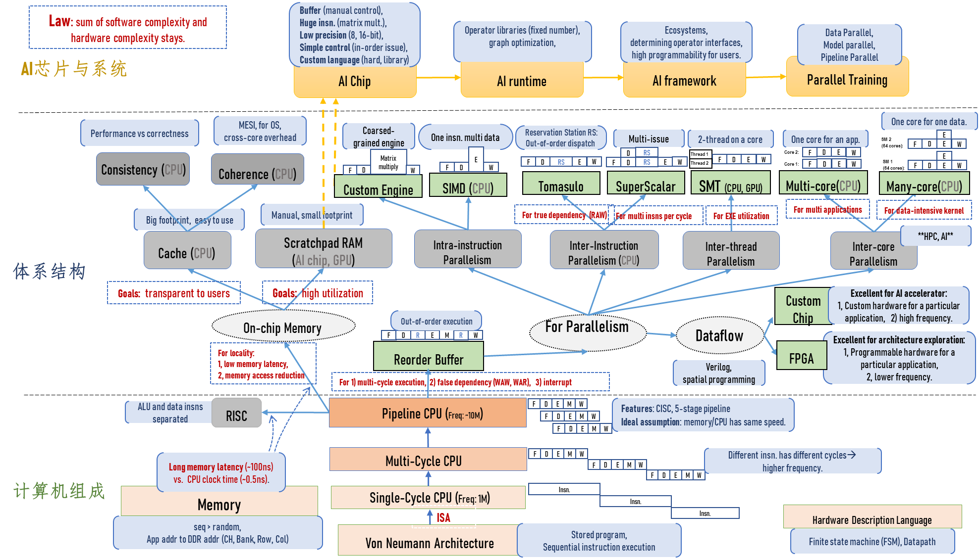
Where Are We?

Slide 16
The Memory Hierarchy

Slide 17
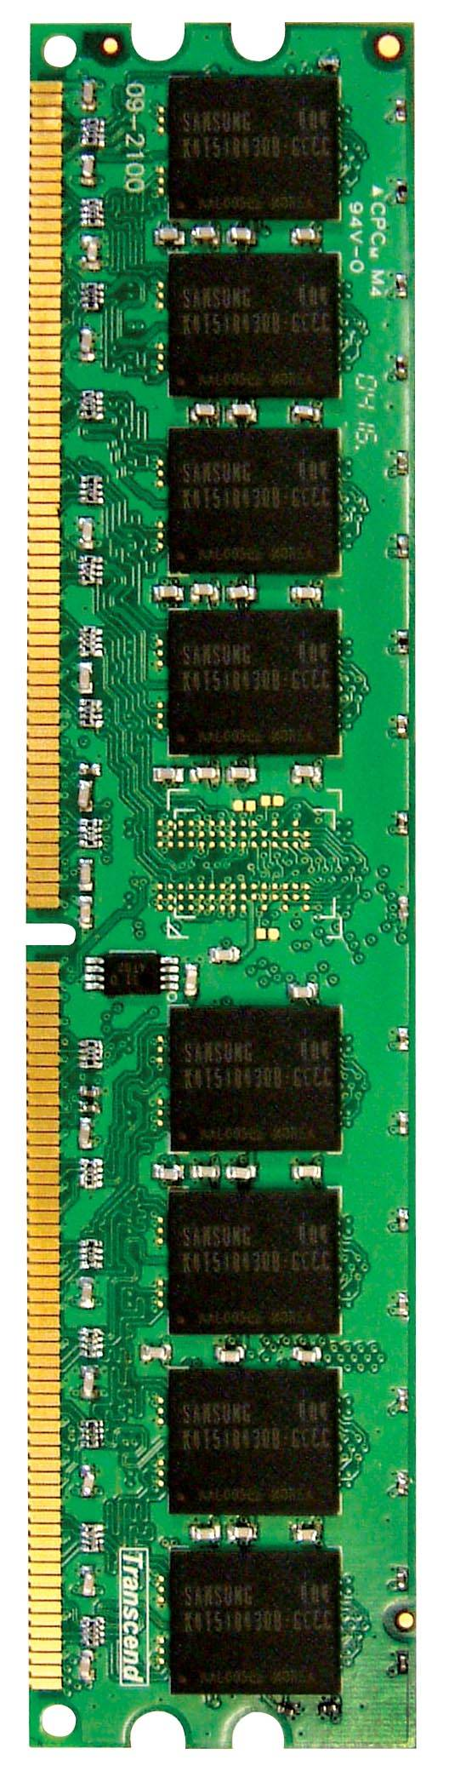
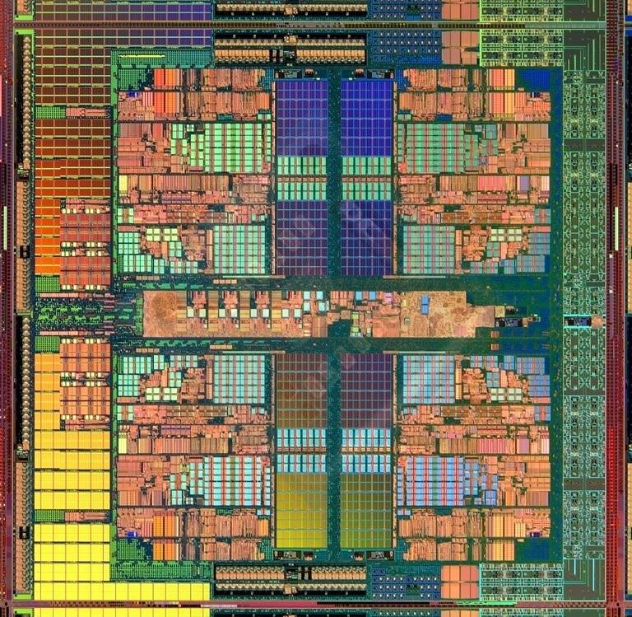
Memory Hierarchy in a Modern System (I)
CORE 0
L2 CACHE 1
CORE 1
L2 CACHE 0
SHARED L3 CACHE
DRAM INTERFACE
DRAM MEMORY CONTROLLER
DRAM BANKS
L2 CACHE 2
CORE 3
CORE 2
L2 CACHE 3
AMD Barcelona, circa 2006

Slide 18
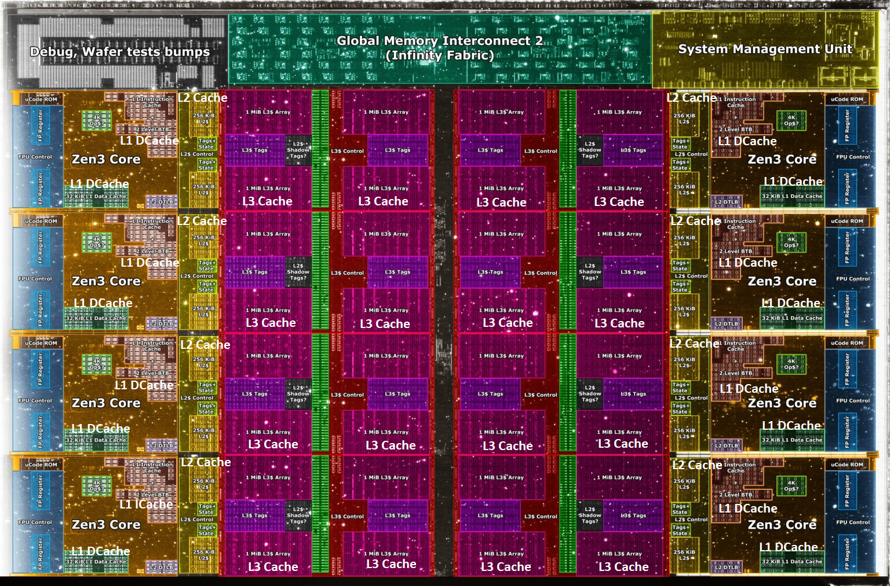
Memory Hierarchy in a Modern System (II)
Core Count:
8 cores/16 threads
L1 Caches:
32 KB per core
L2 Caches:
512 KB per core
L3 Cache:
32 MB shared
AMD Ryzen 5000, 2020
https://wccftech.com/amd-ryzen-5000-zen-3-vermeer-undressed-high-res-die-shots-close-ups-pictured-detailed/

Slide 19
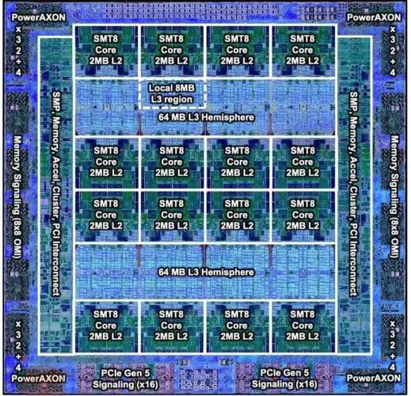
Memory Hierarchy in a Modern System (III)
IBM POWER10,
2020
Cores:
15-16 cores,
8 threads/core
L2 Caches:
2 MB per core
L3 Cache:
120 MB shared
https://www.it-techblog.de/ibm-power10-prozessor-mehr-speicher-mehr-tempo-mehr-sicherheit/09/2020/

Slide 20
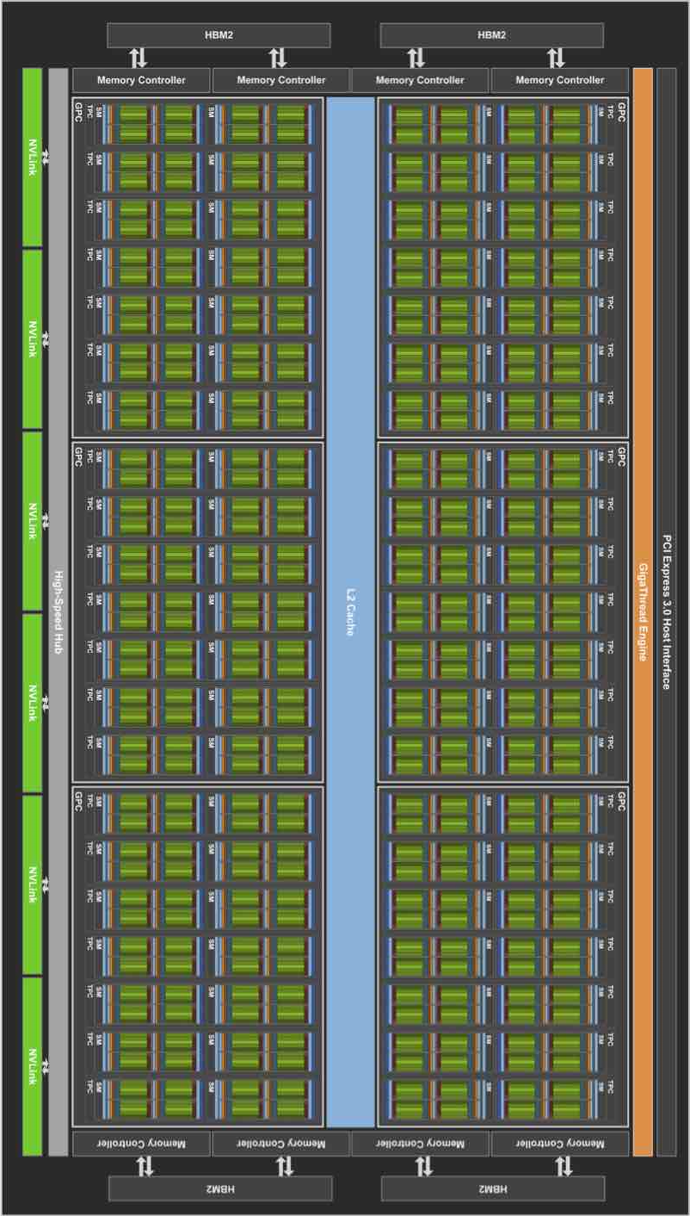
Memory Hierarchy in a Modern System (IV)
Cores:
108 Streaming Multiprocessors
L1 Cache or Scratchpad:
192KB per SM
Can be used as L1 Cache and/or Scratchpad
L2 Cache:
40 MB shared
Nvidia Ampere, 2020
https://www.tomshardware.com/news/infrared-photographer-photos-nvidia-ga102-ampere-silicon

Slide 21
Ideal Memory
Properties of ideal memory:
Zero access time (latency)
Infinite capacity
Infinite bandwidth (to support multiple accesses in parallel)
Zero cost

Slide 22
The Problem of Ideal Memory
Ideal memory’s requirements oppose each other
Bigger is slower
Bigger → Takes longer to determine the location
Faster is more expensive
Memory technology: SRAM vs. DRAM vs. SSD vs. Disk vs. Tape
Higher bandwidth is more expensive
Need more banks, more ports, more channels, higher frequency or faster technology

Slide 23
The Problem of Ideal Memory
Bigger is slower
SRAM, 512 Bytes, sub-nanosec
SRAM, KByte~MByte, ~nanosec
DRAM, Gigabyte, ~50 nanosec
PCM-DIMM (Intel Optane DC DIMM), Gigabyte, ~200 nanosec
PCM-SSD (Intel Optane SSD), Gigabyte, ~10 µs
Flash memory, Gigabyte~Terabyte, ~100 µs
Hard Disk, Terabyte, ~10 millisec
Faster is more expensive (dollars and chip area)
SRAM, < 0.3$ per Megabyte
DRAM, < 0.03$ per Megabyte
PCM-DIMM (Intel Optane DC DIMM), < 0.004$ per Megabyte
PCM-SSD, < 0.001$ per Megabyte
Flash memory, < 0.00008$ per Megabyte
Hard Disk, < 0.00003$ per Megabyte
These sample values (circa ~2021) scale with time
Other technologies have their place as well
MRAM, RRAM, STT-MRAM, … (not mature yet)

Slide 24
The Problem (Table View)
Bigger is slower
Memory Device | Capacity | Latency | Cost per Megabyte
SRAM | 512 Bytes | sub-nanosec
SRAM | KByte~MByte | ~nanosec | < 0.3$
DRAM | Gigabyte | ~50 nanosec | < 0.03$
PCM-DIMM (Intel Optane DC DIMM) | Gigabyte | ~200 nanosec | < 0.004$
PCM-SSD (Intel Optane SSD) | Gigabyte ~Terabyte | ~10 µs | < 0.001$
Flash memory | Gigabyte ~Terabyte | ~100 µs | < 0.00008$
Hard Disk | Terabyte | ~10 millisec | < 0.00003$
Faster is more expensive
(dollars and chip area)
These sample values (circa ~2021) scale with time

Slide 25
Aside: The Problem (2011 Version)
Bigger is slower
SRAM, 512 Bytes, sub-nanosec
SRAM, KByte~MByte, ~nanosec
DRAM, Gigabyte, ~50 nanosec
Hard Disk, Terabyte, ~10 millisec
Faster is more expensive (dollars and chip area)
SRAM, < 10$ per Megabyte
DRAM, < 1$ per Megabyte
Hard Disk < 1$ per Gigabyte
These sample values (circa ~2011) scale with time
Other technologies have their place as well
Flash memory (mature), PC-RAM, MRAM, RRAM (not mature yet)

Slide 26

Why Cache?
Challenge: DRAM latency is ~100ns, slightly decreasing over time.
Our Goal: CPU wants both fast (~1ns) and large memory (GB) without modifying user code.
Notes:
九品芝麻官电影

Slide 27
DRAM Capacity, Bandwidth & Latency
128x
20x
1.3x
Notes:
Latency issue is still there…

Slide 28
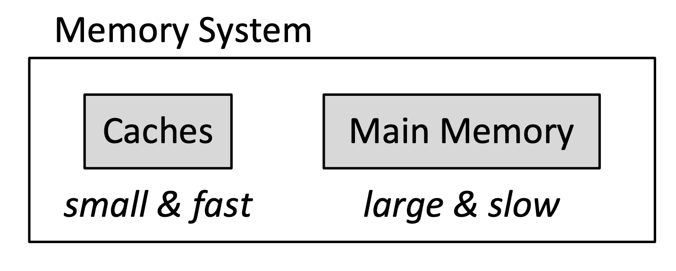
Why Cache?
Observation: we cannot achieve both with a single level of memory
Idea:
Have multiple levels of storage (progressively bigger and slower as the levels are farther from the processor) and
Ensure most of the data the processor needed is kept in the fast(er) level(s).

Slide 29
Memory Hierarchy
Fundamental tradeoff
Fast memory: small
Large memory: slow
Idea: Memory hierarchy.
Latency, cost, size,
bandwidth
Hard Disk
Main
Memory
(DRAM)
CPU
Cache
RF

Slide 30
The Memory Hierarchy
move what you use here
fast
small
With good locality of reference, memory appears as fast as
and as large as
faster per byte
cheaper per byte
backup
everything
here
large but slow

Slide 31
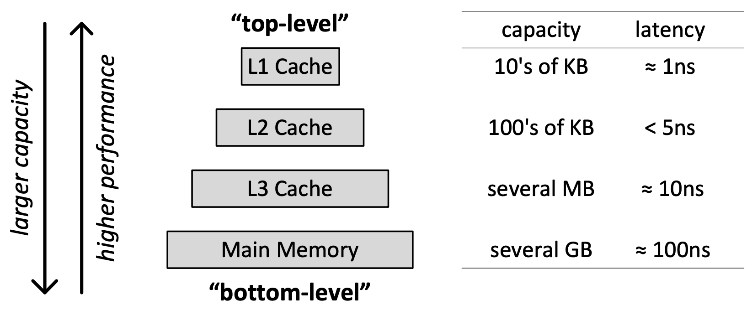
Memory Hierarchy Example
Kim & Mutlu, “Memory Systems,” Computing Handbook, 2014
https://people.inf.ethz.ch/omutlu/pub/memory-systems-introduction_computing-handbook14.pdf

Slide 32
Why Cache Works? Locality
Locality: One’s recent past is a very good predictor of his/her near future.
Temporal Locality: If you just did something, it is very likely that you will do the same thing again soon
since you are here today, there is a good chance you will be here again and again regularly
Spatial Locality: If you did something, it is very likely you will do something similar/related (in space)
every time I find you in this room, you are probably sitting close to the same people

Slide 33
Why Cache Works? Memory Locality
A “typical” program has a lot of locality in memory references
typical programs are composed of “loops”
Temporal Locality: A program tends to reference the same memory location many times and all within a small window of time
Spatial Locality: A program tends to reference nearby memory locations within a window of time
most notable examples:
1. instruction memory references → most sequential/streaming
2. references to arrays/vectors → often streaming/strided

Slide 34
Caching Basics: Exploit Temporal Locality
Idea: Store recently accessed data in automatically-managed fast memory (called cache)
Anticipation: same mem. location will be accessed again soon
Temporal locality principle
Recently accessed data will be again accessed in the near future
This is what Maurice Wilkes had in mind:
“The use is discussed of a fast core memory of, say 32000 words as a slave to a slower core memory of, say, one million words in such a way that in practical cases the effective access time is nearer that of the fast memory than that of the slow memory.”
Wilkes, “Slave Memories and Dynamic Storage Allocation,” IEEE Trans. On Electronic Computers, 1965.

Slide 35
Caching Basics: Exploit Spatial Locality
Idea: Store data in addresses adjacent to the recently accessed one in automatically-managed fast memory
Logically divide memory into equal-size blocks
Fetch to cache the accessed block in its entirety
Anticipation: nearby memory locations will be accessed soon
Spatial locality principle
Nearby data in memory will be accessed in the near future
E.g., sequential instruction access, array traversal
This is what IBM 360/85 implemented
16 Kbyte cache with 64 byte blocks
Liptay, “Structural aspects of the System/360 Model 85 II: the cache,” IBM Systems Journal, 1968.

Slide 36
The Bookshelf Analogy
Book in your hand
Desk
Bookshelf
Boxes at home
Boxes in storage
Recently-used books tend to stay on desk
Comp Arch books, books for classes you are currently taking
Until the desk gets full
Adjacent books in the shelf needed around the same time
If I have organized/categorized my books well in the shelf

Slide 37
Caching in a Pipelined Design
The cache needs to be tightly integrated into the pipeline
Ideally, access in 1-cycle so that load-dependent operations do not stall
High frequency pipeline → Cannot make the cache large
But, we want a large cache AND a pipelined design
Idea: Cache hierarchy
Main
Memory
(DRAM)
Level 2
Cache
CPU
Level1
Cache
RF

Slide 38
A Note on Manual vs. Automatic Management
Manual: Programmer manages data movement across levels
-- too painful for programmers on substantial programs
“core” vs “drum” memory in the 1950s
done in embedded processors (on-chip scratchpad SRAM in lieu of a cache), GPUs (called “shared memory”), ML accelerators, …
Automatic: Hardware manages data movement across levels, transparently to the programmer
++ programmer’s life is easier
the average programmer doesn’t need to know about caches
You don’t need to know how big the cache is and how it works to write a “correct” program! (What if you want a “fast” program?)

Slide 39
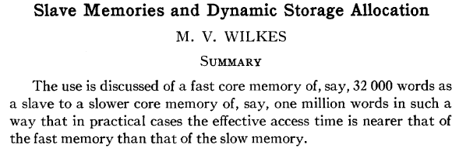
Automatic Management in Memory Hierarchy
Wilkes, “Slave Memories and Dynamic Storage Allocation,” IEEE Trans. On Electronic Computers, 1965.
“By a slave memory I mean one which automatically accumulates to itself words that come from a slower main memory, and keeps them available for subsequent use without it being necessary for the penalty of main memory access to be incurred again.”

Slide 40
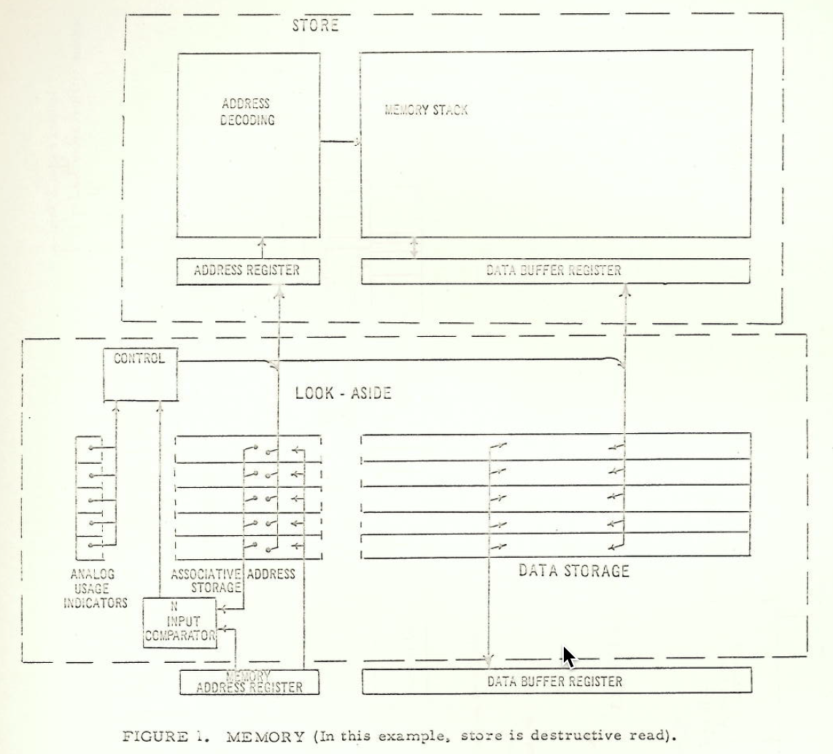
Cache in 1962 (Bloom, Cohen, Porter)

Slide 41
A Modern Memory Hierarchy
Register File
32 words, sub-nsec
L1 cache
~10s of KB, ~nsec
L2 cache
100s of KB ~ few MB, many nsec
L3 cache,
many MBs, even more nsec
Main memory (DRAM),
Many GBs, ~100 nsec
Swap Disk
~100 GB or few TB, ~10s of usec-msec
manual/compiler
register spilling
Memory
Abstraction
automatic
HW cache
management
automatic
demand
paging

Slide 42
Hierarchical Latency Analysis
For a given memory hierarchy level i it has a technology-intrinsic access time of t_{i,} The perceived access time T_{i} is longer than t_{i}
Except for the outer-most hierarchy, when looking for a given address there is
a chance (hit-rate hr_{i}) you “hit” and access time is t_{i}
a chance (miss-rate mr_{i}) you “miss” and access time t_{i} + T_{i+1}
hr_{i} + mr_{i} = 1
Thus
T_{i} = hr_{i}·t_{i} + mr_{i}·(t_{i} + T_{i+1})
T_{i} = t_{i} + mr_{i} ·T_{i+1}
hr_{i} and mr_{i} are defined to be the hit-rate and miss-rate of just the references that missed at L_{i-1}

Slide 43
Hierarchy Design Considerations
Recursive latency equation
T_{i} = t_{i} + mr_{i} ·T_{i+1}
The goal: achieve desired T_{i} within allowed cost
T_{i} ≈ t_{i} is desirable, when we
Keep mr_{i} low
increasing capacity C_{i} lowers mr_{i}, but beware of increasing t_{i}
lower mr_{i} by smarter cache management (replacement::anticipate what you don’t need, prefetching::anticipate what you will need)
Keep T_{i+1} low
faster lower hierarchies, but beware of increasing cost
introduce intermediate hierarchies as a compromise

Slide 44
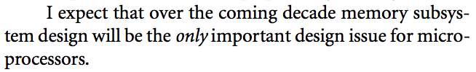
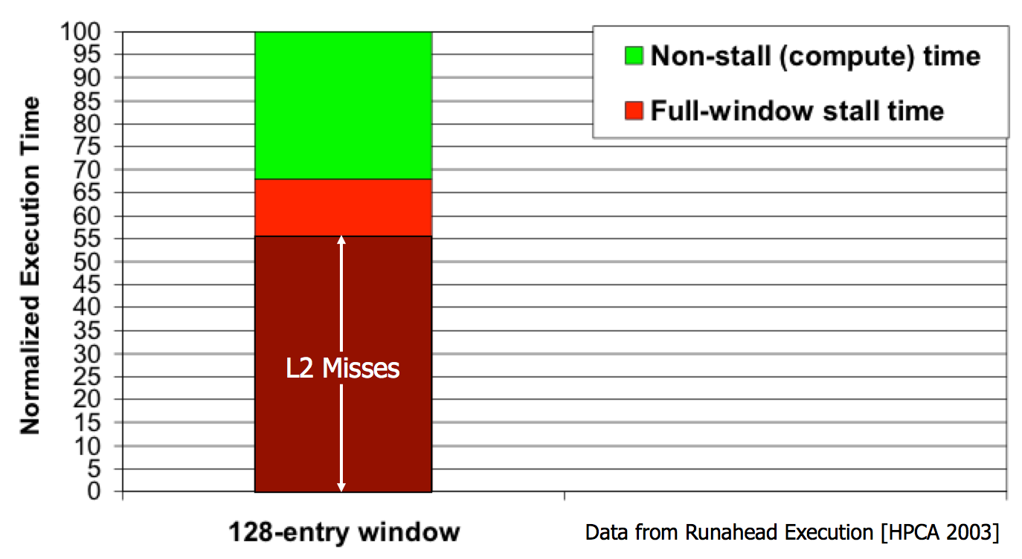
Memory Bottleneck
“It’s the Memory, Stupid!” (Richard Sites, MPR, 1996)
Mutlu+, “Runahead Execution: An Alternative to Very Large Instruction Windows for Out-of-Order Processors,” HPCA 2003.

Slide 45
Comparison of Latency: L1 of Intel CPU
Addr
Data
L1
L2
Memory
Really fast
L1: 1 cycle

Slide 46
Comparison of Latency: L2 of Intel CPU
Addr
Data
Addr
Data
L1
L1
L2
L2
Memory
Memory
Really fast
Moderate
L1: 1 cycle
L2: 14 cycles

Slide 47
Comparison of Latency: Memory of Intel CPU
Addr
Data
Addr
Data
Addr
Data
L1
L1
L1
L2
L2
L2
Memory
Memory
Memory
Really fast
Moderate
Extremely slow
L1: 1 cycle
L2: 14 cycles
Memory: 200 cycles

Slide 48
Cache Basics and Operation
Notes:
ISCA: international Symposium of cache architecture

Slide 49
Cache
Any structure that “memorizes” frequently used results/data
to avoid repeating the long-latency operations required to reproduce/fetch the results/data from scratch
e.g., a web cache
Most commonly in the processor design context: an automatically-managed memory structure
e.g., memorize in fast SRAM the most frequently or recently accessed DRAM memory locations to avoid repeatedly paying for the DRAM access latency

Slide 50
Blocks
Main memory logically divided into fixed-size chunks (blocks)
Cache can house only a limited number of blocks
Each block address maps to a potential location in the cache, determined by the index bits in the address
used to index into the tag and data stores
tag
index
byte in block
2b
3 bits
3 bits
8-bit address

Slide 51
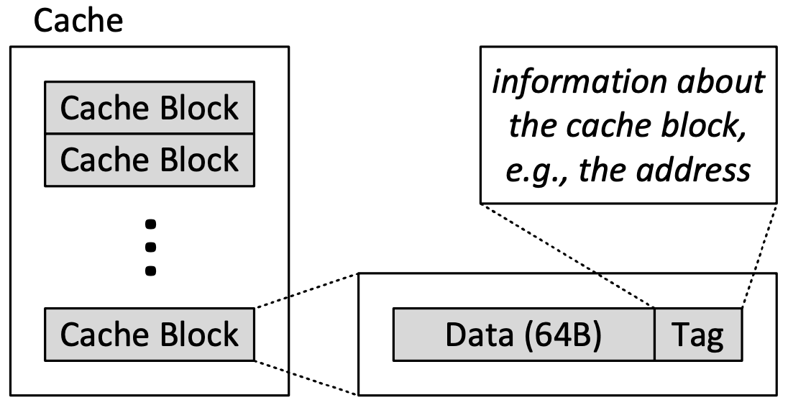
Conceptual Picture of a Cache
Kim & Mutlu, “Memory Systems,” Computing Handbook, 2014
https://people.inf.ethz.ch/omutlu/pub/memory-systems-introduction_computing-handbook14.pdf

Slide 52
Cache Abstraction and Metrics
Cache hit rate = (# hits) / (# hits + # misses) = (# hits) / (# accesses)
Average memory access time (AMAT)
= ( hit-rate * hit-latency ) + ( miss-rate * miss-latency )
Important Aside: Is reducing AMAT always beneficial for performance?
Address
Tag Store
(Valid bit +
Address tag +
Replacement policy bits)
Data Store
(stores
memory
blocks)
Hit/miss?
Data
Notes:
Reducing AMAT is not always beneficial for performance. The direct metric is instruction throughput, which might be orthogonal to latency.

Slide 53




Addressing the Cache
Cache access:
1) index into the tag and data stores with index bits in address;
2) checks valid bit in tag store;
3) compares tag bits in address with the stored tag in tag store;
4) If a block is in the cache (cache hit), the stored tag should be valid and match the tag of the block, and read out data.

Slide 54
A Toy Example for Cache
Toy example:
256-byte memory,
→ 8-bit address
64-byte cache, 8-byte blocks
→ least significant 3 bits within a line
Kim & Mutlu, “Memory Systems,” Computing Handbook, 2014

Slide 55
Caching Basics
Cache Block (line): Unit of storage in the cache
Memory is logically divided into blocks that map to potential locations in the cache.
On a reference:
HIT: If in cache, use cached data instead of accessing memory
MISS: If not in cache, bring block into cache
May have to evict some other block
For high cache hit rate, important cache design decisions:
Placement: where and how to place/find a block in cache?
Replacement: what data to remove to make room in cache?
Granularity of management: large or small blocks? Subblocks?
Write policy: what do we do about writes?
Instructions/data: do we treat them separately?

Slide 56
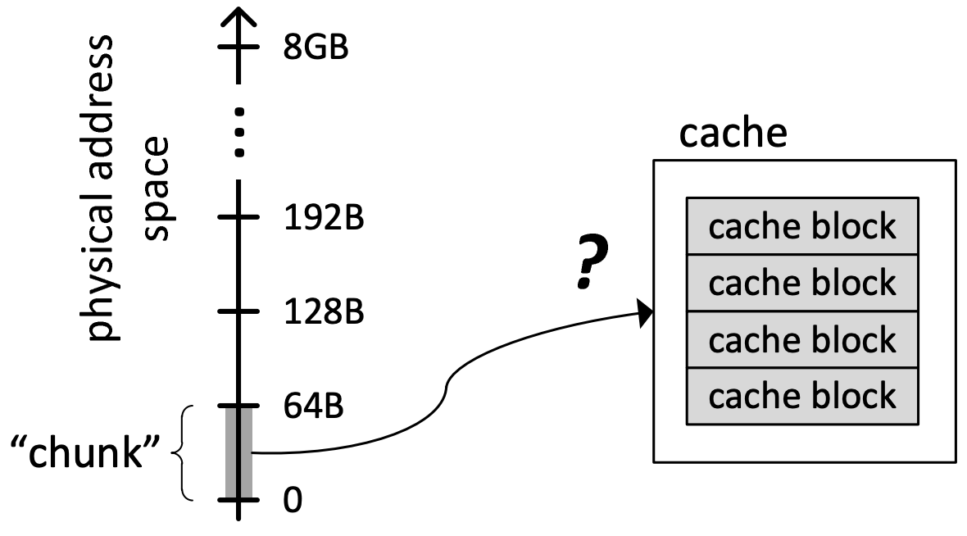
Cache: Placement
A key question: How to map chunks of the main memory address space to blocks in the cache?
Which location in cache can a given “main memory chunk” be placed in?

Slide 57
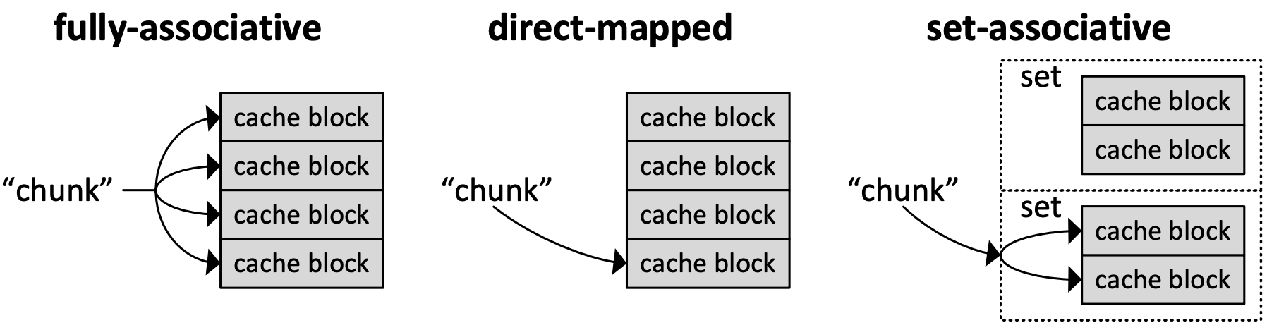
Three Cache Organization Methods
Direct-mapped:
A chunk can go to only one cache block in the cache. (Another extreme)
Fully-associative:
A chunk can go to any cache block in the cache. (One extreme)
Set-associative:
A chunk can go to N cache blocks in the N-way set-associative cache. (Best choice)
Kim & Mutlu, “Memory Systems,” Computing Handbook, 2014

Slide 58
Direct-Mapped Cache: Placement and Access
Block: 00000
Direct-mapped (A block can go to only one location)
Assume memory: 256 bytes, 8-byte blocks → 32 blocks
Assume cache: 64 bytes, 8 blocks
Blocks with same index contend for the same cache location
Cause conflict misses when accessing blocks in green consecutively
Block: 00001
Block: 00010
Block: 00011
Block: 00100
Block: 00101
Block: 00110
Block: 00111
Block: 01000
Block: 01001
Block: 01010
Block: 01011
tag
set
byte in block
Block: 01100
Block: 01101
2b
3 bits
3 bits
Tag store
Data store
Block: 01110
Block: 01111
Address
Block: 10000
Block: 10001
Block: 10010
Block: 10011
Block: 10100
Block: 10101
Block: 10110
V
tag
Block: 10111
Block: 11000
Block: 11001
byte in block
Block: 11010
=?
MUX
Block: 11011
Block: 11100
Block: 11101
Hit?
Data
Block: 11110
Block: 11111
Main memory:

Slide 59
Advantage and Issue of Direct-Mapped Caches
Direct-mapped cache:
Two blocks in memory that map to the same index in the cache cannot be present in the cache at the same time.
One index → one entry
Main advantage of direct-mapped cache:
Easy to implement
Main issue of direct-mapped cache:
Can lead to 0% hit rate if more than one block accessed in an interleaved manner map to the same index
Assume addresses A and B have the same index bits but different tag bits
A, B, A, B, A, B, A, B, … → conflict in the cache index
All accesses are conflict misses

Slide 60
Three Cache Organization Methods
Direct-mapped:
A chunk can go to only one cache block in the cache. (Another extreme)
Fully-associative:
A chunk can go to any cache block in the cache. (One extreme)
Set-associative:
A chunk can go to N cache blocks in the N-way set-associative cache. (Best choice)
Kim & Mutlu, “Memory Systems,” Computing Handbook, 2014

Slide 61
Full Associativity
Fully-associative cache
A block can be placed in any cache location
Address
tag
byte in block
5 bits
3 bits
Tag store
=?
=?
=?
=?
=?
=?
=?
=?
Logic
Hit?
Data store
MUX
MUX
byte in block

Slide 62
Advantage and Issue of Fully-associative Caches
Fully-associative cache:
A block can be placed in any cache block.
Main advantage of fully-associative cache:
Highly utilization of cache blocks (global view)
Main issue of fully-associative cache:
Can lead to extremely difficult to implement when the number of cache blocks in the cache is large.
Number of cache blocks in modern CPU reaches 32M/64=512K.
Choosing one out of 512K cache lines is extremely costly.

Slide 63
Three Cache Organization Methods
Direct-mapped:
A chunk can go to only one cache block in the cache. (Another extreme)
Fully-associative:
A chunk can go to any cache block in the cache. (One extreme)
Set-associative:
A chunk can go to N cache blocks in the N-way set-associative cache. (Best choice)
Kim & Mutlu, “Memory Systems,” Computing Handbook, 2014
Notes:
相连

Slide 64
2-way Set-Associative Cache: Structure
Set-Associative Cache
A block can be placed in any of N blocks of N-way set-associative cache
Example of 2-way cache:
Instead of having one column of 8, have 2 columns of 4 blocks
Address:
tag
set
byte in block
3 bits
2 bits
3 bits
Tag store
2-way SET
Data store
V
tag
V
tag
=?
=?
MUX
Logic
MUX
byte in block
Hit?

Slide 65
4-way Set Associativity
Address
4-way
+ Likelihood of conflict misses even lower
-- More tag comparators and wider data mux; larger tags
tag
set
bytes
Tag store
4 bits
1 b
3 bits
V
tag
V
tag
V
tag
V
tag
=?
=?
=?
=?
Logic
Hit?
Data store
MUX
MUX
byte in block

Slide 66
Set-Associative Cache: Advantage and Issue
Set-Associative Cache
Key Idea: Associative memory within the set
Advantage of Set-Associative Cache
Accommodates conflicts better (fewer conflict misses)
Assume addresses A and B have the same index bits but different tag bits
A, B, A, B, A, B, A, B, … → store in the cache set
All accesses are cache hit
Issue of Set-Associative Cache
More complex, slower access, larger tag store
How about in Deep Learning application？

Slide 67
Associativity (and Tradeoffs)
Degree of associativity:
How many blocks can map to the same index (or set)?
Higher associativity
++ Higher hit rate
-- Slower cache access time (hit latency and data access latency)
-- More expensive hardware (more comparators)
Diminishing returns from higher
associativity
hit rate
associativity

Slide 68
Memory Roofline Model
Memory Roofline Model:
DRAM: limited memory bandwidth;
HBM: medium memory bandwidth;
Cache: large memory bandwidth
Peak Flop/s
HBM GB/s
Cache GB/s
Throughput (Flop/s)
DRAM GB/s
Arithmetic Intensity (Flop:Byte)
9
Williams, Waterman, Patterson, “Roofline: An Insightful Visual Performance Model for Multicore Architectures”, CACM, 2009
Notes:
All these works rely on many different methodology's to identify memory bottlenecks in a system. Often, such methodologies are intuitively used as a indication of NDP suitability for a given application
[CLICK] However, as I will show next, none of those models are comprehensive enough to identify memory bottlenecks and NDP suitability. This happens because these models are built targeting to identify specific sources of data movement bottlenecks, and often their definitions of compute and memory bound are not enough to indicate NDP suitability.
[CLICK] For that, we will analyze two commonly used approaches: the roofline model, which correlates the arithmetic intensity of an application with performance,
[CLICK] and identifying application that has high misses-per-kilo instructions or MPKI.
[NEXT]

