Slide 1
House Rental Website

Slide 2
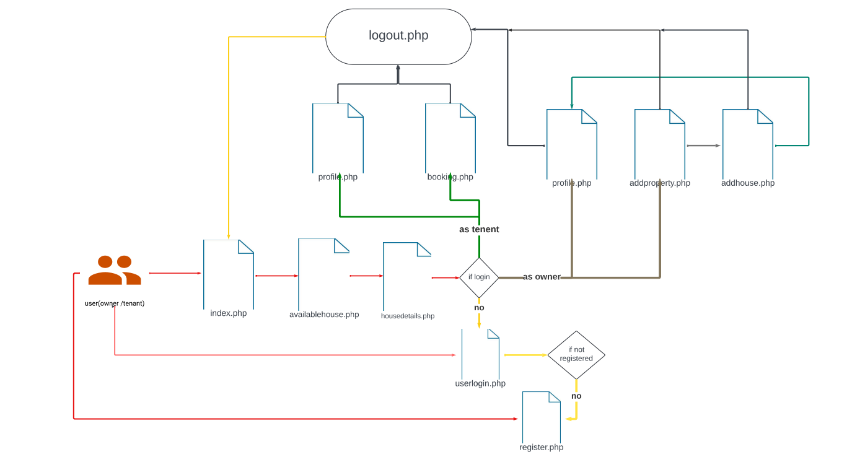
Use case Diagram

Slide 3
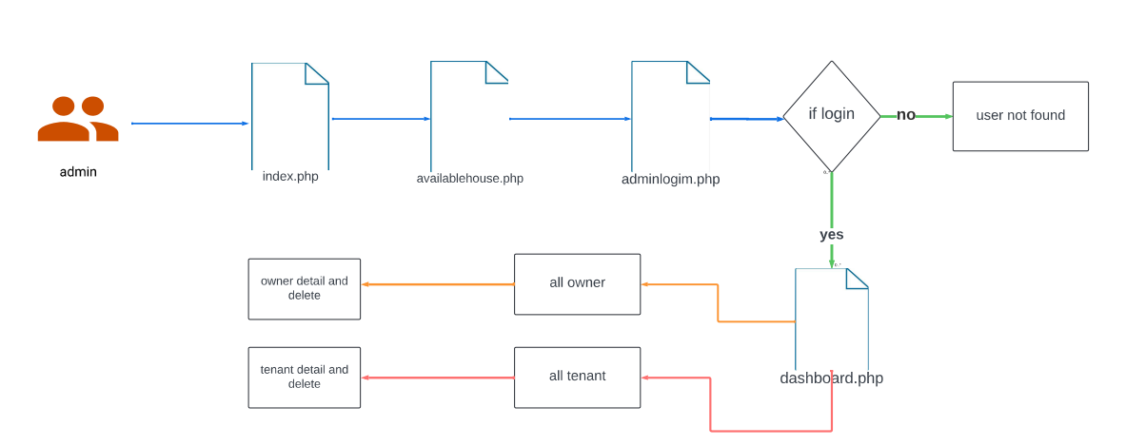
For Admin

Slide 4
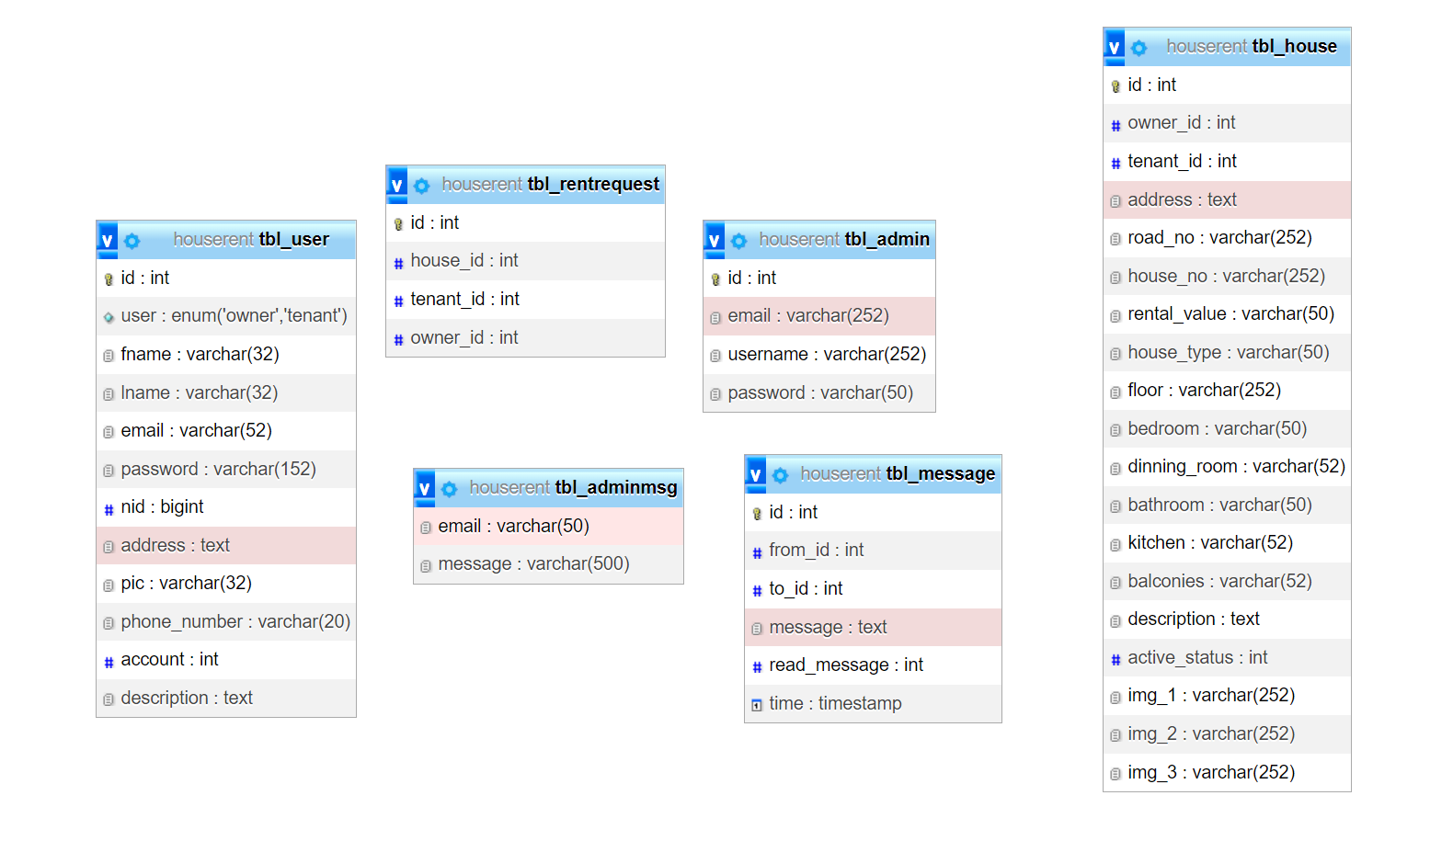
Database Structure

