Slide 1
Source Control
Git and Github

Slide 2
Purpose
Keep track of all changes
Work together on same project without hindering each other
Easily get Peer review
Compare files from previous versions or different builds
Efficient Merge from Production to Release
And more…

Slide 3
Source Controls
SVN (Subversion)
GIT
Our Focus
Github
Mercurial
…

Slide 4
GUI VS Console
Graphical User Interface VS Command Line Console
GUI is friendly to a new user.
In the end, they both initiate the same commands.
What is important in this case is to understand the command required.
In my honest opinion, the Gui’s aren’t solid. Filled with Issues.
It could be that they don’t rely the errors correctly.
They are missing functionality.
Or just simply they have errors.

Slide 5
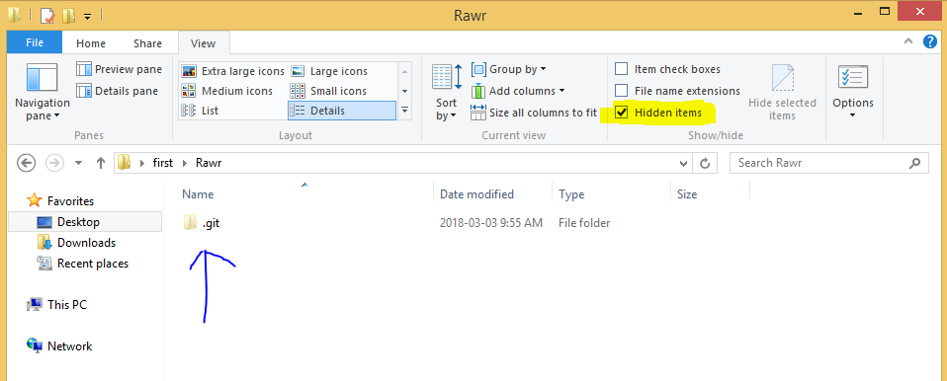
GIT Getting Started
Git init [project-name]
Creates the git folder in your directory
This hidden folder tracks all changes
Also, applies all changes to your directory.
Fresh project that you are initializing.
Git clone [url]
Downloads from server all the files in your project and all the change history
A Project that has been started and pushed onto the server.

Slide 6
GIT Getting Started
In that folder:
All changes are tracked.
It will up to you to commit that change and push it to the server.

Slide 7
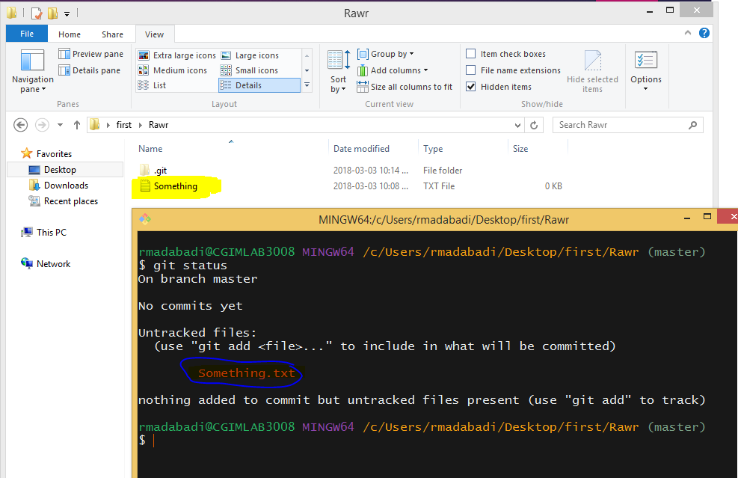
GIT Status
Git status:
View all changes
Notice something.txt
It is in RED
Meaning Untracted.

Slide 8
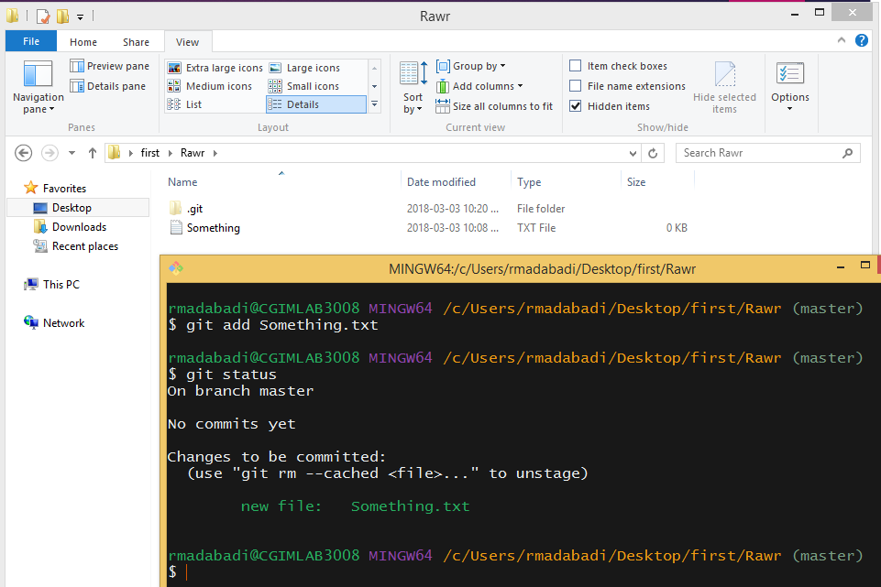
GIT Add
Git add [filename]
Adds the file to be tracked.
Notice it is GREEN.
Ready to be commited.

Slide 9
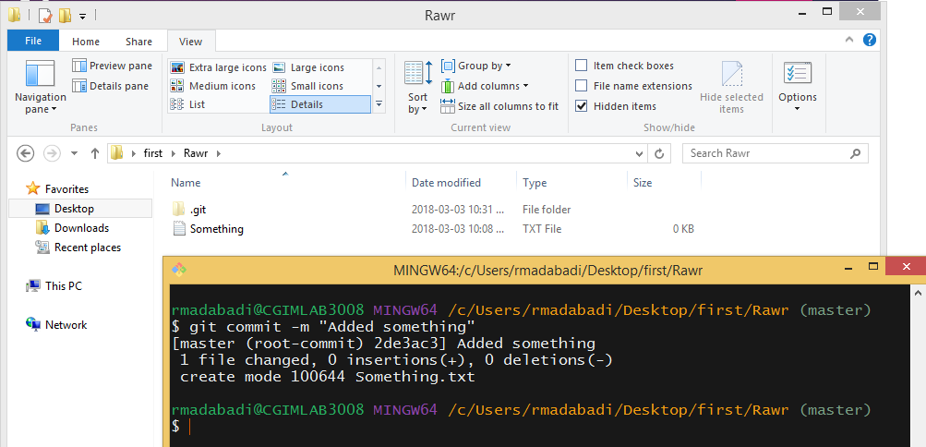
GIT Commit
Git commit –m “description”
Stores the current contents.
It is stored in the LOCAL database.

Slide 10
GIT push
Git push
Sends your commits to the Server
You need to make sure you have a server to push to.

Slide 11
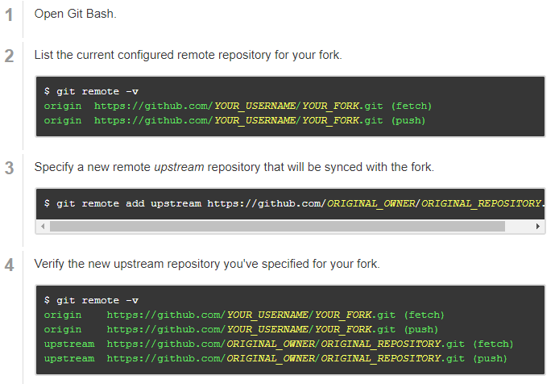
GIT remote
Git remote -v
Shows you all the upstream you currently have connected.
Git remote add [name] [url]
Adds an upstream with that name that is connected to that server.

Slide 12
GIT fetch and pull
Git fetch
Download all history from repo(server)
To apply those changes you need to do git merge
Git pull
Download all history and incorporate changes.

