Slide 1

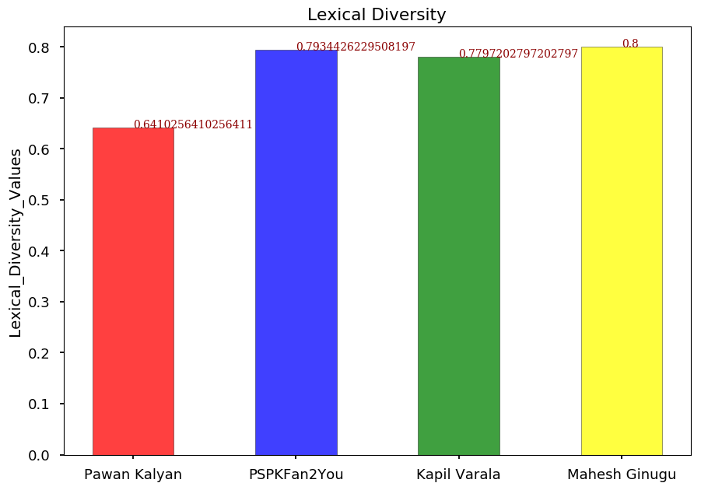
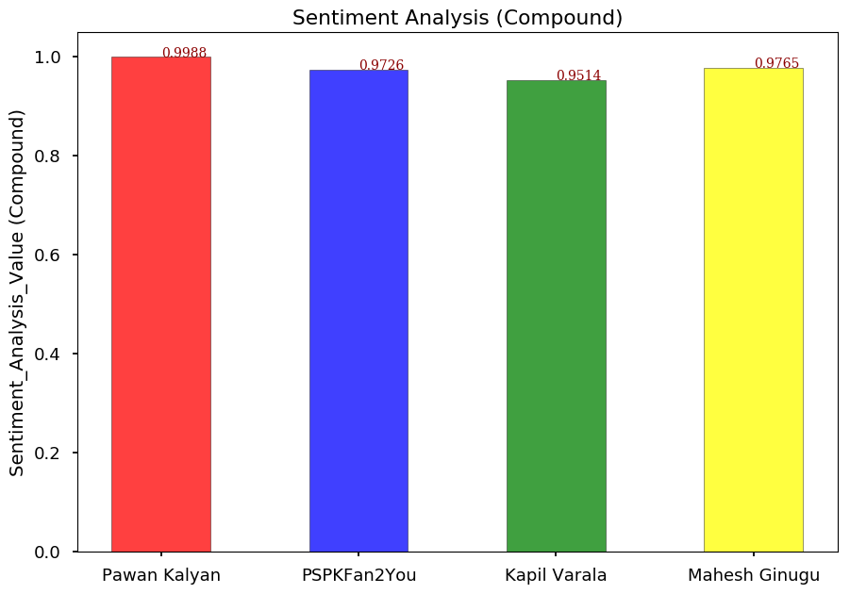


A Comparison of Celebrity Tweets to the Tweets of Their Fans
Priyanka Galla
Northwest Missouri State University
Question
Results
Conclusion
Do the tweets of Pawan Kalyan, one of the famous celebrities in Andhra Pradesh, India and his fans resemble each other and whether they share similar styles in their tweets?
Hypothesis
I believe there will be a correlation between the tweets of the celebrities and those of their fans.
Project Overview
Record all tweets from the twitter account of PawanKalyan and 3 of his fans (PSPKFan2You, Kapilvarala and MaheshGinugu).
Analyze the stored data for lexical diversity and sentiment analysis
Compare these analyses and determine if there is a correlation among the tweets.
Acknowledgements
Created for Dr.Nathan Eloe for web mining course.
Bibliography, Additional Resources
GitHub Link
Used the Twitter Api for collecting and storing data.
Mathplot.lib for plotting bar graph
https://github.com/44520-s19/wm-final-project-GallaPriyanka

