Slide 1

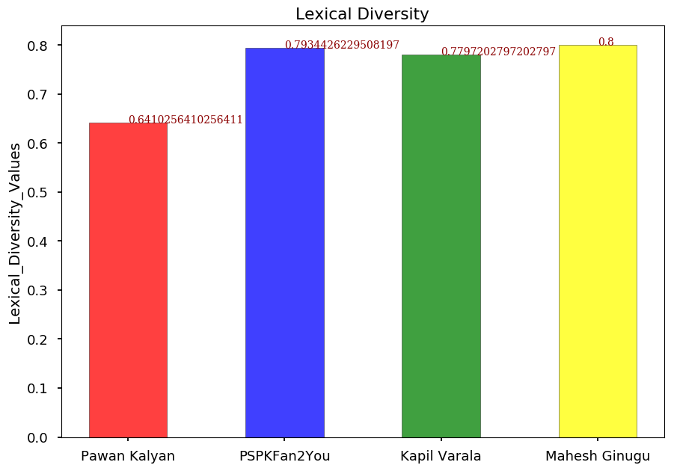
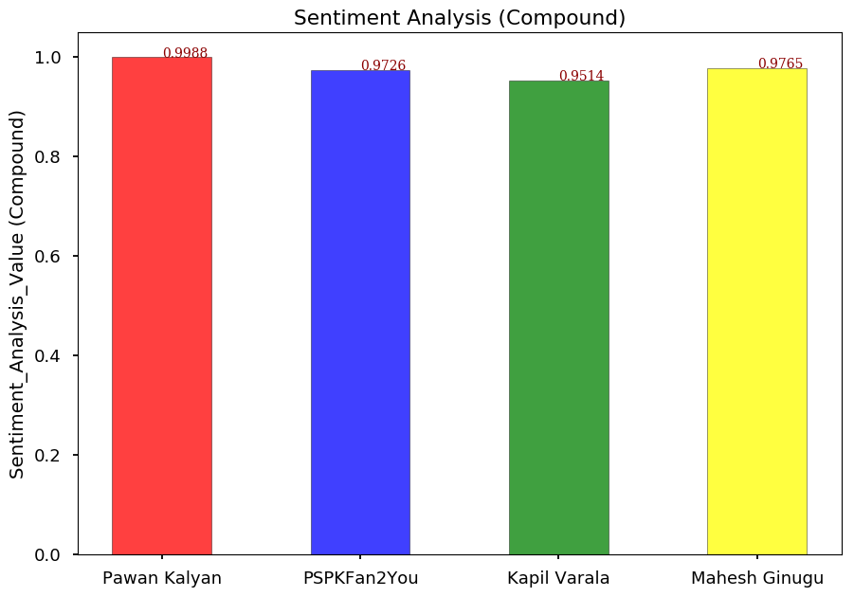


A Comparison of Celebrity Tweets to the Tweets of Their Fans
By: Priyanka Galla | Advisor: Dr. Nathan Eloe
Email: s534884@nwmissouri.edu
Question
Results
Conclusion
Do the tweets of Pawan Kalyan, one of the prominent personalities in Andhra Pradesh, India and his fans resemble each other and whether they share similar styles in their tweets?
Based on the results presented, there is a clear correlation between the style of the famous personalities and his fans.
The Sentiment Analysis results of the fans are very close to those of the celebrity, with very negligible differences among each other as well, thus strongly supporting my hypothesis.
The Lexical Diversity results of the fans did show a slight increase from those of the celebrity and do not strongly support my hypothesis.
However, this variation is only a smaller one and so it can be deduced from the results that, the tweets of the prominent personalities and those of their fans are similar in most cases with a slightly more diversity in the tweets of the fans when compared to the celebrity.
Hypothesis
I believe there will be a correlation between the tweets of the prominent personalities and those of their fans.
Project Overview
Record all tweets from the twitter account of PawanKalyan and 3 of his fans (PSPKFan2You, Kapilvarala and MaheshGinugu).
Analyze the stored data for lexical diversity and sentiment analysis
Compare these analyses and determine if there is a correlation among the tweets.
Acknowledgements
GitHub Link
Bibliography, Additional Resources
Created for Dr.Nathan Eloe for web mining course.
https://github.com/44520-s19/wm-final-project-GallaPriyanka
Used the Twitter Api for collecting and storing data.
Mathplot.lib for plotting the bar graphs.

