Slide 1
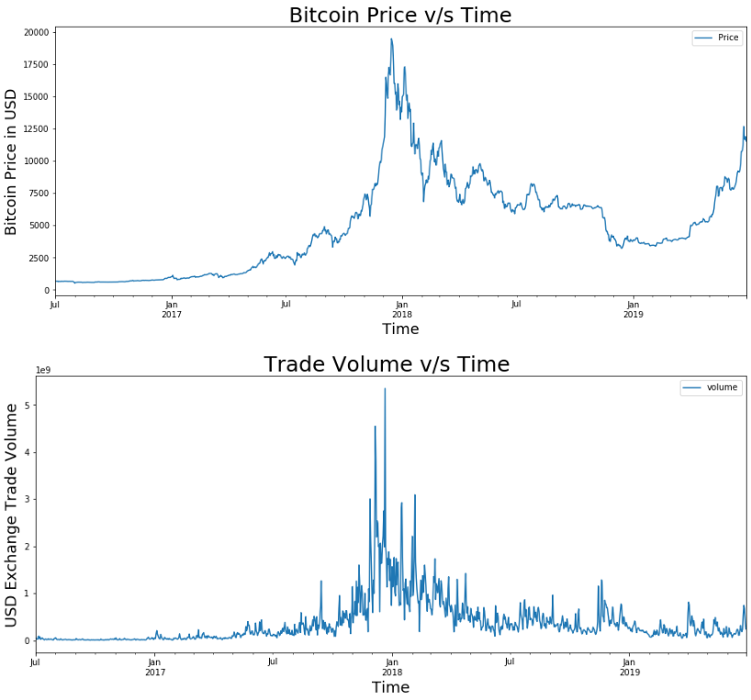
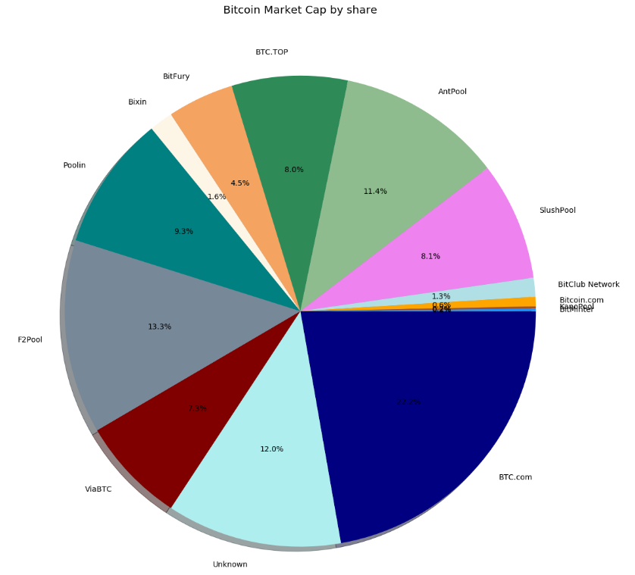
Bitcoin Price Ticker
Rohit Saidugari | Dr. Nathan Eloe | Northwest Missouri State University
Project Objective
Results
Results
The objective of the project is to determine the correlation between BitCoin price and BitCoin trade volume and also determine the distribution of BitCoins across some platforms who provides the trading services to users over the past 3 years.
Procedure
Capture the data from blockchain.info’s api
Extract useful information from raw data and store them in a csv file as a time series data
Use Exported time series data to plot graphs of Bitcoin price vs time and trade volume vs time and visualize it using pandas and matplotlib
For the Pie charts use matplotlib to plot graph
Modules used
The following modules has been used in this project.
Requests, Json, Objectpath, Datetime, Csv, Itertools, Pandas, matplotlib
Data / Observations
Conclusion
Works Cited
Observation 1: BitCoin price reached its maximum in December 2018 and dropped sharply.
Observation 2: Over the past 3 years there is an increasing trend in the price of BitCoin.
Observation 3: Trade volume is very high in between November 2018 and January 2019.
Observation 4: Btc.com has highest market share of BitCoin
From time series charts we can see a trend of increasing trade volume with increase in bit coin price. When the price is at its highest, users tend to trade a lot .
The pie chart shows the respective percentages of market share of the most popular bitcoin mining pools.
Includes data from blockchain.info api.
Notes:
To change this poster, replace our sample content with your own. Or, if you'd rather start from a clean slate, press the New Slide button on the Home tab to insert a new page. Now enter your text and pictures in the empty placeholders. If you need more placeholders for titles, subtitles or body text, copy any of the existing placeholders, then drag the new one into place.

