Slide 1

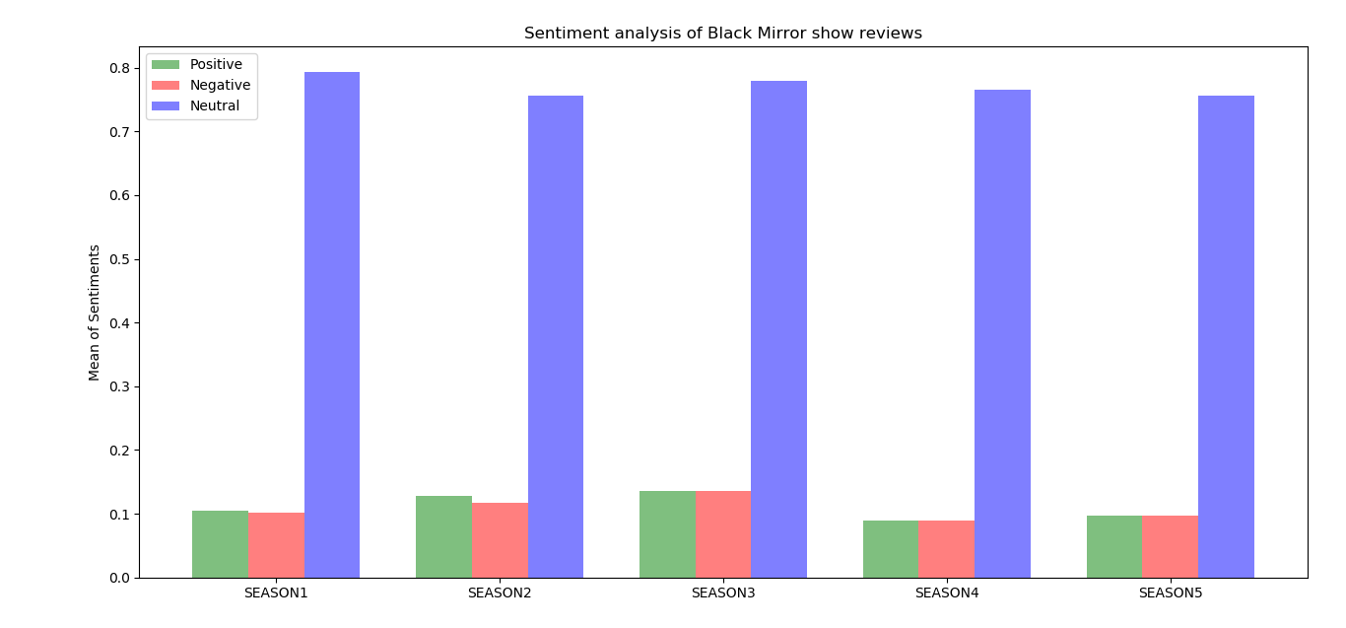
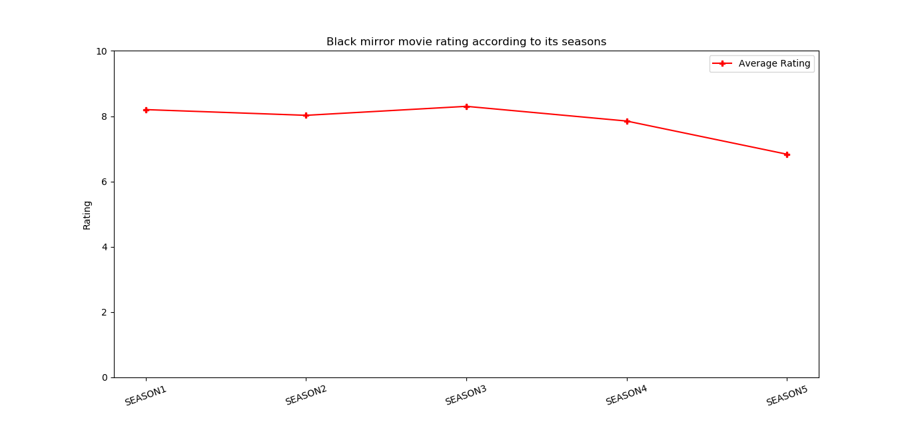

IMDb Movie Analysis
Sai Samrat Adloori
Email: S534568@nwmissouri.edu
Introduction
Results
Conclusion
I thought that it would be interesting to analyze the movies data on the IMDB. I predicted a movie based on the user ratings and reviews
Black Mirror is one of the famous web series. After analyzing this movie had a good start with a rating of approx.(8) until season 3. And started to decrease gradually from season 3.Most of the viewers found Black mirrors was interesting show for the first two seasons.
when we compare line graph with bar graph even though ratings went down but the comments on the movie are still neutral.
Data Collection
Retrieved data from IMDb using the IMDb package with the help of movie ID
Working
installed IMDb packages.
Retrieved data according to Seasons and episodes from IMDb website.
Getting reviews and rating according to seasons and episodes. And calculating their mean
Applied sentiment analysis on rating and reviews.
Resources
Resources
IMDb website: https://www.imdb.com/?ref_=nv_home
Natural Language Toolkit (sentiment analysis): ntlk.org
https://github.com/44520-s19/wm-final-project-SAISAMRATADLOORI.git

