Slide 1
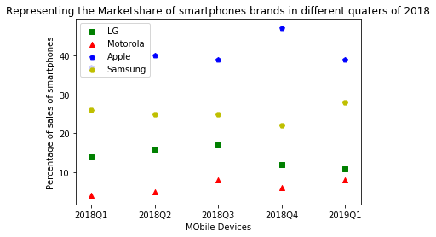

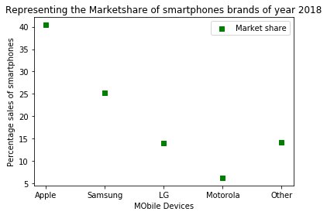
ANALYSIS OF MOBILE DEVICE SALES Subodh Bhargav Lakhinana Advisor: Dr. Nathan Eloe Applied Computer Science | Northwest Missouri State University
Objective
Data
Results
The main objective of the project is to
represent the brand that took the highest
market share in the smartphone sales
over the year of 2018 in USA
The data that is retrieved through web scrapping provides us with the information of market shares of different mobile devices brands in different quarters of 2018.
Market share is the percentage of sales off smart phones devices
Abstract
s
Tools/Methodology
Mobiles are the most commonly used electronic devices in the last decade . There are many brands and companies that came up. Analyzing the sales of these companies is useful in estimating the competition.
Representing:
the market shares of mobile devices over different quarters in the year if 2018
Overall market shares of different brands in 2018
Jupyter Notebook as online editor to execute the code
Python as scripting language
Web scraping methodology is used to get the data from internet.
BeautifulSoup and requests to read the data
Maplotlib for visualizing the data
Procedure
Results
Conclusions
Retrieve the data using web scraping
Traversing through the data to gather the relevant information
Cleaning the data by segregating the relevant data into different lists
Analysis of the cleansed data to find the overall market share of the brands
Visualization of the results
The first graph represents the market share of mobile device brands in different quarters. As the graph represents sales of different brands like Apple, Samsung, LG , Motorola and other devices.
The second graph represents the overall market share of each brand in 2018. Apple holding the highest shares of 40.4%, Samsung being the second with 25.2 % of sales and other brands apart from LG and Motorola holds the third position with 14.2%
Mobile device sales in USA are mainly operator-driven, analyzing these details will provide more insight on the market
Data is analyzed to see which smart phone brand has the highest market share and which leads the competition of mobile sales in 2018.
Data represents the percentage of sales of different mobile device brands
This data can be used to analyze our objective
According to the sales of 2018., Apple company holds the highest market share in USA
Where as Motorola has the lowest share of 6.2
Notes:
To change this poster, replace our sample content with your own. Or, if you’d rather start from a clean slate, use the New Slide button on the Home tab to insert a new page, then enter your text and content in the empty placeholders. If you need more placeholders for titles, subtitles or body text, copy any of the existing placeholders, then drag the new one into place.

