Slide 1

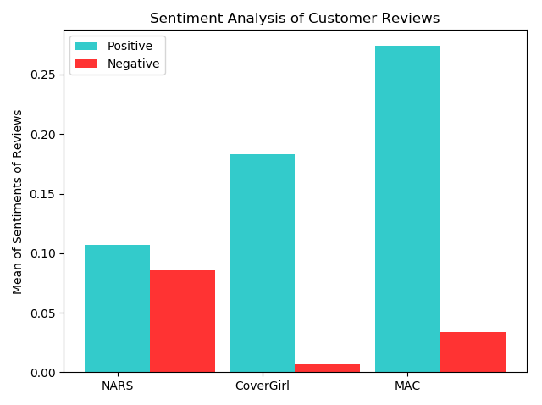
Sentimental Analysis for Reviews of Beauty Products of Different Brands on Amazon
Sushma Rani Reddy Aleti
Email: S534741@nwmissouri.edu
Introduction
Results
Conclusion
The main aim of this project is to analyze the reviews given by the customers based on the three different brands of a product on popular Amazon website.
sds
On Comparing the three different beauty products such as NARS, CoverGirl and MAC, the conclusions drawn were:
MAC has got most positive number of reviews compared to NARS and CoverGirl.
CoverGirl has got the second most positive reviews and is also the first most product which has got the least negative reviews Compared to NARS and MAC.
Finally, NARS is the product which has less positive reviews than CoverGirl and MAC and highest negative reviews compared to both the other products.
On the whole, customers will easily identify which product has got more number of positive reviews and hence could choose the product.
Procedure
Here, I used Web Scraping to fetch the product data from Amazon website.
I have used matplotlib to obtain the bar graph for the different beauty products.
I have also used Natural Language Toolkit (NLTK) which is one of the popular packages in Python that can aid in sentiment analysis.
Additional Resources
Repository
Matplotlib.pyplot.bar: https://matplotlib.org
Links to the different products: Luminous Weightless Foundation-#3 , Fluid Foundation SPF15
Ageless Foundation
Logo Link: amazon logo
GitHub

