Slide 1

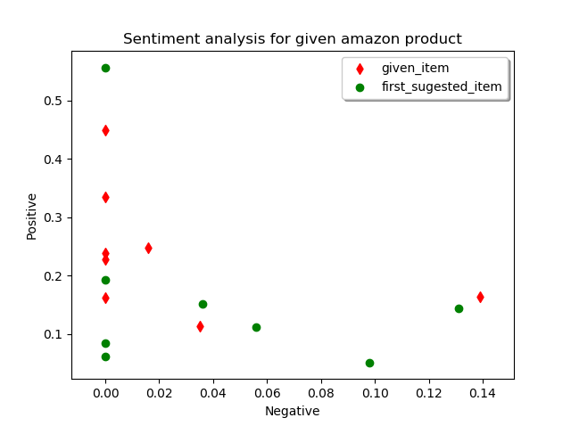
Amazon Product review Analyzer with first similar product
Subrahmanya Sai Bharadwaj Gandrakota | Advisor : Dr. Nathan Eloe
School of Computer Science and Information Systems | Northwest Missouri State University
Objective
Automatically retrieves the first suggestion product and retrieve the product details and customer reviews
Apply sentiment analysis on the customer reviews and plot them in 3d graph such that most of the positive reviews for a product will be in the positive axis
Screen shot showing the it automatically retrieves the first suggestion product details
How you gona choose a product in amazon site ?
Usually we will search for category of the required product
we will look into ratings which are given by the users who already purchased it.
This project makes an advantage to the people who would like to compare the reviews
this project will take an product url as an input to the flow retrieves the title and price details and customer reviews of given product and first product in the suggestions (similar) products
so there will be a compression of two identical products
Results
Conclusion
Below 2D pot shows the analysis of the customer reviews and first suggested product
With this application I have performed sentiment analysis
on customer reviews of given product and first product in the suggestion list
As the input product is 2017 HP Chromebook 11.6 inch Premium Flagship Laptop as input suggestion was HP 15-bs234wm Intel Pentium N5000 Quad Core
After applying analysis from the graph can conclude that
the given product has more positive reviews than suggested product
Procedure
Scrap the given amazon product page and get the details of the product
Retrieve the customer reviews from the given page and apply the sentiment analysis

