Slide 1
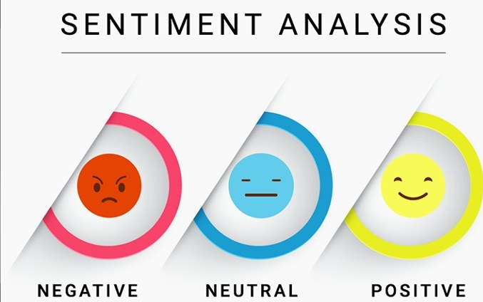
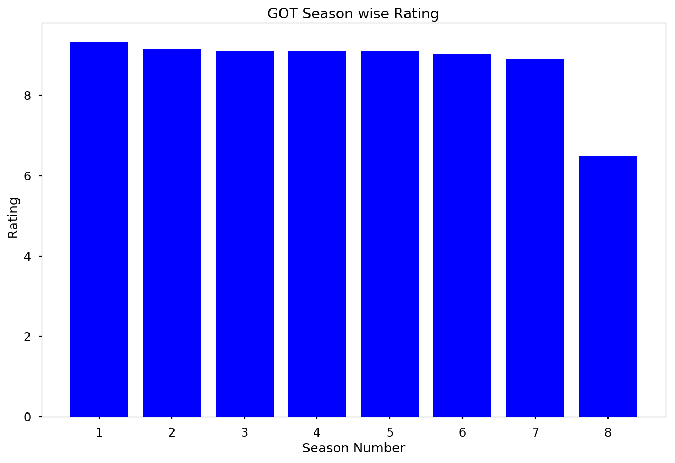
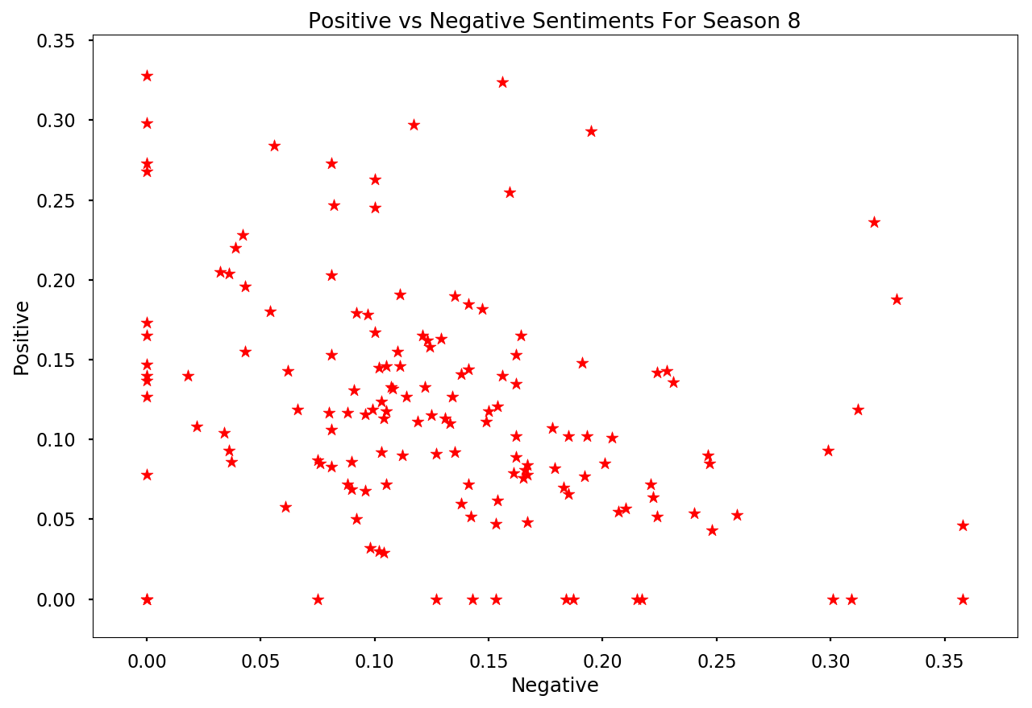

Sentimental Analysis Of User Reviews For Game of Thrones
Rajesh Kammari
EMAIL: S534844@NWMISSOURI.EDU
Question
Results
Conclusions
What is the growth rate of rating of Game of thrones series.
What is the sentimental Analysis of season 8 of User Reviews.
From the histogram, we can clearly see that season 1-7 ratings were steady.
Rapid decrease of season 8 rating can be observed from bar graph.
The user reviews found to be polarized that is they have mutually exclusive opinions.
From this we can conclude that most of users were not satisfied with season 8 as compared to rest of the seasons .
Methods
Using IMDbPY package imported the user reviews and ratings of all seasons into separate lists.
Using sentimental Analyzer analyzed the data.
Visualized the analysis in Scatterplot using matplotlib
Represented rating of each season in a histogram.
Additional Resources
Acknowledgements
Poster Repository
IMDbPY package,Natural Language Toolkit, SentimentIntensityAnalyzer
https://imdbpy.readthedocs.io/en/latest/
Dr. Nathan Eloe,
CSIS Department
https://github.com/44520-s19/wm-final-project-rajeshoo7

