Slide 1
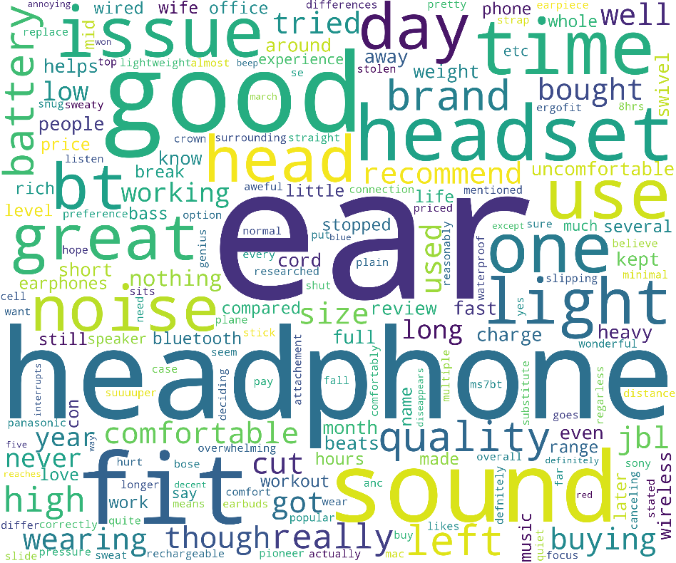
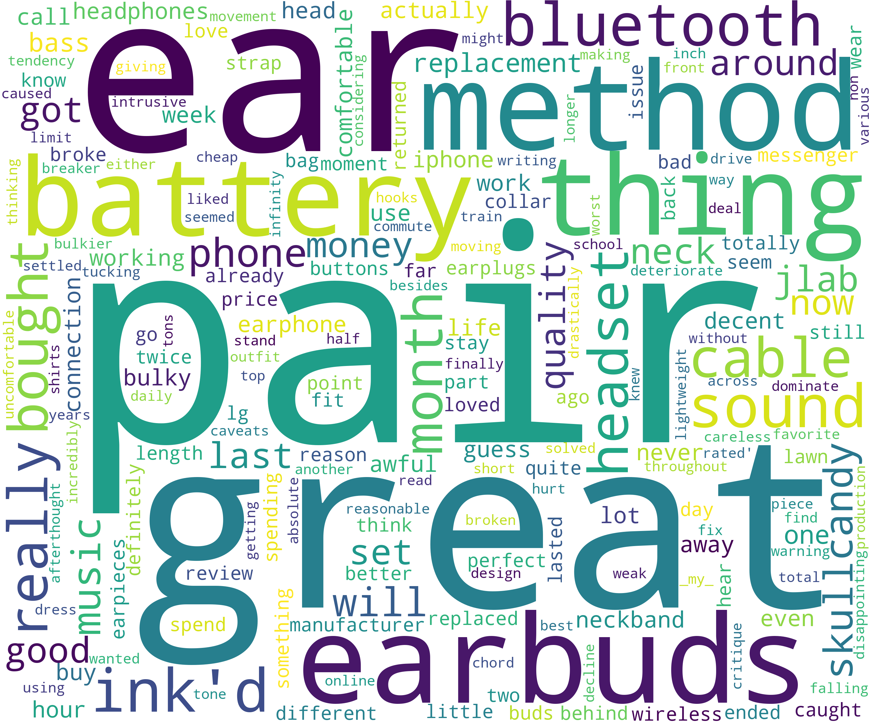
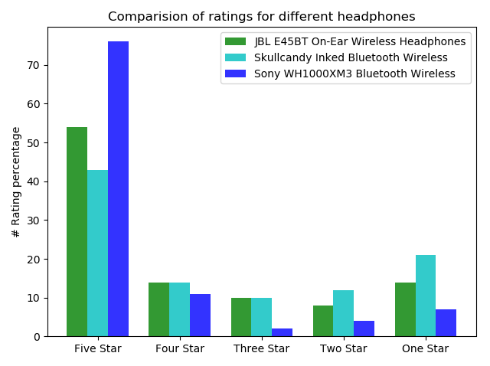
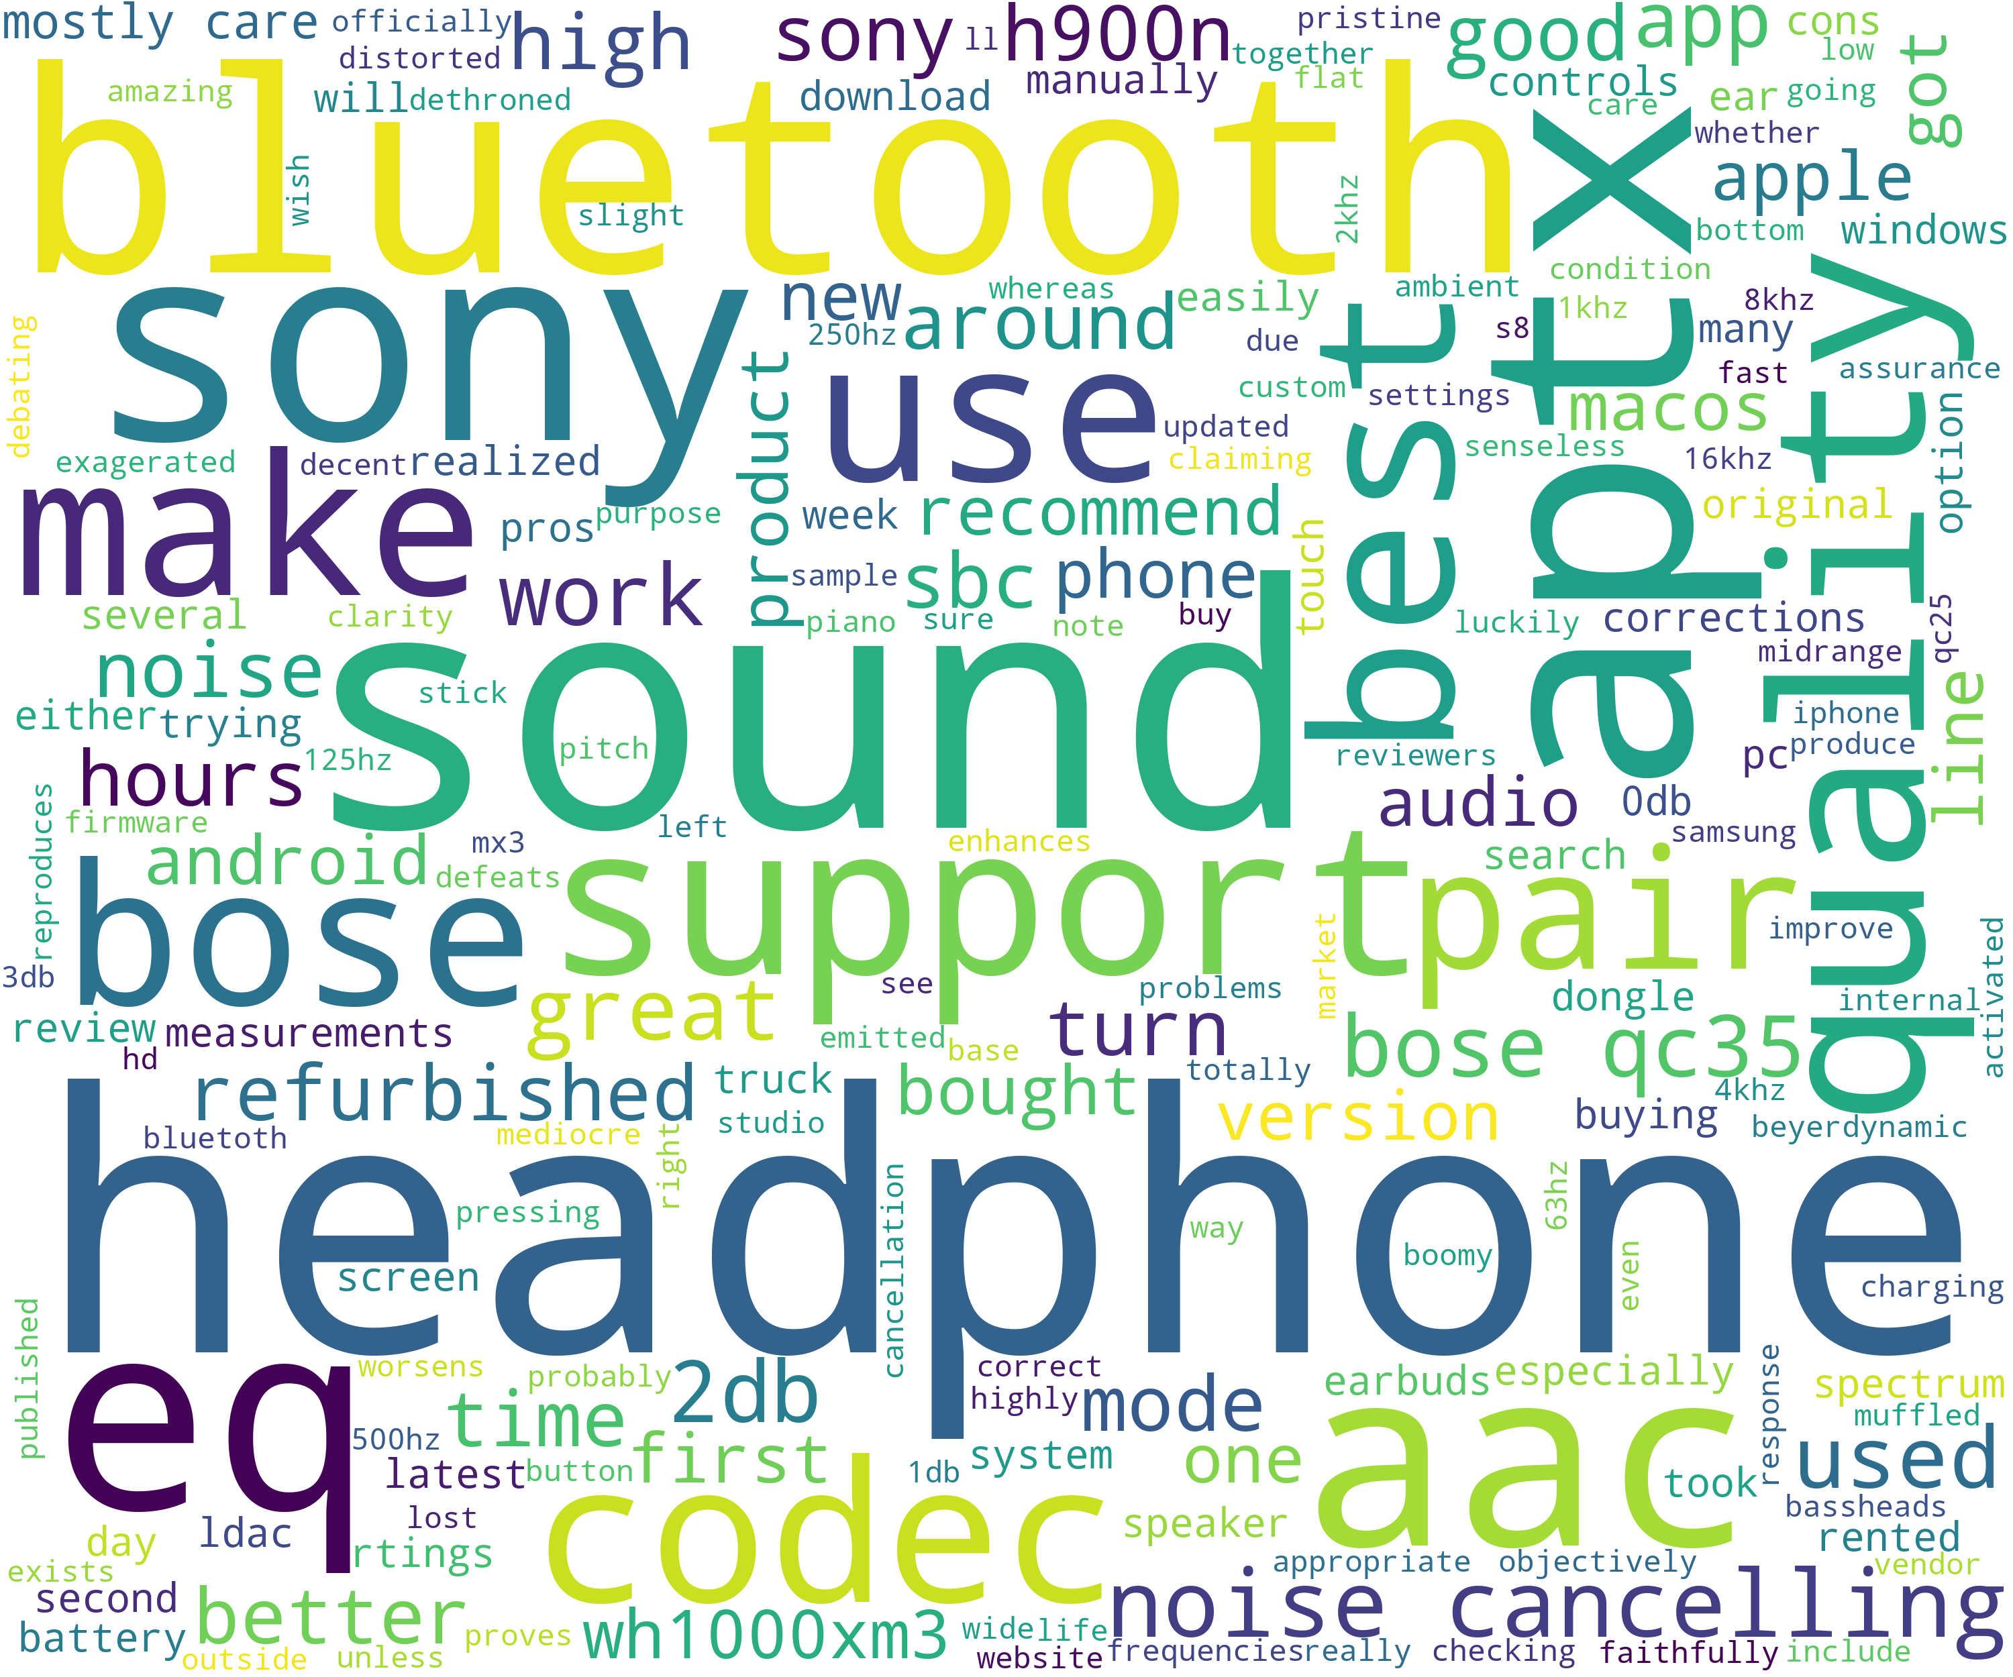
Most Common Words in Reviews of Different Headphones on Amazon Shopping Site and Their Rating Comparison
Pavan Kumar Reddy Byreddy
Email: S534625@nwmissouri.edu
Introduction
Results
Conclusion
The purpose of this project is to find the most common words in the customer reviews of different headphones on Amazon shopping and also comparing their customer ratings.
JBL E45BT On-Ear Wireless Headphones
Skullcandy Inked Bluetooth Wireless
From the results, I can conclude that the most common words for different headphones are related to their properties and various attributes such as sound, quality etc.
The most common words that stand out in the reviews also indicate the ratings. Here, from the comparison of ratings we can easily compare the ratings of the different products.
If product has more five stars it doesn’t mean it is very good, it is necessary to check one star rating also. For example, skullcandy has a good five stars and also it has more one stars compared to others. Overall customers are not much satisfied with skullcandy compared to JBL and Sony.
Procedure
I used web scraping to get the details of the products from Amazon shopping site.
Using word cloud the most common words from the reviews of the products are teased out.
The rating comparison is visualized using the matplotlib.pyplot.bar
Sony WH1000XM3 Bluetooth Wireless
Repository
Github link: 44520-s19/wm-final-project-redhug

