Slide 1

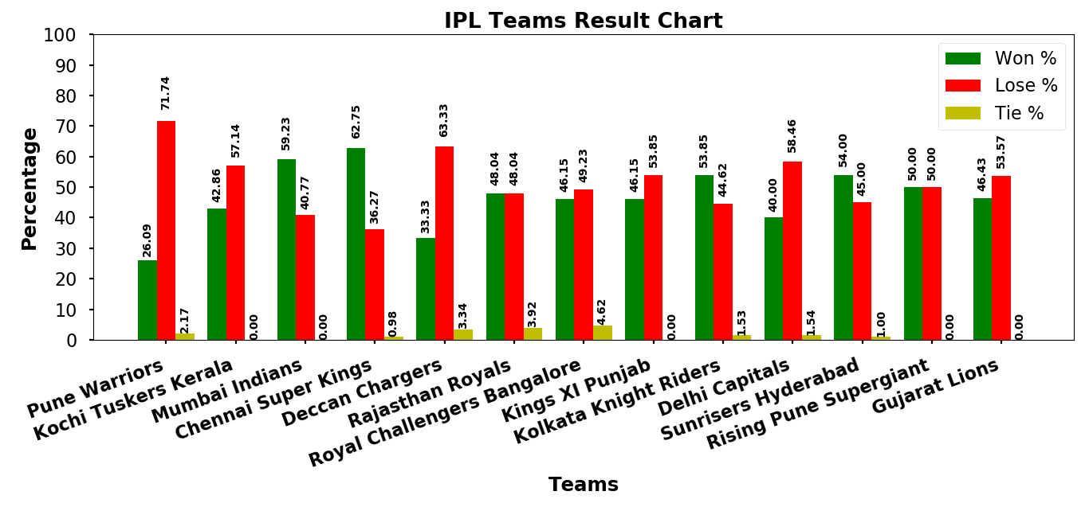
Indian Premiere League Teams Performance
Venkatesh Kunduru | Advisor: Dr. Nathan Eloe
School of Computer Science and Information Systems | Northwest Missouri State University
Introduction
Result
Indian Premiere League (IPL) is a professional Twenty20 cricket league in India contested during March or April and May of every year by different teams representing different cities in India.
Procedure
Web Scrape the Indian Premier League points tables from Cricbuzz website to collect the data, I used Beautiful Soup.
Collected the points table from 2011 to 2019 years and calculated the won, lost and tie percentage.
Performed Data cleaning to get effective results.
Analyze, Visualize & conclude the solution using collected data.
Conclusion
‘Chennai Super Kings’ is having more winning percentage of (62.75%) followed by ‘Mumbai Indians’ having (59.23%).
‘Pune Warriors’ is the most losing team in the IPL history with (71.74%) followed by ‘Deccan Chargers’ having (63.33%).
Reference
Repository
Cricbuzz - https://www.cricbuzz.com/search?q=indian-premiere-league&tab=series
https://github.com/44520-s19/wm-final-project-venkateshkunduru123

