Slide 1
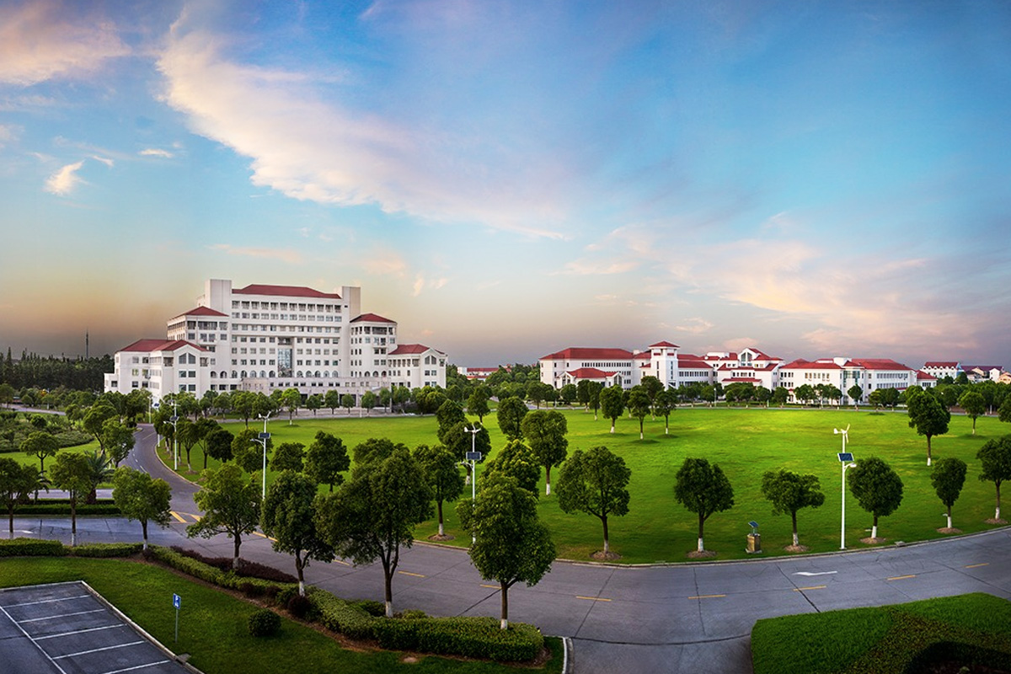

自然语言处理
廉洁，lianjie@shnu.edu.cn

Slide 2

Lecture Plan
1
Weakness of PCFG
2
Lexical PCFG

Slide 3
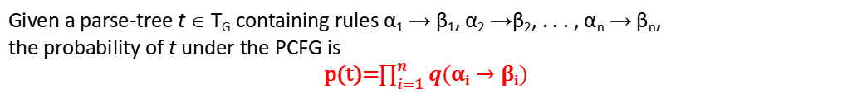
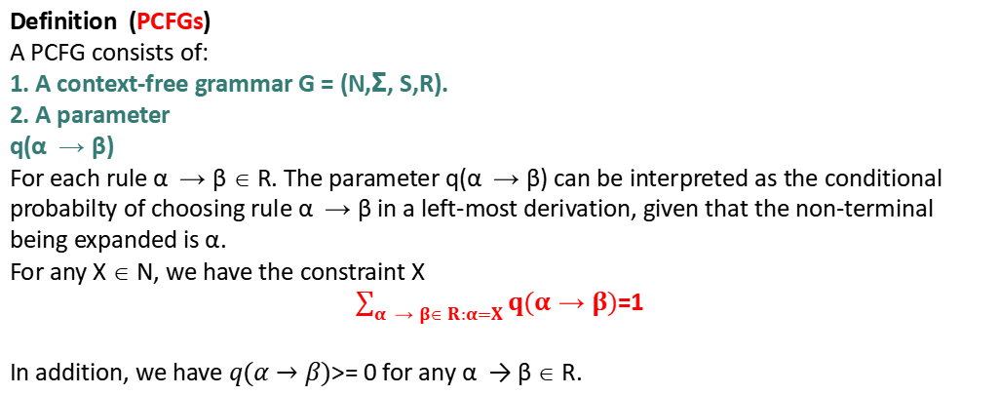
概率上下文无关文法
Definition (PCFGs)
A PCFG consists of:
1. A context-free grammar G = (N,Σ, S,R).
2. A parameter
q(α → β)
For each rule α → β ∈ R. The parameter q(α → β) can be interpreted as the conditional probabilty of choosing rule α → β in a left-most derivation, given that the non-terminal being expanded is α.
For any X ∈ N, we have the constraint X
$\sum_{α → β∈ R:α=X}{q(α→β)}$=1
In addition, we have $q(α→β)$>= 0 for any α → β ∈ R.
Given a parse-tree t ∈ T_{G} containing rules α₁ $→$ β₁, α₂ $→$β₂, . . . , α_{n} $→$ β_{n},
the probability of t under the PCFG is
p(t)=$\prod_{i=1}^{n}{q(αi→βi)}$

Slide 4
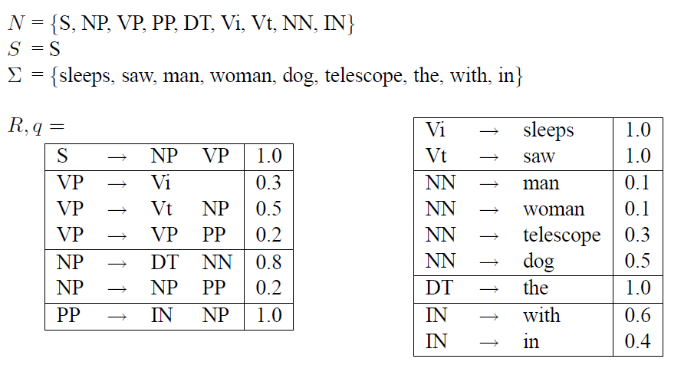
概率上下文无关文法

Slide 5
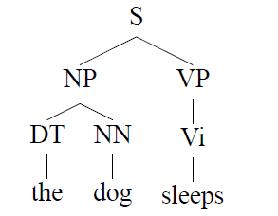
概率上下文无关文法
p(t) =
q(S → NP VP) ×
q(NP → DT NN) ×
q(DT → the) ×
q(NN → dog) ×
q(VP → Vi) ×
q(Vi → sleeps)

Slide 6
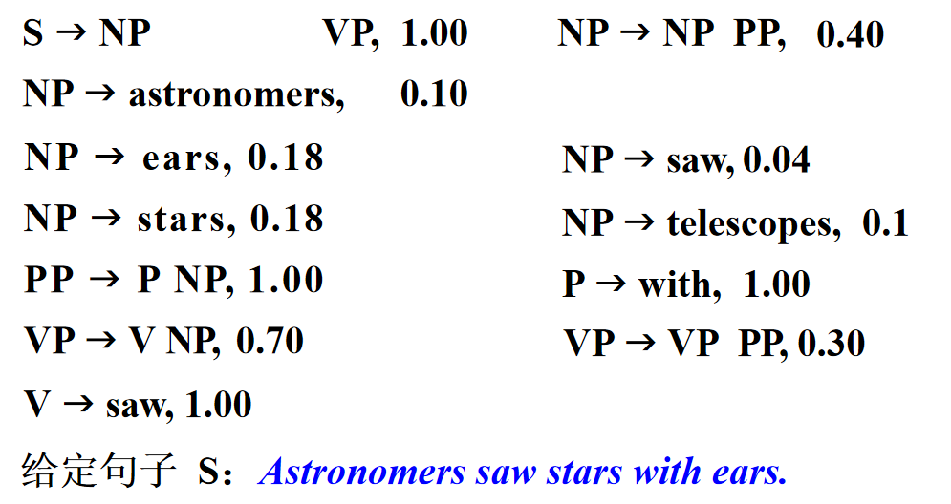
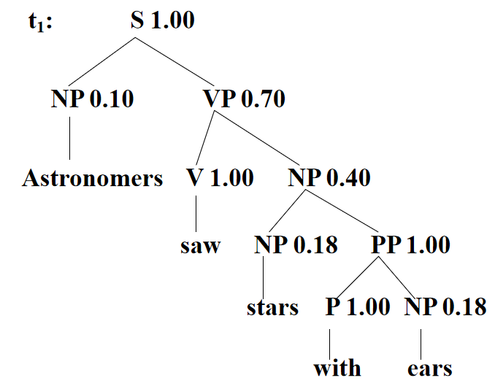
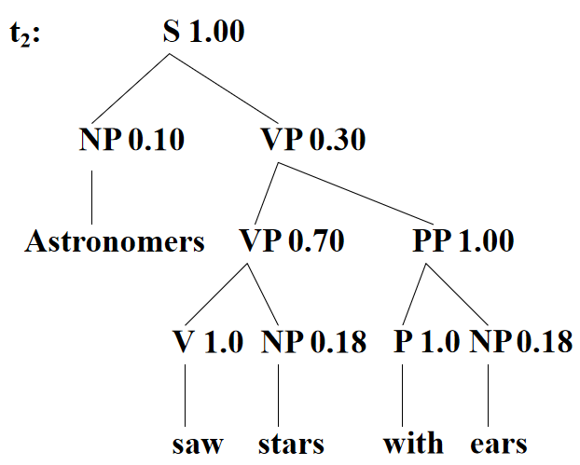
概率上下文无关文法

Slide 7
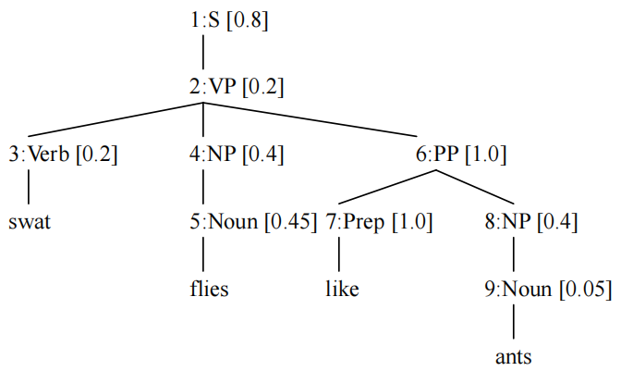
PCFG的三条假设
假设 1
位置无关性假设：子结点的概率与该子结点所直接管辖的字符串在句子中的位置无关。
假设 2
上下文无关性假设：子结点的概率与不受该子结点直接管辖的其他符号串无关。
假设 3
祖先结点无关性假设：子结点的概率与支配该结点的所有祖先结点的概率无关。

Slide 8
Weaknesses of PCFGs as Parsing Models
Lack of sensitivity to lexical information
Lack of sensitivity to structural preferences

Slide 9
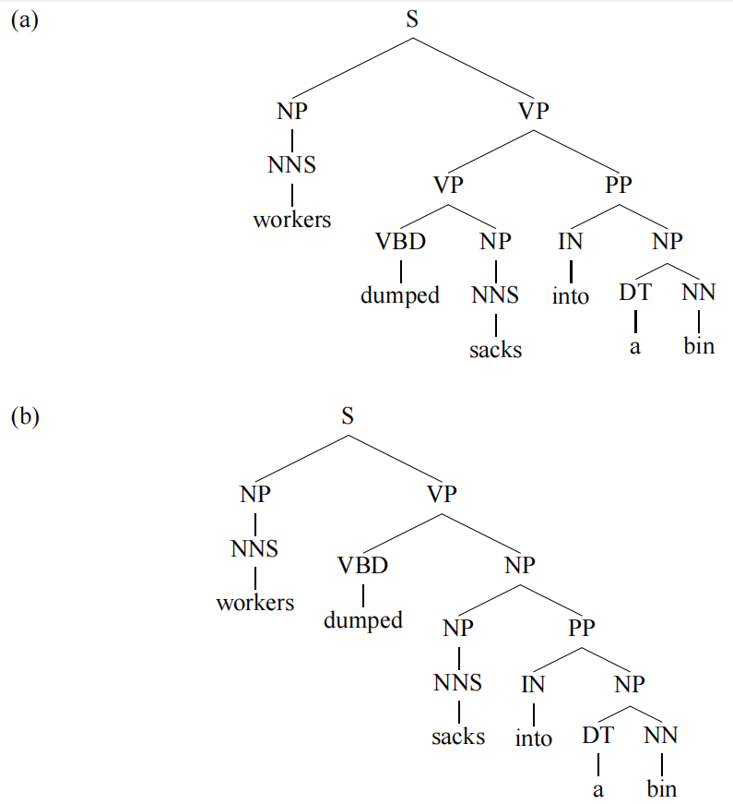
Lexical Sensitivity
“workers dumped sacks into a bin”

Slide 10
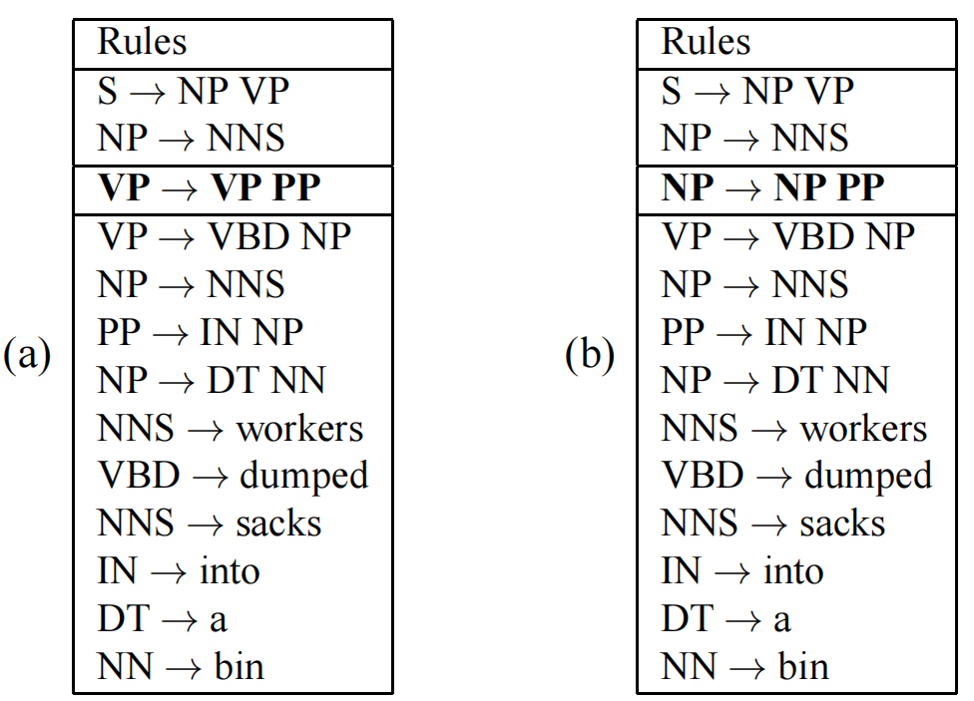
Lexical Sensitivity

Slide 11
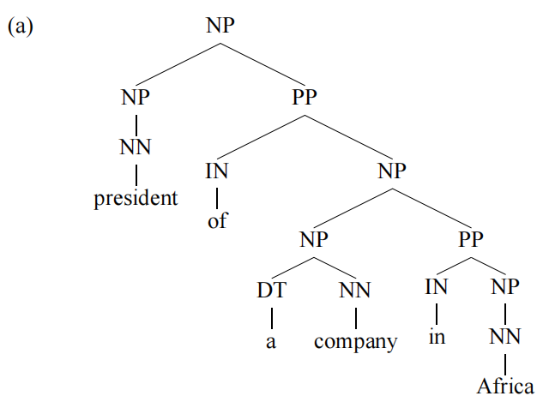
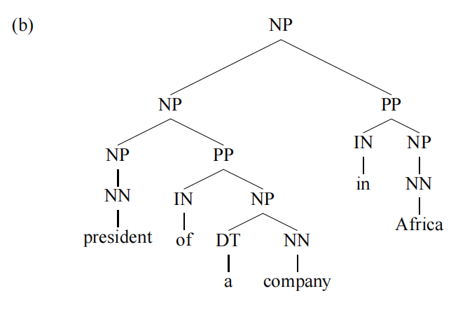
Structural Sensitivity
“president of a company in Africa”

Slide 12
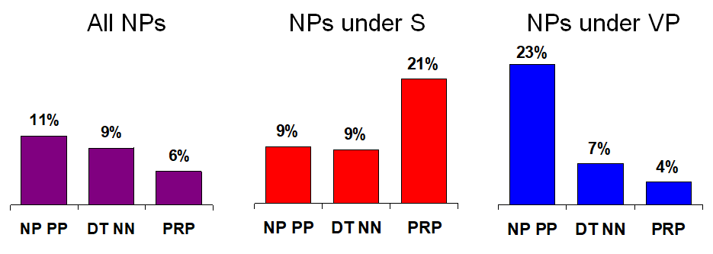
Structural Sensitivity

Slide 13
Lexicalized PCFG
基于不同动词的动词完全框架概率
Local Tree | come | take | think | want
VP→V | 9.5% | 2.6% | 4.6% | 5.7%
VP→V NP | 1.1% | 32.1% | 0.2% | 13.9%
VP→V PP | 34.5% | 3.1% | 7.1% | 0.3%
VP→V SBAR | 6.6% | 0.3% | 73.0% | 0.2%
VP→V S | 2.2% | 1.3% | 4.8% | 70.8%
VP→V NP S | 0.1% | 5.7% | 0% | 0.3%
VP→V PRT NP | 0.3% | 5.8% | 0% | 0%
VP→V PRT PP | 6.1% | 1.5% | 0.2% | 0%

Slide 14
Lexicalized PCFG
双词汇（bilexical）概率，在加入的条件变多以后概率明显提升。
P(prices|n-plural)=0.013
P(prices|n-plural, NP)=0.013
P(prices|n-plural, NP, S)=0.025
P(prices|n-plural, NP, S, v-past)=0.052
P(prices|n-plural, NP, S, v-past, fell)=0.146

Slide 15
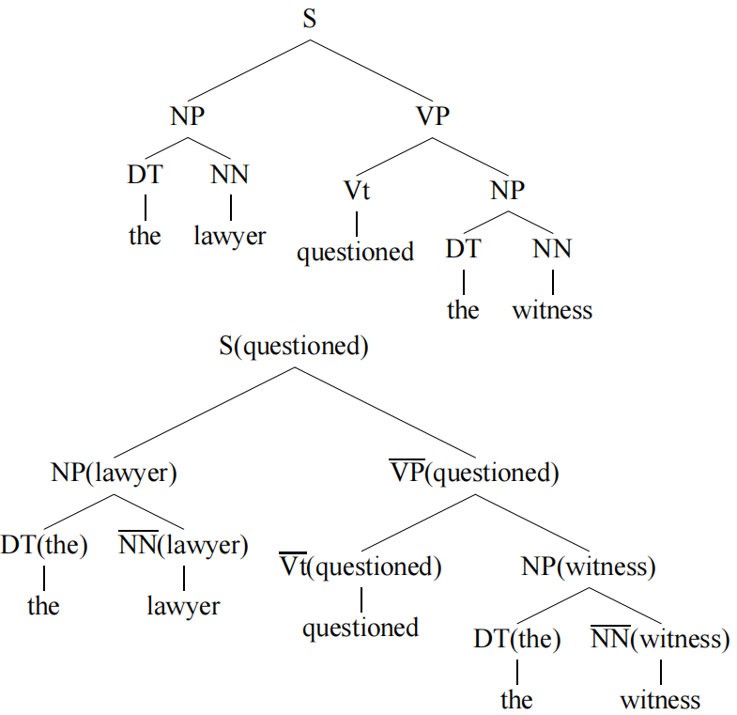
Lexicalized PCFG
“the lawyer questioned the witness”
Unlexicalized parse tree
Lexicalized parse tree

Slide 16
Lexicalized PCFG
Specifies the head of the rule:
The head of a context free rule intuitively corresponds to the “center” or the most important child of the rule.
X → Y₁ Y₂ . . . Y_{n}
specify an index h ∈ {1 . . . n}
S → NP VP, h=2, according to VP
NP → NP PP PP PP, h=1, according to NP
NP → DT NN, h=2, according to NN
Non-terminals higher in the tree receive the lexical item from their head child:
For example, the NP in this example receives the lexical item lawyer, because this is the lexical item associated with the NN which is the head child of the NP.
S→NP VP
S(examined) →₂ NP(lawyer) VP(examined)

Slide 17
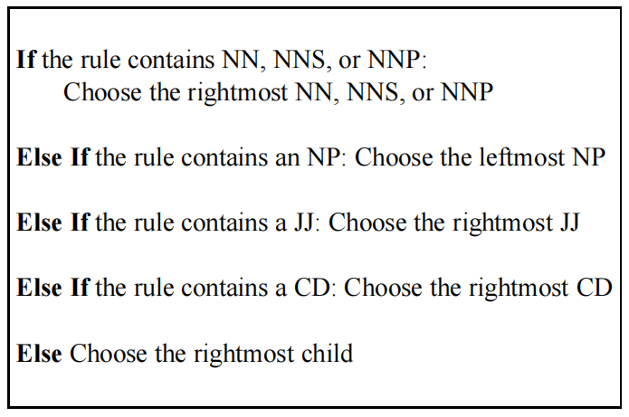
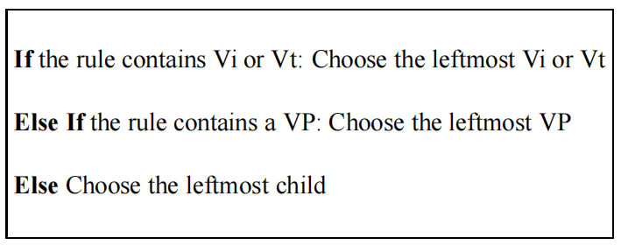
Lexicalized PCFG
Q: How to identify heads?
A: based on rules.

Slide 18
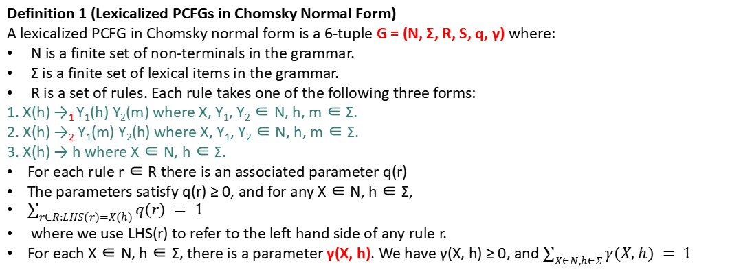
Lexicalized PCFG
Definition 1 (Lexicalized PCFGs in Chomsky Normal Form)
A lexicalized PCFG in Chomsky normal form is a 6-tuple G = (N, Σ, R, S, q, γ) where:
N is a finite set of non-terminals in the grammar.
Σ is a finite set of lexical items in the grammar.
R is a set of rules. Each rule takes one of the following three forms:
1. X(h) →₁ Y₁(h) Y₂(m) where X, Y₁, Y₂ ∈ N, h, m ∈ Σ.
2. X(h) →₂ Y₁(m) Y₂(h) where X, Y₁, Y₂ ∈ N, h, m ∈ Σ.
3. X(h) → h where X ∈ N, h ∈ Σ.
For each rule r ∈ R there is an associated parameter q(r)
The parameters satisfy q(r) ≥ 0, and for any X ∈ N, h ∈ Σ,
$\sum_{r∈R:LHS(r)=X(h)}{q(r) = 1}$
where we use LHS(r) to refer to the left hand side of any rule r.
For each X ∈ N, h ∈ Σ, there is a parameter γ(X, h). We have γ(X, h) ≥ 0, and $\sum_{X∈N,h∈Σ}{γ(X, h) = 1}$
Given a left-most derivation r₁, r₂, . . . r_{N} under the grammar, where each r_{i} is a member of R, the probability of the derivation is:
γ(LHS(r1)) × $\prod_{i=1}^{N}{q(ri)}$

Slide 19
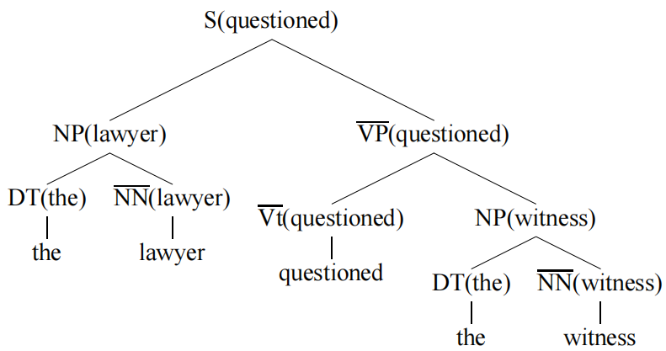
Lexicalized PCFG
Rules:
S(questioned) →₂ NP(lawyer) VP(questioned)
NP(lawyer) →₂ DT(the) NN(lawyer)
DT(the) → the
NN(lawyer) → lawyer
VP(questioned) →₁ Vt(questioned) NP(witness)
NP(witness) →₂ DT(the) NN(witness)
DT(the) → the
NN(witness) → witness
The probability of the tree is calculated as
γ(S, questioned)
×q(S(questioned) →₂ NP(lawyer) VP(questioned)) ×q(NP(lawyer) →₂ DT(the) NN(lawyer))
×q(DT(the) → the)
×q(NN(lawyer) → lawyer)
×q(VP(questioned) →₁ Vt(questioned) NP(witness)) ×q(NP(witness) →₂ DT(the) NN(witness))
×q(DT(the) → the) ×q(NN(witness) → witness)

Slide 20
Lexicalized PCFG
Parameter Estimation in Lexicalized PCFGs:
X(h) →₁ Y₁(h) Y₂(m)
or
X(h) →₂ Y₁(m) Y₂(h)
Define the following variables:
X is the non-terminal on the left-hand side of the rule;
h is the head-word of that non-terminal;
R is the rule used, either of the form X →₁ Y₁ Y₂ or X →₂ Y₁ Y₂;
m is the modifier word.
S(questioned) →₂ NP(lawyer) VP(questioned)
X = S
h = questioned
R = S →₂ NP VP
m = lawyer

Slide 21
Lexicalized PCFG
X = S
h = questioned
R = S →₂ NP VP
m = lawyer
S(questioned) →₂ NP(lawyer) VP(questioned)
q(S(questioned) →₂ NP(lawyer) VP(questioned))
= P(R = S →₂ NP VP, m = lawyer|X = S, h = questioned)
= P(R = S →₂ NP VP|X = S, h = questioned)×P(m = lawyer|R = S →₂ NP VP, X = S, h =questioned)
qML(S →₂ NP VP|S, questioned) =$\frac{count(R = S →2 NP VP, X = S, h = questioned) }{count(X = S, h = questioned) }$
qML(S →₂ NP VP|S) = $\frac{count(R = S →2 NP VP, X = S)}{count(X = S) }$
P(R = S →₂ NP VP|X = S, h = questioned)=λ₁ × qML(S →₂ NP VP|S, questioned) + (1 − λ₁) × qML(S →₂ NP VP|S)

Slide 22
Lexicalized PCFG
原因：直接计算的条件概率是非常稀疏的，所以Charniak提出了一种线性插值的方法。
这种方法能帮助我们在没有充足的数据的时候，进行数据平滑。
比如P(S →₂ NP VP|S, questioned)估计为0时

Slide 23
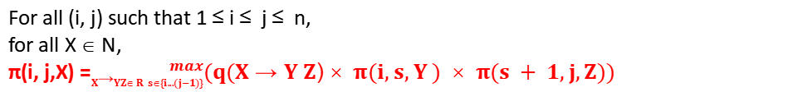
Lexicalized PCFG
Parsing with Lexicalized PCFGs:
For all (i, j) such that 1 ≤ i ≤ j ≤ n,
for all X ∈ N,
π(i, j,X) =${}_{X→YZ R s\{i...(j−1)\}}^{ max}{(q(X→Y Z)× π(i, s, Y ) × π(s + 1, j,Z))}$
A key difference is that each non-terminal in the grammar includes a lexical item.
A key observation is that for a given input sentence x₁ . . . x_{n}, parse trees for that sentence can only include non-terminals with lexical items that are one of x₁ . . . x_{n}.
Definition 2 (Dynamic programming table for lexicalized PCFGs.)
π(i, j, h, X) is the highest probability for any parse tree with non-terminal X and lexical item h at its root, spanning words i . . . j in the input.
h ∈ {i . . . j}, X ∈ N, where N is the set of unlexicalized non-terminals in the grammar
n = 7
π(2, 7, 2, VP) will be the highest probability for any subtree rooted in VP(dumped), spanning words 2 . . . 7 in the sentence.
“workers dumped the sacks into a bin”

Slide 24
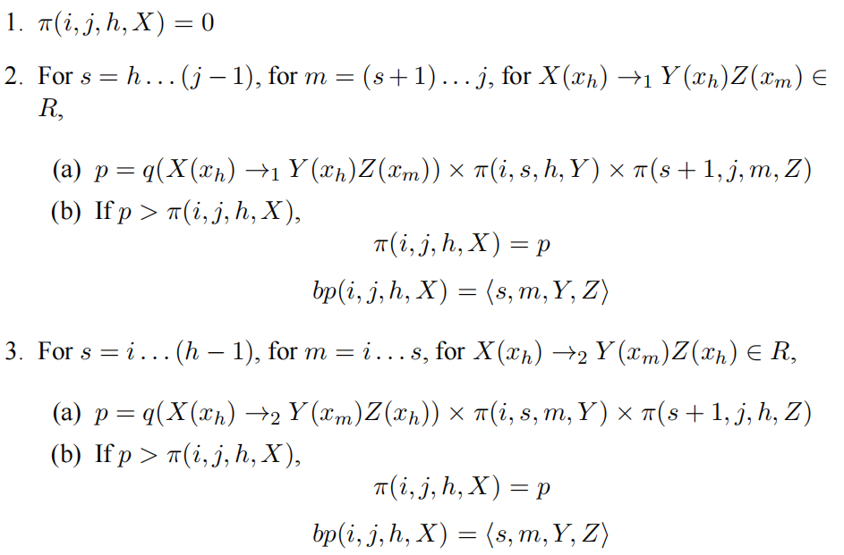
Lexicalized PCFG
More generally, to find the value for any π(i, j, h, X), we need to search over all possible choices for s, m, and all rules of the form X(x_{h}) →₁ Y₁(x_{h}) Y₂(x_{m}) or X(x_{h}) →₂ Y₁(x_{m}) Y₂(x_{h}).

