Slide 2
Introduction To Hydroponic Farming
It is technique for growing plants without soil.
Utilizing this methodology, the roots absorb balanced nutrients that are dissolved in water. which meets all the plant developmental requirements.
As a result, the plants can grow quicker and healthier.
So, as long as there’s water and nutrients, they can sustain themselves and survive.

Slide 3
Objective
The main objective of this project is to maintain the plants in their natural state by monitoring the factors that increase plant life
We provide the light to the plants by providing red and blue LED’s light that facilitate the photosynthesis.
Using Hydroponic farming we can provide plants sufficient nutrients and water supply for faster growth.
We can control the water supply using a smart phone.

Slide 4
Hardware and Technologies:
ESP32
DS18B20
MQ135
DHT11
Ultrasonic sensor
Submersible pump
Dc motor
Arduino IDE:
Arduino is a prototype platform (open-source) based on an easy-to-use hardware and software.
It is used to write and upload the computer code to the physical board
Blynk IOT:
Blynk is a simple and powerful no-code application builder where you can prototype, deploy, and manage connected electronic devices at any scale.

Slide 5
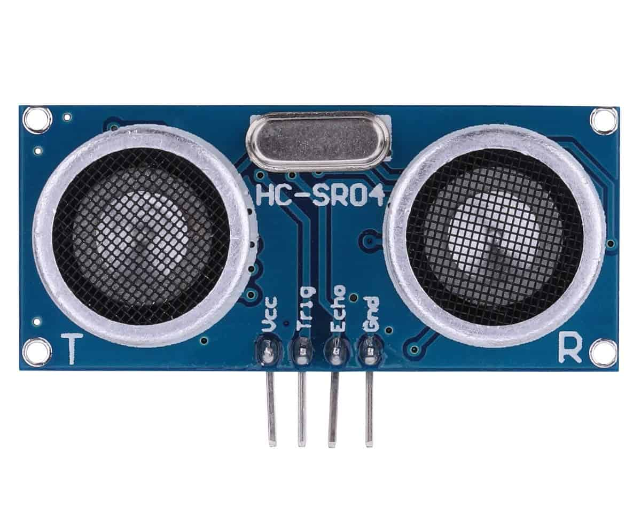
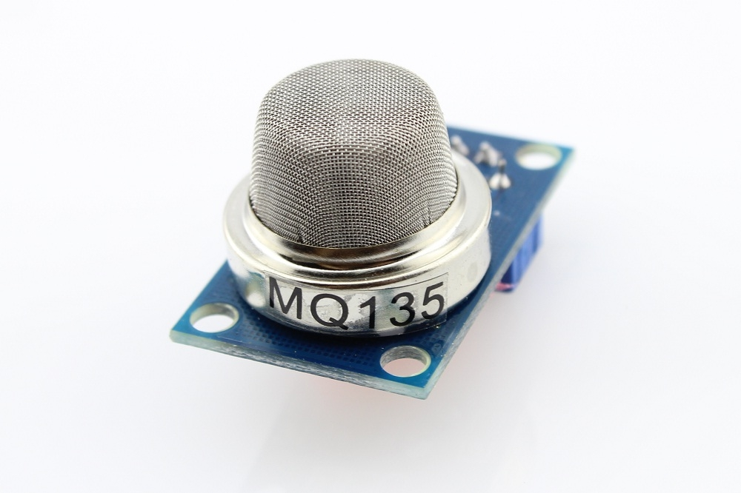
HCSR04
An ultrasonic sensor is an electronic device that measures the distance of a target object by emitting ultrasonic sound waves.
It is used to detect the water level in the tank.
MQ135
It is an air quality sensor for detecting a wide range of gases, including NH3, NOx, alcohol, smoke and CO2.
It is used as a fire alarm in the project

Slide 6
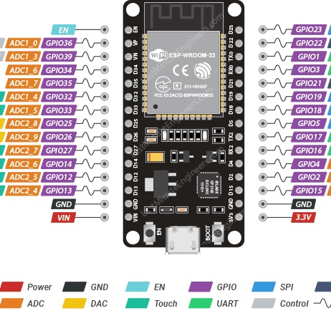
ESP32
The ESP32 is an updated version of the ESP8266.
It offers both Bluetooth and BLE (Bluetooth Low Energy), whereas the ESP8266 only has Wi-Fi .
The ESP32 has 36 GPIO pins.
It supports clock frequency up to 240MHz.
It is faster and is available in a dual-core design. It is also capable of operating in an ultra-low-power mode, ideal for battery-powered applications.

Slide 7
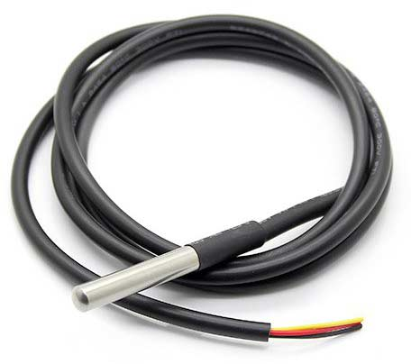
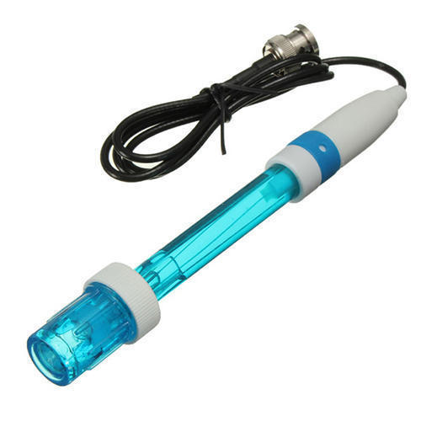
DS18B20
The DS18B20 is a digital thermometer that can provide 9-bit to 12-bit resolution and can measure temperatures from -55°C to +125°C
It is used to measure water temperature in this project.
PH sensor
A pH sensor helps to measure the acidity or alkalinity of the water with a value between 0-14

Slide 8
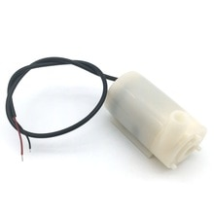
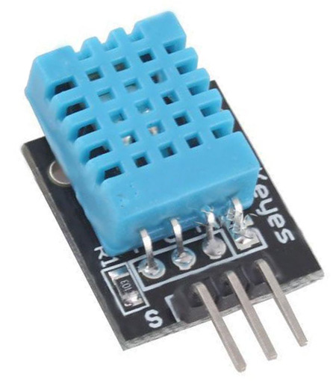
DHT 11
It is a digital humidity temperature sensor consists of capacitive humidity sensing element and a thermistor for sensing temperature.
As temperature decreases resistivity increases.
Submersible pump:
It is used to control the water flow in the tank.

Slide 9
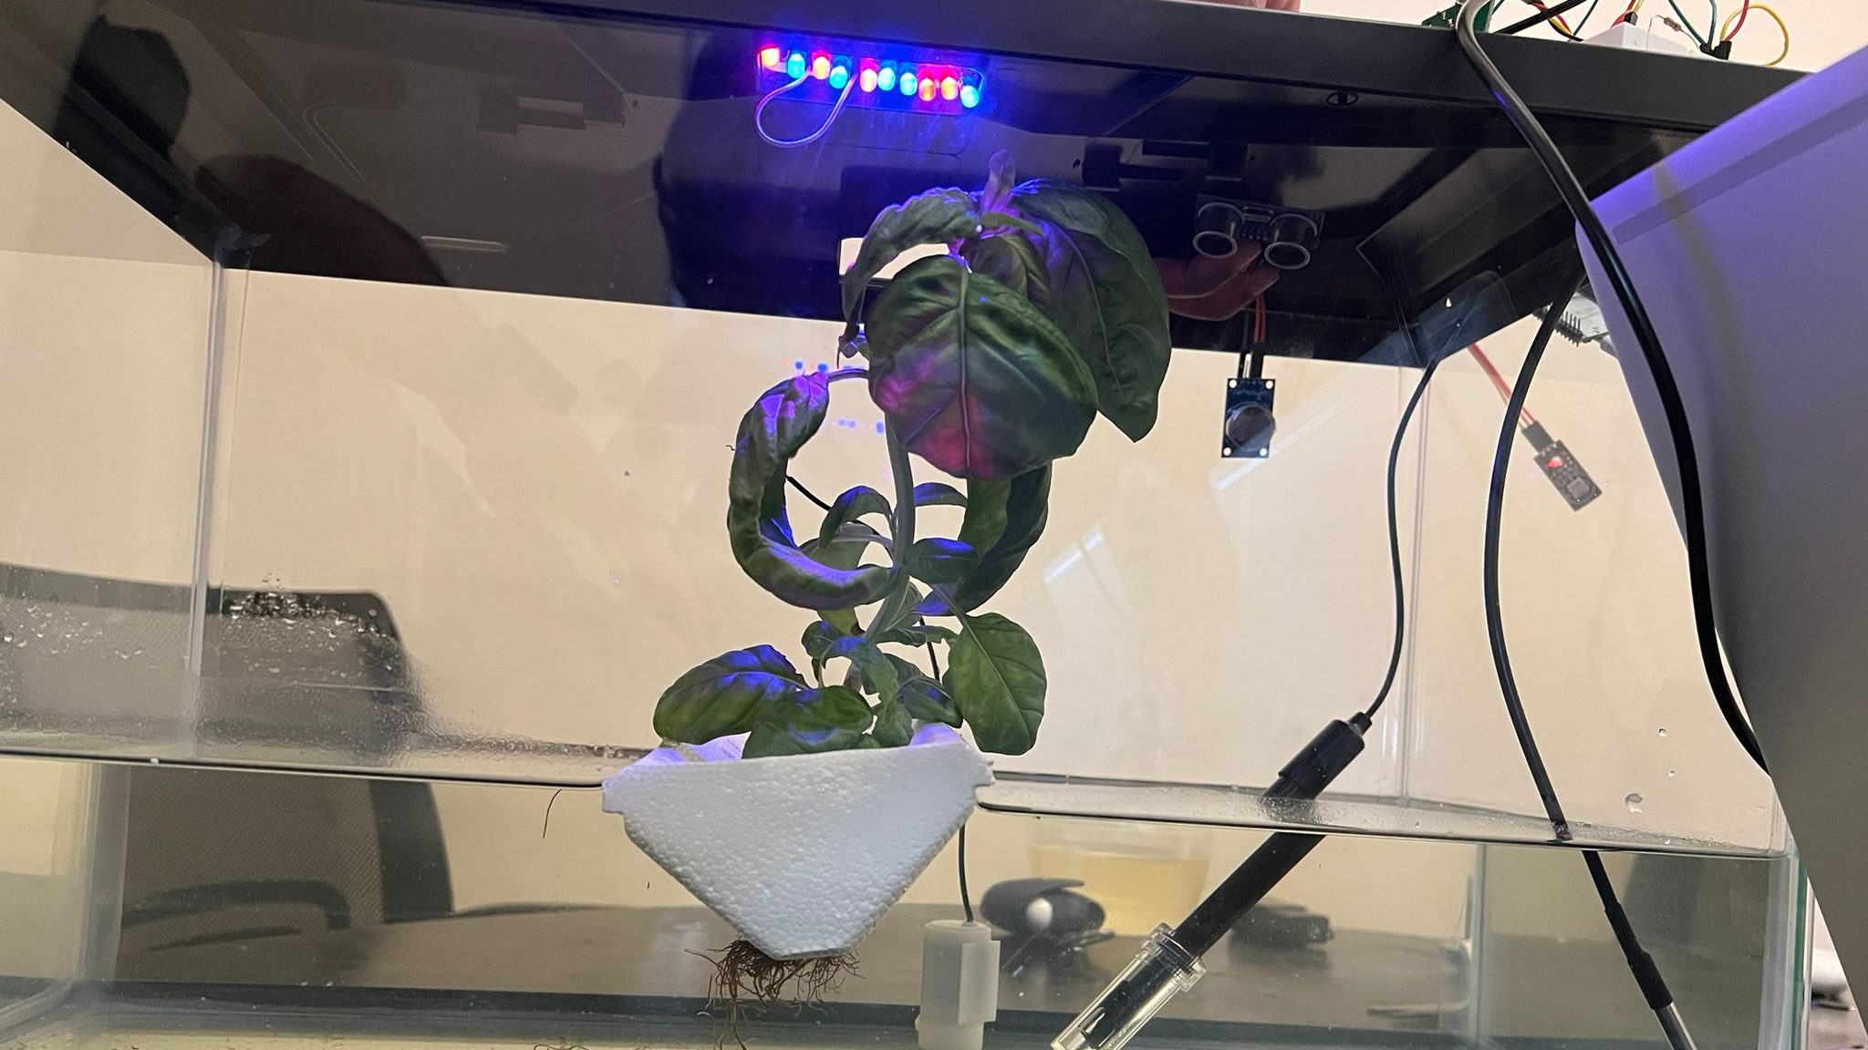

Slide 10
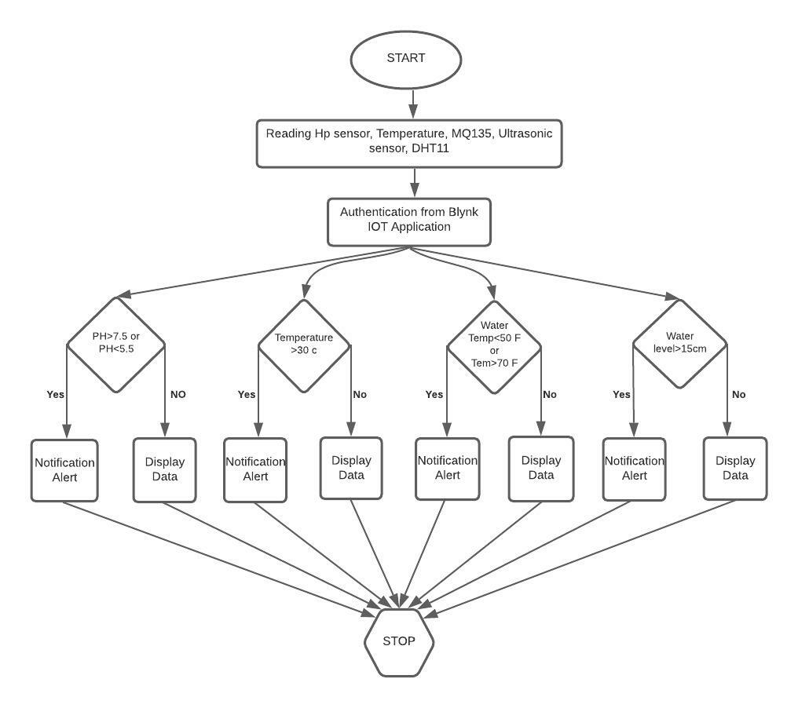
Flow Chart
Initially, the user begins by starting the device, whenever the system is started it starts reading the values of pH, temperature, water temperature of the liquid solution and water level inside the tank.
Whenever the threshold value exceeds a notification alert is sent to the user through Blynk IoT else display the data to the user.
The rules set to regulate the motor state based on the input of pH, water temperature and water level inside the tank.

Slide 11
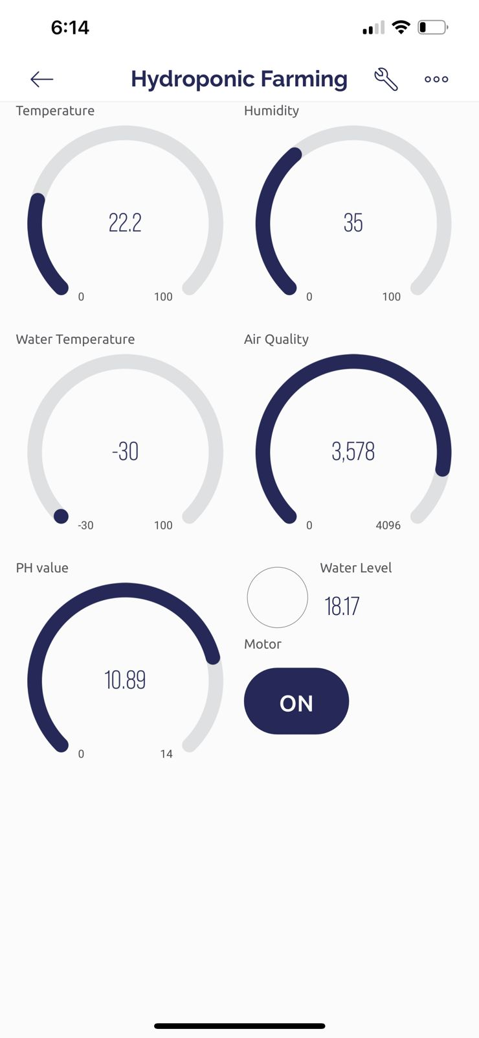
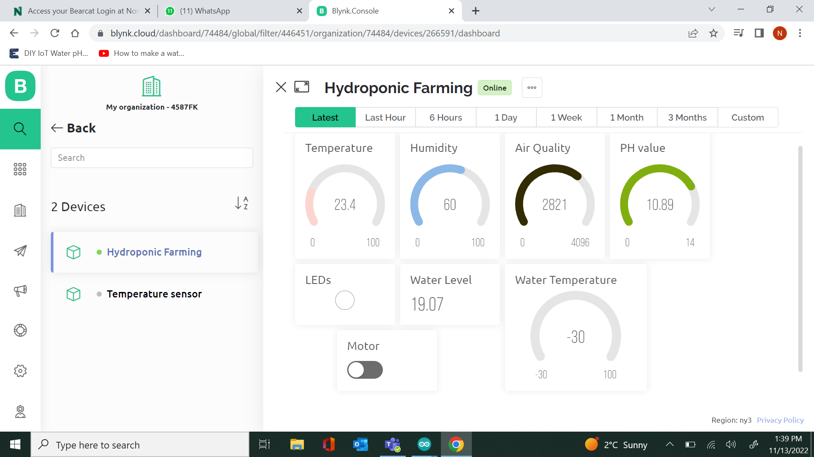
Blynk IoT

Slide 12
Conclusion
By this project we can avoid wastage of water by reusing the same water.
We can avoid weeds that grow together with the crops and achieve the high yield of crops.
We can supply sufficient nutrients to the plants as roots are directly deployed in water, As water is a good dissolvent.
Finally, IOT helps us to monitor and control the conditions of the plant on a regular basis and analyze it using a smart phone.

