Slide 1
Northwest Missouri State University
Research Content Management
Presented by
Guided by
Nithin Reddy Kumbham
Vamsidhar Reddy Police
Saivivek Reddy Kusukuntla
Jawahar Reddy Nomula
Gopi Krishna Kandimalla
Abhinav Bellamkonda
Dr. Ratan Lal (Assistant Professor) School of Computer Science and Information Systems.
Program : Applied Computer Science
06-02-2022

Slide 2
Roles and Responsibilities
Front-end Development
Vamsidhar Reddy Police
Saivivek Reddy Kusukuntla
Back-end Development
Nithin Reddy Kumbham
Abhinav Bellamkonda
Database Management
Jawahar Reddy Nomula
Gopi Krishna Kandimalla
Research Content Management
06/02/2022
2

Slide 3
Introduction
In this project, we had worked together as a team to create a website where users can store all of his research papers they have worked on and search for their uploaded papers using sorting functions.
We will have a signup and login page where user can register and signin.
We further have a page where user can upload their saved files and notify what topic, year, and subtopics that the paper belongs to. Faculty can search their uploaded papers by using sorting functions like title, topic, year, and subtopics.
The desired research paper content is displayed after clicking on it in the pdf format. Author can review and add the comments or note the important information in it in a comment section text box.
Research Content Management
06/02/2022
3
3

Slide 4
Scope
The main objective of this project is to make user access his research papers with user friendly environment to make a note of his research work for referencing.
User can search and sort out easily from a bulk of research papers and can have an idea regarding the research paper by adding some comments and text highlighting functionality inside a PDF.
It is much helpful when referencing
Month - Year
4
Research Content Management
06/02/2022
4

Slide 5
Functionalities
This website initially has an Authentication process, where the users must either register or login to the website using credentials.
If the user want to upload a research paper, should fill the text fields like topic, year, subtopic, and technique.
In the search page, the user can search for the desired paper using keywords which user used while uploading the paper.
Once the user access the website, the dashboard is displayed in which it has upload and search page.
User can view the paper in pdf format and can even download it.
If the user wants to note an important points for reference or for future use, he can add the comments in the comment section.
Research Content Management
06/02/2022
5

Slide 6


Technologies used
React: It is a JavaScript library used to easily create fast user interfaces for websites and applications.
Firebase: The Firebase Firestore Database is used to build rich, collaborative applications by allowing secure access to the database directly from client-side code.
Research Content Management
06/02/2022
6

Slide 7


Tools used
GitHub: This tool is used for collaborating between the team members while implementing the project.
VS Code: This is an IDE, where the actual code is written and for running the project.
Research Content Management
06/02/2022
7

Slide 8
Register
The first step in our application is for the user to create an account so that user can upload documents and leave comments for uploaded papers for future reference.
The registration page asks for the user's name, email address, and password, which are saved in firebase authentication when the user clicks on the register button.
After creating an account, the user can successfully log in to the application using the credentials provided at registration.
It should be noted that during registration, all fields are required, and skipping any field results in a message stating that the field cannot be left blank.
Registration page also consists of signing up an account using google account credentials where user will be redirected to google accounts page. It is one of the feature provided by firebase as authentication process.
Research Content Management
06/02/2022
8

Slide 9
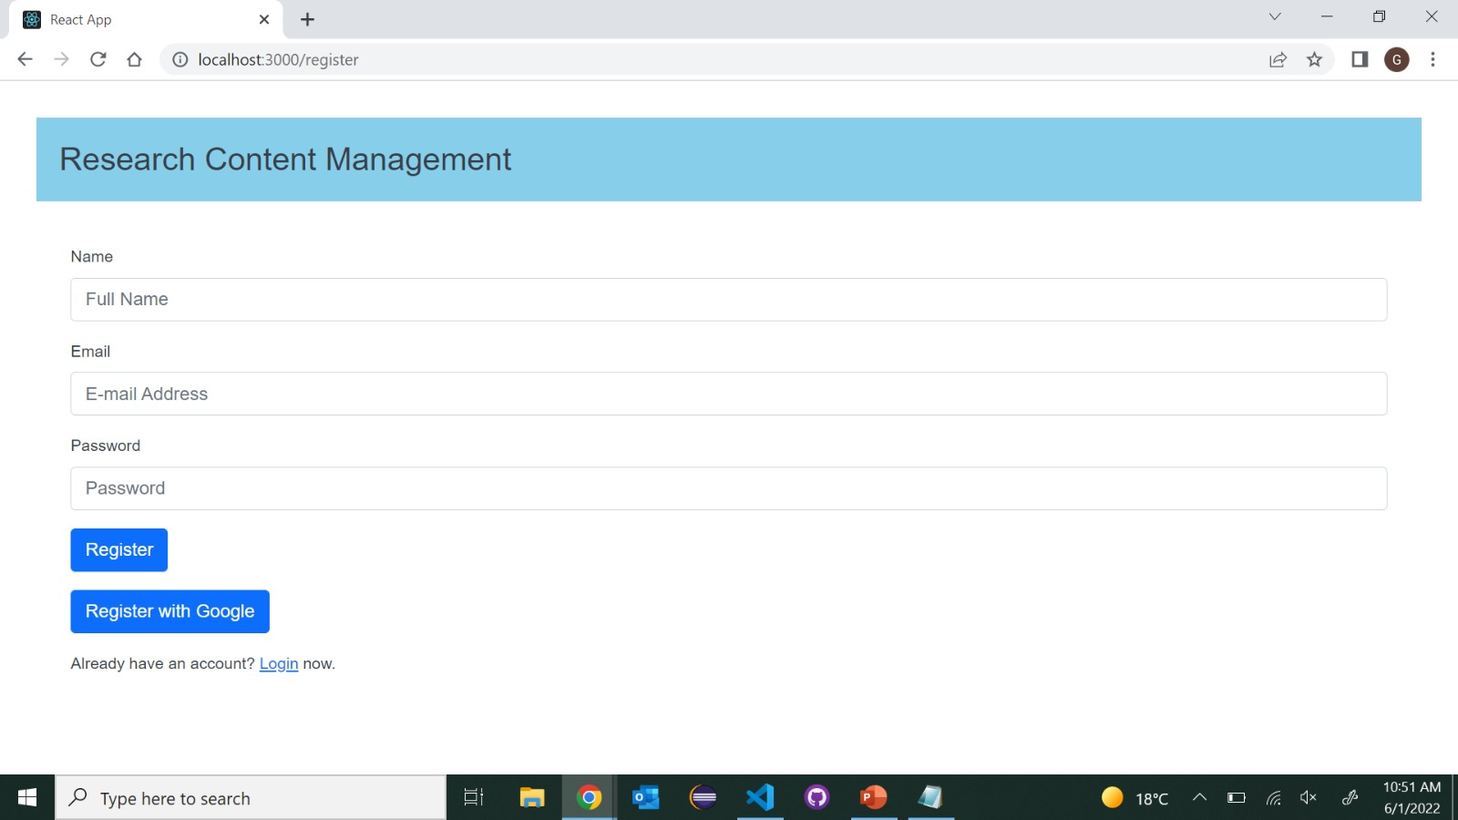
Register Page
Research Content Management
06/02/2022
9

Slide 10
login
Once the user has completed the registration successfully, the dashboard is displayed, and he can complete his desired operations of upload, search, view and logout of the account.
Whenever the registered user comes back, he can access to the login page and enter the credentials, which he provided during registration process.
The authentication details are stored in the firebase, so if the details matches, it will render the next page otherwise it will throw an error.
In the Login page, we added a button called "Login With Google", where the user can directly login using his google account.
We added an option of forgot password to the login page when user forgets the password and click on forgot password user will be receiving an email to reset the password.
Research Content Management
06/02/2022
10

Slide 11
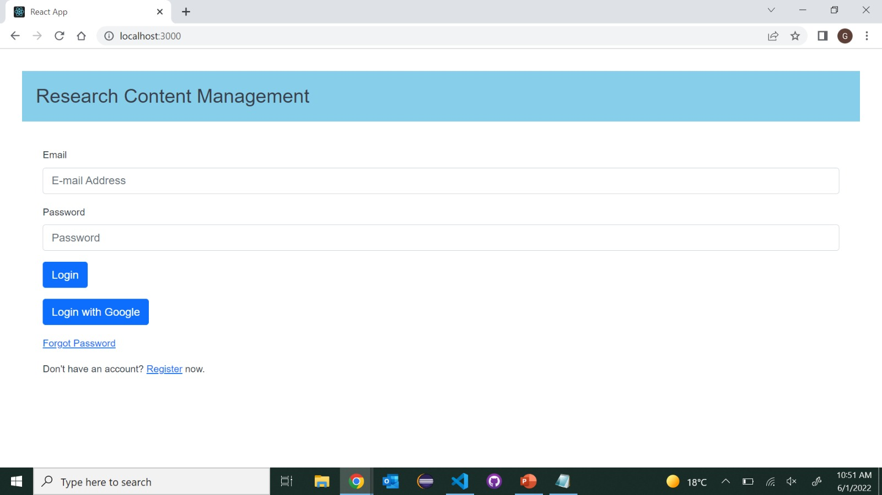
Login page
Research Content Management
06/02/2022
11

Slide 12
Dashboard
When the user get access to the application after successful login, User will be redirected to dashboard where user can see upload and search tabs. So, that user can navigate between the two tabs easily.
In dashboard page user can view his username, email and logout button in Home bar.
Upload has options to upload a paper and search has options to view a paper and search a respective paper from a collection of papers.
Research Content Management
06/02/2022
12

Slide 13
Upload
As the application has upload function for the user to upload a research paper.
User need to upload the file in the pdf* format.
User must mention the year of publishing, title of the paper, technique used in the paper and title of the research paper.
When user clicks on submit button after entering all the above fields the data will be uploaded to firestore database in the firebase.
Once it was uploaded user gets a popup that file has been uploaded successfully.
Research Content Management
06/02/2022
13

Slide 14
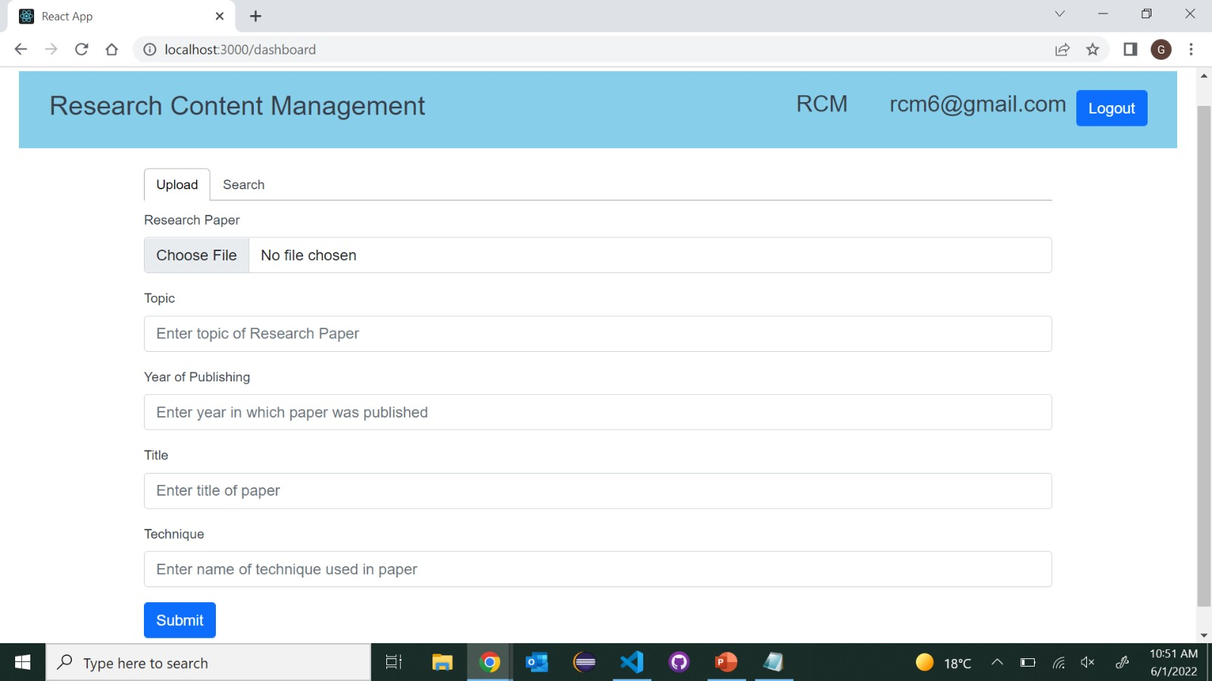
Upload Page
Research Content Management
06/02/2022
14

Slide 15
Search
Once search page is opened user can see the list of all the uploaded papers in a list view.
There is also a sorting function to search the Research papers from a collection of papers.
Sorting can be done by title, year, topic and technique which the user had provided during uploading a paper.
User can see uploaded papers according to the sorting functions where he can view his research paper on the same page.
Research Content Management
06/02/2022
15

Slide 16
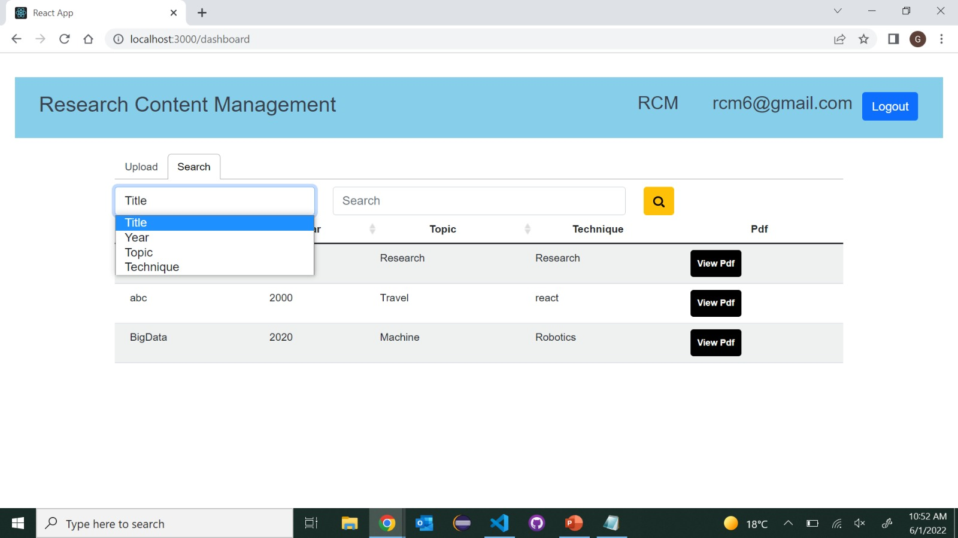
Search Page
Research Content Management
06/02/2022
16

Slide 17
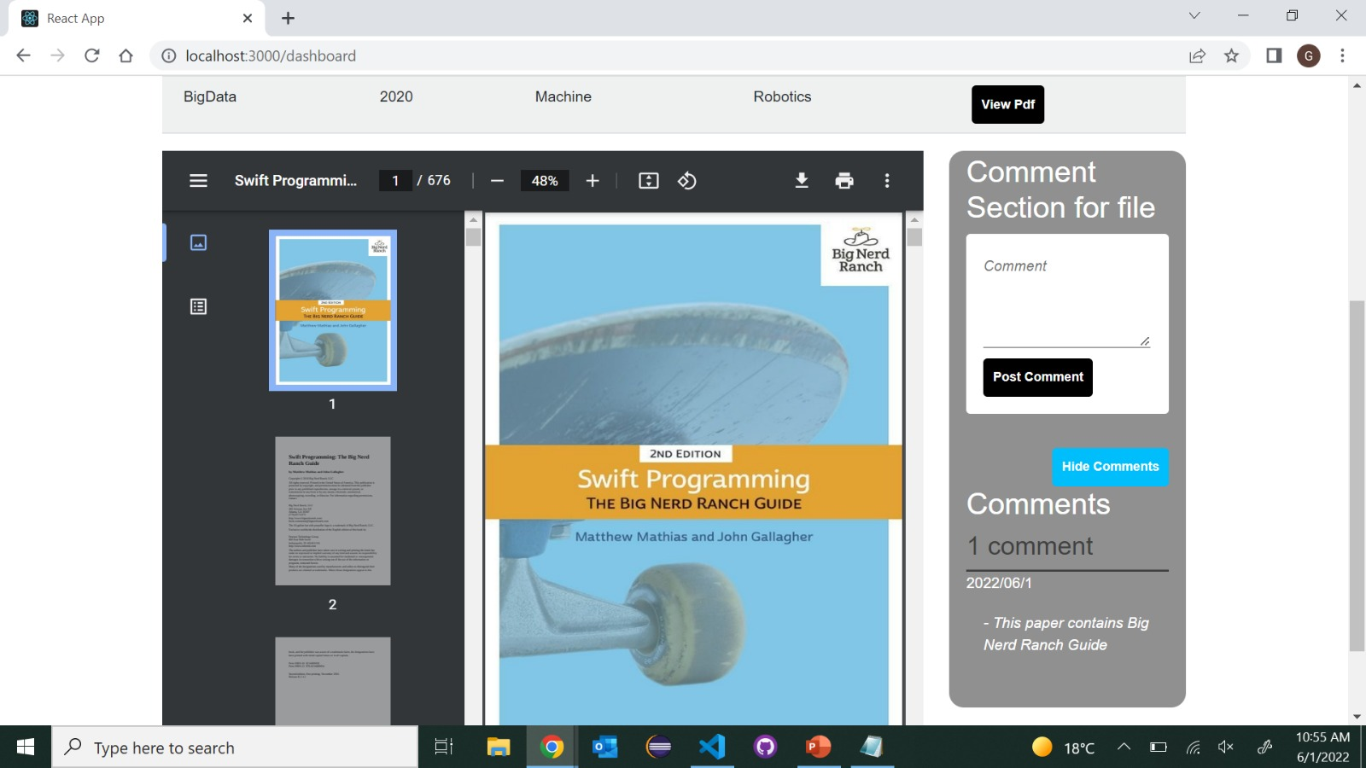
View
Research Content Management
06/02/2022
17

Slide 18
Challenges Faced
We were all working together by learning and implementing while working.
We struggled initially for integrating firebase with React.
Main challenging issue faced was to implement sorting functions.
Completing project on limited time
Research Content Management
06/02/2022
18

Slide 19
Conclusion
This project is appropriate for user who needs a place to save PDF files.
Based on the project's features, we can say that it makes it simple for users to track down files by performing searching operations and adding comments for reference.
We performed tasks according to the schedule.
We have successfully completed our project on time.
Research Content Management
06/02/2022
19

Slide 20
Introduction To Hydroponic Farming
It is technique for growing plants without soil.
Utilizing this methodology, the roots absorb balanced nutrients that are dissolved in water. which meets all the plant developmental requirements.
As a result, the plants can grow quicker and healthier.
So, as long as there’s water and nutrients, they can sustain themselves and survive.

Slide 21
Objective
The main objective of this project is to maintain the plants in their natural state by monitoring the factors that increase plant life
We provide the light to the plants by providing red and blue LED’s light that facilitate the photosynthesis.
Using Hydroponic farming we can provide plants sufficient nutrients and water supply for faster growth.
We can control the water supply using a smart phone.

Slide 22
Hardware and Technologies:
ESP32
DS18B20
MQ135
DHT11
Ultrasonic sensor
Submersible pump
Dc motor
Arduino IDE:
Arduino is a prototype platform (open-source) based on an easy-to-use hardware and software.
It is used to write and upload the computer code to the physical board
Blynk IOT:
Blynk is a simple and powerful no-code application builder where you can prototype, deploy, and manage connected electronic devices at any scale.

Slide 23
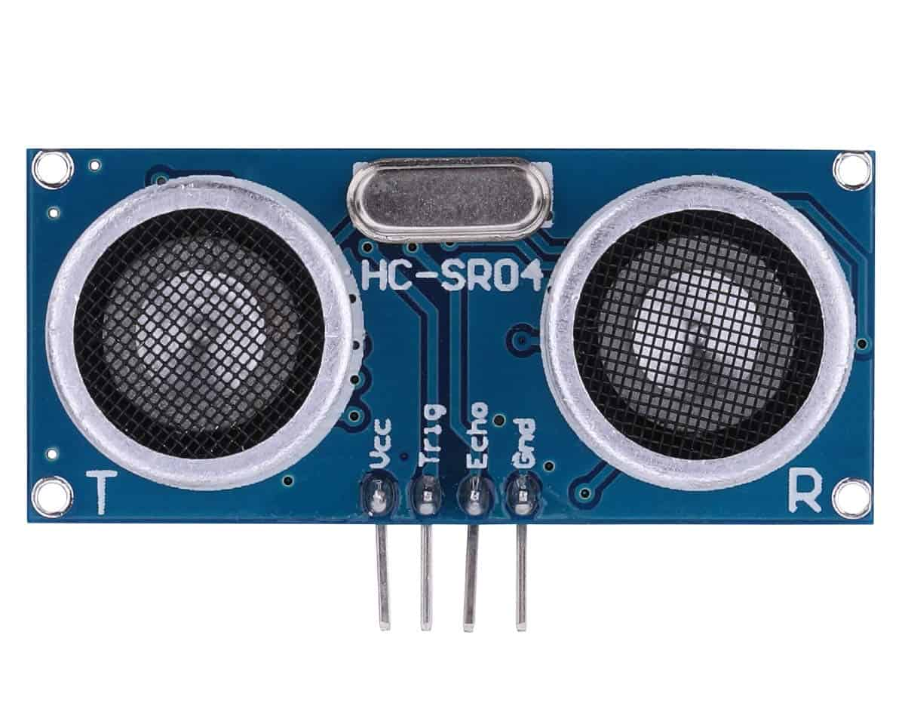
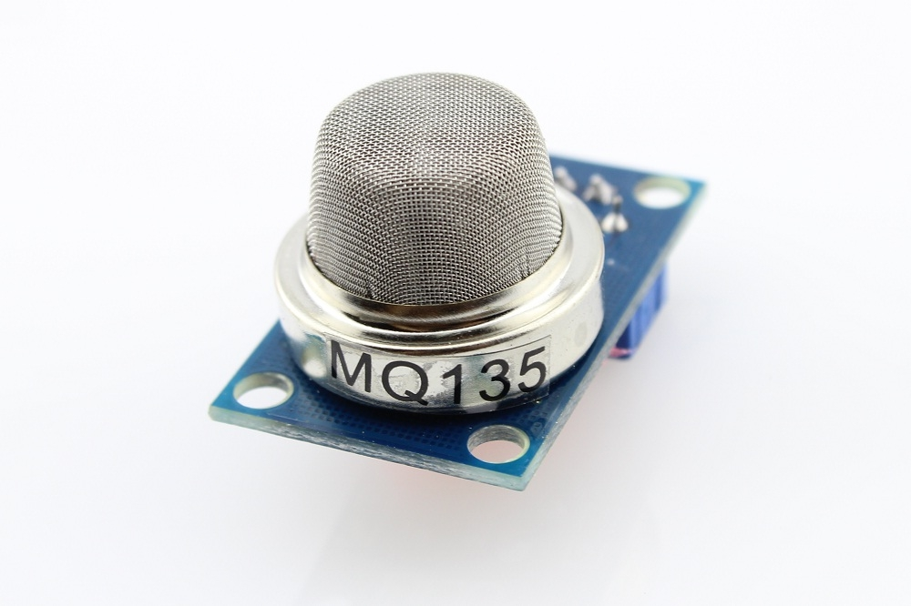
HCSR04
An ultrasonic sensor is an electronic device that measures the distance of a target object by emitting ultrasonic sound waves.
It is used to detect the water level in the tank.
MQ135
It is an air quality sensor for detecting a wide range of gases, including NH3, NOx, alcohol, smoke and CO2.
It is used as a fire alarm in the project

Slide 24
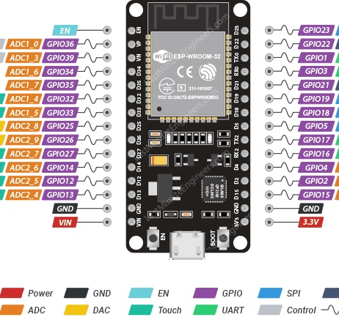
ESP32
The ESP32 is an updated version of the ESP8266.
It offers both Bluetooth and BLE (Bluetooth Low Energy), whereas the ESP8266 only has Wi-Fi .
The ESP32 has 36 GPIO pins.
It supports clock frequency up to 240MHz.
It is faster and is available in a dual-core design. It is also capable of operating in an ultra-low-power mode, ideal for battery-powered applications.

Slide 25
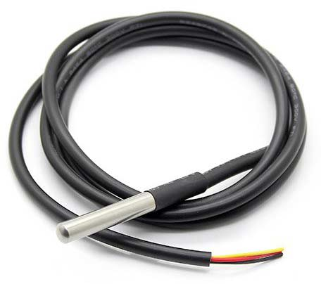
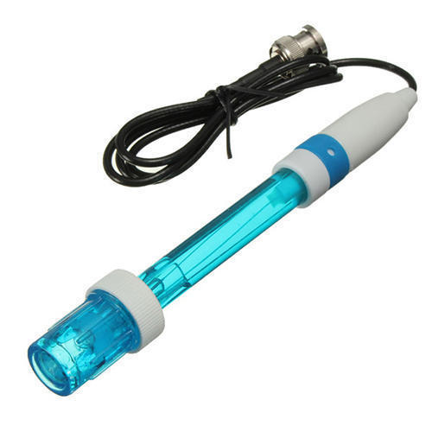
DS18B20
The DS18B20 is a digital thermometer that can provide 9-bit to 12-bit resolution and can measure temperatures from -55°C to +125°C
It is used to measure water temperature in this project.
PH sensor
A pH sensor helps to measure the acidity or alkalinity of the water with a value between 0-14

Slide 26
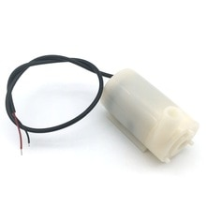
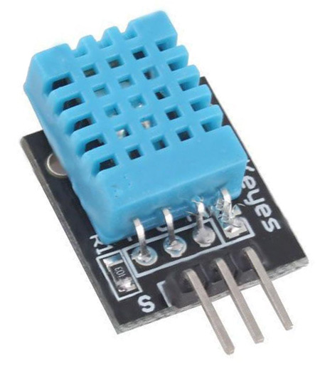
DHT 11
It is a digital humidity temperature sensor consists of capacitive humidity sensing element and a thermistor for sensing temperature.
As temperature decreases resistivity increases.
Submersible pump:
It is used to control the water flow in the tank.

Slide 27
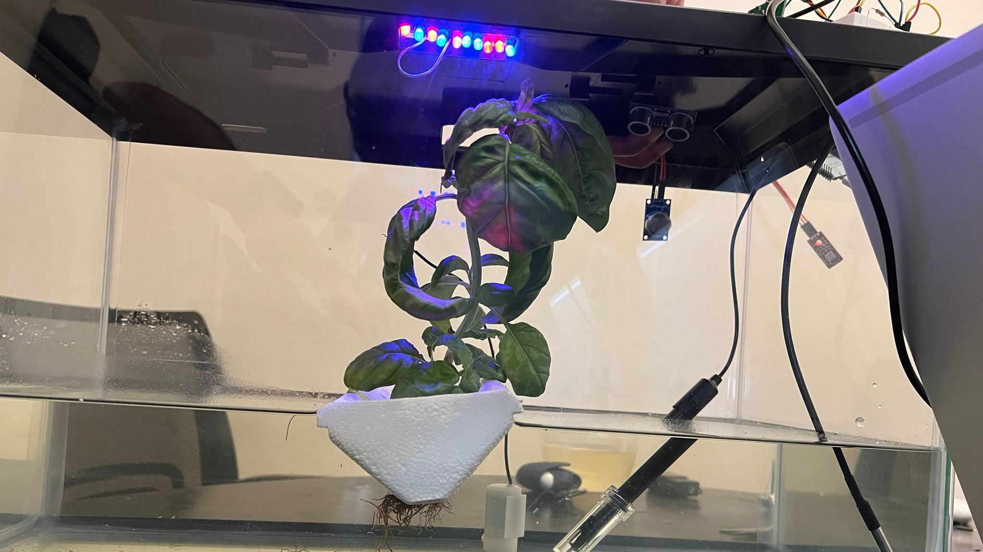

Slide 28
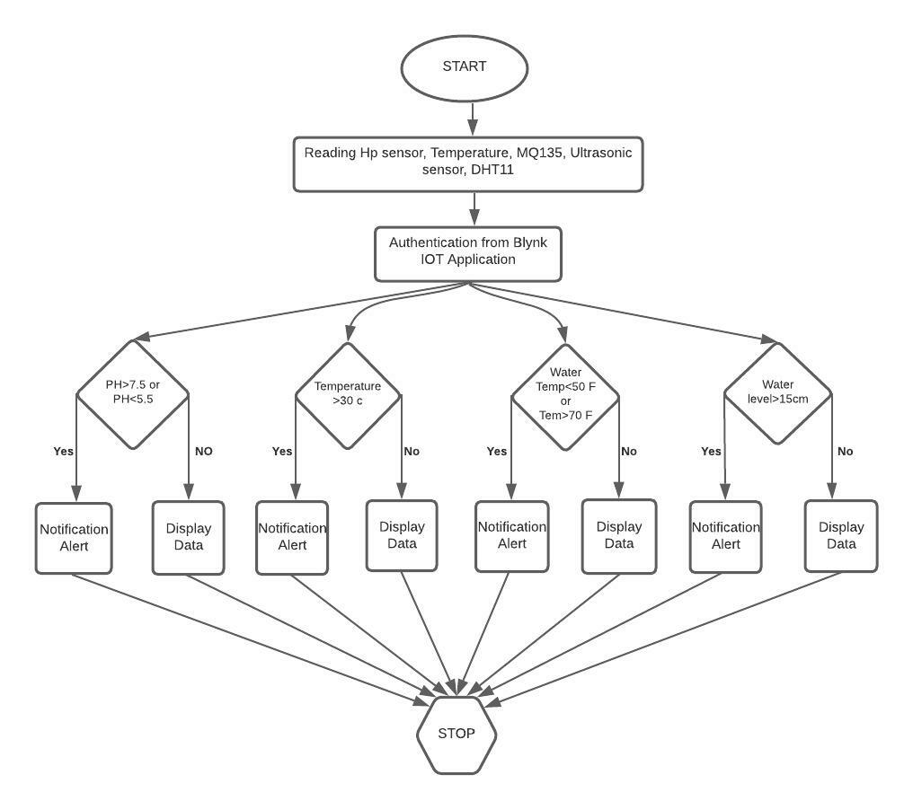
Flow Chart
Initially, the user begins by starting the device, whenever the system is started it starts reading the values of pH, temperature, water temperature of the liquid solution and water level inside the tank.
Whenever the threshold value exceeds a notification alert is sent to the user through Blynk IoT else display the data to the user.
The rules set to regulate the motor state based on the input of pH, water temperature and water level inside the tank.

Slide 29
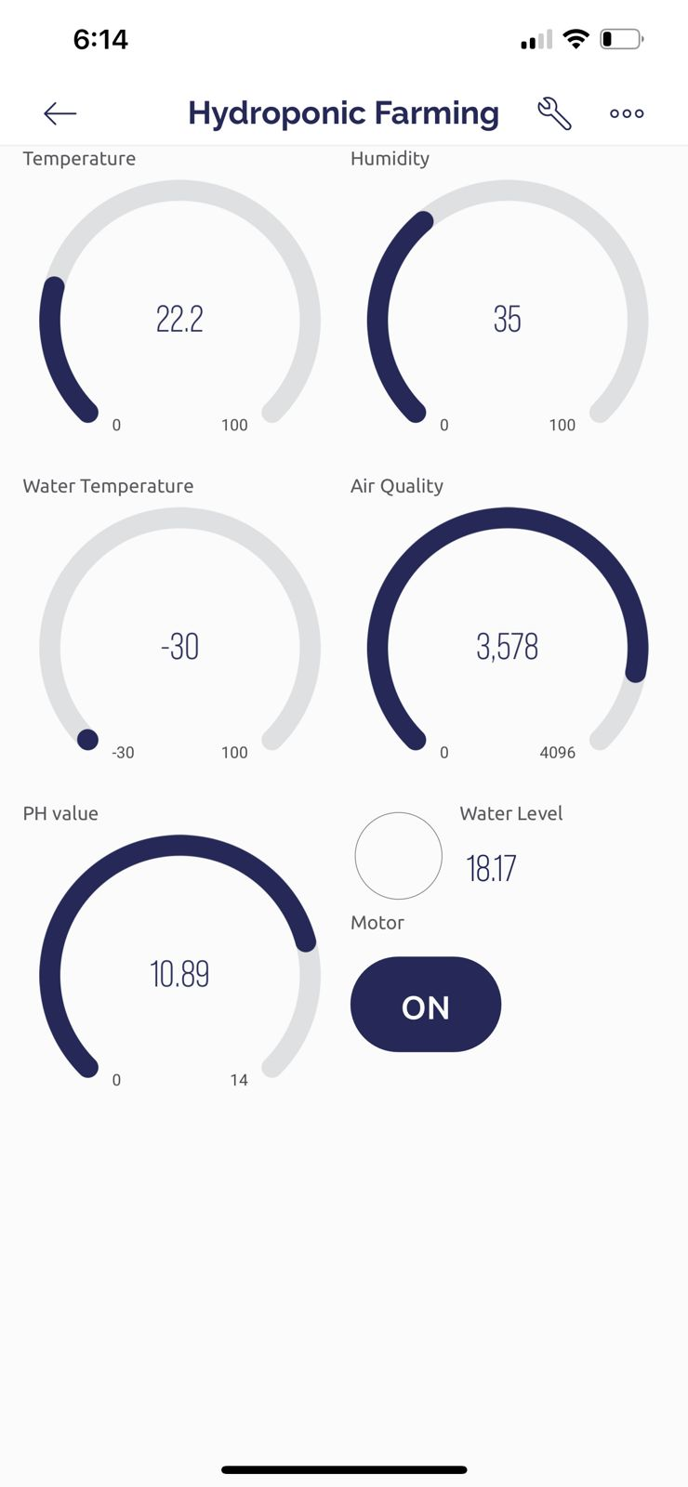
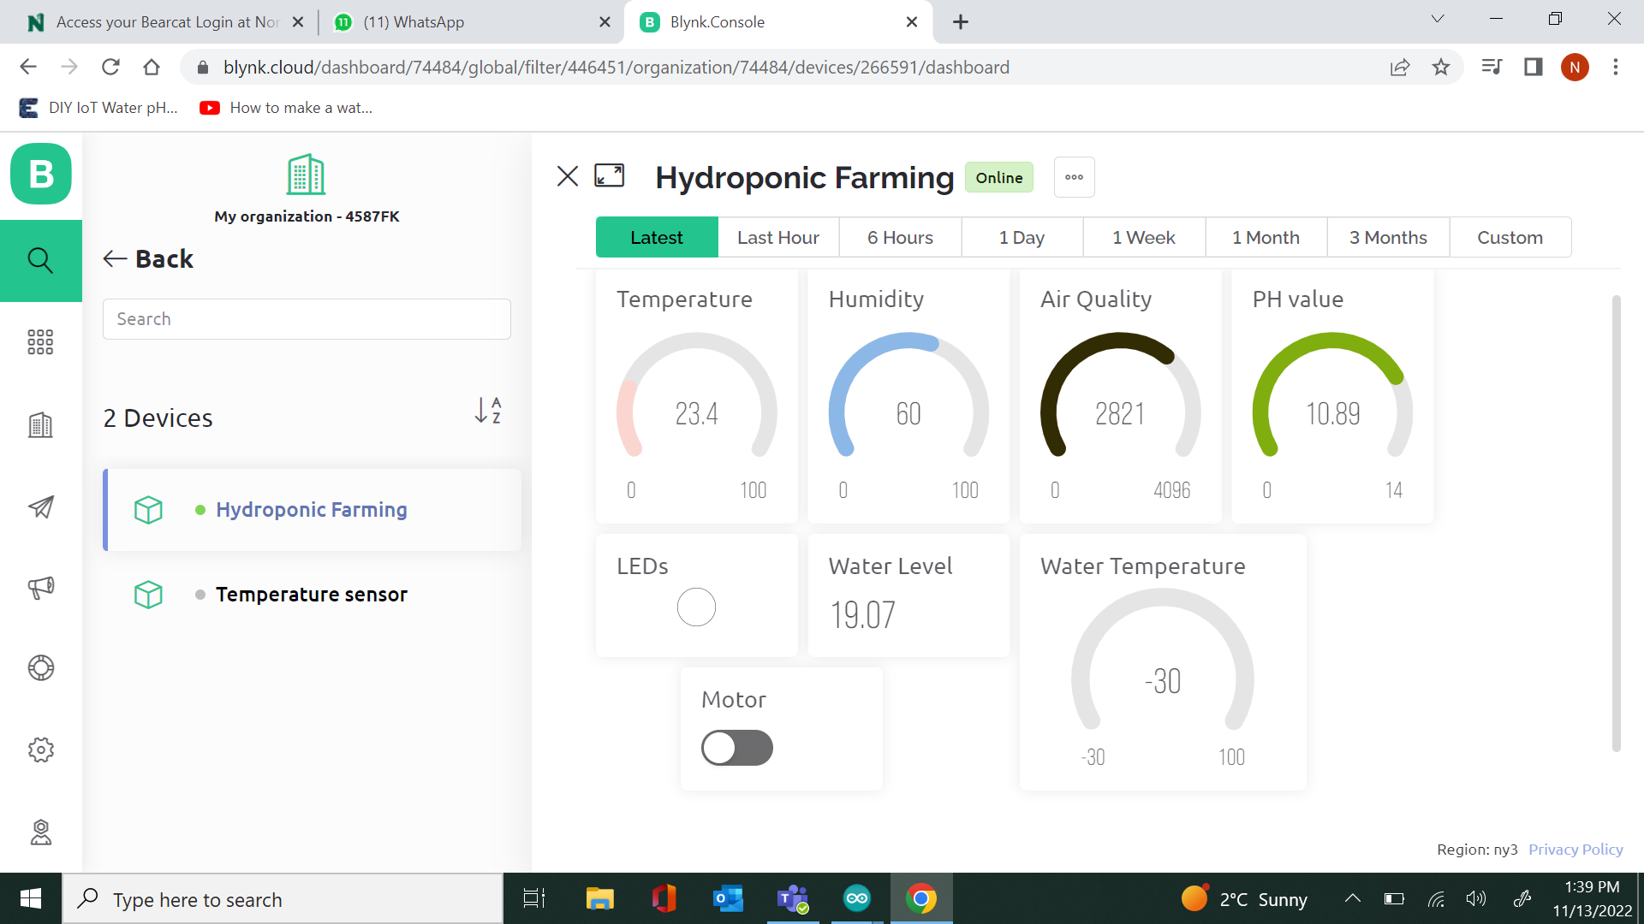
Blynk IoT

Slide 30
Conclusion
By this project we can avoid wastage of water by reusing the same water.
We can avoid weeds that grow together with the crops and achieve the high yield of crops.
We can supply sufficient nutrients to the plants as roots are directly deployed in water, As water is a good dissolvent.
Finally, IOT helps us to monitor and control the conditions of the plant on a regular basis and analyze it using a smart phone.

