Slide 1
Northwest Missouri State University
  Research Content Management
Presented by
Guided by
  Nithin Reddy Kumbham
  Vamsidhar Reddy Police
  Saivivek Reddy Kusukuntla
  Jawahar Reddy Nomula
  Gopi Krishna Kandimalla
  Abhinav Bellamkonda
Dr. Ratan Lal (Assistant Professor) School of Computer Science and Information Systems.
Program : Applied Computer Science

Slide 2
Roles and Responsibilities
Front-end Development
Vamsidhar Reddy Police
Saivivek Reddy Kusukuntla
Back-end Development
Nithin Reddy Kumbham
Abhinav Bellamkonda
Database Management
Jawahar Reddy Nomula
Gopi Krishna Kandimalla

Slide 3
Motivation
Research Content Management is a web application where users can store all their research papers.
The application is designed with less complex structure making users to understand easily.
Research Content Management application is a one place to store papers and use them for future reference.
Examples:
  Google Drive
  iCloud
  Microsoft OneDrive
  Dropbox

Slide 4
Scope
The main objective of this project is to make user access his research papers with user friendly environment to make a note of his research work for referencing.
User can search and sort out easily from a bulk of research papers and can have an idea regarding the research paper by adding some comments and text highlighting functionality inside a PDF.
It is much helpful when referencing.

Slide 5


Technologies used
React: It is a JavaScript library used to create fast user interfaces for websites and applications.
Firebase: The Firebase Firestore Database is used to build rich, collaborative applications by allowing secure access to the database directly from client-side code.

Slide 6


Tools Used
GitHub: This tool is used for collaborating between the team members while implementing the project.
VS Code: This is an IDE, where the actual code is written and for running the project.

Slide 7
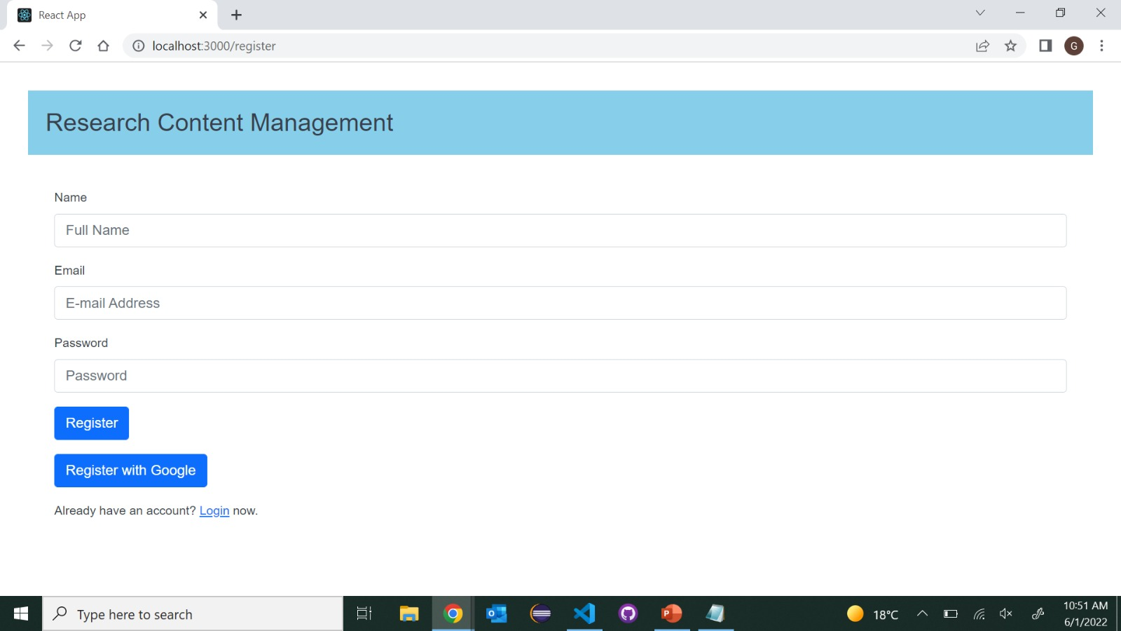
Register Page
Register page is to create an account for the user.
Register page also provides an option to signup with Google.
All the fields in the register page are mandatory.
User can navigate to login page if he/she is already registered as a user.
User credentials are stored in database which is further used for authentication.

Slide 8
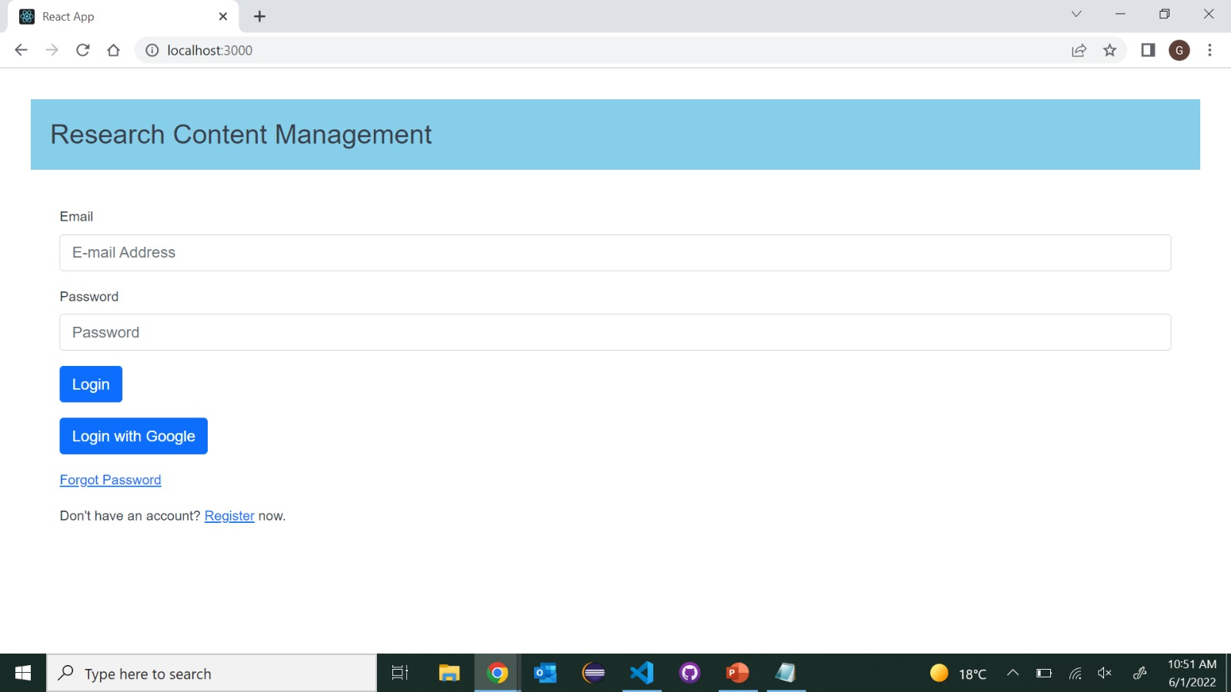
Login page
Login page is used to login to the application.
User needs to enter email address and password to login or can login with Google account.
If user had forgotten his credentials, he/she can retrieve it by using forgot password link.
If user credentials doesn’t match an error will be popped up saying incorrect credentials.

Slide 9
Dashboard
When user had successfully logged in using his credentials, user will be navigated to dashboard of the application.
In dashboard page user can view his username, email and logout button in Home bar.
Upload has options to upload a paper and search has options to search for a particular paper from list of papers.

Slide 10
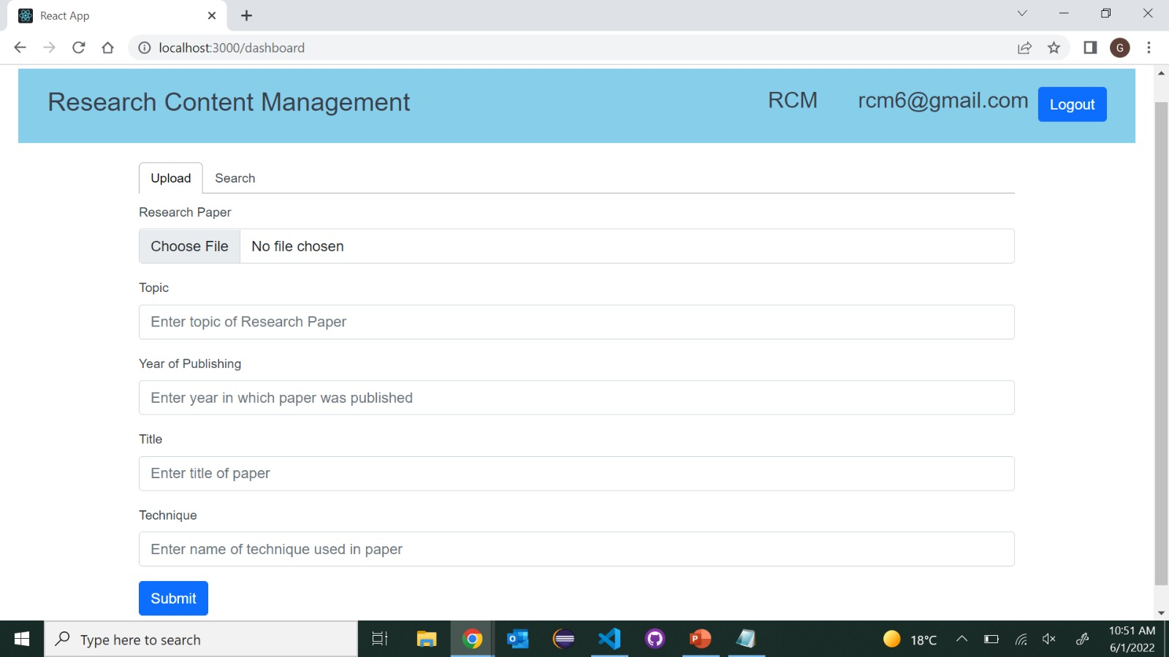
Upload Page
User need to upload the file in the pdf format.
User can Enter the year of publishing, title of the paper, technique used in the paper and title of the research paper.
When user clicks on submit button the data will be uploaded to the firebase.
The uploaded paper will be unique with other list of papers.

Slide 11
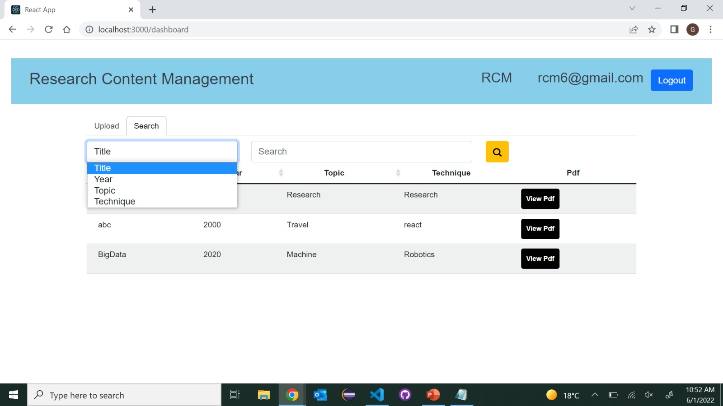
Search Page
In search page user can see the list of all uploaded papers in a list view.
It has a functionality to search the Research papers.
Sorting can be done by title, year, topic and technique which the user had provided during uploading a paper.
User can see uploaded papers according to the sorting functions.
User can view the uploaded paper by clicking on view pdf option.

Slide 12
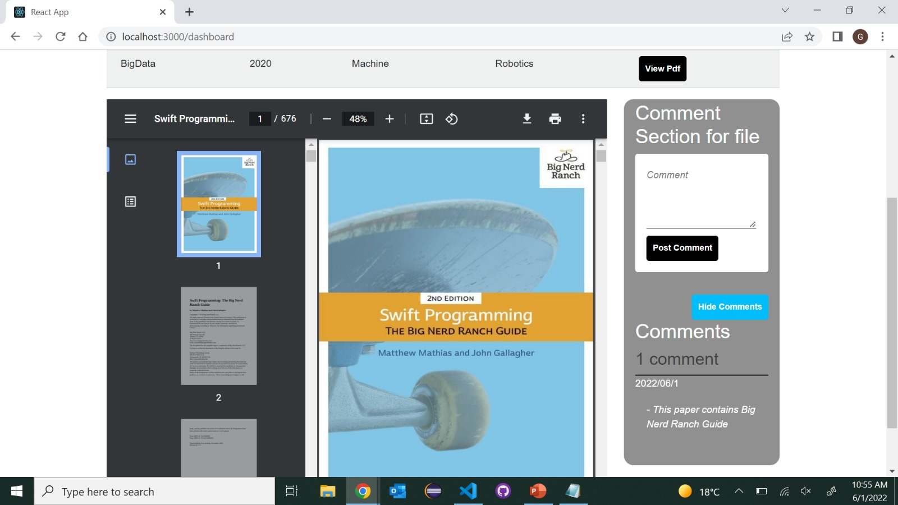
View

Slide 13
Conclusion
This project is appropriate for user who needs a place to save PDF files.
It makes it simple for users to track down files by performing searching operations and adding comments for reference.

Slide 14
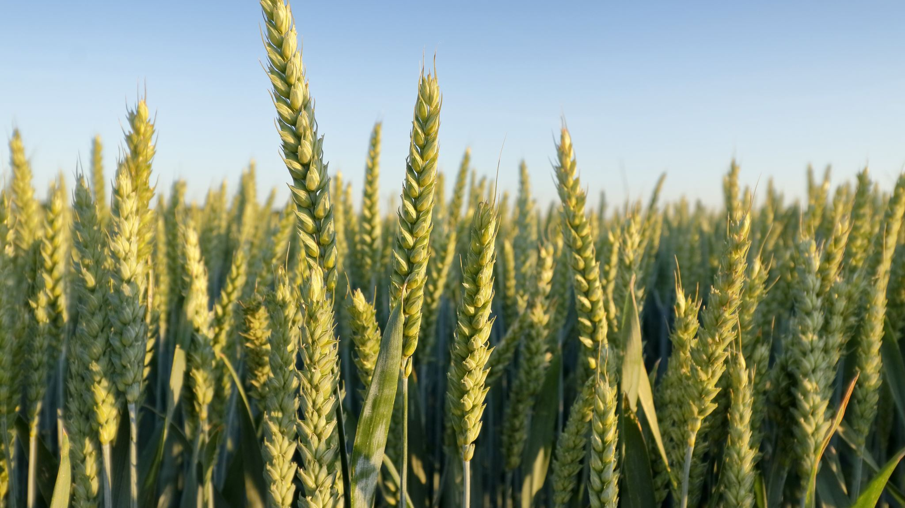
Smart Hydroponic Farming Using Internet of Things

Slide 15

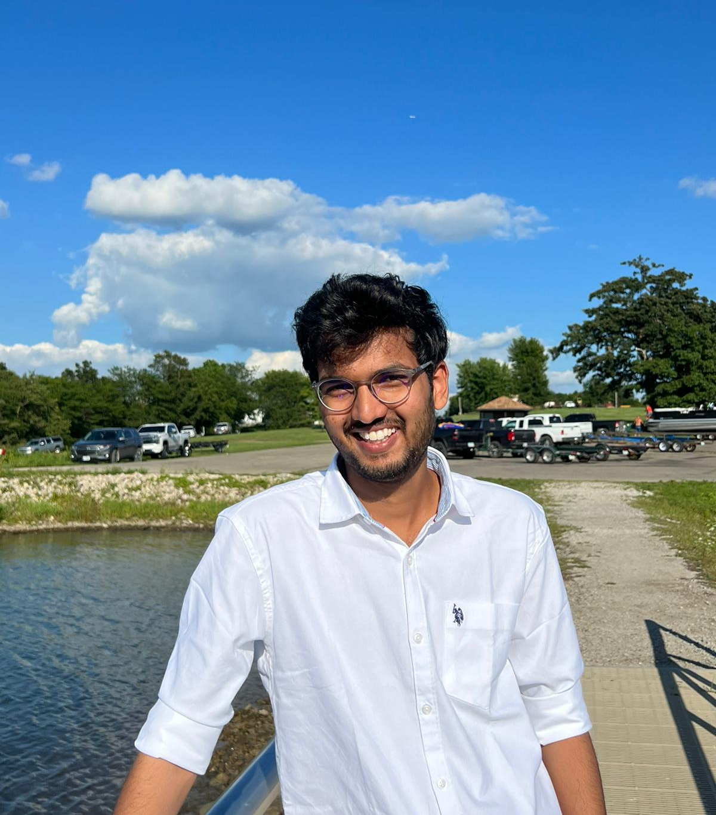
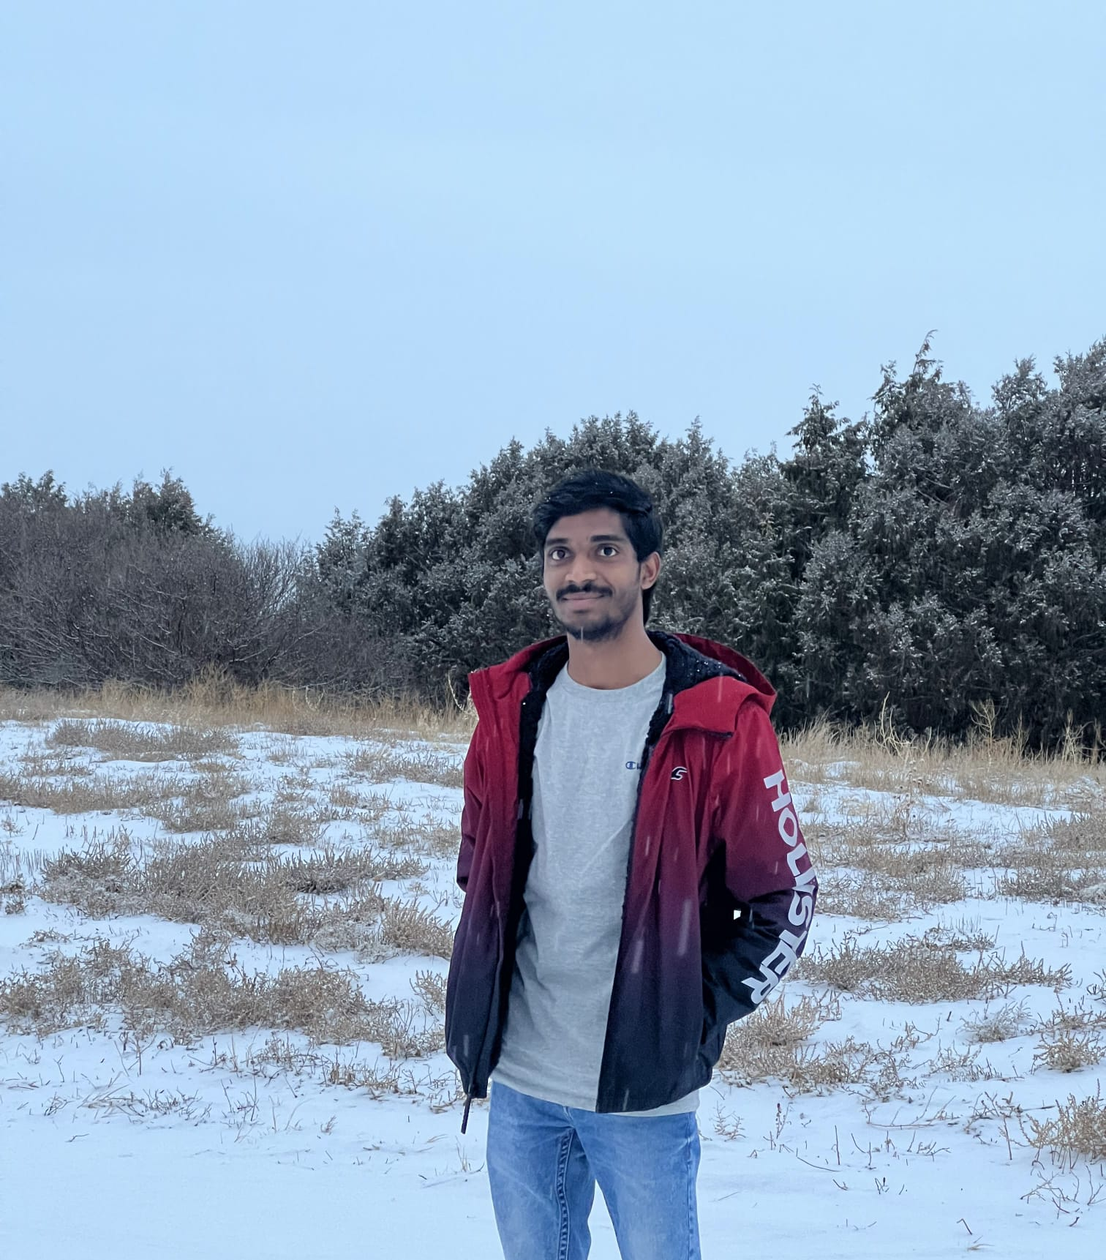
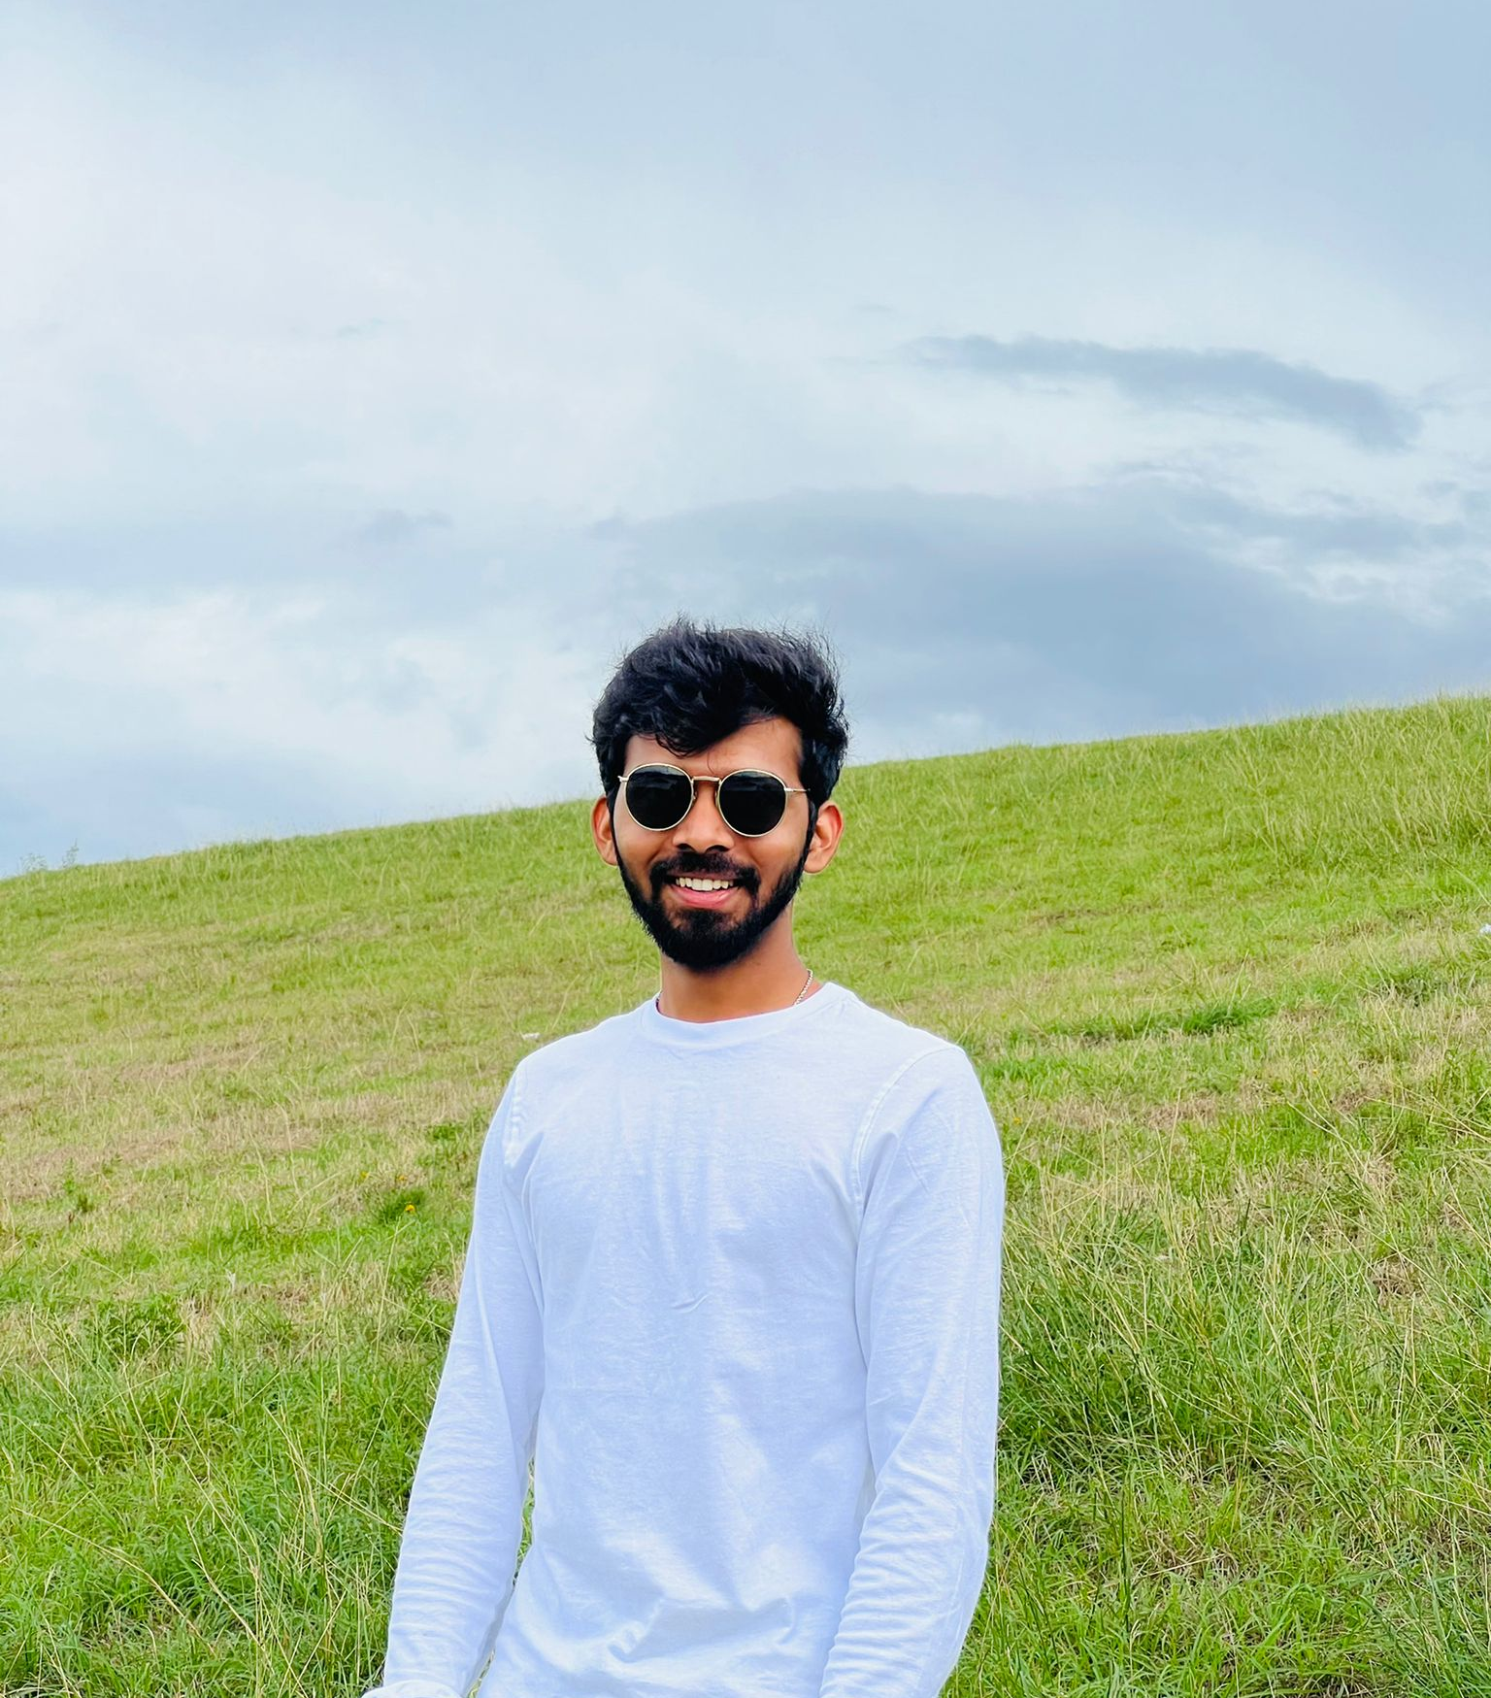
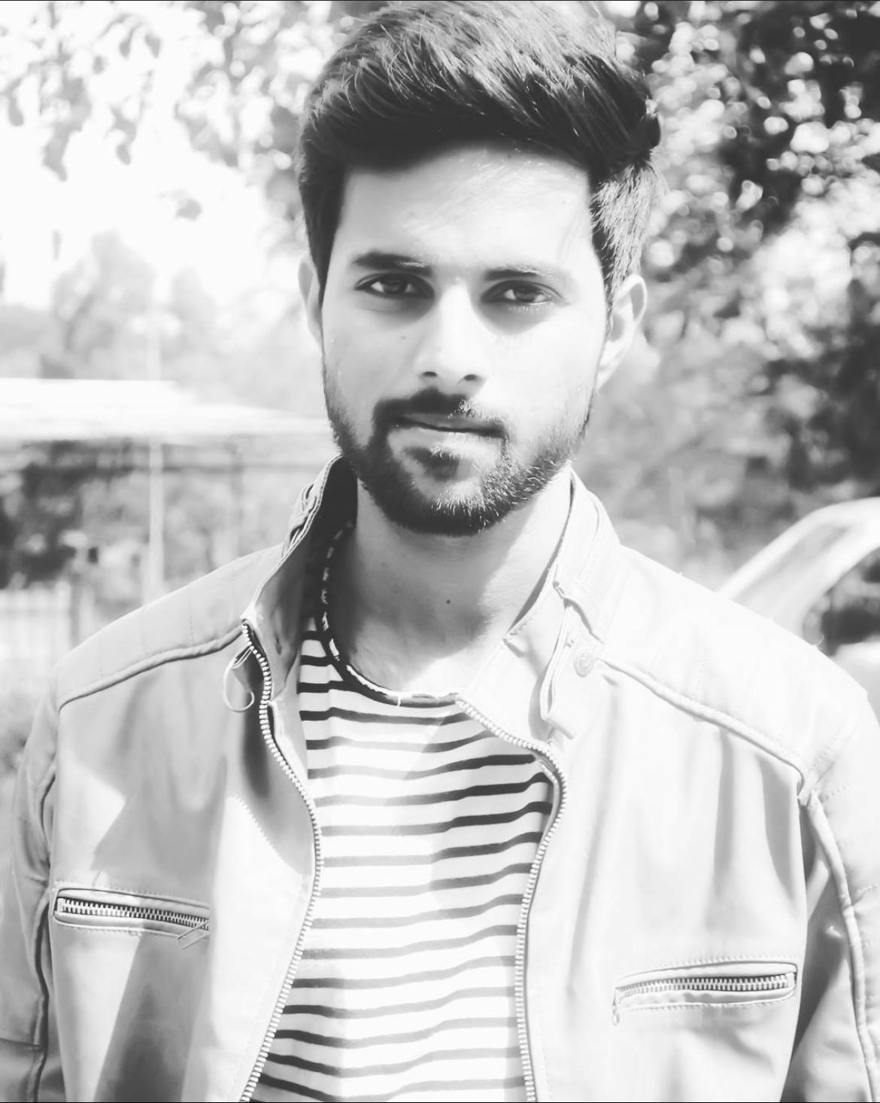

Team Members
Abhinav Bellamkonda
Vamsidhar Reddy Police
Nithin Reddy Khumbam
Saivivek Reddy Kusukuntla
Gopi Krishna Kandimalla
Jawahar Reddy Nomula

Slide 16
Motivation
There are many reasons that plants die:
    Lack of water supply
    Lack of sunlight
    Lack of nutrients
Using Hydroponic Farming we can overcome the challenges
Hydroponic Farming is technique for growing plants without soil.
Using this methodology, the roots absorb balanced nutrients that are dissolved in water. which meets all the plant developmental requirements.
As a result, the plants can grow quicker and healthier.
So, as long as there’s water and nutrients, they can sustain themselves and survive.

Slide 17
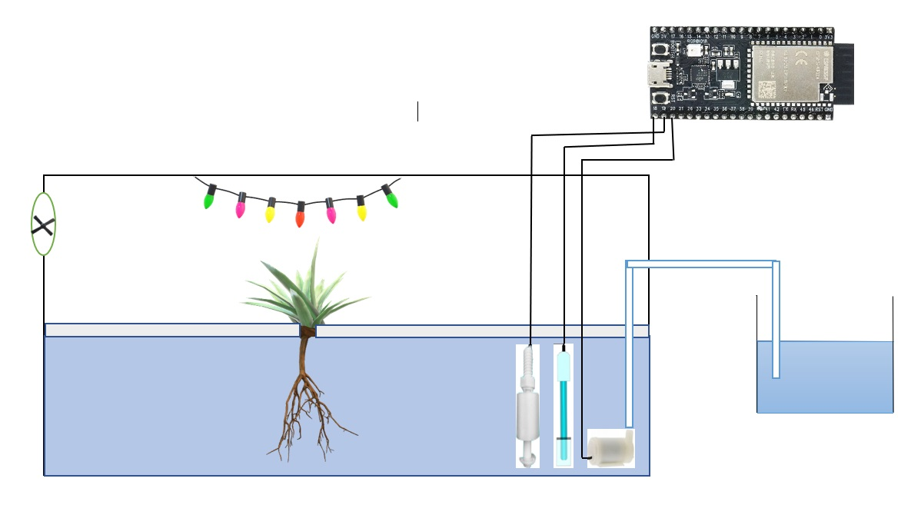
Objective
The main objective of this project is to maintain the plants in their natural state by monitoring the factors that increase plant life
Manual Monitoring of the plant environmental factors is a trivial task.
Using Hydroponic farming integrated with IoT, we can monitor the parameters by a smart phone.
We can control the water supply using a smart phone.

Slide 18
Hardware and Technologies
Arduino IDE:
Arduino is a prototype platform (open-source) based on an easy-to-use hardware and software.
It is used to write and upload the computer code to the physical board
Blynk IOT:
Blynk is a simple and powerful no-code application builder where you can prototype, deploy, and manage connected electronic devices at any scale.
ESP32
DS18B20
MQ135
DHT11
Ultrasonic sensor
Submersible pump
Dc motor

Slide 19
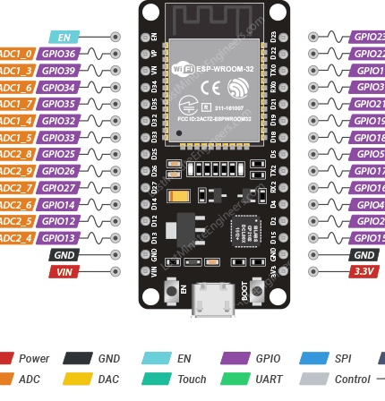
ESP32
The ESP32 is an updated version of the ESP8266.
It offers both Bluetooth and BLE (Bluetooth Low Energy), whereas the ESP8266 only has Wi-Fi .
The ESP32 has 36 GPIO pins.
It supports clock frequency up to 240MHz.
It is faster and is available in a dual-core design. It is also capable of operating in an ultra-low-power mode, ideal for battery-powered applications.

Slide 20
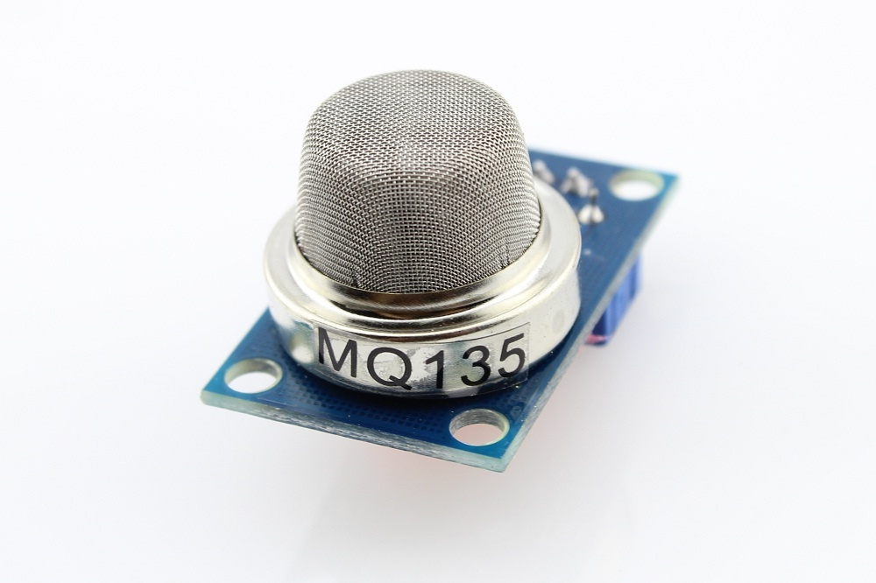
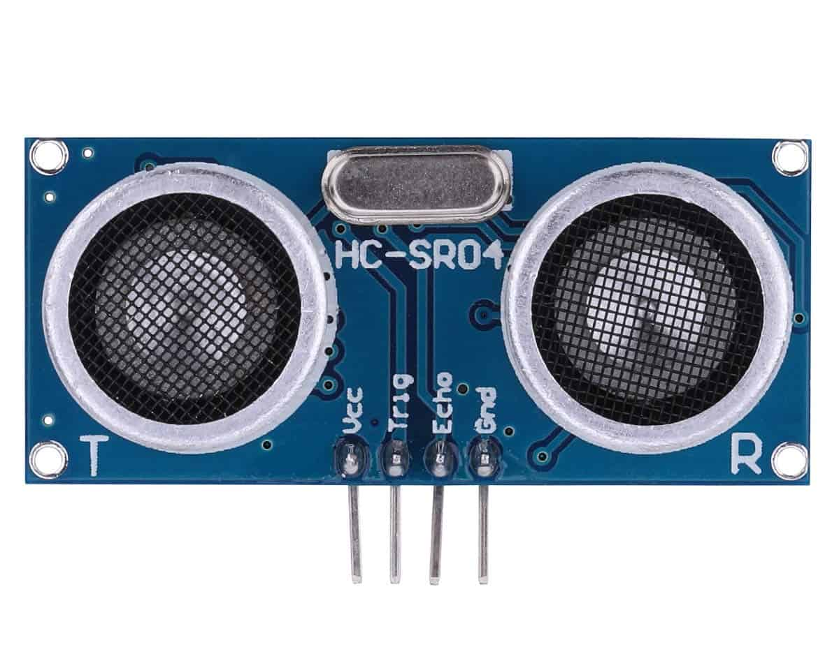
Sensors
MQ135
It is an air quality sensor for detecting a wide range of gases, including NH3, NOx, alcohol, smoke and CO2.
It is used as a fire alarm in the project
HCSR04
An ultrasonic sensor is an electronic device that measures the distance of a target object by emitting ultrasonic sound waves.
It is used to detect the water level in the tank.

Slide 21
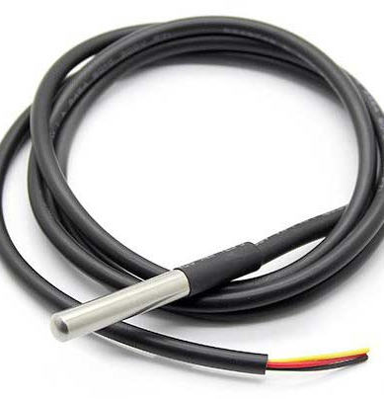
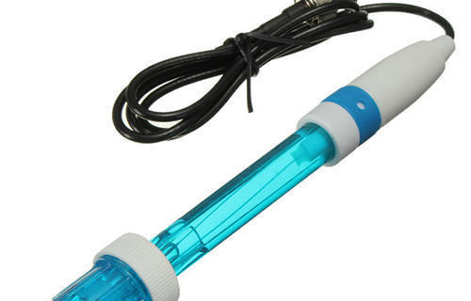
Sensors
DS18B20
The DS18B20 is a digital thermometer that can provide 9-bit to 12-bit resolution and can measure temperatures from -55°C to +125°C
It is used to measure water temperature in this project.
PH sensor
A pH sensor helps to measure the acidity or alkalinity of the water with a value between 0-14.

Slide 22
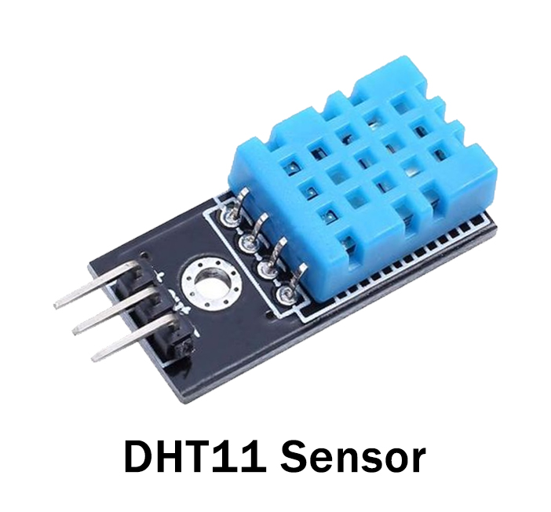
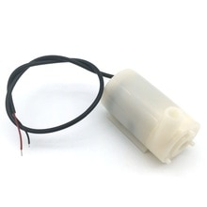
Sensors
DHT 11
It is a digital humidity temperature sensor consists of capacitive humidity sensing element and a thermistor for sensing temperature.
As temperature decreases resistivity increases.
Submersible pump:
It is used to control the water flow in the tank.

Slide 23
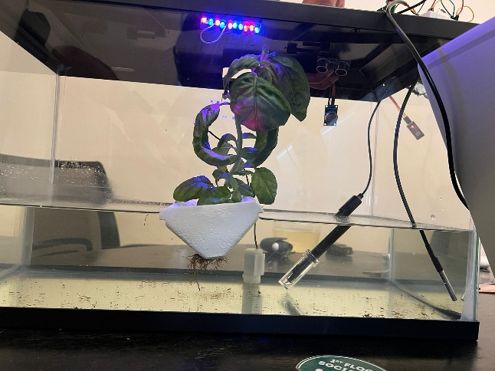
Working Project

Slide 24
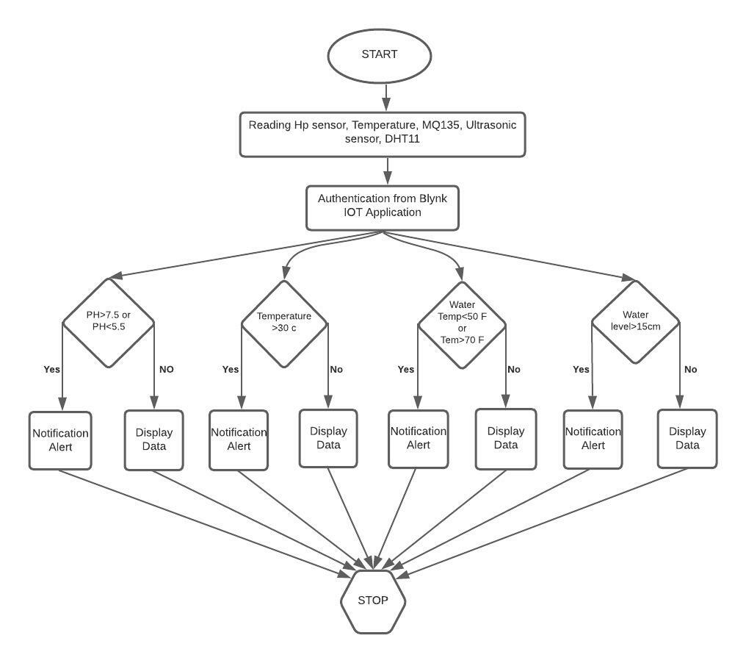
Flow Chart
Step 1: Start
Step 2: reading the values of pH, temperature, water temperature and water level inside the tank.
Step 3: Display Data on Blynk Platform.
Step 4: Whenever the threshold value exceeds a notification alert is sent to the user through Blynk IoT else display the data to the user.
Step 5: The rules set to regulate the motor state based on the input of pH, water temperature and water level inside the tank.
Step 6: Stop

Slide 25
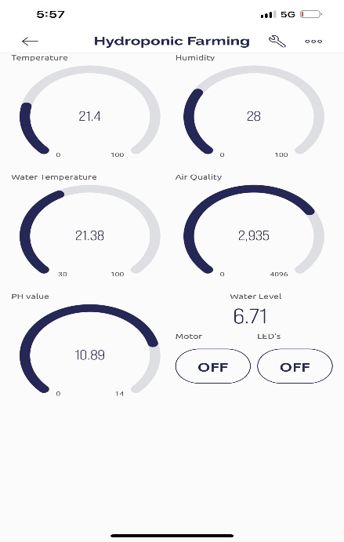
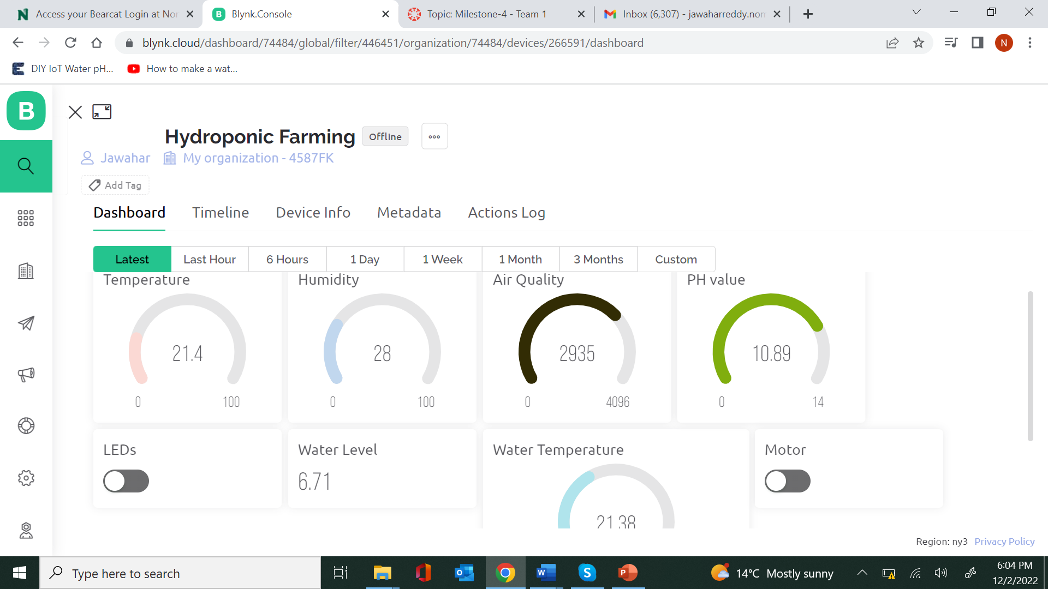
Blynk IoT

Slide 26
Conclusion
By this project we can avoid wastage of water by reusing the same water.
We can avoid weeds that grow together with the crops and achieve the high yield of crops.
We can supply sufficient nutrients to the plants as roots are directly deployed in water, As water is a good dissolvent.
Finally, IOT helps us to monitor and control the conditions of the plant on a regular basis and analyze it using a smart phone.

Slide 27
Thank You

