Slide 1
Northwest Missouri State University
Research Content Management
Presented by
Guided by
Nithin Reddy Kumbham
Vamsidhar Reddy Police
Saivivek Reddy Kusukuntla
Jawahar Reddy Nomula
Gopi Krishna Kandimalla
Abhinav Bellamkonda
Dr. Ratan Lal (Assistant Professor) School of Computer Science and Information Systems.
Program : Applied Computer Science
06-02-2022

Slide 2
Roles and Responsibilities
Front-end Development
Vamsidhar Reddy Police
Saivivek Reddy Kusukuntla
Back-end Development
Nithin Reddy Kumbham
Abhinav Bellamkonda
Database Management
Jawahar Reddy Nomula
Gopi Krishna Kandimalla
Research Content Management
06/02/2022
2

Slide 3
Motivation
Research Content Management is a web application where users can store all their research papers.
The application is designed with less complex structure making users to understand easily.
Research Content Management application is a one place to store papers and use them for future reference.
Examples:
I. Google Drive
II. iCloud
III. Microsoft OneDrive
IV. Dropbox
Research Content Management
06/02/2022
3
3

Slide 4
Scope
The main objective of this project is to make user access his research papers with user friendly environment to make a note of his research work for referencing.
User can search and sort out easily from a bulk of research papers and can have an idea regarding the research paper by adding some comments and text highlighting functionality inside a PDF.
It is much helpful when referencing
Month - Year
4
Research Content Management
06/02/2022
4

Slide 5
Functionalities
This website initially has an Authentication process, where the users must either register or login to the website using credentials.
If the user want to upload a research paper, should fill the text fields like topic, year, subtopic, and technique.
In the search page, the user can search for the desired paper using keywords which user used while uploading the paper.
Once the user access the website, the dashboard is displayed in which it has upload and search page.
User can view the paper in pdf format and can even download it.
If the user wants to note an important points for reference or for future use, he can add the comments in the comment section.
Research Content Management
06/02/2022
5

Slide 6


Technologies used
React: It is a JavaScript library used to create fast user interfaces for websites and applications.
Firebase: The Firebase Firestore Database is used to build rich, collaborative applications by allowing secure access to the database directly from client-side code.
Research Content Management
06/02/2022
6

Slide 7


Tools used
GitHub: This tool is used for collaborating between the team members while implementing the project.
VS Code: This is an IDE, where the actual code is written and for running the project.
Research Content Management
06/02/2022
7

Slide 8
Register
Register page is to create an account for the user with full name, email address, and password.
Register page also provides an option to signup with Google.
All the fields in the register page are mandatory with minimum of 6-character length for password.
User can navigate to login page if he/she is already registered as a user.
User credentials are stored in database which is further used for authentication.
Research Content Management
06/02/2022
8

Slide 9
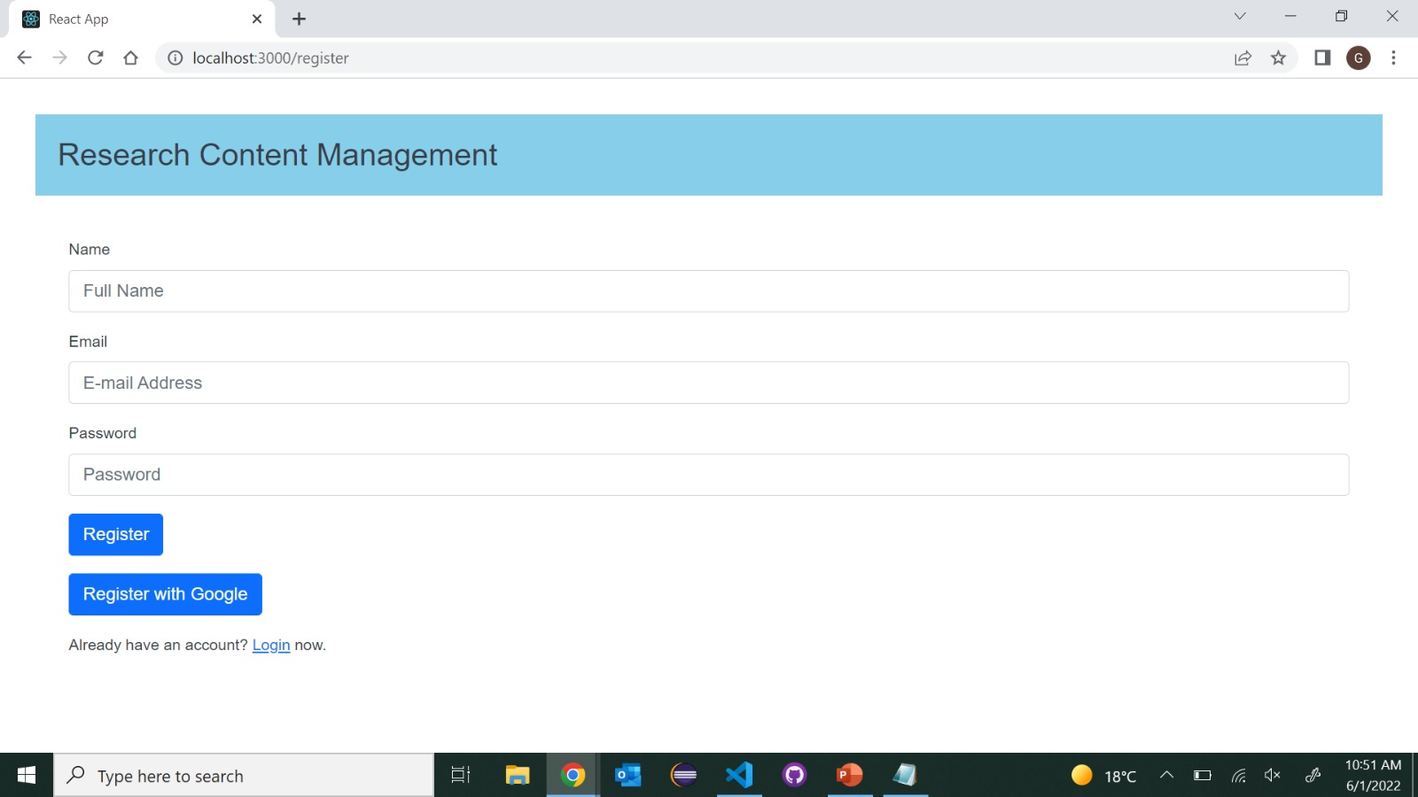
Register Page
Research Content Management
06/02/2022
9

Slide 10
login
Login page is used to login to the application with credentials provided during registration.
User needs to enter email address and password to login or can login with Google account.
If user had forgotten his credentials, he/she can retrieve it by using forgot password link.
If user credentials doesn’t match with the one provided during registration an error will be popped up saying incorrect credentials.
Research Content Management
06/02/2022
10

Slide 11
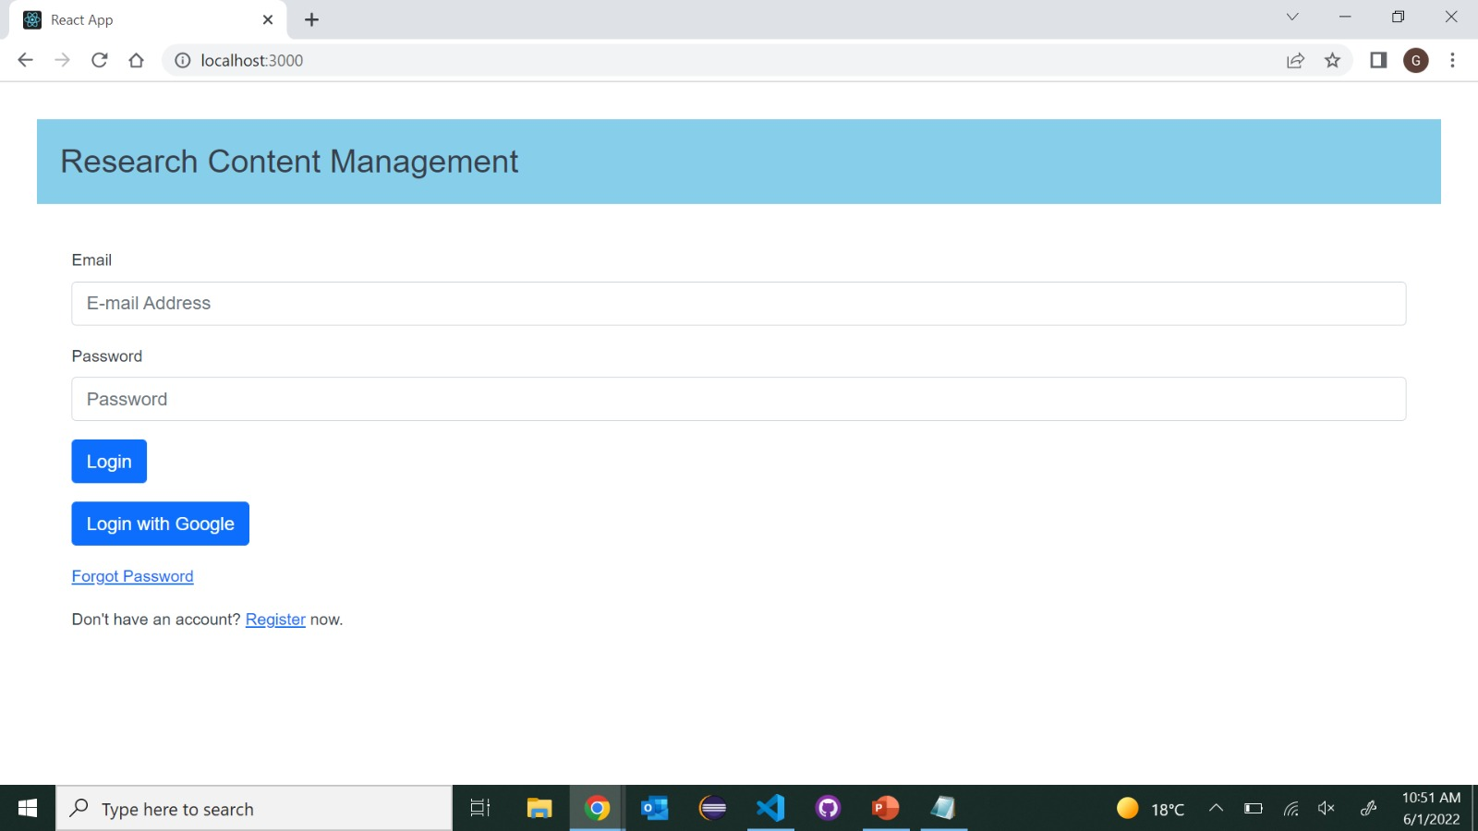
Login page
Research Content Management
06/02/2022
11

Slide 12
Dashboard
When user had successfully logged in using his credentials, user will be navigated to dashboard of the application.
In dashboard page user can view his username, email and logout button in Home bar.
Upload has options to upload a paper and search has options to search for a particular paper from list of papers.
Research Content Management
06/02/2022
12

Slide 13
Upload
User need to upload the file in the pdf* format.
User can further mention the year of publishing, title of the paper, technique used in the paper and title of the research paper.
When user clicks on submit button the data will be uploaded to database in the firebase.
By mentioning all the above details of the paper, the uploaded paper will be unique with other list of papers.
Research Content Management
06/02/2022
13

Slide 14
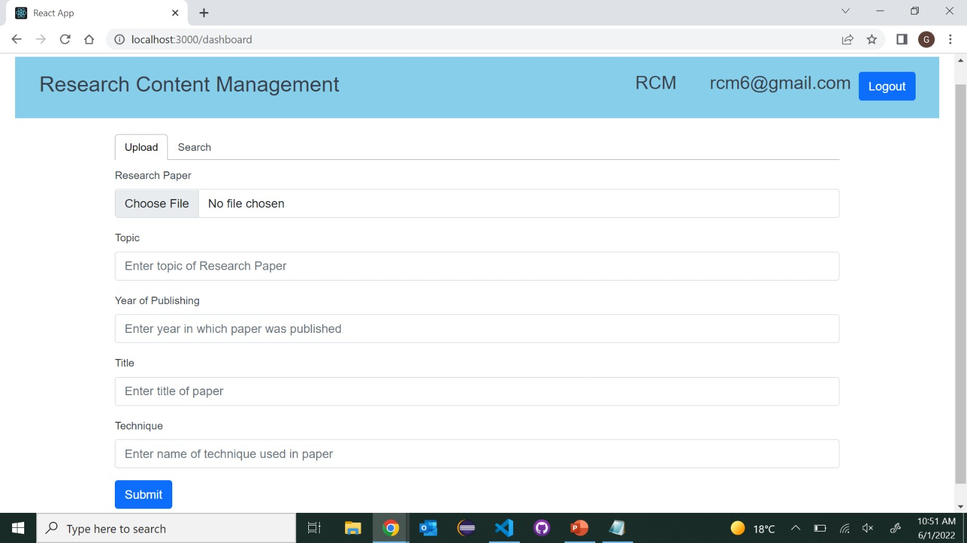
Upload Page
Research Content Management
06/02/2022
14

Slide 15
Search
In search page user can see the list of all uploaded papers in a list view.
There is also a sorting function to search the Research papers from a collection of papers.
Sorting can be done by title, year, topic and technique which the user had provided during uploading a paper.
User can see uploaded papers according to the sorting functions.
User can view the uploaded paper by clicking on view pdf option.
User can further add comments to the paper where the comments are stored by timestamp.
Research Content Management
06/02/2022
15

Slide 16
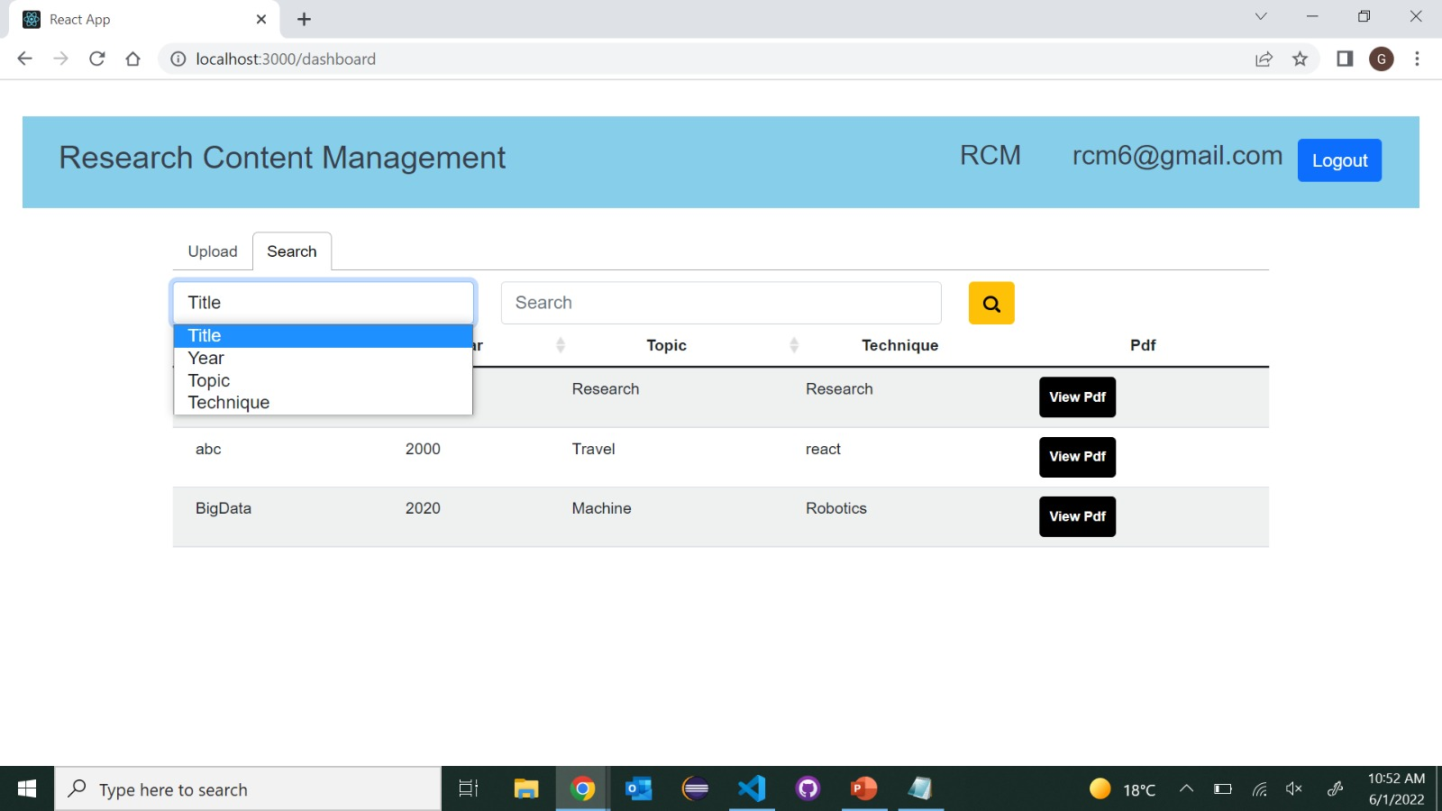
Search Page
Research Content Management
06/02/2022
16

Slide 17
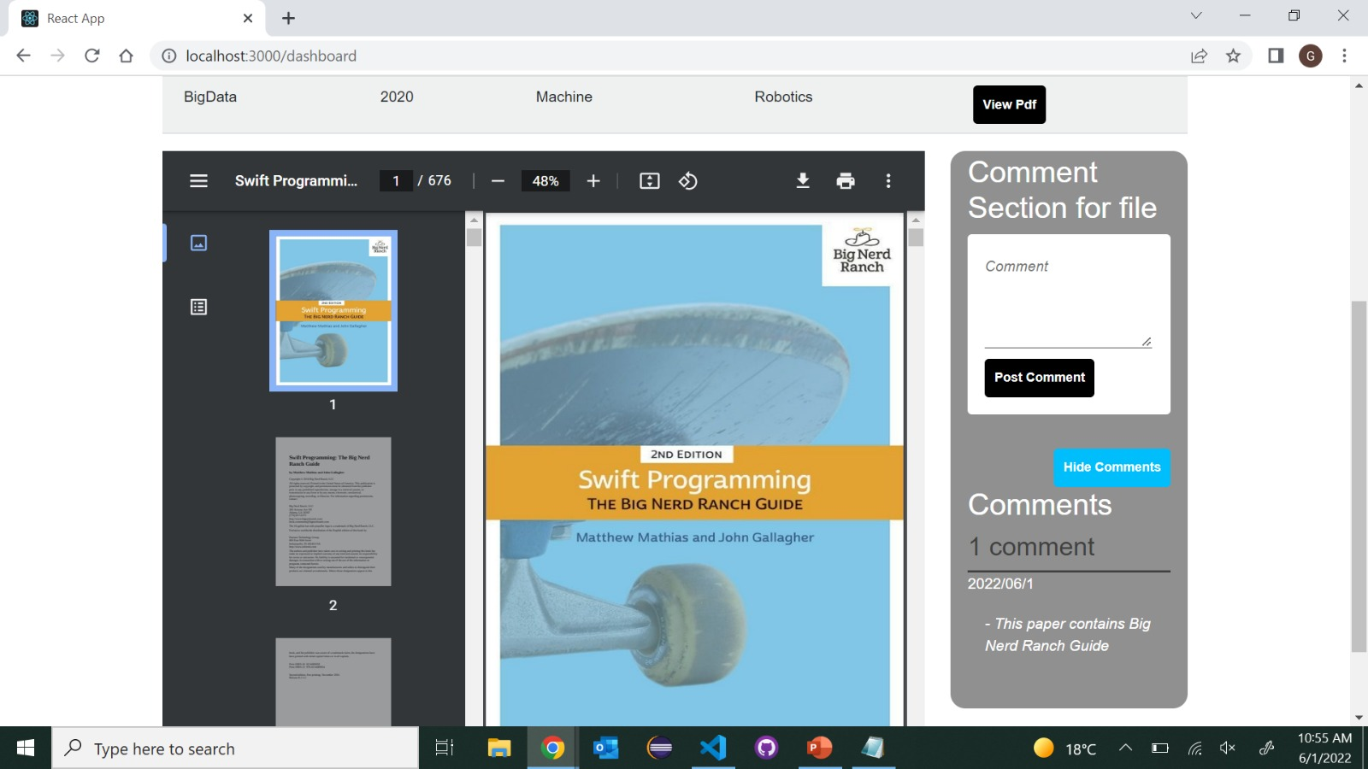
View
Research Content Management
06/02/2022
17

Slide 18
Conclusion
This project is appropriate for user who needs a place to save PDF files.
Based on the project's features, we can say that it makes it simple for users to track down files by performing searching operations and adding comments for reference.
Research Content Management
06/02/2022
18

Slide 19
Introduction To Hydroponic Farming
It is technique for growing plants without soil.
Utilizing this methodology, the roots absorb balanced nutrients that are dissolved in water. which meets all the plant developmental requirements.
As a result, the plants can grow quicker and healthier.
So, as long as there’s water and nutrients, they can sustain themselves and survive.

Slide 20
Objective
The main objective of this project is to maintain the plants in their natural state by monitoring the factors that increase plant life
We provide the light to the plants by providing red and blue LED’s light that facilitate the photosynthesis.
Using Hydroponic farming we can provide plants sufficient nutrients and water supply for faster growth.
We can control the water supply using a smart phone.

Slide 21
Hardware and Technologies:
ESP32
DS18B20
MQ135
DHT11
Ultrasonic sensor
Submersible pump
Dc motor
Arduino IDE:
Arduino is a prototype platform (open-source) based on an easy-to-use hardware and software.
It is used to write and upload the computer code to the physical board
Blynk IOT:
Blynk is a simple and powerful no-code application builder where you can prototype, deploy, and manage connected electronic devices at any scale.

Slide 22
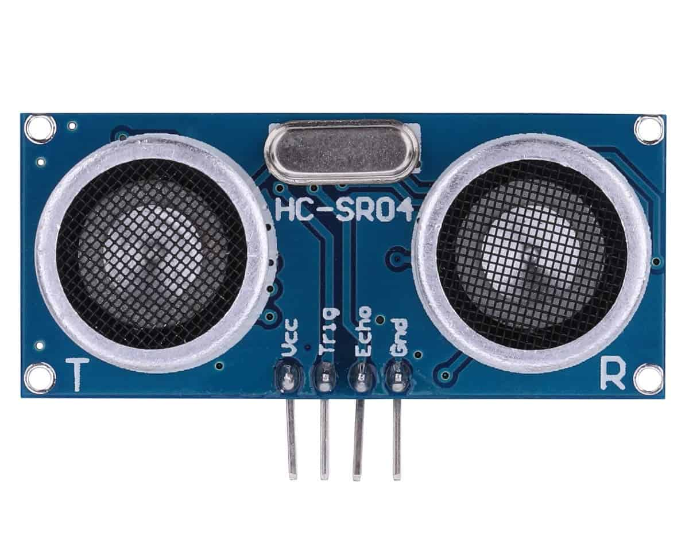
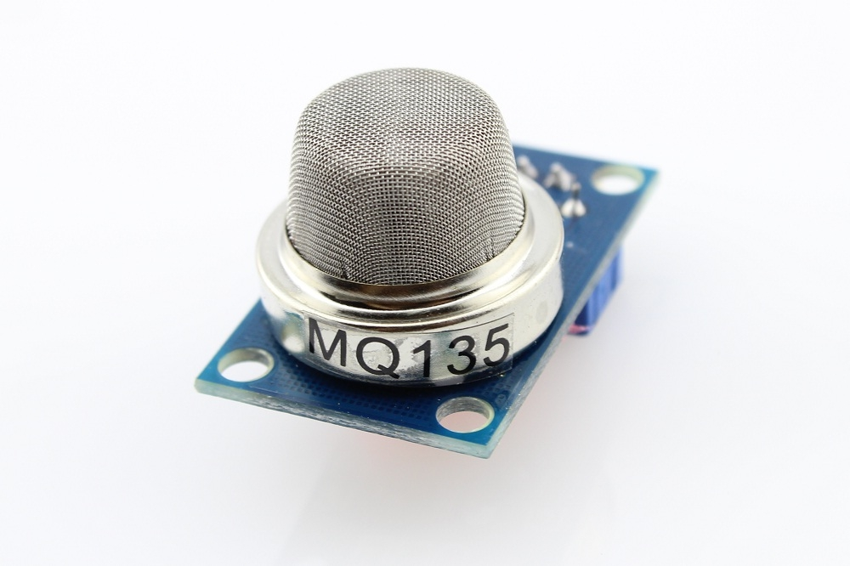
HCSR04
An ultrasonic sensor is an electronic device that measures the distance of a target object by emitting ultrasonic sound waves.
It is used to detect the water level in the tank.
MQ135
It is an air quality sensor for detecting a wide range of gases, including NH3, NOx, alcohol, smoke and CO2.
It is used as a fire alarm in the project

Slide 23
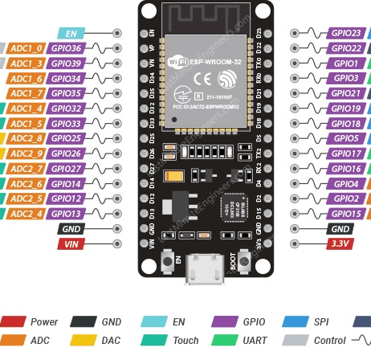
ESP32
The ESP32 is an updated version of the ESP8266.
It offers both Bluetooth and BLE (Bluetooth Low Energy), whereas the ESP8266 only has Wi-Fi .
The ESP32 has 36 GPIO pins.
It supports clock frequency up to 240MHz.
It is faster and is available in a dual-core design. It is also capable of operating in an ultra-low-power mode, ideal for battery-powered applications.

Slide 24
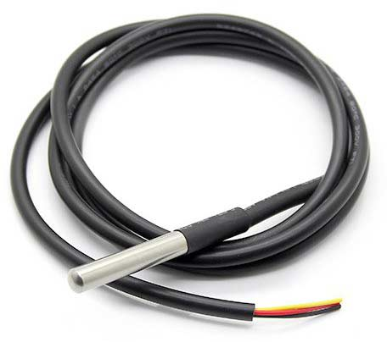
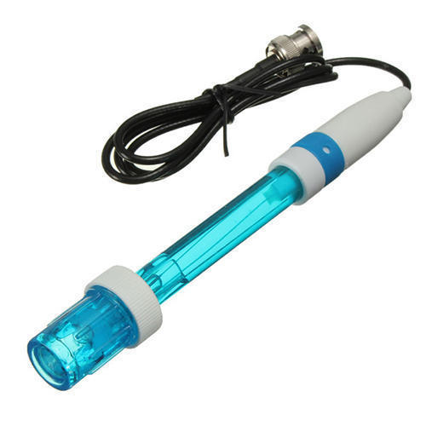
DS18B20
The DS18B20 is a digital thermometer that can provide 9-bit to 12-bit resolution and can measure temperatures from -55°C to +125°C
It is used to measure water temperature in this project.
PH sensor
A pH sensor helps to measure the acidity or alkalinity of the water with a value between 0-14

Slide 25
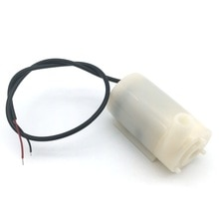
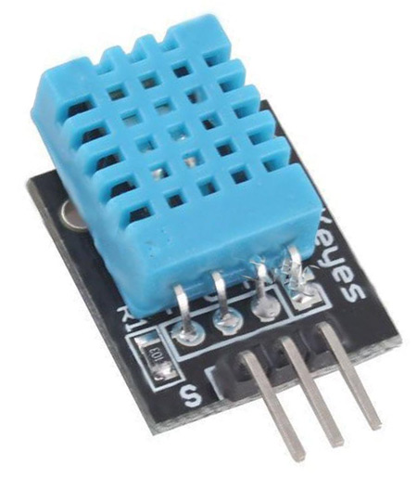
DHT 11
It is a digital humidity temperature sensor consists of capacitive humidity sensing element and a thermistor for sensing temperature.
As temperature decreases resistivity increases.
Submersible pump:
It is used to control the water flow in the tank.

Slide 26
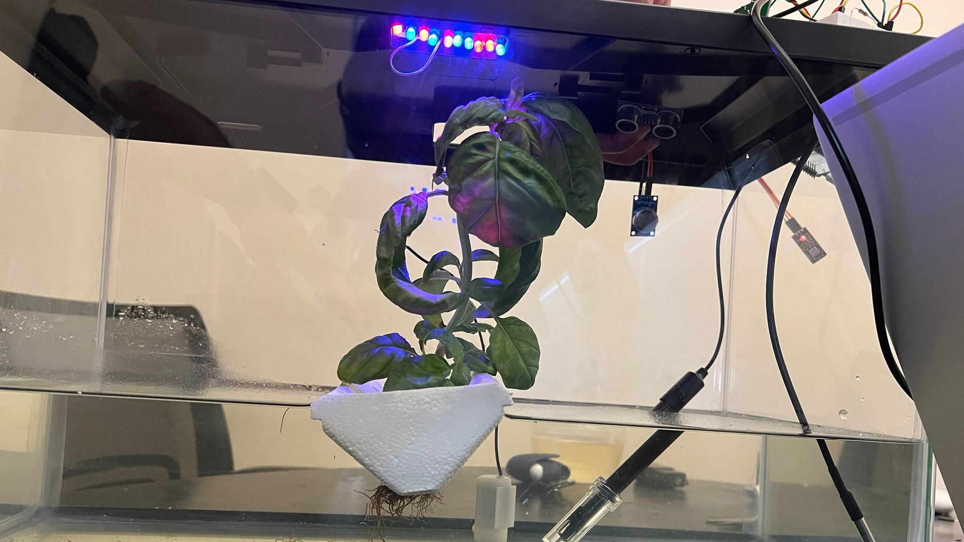

Slide 27
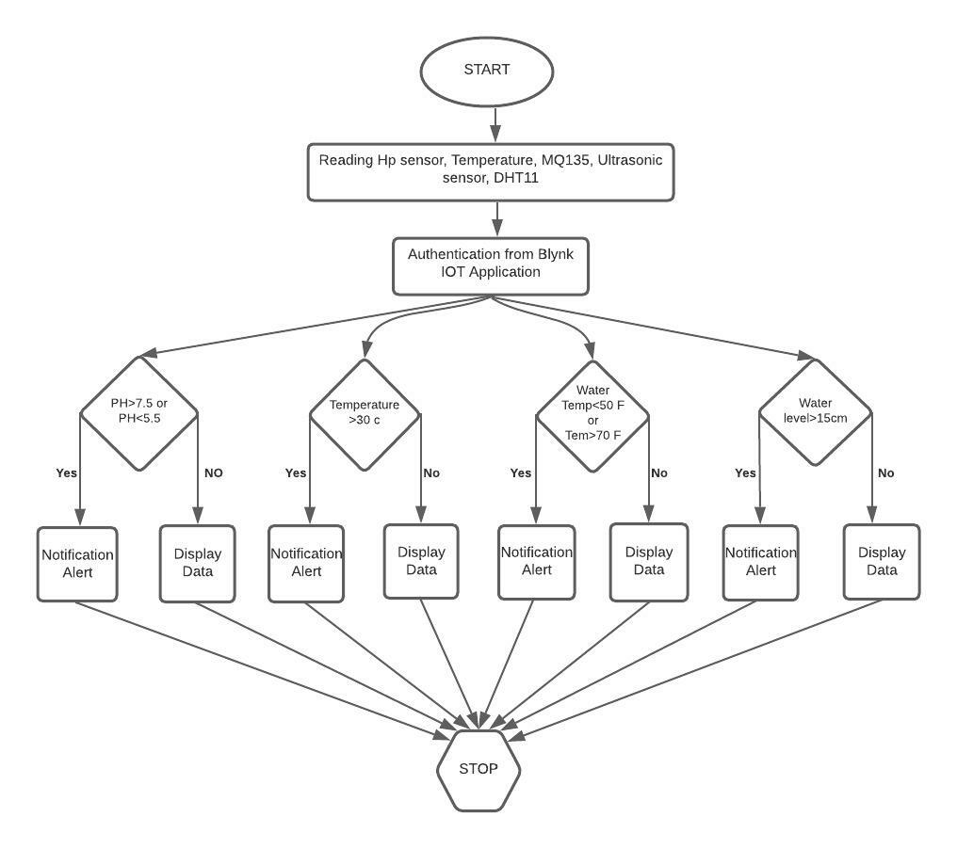
Flow Chart
Initially, the user begins by starting the device, whenever the system is started it starts reading the values of pH, temperature, water temperature of the liquid solution and water level inside the tank.
Whenever the threshold value exceeds a notification alert is sent to the user through Blynk IoT else display the data to the user.
The rules set to regulate the motor state based on the input of pH, water temperature and water level inside the tank.

Slide 28
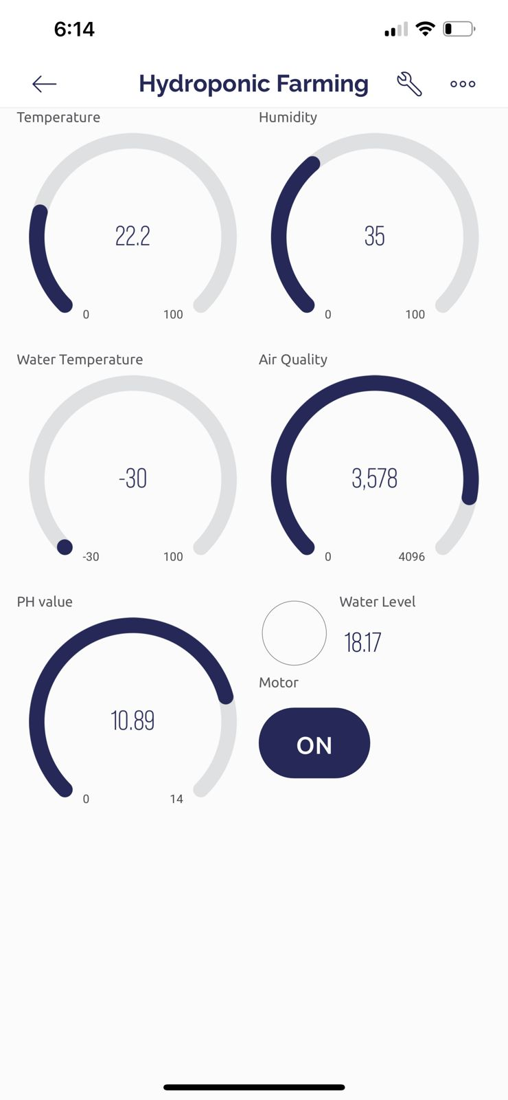
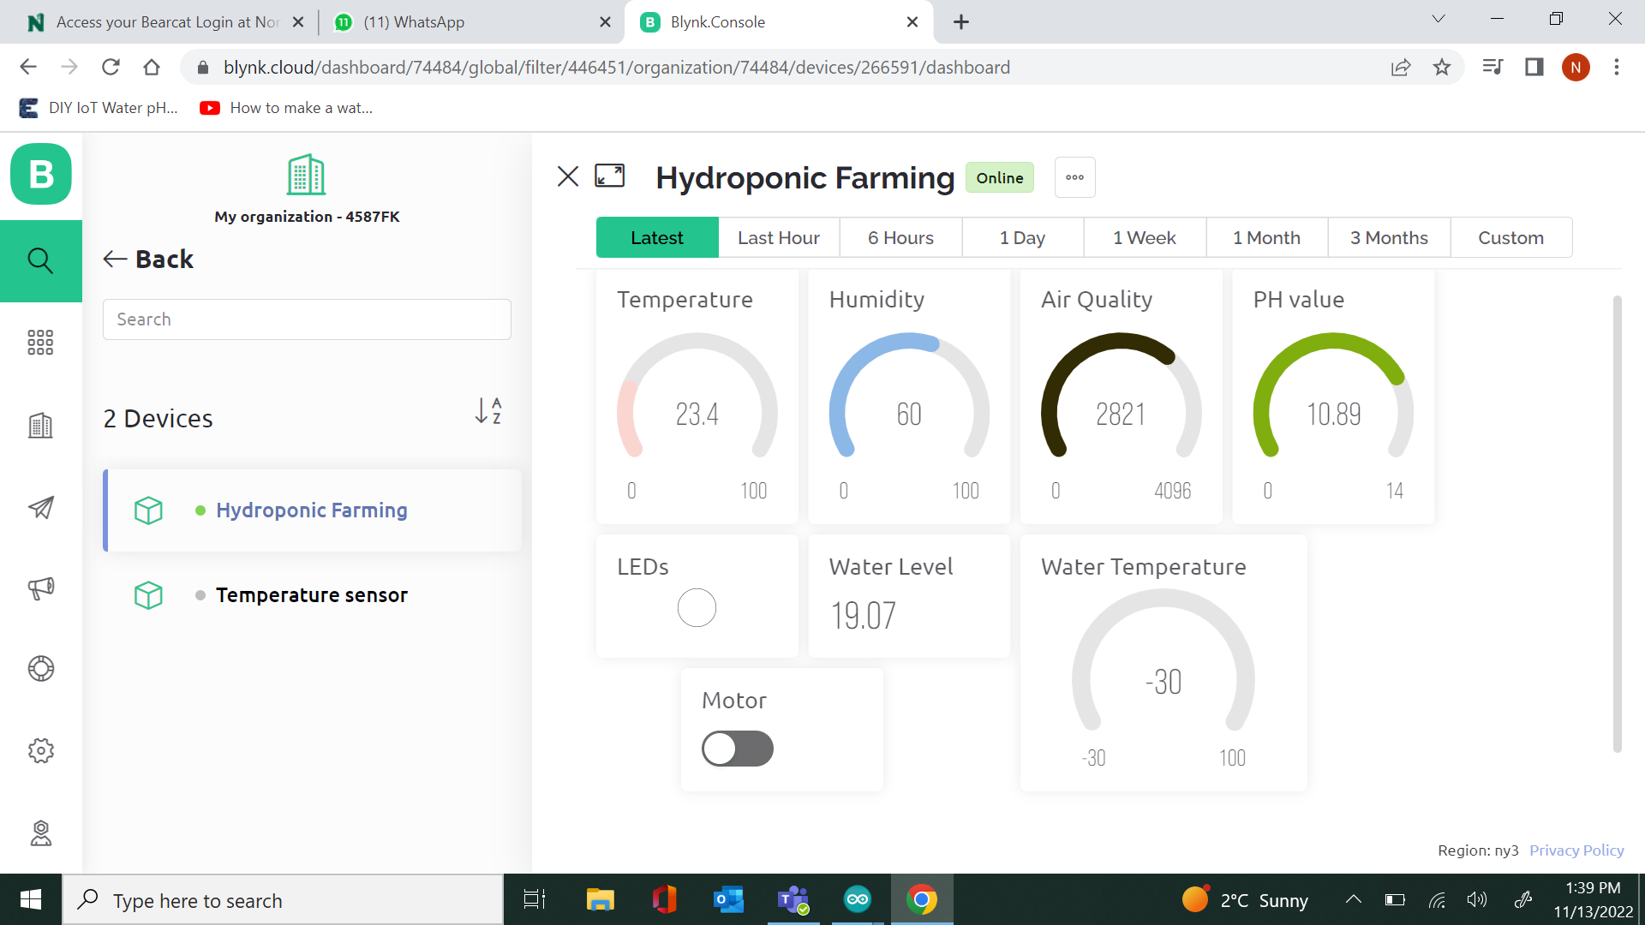
Blynk IoT

Slide 29
Conclusion
By this project we can avoid wastage of water by reusing the same water.
We can avoid weeds that grow together with the crops and achieve the high yield of crops.
We can supply sufficient nutrients to the plants as roots are directly deployed in water, As water is a good dissolvent.
Finally, IOT helps us to monitor and control the conditions of the plant on a regular basis and analyze it using a smart phone.

