Slide 1
BadiliX
Solana for Dumb Phones

Slide 2
Problem
Solana wallets connect only smartphone users to the blockchain leaving out millions of users who use dumb phones.
Even users of dumb phones need financial freedom at the speed of light :)

Slide 3
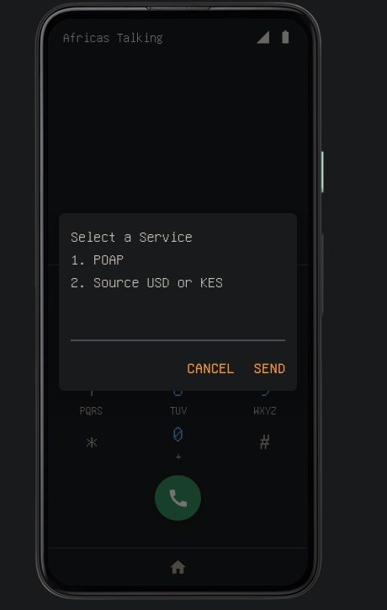
Solution
USSD is a service that acts as an intermediary between a dumb phone and a software program using a telecom provider as the intermediary
The dumb phone does not need internet, just the SIM card. Even a 2G network will do.

Slide 4
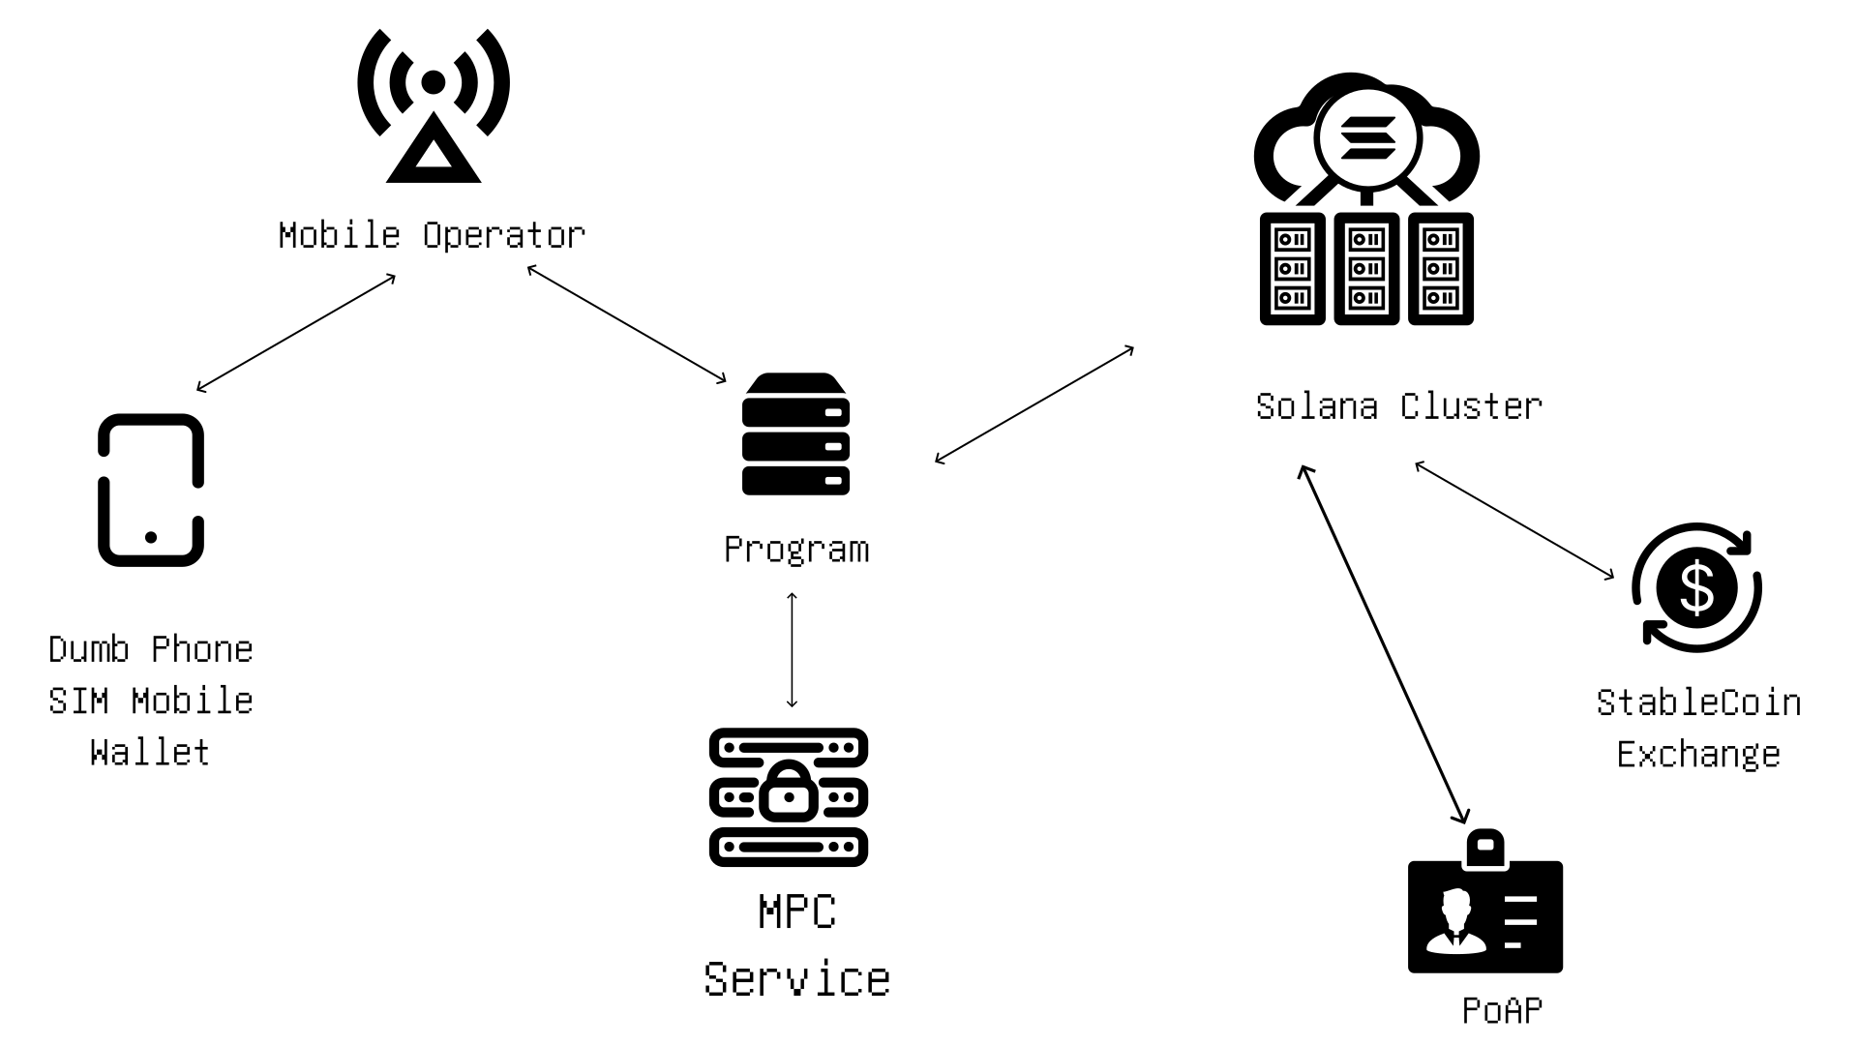
Network relay structure

Slide 5
BadiliX – Onboard millions more to Solana.

