Slide 1




Trenches Fund
Financing Open Source Maintainers while they Build in the Trenches
Notes:
Superteam Deck Notes: Put your startup name and logo with a 1-line subtitle.
This subtitle should be a game changer - it focuses on outcomes and the secret sauce.
(eg. “Decentraland - a virtual world owned by its users”)

Slide 2




Open source runs the world—on the unpaid, overworked shoulders of a few.
xkcd
Almost 60% of maintainer burnout have quit or considered quitting
Lack of a harmonized way of updating dependents of their project as most users expect instant fixes to problems
Survey by sonarsource shows that 38% of open source maintainers cited not getting paid enough as their next reason for quitting
Trenches Fund
01
Notes:
Use slide 2, 3, or 4 for the problem statement.
State your problem version 1: In this slide, there can be more than one problem statement. Data offers an objective foundation to the statement and intergration of stories can enhance the claim by providing relatiability.(eg: 73% of developers express reservations about diving into blockchain
Current platforms fail to provide X, causing frustration and inefficiencies in Y)
Incorporate any data / personal anecdotes that support your claim.

Slide 3

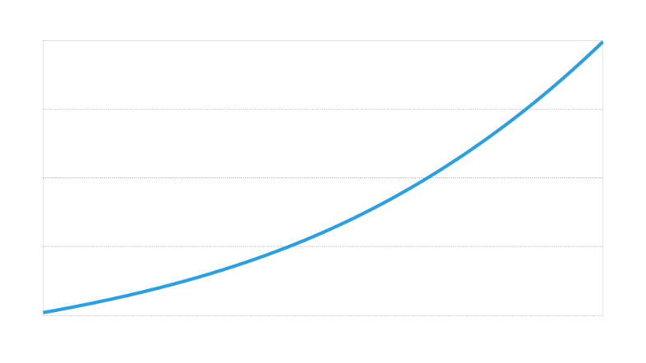

Open source Maintainer difficulties
Cause of Problems
User Feature Demands
Maintainers have access to only traditional methods of receiving contributions
Funding options exclude tokens that can be traded for SOL and stable coins
Reliance on established institutions like Solana Foundation or awesome-solana repository from Helius for reach
Contributions
Commits
01
Notes:
State your problem version 2: In this slide, there can be more than one problem statement. Data offers an objective foundation to the statement and intergration of stories can enhance the claim by providing relatiability.(eg: 73% of developers express reservations about diving into blockchain
Current platforms fail to provide X, causing frustration and inefficiencies in Y)
Incorporate any data / personal anecdotes that support your claim.

Slide 4


Traditional Funding Rails
Contributions are done via traditional finance & fiat
Long wait times to receive funds especially for KYC requirements
Poor reach for other funding avenues like selling Solana merchandise for a commission
01
Notes:
State your problem version 3: In this slide, there can be more than one problem statement. Data offers an objective foundation to the statement and intergration of stories can enhance the claim by providing relatiability.(eg: 73% of developers express reservations about diving into blockchain
Current platforms fail to provide X, causing frustration and inefficiencies in Y)
Incorporate any data / personal anecdotes that support your claim.

Slide 5






Existing players solving it...but poorly
Open Collective
Code Hosting Platforms like Github Sponsors
Relies on traditional finance like banks
No onchain tokens and liquidity
Processing fees as high as 6%
GitHub ecosystem lock-in, low external visibility
Expensive transaction costs & currency exchange fees
Transfer of funds are not instant
Long Wait Times for disbursement of funds
Hard to split or manage funds transparently
Long wait times
Visibility of contributions can discourage reimbursements
Geographic restrictions especially due to geopolitics
Individual-focused, not team-friendly
02
Notes:
Use slides 5, 6 or 7 for competitor analysis
Competitor Slides Version 1: For example: For digital voting systems, many institutions still rely on methods that can be susceptible to tampering, instead of exploring secure, decentralized voting mechanisms.

Slide 6
Here’s how our approach stands out...
Onchain access via native SOL, airdrops or other liquid tokens
Interest earning contributions using mechanisms like staking and liquidity pools
Fast confidential transfers with no processing fees
Team friendly using DAO management and multi-signature wallets using Squads smart contracts
02
Notes:
This is an optional slide
This can be about your product, or your business model.
This is the why we’re gonna win slide - explain your “differentiated approach” in simple terms.

Slide 7

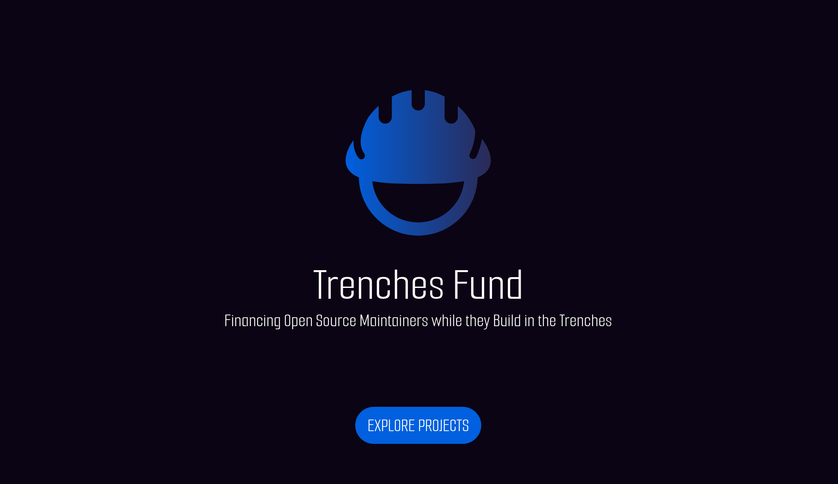
Introducing
Trenches Fund
03
Notes:
Add a working demo of the product you've built. If your demo doesn't fit in a single slide, you can add another. (Add Product Demo Screenshot/Video Here)

Slide 8


Making it happen (Use-cases)
Current
Near Future
Distant Future
Receive Funding Via Airdrops & Solana Pay
Mobile dapp on Solana Dapp store & Instant Push Notifications
Confidential Transfers
DAO & Multi-sig dashboards via SIWS
No DAO Management or Social Integration
Social integration via Fediverse activity pub
Project Discovery Dashboard via Sign
04
Notes:
This info is instrumental in enlightening judges and investors about potential go-to-market strategies and identifying lucrative business opportunities therein.

Slide 9


Why Now?
Solana is growing fast and attracting projects in various industries outside of finance like AI, GPU compute, Bio-medicine and many more...
Activation of confidential transfers
More signature validations like Secp256k1 & Secp256r1
Solana validator upgrades allow this project to reach it’s full potential
Increased liquidity in DEX volumes
Free tier infrastructure offers from likes of Helius and Triton One
06
Notes:
Use slide 12, 13, or 14 for Why Now?
Why now? The more specific the better. Is it due to regulatory support (like countries legitmizing digital currencies), or a cultural shift (as seen with the widespread adoption of NFTs in art and entertainment).

Slide 10

Why Now? / Version2
Tradable tokens like in-game tradable virtual currencies
Access to more funding opportunities
Regulatory Clarity especially on stablecoins
Mainstream Acceptance of cryptocurrency payments
Partnerships for merchandise that promotes Solana ecosystem
06
Notes:
Why now? The more specific the better. Is it due to regulatory support (like countries legitmizing digital currencies), or a cultural shift (as seen with the widespread adoption of NFTs in art and entertainment).

Slide 11

Why are we the ones to do it?
448-OG
Successfully launched two open source projects with over 5k downloads with support from the Solana Foundation
Open Source Maintainer
https://github.com/JamiiDao/
07
Notes:
Team’s creds, past achievements & experiences, and any other relevant social proofing.The investor should feel like you were put on earth to do this. Ideally, your skills and life experiences prepared you for this.

Slide 12










Where will we be next year if we win the hackathon?
Support Confidential Transfers
Solana Dapp Store Release
Build Discovery Dashboard
Support Squads Multi-sig
Support Fediverse
Q2 2025
Q3 2025
Q4 2025
Q1 2026
08
Notes:
What objectives will you conquer immediately after you get the resources? Can list down a short plan of action.

Slide 13


How we will keep the lights on?
Trenches Fund is a public good initiative. Funding will be based on donations from the community
Partnerships with Solana leading projects and the Solana Foundation.
01
Notes:
Don't forget the call to action. Give them a way to contact you.
Drag and Drop A QR Code of your work here.

Slide 14




448-OG
Open Source Maintainer
https://github.com/JamiiDao/
Trenches Fund
support@jamiidao.app
Financing Open Source Maintainers while they Build in the Trenches
https://inthetrenches.cloud/
Notes:
Don't forget the call to action. Give them a way to contact you.
Drag and Drop A QR Code of your work here.

