Slide 1
SQL

Slide 2
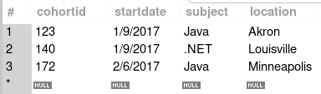
Tables
Every SQL Table is a collection of data consisting of rows (blue) and columns (red)

Slide 3
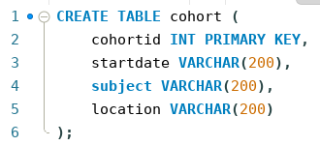
Creating Tables
You create a table by specifying
  Column Names
  Column Data Type
  Key?

Slide 4
Adding Data
You insert data by specifying the table, the column names in order and the values
Each insert is a row in the table

Slide 5
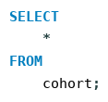
Viewing/Selecting Data
You can view the data within a table using the SELECT command and specifying the table

Slide 6
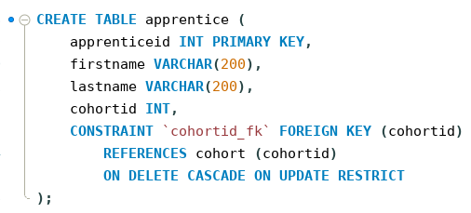
Foreign Keys
You can insert a column from another table as a foreign key
  Create the column in your table and then assign it a constraint afterwards

