Slide 1
SQL Homework 2
SQL, DDL and DDM

Slide 2
SQL Exercises
Selecting Data
Filtering Data
Counting Rows
Creating Calculated Fields
Checking Data Exists
Multiple Selections

Slide 3
Initializing Databases
Before beginning any set of selection queries, make sure
  The database you want to use is created
  The tables are created
  Data exists in the tables
  You are using the database

Slide 4
Using the Database
Using the database is simple. Simply type the following statement (make sure you have a semicolon)
USE PersonalTrainer;

Slide 5
Selecting Data
You can select all the data from a table by typing the following command (make sure the table exists)
SELECT * FROM [tablename]

Slide 6
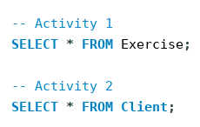

Slide 7
Filtering Data
Rarely do you ever want the entire dataset when searching through data
  To filter down data, you can use WHERE to create conditions

Slide 8
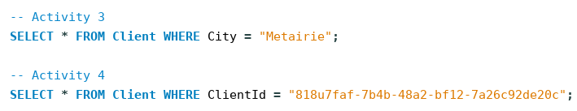

Slide 9

Counting Rows
Special functions such as Count exist to help with easy activities like counting the number of rows
  Be smart and let the computer do the work for you

Slide 10
Other Functions
AVG
MAX
MIN
SUM

Slide 11
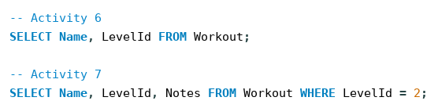
Selecting Multiple Columns
You can select multiple columns and also apply conditional statements to them

Slide 12
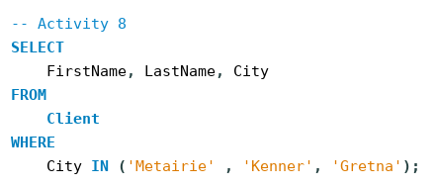
Filtering Based on Multiple Values
You can pass multiple possible values using the IN statement

Slide 13
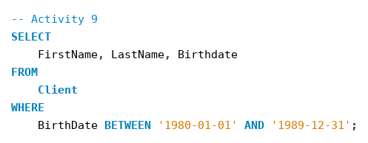
Filtering Based on Ranges
For numeric values such as INT or Dates, you can filter based on ranges using BETWEEN

Slide 14
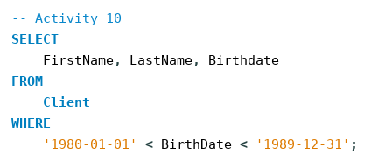
Filtering Based on Ranges
You can use the lesser than ‘<’ or greater than ‘>’ symbols as well to indicate a range

Slide 15

Regular Expressions
You can use regular expressions to filter the data as well using the LIKE statement

Slide 16

NOT Statements
Using the NOT statement excludes any conditions that you have set

Slide 17
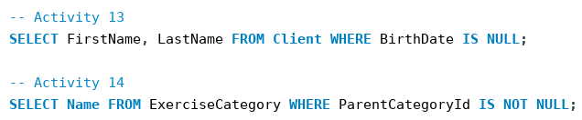
Filtering NULL Values
NULL values are special values in SQL that require you to check if a value is or is not NULL, rather than using ‘= NULL’ or similar checks

Slide 18
Combining Conditions
You can combine multiple conditions in a single WHERE statement for more powerful and precise filtering

Slide 19
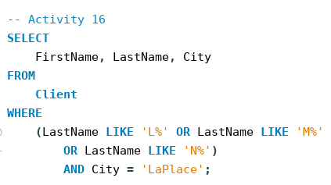

Slide 20
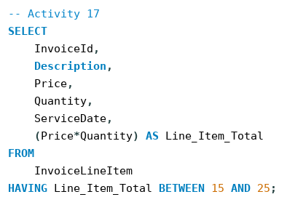
Calculated Columns
You can calculate existing fields and create new fields that can be referred to later on

Slide 21
Calculated Columns
However, using these calculated fields as filter conditions requires the ‘HAVING’ statement rather than WHERE

Slide 22
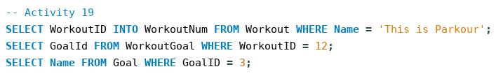
Conditionally Selecting
To select based on the output of another table (especially if filtered), you can use two methods
  Manual referencing of the values (or you can store output INTO variables that can be later referenced)

Slide 23
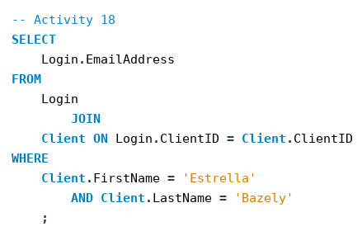
Conditionally Selecting
Or using a JOIN statement

Slide 24
DDL
Data Structuring
Setting Constraints
Altering Tables

Slide 25
Data Structuring
In SQL, it’s important to define
  What type of data a field is
  Whether it is required (NOT NULL)
  If it can auto increment (such as for keys)

Slide 26
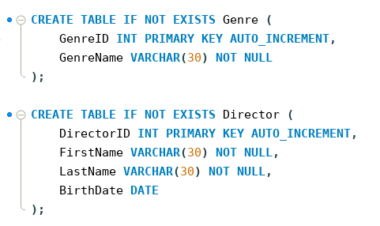

Slide 27
Setting Constraints
When using foreign keys, it’s good to have names so that they can be referenced, and setting constraints helps to determine what happens when data is altered as well

Slide 28
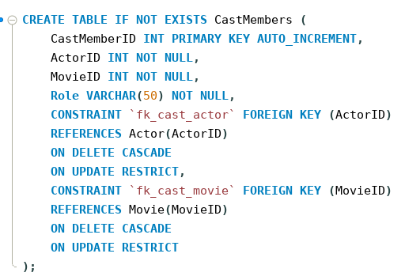
Setting Constraints

Slide 29
Altering Tables
After creating tables, if you want to add columns or foreign keys, you need to do so through the ALTER statement

Slide 30
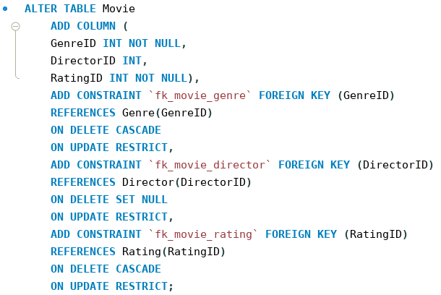

Slide 31
DDM
Changing Data
Deleting Data
Adding Data

Slide 32
Changing Data
Often, you may wish to change data in a given table
You can do this through using the UPDATE and SET statements

Slide 33
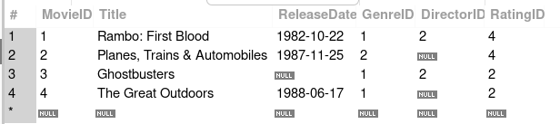
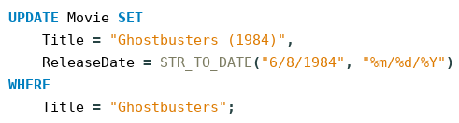
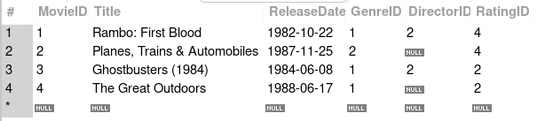

Slide 34
Deleting Data
You may also want to delete data from a table
You can do this with the DELETE statement

Slide 35



Slide 36
Adding Data
You may also want to add data, like new columns rather than simply inserting into existing data
You can do this through a combination of adding a new column and setting values

Slide 37
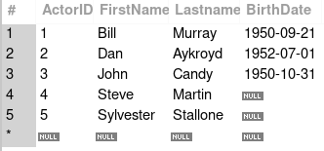
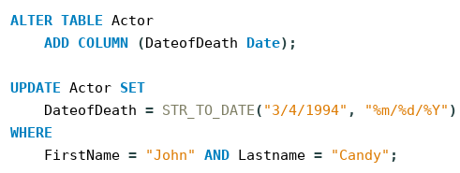
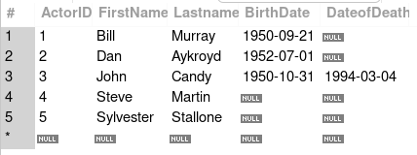

Slide 38
Questions?

