Slide 1

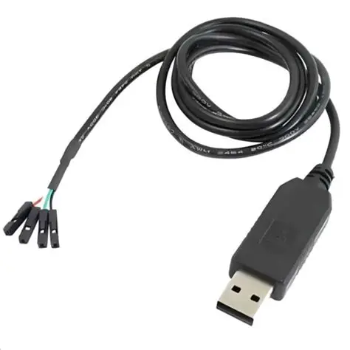
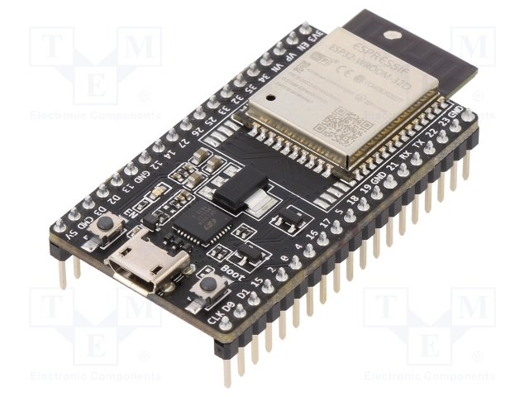
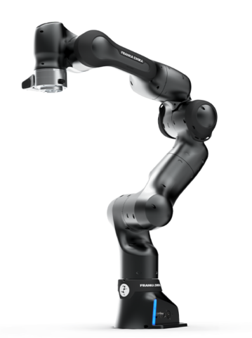



2. Hardware-In-The Loop(HIL) Validation
ESP32 (Target)
HIL Python Code
Serial (UART)
Firmware .ino
INT8 model in Flash
Simulated 7-DOF
Franka Panda Robot on PC
Action
Execution
< / >
model_data.h
115200bps
(default)
Message Format
Header 1B
Length 2B
Payload (float32/int8)
CRC 2B
Receives Observation Vector
Runs INT8 model using TFLite-micro
Sends 7-D action vector back to PC
Timing watchdog and safety checks
0x20, 0x03, 0x0F, 0x4A, 0x01… … … …
Runs robosuite with rendering
Sends observation to ESP32
Receives actions from ESP32
Logs data, metrics & episodes
State /observations
From
simulator
C array (cons unit8 t[])
(included in firmware)
Model Conversion Process
Pass / Fail Decisions
Meet HIL performance Criteria
Revisit Training
/Compression
/Firmware
HIL Validation Metrics
Task success rate (%)
Completion time(S)
Accuracy Latency (ms)
Drop / Failure reasons
Communication Reliability packet loss, CRC errors , timeouts
Conversion Script
( python)
model_data.h
(cons unit8 t[])
.tflite
0x0F, 0x4A, 0x01… …
</>
Included in .ino project via #include model_data.h
SAFETY MEASURES (HIL)
Watchdog timer on ESP32
Max action limits and rate limiting
Emergency stop in firmware and PC
Gripper Open on error/timeout

