Slide 1
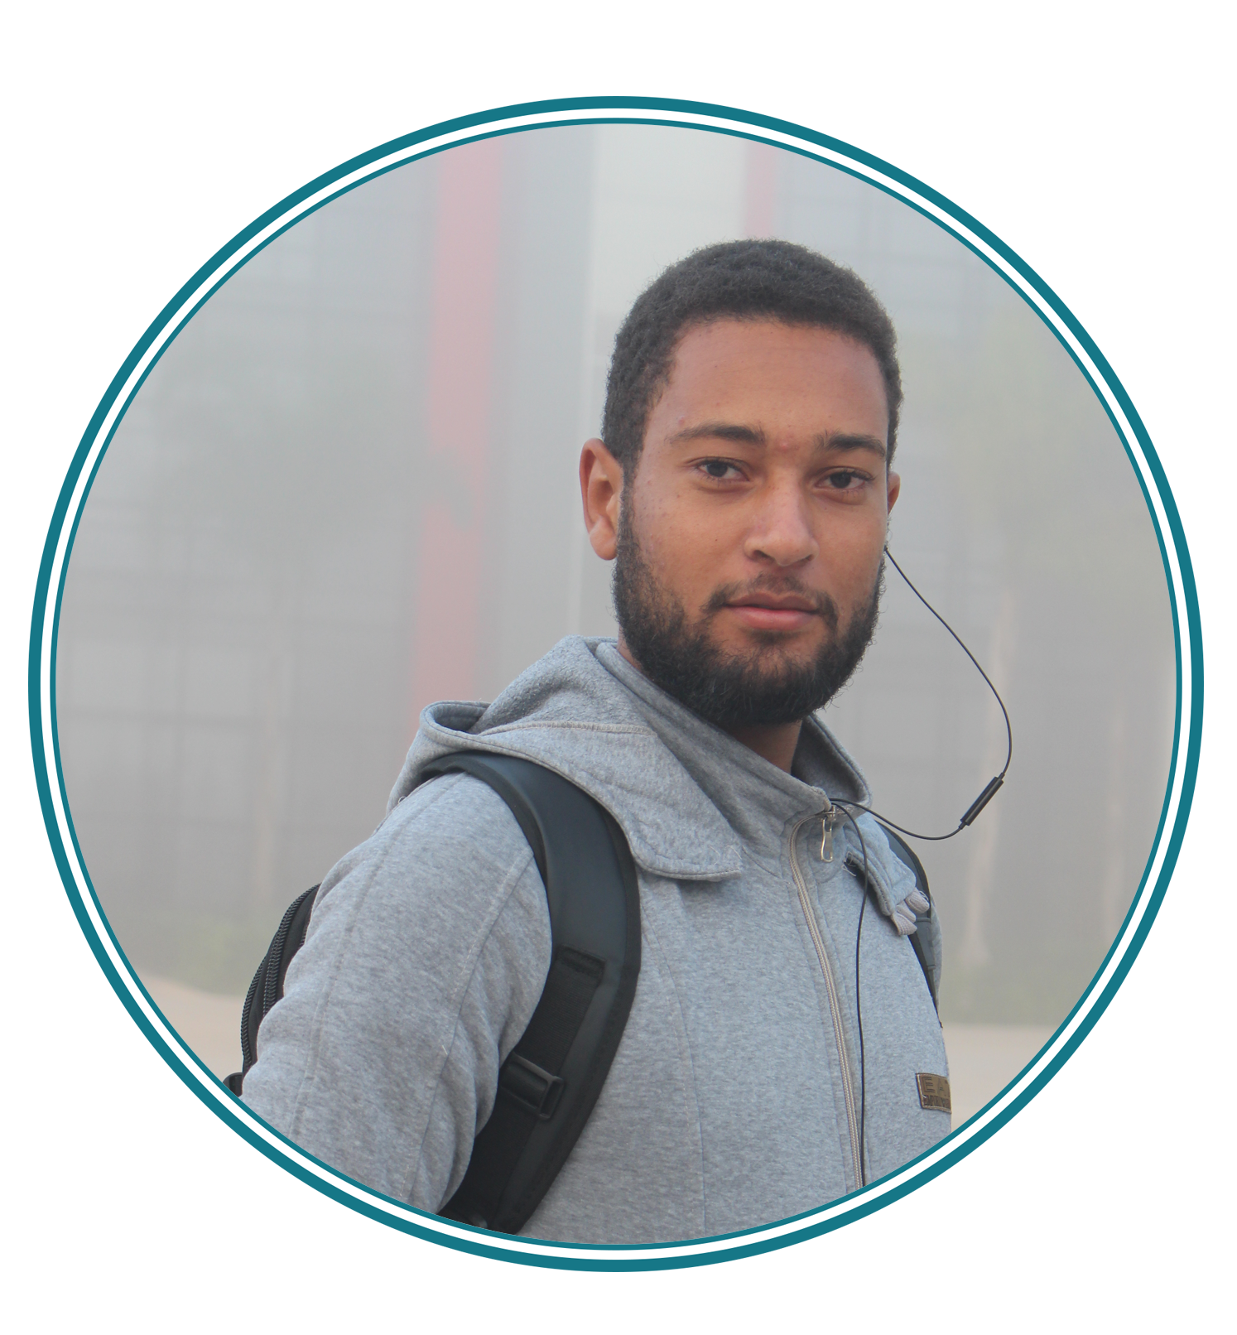








HAMDAOUI Hamza
InternShip
About me :
A young guy who made programing his passion, ready to learn more about anything related to technology and programing
Professional Experiences
22ans, Célibataire
EL Jadida, Morocco
06-98-74-46-91
hhamdaoui31@gmail.com
2016-2017
OCP GROUP
Software developper
An internship for 40 days between 21st March and 7th May in the middle of OCP group As a software developper for my final Project.
Skills
Web developpement
Data base management
Software developpement
Photoshop
FORMATIONS
Adobe XD
2018
YOUCODE
JOINING Youcode school
PERSONNALITY
Agility (Scrum)
2015-2017
OFPPT CITE DE L’AIR
dgree in IT developpement
Leadership
Creativity
Curioucity
2014-2015
LYCÉE BIRANZARAN
Baccalauréat en Sciences de Vie et de Terre
LANGAGES
Arabic
CENTRES D’INTERET
Anglais
French

