Slide 1
PES UNIVERSITY ELECTRONIC CITY CAMPUS R PROGRAMMING
TITLE :- LEARNING R USING Pokémon DATASET
BATCH NO :- 11
BY
SHREYAS MD
AAYUSH KAPOOR

Slide 2
OBJECTIVES
Pokémon have advantage over other certain types like Fire against Grass.
There are Pokémon's with mega evolution.
Few Pokémon are multi-type.
We can compare generation the Pokémon belong to.
We can compare the Pokémon’s HP , Special Attack , Defense and so on.

Slide 3
LITERATURE SURVEY Aayush
After its initial release by Niantic in 2016, Pokemon go has become one of the most downloaded augmented reality games in this world.
The game involves the use of geolocation and needs the player to move around in order to find Pokémon , capture them and use them to fight the other pokemon.
The game has its own share of benefits and drawbacks in its run starting from 2016 till this date.
Benefits:
1.more visits to public parks , meuseums and historic locations have been noticed
2.but the most clearly visible advantage is that of the increased levels of physical activity,which has had very positive influence on the health of individuals.
3.A conducted survey shows that the weekly physical activity like walking of a minimum of 150 minutes has increased from 31% to 75% of the people after owning the game.
3.Drawbacks:
1.A major drawback is seen in the form of driving , biking accidents as a lot of the users tend to play it while driving/riding.
2.There has also been an increase in trespassing and visits to dangerous locations where people have been mugged etc.

Slide 4
LITERATURE SURVEY
Pokémon go is one of most owned augmented reality games in the world and continues to grow till date.
The game involves the user to move around in real life in order to progress and capture Pokémon which are present in different locations.
Health effects of pokemon GO:
1.There have been a lot of cases where Pokémon go has helped a lot of people fight depression.
2.The number of obesity cases have reduced significantly in countries like the U.S, where a lot of the youth population suffers from it.
3.There have been cases where it has also reduced the type 2 diabetes burden.
4.It has helped a lot of the youth battle the deficiency in vitamin D.
Overall, even though the app wasn't marketed as a health app, in many ways it acts as one due to the regular physical activity(walking etc.) the people indulge in, in order to progress in the game.
Safety fears:
1.The game draws people into a lot of geographical locations which are deemed dangerous. There have been many cases where in the users have been rescued from such locations by the emergency services.
2.Teenagers have been robbed of phones at gunpoint in many areas as the game draws a lot of people to real places, making it easy for criminals to spot congregation points.
3.Also as the majority of the users are teenagers( a significant population below 18), The worrying fact is that a lot of locations are deemed dangerous for this population and yet, there hasn’t been any action taken towards prohibiting their entry into such places.
Many believe that the solution to this is by hiding certain locations for people under 18.

Slide 5
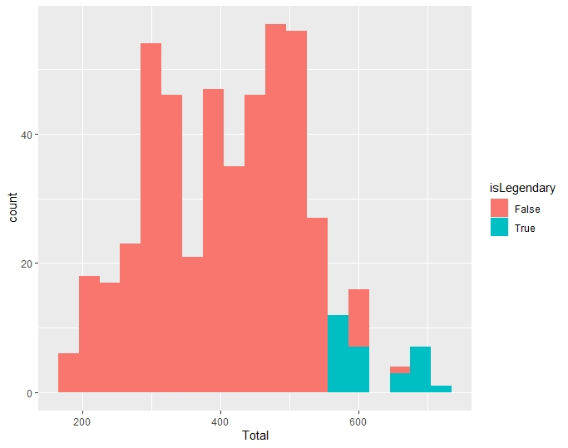
Check whether the Pokémon of 6th generation are Legendary or not based on Total value.
trainingData <- data [data $ Generation < 5,]
statsData <- subset (trainingData, select = c(+Name, +Total, +HP, +Attack, +Defense, +Sp_Atk, +Sp_Def, +Speed, +isLegendary))
ggplot(statsData, aes(Total, fill = isLegendary)) + geom_histogram( binwidth = 30)

Slide 6
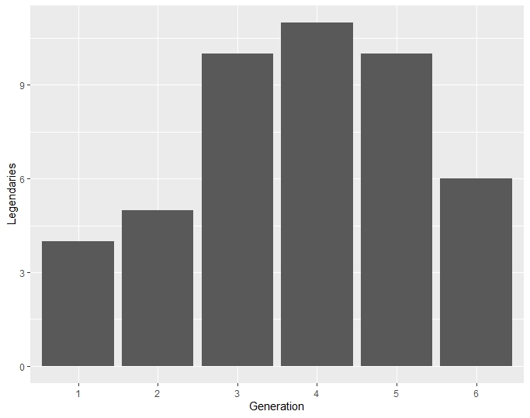
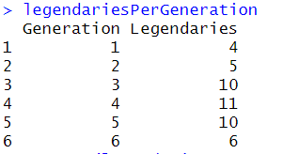
Count of Legendary Pokémon in each generation along with its summary. allLegendaries<-data[data$isLegendary == “TRUE”] allLegendaries $ isLegendary<-factor(allLegendaries [ , ”isLegendary”]) legendariesPerGeneration <- as.data.frame (table(allLegendaries$Generation)) colnames ( legendariesPerGeneration ) <- c (“Generation” , ”Legendaries”) legendariesPerGeneration ggplot ( legendariesPerGeneration , aes (Generation , Legendaries))+geom_bar(stat = “identity”)

Slide 7
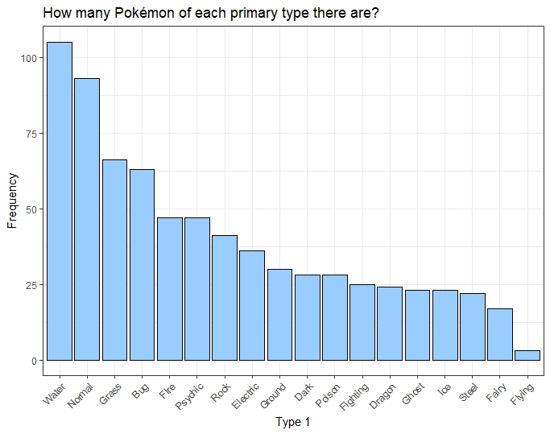
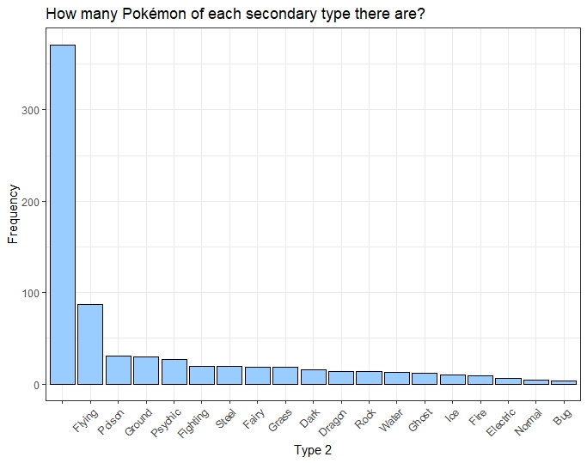
Comparing Types of Pokémon
ggplot(data, aes(x=fct_infreq(Type_2))) +
geom_bar(fill="#99CCFF", colour="black") + labs(x="Type 2", y="Frequency",
title="How many Pokémon of each secondary type there are?") +
theme_bw() +theme(axis.text.x=element_text(angle=45, hjust=1))
ggplot(data, aes(x=fct_infreq(Type_1))) +
geom_bar(fill="#99CCFF", colour="black") + labs(x="Type 1", y="Frequency",
title="How many Pokémon of each primary type there are?") +
theme_bw() + theme(axis.text.x=element_text(angle=45, hjust=1))

Slide 8
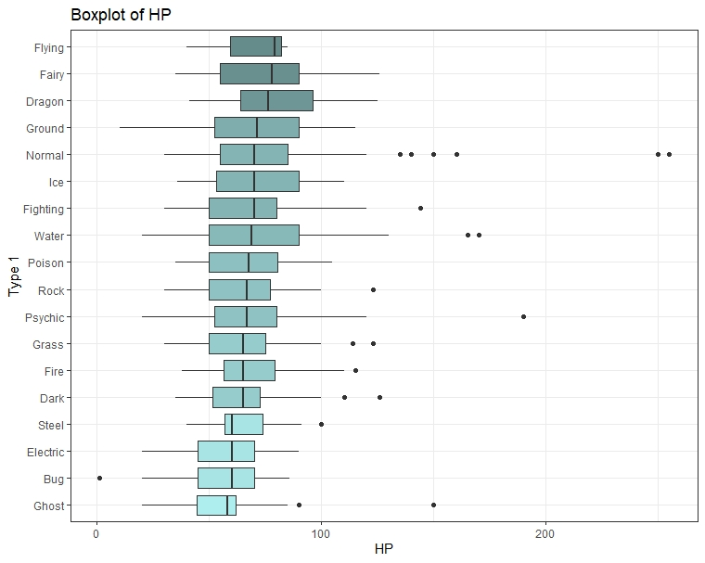
Boxplot for HP
ggplot2(data %>% group_by(Type.1) %>% mutate(med=median(HP)),
aes(x=reorder(Type_1, HP, FUN=median), y=HP)) +
geom_boxplot(aes(fill=med)) +
scale_fill_gradient(low="paleturquoise", high="paleturquoise4") +
coord_flip() + labs(x="Type 1", title="Boxplot of HP") +
theme_bw() +
theme(legend.position="none")

Slide 9
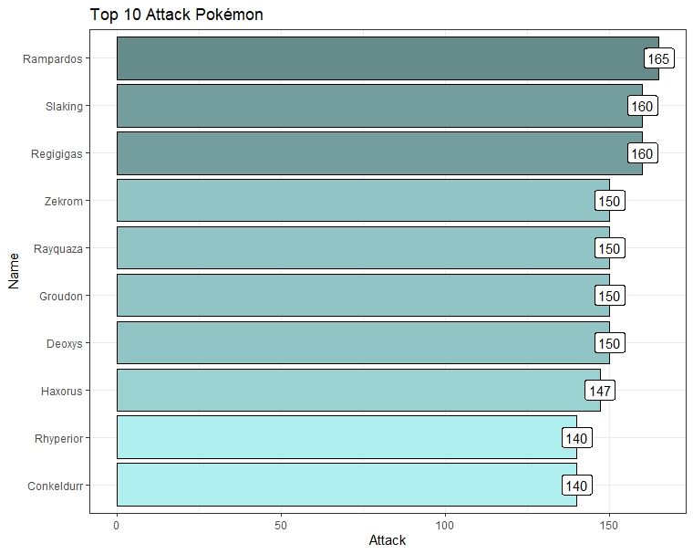
Display Pokémon with the highest attack
data %>%
select(Name , Attack) %>%
arrange(desc(Attack)) %>%
slice(1:10) %>%
ggplot(aes(x=reorder(Name , Attack), y=Attack)) +
geom_bar(stat=“identity”, aes(fill=Attack), colour=“black”, show.legend=FALSE) +
geom_label ( aes (label=Attack)) +
scale_fill_gradient(low=“paleturquoise” , high=“paletturquoise4”) +
coord_flip() + labs( x =“Name” , title =“ Top 10 Attack Pokemon”) +
theme_bw()

Slide 10
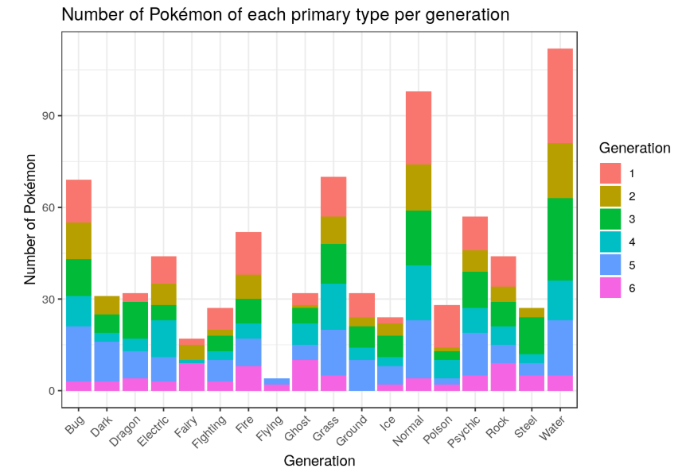
ggplot(data, aes(x=Type_1, fill=Generation)) + geom_bar() + labs(x="Generation", y="Number of Pokémon", title="Number of Pokémon of each primary type per generation") + theme_bw() + theme(axis.text.x=element_text(angle=45, hjust=1))

