Slide 1
Lab 2: Machine Learning for Network Attack Detection
223,082
clean CIC-IDS2017 flows, 59 features
0.9996
CIC-IDS2017 Friday DDoS dataset
Security Insider Lab I · Group 8
Justlyn Kaniyanthara Johnson (121024)
Aayush Kapoor (120957)
9 November 2026
DDoS F1 of the Decision Tree (test split)
0 alerts
on our own benign traffic (547 flows)
Notes:
Lab 2 of the Security Insider Lab: detecting network attacks from flow features with Logistic Regression and Decision Trees. We use the Friday DDoS file of CIC-IDS2017. The three numbers on the right are our main results: a clean set of 223,082 flows with 59 features, a DDoS F1 of 0.9996 for the Decision Tree, and no alert on our own benign capture.

Slide 2
Four tasks lead from our capture to a detector
1
Task 1
2
Task 2
3
Task 3
4
Task 4
Flows
Dataset
Pre-processing
Classifiers
Capture our own traffic and convert it into flows with CICFlowMeter
Analyze CIC-IDS2017: the Friday-afternoon DDoS file
Clean inf/NaN and duplicates, min-max scale, select 20 features with χ²
Train LR and Decision Tree, then classify our own flows one by one
Our dataset
We use Friday-WorkingHours-Afternoon-DDos.csv, the file named in the lab slides. It has two labels, BENIGN and DDoS, so every model is a binary classifier and the real-time detector flags DDoS.
Notes:
Overview of the four lab tasks. For the dataset we follow the lab slides and use the Friday-afternoon DDoS file of CIC-IDS2017. It contains benign flows and DDoS flows, so the problem is binary.

Slide 3
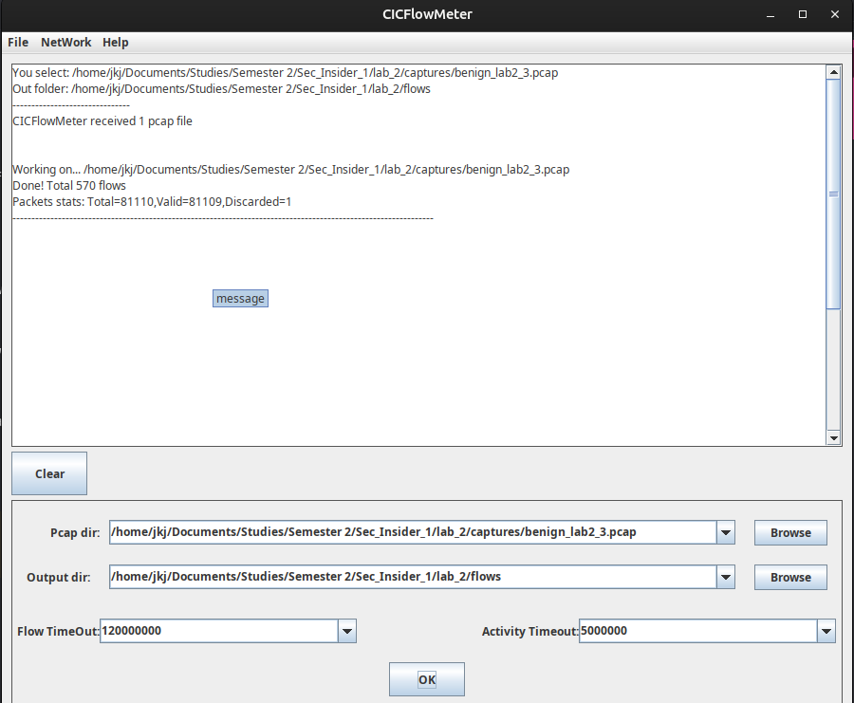
A flow summarizes one bidirectional exchange
A flow is keyed by source and destination IP, ports and protocol
84 columns: metadata, 77 numeric features (packet lengths, inter-arrival times, TCP flags, window sizes, idle/active times) and a label
A flow ends on FIN/RST, after 5 s of inactivity or after 120 s in total
Only flows with ≥ 2 packets are written, so a lone DNS query or traceroute probe never appears
Our capture: 81,110 frames over 347.4 s of browsing, DNS and the Steam client (4 Nov 2026), benign by construction
CICFlowMeter offline mode: 81,110 packets → 569 flows (570 lines incl. header)
Notes:
Explain what a flow is and how CICFlowMeter terminates flows: FIN or RST, 5 s without activity, or 120 s in total. Only flows with at least two packets are written. The screenshot shows the offline conversion of our final capture with the default timeouts; the reported 570 flows count the header line, so there are 569 flows.

Slide 4
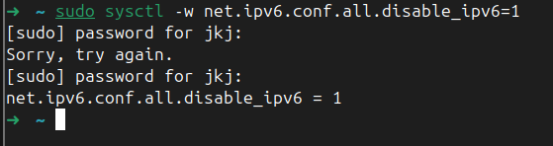
Disabling IPv6 lifted valid flows from 5 % to 96 %
Symptom: protocol 0, port 0 and impossible IPs in most flows of the first two captures
Root cause: readIP6 = false is hard-coded in CICFlowMeter (Cmd.java:126); every non-IPv4 frame is force-parsed as an IPv4 header from byte 0
Fake IPs: 134.221.96.0 = 86 DD 60 00, i.e. the IPv6 EtherType; 136.225.x = HomePlug, 8.6.x = ARP
Fix: disable IPv6 on the capturing laptop, which keeps flows IPv4-only like the training data
Valid flows: 78/532, 67/1,327, 547/569
Notes:
Our first two captures were mostly IPv6, with 98 and 89.5 percent IPv6 frames. We traced the bogus flows to CICFlowMeter's hard-coded IPv4-only parsing. We did not enable its IPv6 path because its UDP branch reads the header length from the TCP header. After sysctl disabled IPv6, the share of valid flows rose from 15 and 5 percent to 96 percent.

Slide 5
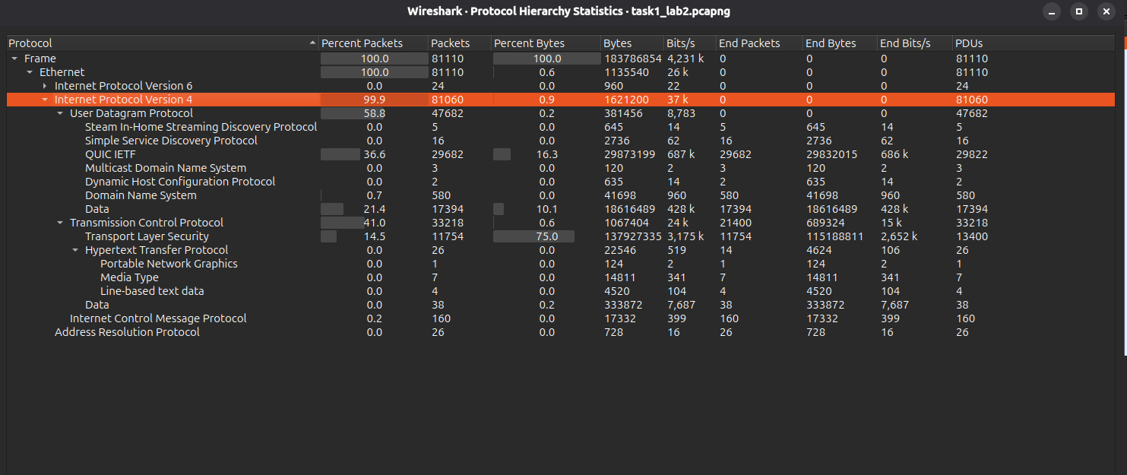
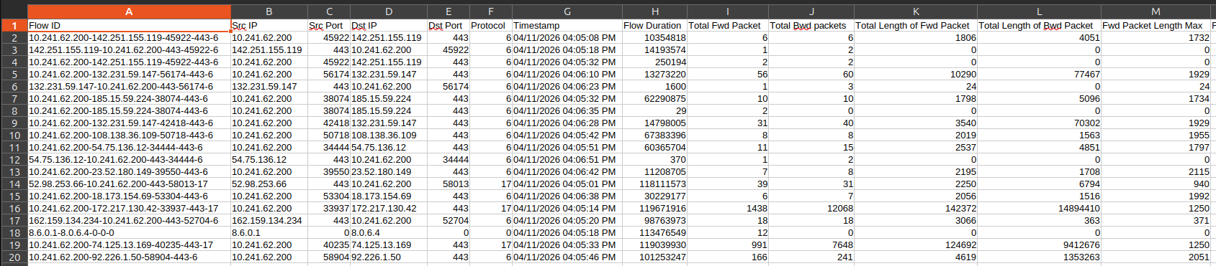
The final capture yields 547 usable flows
569
547
22
99.94 %
flows written by CICFlowMeter
TCP/UDP flows classified
protocol-0 flows dropped (ICMP, ARP, IPv6)
of frames are IPv4
First rows of task2_lab2.pcap_Flow.csv
289 flows are DNS queries (port 53)
213 flows go to port 443, 15 to port 80
≈ 70 % of valid flows are UDP: DNS, QUIC, Steam
Wireshark protocol hierarchy of task1_lab2.pcapng
Notes:
With IPv6 off, 547 of 569 flows are valid. The 22 protocol-0 flows are 15 real ICMP flows, 4 left-over IPv6 flows and 3 ARP flows. The classified flows contain 99.8 percent of all IPv4 TCP/UDP frames; the rest are single-packet exchanges. The application mix, QUIC and Steam, differs from the 2017 testbed, so we expect domain shift.

Slide 6
The Friday file has 57 % attack flows
225,745 × 79
flows × columns: 78 features and the Label
Port 80
is the destination of virtually all DDoS flows
56.71 %
DDoS is the majority class, yet we still report per-class P/R/F1 and macro-F1
Shares: BENIGN 43.29 %, DDoS 56.71 % raw; 42.62 % / 57.38 % cleaned
Notes:
The file has 225,745 flows and 79 columns, with the labels BENIGN, 97,718 flows, and DDoS, 128,027 flows. The attack is the majority class, so accuracy is less misleading than on a dataset with a rare attack, but we still report per-class precision, recall and F1, macro-F1 and confusion matrices. Virtually all DDoS flows target destination port 80.

Slide 7
Nine steps turn raw flows into model input
1
Load & strip names
2
Drop duplicate column
3
±∞ → NaN, drop rows
65 of 79 column names carry stray spaces; labels already clean
Fwd Header Length appears twice
34 rows: 32 BENIGN, 2 DDoS
4
Drop duplicate rows
5
Drop constant columns
6
Drop identical columns
2,629 rows, before the split so none lands in train and test
10 columns that never change
8 columns (tolerance 1e-6), so the 20 features are distinct
7
Stratified 70/30 split
8
Min-max scaling
9
SelectKBest(χ², k = 20)
On the label, random_state = 42
MinMaxScaler(clip=True), fitted on train only
χ² needs non-negative input, so scaling comes first
Notes:
Steps 1 to 6 clean the data and use no labels. Steps 7 to 9, in navy, are fitted on the training split only, so no test statistics leak into training. The infinite and NaN values occur only in Flow Bytes/s and Flow Packets/s, because CICFlowMeter divides by a flow duration that is 0 for some flows.

Slide 8
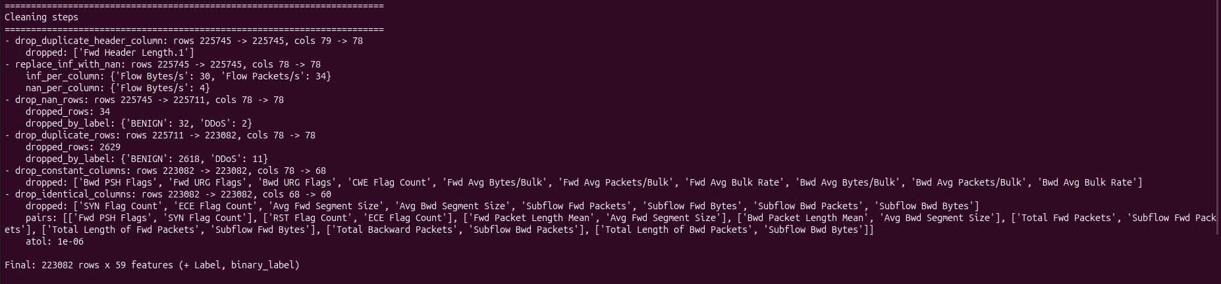
Cleaning leaves 223,082 flows with 59 features
Cleaning steps as logged by the pre-processing script
−34
−2,629
−18
59
rows with ±∞/NaN (32 BENIGN, 2 DDoS)
duplicate rows (2,618 BENIGN, 11 DDoS)
columns: 10 constant, 8 identical
features remain, 128,014 DDoS flows
Data quality: Fwd PSH Flags is identical to SYN Flag Count although PSH and SYN are different TCP flags, and six bulk-transfer features are always 0.
Notes:
The raw file has 2,633 duplicate rows, but 4 of them contain infinite or NaN values and are already gone after step 3, so the duplicate step drops 2,629. Fwd PSH Flags equal to SYN Flag Count points to a feature-extraction problem in the CICFlowMeter version used for CIC-IDS2017, in line with the literature (Engelen et al. 2021). After cleaning there are 95,068 BENIGN and 128,014 DDoS flows.

Slide 9
Packet sizes dominate the top 20 features
Packet sizes
12 of the 20 features describe packet lengths: forward and backward statistics, maximum, mean, standard deviation, variance.
Destination Port ranks 2nd
Score 28,476. Virtually all DDoS flows target port 80, so a model can learn the port instead of the attack.
Flags and timing
3 TCP flag counts (URG, Fwd PSH, PSH), 3 backward inter-arrival times, and Down/Up Ratio.
Notes:
URG Flag Count leads with a score of 30,058, followed by Destination Port at 28,476 and Bwd Packet Length Max at 22,197. The scores fall steadily down the ranking. The χ² test on min-max-scaled continuous data is only a heuristic: heavy-tailed features are squeezed towards 0, which lowers their scores. We expect testbed-specific features such as the destination port to generalize poorly to other networks.

Slide 10
Four binary models share one pipeline
MinMaxScaler
clip = True
SelectKBest
χ², k = 20
Classifier
LR or Decision Tree
One scikit-learn Pipeline per model, fitted on the 156,157 training flows and saved with joblib
 | Default | class_weight = "balanced"
LogisticRegression(max_iter=5000) | binary: BENIGN vs. DDoS | binary: BENIGN vs. DDoS
DecisionTreeClassifier(random_state=42) | binary: BENIGN vs. DDoS | binary: BENIGN vs. DDoS
The file has one attack class: 2 algorithms × 2 weightings = 4 binary models.
156,157 / 66,925
38,404
48
training / test flows
DDoS flows in the test split
iterations until both LR models converged (limit 5,000)
Notes:
Scaler and selector are fitted on the training split only. All models are evaluated on the held-out test split of 66,925 flows, 38,404 of them DDoS. Inference time is the median of five timed predict calls on the whole test split after one warm-up call, scaled to 1,000 flows.

Slide 11
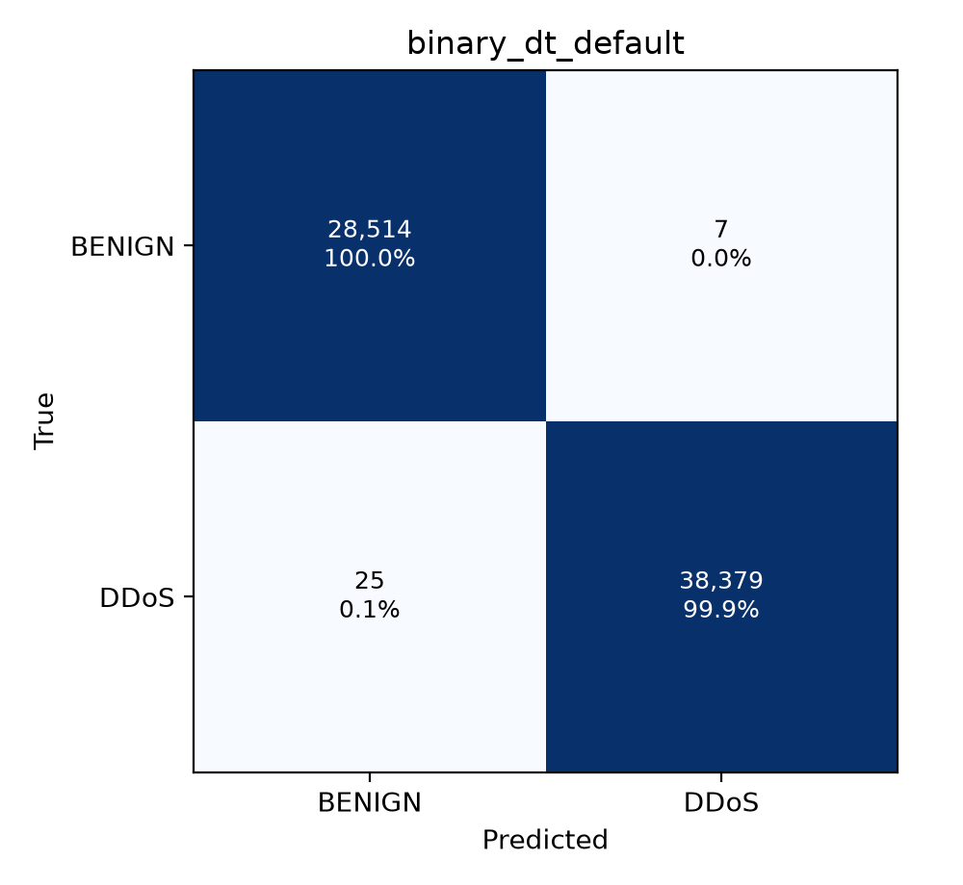

The Decision Tree makes 32 errors on 66,925 flows
Model | Macro-F1 | Prec. | Recall | F1 | FP | FN
LR default | 0.9683 | 0.9503 | 0.9988 | 0.9739 | 2,008 | 45
LR balanced | 0.9689 | 0.9511 | 0.9988 | 0.9744 | 1,974 | 45
DT default | 0.9995 | 0.9998 | 0.9993 | 0.9996 | 7 | 25
DT balanced | 0.9995 | 0.9998 | 0.9993 | 0.9996 | 7 | 25
Test split; precision, recall, F1 for the DDoS class; FP/FN = false positives/negatives
Decision Tree: 7 false positives and 25 false negatives, DDoS F1 0.9996
Logistic Regression: finds almost as many attacks (recall 0.9988) but raises about 2,000 false alarms, so precision is about 0.95
Notes:
The default Decision Tree makes 7 false positives and 25 false negatives, which gives a DDoS precision of 0.9998, a recall of 0.9993 and an F1 of 0.9996. Logistic Regression detects 38,359 of 38,404 DDoS flows but raises 2,008 false alarms for the default and 1,974 for the balanced variant. Right: confusion matrices of the default tree and the balanced Logistic Regression.

Slide 12
Class weighting changes almost nothing here
57 % : 43 %
DDoS to BENIGN after cleaning, so balanced weights are close to one
2,008 → 1,974
false positives of LR: balancing removes only 34
Why binary_dt_default
Identical to the balanced tree on the test split, so we take the simpler model.
Fewest errors of all four: 7 FP and 25 FN.
Balanced and default Decision Tree have identical confusion matrices
Notes:
Because the classes are close to balanced, class_weight balanced gives both classes weights close to one. For the tree, the balanced variant has exactly the same confusion matrix and metrics as the default one; for Logistic Regression the false positives drop only from 2,008 to 1,974. We use binary_dt_default in the real-time part.

Slide 13


Streaming reproduces the offline predictions exactly
Capture .pcapng
CICFlowMeter (offline)
Map V4 → training columns
Drop protocol 0, inf/NaN → 0
Pipeline: verdict per flow
66,925
test flows streamed through the detector: identical to the offline predictions, row for row
Fast tests: 24 passed, 3 deselected
24 + 3
fast and end-to-end tests pass
Same model: the detector loads the saved binary_dt_default pipeline unchanged.
End-to-end tests: 3 passed, 24 deselected (includes the parity test)
Notes:
The detector streams flows one by one in timestamp order, maps the V4 column names to the training names (all 77 features map), drops Protocol 0 rows, replaces infinite and NaN values by 0 and classifies each flow. The parity test converts the 66,925-flow test split to the V4 column names and streams it through the detector; the predictions equal those of the offline pipeline, both for batches of 1,000 flows and, on the first 500 flows, for batches of one flow. Real time here means replaying a recorded capture; we do not capture live.

Slide 14
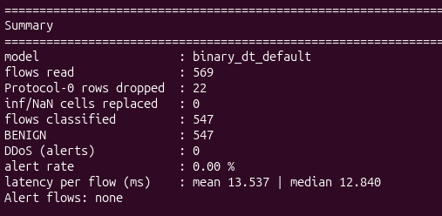
547 of our flows classified, 0 DDoS alerts
569
22
547
0
flows read
protocol-0 flows dropped
flows classified, all BENIGN
DDoS alerts (0.00 %)
Benign-only capture
We measure false alarms on our network, but not the detection rate: whether the model would flag a real DDoS in our flows is untested.
Domain shift
Training flows come from an older CICFlowMeter version on the 2017 testbed; ours come from V4 on a different network with QUIC and Steam traffic.
Summary printed by the real-time detector
Latency: 13.537 ms mean (12.840 ms median) per flow, one flow at a time. Batched, the model needs 0.695 ms per 1,000 flows.
Notes:
Of 569 flows, 22 were dropped (protocol 0) and 547 were classified, all as BENIGN. No infinite or NaN cells had to be replaced. Our traffic is benign by construction, so every flow is correctly classified. The per-flow latency is per-call pandas and scikit-learn overhead; in practice the detection delay is dominated by CICFlowMeter, which emits a flow only when it ends or times out after 5 s of inactivity or 120 s in total.

Slide 15
Near-perfect on the test split, detection untested outside the testbed
Takeaways
Decision Tree beats LR: F1 0.9996 vs. 0.9744 at best, 7 vs. about 2,000 false alarms
Port-80 shortcut: Destination Port ranks 2nd, and virtually all DDoS flows use port 80
No false alarms on our traffic, but our capture has no attack, so the detection rate is untested
0.9996
DDoS F1 of the Decision Tree on the CIC-IDS2017 test split
0 alerts
on 547 benign flows of our own capture, which contains no attack
Possible improvements
Prune the tree: max_depth, min_samples_leaf; we use a single split without cross-validation
Remove shortcuts: drop testbed-specific features such as Destination Port
Test further: evaluate on a second attack capture from another network, and add benign traffic from the deployment network to training
Notes:
Conclusion: the Decision Tree makes only 32 errors on 66,925 test flows, but the test split comes from the same capture as the training data and cannot reveal a shortcut such as the destination port. The 0 alerts on our capture show only that this benign traffic is not mistaken for DDoS. The improvements are not implemented. Thank you; questions welcome.

