Slide 1
Machine Learning for Network Attack Detection
164,179
clean CIC-IDS2017 flows, 60 features
0.986
Security Insider Lab I · Lab 2
Group 8
Justlyn Kaniyanthara Johnson (121024)
Aayush Kapoor (120957)
6 November 2026
attack F1 of the Decision Tree (test split)
0.55 %
false alarms on our own benign traffic
Notes:
Lab 2 of the Security Insider Lab: detecting network attacks from flow features with Logistic Regression and Decision Trees. The three numbers on the right are the story of the talk.

Slide 2
Four Tasks, One Pipeline
1
Task 1
2
Task 2
3
Task 3
4
Task 4
Flows
Dataset
Pre-processing
Classifiers
Capture our own traffic and convert it into flows with CICFlowMeter
Choose and analyze CIC-IDS2017: Thursday web-attack file
Clean inf/NaN and duplicates, min-max scale, select 20 features with χ²
Train LR and Decision Tree, then classify our own flows one by one
Our dataset choice
The slides suggest the Friday DDoS file. We chose Thursday-WorkingHours-Morning-WebAttacks instead: Brute Force, XSS and SQL injection are low-volume, application-layer attacks whose flows look like ordinary HTTP. Volume alone gives a DDoS away, so web attacks are harder, and more interesting, to detect.
Notes:
Overview of the four lab tasks and why we deviated from the suggested DDoS dataset.

Slide 3
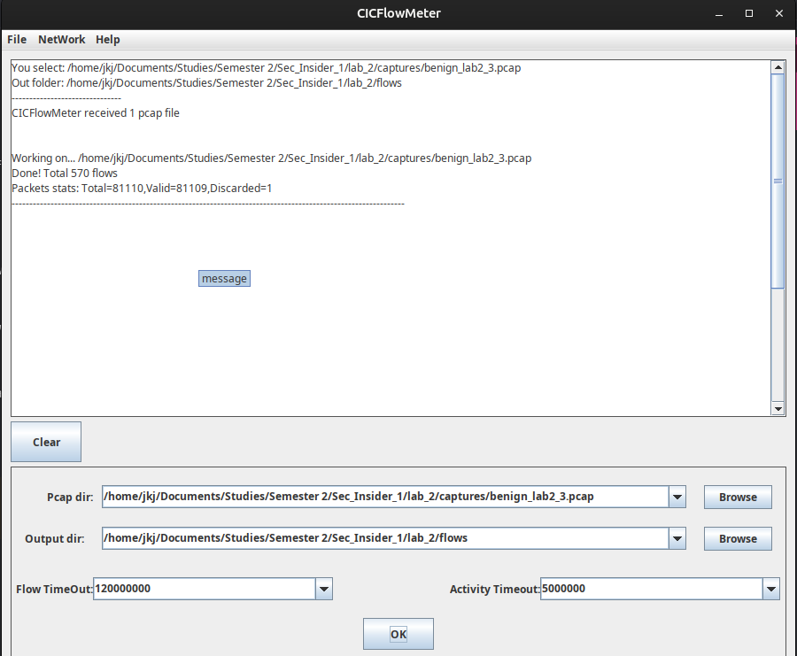
Task 1: From Packets to Flows
A flow summarizes a bidirectional packet exchange identified by IPs, ports and protocol
84 columns: metadata, 77 numeric features (packet lengths, inter-arrival times, TCP flags, window sizes, idle/active times) and a label
A flow ends on FIN/RST, after 5 s of inactivity or after 120 s in total
Only flows with ≥ 2 packets are written, so a lone DNS query or traceroute probe never appears
Our capture: 81,110 frames over 347.4 s of browsing, DNS and the Steam client (4 Nov 2026), benign by construction
CICFlowMeter offline mode: 81,110 packets → 569 flows (570 lines incl. header)
Notes:
Explain what a flow is and how CICFlowMeter terminates flows. The screenshot shows the offline conversion of our final capture with default timeouts.

Slide 4
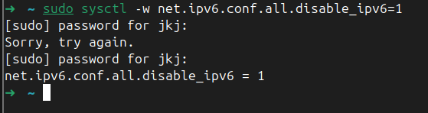
The IPv6 Problem: 95 % Garbage Flows
Symptom: protocol 0, port 0 and impossible IPs in most flows of the first two captures
Root cause: readIP6 = false is hard-coded in CICFlowMeter (Cmd.java:126); every non-IPv4 frame is force-parsed as an IPv4 header from byte 0
Fake IPs: 134.221.96.0 = 86 DD 60 00, i.e. the IPv6 EtherType; 136.225.x = HomePlug, 8.6.x = ARP
Fix: disable IPv6 on the capturing laptop, which keeps flows IPv4-only like the training data
Valid flows: 78/532, 67/1,327, 547/569
Notes:
Our first two captures were mostly IPv6. We traced the bogus flows to CICFlowMeter's hard-coded IPv4-only parsing. We did not enable its IPv6 path because its UDP branch reads the header length from the TCP header.

Slide 5
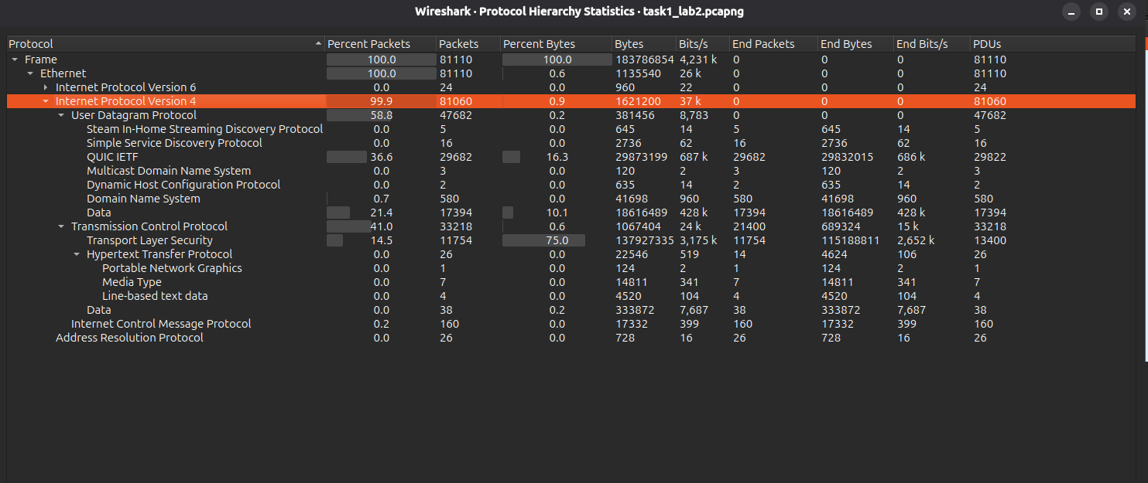
The Final Capture: 547 Usable Flows
569
547
22
99.94 %
flows written by CICFlowMeter
TCP/UDP flows classified
protocol-0 flows dropped (ICMP, ARP, IPv6)
of frames are IPv4
289 flows are DNS queries (port 53)
213 flows go to port 443, 15 to port 80
≈ 70 % of valid flows are UDP: DNS, QUIC, Steam
Domain shift ahead: QUIC and Steam did not exist in the 2017 testbed
Wireshark protocol hierarchy of task1_lab2.pcapng
Notes:
With IPv6 off, 547 of 569 flows are valid. The classified flows contain 99.8 % of all IPv4 TCP/UDP frames; the rest are single-packet exchanges.

Slide 6
Task 2: CIC-IDS2017 Web Attacks
Thursday-WorkingHours-Morning-WebAttacks: 170,366 flows, 78 features + Label. Attacks were run against DVWA and automated with Selenium.
98.7 %
Label | Raw | Share | Cleaned
BENIGN | 168,186 | 98.72 % | 162,036
Web Attack – Brute Force | 1,507 | 0.88 % | 1,470
Web Attack – XSS | 652 | 0.38 % | 652
Web Attack – SQL Injection | 21 | 0.01 % | 21
Total | 170,366 | 100 % | 164,179
accuracy of a model that always answers BENIGN, so we report per-class F1 and macro-F1
Port 80
is the destination of all 2,180 attack flows, a shortcut a model can learn
1 : 76
Attacks are 1.28 % of the raw flows; only 21 SQL injection flows exist.
attacks to benign flows after cleaning
Notes:
The dataset is extremely imbalanced, so accuracy is meaningless. All attacks target port 80, which becomes a shortcut feature.

Slide 7
Task 3: Pre-processing in Nine Steps
1
Load & fix labels
2
Drop duplicate column
3
±∞ → NaN, drop rows
Strip 65 padded column names; U+FFFD → “-” in labels
Fwd Header Length appears twice
135 rows, all BENIGN (Flow Bytes/s, Flow Packets/s)
4
Drop duplicate rows
5
Drop constant columns
6
Drop identical columns
Before the split, so no row lands in train and test
10 columns that never change
7 pairs (tolerance 1e-6), so the 20 features are distinct
7
Stratified 70/30 split
8
Min-max scaling
9
SelectKBest(χ², k = 20)
On the 4-class label, random_state = 42
MinMaxScaler(clip=True), fitted on train only
χ² needs non-negative input, so scaling comes first
Notes:
Steps 1 to 6 clean the data and use no labels. Steps 7 to 9, in navy, are fitted on the training split only, so no test statistics leak into training.

Slide 8
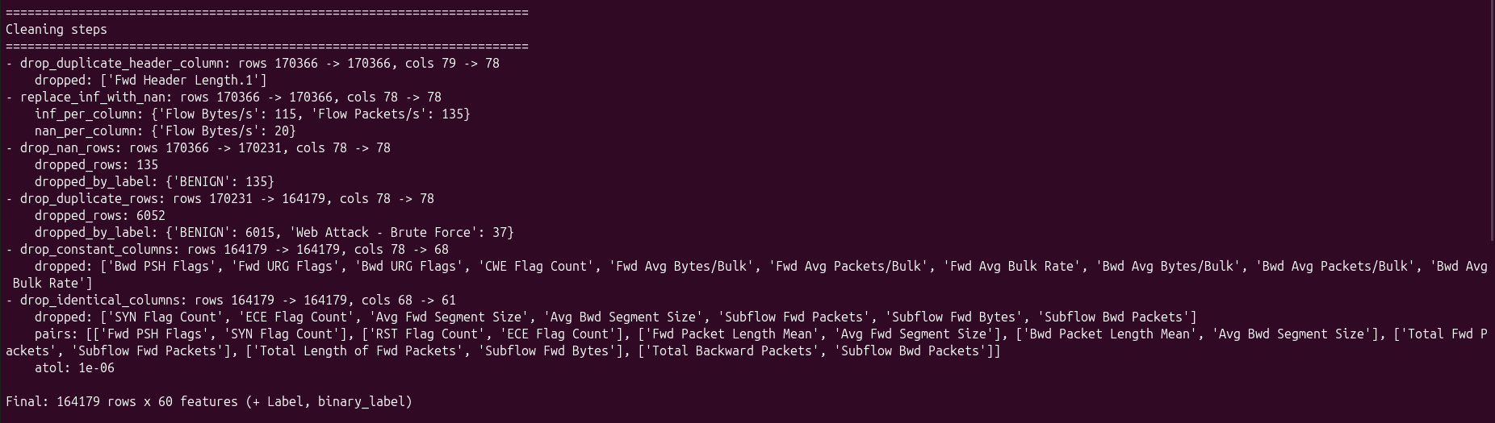
Cleaning Result: 164,179 Flows × 60 Features
Cleaning steps as logged by task3_preprocess.py
−135
−6,052
−17
60
rows with ±∞/NaN (all BENIGN)
duplicate rows (37 Brute Force)
columns: 10 constant, 7 identical
features remain, 2,143 attacks
Notes:
Fwd PSH Flags is identical to SYN Flag Count although they are different TCP flags, a known feature-extraction problem of the CICFlowMeter version used for CIC-IDS2017 (Engelen et al. 2021).

Slide 9
The 20 Best Features by χ²
Shortcut features
Init_Win_bytes_* reflect the 2017 hosts' TCP stacks; Destination Port works because every attack hits port 80.
Behavioral features
PSH/ACK/URG flags capture HTTP request patterns; IAT and Idle times capture the regular pacing of Selenium.
18 of 20 shared
Binary and multiclass lists differ in only two features each. The top 3 score above 1,600, the rest below 250.
Notes:
χ² on min-max-scaled continuous data is a heuristic: heavy-tailed features like Flow Bytes/s are squeezed towards 0, which lowers their scores. We expect the testbed-specific features to generalize poorly.

Slide 10
Task 4: Eight Models, One Pipeline
MinMaxScaler
clip = True
SelectKBest
χ², k = 20
Classifier
LR or Decision Tree
One scikit-learn Pipeline per model, fitted on the 114,925 training flows and saved with joblib
 | Default | class_weight = "balanced"
LogisticRegression(max_iter=5000) | binary + multiclass | binary + multiclass
DecisionTreeClassifier(random_state=42) | binary + multiclass | binary + multiclass
49,254
held-out test flows
643
2 algorithms × 2 weightings × 2 targets = 8 models, all converged
attacks in the test split (6 SQL injection)
Notes:
Scaler and selector are fitted on the training split only. Inference time is the median of five timed predict calls, scaled to 1,000 flows.

Slide 11
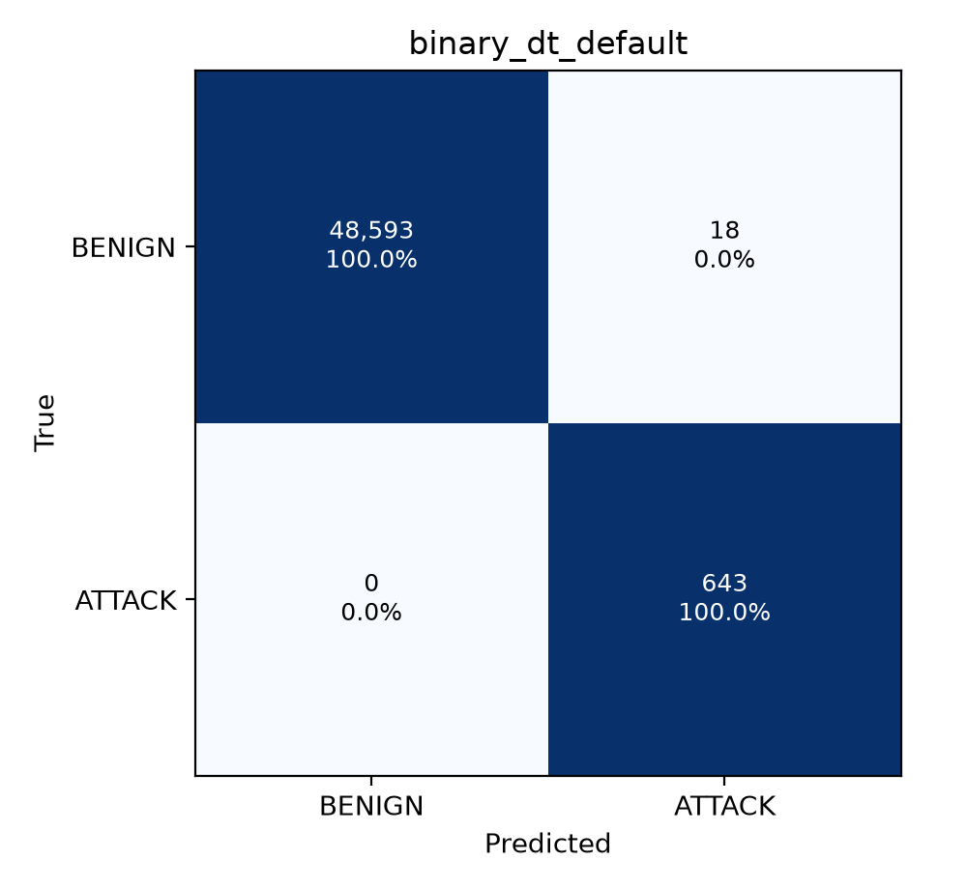

Binary: The Decision Tree Misses No Attack
Model | Macro-F1 | Prec. | Recall | F1 | FP | FN
LR default | 0.8926 | 0.7320 | 0.8538 | 0.7882 | 201 | 94
LR balanced | 0.6789 | 0.2349 | 0.9907 | 0.3797 | 2,075 | 6
DT default | 0.9930 | 0.9728 | 1.0000 | 0.9862 | 18 | 0
DT balanced | 0.9925 | 0.9815 | 0.9891 | 0.9853 | 12 | 7
Test split; precision, recall, F1 for the attack class
Best model: the default Decision Tree finds all 643 attacks with 18 false alarms
Class weighting buys LR recall (0.85 → 0.99) at ten times the false alarms
Notes:
The default Decision Tree is the best binary model and is the one used in the real-time part. Balanced LR detects 99 % of attacks but raises 2,075 false alarms.

Slide 12
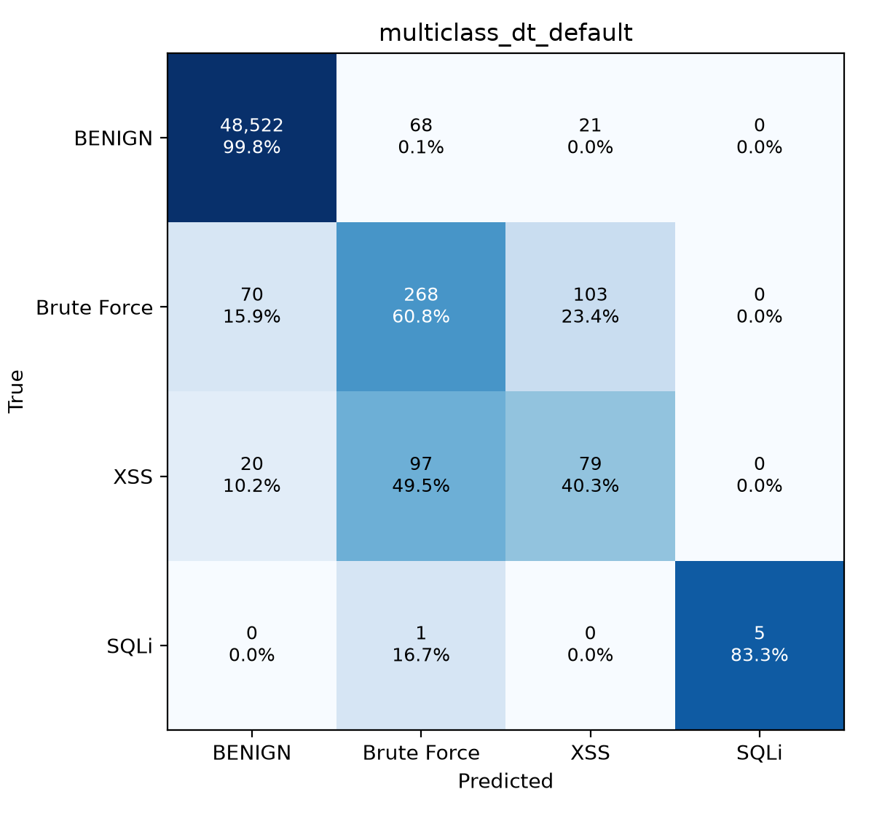
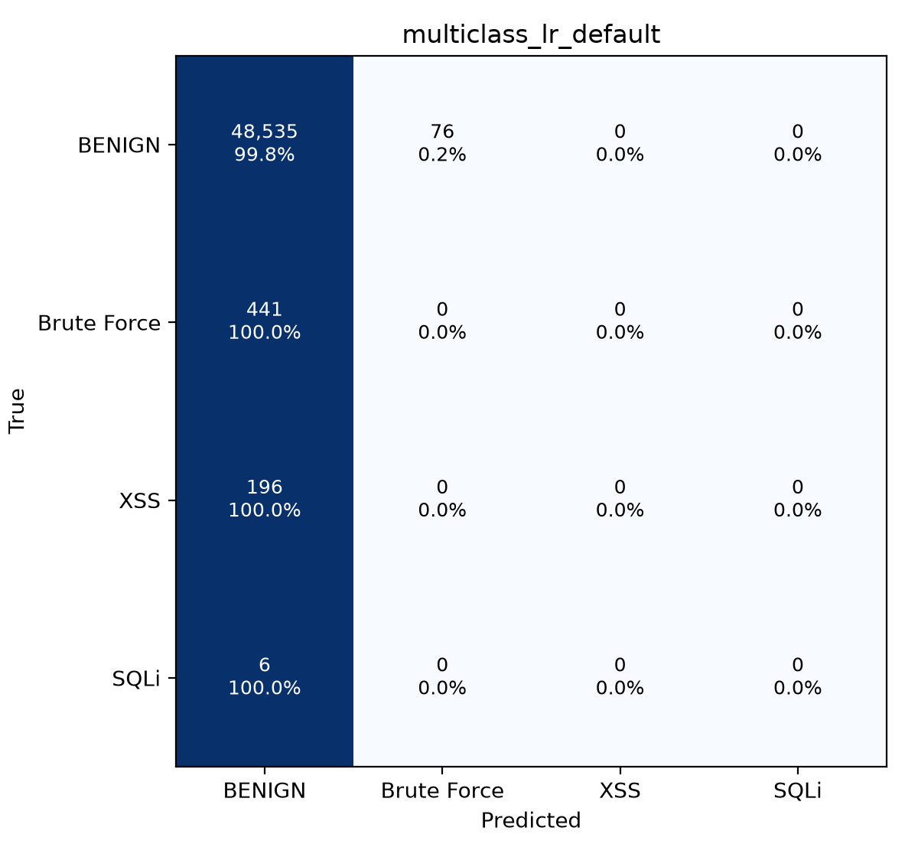
Multiclass: Accuracy Hides a Blind Model
98.54 %
accuracy of default LR, which detects not a single attack: it predicts almost everything as BENIGN.
Macro-F1: DT 0.729 · DT bal. 0.564 · LR bal. 0.319 · LR 0.248
Brute Force and XSS are confused (103 and 97 flows): flow statistics cannot see the payload. SQLi F1 0.909 rests on 6 test flows.
Notes:
The accuracy paradox: 98.7 % of the data is benign, so a model that ignores attacks still looks excellent by accuracy. Class weighting does not fix this for LR and hurts the tree.

Slide 13
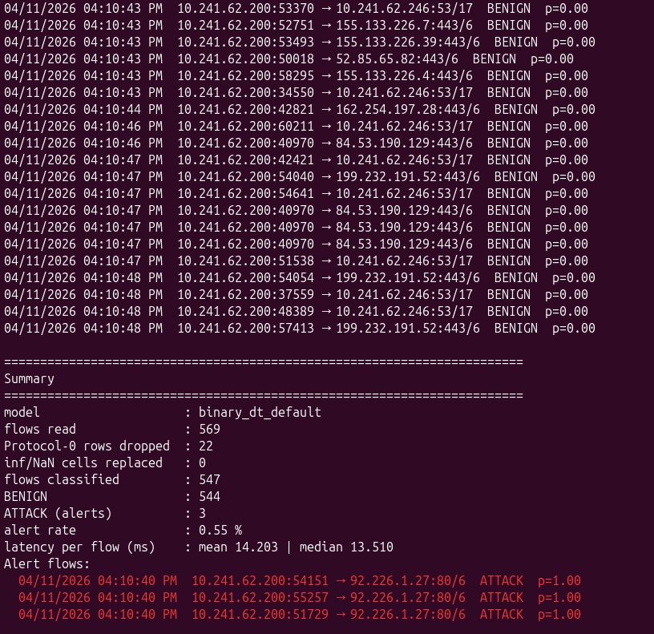
Real-Time Detection on Our Own Flows
Capture .pcapng
CICFlowMeter (offline)
Map V4 → training columns
Drop protocol 0, inf/NaN → 0
Pipeline: verdict per flow
547
3
flows classified, one by one
ATTACK alerts (0.55 %)
14.2 ms
0.67 ms
mean latency per flow
per 1,000 flows when batched
Parity test: the 49,254 test flows streamed through the detector give the offline predictions row for row; 21 unit and 3 full-dataset tests pass.
Detector output: streamed verdicts, summary and the three alerts in red
Notes:
The detector loads the saved binary Decision Tree pipeline unchanged. Real time here means streaming recorded flows one by one; we do not capture live. Detection delay is dominated by CICFlowMeter's flow timeouts.

Slide 14
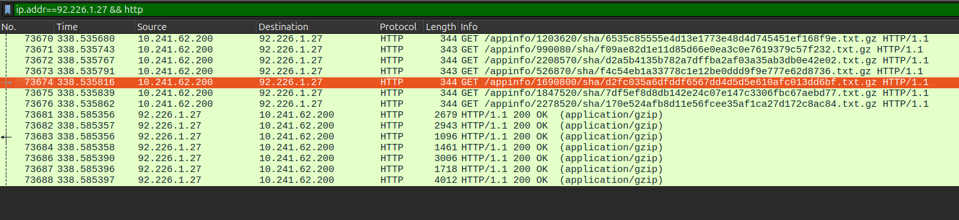
Three False Alarms, One Steam Burst
Seven parallel Steam requests to the Steam CDN at 92.226.1.27, all answered 200 OK
1
What happened
2
Why the tree fires
3
Why only 3 of 7
At 16:10:40 Steam sent 7 parallel GET /appinfo/… over plain HTTP to port 80: tiny gzip files, about 101 ms each, 2 PSH flags.
Server window 507 lies in 235 < x ≤ 1,146 and port ≤ 85. In training, that region holds only attacks: the shortcut features.
A depth-15 split on packet-length features lets 4 near-identical flows pass. The unpruned tree has overfitted.
Notes:
All three alerts are false positives, since our traffic is benign by construction. Automated plain-HTTP bursts to port 80 from a small-window server resemble the Selenium-driven attacks of 2017.

Slide 15
The benchmark score does not carry over
Takeaways
Decision Tree beats LR: attack F1 0.986 vs. 0.788, macro-F1 0.729 vs. 0.319
Never trust accuracy alone: 98.5 % accuracy with zero attacks detected
Shortcuts and domain shift: port 80 and initial TCP windows, plus a newer CICFlowMeter, QUIC and Steam
0.037 %
false-positive rate on the CIC-IDS2017 test split
0.55 %
on our own benign traffic, about 15 times higher
Limitations and next steps
Limits: single split without cross-validation, only 6 SQLi test flows, replay instead of live capture
Prune the tree: max_depth, min_samples_leaf
Remove shortcuts: drop Destination Port and Init_Win_bytes_*, add benign traffic from the deployment network
Notes:
Conclusion: near-perfect benchmark scores, but the model partly learned 'automated HTTP to port 80 from a small-window server' rather than the attack. Thank you; questions welcome.

