Slide 1
Lab 1: Networking Basics, Monitoring Tools, Network Attacks and Defense, and Machine Learning
Security Insider Lab I
Group 8
Justlyn Kaniyanthara Johnson
&
Aayush Kapoor
121024
&
120957
28 October 2026

Slide 2
TCP/IP Stack and Core Protocols
Application
HTTP, DNS, TLS
Data
Protocol | What it does
IP | Addressing, best-effort delivery
ICMP | Diagnostics (ping, traceroute)
TCP | Reliable, ordered; handshake
UDP | No handshake, low overhead
DNS | Names to IP addresses
HTTP | Web requests and responses
TLS | Encryption, authentication
Transport
TCP, UDP
TCP hdr
Data
Internet
IP, ICMP
IP hdr
TCP hdr
Data
Link
Ethernet, Wi-Fi
Eth hdr
IP hdr
TCP hdr
Data
Trailer
Our first SYN: 14 B Ethernet + 40 B IPv6 + 40 B TCP = 94 bytes

Slide 3
BGP, IXPs and DE-CIX
BGP
Networks announce which IP prefixes they can reach
Like airlines sharing route maps
Trust problem: hijacks and route leaks; fix: RPKI
Facebook outage, 4 October 2021
1
Maintenance command cuts the data-center links
2
DNS servers withdraw their BGP routes
3
facebook.com stops resolving
4
Engineers go on site; about six hours down
ISP sells Internet access
IXP networks swap traffic directly: cheaper, faster, more redundant
1995
60+
~1,100
21.47
founded
exchanges
networks in Frankfurt
Tbit/s record, Oct 2026
Press figures; see de-cix.net for current values.

Slide 4
Wireshark: Ping and DNS
ICMP ping
DNS lookup
11.2 ms
average round trip
78 of 3,921
packets are DNS
icmp alone shows nothing: it is ICMPv6
Hop limit 64 out, 111 back
Router's MAC, not Google's
A: 17.9 ms, four IPv4 addresses
AAAA: no address (SOA only)
Queries went over IPv4
Ubuntu 24.04, Wireshark 4.2.2, home Wi-Fi, own traffic only, 20 October 2026

Slide 5
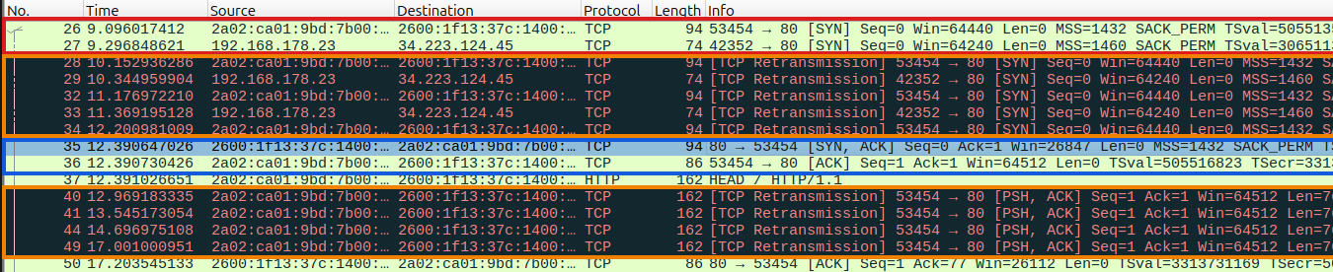
Wireshark: TCP Handshake
Client
Server
What the capture added
SYN, Seq=0
SYN at 9.1 s, SYN-ACK at 12.4 s: three retransmissions
HTTP request retransmitted four times
IPv4 SYN 200 ms later (Happy Eyeballs)
Cause unknown
SYN-ACK, Seq=0, Ack=1
ACK, Seq=1, Ack=1

Slide 6
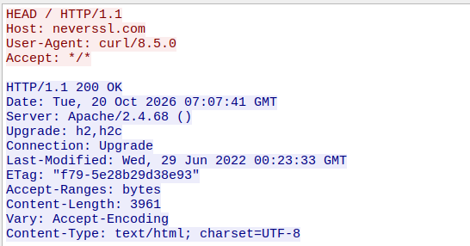
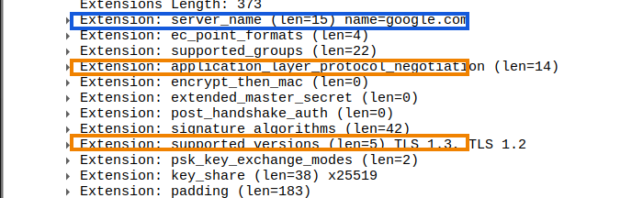
Wireshark: HTTP versus TLS
Plain HTTP
HTTPS with TLS
curl -I http://neverssl.com
curl https://google.com
Everything is readable
200 OK from an Apache server
Client Hello readable: SNI google.com
After Server Hello: only Application Data
Even with TLS 1.3, addresses, ports, timing and the SNI stay visible

Slide 7
Network Attacks and DDoS
Attack | How it works | Main defense
DDoS | Many machines flood a target | Rate limiting, scrubbing, anycast
Man-in-the-middle | Relays and alters traffic | TLS, VPN
ARP spoofing | Fake replies redirect traffic | Dynamic ARP inspection
DNS spoofing | Forged answers misdirect names | DNSSEC
Port scanning | Probes for open ports | Firewall, IDS
Volumetric
Bandwidth (bit/s), e.g. amplification
Protocol
Server state (packets/s), e.g. SYN flood
Application
The app itself (requests/s), e.g. Slowloris
557×
47.1M
31.4 Tbit/s
NTP amplification factor
attacks in 2025 (+121 %)
peak in 2025, lasted 35 s
Sources: CISA; Cloudflare reports via press coverage

Slide 8
Attack Tools and Defenses
Tool | In short
LOIC | Simple GUI flooder, around 2010
Slowloris | Slow headers, little bandwidth
hping3 | Custom packets; also a test tool
Mirai | IoT botnet, took down Dyn (2016)
Aisuru / Kimwolf | Millions of devices; 2025 records
 | Cloudflare | eBPF / XDP
Runs | Provider network, anycast | One Linux host
Strength | Absorbs huge volumes | Very fast, full control
Weakness | Third-party dependency | Cannot fix a full link
Best against | Volumetric floods | Protocol floods at the host
Cloudflare stopped the 31.4 Tbit/s attack automatically
Researched from the literature; no tool was run (§ 303b StGB)

Slide 9
Machine Learning Detection
Traffic
Flows and features
Trained model
Attack or not?
Alert or block
Algorithm | Strength | Limitation
Random Forest | Robust | Large models are slow
XGBoost | Best accuracy on flow features | Needs tuning
SVM | Handles many features | Slow on big data
LSTM | Captures change over time | Data-hungry, hard to explain
Isolation Forest | No labels needed | More false alarms
Judge detectors by precision, recall and false-positive rate, not accuracy alone

Slide 10
Summary and Limitations
What we found
Captures matched the textbook, plus surprises: IPv6 ping, SYN retransmissions
A SYN flood abuses the handshake; UDP enables spoofing
Cloudflare and XDP complement each other; ML supplies detection
Limitations
One laptop, one network, one day
Retransmission cause unknown
Attack figures come from reports
No attack tool was run

