Slide 1
Security Insider Lab1
Talaya Farasat, Aleena Elsa George

Slide 2
Total 5 Labs
Lab 1 (Theoractical Understanding Networking, Monitoring Tools Network attacks/Defense)
Lab 2 (Machine Learning for DDoS detection)
Lab 3 (Training of Machine Learning algorithms for DDoS detection)
Lab 4 (DDoS Defense (Filtration) (configuration of eBPF/XDP))
Lab 5 (Mini Project)

Slide 3
How to Proceed...
Each lab should be completed on time
Each lab will be discussed during the lab session and then will be uploaded on StudIP
Each Lab will have presentation sessions
Each lab detailed report should be submitted before the presentation sessions
Students can work on groups but each group is limited to a maximum of 2 members

Slide 4
Reports
Remember to document everything
Make it short and clear. Include screenshots
Must follow Report submission deadlines (before presentation session)
Send the report to: tf@sec.uni-passau.de, aeg@sec.uni-Passau.de
Make sure you send all your reports in the same email conversation (don’t start a
new email each time). From your first report to your last one, always reply to the
same email thread.
Email Subject: Lab-2026: matriculation ID-1, matriculation ID-2
Report Format Name: GX.ReportY.pdf (X: Group No, Y: Report No)
Number of pages: 10-15 pages

Slide 5
Presentations
Each lab will have Presentation sessions
Each member of the group should present his task
Presentation ideally should be 10 minutes (+ 2 minutes discussion)
Each member must need to attend all presentation sessions
Slides should be designed in a standard presentation way

Slide 6
Schedule & Deadlines
Lab 1 (October 14)
Lab 2 (October 28)
Lab 3 (November 11)
Lab 4 (November 25)
Lab 5 (project January 13)

Slide 7
Lab 2 (Machine Learning for DDoS detection)
Task 1 ) Network Flows and Features
Go to https://github.com/ahlashkari/CICFlowMeter
Download and install it
The pcap files that you were collected from the lab 1 with Wireshark, now convert it into network flows/features

Slide 8
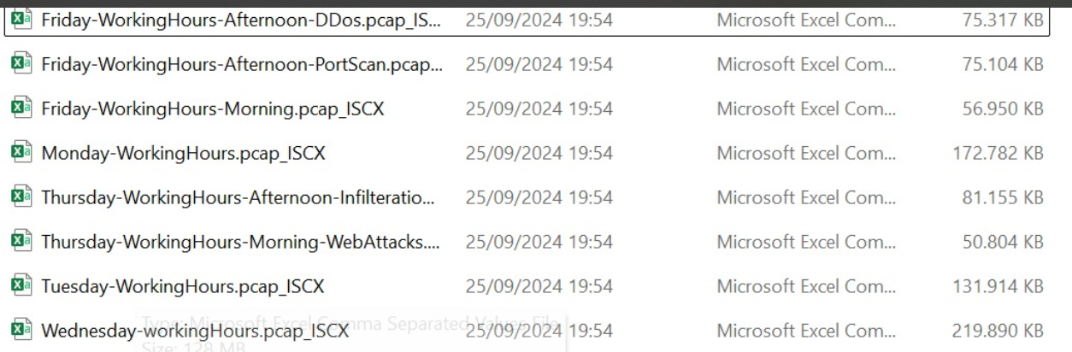
Task 2 ) DDoS Dataset
Go to https://www.unb.ca/cic/datasets/ids-2017.html
Download the dataset
You will see 8 different types of dataset files
Consider first file Friday WorkingHours-Afternoon-DDoS.pcap_ISCX

Slide 9
Task 3 ) Data Pre-processing
Can use any programming language (recomemded Python)
Analyze the dataset file and see Labels properly
Manage Infinity and NaN values
Use min-max scaler to scale the Dataset
Find best features. For python you can apply sklearn SelectKBest algorithm to find the best network flow features
Select 20 best features/flows

Slide 10
Task 4 ) Machine learning Algorithms
Apply these classification Algorithms
-logistic regression
-Decision Tree
Try to use trained classifier in a real time for network traffic

Slide 11
Submission
Send the report to: tf@sec.uni-passau.de, aeg@sec.uni-Passau.de
till November 11
Report Format: GX.ReportY.pdf (X: Group No, Y: Report No)
• Number of pages: 10-15 pages
Presentation will be on November 11
Any question send email to tf@sec.uni-passau.de, aeg@sec.uni-Passau.de

