Slide 1
Cypress

Slide 2

Introduction
Most testing tools (like selenium) operate by running outside of the browser and executing remote commands across the network. But cypress engine directly operates inside the browser.
This enables cypress to listen and modify the browser behavior at run time by manipulating DOM and altering network request.
cypress have the ability to control to test both front end and back end.
Cypress support browser such as
Google chrome
Electron
Firefox

Slide 3
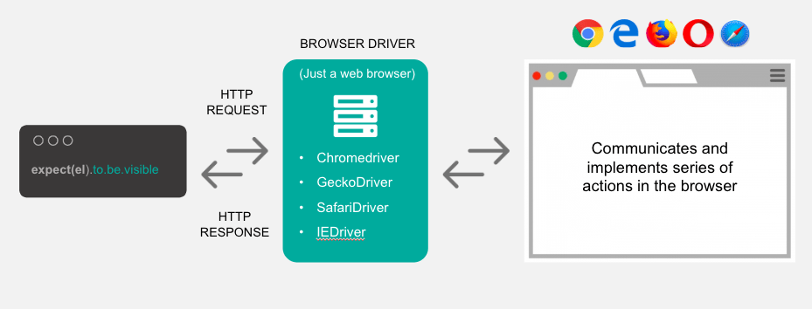
Cypress vs Selenium

Slide 4
Cypress & Selenium
Cypress is uniqueness from other tools :
Cypress automatically waits for commands and assertions before moving on .
Ability to test edge test case by mocking the server response.
cypress takes snapshot as your test run . we can hover over each commands in the command log to see
exactly what happened at each step .
Because of its architectural design, cypress delivers fast , consistent and reliable test execution .
view videos on entire test execution when run from the cypress .
Cypress build on node js and comes packaged as npm module .
As it is build on node js it use java script to write tests.
cypress also bundles with jquery and inherits many of the jquery methods for UI .

Slide 5
who use cypress
Our users are typically developers or QA engineers building web applications using modern JavaScript frameworks.
Cypress enables you to write all types of tests:
End-to-end tests
Component tests
Integration tests
Unit tests

Slide 6
Test Types
End to End :
Cypress was originally designed to run end-to-end (E2E) tests on anything that runs in a browser. A typical E2E test visits the application in a browser and performs actions via the UI just like a real user would.
it('adds todos', () => {
cy.visit('https://example.cypress.io/')
cy.get('[data-testid="new-todo"]')
.type('write code{enter}')
.type('write tests{enter}')
// confirm the application is showing two items
cy.get('[data-testid="todos"]').should('have.length', 2)
})

Slide 7
Component Test
Component Test :
You can also use Cypress to mount components from supported web frameworks and execute component tests.
it('contains the correct number of todos', () => {
const todos = [
{ text: 'Buy milk', id: 1 },
{ text: 'Learn Component Testing', id: 2 },
]
cy.mount(<TodoList todos={todos} />)
// the component starts running like a mini web app
cy.get('[data-testid="todos"]').should('have.length', todos.length)
})

Slide 8
API Testing
Cypress can perform arbitrary HTTP calls, thus you can use it for API testing.
it('adds a todo', () => {
cy.request({
url: '/todos',
method: 'POST',
body: {
title: 'Write REST API',
},
})
.its('body')
.should('deep.contain', {
title: 'Write REST API',
completed: false,
})
})

Slide 9
Installing Cypress and open
Install Cypress via npm:
npm install cypress --save-dev
npx cypress open
Adding npm Scripts:
it's much easier and clearer to add Cypress commands to the scripts field in your package.json file.
{
"scripts": {
"cypress:open": "cypress open"
}
}

Slide 10
Cypress installation and project setup
Steps are given follows:
Download node
set node to Environment variable
create basic cypress working folder
download vs code editor
download cypress dependencies
start cypress test runner
Explore project structure generated by cypress
understand cypress test writing principles
create first cypress test case
understand how to run tests from test runner and command line

Slide 12
THANK YOU !!

