Slide 1
Chapter 10: Storage and File Structure

Slide 2
Chapter 10: Storage and File Structure
Overview of Physical Storage Media
Magnetic Disks
Storage Access
File Organization
Organization of Records in Files
Data-Dictionary Storage

Slide 3

Storage Hierarchy

Slide 4

Magnetic Hard Disk Mechanism
NOTE: Diagram is schematic, and simplifies the structure of actual disk drives

Slide 5
Magnetic Disks
Surface of platter divided into circular tracks
  Over 50K-100K tracks per platter on typical hard disks
Each track is divided into sectors.
  A sector is the smallest unit of data that can be read or written.
  Sector size typically 512 bytes
  Typical sectors per track: 500 to 1000 (on inner tracks) to 1000 to 2000 (on outer tracks)
To read/write a sector
  disk arm swings to position head on right track
  platter spins continually; data is read/written as sector passes under head
Cylinder i consists of i^{th} track of all the platters

Slide 6
Performance Measures of Disks
Access time = – the time it takes from when a read or write request is issued to when data transfer begins.
Access time = Seek time + Rotational latency
  Seek time – time it takes to reposition the arm over the correct track.
    Average seek time is 1/2 the worst case seek time.
      Would be 1/3 if all tracks had the same number of sectors, and we ignore the time to start and stop arm movement
    4 to 10 milliseconds on typical disks
  Rotational latency – time it takes for the sector to be accessed to appear under the head.
    Average latency is 1/2 of the worst case latency.
    4 to 11 milliseconds on typical disks (5400 to 15000 r.p.m.)
Data-transfer rate – the rate at which data can be retrieved from or stored to the disk.
  25 to 100 MB per second max rate, lower for inner tracks
  Multiple disks may share a controller, so rate that controller can handle is also important
    E.g. SATA: 150 MB/sec, SATA-II 3Gb (300 MB/sec)
    Ultra 320 SCSI: 320 MB/s, SAS (3 to 6 Gb/sec)
    Fiber Channel (FC2Gb or 4Gb): 256 to 512 MB/s

Slide 7
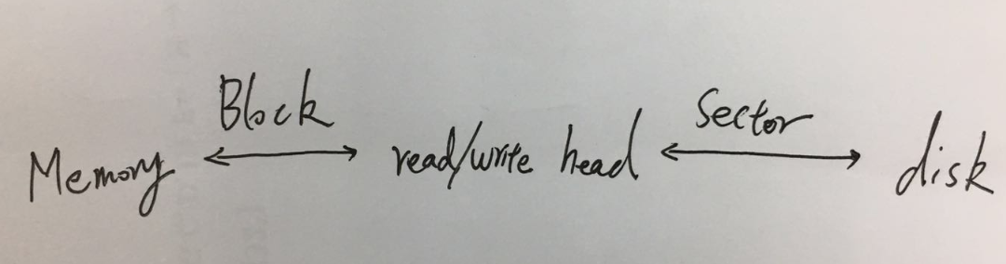
Optimization of Disk-Block Access
Block – a contiguous sequence of sectors from a single track
  data is transferred between disk and main memory in blocks
  1 block = multiple consecutive sectors
  sizes range from 512 bytes to several kilobytes
    Smaller blocks: more transfers from disk
    Larger blocks: more space wasted due to partially filled blocks
    Typical block sizes today range from 4 to 16 kilobytes

Slide 8
Optimization of Disk Block Access (Cont.)
File organization – optimize block access time by organizing the blocks to correspond to how data will be accessed
  E.g. Store related information on the same or nearby cylinders.
  Files may get fragmented over time
    E.g. if data is inserted to/deleted from the file
    Or free blocks on disk are scattered, and newly created file has its blocks scattered over the disk
    Sequential access to a fragmented file results in increased disk arm movement
  Some systems have utilities to defragment the file system, in order to speed up file access

Slide 9
小结
  磁盘
      1 block = 多个连续的 sector
      1个文件(哈希文件除外)= 多个连续的block
磁头与磁盘
    磁头往磁盘读写数据的最小单位是sector
内存与磁盘
    内存与磁盘交换信息的最小单位是block
开销=寻道时间+ 旋转时间+传输时间
数据库只关注:
  寻道次数
  传输磁盘块个数
设访问的磁盘块依次分别是: B1, B2
  寻道次数 : 如果B1, B2相邻, 则寻道1次
  传输磁盘块的个数: 无论相邻与否, 都是2.

Slide 10
Buffer Manager
Programs call on the buffer manager when they need a block from disk.
  If the block is already in the buffer, buffer manager returns the address of the block in main memory
  If the block is not in the buffer, the buffer manager
    Allocates space in the buffer for the block
      Replacing (throwing out) some other block, if required, to make space for the new block.
      Replaced block written back to disk only if it was modified since the most recent time that it was written to/fetched from the disk.
    Reads the block from the disk to the buffer, and returns the address of the block in main memory to requester.

Slide 11
Buffer-Replacement Policies
Most operating systems replace the block least recently used (LRU strategy)
Idea behind LRU – use past pattern of block references as a predictor of future references
Queries have well-defined access patterns (such as sequential scans), and a database system can use the information in a user’s query to predict future references
  LRU can be a bad strategy for certain access patterns involving repeated scans of data
    For example: when computing the join of 2 relations r and s by a nested loops
    for each tuple tr of r do
    for each tuple ts of s do
    if the tuples tr and ts match …
  Toss-immediate(立即丢弃） strategy is preferable（see later)
r s

Slide 12
Buffer-Replacement Policies (Cont.)
Pinned block – memory block that is not allowed to be written back to disk.
Toss-immediate strategy – frees the space occupied by a block as soon as the final tuple of that block has been processed
Most recently used (MRU) strategy – system must pin the block currently being processed. After the final tuple of that block has been processed, the block is unpinned, and it becomes the most recently used block.
Buffer manager can use statistical information regarding the probability that a request will reference a particular relation
  E.g., the data dictionary is frequently accessed. Heuristic: keep data-dictionary blocks in main memory buffer
Buffer managers also support forced output of blocks for the purpose of recovery (more in Chapter 16)

Slide 13
File Organization
The database is stored as a collection of files. Each file is a sequence of records. A record is a sequence of fields.
One approach:
  assume record size is fixed
  each file has records of one particular type only
  different files are used for different relations
  This case is easiest to implement; will consider variable length records later.

Slide 14
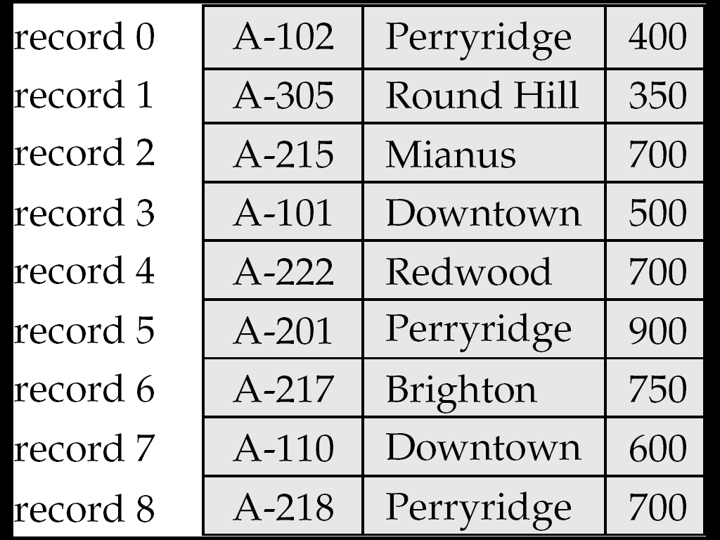
Fixed-Length Records
Simple approach:
  Store record i starting from byte n ∗ (i – 1), where n is the size of each record.
  Record access is simple but records may cross blocks
    Modification: do not allow records to cross block boundaries
Deletion of record i:
alternatives:
  move records i + 1, . . ., n
  to i, . . . , n – 1
  move record n to i
  do not move records, but
  link all free records on a
  free list

Slide 15
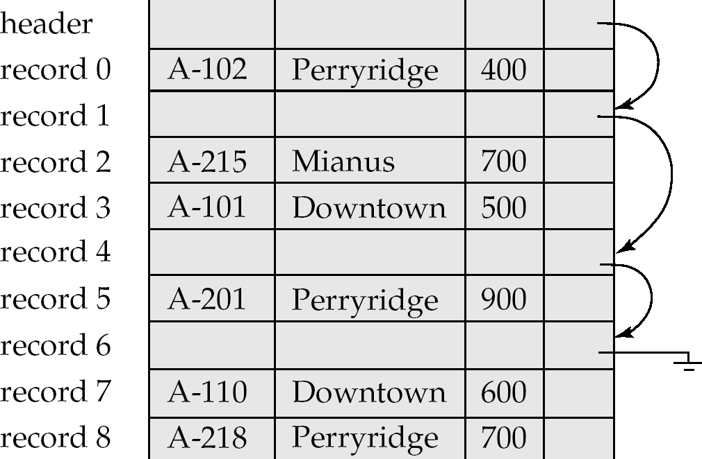
Free Lists
Store the address of the first deleted record in the file header.
Use this first record to store the address of the second deleted record, and so on
Can think of these stored addresses as pointers since they “point” to the location of a record.

Slide 16
Variable-Length Records
Variable-length records arise in database systems in several ways:
  Storage of multiple record types in a file.
  Record types that allow variable lengths for one or more fields.
  ……

Slide 17
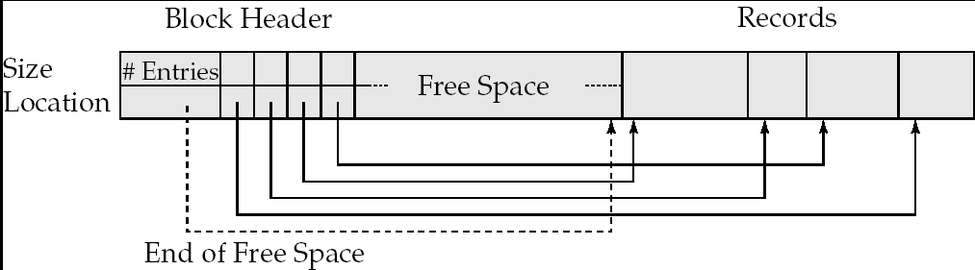
Variable-Length Records: Slotted Page Structure
Slotted page header contains:
  number of record entries
  end of free space in the block
  location and size of each record
Records can be moved around within a page to keep them contiguous with no empty space between them; entry in the header must be updated.
Pointers should not point directly to record — instead they should point to the entry for the record in header.

Slide 18
Organization of Records in Files
Heap – a record can be placed anywhere in the file where there is space
Sequential – store records in sequential order, based on the value of the search key of each record
Hashing – a hash function computed on some attribute of each record; the result specifies in which block of the file the record should be placed
Records of each relation may be stored in a separate file. In a multitable clustering file organization records of several different relations can be stored in the same file
  Motivation: store related records on the same block to minimize I/O

Slide 19
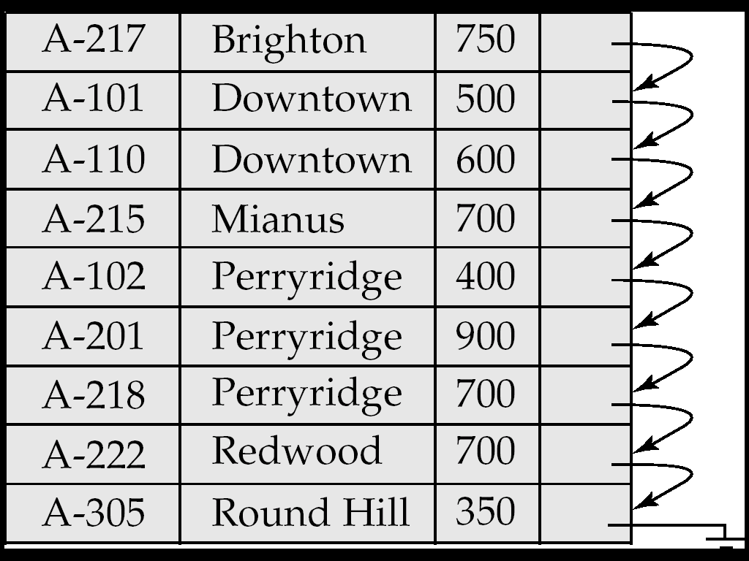
Sequential File Organization
Suitable for applications that require sequential processing of the entire file
The records in the file are ordered by a search-key

Slide 20
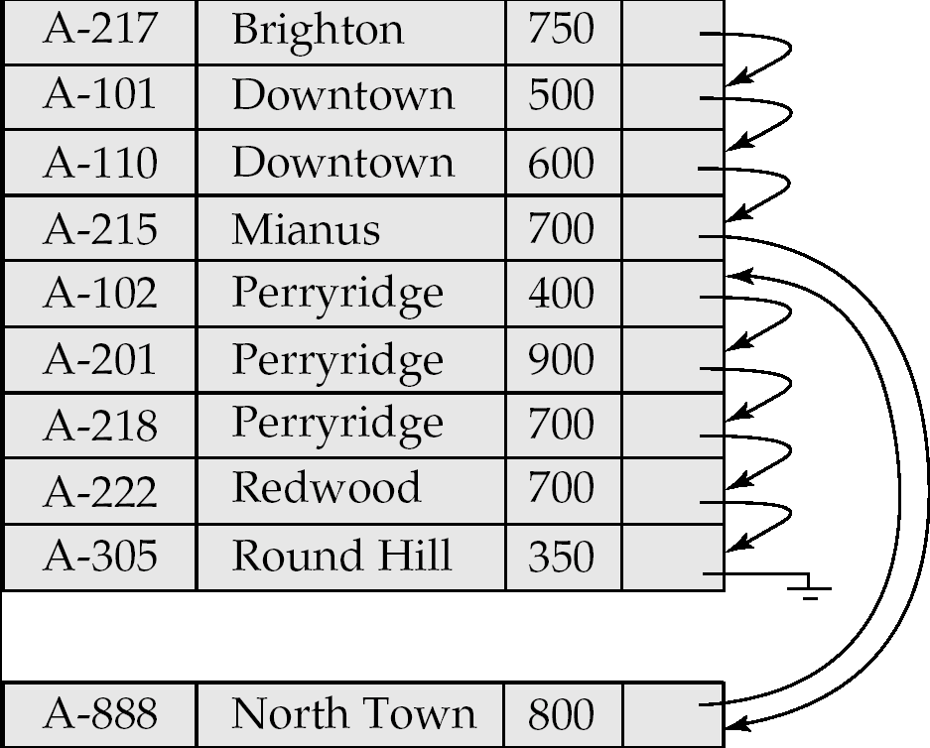
Sequential File Organization (Cont.)
Deletion – use pointer chains
Insertion –locate the position where the record is to be inserted
  if there is free space insert there
  if no free space, insert the record in an overflow block
  In either case, pointer chain must be updated
Need to reorganize the file
from time to time to restore
sequential order

Slide 21
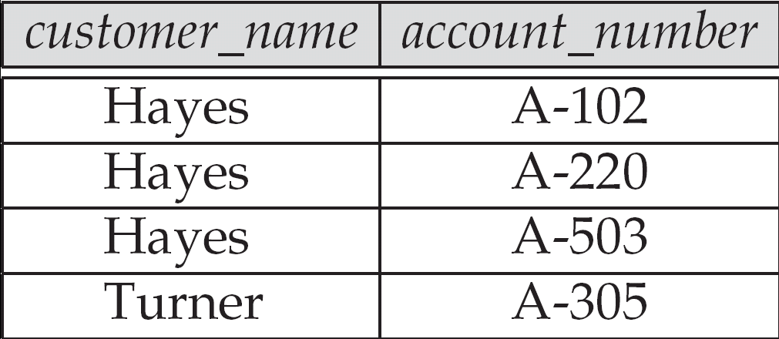
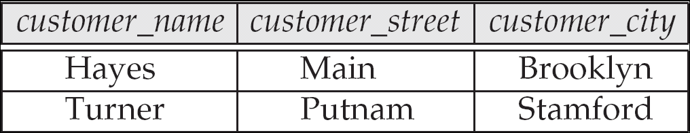
Multitable Clustering File Organization
Store several relations in one file using a multitable clustering file organization

Slide 22
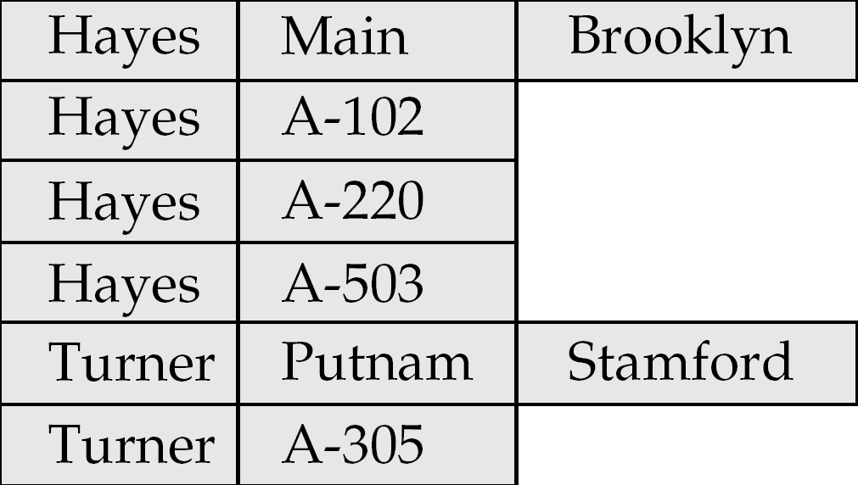
Multitable Clustering File Organization (cont.)
Multitable clustering organization of customer and depositor:
  good for queries involving depositor customer, and for queries involving one single customer and his accounts
  bad for queries involving only customer
  results in variable size records
  Can add pointer chains to link records of a particular relation

Slide 23
Data Dictionary Storage
Data dictionary (also called system catalog) stores metadata; that is, data about data, such as
Information about relations
  names of relations
  names and types of attributes of each relation
  names and definitions of views
  integrity constraints
User and accounting information, including passwords
Statistical and descriptive data
  number of tuples in each relation
Physical file organization information
  How relation is stored (sequential/hash/…)
  Physical location of relation
Information about indices (Chapter 11)

Slide 24
Data Dictionary Storage (Cont.)
A possible catalog representation:
Relation_metadata = (relation_name, number_of_attributes,
storage_organization, location)
Attribute_metadata = (attribute_name, relation_name, domain_type,
position, length)
User_metadata = (user_name, encrypted_password, group)
Index_metadata = (index_name, relation_name, index_type,
index_attributes)
View_metadata = (view_name, definition)

Slide 25
End of Chapter

