Slide 1
Chapter 14: Transactions

Slide 2
Chapter 14: Transactions
Transaction Concept
Transaction State
Concurrent Executions
Serializability
Recoverability
Implementation of Isolation
Transaction Definition in SQL
Testing for Serializability.

Slide 3
Transaction Concept
A transaction is a unit of program execution that accesses and possibly updates various data items.
E.g. transaction to transfer $50 from account A to account B:
  1. read(A)
  2. A := A – 50
  3. write(A)
  4. read(B)
  5. B := B + 50
  6. write(B)
Two main issues to deal with:
  Failures of various kinds, such as hardware failures and system crashes
  Concurrent execution of multiple transactions

Slide 4
Example of Fund Transfer
Transaction to transfer $50 from account A to account B:
  1. read(A)
  2. A := A – 50
  3. write(A)
  4. read(B)
  5. B := B + 50
  6. write(B)
Atomicity requirement
  if the transaction fails after step 3 and before step 6, money will be “lost” leading to an inconsistent database state
    Failure could be due to software or hardware
  the system should ensure that updates of a partially executed transaction are not reflected in the database
Durability requirement — once the user has been notified that the transaction has completed (i.e., the transfer of the $50 has taken place), the updates to the database by the transaction must persist even if there are software or hardware failures.

Slide 5
Example of Fund Transfer (Cont.)
Transaction to transfer $50 from account A to account B:
  1. read(A)
  2. A := A – 50
  3. write(A)
  4. read(B)
  5. B := B + 50
  6. write(B)
Consistency requirement in above example:
  the sum of A and B is unchanged by the execution of the transaction
In general, consistency requirements include
    Explicitly specified integrity constraints such as primary keys and foreign keys
    Implicit integrity constraints
      e.g. sum of balances of all accounts
  A transaction must see a consistent database.
  During transaction execution the database may be temporarily inconsistent.
  When the transaction completes successfully the database must be consistent
    Erroneous transaction logic can lead to inconsistency

Slide 6
Example of Fund Transfer (Cont.)
Isolation requirement — if between steps 3 and 6, another transaction T2 is allowed to access the partially updated database, it will see an inconsistent database (the sum A + B will be less than it should be).
T1 T2
  1. read(A)
  2. A := A – 50
  3. write(A)
  read(A), read(B), print(A+B)
  4. read(B)
  5. B := B + 50
  6. write(B
Isolation can be ensured trivially by running transactions serially
  that is, one after the other.
However, executing multiple transactions concurrently has significant benefits, as we will see later.

Slide 7
ACID Properties
A transaction is a unit of program execution that accesses and possibly updates various data items.To preserve the integrity of data the database system must ensure:
Atomicity. Either all operations of the transaction are properly reflected in the database or none are.
Consistency. Execution of a transaction in isolation preserves the consistency of the database.
Isolation. Although multiple transactions may execute concurrently, each transaction must be unaware of other concurrently executing transactions. Intermediate transaction results must be hidden from other concurrently executed transactions.
  That is, for every pair of transactions Tand F, it appears to T that either F 完成后， T 才开始执行, or F started execution after T finished.
Durability. After a transaction completes successfully, the changes it has made to the database persist, even if there are system failures.

Slide 8
Transaction State
Active – the initial state; the transaction stays in this state while it is executing
Partially committed – after the final statement has been executed.
Failed -- after the discovery that normal execution can no longer proceed.
Aborted – after the transaction has been rolled back and the database restored to its state prior to the start of the transaction. Two options after it has been aborted:
  restart the transaction
    can be done only if no internal logical error
  kill the transaction
Committed – after successful completion. A transaction is said to have committed when its commit log record is output to stable storage

Slide 9

Transaction State (Cont.)

Slide 10
Concurrent Executions
Multiple transactions are allowed to run concurrently in the system. Advantages are:
  increased processor and disk utilization, leading to better transaction throughput
    E.g. one transaction can be using the CPU while another is reading from or writing to the disk
  reduced average response time for transactions: short transactions need not wait behind long ones.
Concurrency control schemes – mechanisms to achieve isolation and consistency
  that is, to control the interaction among the concurrent transactions in order to prevent them from destroying the consistency of the database
    Will study in Chapter 16, after studying notion of correctness of concurrent executions.

Slide 11
Schedules
Schedule – a sequences of instructions that specify the chronological order in which instructions of concurrent transactions are executed
  a schedule for a set of transactions must consist of all instructions of those transactions
  must preserve the order in which the instructions appear in each individual transaction.
  T1={a1, a2, … ,a10} , T2={b1, b2, ...., b10}
  Schedule 就是要合理执行完{a1, a2, … ,a10 , b1, b2, ...., b10}
A transaction that successfully completes its execution will have a commit instruction as the last statement
  by default transaction assumed to execute commit instruction as its last step
A transaction that fails to successfully complete its execution will have an abort instruction as the last statement

Slide 12

Schedule 1
Let T₁ transfer $50 from A to B, and T₂ transfer 10% of the balance from A to B.
A serial schedule in which T₁ is followed by T₂ :

Slide 13

Schedule 2
A serial schedule where T₂ is followed by T₁

Slide 14

Schedule 3
Let T₁ and T₂ be the transactions defined previously. The following schedule is not a serial schedule, but it is equivalent to Schedule 1.
In Schedules 1, 2 and 3, the sum A + B is preserved.

Slide 15

Schedule 4
The following concurrent schedule does not preserve the value of (A + B ).

Slide 16
Serializability
Basic Assumption – Each transaction preserves database consistency.
Thus serial execution of a set of transactions preserves database consistency.
A (possibly concurrent) schedule is serializable if it is equivalent to a serial schedule. Different forms of schedule equivalence give rise to the notions，one of the most important one is:
conflict serializability

Slide 17
Simplified view of transactions
  We ignore operations other than read and write instructions
  We assume that transactions may perform arbitrary computations on data in local buffers in between reads and writes.
  Our simplified schedules consist of only read and write instructions.

Slide 18
Conflicting Instructions
Instructions t and f of transactions T and F respectively, conflict if and only if
there exists some item Q accessed by both t and f,
at least one of these instructions wrote Q.
1. t = read(Q), f = read(Q). t and f don’t conflict.
2. t = read(Q), f = write(Q). They conflict.
3. t = write(Q), f = read(Q). They conflict
4. t = write(Q), f = write(Q). They conflict
为什么可以调度？ If t and f are consecutive in a schedule and they do not conflict, their results would remain the same even if they had been interchanged in the schedule.

Slide 19
Conflict Serializability
If a schedule S can be transformed into a schedule S２ by a series of swaps of non-conflicting instructions, we say that S and S２ are conflict equivalent.
We say that a schedule S is conflict serializable if it is conflict equivalent to a serial schedule． 也就是说， schedule S 是conflict serializable ， 当且仅当， 通过交换schedule S中无冲突的指令顺序， 我们可以得到一个新的schedule S２， 并且S２是个串行schedule．

Slide 20


Conflict Serializability (Cont.)
Schedule 3 can be transformed into Schedule 6, a serial schedule where T₂ follows T₁, by series of swaps of non-conflicting instructions. Therefore Schedule 3 is conflict serializable.
Schedule 3
Schedule 6

Slide 21

Conflict Serializability (Cont.)
Example of a schedule that is not conflict serializable:
We are unable to swap instructions in the above schedule to obtain either the serial schedule < T₃, T₄ >, or the serial schedule < T₄, T₃ >.

Slide 22
Testing for Serializability
已知某个调度方案， 我们如何判断它是否达到了Serializability？
Consider some schedule of a set of transactions T₁, T₂, ..., T_{n}
Precedence graph — a direct graph where the vertices are the transactions (names).
We draw an arc T1→T2 ， if one of three conditions holds:
1. T1executes write(Q) before T2 executes read(Q).
2. T1executes read(Q) before T2 executes write(Q).
3. T1executes write(Q) before T2 executes write(Q).
判断定理: A schedule is conflict serializable if and only if its precedence graph is acyclic.

Slide 23
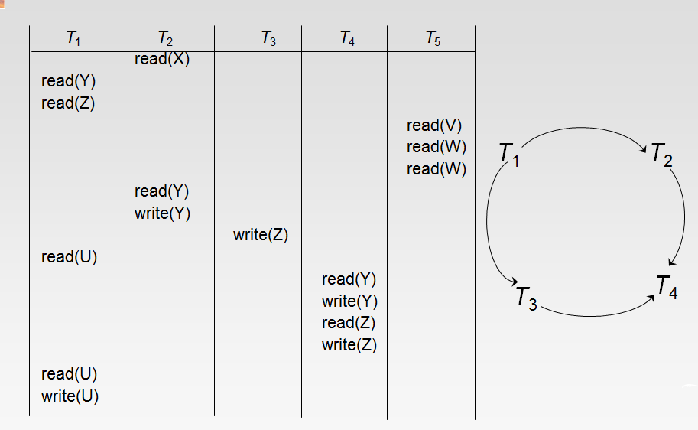

Slide 24
Test for Conflict Serializability
判断定理： A schedule is conflict serializable if and only if its precedence graph is acyclic.
Cycle-detection algorithms exist which take order n² time, where n is the number of vertices in the graph.
  (Better algorithms take order n + e where e is the number of edges.)

Slide 25

Test for Conflict Serializability
If precedence graph is acyclic, the serializability order can be obtained by a topological sorting of the graph.
  These are linear orders consistent with the partial order of the graph.
  For example, a serializability order for Schedule A in slide before(slide 23) would be
  T₅ → T₁ → T₃ → T₂ → T₄
    Are there others?

Slide 26

Recoverable Schedules
Need to address the effect of transaction failures on concurrently
running transactions.
Recoverable schedule — 已知T ：Ｒ（Ｑ）和F：Ｗ（Ｑ）在Q上冲突． 如果在某个调度中，先执行F的Ｗ（Ｑ）后执行T的Ｒ（Ｑ），先提交F后提交T ．那么该调度可恢复．
The following schedule (Schedule 11) is not recoverable if T₉ commits immediately after the read
If T₈ should abort, T₉ would have read (and possibly shown to the user) an inconsistent database state. Hence, database must ensure that schedules are recoverable.
允许读未提交数据

Slide 27

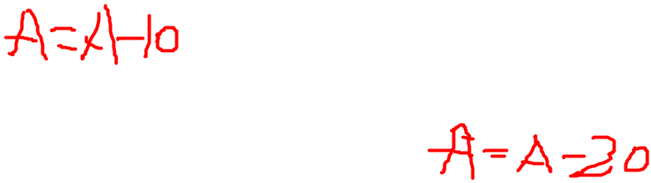
Cascading Rollbacks
Cascading rollback – a single transaction failure leads to a series of transaction rollbacks. Consider the following schedule where none of the transactions has yet committed (so the schedule is recoverable)
If T₁₀ fails, T₁₁ and T₁₂ must also be rolled back.
Cascading rollback aims to get consistency.
Can lead to the undoing of a significant amount of work

Slide 28
Cascadeless Schedules
Cascadeless schedules — cascading rollbacks cannot occur; for each pair of 发生冲突的transactions ｛T， F｝
先执行F的Ｗ（Ｑ）, 并且先提交F， 后执行T的Ｒ（Ｑ）并且后提交．
.
Every cascadeless schedule is also recoverable
It is desirable to restrict the schedules to those that are cascadeless
说明：不允许读未提交数据，须读提交的数据

Slide 29
Concurrency Control
A database must provide a mechanism that will ensure that all possible schedules are
  either conflict or view serializable, and
  are recoverable and preferably cascadeless
A policy in which only one transaction can execute at a time generates serial schedules, but provides a poor degree of concurrency
  Are serial schedules recoverable/cascadeless?
Testing a schedule for serializability after it has executed is a little too late!
Goal – to develop concurrency control protocols that will assure serializability.

Slide 30
Concurrency Control (Cont.)
Schedules must be
  conflict or view serializable,
  and recoverable, for the sake of database consistency,
  and preferably cascadeless.
A policy in which only one transaction can execute at a time generates serial schedules, but provides a poor degree of concurrency.
Concurrency-control schemes tradeoff between the amount of concurrency they allow and the amount of overhead that they incur.
Some schemes allow only conflict-serializable schedules to be generated, while others allow view-serializable schedules that are not conflict-serializable.

Slide 31
Concurrency Control vs. Serializability Tests
Concurrency-control protocols allow concurrent schedules, but ensure that the schedules are
  conflict/view serializable, (这就保证了隔离性)
  recoverable (保证一致性)
  cascadeless . (降低abort时的开销)
Concurrency control protocols generally do not examine the precedence graph as it is being created
  Instead a protocol imposes a discipline that avoids nonseralizable schedules.
  We study such protocols in Chapter 16.

Slide 32
Concurrency Control vs. Serializability Tests
Different concurrency control protocols provide different tradeoffs between the amount of concurrency they allow and the amount of overhead that they incur.
Tests for serializability help us understand why a concurrency control protocol is correct.

Slide 33
Weak Levels of Consistency
Some applications are willing to live with weak levels of consistency, allowing schedules that are not serializable
  E.g. a read-only transaction that wants to get an approximate total balance of all accounts
  E.g. database statistics computed for query optimization can be approximate (why?)
  Such transactions need not be serializable with respect to other transactions
Tradeoff accuracy for performance

Slide 34
Levels of Isolation in SQL-92
Serializable — default
Repeatable read — only committed records to be read, repeated reads of same record must return same value.
Read committed — only committed records can be read, but successive reads of record may return different (but committed) values.
Read uncommitted — even uncommitted records may be read.
Lower degrees of consistency useful for gathering approximate
information about the database
Warning: some database systems do not ensure serializable schedules by default
  E.g. Oracle and PostgreSQL by default support a level of consistency called snapshot isolation (not part of the SQL standard)

Slide 35
Transaction Definition in SQL
Data manipulation language must include a construct for specifying the set of actions that comprise a transaction.
In SQL, a transaction begins implicitly.
A transaction in SQL ends by:
  Commit work commits current transaction and begins a new one.
  Rollback work causes current transaction to abort.
In almost all database systems, by default, every SQL statement also commits implicitly if it executes successfully
  Implicit commit can be turned off by a database directive
    E.g. in JDBC, connection.setAutoCommit(false);

Slide 36
End of Chapter 14

