Slide 1
Chapter 13: Query Optimization

Slide 2
Chapter 13: Query Optimization
Introduction
Transformation of Relational Expressions
Catalog Information for Cost Estimation
Statistical Information for Cost Estimation
Cost-based optimization
Dynamic Programming for Choosing Evaluation Plans
Materialized views

Slide 3

Introduction
Alternative ways of evaluating a given query
  Equivalent expressions
  Different algorithms for each operation

Slide 4

Introduction (Cont.)
An evaluation plan defines exactly what algorithm is used for each operation, and how the execution of the operations is coordinated.
Find out how to view query execution plans on your favorite database

Slide 5
Introduction (Cont.)
Cost difference between evaluation plans for a query can be enormous
  E.g. seconds vs. days in some cases
Steps in cost-based query optimization
  Generate logically equivalent expressions using equivalence rules
  Annotate resultant expressions to get alternative query plans
  Choose the cheapest plan based on estimated cost
Estimation of plan cost based on:
  Statistical information about relations. Examples:
    number of tuples, number of distinct values for an attribute
  Statistics estimation for intermediate results
    to compute cost of complex expressions
  Cost formulae for algorithms, computed using statistics

Slide 6
Generating Equivalent Expressions

Slide 7
Transformation of Relational Expressions
Two relational algebra expressions are said to be equivalent if the two expressions generate the same set of tuples on every legal database instance
  Note: order of tuples is irrelevant
  we don’t care if they generate different results on databases that violate integrity constraints
In SQL, inputs and outputs are multisets of tuples
  Two expressions in the multiset version of the relational algebra are said to be equivalent if the two expressions generate the same multiset of tuples on every legal database instance.
An equivalence rule says that expressions of two forms are equivalent
  Can replace expression of first form by second, or vice versa

Slide 8



Equivalence Rules
1. Conjunctive selection operations can be deconstructed into a sequence of individual selections.
2. Selection operations are commutative.
3. Only the last in a sequence of projection operations is needed, the others can be omitted.
Selections can be combined with Cartesian products and theta joins.
  σ_{θ}(E₁ X E₂) = E₁ _{θ} E₂
  σ_{θ1}(E₁ _{θ2} E₂) = E₁ _{θ1∧ θ2} E₂

Slide 9
Equivalence Rules (Cont.)
5. Theta-join operations (and natural joins) are commutative.
E_{1 θ} E₂ = E₂ _{θ} E₁
6. (a) Natural join operations are associative:
(E₁ E₂) E₃ = E₁ (E₂ E₃)
(b) Theta joins are associative in the following manner:
(E_{1 θ1} E₂) _{θ2∧ θ3} E₃ = E_{1 θ1∧ θ3} (E₂ _{θ2} E₃)
where θ₂ involves attributes from only E₂ and E₃.

Slide 10

Pictorial Depiction of Equivalence Rules

Slide 11
Equivalence Rules (Cont.)
7. The selection operation distributes over the theta join operation under the following two conditions:
(a) When all the attributes in θ₀ involve only the attributes of one
of the expressions (E₁) being joined.
σ_{θ0}(E₁ _{θ} E₂) = (σ_{θ0}(E₁)) _{θ} E₂
(b) When θ ₁ involves only the attributes of E₁ and θ₂ involves
only the attributes of E₂.
σ_{θ1}∧_{θ2} (E₁ _{θ} E₂) = (σ_{θ1}(E₁)) _{θ} (σ_{θ2} (E₂))

Slide 12
Equivalence Rules (Cont.)
The projection operation distributes over the theta join operation as follows:
Let L₁ and L₂ be sets of attributes from E₁ and E₂, respectively.
(a) if θ involves only attributes from L₁ ∪ L₂:
(b) Consider a join E_{1 θ} E₂.
  Let L₃ be attributes of E₁ that are involved in join condition θ, but are not in L₁ ∪ L₂, and
  let L₄ be attributes of E₂ that are involved in join condition θ, but are not in L₁ ∪ L₂.
∏
(
E
E
)
=
(
∏
(
E
))
(
∏
(
E
))
L
1
∪
L
2
1
θ
2
L
1
1
θ
L
2
2
∏
(
E
E
)
=
∏
((
∏
(
E
))
(
∏
(
E
)))
L
1
∪
L
2
1
θ
2
L
1
∪
L
2
L
1
∪
L
3
1
θ
L
2
∪
L
4
2

Slide 13
Equivalence Rules (Cont.)
The set operations union and intersection are commutative
E₁ ∪ E₂ = E₂ ∪ E₁
E₁ ∩ E₂ = E₂ ∩ E₁
  (set difference is not commutative).
Set union and intersection are associative.
(E₁ ∪ E₂) ∪ E₃ = E₁ ∪ (E₂ ∪ E₃)
(E₁ ∩ E₂) ∩ E₃ = E₁ ∩ (E₂ ∩ E₃)
The selection operation distributes over ∪, ∩ and –.
σ_{θ} (E₁ – E₂) = σ_{θ} (E₁) – σ_{θ}(E₂)
and similarly for ∪ and ∩ in place of –
Also: σ_{θ} (E₁ – E₂) = σ_{θ}(E₁) – E₂
and similarly for ∩ in place of –, but not for ∪
12. The projection operation distributes over union
Π_{L}(E₁ ∪ E₂) = (Π_{L}(E₁)) ∪ (Π_{L}(E₂))

Slide 14

Transformation Example: Pushing Selections
Query: Find the names of all instructors in the Music department, along with the titles of the courses that they teach
  Π_{name, title}(σ_{dept_name= “Music”}
  (instructor (teaches Π_{course_id, title} (course))))
Transformation using rule 7a.
  Π_{name, title}((σ_{dept_name= “Music”}(instructor))
  (teaches Π_{course_id, title} (course)))
Performing the selection as early as possible reduces the size of the relation to be joined.

Slide 15
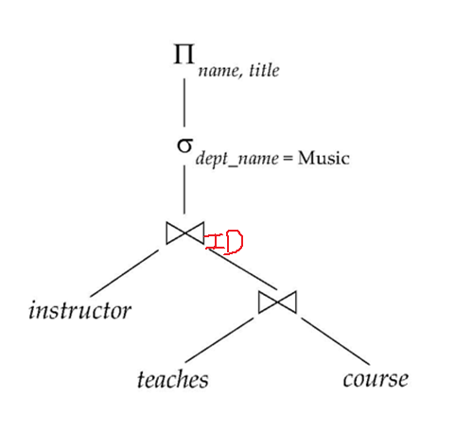
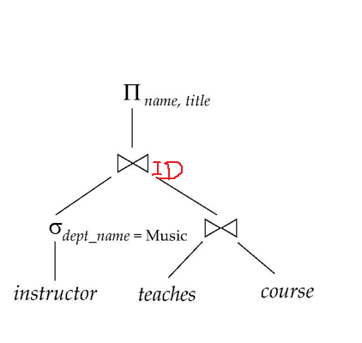
Introduction
Query: Find the names of all instructors in the Music department, along with the titles of the courses that they teach

Slide 16
Example with Multiple Transformations
Query: Find the names of all instructors in the Music department who have taught a course in 2009, along with the titles of the courses that they taught
  Π_{name, title}(σ_{dept_name= “Music”∧year = 2009}
  (instructor (teaches Π_{course_id, title} (course))))
Transformation using join associatively (Rule 6a):
  Π_{name, title}(σ_{dept_name= “Music”∧year = 2009}
  ((instructor teaches) Π_{course_id, title} (course)))
Second form provides an opportunity to apply the “perform selections early” rule, resulting in the subexpression
σ_{dept_name = “Music”} (instructor) σ _{year = 2009} (teaches)

Slide 17
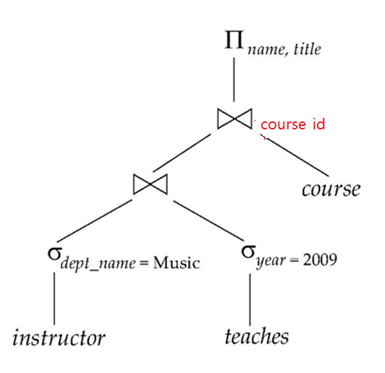
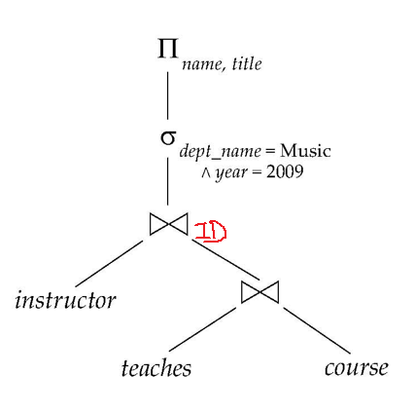
Multiple Transformations (Cont.)

Slide 18
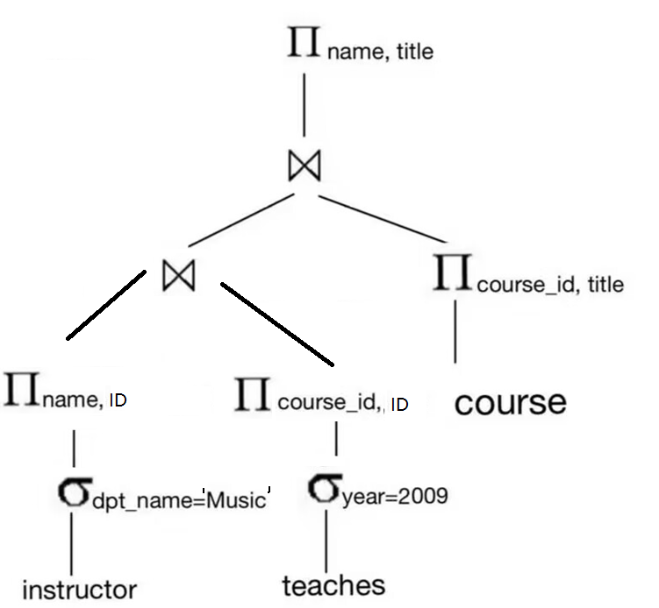
Multiple Transformations (Cont.)

Slide 19
Transformation Example: Pushing Projections
Consider: Π_{name, title}(σ_{dept_name= “Music”} (instructor) teaches)
Π_{course_id, title} (course))))
When we compute
σ_{dept_name = “Music”} (instructor ) teaches
we obtain a relation whose schema is:
(ID, name, dept_name, salary, course_id, sec_id, semester, year)
Push projections using equivalence rules 8a and 8b; eliminate unneeded attributes from intermediate results to get:
Π_{name, title}(
Π_{name, course_id} (σ_{dept_name= “Music”} (instructor) teaches))
Π_{course_id, title} (course))))
Performing the projection as early as possible reduces the size of the relation to be joined.

Slide 20
Join Ordering Example
For all relations r_{1,} r_{2,} and r₃,
(r₁ r₂) r₃ = r₁ (r₂ r₃ )
(Join Associativity)
If r₂ r₃ is quite large and r₁ r₂ is small, we choose
(r₁ r₂) r₃
so that we compute and store a smaller temporary relation.

Slide 21
Join Ordering Example (Cont.)
Consider the expression
Π_{name, title}((σ_{dept_name= “Music”} (instructor) teaches)
Π_{course_id, title} (course))
Plan 1:
  a← teaches Π_{course_id, title} (course)
  a σ_{dept_name= “Music”} (instructor)
  the result of the first join is likely to be a large relation.
better Plan:
  a← σ_{dept_name= “Music”} (instructor) teaches
  a Π_{course_id, title} (course)

Slide 22
Enumeration of Equivalent Expressions
Query optimizers use equivalence rules to systematically generate expressions equivalent to the given expression
Can generate all equivalent expressions as follows:
  Repeat
    apply all applicable equivalence rules on every subexpression of every equivalent expression found so far
    add newly generated expressions to the set of equivalent expressions
    Until no new equivalent expressions are generated above
The above approach is very expensive in space and time
  Two approaches
    Optimized plan generation based on transformation rules
    Special case approach for queries with only selections, projections and joins

Slide 23
Implementing Transformation Based Optimization
Space requirements reduced by sharing common sub-expressions:
  when E1 is generated from E2 by an equivalence rule, usually only the top level of the two are different, subtrees below are the same and can be shared using pointers
    E.g. when applying join commutativity
  Same sub-expression may get generated multiple times
    Detect duplicate sub-expressions and share one copy
Time requirements are reduced by not generating all expressions
  Dynamic programming
    We will study only the special case of dynamic programming for join order optimization
E1
E2

Slide 24
Statistics for Cost Estimation

Slide 25
Cost Estimation
Cost of each operator computer as described in Chapter 12
  Need statistics of input relations
    E.g. number of tuples, sizes of tuples
Inputs can be results of sub-expressions
  Need to estimate statistics of expression results
  To do so, we require additional statistics
    E.g. number of distinct values for an attribute
cost estimation
  number of tuples
    Select
    Join
  number of distinct values for an attribute
    Select
    Join

Slide 26
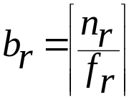
Statistical Information for Cost Estimation
n_{r}: number of tuples in a relation r.
b_{r}: number of blocks of r.
l_{r}: size of a tuple of r.
f_{r}: blocking factor of r — i.e., the number of tuples of r that fit into one block.
If tuples of r are stored together physically in a file, then:
V(A, r): number of distinct values that appear in r for attribute A; same as the size of ∏_{A}(r).

Slide 27
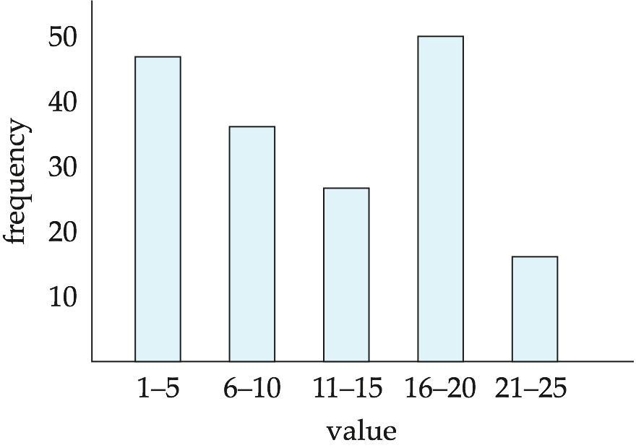
Histograms
Histogram on attribute age of relation person
Equi-width histograms
Equi-depth histograms

Slide 28
Selection Size Estimation
Example query：
select * from student where department=“SE”
Question： how many tuples of resultant relation ？

Slide 29
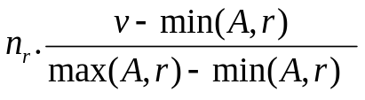
Selection Size Estimation
We always assum that the events are uniformly distributed
σ_{A=v}(r)
    n_{r} / V(A,r) : number of records that will satisfy the selection
    Equality condition on a key attribute: size estimate = 1
σ_{A≤V}(r) (case of σ_{A ≥ V}(r) is symmetric)
Let c denote the estimated number of tuples satisfying the condition.
  If min(A,r) and max(A,r) are available in catalog
    c = 0 if v < min(A,r)
    c =
  If histograms available, can refine above estimate
  In absence of statistical information c is assumed to be n_{r} / 2.

Slide 30

Size Estimation of Complex Selections
The selectivity p_{i} of a condition θ_{i} is the probability that a tuple in the relation r satisfies θ_{i} . Let s_{i} be the number of satisfying tuples. Then
        p_{i} = s_{i} /n_{r} .
Assume that each condition is indepdent.
Conjunction: σ_{θ1∧ θ2∧. . . ∧ θn} (r). estimated size of result is
(p₁ p₂ p₃ …. p_{n})* n_{r}
Disjunction:σ_{θ1∨} _{θ2 ∨. . . ∨} _{θn} (r). estimated size of result :
Negation: σ_{¬θ}(r). Estimated number of tuples:
n_{r} – size(σ_{θ}(r))

Slide 31
Join Operation: Running Example
Running example:
student takes
V(ID, takes) = 2500, which implies that on average, each student who has taken a course has taken 4 courses.
Attribute ID in takes is a foreign key referencing student.
V(ID, student) = 5000 (primary key!)
how many tuples in student takes?
  10000 or 5000*4?
  10000
relation | records | blocks
student | 5,000 | 100
takes | 10,000 | 400

Slide 32
Estimation of the Size of Joins r s
Case 1. The Cartesian product r x s contains n_{r} n_{s} tuples; each tuple occupies s_{r} + s_{s} bytes.
Case 2. If R ∩ S = ∅, then r s is the same as Case 1.
Case 3. If R ∩ S is a key for R, then a tuple of s will join with at most one tuple from r
  then |r s|≤ |s|.
  Example |student takes|≤ | takes |
Case 4. R ∩ S in S is a foreign key in S referencing R, then
|r s|= |s|.
    Example |student takes|= | takes |
    The case for R ∩ S being a foreign key referencing S is symmetric.

Slide 33
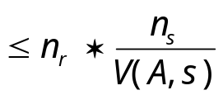
Estimation of the Size of Joins (Cont.)
Compute the size estimates for takes student without using information about foreign keys:
  V(ID, takes) = 2500, and
  V(ID, student) = 5000
  |R S|
  The two estimates are
    5000 * 10000/2500 = 20,000
    And 10000 * 5000 /5000 = 10000
  We choose the lower estimate, which in this case, is the same as our earlier computation using foreign keys.
relation | records | blocks
student | 5,000 | 100
takes | 10,000 | 400

Slide 34
Estimation of Number of Distinct Values
Example query：
select * from student where ID=“003”
Question： how many IDs of resultant relation ？
Example query：
select * from student where ID<“008”
Question： how many IDs of resultant relation ？

Slide 35
Estimation of Number of Distinct Values
Selections: σ_{θ} (r)
If θ forces A to take a specified value:
    e.g., V(ID,σ_{ID=3} (student)) =1 ,
    V(A,σ_{A=v} (r)) = 1
If θ forces A to take on one of a specified set of values:
  e.g., V(ID,σ _{ID= 1 V ID = 3 V ID = 4} (student))=3,
  V(A,σ_{θ} (r)) = number of specified values.

Slide 36
Estimation of Number of Distinct Values
Selections: σ_{θ} (r)
If the selection condition θ = A op v, we estimate
V(A,σ_{A op v} (r)) = V(A.r) * p
    where p is the selectivity of the selection.
    Example V(salary,σ_{salary > 50000} (instructor)) = ??
In all the other cases: use approximate estimate of
min(V(A,r), n_{σθ (A) (r)} )
  More accurate estimate can be got using probability theory, but this one works fine generally

Slide 37
Estimation of Distinct Values (Cont.)
Joins: r s
If all attributes in A are from r
estimated V(A, r s) = min (V(A,r), n _{r s})
Example: V(salary, instructor department )
If A=(A1 , A2,… ) contains attributes A1 from r and A2 from s, then estimated
V(A,r s) =
min(V(A1,r)*V(A2 – A1,s), V(A1 – A2,r)*V(A2,s), n_{r s})
Example: V((salary, building, budget), instructor department )
  More accurate estimate can be got using probability theory, but this one works fine generally

Slide 38
Choice of Evaluation Plans
Must consider the interaction of evaluation techniques when choosing evaluation plans
  choosing the cheapest algorithm for each operation independently may not yield best overall algorithm. E.g.
    merge-join may be costlier than hash-join, but may provide a sorted output which reduces the cost for an outer level aggregation.
    nested-loop join may provide opportunity for pipelining
Practical query optimizers incorporate elements of the following two broad approaches:
  1. Search all the plans and choose the best plan in a
  cost-based fashion.
  2. Uses heuristics to choose a plan.

Slide 39
Cost-Based Optimization
Consider finding the best join-order for r₁ r₂ . . . r_{n}.
There are (2(n – 1))!/(n – 1)! different join orders for above expression. With n = 7, the number is 665280, with n = 10, the number is greater than 176 billion!
No need to generate all the join orders. Using dynamic programming, the least-cost join order for any subset of
{r₁, r₂, . . . r_{n}} is computed only once and stored for future use.

Slide 40
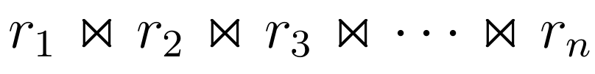
Dynamic Programming in Optimization
find best join tree for a set of n relations

Slide 41

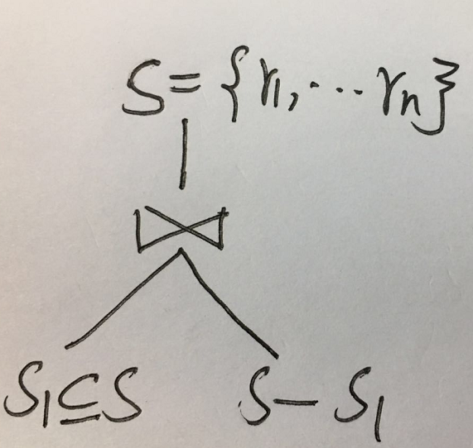
Dynamic Programming in Optimization
To find best plan for a set of n relations,
consider all possible plans of the form: S₁ (S – S₁) where S₁ is any non-empty subset of S.

Slide 42
Dynamic Programming in Optimization
Recursively compute costs for joining subsets of S to find the cost of each plan. Choose the cheapest of the 2^{n} – 2 alternatives.
Base case for recursion: single relation access plan
  Apply all selections on R_{i} using best choice of indices on R_{i}
When plan for any subset is computed, store it and reuse it when it is required again, instead of recomputing it
  Dynamic programming

Slide 43
Join Order Optimization Algorithm
Question: How to implement join operation efficiently?
Input : a set of relation
Data structure: structure bestplan { cost, plan };
  bestplan[S].plan: a known algorithm Alg which is possibly the most efficient.
  bestplan[S].cost: cost of algorithm Alg.
* Some modifications to allow indexed nested loops joins on relations that have
selections (see book)

Slide 44
Join Order Optimization Algorithm
Question: How to implement join operation efficiently?
Input : a set of relation
procedure findbestplan(S):
// 1. End case: the possibly best algorithm is found
if (bestplan[S].cost ≠ ∞)
return bestplan[S]

Slide 45
Join Order Optimization Algorithm
// 2. computation case:
// 2.1 Basic case
if (S contains only 1 relation)
set bestplan[S].plan and bestplan[S].cost based on the best way
of accessing S /* Using selections on S and indices on S */
// 2.2 Recursive case
else for each non-empty subset S1 of S such that S1 ≠ S
P1= findbestplan(S1)
P2= findbestplan(S - S1)
A = best algorithm for joining results of P1 and P2
cost = P1.cost + P2.cost + cost of A
if cost < bestplan[S].cost
bestplan[S].cost = cost
bestplan[S].plan = “execute P1.plan; execute P2.plan;
join results of P1 and P2 using A”
return bestplan[S]
* Some modifications to allow indexed nested loops joins on relations that have
selections (see book)

Slide 46
Cost of Optimization
dynamic programming
1. time complexity of optimization is O(3^{n}).
  With n = 10, this number is 59000 instead of 176 billion!
2. Space complexity is O(2^{n})

Slide 47

Left Deep Join Trees
In left-deep join trees, the right-hand-side input for each join is a relation, not the result of an intermediate join.

Slide 48
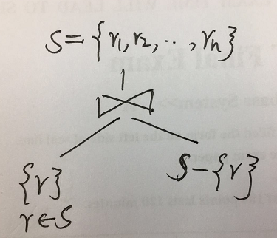
Cost of Optimization
To find best left-deep join tree for a set of n relations:
  Consider n alternatives with one relation as right-hand side input and the other relations as left-hand side input.
  Modify optimization algorithm:
    Replace “for each non-empty subset S1 of S such that S1 ≠ S”
    By: for each relation r in S
    let S1 = S – r .

Slide 49
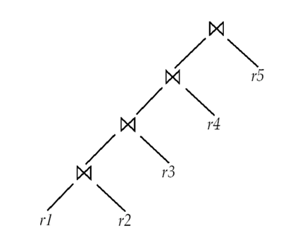
Cost of Optimization
If left-deep trees are considered in Join Order Optimization Algorithm, then
1. time complexity of finding best join order is O(n 2^{n})
  2. Space complexity remains at O(2^{n})
Cost-based optimization is expensive, but worthwhile for queries on small datasets (typical queries have small n, generally < 10)
⇒

Slide 50
Heuristic Optimization
Cost-based optimization is expensive, even with dynamic programming.
Systems may use heuristics to reduce the number of choices that must be made in a cost-based fashion.
Heuristic optimization transforms the query-tree by using a set of rules that typically (but not in all cases) improve execution performance:
  Perform selection early (reduces the number of tuples)
  Perform projection early (reduces the number of attributes)
  Perform most restrictive selection and join operations (i.e. with smallest result size) before other similar operations.
  Some systems use only heuristics, others combine heuristics with partial cost-based optimization.

