Slide 1
Chapter 15 : Concurrency Control

Slide 2
Chapter 15: Concurrency Control
Lock-Based Protocols
Insert and Delete Operations
Concurrency in Index Structures

Slide 3
Lock-Based Protocols
A lock is a mechanism to control concurrent access to a data item
Data items can be locked in two modes:
1. exclusive (X) mode. Data item can be both read as well as
written. X-lock is requested using lock-X instruction.
2. shared (S) mode. Data item can only be read. S-lock is
requested using lock-S instruction.
Lock requests are made to concurrency-control manager. Transaction can proceed only after request is granted.

Slide 4
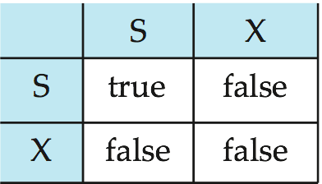
Lock-Based Protocols (Cont.)
Lock-compatibility matrix
A transaction may be granted a lock on an item if the requested lock is compatible with locks already held on the item by other transactions.
Any number of transactions can hold shared locks on an item,
  but if any transaction holds an exclusive on the item no other transaction may hold any lock on the item.
If a lock cannot be granted, the requesting transaction is made to wait till all incompatible locks held by other transactions have been released. The lock is then granted.

Slide 5
Lock-Based Protocols (Cont.)
Example of a transaction performing locking:
T₂: lock-S(A);
read (A);
unlock(A);
lock-S(B);
read (B);
unlock(B);
display(A+B)
Locking as above is not sufficient to guarantee serializability — if A and B get updated in-between the read of A and B, the displayed sum would be wrong.
A locking protocol is a set of rules followed by all transactions while requesting and releasing locks. Locking protocols restrict the set of possible schedules.

Slide 6

Pitfalls of Lock-Based Protocols
Consider the partial schedule
Neither T₃ nor T₄ can make progress — executing lock-S(B) causes T₄ to wait for T₃ to release its lock on B, while executing lock-X(A) causes T₃ to wait for T₄ to release its lock on A.
Such a situation is called a deadlock.
  To handle a deadlock one of T₃ or T₄ must be rolled back
  and its locks released.

Slide 7
Pitfalls of Lock-Based Protocols (Cont.)
The potential for deadlock exists in most locking protocols. Deadlocks are a necessary evil.
Starvation is also possible if concurrency control manager is badly designed. For example:
  9:00 T1 L-S(Q) 9:00-10:00; 9:30 T2 L-X(Q);
  9:50 T3 L-S(Q) 9:50 -11:00; 10:50 T4 L-S(Q) 10:50-12:00;
  T5 request L-S(Q); T6 request L-S(Q);…..
  if T3 T4 T5 T6 are granted an S-lock, then T2 is starved.
  A transaction may be waiting for an X-lock on an item, while a sequence of other transactions request and are granted an S-lock on the same item.
  The same transaction is repeatedly rolled back due to deadlocks.
Concurrency control manager can be designed to prevent starvation.

Slide 8
The Two-Phase Locking Protocol
This is a protocol which ensures conflict-serializable schedules.
Phase 1: Growing Phase
  transaction may obtain locks
  transaction may not release locks
Phase 2: Shrinking Phase
  transaction may release locks
  transaction may not obtain locks

Slide 9
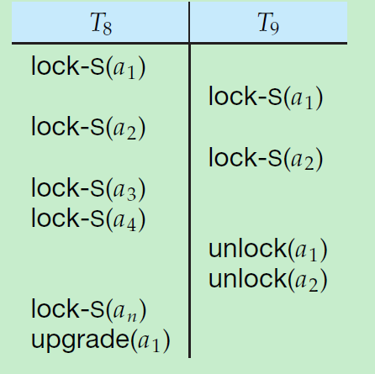
The Two-Phase Locking Protocol assures serializability. It can be proved that the transactions can be serialized in the order of their lock points (i.e., the point where a transaction acquired its final lock).

Slide 10
The Two-Phase Locking Protocol (Cont.)
优点: assures serializability
缺点1: Deadlock is possible.
缺点2: Cascading roll-back is possible.
  改进1: strict 严格 two-phase locking. Here a transaction must hold all its exclusive locks till it commits/aborts.
  改进2: Rigorous 强 two-phase locking is even stricter: here all locks are held till commit/abort. In this protocol, transactions can be serialized in the order in which they commit.

Slide 11
The Two-Phase Locking Protocol (Cont.)
缺点3: There can be conflict serializable schedules that cannot be obtained if two-phase locking is used. 完整性错误.
However, in the absence of extra information (e.g., ordering of access to data), two-phase locking is needed for conflict serializability in the following sense:
Given a transaction T_{i} that does not follow two-phase locking, we can find a transaction T_{j} that uses two-phase locking, and a schedule for T_{i} and T_{j} that is not conflict serializable.

Slide 12
Lock Conversions加锁转换
Two-phase locking with lock conversions:
– First Phase:
  can acquire a lock-S on item
  can acquire a lock-X on item
  can convert a lock-S to a lock-X (upgrade)
– Second Phase:
  can release a lock-S
  can release a lock-X
  can convert a lock-X to a lock-S (downgrade)
This protocol assures serializability. But still relies on the programmer to insert the various locking instructions.

Slide 14
Automatic Acquisition of Locks
A transaction T_{i} issues the standard read/write instruction, without explicit locking calls.
The operation read(D) is processed as:
if T_{i} has a lock on D
then
read(D)
else begin
if necessary, wait until no other
transaction has a lock-X on D
grant T_{i} a lock-S on D;
read(D)
end

Slide 15
Automatic Acquisition of Locks (Cont.)
write(D) is processed as:
if T_{i} has a lock-X on D
then
write(D)
else begin
if necessary wait until no other trans. has any lock on D,
if T_{i} has a lock-S on D
then
upgrade lock on D to lock-X
else
grant T_{i} a lock-X on D
write(D)
end;
All locks are released after commit or abort

Slide 16
Graph-Based Protocols
Graph-based protocols are an alternative to two-phase locking.
Impose a partial ordering → on the set D = {d₁, d₂ ,..., d_{h}} of all data items.
  If d_{i} → d_{j} then any transaction accessing both d_{i} and d_{j} must access d_{i} before accessing d_{j}.
  Implies that the set D may now be viewed as a directed acyclic graph, called a database graph.
The tree-protocol is a simple kind of graph protocol.

Slide 17
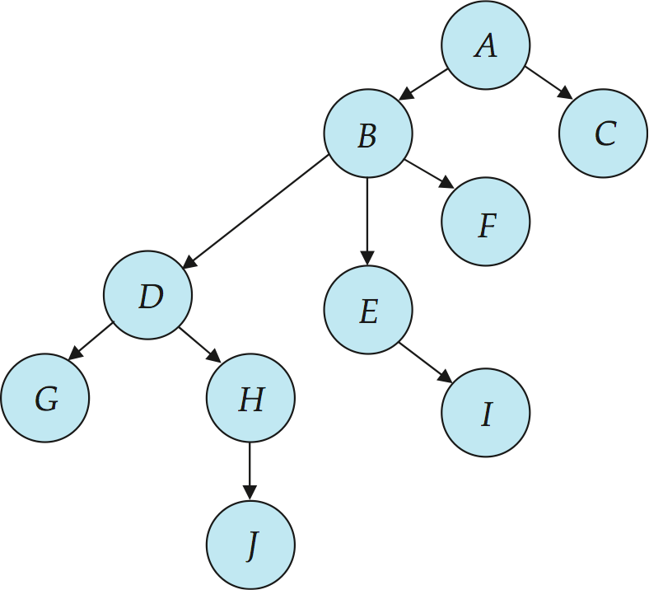
Tree Protocol
Only exclusive locks are allowed.
The first lock by T_{i} may be on any data item. Subsequently, a data Q can be locked by T_{i} only if the parent of Q is currently locked by T_{i}.
Data items may be unlocked at any time.
A data item that has been locked and unlocked by T_{i} cannot subsequently be relocked by T_{i} .

Slide 18
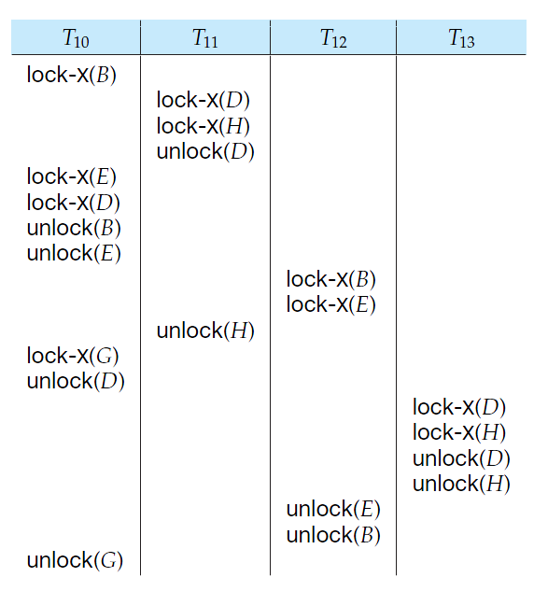
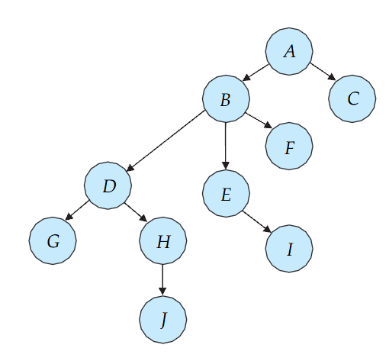
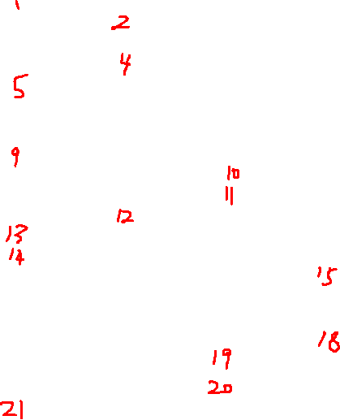
Is the schedule legal?
Is it conflict serializable?
What is the equivalent serial schedule?

Slide 19
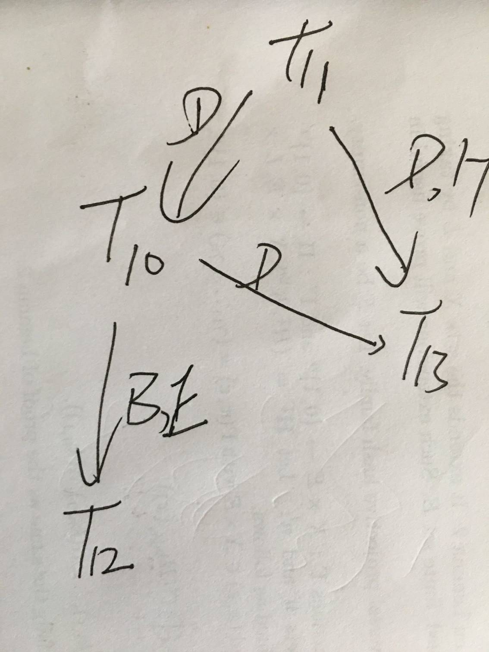

Slide 20
Graph-Based Protocols (Cont.)
优点: The tree protocol ensures conflict serializability as well as freedom from deadlock.
Unlocking may occur earlier in the tree-locking protocol than in the two-phase locking protocol.
  shorter waiting times, and increase in concurrency
  protocol is deadlock-free, no rollbacks are required
Drawbacks
  Protocol does not guarantee recoverability or cascade freedom
    Need to introduce commit dependencies to ensure recoverability
  Transactions may have to lock data items that they do not access.
    increased locking overhead, and additional waiting time
    potential decrease in concurrency
Schedules not possible under two-phase locking are possible under tree protocol, and vice versa.

Slide 21
协议名 | conflict-serializable | NO deadlock | Recoverability | cascadelessness
Two-Phase Locking Protocol | Y | N | N | N
strict Two-Phase Locking Protocol | Y |  | Y | Y
Rigorous Two-Phase Locking Protocol | Y |  | Y | Y
tee Protocols | Y | Y | N | N

Slide 22

Deadlock Handling
Consider the following two transactions:
T₁: write (X) T₂: write(Y)
write(Y) write(X)
Schedule with deadlock

Slide 23
Deadlock Handling
System is deadlocked if there is a set of transactions such that every transaction in the set is waiting for another transaction in the set.
对待死锁的2种策略:
  1. 预防， 使得死锁不出现. Deadlock prevention.
  2. 允许出现死锁, 然后解锁. 检测+恢复.

Slide 24
Strategy 1： Deadlock Prevention
System is deadlocked if there is a set of transactions such that every transaction in the set is waiting for another transaction in the set.
Deadlock prevention protocols ensure that the system will never enter into a deadlock state. Some prevention strategies:
  prevention 1. Require that each transaction locks all its data items before it begins execution (predeclaration).
  prevention 2. Impose partial ordering of all data items and require that a transaction can lock data items only in the order specified by the partial order (graph-based protocol).

Slide 25
More Deadlock Prevention Strategies
Following schemes use transaction timestamps for the sake of deadlock prevention alone.
prevention 3. wait-die scheme — non-preemptive (老的等, 新的死)
  older transaction may wait for younger one to release data item. Younger transactions never wait for older ones; they are rolled back instead.
  a transaction may die several times before acquiring needed data item
prevention 4. wound-wait scheme — preemptive(老的抢, 新的等)
  older transaction wounds (forces rollback) of younger transaction instead of waiting for it. Younger transactions may wait for older ones.
  may be fewer rollbacks than wait-die scheme

Slide 26
Deadlock prevention (Cont.)
Both in wait-die and in wound-wait schemes, a rolled back transactions is restarted with its original timestamp. Older transactions thus have precedence over newer ones, and starvation is hence avoided.
prevention 5 Timeout-Based Schemes:
  a transaction waits for a lock only for a specified amount of time. After that, the wait times out and the transaction is rolled back.
  thus deadlocks are not possible
  simple to implement; but starvation is possible. Also difficult to determine good value of the timeout interval.

Slide 27
Strategy 2.1： Deadlock Detection
Deadlocks can be described as a wait-for graph, which consists of a pair G = (V,E),
  V is a set of vertices (all the transactions in the system)
  E is a set of edges; each element is an ordered pair T_{i} →T_{j}.
图的构造: T_{i} → T_{j} iff T_{i} is waiting for T_{j} to release a data item.
When T_{i} requests a data item currently being held by T_{j}, then the edge T_{i} T_{j} is inserted in the wait-for graph. This edge is removed only when T_{j} is no longer holding a data item needed by T_{i}.
判断定理: The system is in a deadlock state if and only if the wait-for graph has a cycle. Must invoke a deadlock-detection algorithm periodically to look for cycles.

Slide 29
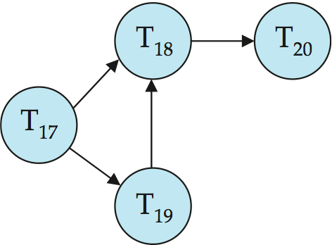
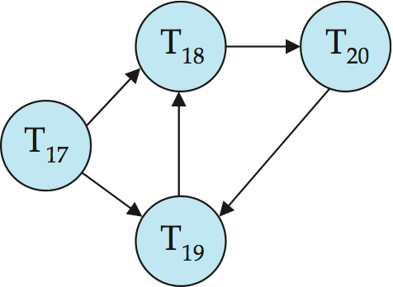
Deadlock Detection (Cont.)
Wait-for graph without a cycle
Wait-for graph with a cycle

Slide 30
2.2 Deadlock Recovery
When deadlock is detected:
  Some transaction will have to rolled back (made a victim) to break deadlock. Select that transaction as victim that will incur minimum cost.
  Rollback -- determine how far to roll back transaction
    Total rollback: Abort the transaction and then restart it.
    More effective to roll back transaction only as far as necessary to break deadlock.
  Starvation happens if same transaction is always chosen as victim. Include the number of rollbacks in the cost factor to avoid starvation

Slide 31
Multiple Granularity
Allow data items to be of various sizes and define a hierarchy of data granularities, where the small granularities are nested within larger ones.
Can be represented graphically as a tree (but don‘t confuse with tree-locking protocol)根据资源的包含关系来决定父子关系
When a transaction locks a node in the tree explicitly, it implicitly locks all the node's descendents in the same mode.
Granularity of locking (level in tree where locking is done):
  fine granularity (lower in tree): high concurrency, high locking overhead
  coarse granularity (higher in tree): low locking overhead, low concurrency

Slide 32
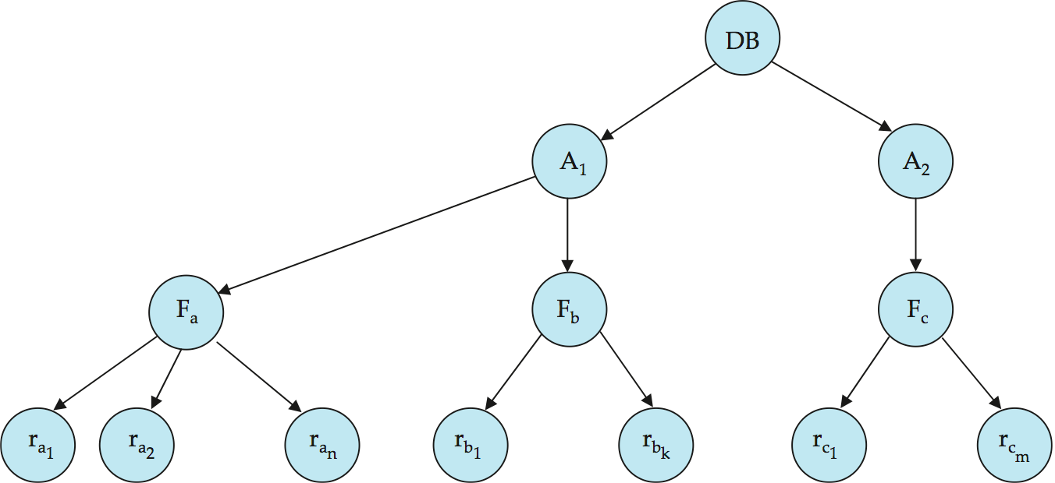
Example of Granularity Hierarchy
The levels, starting from the coarsest (top) level are:
  DB： Database, 例如整个数据库服务器
  A：area, 例如某个特定的数据库, 华工数据库, 清华数据库
  F： file, 例如教工表, 学生表
  R： record ，表格中的一行. 例如,爱因斯坦所在行

Slide 33
Intention Lock Modes（不要求）
In addition to S and X lock modes, there are three additional lock modes with multiple granularity:
  intention-shared (IS): indicates explicit locking at a lower level of the tree but only with shared locks.
  intention-exclusive (IX): indicates explicit locking at a lower level with exclusive or shared locks
  shared and intention-exclusive (SIX): the subtree rooted by that node is locked explicitly in shared mode and explicit locking is being done at a lower level with exclusive-mode locks.
Intention locks allow a higher level node to be locked in S or X mode without having to check all descendent nodes.

Slide 34
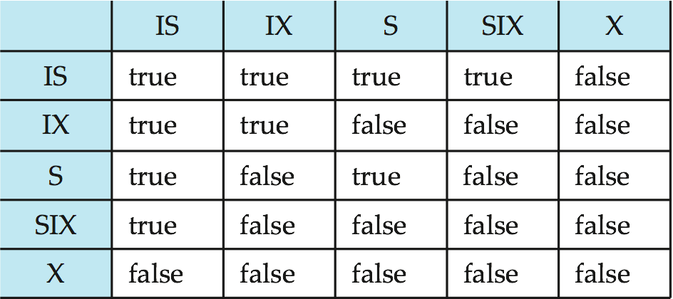
Compatibility Matrix with Intention Lock Modes
The compatibility matrix for all lock modes is:

Slide 35
Insert and Delete Operations（了解）
If two-phase locking is used :
  A delete operation may be performed only if the transaction deleting the tuple has an exclusive lock on the tuple to be deleted.
  A transaction that inserts a new tuple into the database is given an X-mode lock on the tuple
Insertions and deletions can lead to the phantom phenomenon.
  A transaction that scans a relation
    (e.g., 统计物理系的老师数, 然后打印名单)
    and a transaction that inserts a tuple in the relation
    (e.g., 往物理系添加一个新老师)
    (conceptually) conflict in spite of not accessing any tuple in common.
  If only tuple locks are used, non-serializable schedules can result
    E.g., the scan transaction does not see the new account, but reads some other tuple written by the update transaction
    统计的结果是物理系有10人, 打印出的名单却是11个名字.

Slide 36
Insert and Delete Operations (Cont.)
The transaction scanning the relation is reading information that indicates what tuples the relation contains, while a transaction inserting a tuple updates the same information.
  The information should be locked.
One solution (不好的方法):
  Associate a data item with the relation, to represent the information about what tuples the relation contains.
  Transactions scanning the relation acquire a shared lock in the data item.
  Transactions inserting or deleting a tuple acquire an exclusive lock on the data item. (Note: locks on the data item do not conflict with locks on individual tuples.)
Above protocol provides very low concurrency for insertions/ deletions.
Index locking protocols provide higher concurrency while preventing the phantom phenomenon, by requiring locks
on certain index buckets.

Slide 37
Index Locking Protocol好的方法
Every relation must have at least one index. Access to a relation must be made only through one of the indices on the relation.
Lookup transaction
to performs a lookup , transaction T1 must lock all the index buckets that it accesses, in S-mode.
Insertion /deletion transaction
To insert a tuple t_{i} , transaction T1 should update all indices first.
To update all indices , T1 should obtain locks in X-mode on all these index leaf nodes affected by T1’s modification (deletion, insertion, updation).
The rules of the two-phase locking protocol must be observed
  Guarantees that phantom phenomenon won’t occur

Slide 38
Weak Levels of Consistency
Degree-two consistency: differs from two-phase locking in that S-locks may be released at any time, and locks may be acquired at any time
  X-locks must be held till end of transaction
  Serializability is not guaranteed, programmer must ensure that no erroneous database state will occur
Cursor stability:
  For reads, each tuple is locked, read, and lock is immediately released
  X-locks are held till end of transaction
  Special case of degree-two consistency

Slide 39
Weak Levels of Consistency in SQL
SQL allows non-serializable executions
  Serializable: is the default
  Repeatable read: allows only committed records to be read, and repeating a read should return the same value (so read locks should be retained)
    However, the phantom phenomenon need not be prevented
      T1 may see some records inserted by T2, but may not see others inserted by T2
  Read committed: same as degree two consistency, but most systems implement it as cursor-stability
  Read uncommitted: allows even uncommitted data to be read
In many database systems, read committed is the default consistency level
  has to be explicitly changed to serializable when required
    set isolation level serializable

Slide 40
End of Chapter
Thanks to Alan Fekete and Sudhir Jorwekar for Snapshot Isolation examples

