Slide 1

Designing and Analysis of Algorithm
Dr. Han Huang
South China University of Technology

Slide 2
Chapter 1. Introduction
Chapter 1. Introduction
Section 1.1-Section 1.4

Slide 3
Contents
1
What is an Algorithm?
2
Fundamentals of Algorithmic Problem Solving
3
Important Problem Type
4
Fundamental Data Structure
5
Algorithmic Ideas

Slide 4
What is an Algorithm?

Slide 5
Algorithmics is more than a branch of computer science. It is the core of computer science, and, in all fairness, can be said to be relevant to most of science, business, and technology. [Har92], p.6.
David Harel.

Slide 6
What is an algorithm?
An algorithm is a sequence of unambiguous instructions for solving a problem, i.e., for obtaining a required output for any legitimate input in a finite amount of time.
problem
algorithm
“computer”
input
output

Slide 7
What is an algorithm?
Recipe（秘诀）, process, method, technique, procedure, routine,… with following requirements:
Finiteness
    terminates after a finite number of steps
Definiteness
    rigorously and unambiguously specified
Input
    valid inputs are clearly specified
Output
    can be proved to produce the correct output given a valid input
Effectiveness
    steps are sufficiently simple and basic
Notes:
The formalization of the notion of an algorithm led to great breakthroughs in the
foundations of mathematics in the 1930s.

Slide 8
Why study algorithms?
Theoretical importance
  the core of computer science
Practical importance
  A practitioner’s （从业者） toolkit （工具包） of known algorithms
  Framework for designing and analyzing algorithms for new problems

Slide 9
Algorithm
An algorithm is a sequence of unambiguous instructions for solving a problem, i.e., for obtaining a required output for any legitimate input in a finite amount of time.

Slide 10
Historical Perspective
Euclid’s（欧几里得） algorithm for finding the greatest common divisor
Muhammad ibn Musa al-Khwarizmi（花拉子模） – 9th century mathematician https://baike.baidu.com/item/%E9%98%BF%E5%B0%94%C2%B7%E8%8A%B1%E5%89%8C%E5%AD%90%E6%A8%A1/4468848
Notes:
Euclid’s algorithm is good for introducing the notion of an algorithm because it
makes a clear separation from a program that implements the algorithm.
It is also one that is familiar to most students.
Al Khowarizmi (many spellings possible...) – “algorism” (originally) and then
later “algorithm” come from his name.

Slide 11
Notion of algorithm
Problem
Algorithm
“Computer”
Algorithmic Solution
Input
Output
The range of inputs for which an algorithm works must be specified carefully.
The same algorithm can be represented in several different ways.
Several algorithms for solving the same problem may exist.
Algorithms for the same problem can be based on very different ideas and can
solve the with dramatically different speeds.

Slide 12
Euclid’s Algorithm
Problem: Find gcd(m,n), the greatest common divisor of two nonnegative, not both zero integers m and n
Examples: gcd(60,24) = 12, gcd(60,0) = 60, gcd(0,0) = ?
Euclid’s algorithm is based on repeated application of equality
gcd(m,n) = gcd(n, m mod n)
Until the second number becomes 0, which makes the problem trivial.
Example: gcd(60,24) = gcd(24,12) = gcd(12,0) = 12
Notes:
Euclid’s algorithm is good for introducing the notion of an algorithm because it
makes a clear separation from a program that implements the algorithm.
It is also one that is familiar to most students.
Al Khowarizmi (many spellings possible...) – “algorism” (originally) and then
later “algorithm” come from his name.

Slide 13
Two descriptions of Euclid’s algorithm
Step 1 If n = 0, return m and stop; otherwise go to Step 2.
Step 2 Divide m by n and assign the value fo the remainder to r.
Step 3 Assign the value of n to m and the value of r to n. Go to Step 1.
while n ≠ 0 do
r ← m mod n
m← n
n ← r
return m

Slide 14
Other methods for computing gcd(m,n)
Consecutive integer checking algorithm
Step 1 Assign the value of min{m,n} to t
Step 2 Divide m by t. If the remainder is 0, go to Step 3;
otherwise, go to Step 4
Step 3 Divide n by t. If the remainder is 0, return t and stop;
otherwise, go to Step 4
Step 4 Decrease t by 1 and go to Step 2

Slide 15
Other methods for gcd(m,n) [cont.]
Middle-school procedure
Step 1 Find the prime factorization （因式） of m
Step 2 Find the prime factorization of n
Step 3 Find all the common prime factors
Step 4 Compute the product of all the common prime factors and return it as gcd(m,n)
Is this an algorithm?

Slide 16
Sieve of Eratosthenes
Example: find all prime numbers less than or equal to 16
Initialize:
2 3 4 5 6 7 8 9 10 11 12 13 14 15 16
x2
x3
x4
x5
x6
x7
x8
Select 2:
2 3 0 5 0 7 0 9 0 11 0 13 0 15 0
x3
x4
x5
Select 3:
2 3 0 5 0 7 0 0 0 11 0 13 0 0 0
…
…
Final:
2 3 0 5 0 7 0 0 0 11 0 13 0 0 0

Slide 17
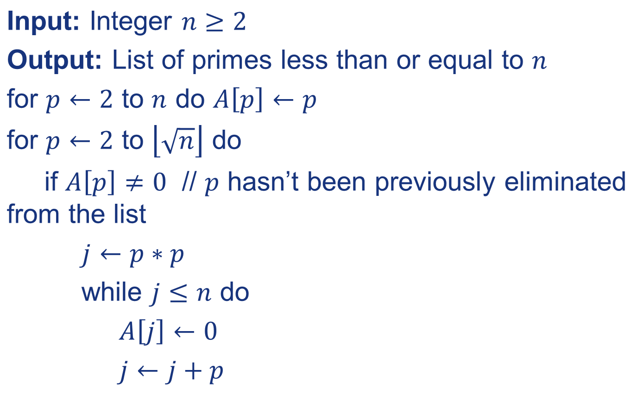
Sieve of Eratosthenes

Slide 18
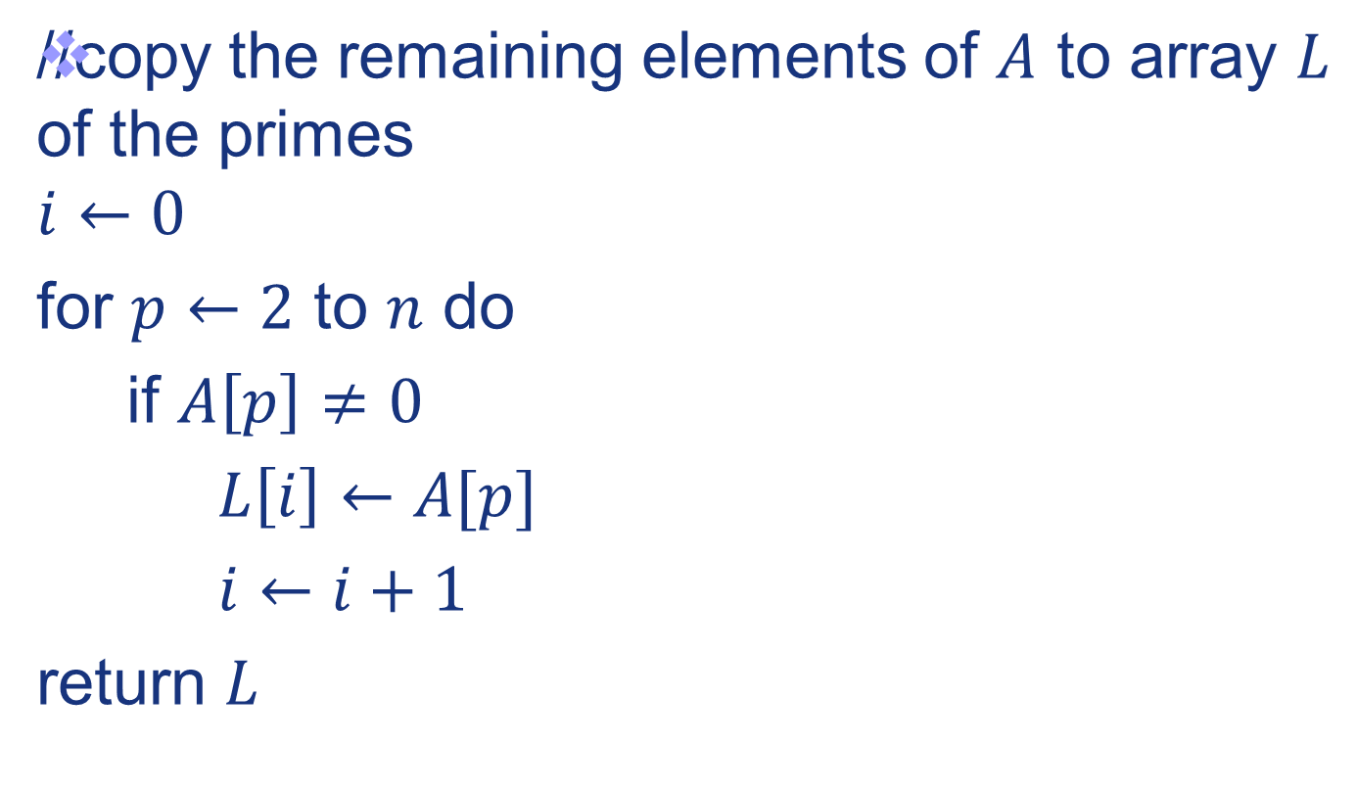
Sieve of Eratosthenes

Slide 19
Fundamentals of Algorithmic Problem Solving

Slide 20
1.2 Fundamentals of Algorithmic Problem Solving
We can consider algorithms to be procedural solutions to problems.
It is this emphasis on precisely defined constructive procedures that makes computer science distinct from other disciplines.

Slide 21
Algorithm design and analysis process
Understand the problem
Decide on: computational means, exact vs. approximate solving, data structure(s), algorithm design technique
Design an Algorithm
Prove correctness
Analyze the algorithm
Code the algorithm

Slide 22
Understand the problem
An input to an algorithm specifies an instance of the problem the algorithm solves.
It is very important to specify exactly the range of instances the algorithm needs to handle.
If you fail to do this, your algorithm may work correctly for a majority of inputs but crash on some “boundary” value.

Slide 23
Ascertaining the Capabilities of a Computational Device
Once you completely understand a problem, you need to ascertain the capabilities of the computational device the algorithm is intended for.
von Neumann machine
Random-access machine (RAM)
Sequential algorithms
Parallel algorithms

Slide 24
Choosing between Exact and Approximate Problem Solving
Exact algorithm – Solving the problem exactly
Approximation algorithm – Solving the problem approximately
There are important problems that simply cannot be solved exactly for most of their instances;
Available algorithms for solving a problem exactly can be unacceptably slow because of the problem’s intrinsic complexity.

Slide 25
Deciding on Appropriate Data Structure
Some algorithms do not demand any ingenuity in representing their inputs.
But others are, in fact, predicated on ingenious data structures.
Algorithms + Data Structure = Programs

Slide 26
Algorithm Design Techniques
An algorithm design technique (or “strategy” or “paradigm”) is a general approach to solving problems algorithmically that is applicable to a variety of problems from different areas of computing.
Why to learn the technique.
1. The technique provide guidance for designing algorithm for new problems for there is no known satisfactory algorithm.
2. Algorithm are the cornerstone of computer science.

Slide 27
Methods of Specifying an Algorithm
Once you have designed an algorithm, you need to specify it in some fashion.
Natural language
Pseudocode
Flowchart

Slide 28
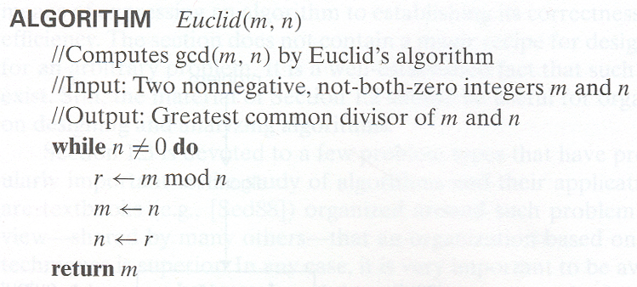
Specifying an Algorithm in Pseudocode

Slide 29
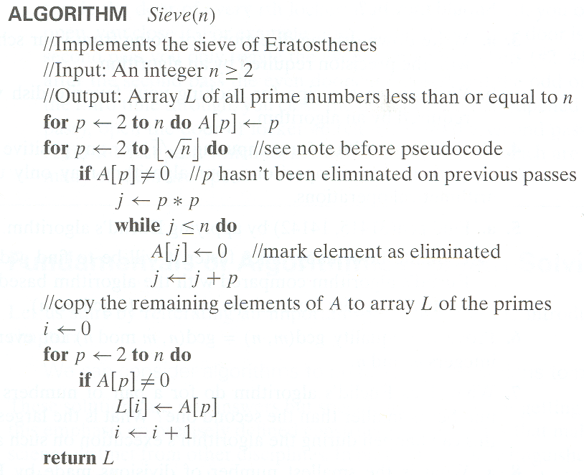
Specifying an Algorithm in Pseudocode

Slide 30






Specifying an Algorithm in Flowchart
Euclid Algorithm:
start
no
yes
end

Slide 31
Proving an Algorithm’s correctness
Once an algorithm has been specified, you have to prove its correctness.
We have to prove that algorithm yields a required result for every legitimate input in finite amount of time.
For some algorithms, a proof of correctness is quite easy; for others, it can be quite complex.
Mathematical induction
Investigation

Slide 32
Analyzing an Algorithm
Time efficiency indicates how fast the algorithm runs.
Space efficiency indicates how much extra memory the algorithm needs.
Another desirable characteristic of an algorithm is simplicity.
For example, most people would agree that Euclid’s algorithm is simpler than the middle-school procedure for computing gcd(m,n).

Slide 33
Coding an Algorithm
Once an algorithm is selected, a 10-50% speedup may be worth an effort.
“As a rule, a good algorithm is a result of repeated effort and rework.”
In the academic world, the question leads to an interesting but usually difficult investigation of an algorithm’s optimality.

Slide 34
There is nothing further from the truth:
“Inventing (or discovering?) algorithms is a very creative and rewarding process.”

Slide 35
Important Problem Type

Slide 36
Important problem types
sorting
searching
string processing
graph problems
combinatorial problems
geometric problems
numerical problems

Slide 37
(1)Example of computational problem: sorting
Statement of problem:
  Input: A sequence of n numbers <a₁, a₂, …, a_{n}>
  Output: A reordering of the input sequence <a´₁, a´₂, …, a´_{n}> so that a´_{i} ≤ a´_{j} whenever i < j
Instance: The sequence <5, 3, 2, 8, 3>
Algorithms:
  Selection sort
  Insertion sort
  Merge （合并）sort
  (many others)

Slide 38
(2)Example of computational problem: Searching
The searching problem deals with finding a given value, called a search key, in a given set.
The latter algorithms are of particular importance for real-life applications because they are indispensable for storing and retrieving information from large databases.

Slide 39
(3)Example of computational problem: String Processing
A string is a sequence of characters from an alphabet.
String matching problem:
Several algorithms that exploit the special nature of this type of searching have been invented.

Slide 40
(4) Example of computational problem: Graph problem
Graph problem: oldest and most interesting
  Area in algorithmic
  Traveling salesman problem
  Graph-coloring problem

Slide 41
(5)Example of computational problem: Combinatorial Problems
Combinatorial problems are the most difficult problems in computing, from both the theoretical and practical standpoints.
  The number of combinatorial objects typically grows extremely fast with a problem’s size.
  There are no known algorithms for most computer scientists believe that such algorithms do not exist.

Slide 42
Some Well-known Computational Problems
Sorting
Searching
Shortest paths in a graph
Minimum spanning tree
Primality testing （素性测试）
Traveling salesman problem
Knapsack problem
Chess
Towers of Hanoi
Program termination
Notes:
1-4 have well known efficient (polynomial-time) solutions
5: primality testing has recently been found to have an efficient solution
This is a great problem to discuss because it has recently been in the news
(see mathworld news at: http://mathworld.wolfram.com/news/2002-08-07_primetest/
or original article: http://www.cse.iitk.ac.in/primality.pdf)
6(TSP)-9(chess) are all problems for which no efficient solution has been found
it is possible to informally discuss the “try all possibilities” approach that is required
to get exact solutions to such problems
10: Towers of Hanoi is a problem that has only exponential-time solutions (simply
because the output required is so large)
11: Program termination is undecidable

Slide 43
(6) Geometric Problems
Geometric algorithms deal with geometric objects such as points, lines, and polygons.
Two classic problems of computational geometry:
The closet-pair problem is self-explanatory: given n points in the plane, find the closet pair among them
The convex-hull problem ask to find the smallest convex polygon that would include all the points of a given set.

Slide 44
(7) Numerical Problems
Problems involving mathematical objects of continuous nature
Solving equations and systems of equations
Computing definite integrals
Evaluating functions

Slide 45
Fundamental Data Structure

Slide 46
Fundamental data structures
list
  array
  linked list
  string
stack
queue
priority queue
graph
tree
set and dictionary

Slide 47
Algorithmic Ideas

Slide 48
Algorithm design techniques/strategies
Brute force
Divide and conquer
Decrease and conquer
Transform and conquer
Space and time tradeoffs
Greedy approach
Dynamic programming
Iterative improvement
Backtracking
Branch and bound

Slide 49
Analysis of algorithms
How good is the algorithm?
  time efficiency
  space efficiency
Does there exist a better algorithm?
  lower bounds
  optimality

Slide 50
Basic Issues Related to Algorithms
How to design algorithms
How to express algorithms
Proving correctness
Efficiency
  Theoretical analysis
  Empirical analysis （经验性分析）
Optimality （最优性）

Slide 51
Exercise

Slide 52
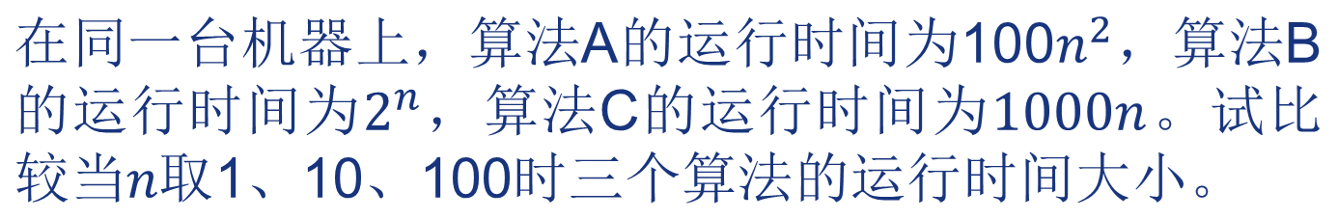











Exercise OF CHAP 1
运行时间：C > A > B
运行时间：A = C > B
运行时间：B > A > C

Slide 53
思政课

Slide 54
《中国的大飞机》
《中国的大飞机》
C919是中长期科技规划的16个重大专项之一，和探月工程是一个级别，20多位院士，22个省市，36所高校，200多家企业，数十万产业人员参与其中。
2021年3月，C919迎来了第一个客户，东航采购5架，虽然数量不多，但多年以后回头一看，这注定是挑战波音、空客霸权的第一步。中国航空逆袭故事才刚刚开始，我们拭目以待吧。

Slide 55
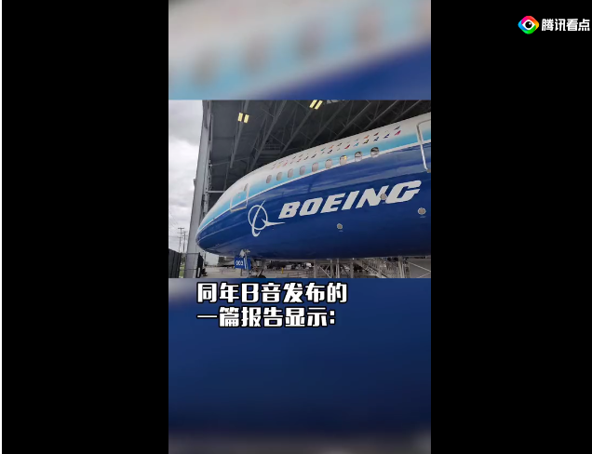
《中国的大飞机》
《中国的大飞机》
2017年以前，中国在国际航空领域方面吃了不少亏。干线飞机，一种载客100人以上，航程3000公里以上的大飞机，都需要向外国波音购买。同年波音发布报告显示，未来20年，中国需要花费1.5万亿美元，相当于400艘辽宁舰的改造费用，去购买他家的飞机。

Slide 56
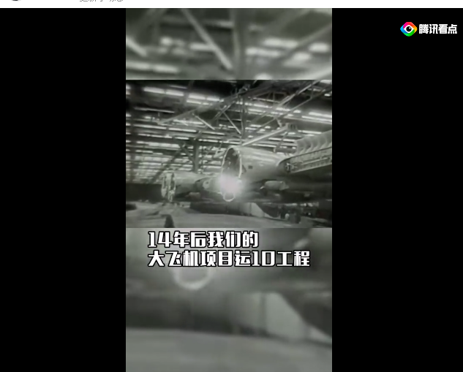
《中国的大飞机》
《中国的大飞机》
某种程度来说，造飞机比导弹还难。1956年学飞机专业的钱学森就迫于当时制造业的限制以及国情，选择研究导弹优先。
1970年大飞机项目运10工程才正式启动，在上海康平的会议室里，航空工程师们接到了任命。设计组没有办公室，只能在食堂饭桌上画图纸。在艰苦环境中研究10年后，1980年运10试飞成功。中国成为世界上第五个独立设计干线飞的国家。

Slide 57



《中国的大飞机》
《中国的大飞机》
但是客观上，和国外飞机相比，运10还是存在差距的。这时候美国的麦道公司提出合作，资源只够一个项目，是选择独立自研还是和美国麦道合作研发？
为了早几年研发出飞机，最后选择了和麦道合作。麦道趁机提出条件，除了钱之外，还得解散运10研究团队，拆除运10生产线。
然而过了好几年还是什么成果都没有。

Slide 58

《中国的大飞机》
《中国的大飞机》
后来又和空客合作，又是各种技术转让费、咨询费，掏了上百亿人民币之后，连样机都无，最后项目还是流产。
这些国际航空公司不止耗费了我们大量的资金、资源，最重要的还有10年时间。尝遍屈辱后，中国航空业决定自己搞。2020年开始研发ARJ21，组织团队才发现还是运10老班底为核心，当年解散时，不少成员自费生活费研究，都等着国家召唤。

Slide 59


《中国的大飞机》
《中国的大飞机》
终于，ARJ21试飞成功，同年，中国自己的大飞机项目C919正式立项
2017年5月4日，上海浦东机场，为了一架飞机的试运行停了大部分航线，4000多人看着它滑行、加速、起飞，79分钟后又看着它安全落地。这架飞机就是c919，中国第一架完全自主研发的国产干线飞机。

Slide 60
《中国的大飞机》
《中国的大飞机》
C919是中长期科技规划的16个重大专项之一，和探月工程是一个级别，20多位院士，22个省市，36所高校，200多家企业，数十万产业人员参与其中。
2021年3月，C919迎来了第一个客户，东航采购5架，虽然数量不多，但多年以后回头一看，这注定是挑战波音、空客霸权的第一步。中国航空逆袭故事才刚刚开始，我们拭目以待吧。

Slide 61
End of the Section 1
Click to edit company slogan .

