Slide 1
Chapter5 Binary Trees
5.1 Definitions and Properties
5.2 Binary Tree Traversals
5.3 Binary Tree Node Implementations
5.4 Binary Search Trees
5.5 Heaps and Priority Queues
5.6 Huffman Coding Trees

Slide 2
Binary Trees
A binary tree is made up of a finite set of nodes that is either empty or consists of a node called the root together with two binary trees, called the left and right subtrees, which are disjoint from each other and from the root.

Slide 3
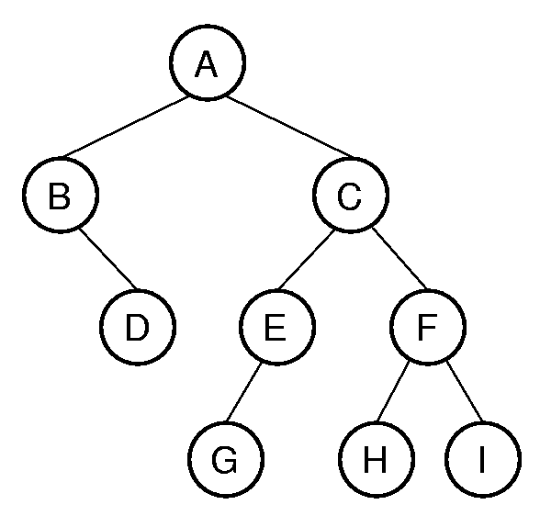
Binary Tree Example
Notation:
Node, edge, path, children, parent, ancestor, descendant, depth, level, height, subtree , leaf node, internal node.
? The number of binary tree in deferent shape with n nodes (1,2,3,4,5,6,…..)

Slide 4
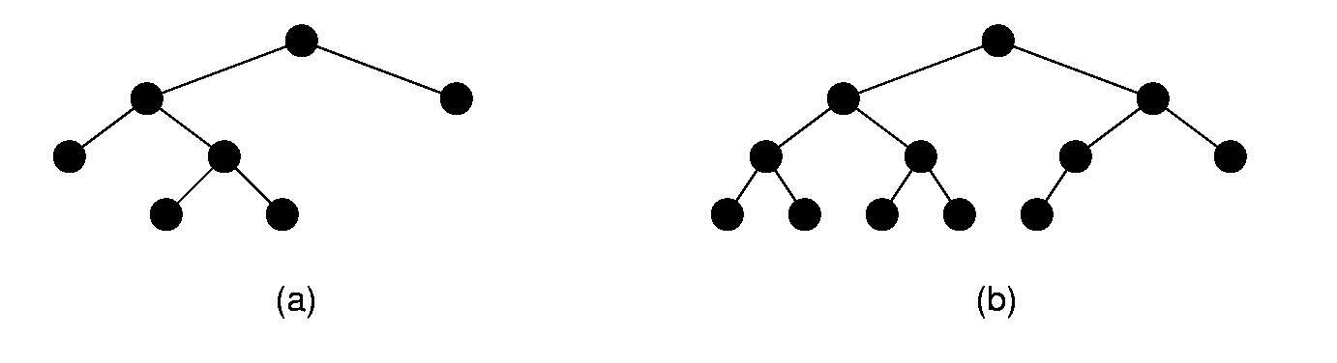
Full and Complete Binary Trees
Full binary tree: Each node is either a leaf or internal node with exactly two non-empty children.
Complete binary tree: If the height of the tree is d, then all levels except possibly level d-1 are completely full. The bottom level has all nodes to the left side.

Slide 5
Full Binary Tree Theorem
Theorem1: The number of leaves in a non-empty full binary tree is one more than the number of internal nodes.
Theorem2: The number of null pointers in a non-empty binary tree is one more than the number of nodes in the tree.

Slide 6
A Binary Tree Node ADT
Template <class Elem> class BinNode {
public:
virtual Elem& val( ) =0;
virtual void setVal( const Elem& ) = 0;
virtual BinNode* left( ) const = 0;
virtual void setLeft( BinNode* ) = 0;
virtual BinNode* right( ) const = 0;
virtual void setRight( BinNode* ) = 0;
virtual bool isLeaf( ) = 0;
}

Slide 7
Chapter5 Binary Trees
5.1 Definitions and Properties
5.2 Binary Tree Traversals
5.3 Binary Tree Node Implementations
5.4 Binary Search Trees
5.5 Heaps and Priority Queues
5.6 Huffman Coding Trees

Slide 8
Traversals (1)
Any process for visiting the nodes in some order is called a traversal.
Any traversal that lists every node in the tree exactly once is called an enumeration of the tree’s nodes.

Slide 9
Traversals (2)
Preorder traversal:
Visit each node before visiting its children.
Postorder traversal:
Visit each node after visiting its children.
Inorder traversal:
Visit the left subtree, then the node, then the right subtree.

Slide 10
Traversals (3)
Example:
Preorder traversal:
A B D C E G F H I
Postorder traversal:
D B G E H I F C A
Inorder traversal:
B D A G E C H F I
Exercise:
Given two traversals ,draw the tree
(every couple can result to an unique bt. EX: pre GHJI& in IHGJ):
Postorder traversal: D E C B H G F A
Inorder traversal: B D C E A F H G

Slide 11
Traversals (4)
template <class Elem> // Good implementation
void preorder(BinNode<Elem>* subroot) {
if (subroot == NULL) return; // Empty
visit(subroot); // Perform some action
preorder(subroot->left());
preorder(subroot->right());
}
template <class Elem> // Bad implementation
void preorder2(BinNode<Elem>* subroot) {
visit(subroot); // Perform some action
if (subroot->left() != NULL)
preorder2(subroot->left());
if (subroot->right() != NULL)
preorder2(subroot->right());
}

Slide 12
Traversal Example
// Return the number of nodes in the tree
template <class Elem>
int count(BinNode<Elem>* subroot) {
if (subroot == NULL)
return 0; // Nothing to count
return 1 + count(subroot->left())
+ count(subroot->right());
}

Slide 13
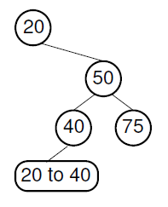
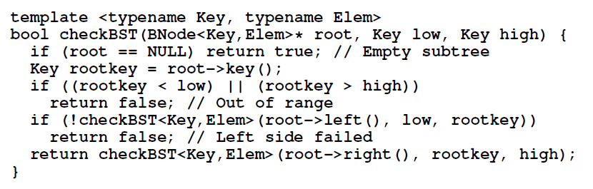
Traversal Example

Slide 14
Chapter5 Binary Trees
5.1 Definitions and Properties
5.2 Binary Tree Traversals
5.3 Binary Tree Node Implementations
5.4 Binary Search Trees
5.5 Heaps and Priority Queues
5.6 Huffman Coding Trees

Slide 15
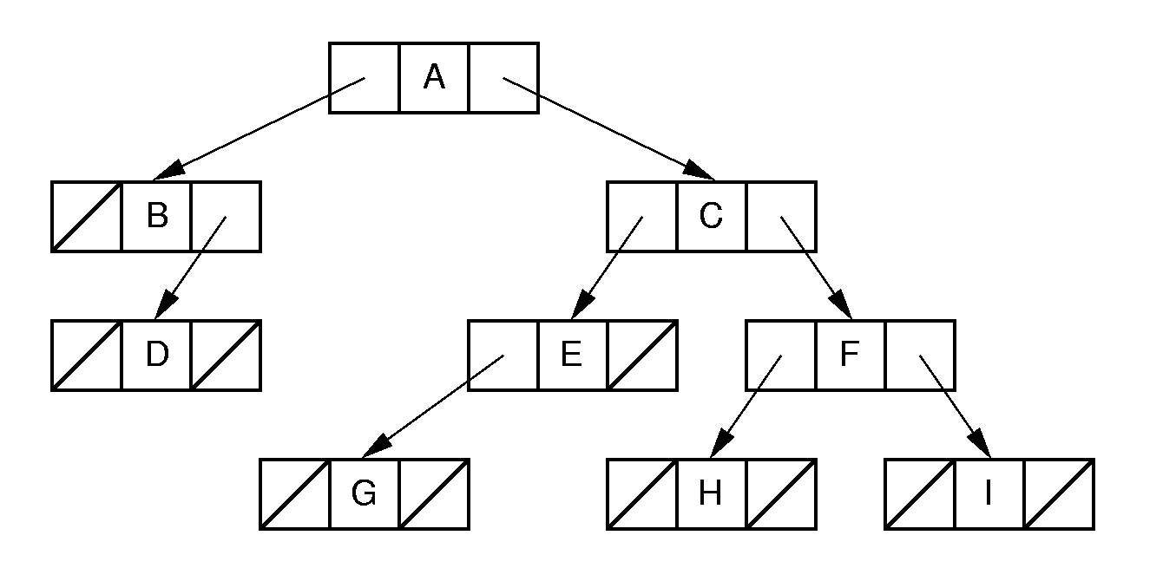
Binary Tree Implementation (1)

Slide 16
Binary Tree Node Class (1)
// Binary tree node class
template <class Elem>
class BinNodePtr : public BinNode<Elem> {
private:
Elem it; // The node's value
BinNodePtr* lc; // Pointer to left child
BinNodePtr* rc; // Pointer to right child
public:
BinNodePtr() { lc = rc = NULL; }
BinNodePtr(Elem e, BinNodePtr* l =NULL,
BinNodePtr* r =NULL)
{ it = e; lc = l; rc = r; }

Slide 17
Binary Tree Node Class (2)
Elem& val() { return it; }
void setVal(const Elem& e) { it = e; }
inline BinNode<Elem>* left() const
{ return lc; }
void setLeft(BinNode<Elem>* b)
{ lc = (BinNodePtr*)b; }
inline BinNode<Elem>* right() const
{ return rc; }
void setRight(BinNode<Elem>* b)
{ rc = (BinNodePtr*)b; }
bool isLeaf()
{ return (lc == NULL) && (rc == NULL); }
};

Slide 18
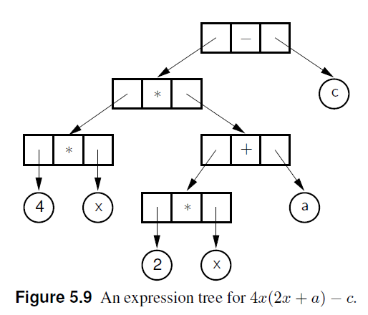
Binary Tree Implementation (2)

Slide 19
Union Implementation (1)
enum Nodetype {leaf, internal};
class VarBinNode { // Generic node class
public:
Nodetype mytype; // Store type for node
union {
struct { // Internal node
VarBinNode* left; // Left child
VarBinNode* right; // Right child
Operator opx; // Value
} intl;
Operand var; // Leaf: Value only
};

Slide 20
Union Implementation (2)
// Leaf constructor
VarBinNode(const Operand& val)
{ mytype = leaf; var = val; }
// Internal node constructor
VarBinNode(const Operator& op,
VarBinNode* l, VarBinNode* r) {
mytype = internal; intl.opx = op;
intl.left = l; intl.right = r;
}
bool isLeaf() { return mytype == leaf; }
VarBinNode* leftchild()
{ return intl.left; }
VarBinNode* rightchild()
{ return intl.right; }
};

Slide 21
Union Implementation (3)
// Preorder traversal
void traverse(VarBinNode* subroot) {
if (subroot == NULL) return;
if (subroot->isLeaf())
cout << "Leaf: “
<< subroot->var << "\n";
else {
cout << "Internal: “
<< subroot->intl.opx << "\n";
traverse(subroot->leftchild());
traverse(subroot->rightchild());
}
}

Slide 22
Inheritance (1)
class VarBinNode { // Abstract base class
public:
virtual bool isLeaf() = 0;
};
class LeafNode : public VarBinNode { // Leaf
private:
Operand var; // Operand value
public:
LeafNode(const Operand& val)
{ var = val; } // Constructor
bool isLeaf() { return true; }
Operand value() { return var; }
};

Slide 23
Inheritance (2)
// Internal node
class IntlNode : public VarBinNode {
private:
VarBinNode* left; // Left child
VarBinNode* right; // Right child
Operator opx; // Operator value
public:
IntlNode(const Operator& op,
VarBinNode* l, VarBinNode* r)
{ opx = op; left = l; right = r; }
bool isLeaf() { return false; }
VarBinNode* leftchild() { return left; }
VarBinNode* rightchild() { return right; }
Operator value() { return opx; }
};

Slide 24
Inheritance (3)
// Preorder traversal
void traverse(VarBinNode *subroot) {
if (subroot == NULL) return; // Empty
if (subroot->isLeaf()) // Do leaf node
cout << "Leaf: "
<< ((LeafNode *)subroot)->value()
<< endl;
else { // Do internal node
cout << "Internal: "
<< ((IntlNode *)subroot)->value()
<< endl;
traverse(
((IntlNode *)subroot)->leftchild());
traverse(
((IntlNode *)subroot)->rightchild());
}
}

Slide 25
Composite (1)
class VarBinNode { // Abstract base class
public:
virtual bool isLeaf() = 0;
virtual void trav() = 0;
};
class LeafNode : public VarBinNode { // Leaf
private:
Operand var; // Operand value
public:
LeafNode(const Operand& val)
{ var = val; } // Constructor
bool isLeaf() { return true; }
Operand value() { return var; }
void trav() { cout << "Leaf: " << value()
<< endl; }
};

Slide 26
Composite (2)
class IntlNode : public VarBinNode {
private:
VarBinNode* lc; // Left child
VarBinNode* rc; // Right child
Operator opx; // Operator value
public:
IntlNode(const Operator& op,
VarBinNode* l, VarBinNode* r)
{ opx = op; lc = l; rc = r; }
bool isLeaf() { return false; }
VarBinNode* left() { return lc; }
VarBinNode* right() { return rc; }
Operator value() { return opx; }
void trav() {
cout << "Internal: " << value() << endl;
if (left() != NULL) left()->trav();
if (right() != NULL) right()->trav();
}
};

Slide 27
Composite (3)
// Preorder traversal
void traverse(VarBinNode *root) {
if (root != NULL)
root->trav();
}

Slide 28
Space Overhead (1)
From the Full Binary Tree Theorem:
Half of the pointers are null.
If leaves store only data, then overhead depends on whether the tree is full.
Ex: All nodes the same, with two pointers to children:
Total space required is (2p + d)n
Overhead: 2pn
If p = d, this means 2p/(2p + d) = 2/3 overhead.

Slide 29
Space Overhead (2)
Eliminate pointers from the leaf nodes:
n/2*(2p) p
n/2*(2p) + dn p + d
This is 1/2 if p = d.
2p/(2p + d) if data only at leaves ⇒ 2/3 overhead.
Note that some method is needed to distinguish leaves from internal nodes.
=

Slide 30
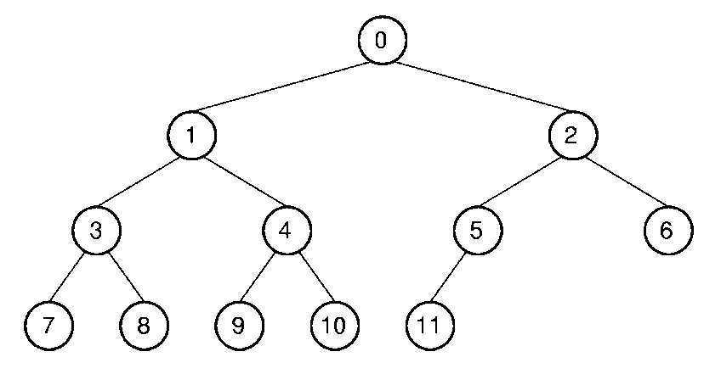
Array Implementation (1)
Position | 0 | 1 | 2 | 3 | 4 | 5 | 6 | 7 | 8 | 9 | 10 | 11
Parent | -- | 0 | 0 | 1 | 1 | 2 | 2 | 3 | 3 | 4 | 4 | 5
Left Child | 1 | 3 | 5 | 7 | 9 | 11 | -- | -- | -- | -- | -- | --
Right Child | 2 | 4 | 6 | 8 | 10 | -- | -- | -- | -- | -- | -- | --
Left Sibling（brother） | -- | -- | 1 | -- | 3 | -- | 5 | -- | 7 | -- | 9 | --
Right Sibling | -- | 2 | -- | 4 | -- | 6 | -- | 8 | -- | 10 | -- | --

Slide 31
Array Implementation (1)
Parent (r) = ⎣(r - 1) / 2 ⎦ if r ≠ 0 and r < n.
Leftchild(r) = 2r + 1 if 2r+1 < n.
Rightchild(r) = 2r + 2 if 2r +2 < n.
Leftsibling(r) = r - 1 if r is even, r > 0 and r < n.
Rightsibling(r) = r + 1 if r is odd, r +1 < n.

Slide 32
Chapter5 Binary Trees
5.1 Definitions and Properties
5.2 Binary Tree Traversals
5.3 Binary Tree Node Implementations
5.4 Binary Search Trees
5.5 Heaps and Priority Queues
5.6 Huffman Coding Trees

Slide 33
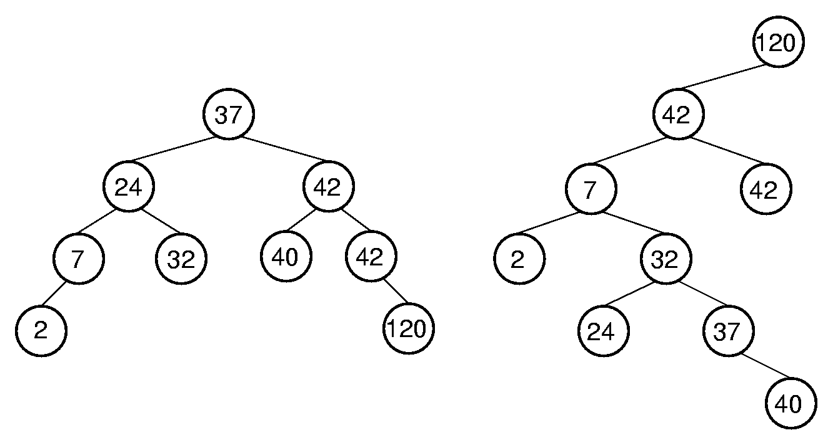
Binary Search Trees
BST Property: All elements stored in the left subtree of a node with value K have values < K. All elements stored in the right subtree of a node with value K have values >= K.

Slide 34
BST ADT(1)
// BST implementation for the Dictionary ADT
template <class Key, class Elem,
class KEComp, class EEComp>
class BST : public Dictionary<Key, Elem,
KEComp, EEComp> {
private:
BinNode<Elem>* root; // Root of the BST
int nodecount; // Number of nodes
void clearhelp(BinNode<Elem>*);
BinNode<Elem>*
inserthelp(BinNode<Elem>*, const Elem&);
BinNode<Elem>*
deletemin(BinNode<Elem>*,BinNode<Elem>*&);
BinNode<Elem>* removehelp(BinNode<Elem>*,
const Key&, BinNode<Elem>*&);
bool findhelp(BinNode<Elem>*, const Key&,
Elem&) const;
void printhelp(BinNode<Elem>*, int) const;

Slide 35
BST ADT(2)
public:
BST() { root = NULL; nodecount = 0; }
~BST() { clearhelp(root); }
void clear() { clearhelp(root); root = NULL;
nodecount = 0; }
bool insert(const Elem& e) {
root = inserthelp(root, e);
nodecount++;
return true; }
bool remove(const Key& K, Elem& e) {
BinNode<Elem>* t = NULL;
root = removehelp(root, K, t);
if (t == NULL) return false;
e = t->val();
nodecount--;
delete t;
return true; }

Slide 36
BST ADT(3)
bool removeAny(Elem& e) { // Delete min value
if (root == NULL) return false; // Empty
BinNode<Elem>* t;
root = deletemin(root, t);
e = t->val();
delete t;
nodecount--;
return true;
}
bool find(const Key& K, Elem& e) const
{ return findhelp(root, K, e); }
int size() { return nodecount; }
void print() const {
if (root == NULL)
cout << "The BST is empty.\n";
else printhelp(root, 0);
}

Slide 37
BST Search
template <class Key, class Elem,
class KEComp, class EEComp>
bool BST<Key, Elem, KEComp, EEComp>::
findhelp(BinNode<Elem>* subroot,
const Key& K, Elem& e) const {
if (subroot == NULL) return false;
else if (KEComp::lt(K, subroot->val()))
return findhelp(subroot->left(), K, e);
else if (KEComp::gt(K, subroot->val()))
return findhelp(subroot->right(), K, e);
else { e = subroot->val(); return true; }
}

Slide 38
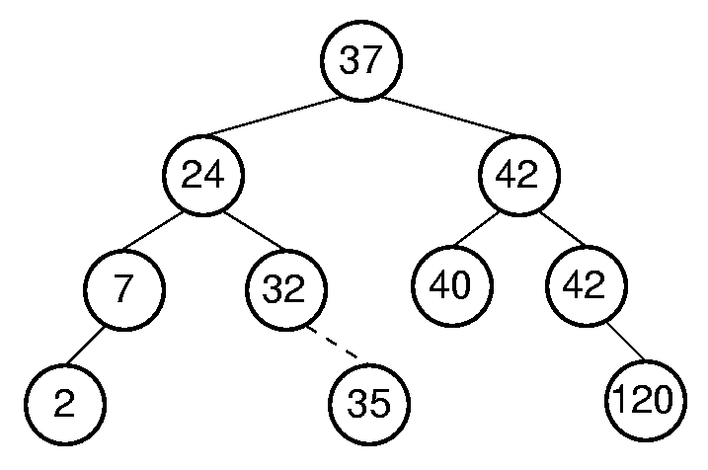
BST Insert (1)

Slide 39
BST Insert (2)
template <class Key, class Elem,
class KEComp, class EEComp>
BinNode<Elem>* BST<Key,Elem,KEComp,EEComp>::
inserthelp(BinNode<Elem>* subroot,
const Elem& val) {
if (subroot == NULL) // Empty: create node
return new BinNodePtr<Elem>(val,NULL,NULL);
if (EEComp::lt(val, subroot->val()))
subroot->setLeft(inserthelp(subroot->left(),
val));
else subroot->setRight(
inserthelp(subroot->right(), val));
// Return subtree with node inserted
return subroot;
}

Slide 40
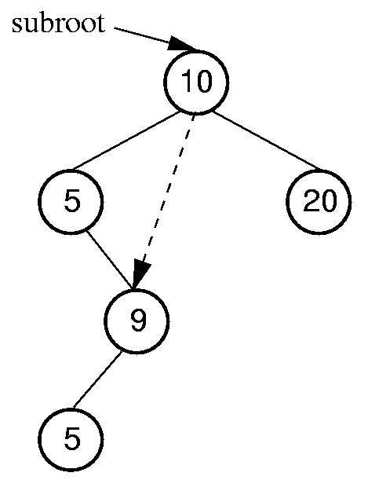
Remove Minimum Value
template <class Key, class Elem,
class KEComp, class EEComp>
BinNode<Elem>* BST<Key, Elem,
KEComp, EEComp>::
deletemin(BinNode<Elem>* subroot,
BinNode<Elem>*& min) {
if (subroot->left() == NULL) {
min = subroot;
return subroot->right();
}
else { // Continue left
subroot->setLeft(
deletemin(subroot->left(), min));
return subroot;
}
}

Slide 41
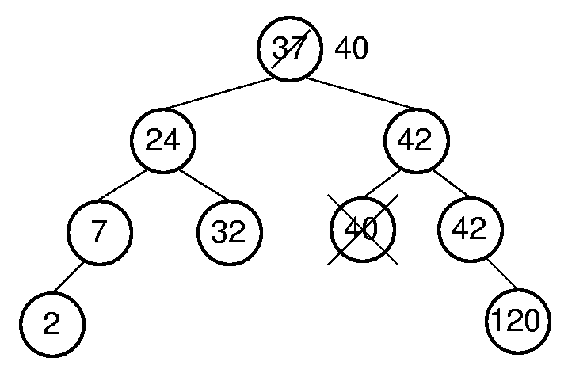
BST Remove (1)
WHY
CHOOSE
ONE
FORM
RIGHT?

Slide 42
BST Remove (2)
template <class Key, class Elem,
class KEComp, class EEComp>
BinNode<Elem>* BST<Key,Elem,KEComp,EEComp>::
removehelp(BinNode<Elem>* subroot,
const Key& K, BinNode<Elem>*& t) {
if (subroot == NULL) return NULL;
else if (KEComp::lt(K, subroot->val()))
subroot->setLeft(
removehelp(subroot->left(), K, t));
else if (KEComp::gt(K, subroot->val()))
subroot->setRight(
removehelp(subroot->right(), K, t));

Slide 43
BST Remove (2)
else { // Found it: remove it
BinNode<Elem>* temp;
t = subroot;
if (subroot->left() == NULL)
subroot = subroot->right();
else if (subroot->right() == NULL)
subroot = subroot->left();
else { // Both children are non-empty
subroot->setRight(
deletemin(subroot->right(), temp));
Elem te = subroot->val();
subroot->setVal(temp->val());
temp->setVal(te);
t = temp;
} }
return subroot;
}

Slide 44
Cost of BST Operations
Find:
Insert:
Delete:
Worst case: θ(n).
Average case: θ(log n).

Slide 45
Chapter5 Binary Trees
5.1 Definitions and Properties
5.2 Binary Tree Traversals
5.3 Binary Tree Node Implementations
5.4 Binary Search Trees
5.5 Heaps and Priority Queues
5.6 Huffman Coding Trees

Slide 46
Heaps
Heap: Complete binary tree with the heap property
Min-heap: All values less than child values.
Max-heap: All values greater than child values.
The values are partially ordered（r,antis,t）.
Heap representation: Normally the array-based complete binary tree representation.

Slide 47
Heap ADT
template<class Elem,class Comp> class maxheap{
private:
Elem* Heap; // Pointer to the heap array
int size; // Maximum size of the heap
int n; // Number of elems now in heap
void siftdown(int); // Put element in place
public:
maxheap(Elem* h, int num, int max);
int heapsize() const;
bool isLeaf(int pos) const;
int leftchild(int pos) const;
int rightchild(int pos) const;
int parent(int pos) const;
bool insert(const Elem&);
bool removemax(Elem&);
bool remove(int, Elem&);
void buildHeap();
};

Slide 48
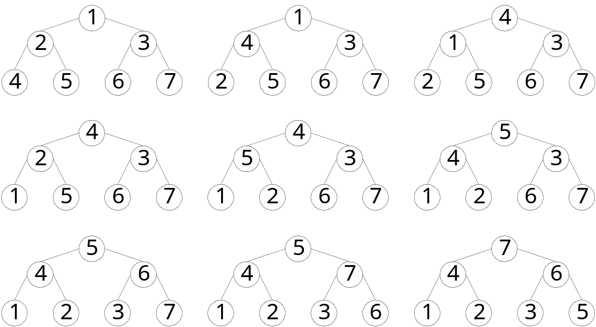
Building the Heap (1)
(7-5)
(4-2) (4-1) (2-1) (5-2) (5-4) (6-3) (7-6)

Slide 49
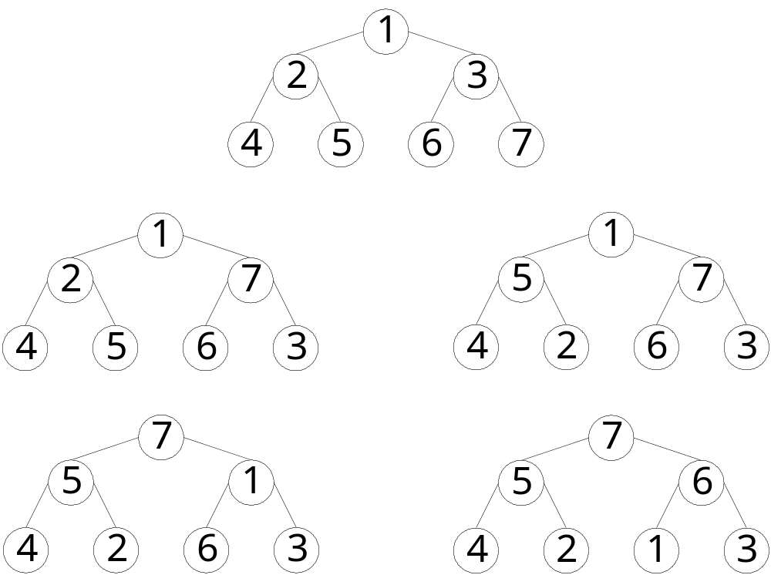
Building the Heap (2)
(7-3),(5-2), (7-1), (6-1)

Slide 50
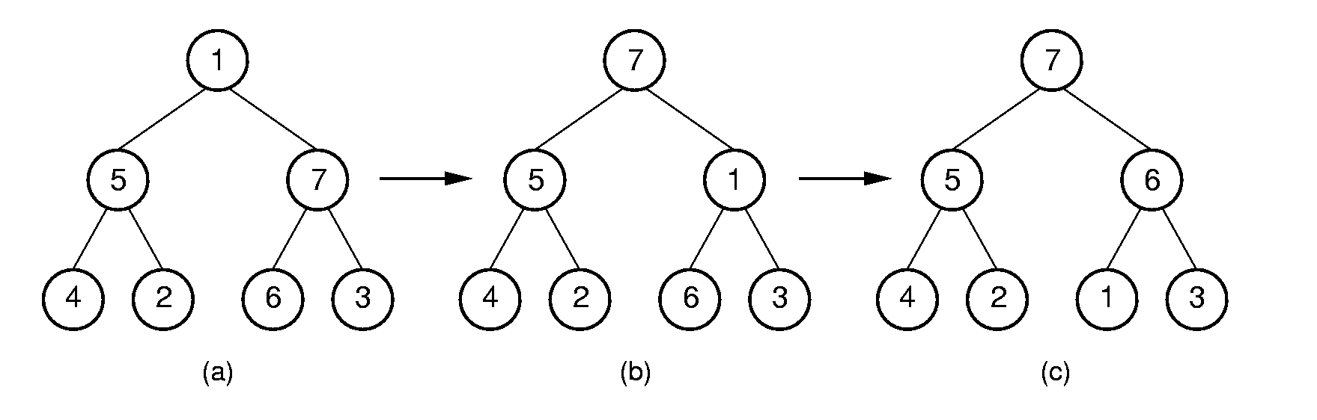
Siftdown (1)

Slide 51
Siftdown (2)
For fast heap construction:
Work from high end of array to low end.
Call siftdown for each item.
Don’t need to call siftdown on leaf nodes.
template <class Elem, class Comp>
void maxheap<Elem,Comp>::siftdown(int pos) {
while (!isLeaf(pos)) {
int j = leftchild(pos);
int rc = rightchild(pos);
if ((rc<n) && Comp::lt(Heap[j],Heap[rc]))
j = rc;
if (!Comp::lt(Heap[pos], Heap[j])) return;
swap(Heap, pos, j);
pos = j;
}}

Slide 52
Buildheap Cost
Cost for heap construction:
log n
∑ (i - 1) n/2^{i} ≈ n.
i=1

Slide 53
Remove Max Value
template <class Elem, class Comp>
bool maxheap<Elem, Comp>::
removemax(Elem& it) {
if (n == 0) return false; // Heap is empty
swap(Heap, 0, --n); // Swap max with end
if (n != 0) siftdown(0);
it = Heap[n]; // Return max value
return true;
}
θ(log n)

Slide 54
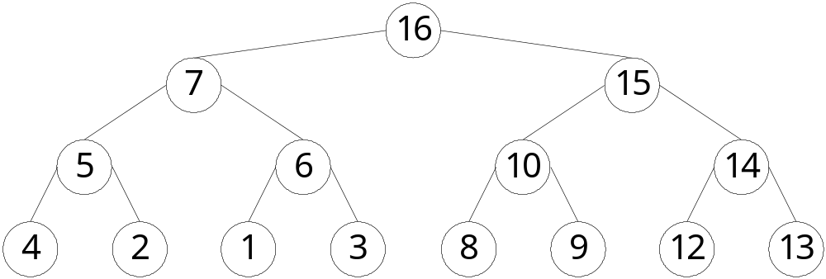
template <class Elem, class Comp>
bool maxheap<Elem, Comp>::remove(int pos,
Elem& it) {
if ((pos < 0) || (pos >= n)) return false;
swap(Heap, pos, --n);
while ((pos != 0) && (Comp::gt(Heap[pos],
Heap[parent(pos)])))
{ swap(Heap, pos, parent(pos));
pos = parent(pos); }
siftdown(pos);
it = Heap[n];
return true;
}

Slide 55
Priority Queues
A priority queue stores objects, and on request releases the object with greatest value.
Example: Scheduling jobs in a multi-tasking operating system.
The priority of a job may change, requiring some reordering of the jobs.
Implementation: Use a heap to store the priority queue.
To support priority reordering, delete and re-insert. Need to know index for the object in question.

Slide 56
Chapter5 Binary Trees
5.1 Definitions and Properties
5.2 Binary Tree Traversals
5.3 Binary Tree Node Implementations
5.4 Binary Search Trees
5.5 Heaps and Priority Queues
5.6 Huffman Coding Trees

Slide 57
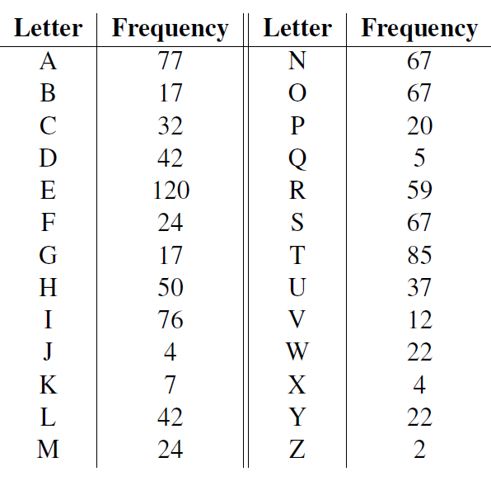

Slide 58
Huffman Coding Trees
ASCII codes: 8 bits per character.
Fixed-length coding.
Can take advantage of relative frequency of letters to save space.
Variable-length coding
Build the tree with minimum external path weight.
Z | K | F | C | U | D | L | E
2 | 7 | 24 | 32 | 37 | 42 | 42 | 120

Slide 59
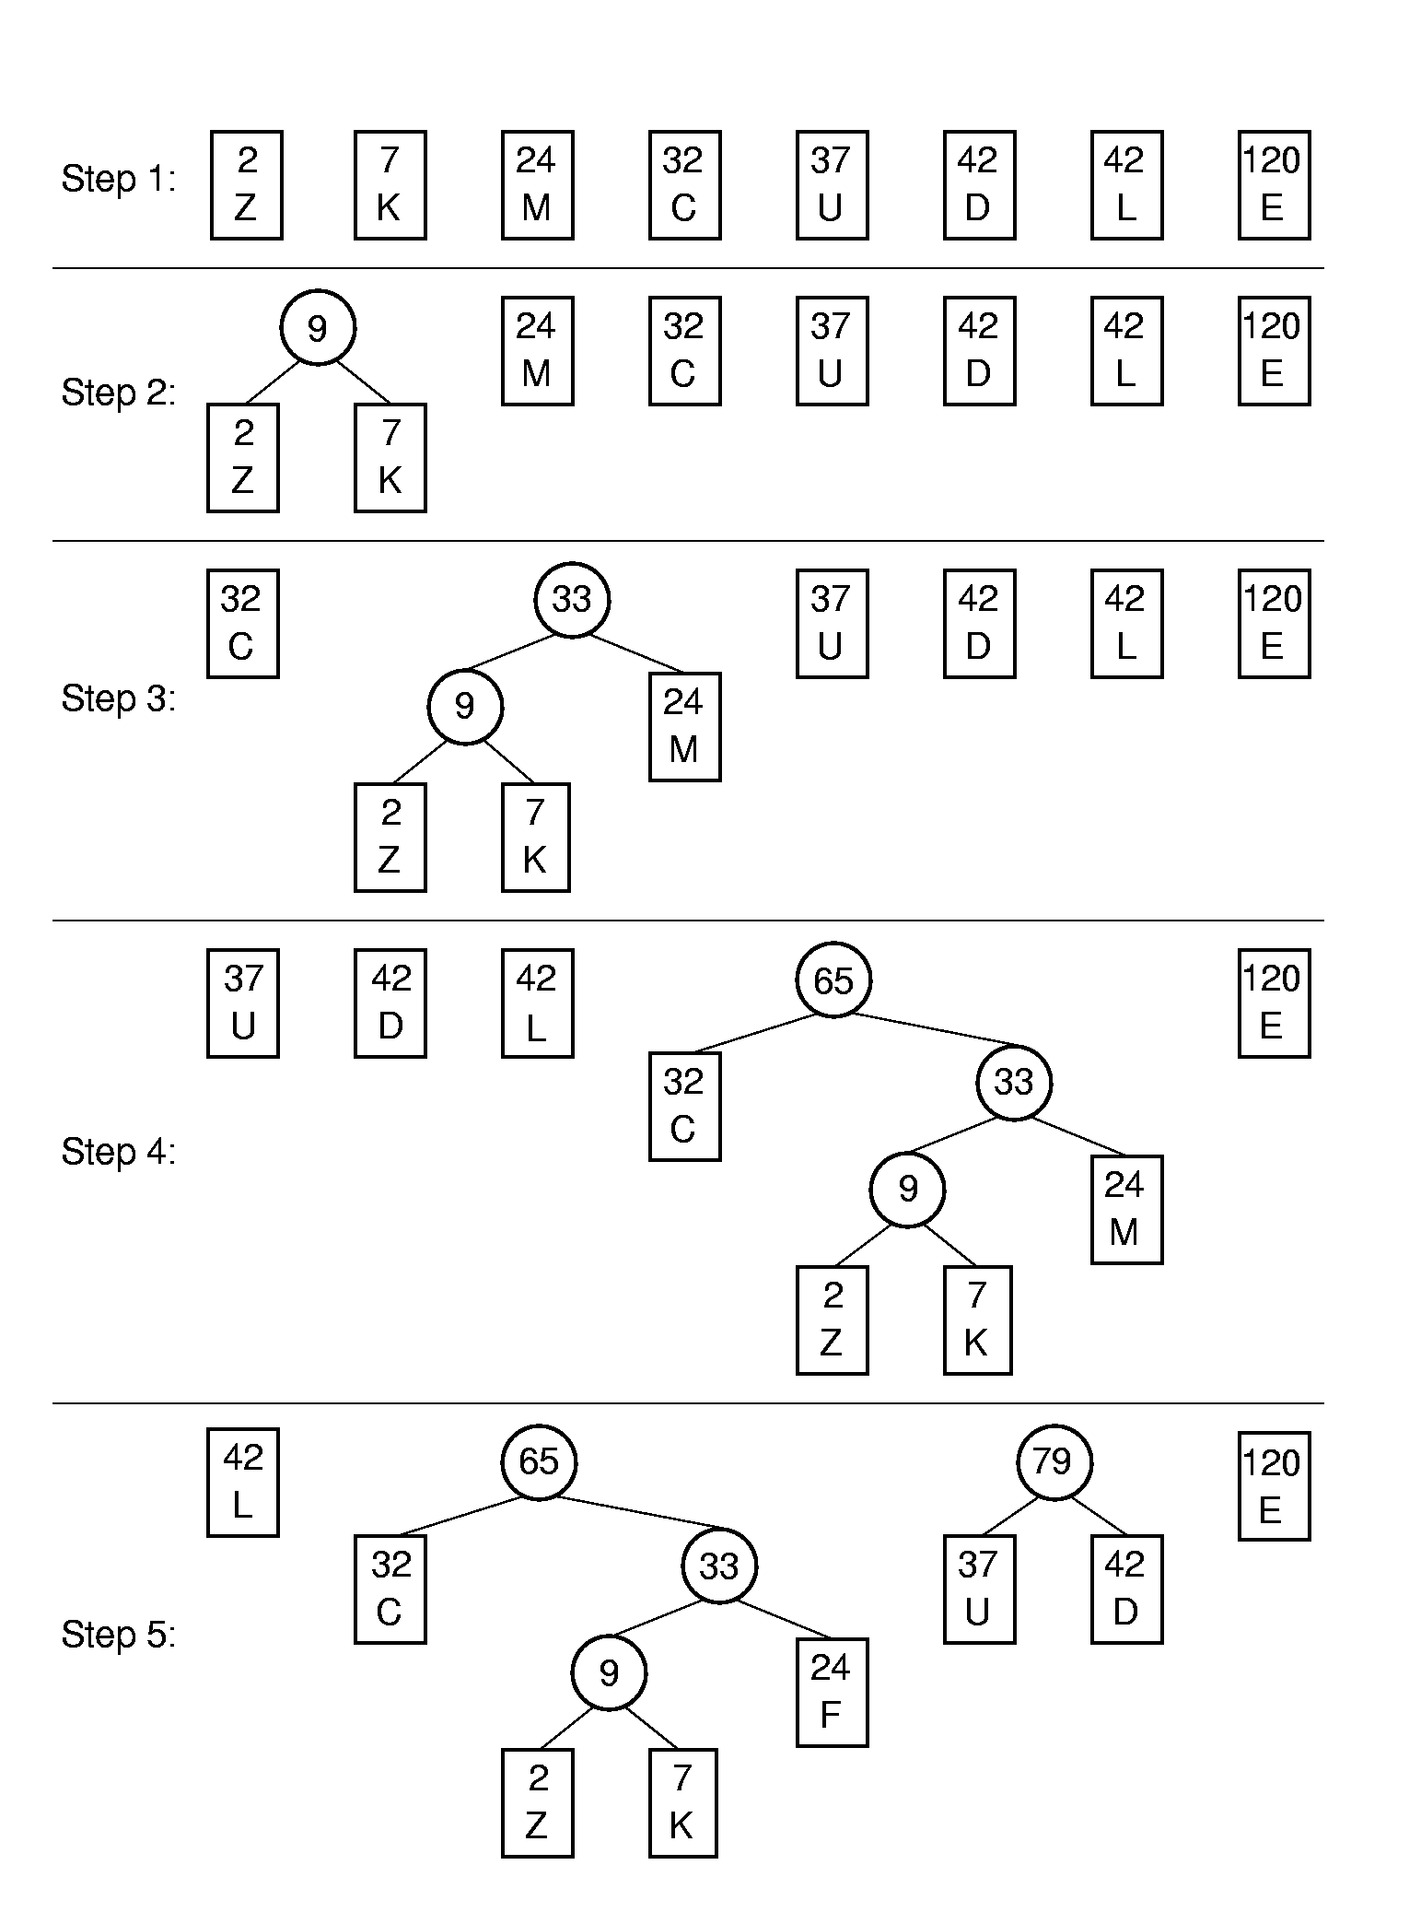
Huffman Tree Construction (1)

Slide 60
Huffman Tree Construction (2)

Slide 61
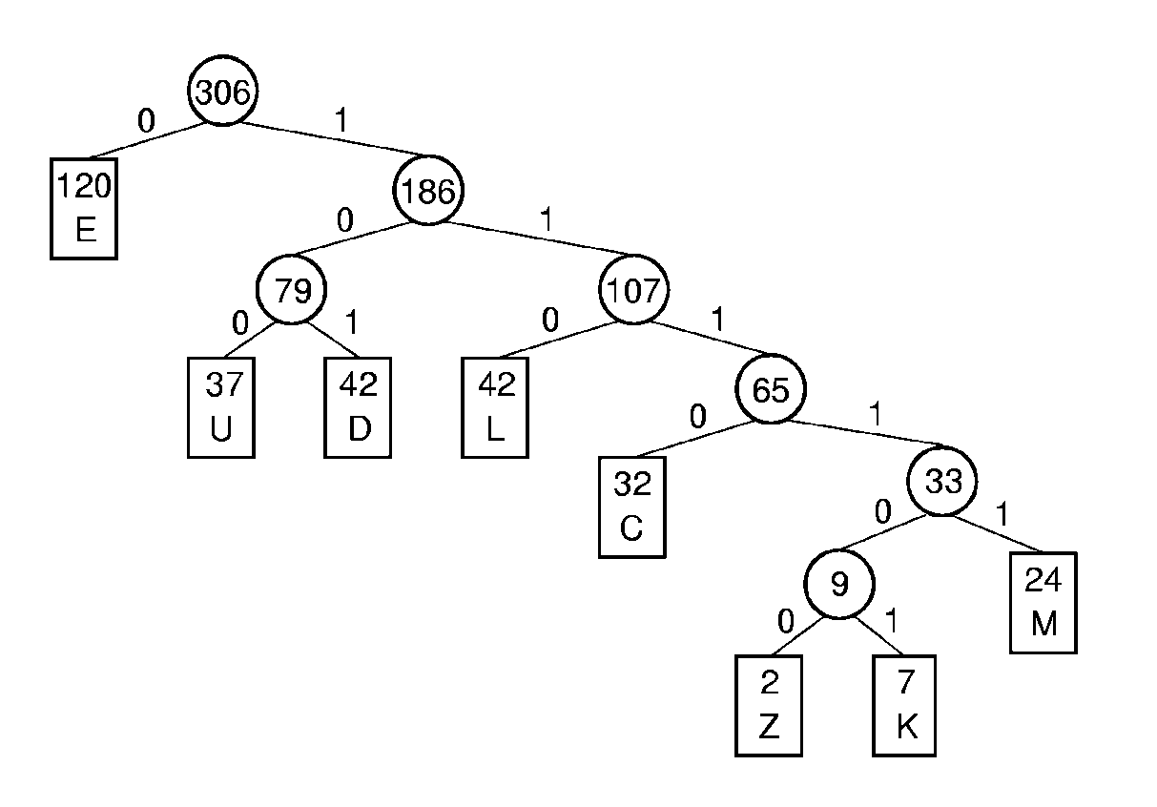
Assigning Codes
Letter | Freq | Code
C | 32 | 1110
D | 42 | 101
E | 120 | 0
M | 24 | 11111
K | 7 | 111101
L | 42 | 110
U | 37 | 100
Z | 2 | 111100

Slide 62
Coding and Decoding
A set of codes is said to meet the prefix property if no code in the set is the prefix of another.
Code for DEED:
101 0 0 101
Decode 1011001110111101:
1011001110111101:
DUCK

Slide 63
Cost
Letter | Freq | Code | Bits
C | 32 | 1110 | 4
D | 42 | 101 | 3
E | 120 | 0 | 1
M | 24 | 11111 | 5
K | 7 | 111101 | 6
L | 42 | 110 | 3
U | 37 | 100 | 3
Z | 2 | 111100 | 6
Expected cost per letter:
(1*120+3*121+4*32+5*24+6*9)/306
= 785/306 = 2.57

Slide 64
Huffman Coding Trees ADT(1)
template <class Elem>
class HuffNode { //Node abstract base class
public:
virtual int weight() = 0;
virtual bool isLeaf() = 0;
virtual HuffNode* left() const = 0;
virtual void setLeft(HuffNode*) = 0;
virtual HuffNode* right() const = 0;
virtual void setRight(HuffNode*) = 0;
};

Slide 65
Huffman Coding Trees ADT(2)
template <class Elem> //leaf node subclass
class LeafNode: public HuffNode<Elem> {
private:
Freqpair<Elem>* it; //Frequency pair
public:
LeafNode(const Elem& val, int freq) //constructor
{ it = new Freqpair<Elem>(val,freq); }
int weight() { return it->weight(); } //Return frequency
Freqpair<Elem>* val() { return it; }
bool isLeaf() { return true; }

Slide 66
Huffman Coding Trees ADT(3)
virtual HuffNode* left() const { return NULL; }
virtual void setLeft(HuffNode*) { }
virtual HuffNode* right() const { return NULL; }
virtual void setRight(HuffNode*) { }
};

Slide 67
Huffman Coding Trees ADT(4)
template <class Elem> //Internal node subclass
class IntlNode: public HuffNode<Elem> {
private:
HuffNode<Elem>* lc; //left child
HuffNode<Elem>* rc; //right child
int wgt; //Subtree weight
public:
IntlNode(HuffNode<Elem> * l; HuffNode<Elem> * r)
{ wgt = l->weight() + r->weight(); lc = l; rc = r; }
int weight() { return wgt; } //Return frequency

Slide 68
Huffman Coding Trees ADT(5)
bool isLeaf() { return false; }
HuffNode<Elem>* left() const { return lc; }
void setLeft(HuffNode<Elem>* b)
{ lc = (HuffNode*)b; }
HuffNode<Elem>* right() const { return rc; }
void setRight(HuffNode<Elem>* b)
{ rc = (HuffNode*)b; }
};

Slide 69
Huffman Coding Trees ADT(6)
template <class Elem>
class FreqPair { //An element / frequency pair
private:
elem it; //An element of some sort
int freq;
public:
FreqPair(const Elem& e, int f) //Constructor
{ it = e; freq = f; }
~FreqPair() { } //Destructor
int weight() { return freq; } //Return the weight
Elem& val() { return it; } //Return the element
};

Slide 70
Huffman Coding Trees ADT(7)
template <class Elem>
class HuffTree {
private:
HuffNode<Elem>* theRoot;
public:
HuffTree(Elem& val, int freq)
{ theRoot = new LeafNode<Elem>(val,freq); }
HuffTree(HuffTree<Elem>* l, HuffTree<Elem>* r)
{ theRoot = new IntlNode<Elem>(l->root(), r->root()); }
~ HuffTree() { }
HuffNode<Elem>* root() { return theRoot; }
int weight() { return theRoot->weight(); }
};

Slide 71
Huffman Coding Trees ADT(8)
template <class Elem> class HHCompare {
public:
static bool lt(HuffTree<Elem>* x, HuffTree<Elem>* y)
{ return x->weight() < y->weight(); }
static bool eq(HuffTree<Elem>* x, HuffTree<Elem>* y)
{ return x->weight() = = y->weight(); }
static bool gt(HuffTree<Elem>* x, HuffTree<Elem>* y)
{ return x->weight() > y->weight(); }
};

Slide 72
Huffman Coding Trees ADT(9)
template <class Elem> HuffTree<Elem>*
buildHuff(SLList<HuffTree<Elem>*,HHCompare<Elem> >* f1) {
HuffTree<Elem>* temp1, *temp2, *temp3;
for (f1->setStart(); f1->leftLength()+f1->rightLength()>1;
f1->setStart()) { //While at least two items left
f1->remove(temp1); //Pull first two trees off the list
f1->remove(temp2);
temp3 = new HuffTree<Elem>(temp1, temp2);
f1->insert(temp3); //Put the new tree back on list
delete temp1; //Must delete the remnants
delete temp2; // of the trees we created
}
return temp3;
}

Slide 73
Exercises
Exercise：
5.6, 5.19,5.27, 5.28
Project：
5.6

