Slide 1
Data Structures and Algorithm Analysis
Chapter 2 Mathematical Background

Slide 2
Mathematical Background
Set concepts and notation.
Recursion
Induction Proofs
Logarithms
Summations
Recurrence Relations

Slide 3
Sets and Relations
Collection of distinguishable members or elements
Base type
Powerset
A relation R over set S is a set of ordered pairs from S
Reflexive, symmetric, anti-symmetric, transitive, equivalence, partition, partial order

Slide 4
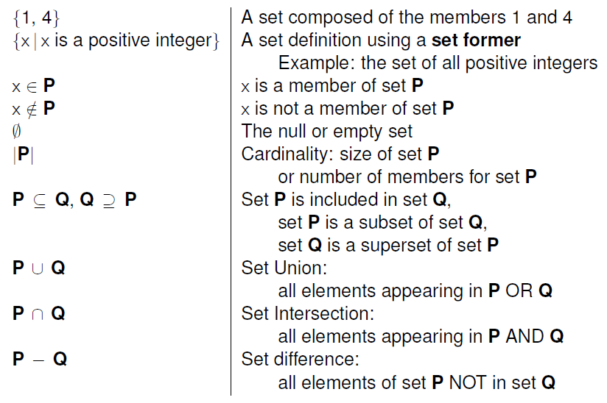
Example for Sets

Slide 5
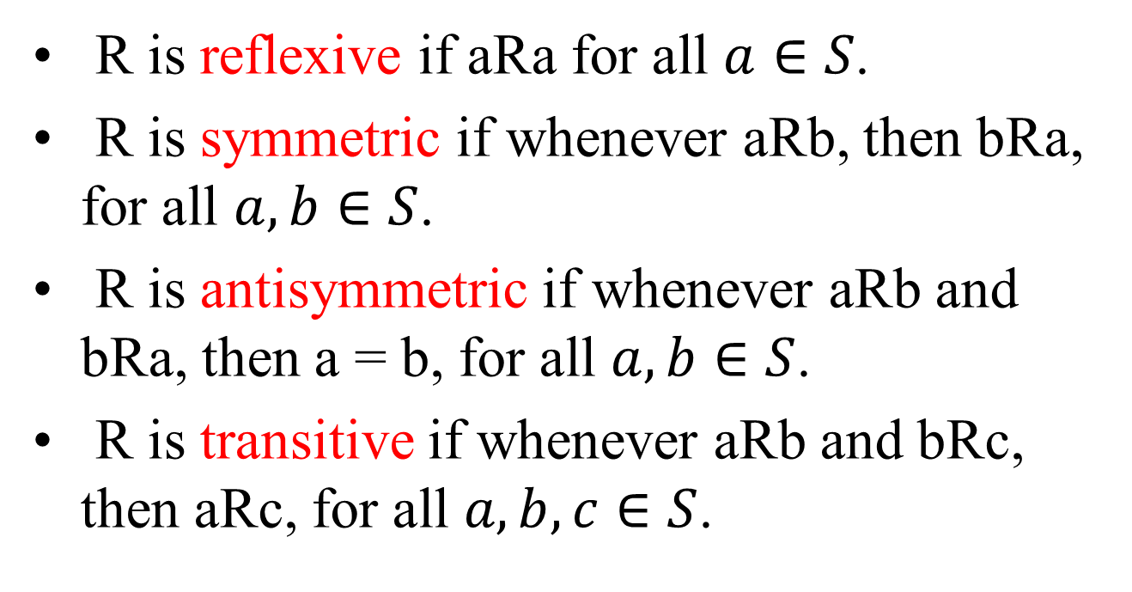
Relations

Slide 6
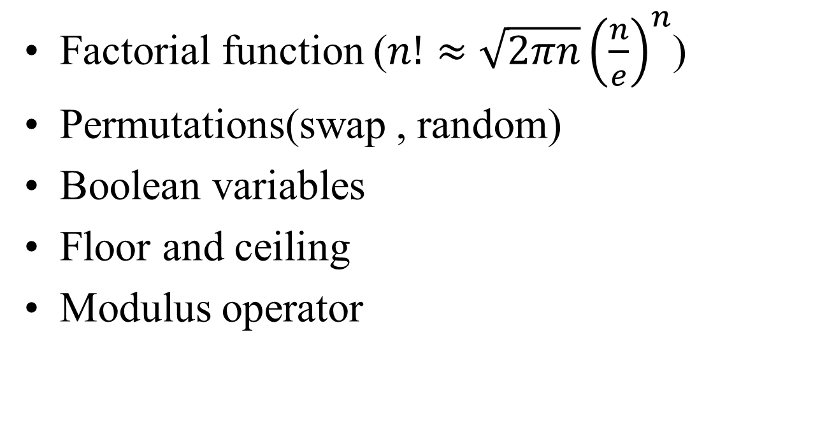
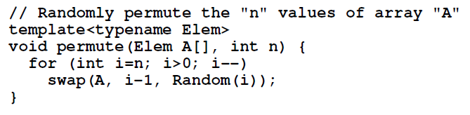
Miscellaneous Notation

Slide 7
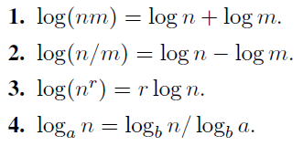
Logarithms
Program requires encoding for a collection of objects
Some properties:

Slide 8
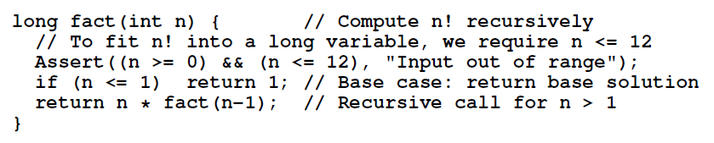
Recursion
Call itself to do part of its work
Base case+recursive part
Example n!
Base case
Recursive part

Slide 9
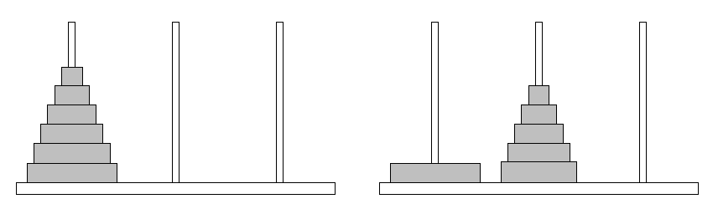
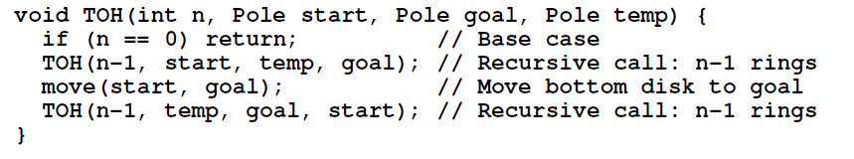
Towers of Hanoi

Slide 10
Summations and Recurrence
Closed solution
Harmonic Series
Recurrence relation（used to model the cost of recursive function）

Slide 11
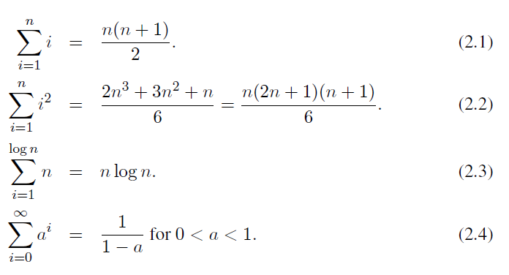
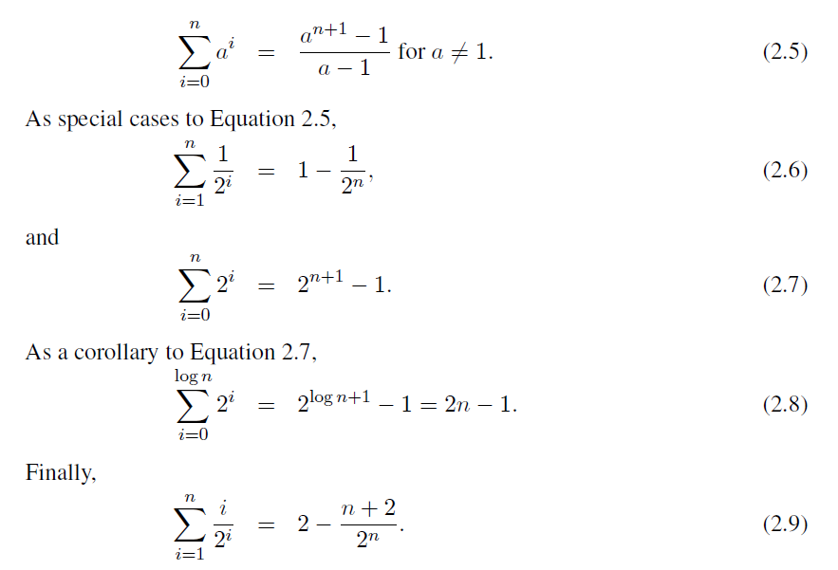
Closed Solution

Slide 12
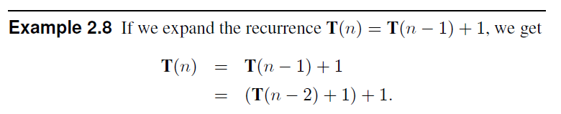

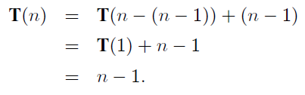
Recurrence relation

Slide 13
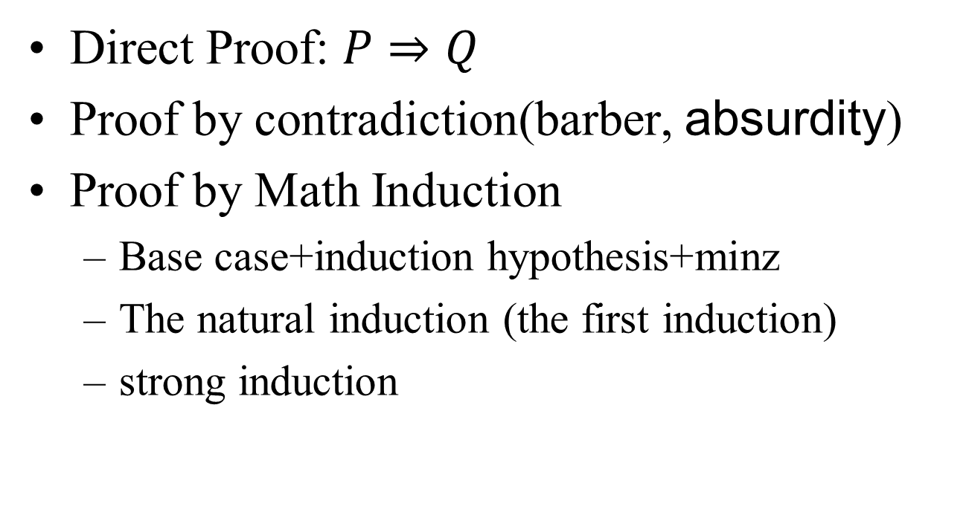
Mathematical Proof Tech
Direct Proof: $P⇒Q$
Proof by contradiction(barber, absurdity)
Proof by Math Induction
Base case+induction hypothesis+minz
The natural induction (the first induction)
strong induction

Slide 14
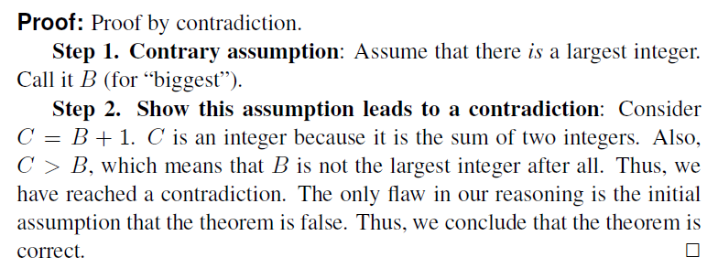

Proof by contradiction
$not P⇒not Q$
Theorem 2.1 There is no largest integer.

Slide 15
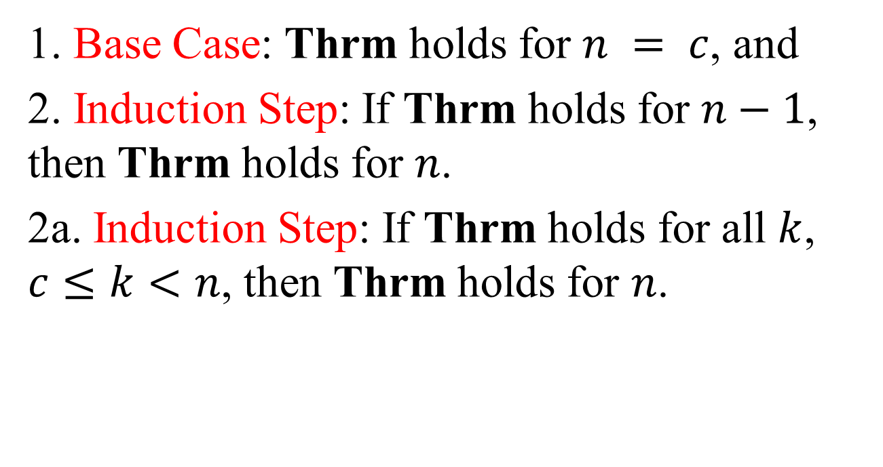
Proof by Mathematical Induction
1. Base Case: Thrm holds for $n = c$, and
2. Induction Step: If Thrm holds for $n−1$, then Thrm holds for $n$.
2a. Induction Step: If Thrm holds for all $k$, $c≤k<n$, then Thrm holds for $n$.

Slide 16


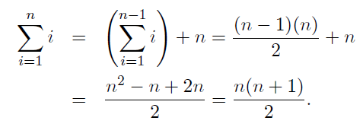
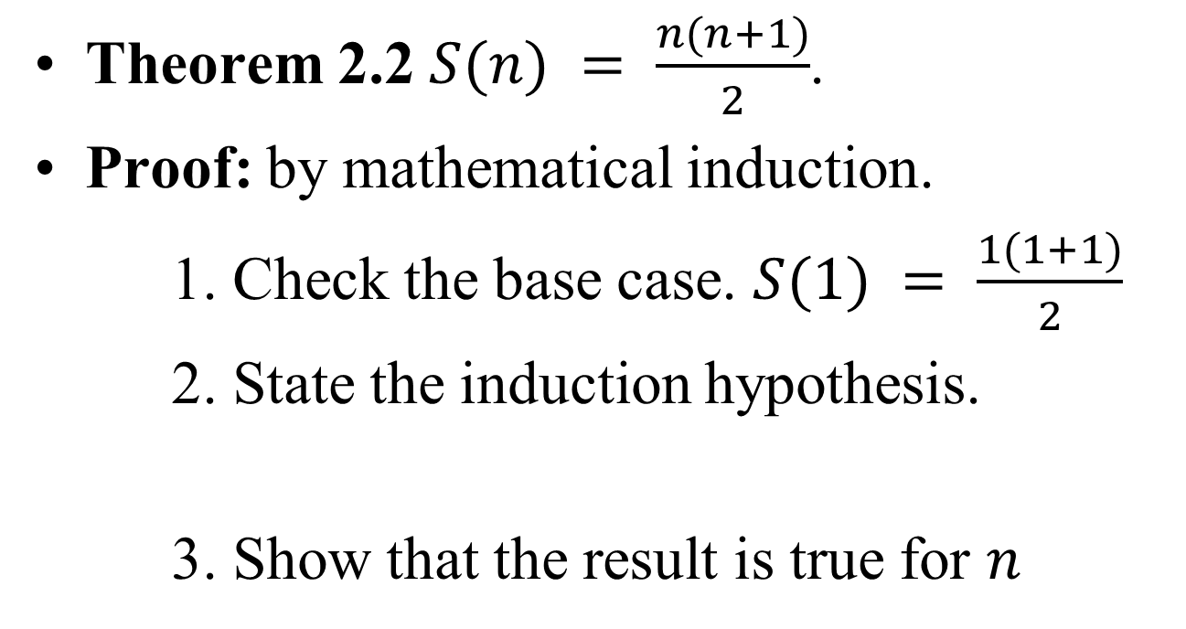
Example
Theorem 2.2 $S(n) = \frac{n(n+1)}{2}$.
Proof: by mathematical induction.
1. Check the base case. $S(1) = \frac{1(1+1)}{2}$
2. State the induction hypothesis.
3. Show that the result is true for $n$

Slide 17
Estimation Techniques
Determine the major parameters that effect the problem.
Derive an equation that relates the parameters to the problem.
Select values for the parameters, and apply the equation to yield and estimated solution.

Slide 18
Estimation Example
How many library bookcases does it take to store books totaling one million pages?
Estimate:
Pages/inch
Feet/shelf
Shelves/bookcase
500
4
5

