Slide 1
Data Structures and Algorithm Analysis
Chapter 3 Algorithm Analysis

Slide 2
Needs of Algorithm Analysis
How long will it take to process the company payroll once we complete our planned merger?
Should I buy a new payroll program from vendor X or vendor Y?
Is a program badly implemented or is it solving a hard problem?
Problem
Algorithm A
Which one is better?
Correct
Efficient
Algorithm C
Algorithm B

Slide 3
Algorithm Analysis
the difficulty of a problem
the relative efficiency of two or more approaches

Slide 4
Algorithm Efficiency
There are often many approaches (algorithms) to solve a problem. How do we choose between them?
At the heart of computer program design are two (sometimes conflicting) goals.
To design an algorithm that is easy to understand, code, debug.
To design an algorithm that makes efficient use of the computer’s resources.

Slide 5
Algorithm Efficiency
Goal (1) is the concern of Software Engineering.
Goal (2) is the concern of data structures and algorithm analysis.
When goal (2) is important, how do we measure an algorithm’s cost?

Slide 6
The problem of sorting
Input: sequence 〈a1, a2, …, an〉 of numbers.
Output: permutation 〈a'1, a'2, …, a'n〉 such that a'1 ≤ a'2 ≤ … ≤ a'n .
Example:
Input: 8 2 4 9 3 6
Output: 2 3 4 6 8 9

Slide 7
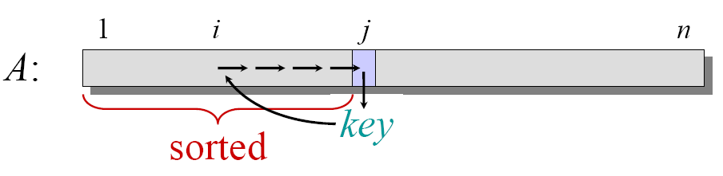
pseudocode
INSERTION-SORT (A, n) ⊳ A[1 . . n]
for j ← 2 to n
do key ← A[ j]
i ← j – 1
while i > 0 and A[i] > key
do A[i+1] ← A[i]
i ← i – 1
A[i+1] = key

Slide 8
Example of insertion sort

Slide 9
Example of insertion sort

Slide 10
Example of insertion sort

Slide 11
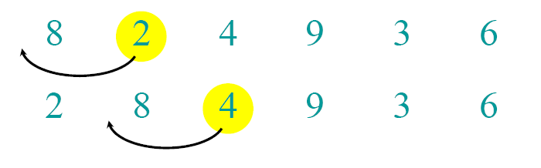
Example of insertion sort

Slide 12
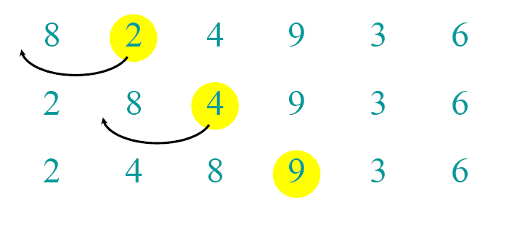
Example of insertion sort

Slide 13
Example of insertion sort

Slide 14
Example of insertion sort

Slide 15
Example of insertion sort

Slide 16
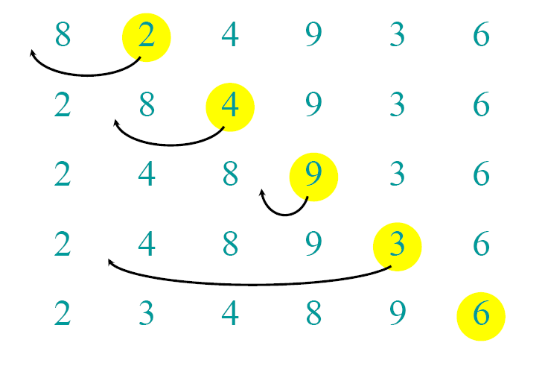
Example of insertion sort

Slide 17
Example of insertion sort

Slide 18
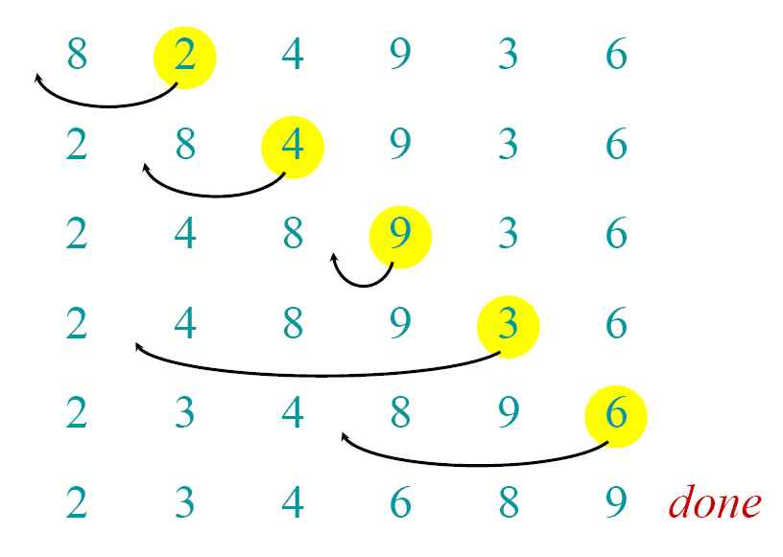
Example of insertion sort

Slide 19
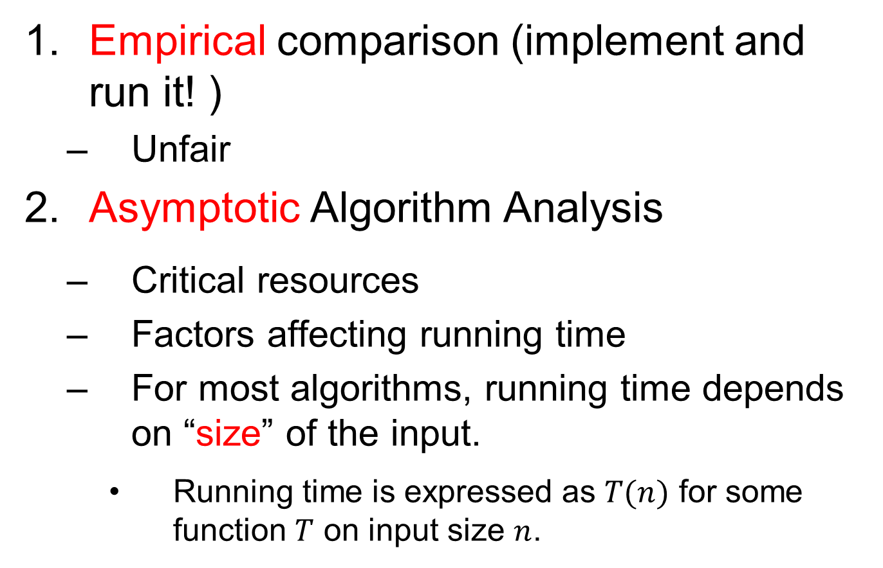
How to Measure Efficiency?
Empirical comparison (implement and run it! )
Unfair
Asymptotic Algorithm Analysis
Critical resources
Factors affecting running time
For most algorithms, running time depends on “size” of the input.
Running time is expressed as $T(n)$ for some function $T$ on input size $n$.

Slide 20
Machine-independent time
What is insertion sort’s worst-case time?
It depends on the speed of our computer:
relative speed (on the same machine),
absolute speed (on different machines).
BIG IDEA:
Ignore machine-dependent constants.
Look at growth of T(n) as n → ∞ .
“Asymptotic Analysis”

Slide 21
Examples of Growth Rate
Example 3.1.(p51)
// Find largest value
int largest(int array[], int n) {
int currlarge = 0; // Largest value seen
for (int i=1; i<n; i++) // For each val
if (array[currlarge] < array[i])
currlarge = i; // Remember pos
return currlarge; // Return largest
}
$$T(n)=cn$$

Slide 22
Examples of Growth Rate
Example 3.2: Assignment statement.
Example 3.3:
sum = 0;
for (i=1; i<=n; i++)
for (j=1; j<=n; j++)
sum++;
}
T(n)=cn²

Slide 23
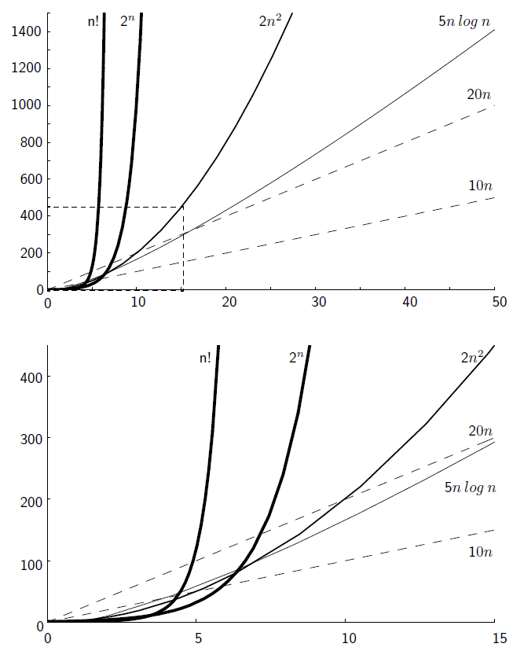
Growth Rate Graph

Slide 24
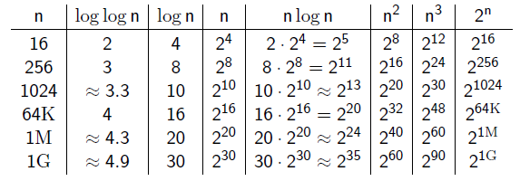
Costs for growth rates

Slide 25
Best, Worst, Average Cases
Not all inputs of a given size take the same time to run.
Sequential search for K in an array of n integers:
Begin at first element in array and look at each element in turn until K is found
Best case:
Worst case:
Average case:
Find at first position: 1 compare
Find at last position: n compares
n/2 compares

Slide 26
Which Analysis to Use?
While average time appears to be the fairest measure, it may be difficult to determine.
Assumption: equally likely at any position
When is the worst case time important?
Real time algorithms

Slide 27
Faster Computer or Algorithm?
What happens when we buy a computer 10 times faster?
T(n) | n | n’ | Change | n’/n
10n | 1,000 | 10,000 | n’ = 10n | 10
20n | 500 | 5,000 | n’ = 10n | 10
5n log n | 250 | 1,842 | √10 n < n’ < 10n | 7.37
2n² | 70 | 223 | n’ = √10n | 3.16
2^{n} | 13 | 16 | n’ = n + 3 | -----

Slide 28
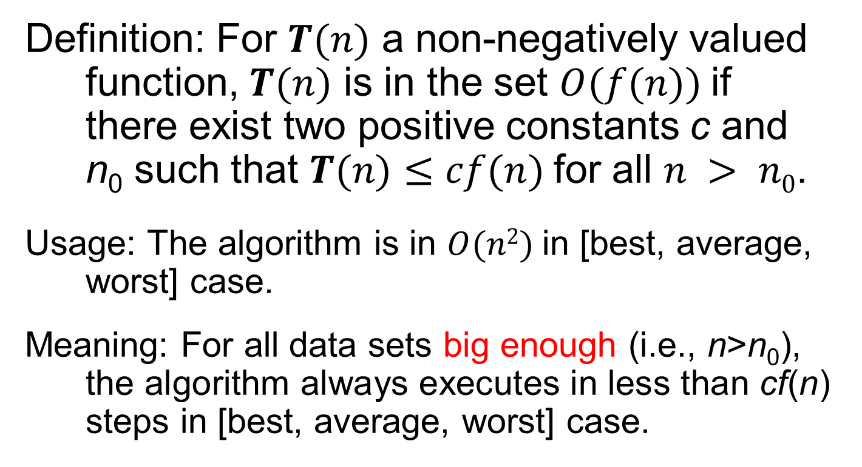
Asymptotic Analysis: Big-oh
Definition: For $T(n)$ a non-negatively valued function, $T(n)$ is in the set $O(f(n))$if there exist two positive constants c and n₀ such that $T(n)≤cf(n)$for all $n > n0$.
Usage: The algorithm is in $O(n2)$in [best, average, worst] case.
Meaning: For all data sets big enough (i.e., n>n₀), the algorithm always executes in less than cf(n) steps in [best, average, worst] case.

Slide 29
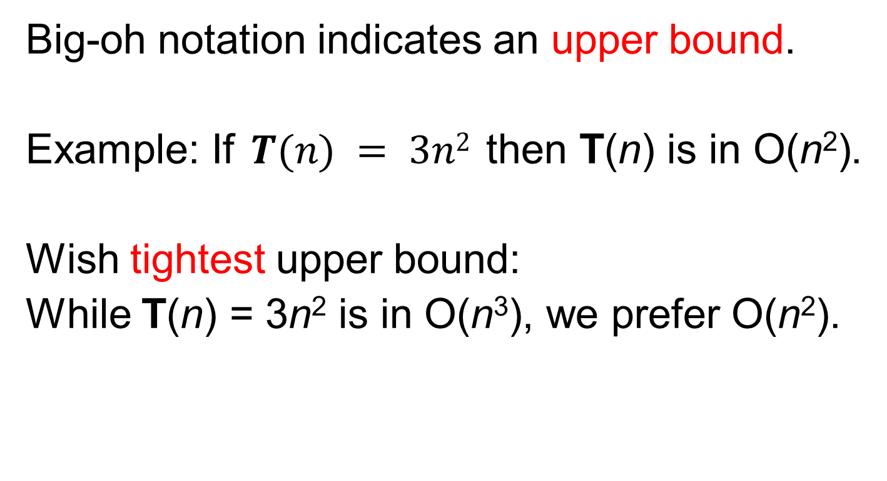
Big-oh Notation
Big-oh notation indicates an upper bound.
Example: If $T(n) = 3n2$then T(n) is in O(n²).
Wish tightest upper bound:
While T(n) = 3n² is in O(n³), we prefer O(n²).

Slide 30
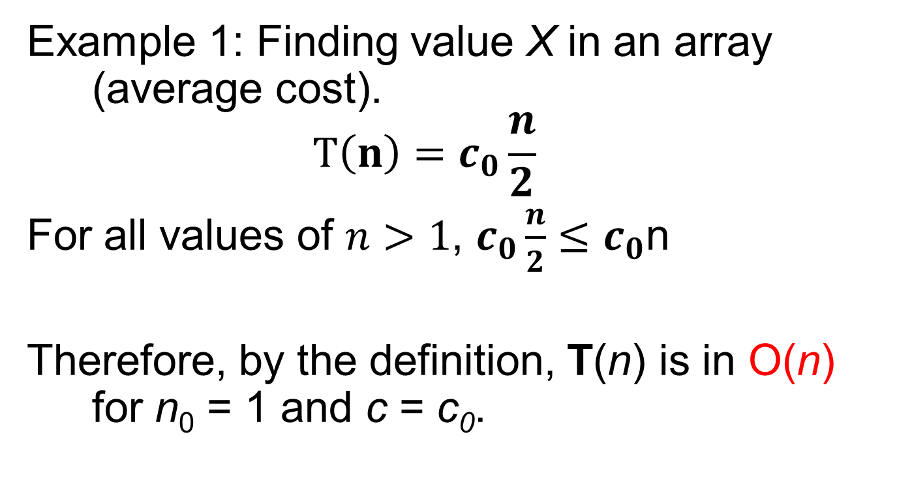
Big-Oh Examples
Example 1: Finding value X in an array (average cost).
$$T\left(n\right)=c_{0}\frac{n}{2}$$
For all values of $n>1$, $c_{0}\frac{n}{2}≤c_{0}$n
Therefore, by the definition, T(n) is in O(n) for n₀ = 1 and c = c₀.

Slide 31
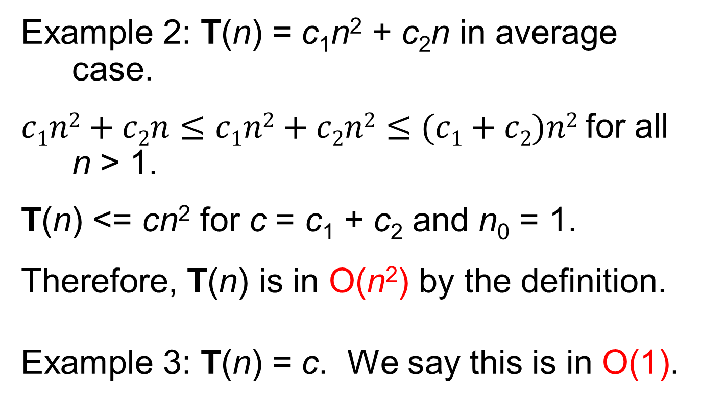
Big-Oh Examples
Example 2: T(n) = c₁n² + c₂n in average case.
$c1n2+c2n≤c1n2+c2n2≤(c1+c2)n2$for all n > 1.
T(n) <= cn² for c = c₁ + c₂ and n₀ = 1.
Therefore, T(n) is in O(n²) by the definition.
Example 3: T(n) = c. We say this is in O(1).

Slide 32
A Common Misunderstanding
“The best case for my algorithm is n=1 because that is the fastest.” WRONG!
Big-oh refers to a growth rate as n grows to ∞.
Best case is defined as which input of size n is cheapest among all inputs of size n.

Slide 33
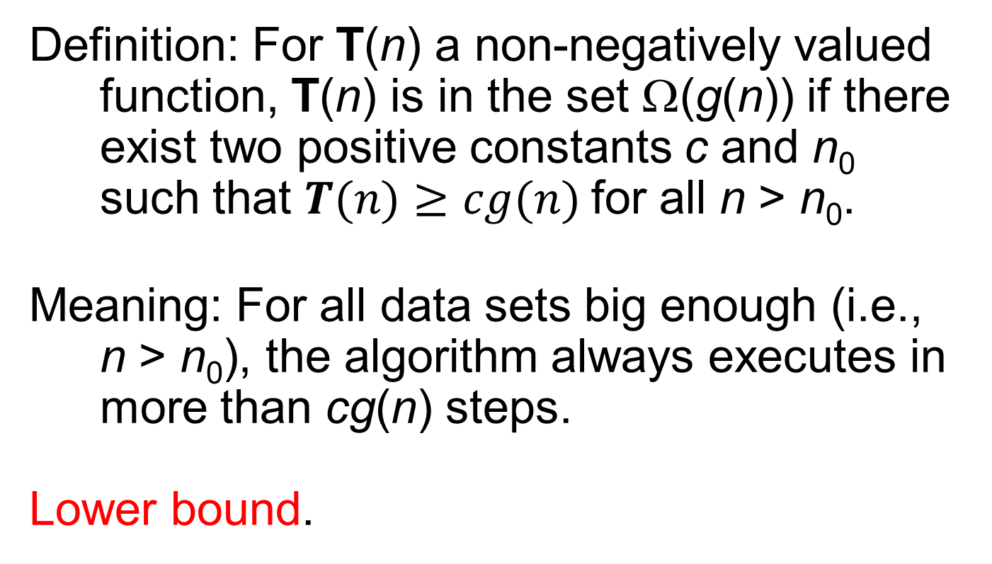
Big-Omega
Definition: For T(n) a non-negatively valued function, T(n) is in the set Ω(g(n)) if there exist two positive constants c and n₀ such that $T(n)≥cg(n)$for all n > n₀.
Meaning: For all data sets big enough (i.e., n > n₀), the algorithm always executes in more than cg(n) steps.
Lower bound.

Slide 34
Big-Omega Example
T(n) = c₁n² + c₂n.
c₁n² + c₂n >= c₁n² for all n > 1.
T(n) >= cn² for c = c₁ and n₀ = 1.
Therefore, T(n) is in Ω(n²) by the definition.
We want the greatest lower bound.

Slide 35
Theta Notation
When big-Oh and Ω meet, we indicate this by using Θ (big-Theta) notation.
Definition: An algorithm is said to be Θ(h(n)) if it is in O(h(n)) and it is in Ω(h(n)).

Slide 36
A Common Misunderstanding
Confusing worst case with upper bound.
Upper bound refers to a growth rate.
Worst case refers to the worst input from among the choices for possible inputs of a given size.

Slide 37
Simplifying Rules
If f(n) is in O(g(n)) and g(n) is in O(h(n)), then f(n) is in O(h(n)).
If f(n) is in O(kg(n)) for any constant k > 0, then f(n) is in O(g(n)).
If f₁(n) is in O(g₁(n)) and f₂(n) is in O(g₂(n)), then (f₁ + f₂)(n) is in O(max(g₁(n), g₂(n))).
If f₁(n) is in O(g₁(n)) and f₂(n) is in O(g₂(n)) then f₁(n)f₂(n) is in O(g₁(n)g₂(n)).

Slide 38
Running Time Examples (1)
Example 1: a = b;
This assignment takes constant time, so it is Θ(1).
Example 2:
sum = 0;
for (i=1; i<=n; i++)
sum += n;
T(n)=cn ⇒ cost is Θ(n)

Slide 39
Running Time Examples (2)
Example 3:
sum = 0;
for (i=1; i<=n; j++) //first loop
for (j=1; j<=i; i++) //double loop
sum++;
for (k=0; k<n; k++) //second loop
A[k] = k;
First statement is Θ(1).
Double loop is Σi= Θ(n²).
Final loop is Θ(n).
Result: Θ(n²).

Slide 40
Running Time Examples (3)
Example 4:
sum1 = 0;
for(i=1;i<=n;i++)//first double loop
for(j=1;j<=n;j++)//do n times
sum1++;
sum2 = 0;
for(i=1;i<=n;i++)//second double loop
for(j=1;j<=i;j++)//do i times
sum2++;
First loop, sum is n². Second loop, sum is (n+1)n/2.
Both are Θ(n²).

Slide 41
Running Time Examples (4)
Example 5:
sum1 = 0;
for (k=1; k<=n; k*=2)
for (j=1; j<=n; j++)
sum1++;
sum2 = 0;
for (k=1; k<=n; k*=2)
for (j=1; j<=k; j++)
sum2++;
First is = Θ(nlog n).
Second is = Θ(n).

Slide 42
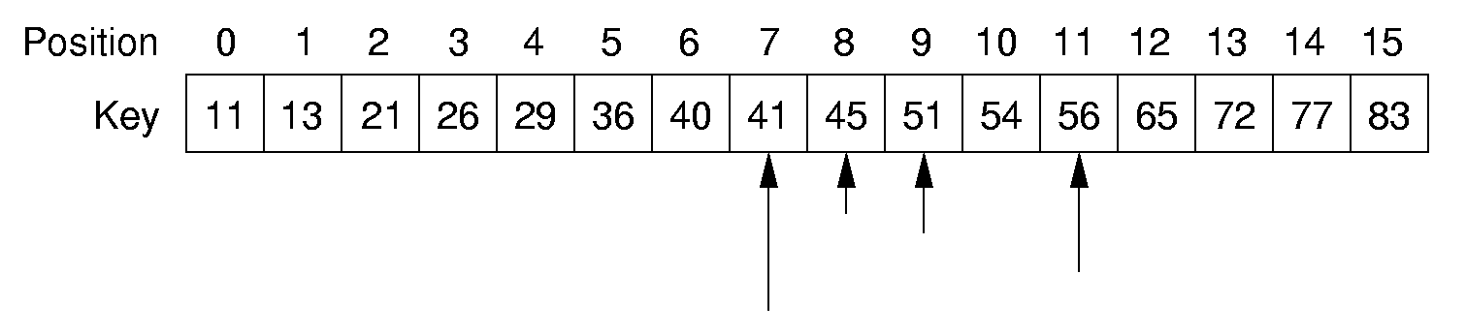
Binary Search(p69)
// Return position of element in sorted
// array of size n with value K.
int binary(int array[], int n, int K) {
int l = -1;
int r = n; // l, r are beyond array bounds
while (l+1 != r) { // Stop when l, r meet
int i = (l+r)/2; // Check middle
if (K < array[i]) r = i; // Left half
if (K == array[i]) return i; // Found it
if (K > array[i]) l = i; // Right half
}
return n; // Search value not in array
}

Slide 43
Binary Search
Analysis:
How many elements are examined in worst case?
T(n)=T(n/2)+1 (n>1) T(1)=1
T(n)=logn+1 cost is Θ(logn)
Comparison:
Sequential search
average case: T(n)=n/2 cost is Θ(n)
worst case: T(n)=n cost is Θ(n)

Slide 44
Other Control Statements
while loop: Analyze like a for loop.
if statement: Take greater complexity of then/else clauses.
switch statement: Take complexity of most expensive case.
Subroutine call: Complexity of the subroutine.

Slide 45
Analyzing Problems
Upper bound:
Upper bound of best known algorithm.
Lower bound:
Lower bound for every possible algorithm.
Common misunderstanding:
No distinction between upper/lower bound when you know the exact running time.

Slide 46
Analyzing Problems: Example
Example of imperfect knowledge: Sorting
1. Cost of I/O: Ω(n).
2. Bubble or insertion sort: O(n²).
3. better sort (Quick-sort, Merge-sort, Heap-sort, etc.): O(n log n).
4. We prove later that sorting is Ω(n log n).

Slide 47
Multiple Parameters
Compute the rank ordering for all C pixel values in a picture of P pixels.
for (i=0; i<C; i++) // Initialize count
count[i] = 0;
for (i=0; i<P; i++) // Look at all pixels
count[value(i)]++; // Increment count
sort(count); // Sort pixel counts
If we use P as the measure, then time is Θ(P log P).
More accurate is Θ(P + C log C).

Slide 48
Space Bounds
Space bounds can also be analyzed with asymptotic complexity analysis.
Time : Algorithm
Space : Data Structure

Slide 49
Space/Time Tradeoff Principle
One can often reduce time if one is willing to sacrifice space, or vice versa.
Encoding or packing information
Boolean flags
Table lookup
Factorials
Disk-based Space/Time Tradeoff Principle: The smaller you make the disk storage requirements, the faster your program will run.

Slide 50
Exercises
P79
3.2 3.3 3.16 3.17

