Slide 1
Data Structures and Algorithm Analysis
Review
Notes:
Überblick

Slide 2
Overview
Data Structures
+
Algorithm
Notes:
Überblick

Slide 3
The Need for Data Structures
Data structures organize data
⇒ more efficient programs.
More powerful computers
⇒ more complex applications.
More complex applications demand more calculations.
Complex computing tasks are unlike our everyday experience.

Slide 4
Organizing Data
Any organization for a collection of records can be searched, processed in any order, or modified.
The choice of data structure and algorithm can make the difference between a program running in a few seconds or many days.

Slide 5
Efficiency
A solution is said to be efficient if it solves the problem within its resource constraints.
  Space
  Time
The cost of a solution is the amount of resources that the solution consumes.

Slide 6
Data Structure Philosophy
Each data structure has costs and benefits.
Rarely is one data structure better than another in all situations.
A data structure requires:
  space for each data item it stores
  time to perform each basic operation
  programming effort
Data + Overhead

Slide 7
Problems
Problem:
a task to be performed.
  Best thought of as inputs and matching outputs.
  Problem definition should include constraints on the resources that may be consumed by any acceptable solution.

Slide 8
Algorithms and Programs
Algorithm: a method or a process followed to solve a problem.
  A recipe.
An algorithm takes the input to a problem (function) and transforms it to the output.
  A mapping of input to output.
A problem can have many algorithms.

Slide 9
Algorithm Properties
An algorithm possesses the following properties:
  It must be correct.
  It must be composed of a series of concrete steps.
  There can be no ambiguity as to which step will be performed next.
  It must be composed of a finite number of steps.
  It must terminate.
A computer program is an instance, or concrete representation, for an algorithm in some programming language.

Slide 10
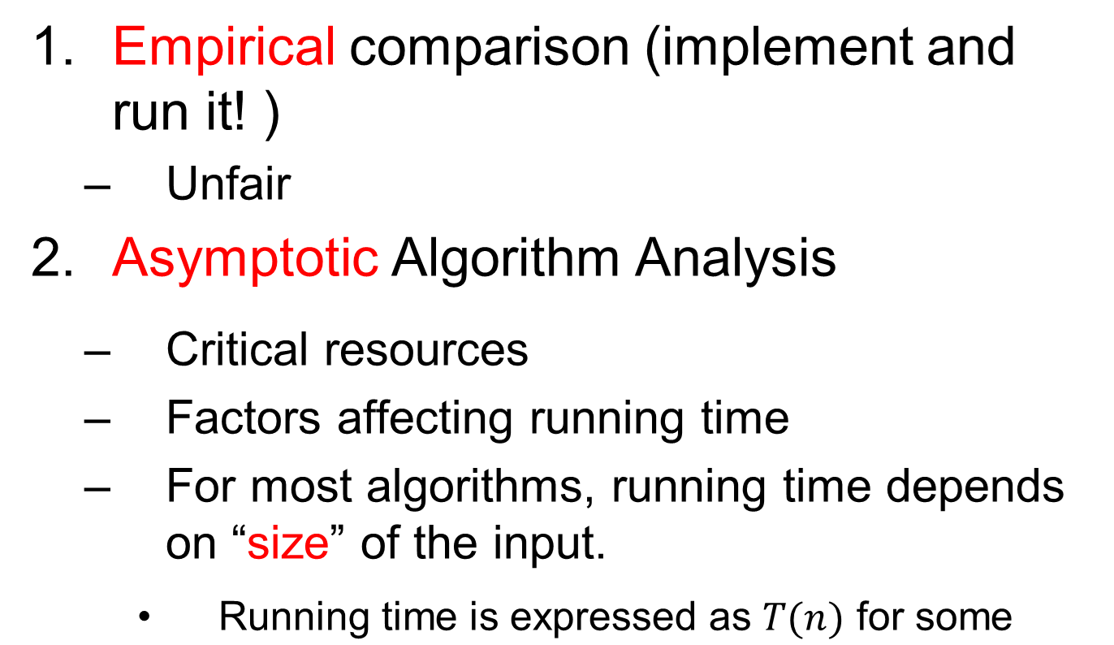
How to Measure Efficiency?

Slide 11
Machine-independent time
What is insertion sort’s worst-case time?
It depends on the speed of our computer:
  relative speed (on the same machine),
  absolute speed (on different machines).
BIG IDEA:
Ignore machine-dependent constants.
Look at growth of T(n) as n → ∞ .
“Asymptotic Analysis”
Preliminaries

Slide 12
Examples of Growth Rate
Example 3.1.(p51)
// Find largest value
int largest(int array[], int n) {
int currlarge = 0; // Largest value seen
for (int i=1; i<n; i++) // For each val
if (array[currlarge] < array[i])
currlarge = i; // Remember pos
return currlarge; // Return largest
}

Slide 13
Best, Worst, Average Cases
Not all inputs of a given size take the same time to run.
Sequential search for K in an array of n integers:
  Begin at first element in array and look at each element in turn until K is found
Best case:
Worst case:
Average case:
Find at first position: 1 compare
Find at last position: n compares
n/2 compares

Slide 14
Lists
Sorted lists have their elements positioned in ascending order of value, while unsorted lists have no necessary relationship between element values and positions.
Notation: ( a₀, a₁, …,a_{n-1} )
What operations should we implement?
Add/delete element anywhere, find, next, previous, test for empty

Slide 15
Space Comparison
DE vs. n(P + E);
E: Space for data value.
P: Space for pointer.
D: Number of elements in array.
n: Current number of elements.

Slide 16
Comparison of Implementations
Array-Based Lists:
Insertion and deletion are Θ(n).
Prev and direct access are Θ(1).
Array must be allocated in advance.
No overhead if all array positions are full.
Linked Lists:
Insertion and deletion are Θ(1).
Prev and direct access are Θ(n).
Space grows with number of elements.
Every element requires overhead.

Slide 17
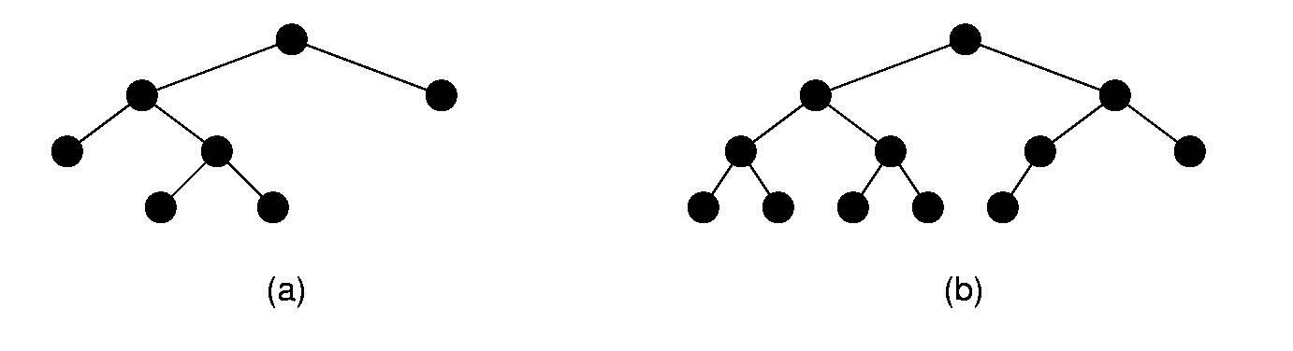
Full and Complete Binary Trees
Full binary tree: Each node is either a leaf or internal node with exactly two non-empty children.
Complete binary tree: If the height of the tree is d, then all levels except possibly level d-1 are completely full. The bottom level has all nodes to the left side.

Slide 18
Traversals (2)
Preorder traversal:
Visit each node before visiting its children.
Postorder traversal:
Visit each node after visiting its children.
Inorder traversal:
Visit the left subtree, then the node, then the right subtree.

Slide 19
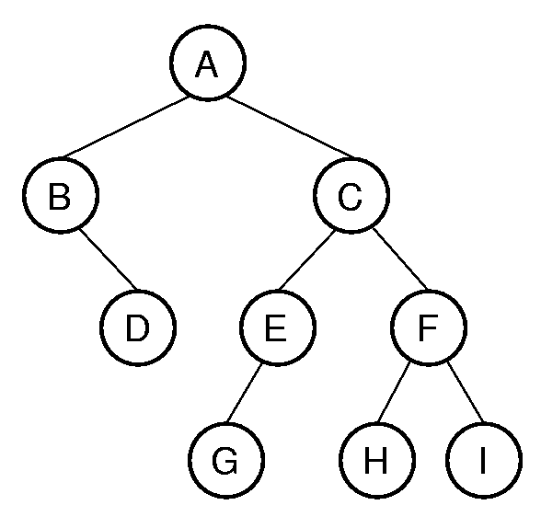
Traversals (3)
Example:
Preorder traversal:
A B D C E G F H I
Postorder traversal:
D B G E H I F C A
Inorder traversal:
B D A G E C H F I
Exercise:
Given two traversals ,draw the tree
(every couple can result to an unique bt. EX: pre GHJI& in IHGJ):
Postorder traversal: D E C B H G F A
Inorder traversal: B D C E A F H G

Slide 20
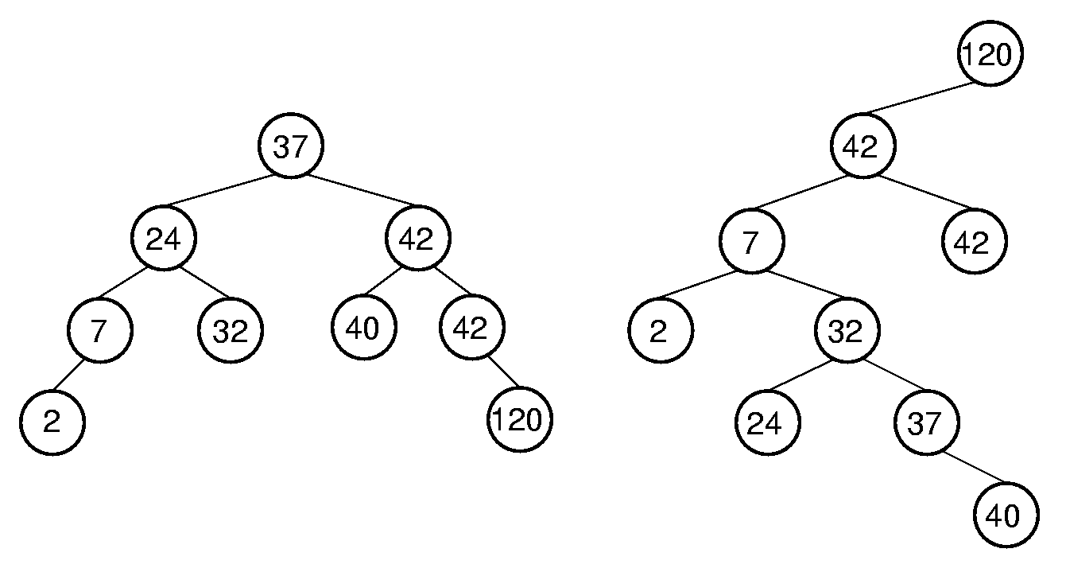
Binary Search Trees
BST Property: All elements stored in the left subtree of a node with value K have values < K. All elements stored in the right subtree of a node with value K have values >= K.

Slide 21
Heaps
Heap: Complete binary tree with the heap property
Min-heap: All values less than child values.
Max-heap: All values greater than child values.
The values are partially ordered（r,antis,t）.
Heap representation: Normally the array-based complete binary tree representation.

Slide 22
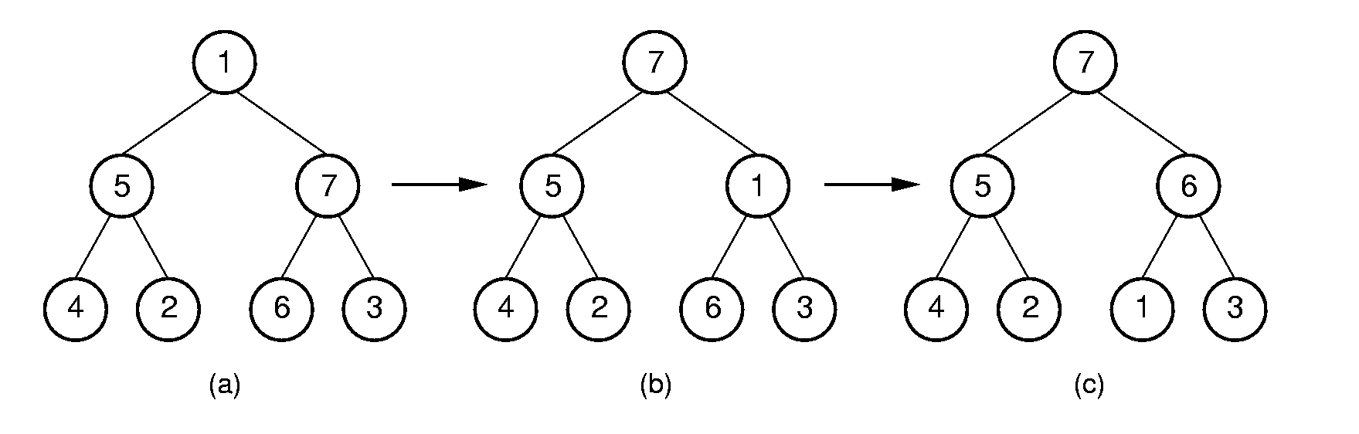
Siftdown (1)

Slide 23
Remove Max Value
template <class Elem, class Comp>
bool maxheap<Elem, Comp>::
removemax(Elem& it) {
if (n == 0) return false; // Heap is empty
swap(Heap, 0, --n); // Swap max with end
if (n != 0) siftdown(0);
it = Heap[n]; // Return max value
return true;
}
θ(log n)

Slide 24
Huffman Coding Trees
ASCII codes: 8 bits per character.
Fixed-length coding.
Can take advantage of relative frequency of letters to save space.
Variable-length coding
Build the tree with minimum external path weight.
Z | K | F | C | U | D | L | E
2 | 7 | 24 | 32 | 37 | 42 | 42 | 120

Slide 25
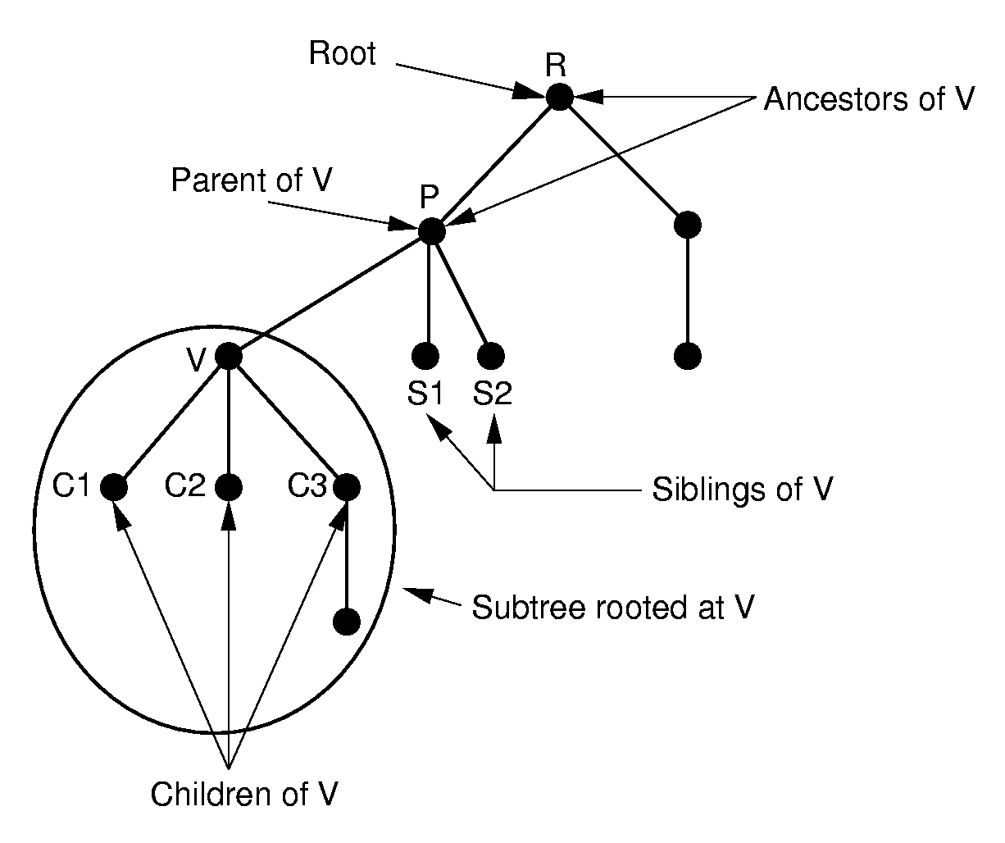
General Trees

Slide 26
Sorting
Given a sequence of records R₁ , R₂ , … , R_{n} with
key values k₁ , k₂ ,… , k_{n} , respectively, arrange the
records into any orders such that records
R_{s1},R_{s2},…,R_{sn} have keys obeying the property
k_{s1} ≤ k_{s2} ≤ …≤ k_{sn}.
Each record contains a field called the key.
Linear order: comparison.
Measures of cost:
Comparisons
Swaps

Slide 27
Summary
 | Insertion | Bubble | Selection
Comparisons:
Best Case | Θ(n) | Θ(n²) | Θ(n²)
Average Case | Θ(n²) | Θ(n²) | Θ(n²)
Worst Case | Θ(n²) | Θ(n²) | Θ(n²)
Swaps
Best Case | 0 | 0 | Θ(n)
Average Case | Θ(n²) | Θ(n²) | Θ(n)
Worst Case | Θ(n²) | Θ(n²) | Θ(n)

Slide 28
Exchange Sorting
All of the sorts so far rely on exchanges of adjacent records.
What is the average number of exchanges required?
  There are n! permutations
  Consider permuation X and its reverse, X’
  Together, every pair requires n(n-1)/2 exchanges.
Shell, Merge, Quick, Heap, Bin, Radix.

Slide 29
Golden Rule of File Processing
Minimize the number of disk accesses!
  1. Arrange information so that you get what you want with few disk accesses.
  2. Arrange information to minimize future disk accesses.
An organization for data on disk is often called a file structure.
Disk-based space/time tradeoff: Compress information to save processing time by reducing disk accesses.

Slide 30
Disk Spec Example
16.8 GB disk on 10 platters = 1.68GB/platter
13,085 tracks/platter
256 sectors/track
512 bytes/sector, 8 sectors/cluster
4KB/cluster, 32 clusters/track.
Track-to-track seek time: 2.2 ms
Average seek time: 9.5ms
Interleaving factor of 3.
5400RPM

Slide 31
Disk Access Cost Example (1)
Read a 1MB file divided into 2048 records of 512 bytes (1 sector) each.
Assume all records are on 8 contiguous tracks.
First track: 9.5 + 11.1/2 + 11.1 = 26.2 ms
Remaining 7 tracks: 2.2 + 11.1/2 + 11.1 = 18.9 ms.
Total: 26.2 + 7 * 18.9 = 158.5ms （335.7ms）

Slide 32
Disk Access Cost Example (2)
Read a 1MB file divided into 2048 records of 512 bytes (1 sector) each.
Assume all file clusters are randomly spread across the disk.
256 clusters. Cluster read time is
(3 x 8)/256 of a rotation for about 1 ms.
256(9.5 + 11.1/2 + 11.1 x ( 8/256 )) is about 3942 ms.

Slide 33
Breaking a File into Runs
General approach:
  Read as much of the file into memory as possible.
  Perform an in-memory sort.
  Output this group of records as a single run.

Slide 34
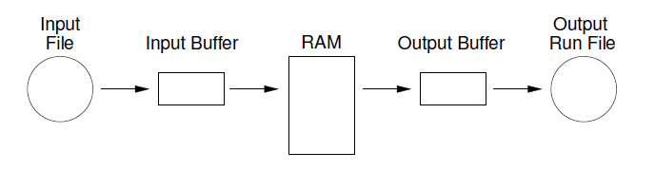
Replacement Selection (1)
Break available memory into an array for the heap, an input buffer, and an output buffer. Fill the array from disk.

Slide 35
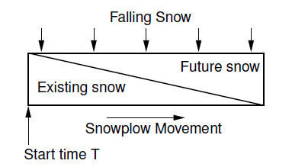
snowplow argument
Size of the run:
  Best case: the entire file
  Worst case: M
  Average case: 2M

Slide 36
Limits to Multi-way Merge (1)
Assume working memory is b blocks in size.
How many runs can be processed at one time?
The runs are 2b blocks long (on average).
How big a file can be merged in one pass?

Slide 37
Limits to Multi-way Merge (2)
Larger files will need more passes -- but the run size grows quickly!
In k merge passes, we process 2b^{(k+1)} blocks.
Example: 0.5MB working memory, 4KB blocks, yield 128 blocks for working memory. Average run size is 1MB, so 128MB can be sorted in one pass on average. 16GB in two merge passes.

Slide 38
Approaches to Search
1. Sequential and list methods (lists, tables, arrays).
2. Direct access by key value (hashing)
3. Tree indexing methods.

Slide 39
Hashing (2)
For any value K in the key range and some hash function h, h(K) = i, 0 <= i < M, such that key (HT[i]) = K.
Hashing is appropriate only for sets (no duplicates).
Good for both in-memory and disk-based applications.
Hashing is not good for range queries.

Slide 40
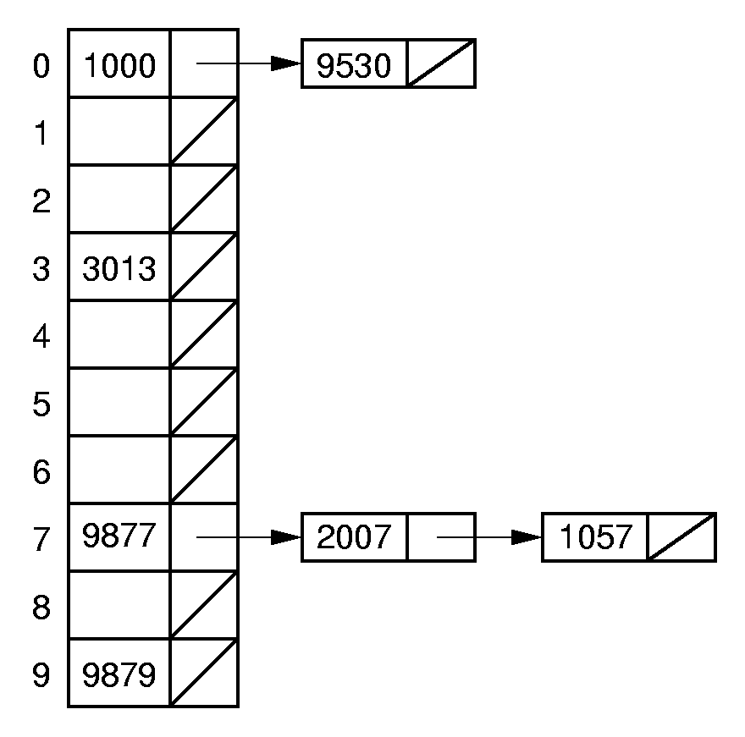
Open Hashing
What to do when collisions occur?
Open hashing treats each hash table slot as a bin.

Slide 41
Closed Hashing
Closed hashing stores all records directly in the hash table.
Each record i has a home position h(k_{i}).
If another record occupies i’s home position, then another slot must be found to store i.
The new slot is found by a collision resolution policy.
Search must follow the same policy to find records not in their home slots.

Slide 42
Indexing
Goals:
  Store large files
  Support multiple search keys
  Support efficient insert, delete, and range queries

Slide 43
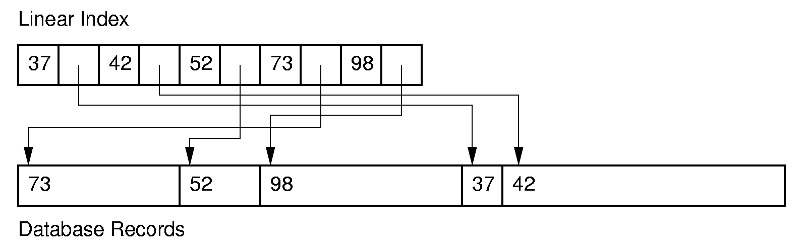
Linear Indexing (1)
Linear index: Index file organized as a simple sequence of key/record pointer pairs with key values are in sorted order.
Linear indexing is good for searching variable-length records.

Slide 44
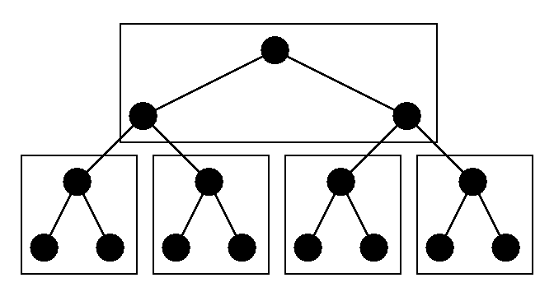
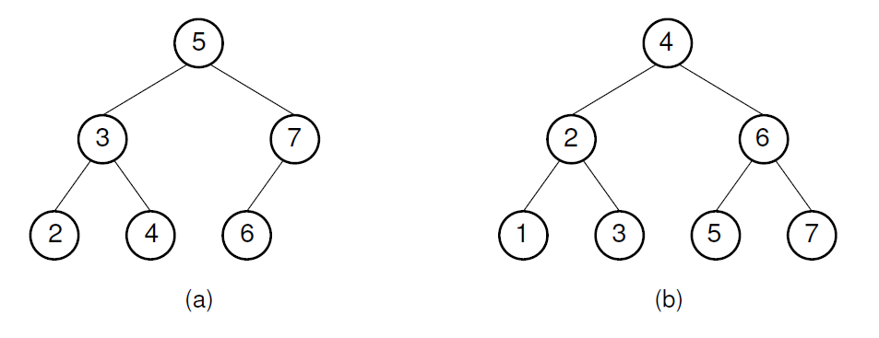
Tree Indexing (2)
Difficulties when storing tree index on disk:
  Tree must be balanced.
  Each path from root to leaf should cover few disk pages.

Slide 45
2-3 Tree (1)
A 2-3 Tree has the following properties:
  A node contains one or two keys
  Every internal node has either two children (if it contains one key) or three children (if it contains two keys).
  All leaves are at the same level in the tree, so the tree is always height balanced.
The 2-3 Tree has a search tree property analogous to the BST.

Slide 46
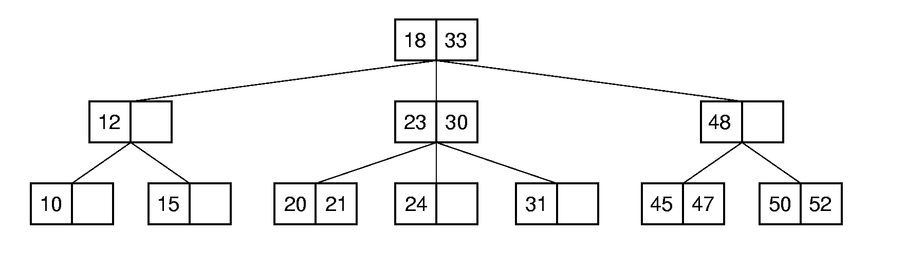
2-3 Tree (2)
The advantage of the 2-3 Tree over the BST is that it can be updated at low cost.

Slide 47
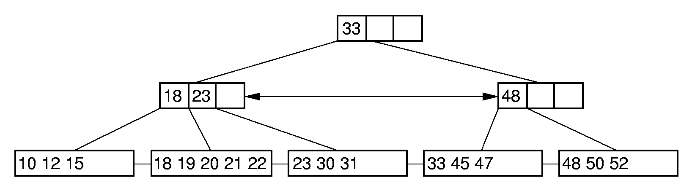
B⁺-Tree Example

Slide 48
Graphs (1)
A graph G = (V, E) consists of a set of vertices V, and a set of edges E, such that each edge in E is a connection between a pair of vertices in V.
The number of vertices is written |V|, and the number edges is written |E|.

Slide 49
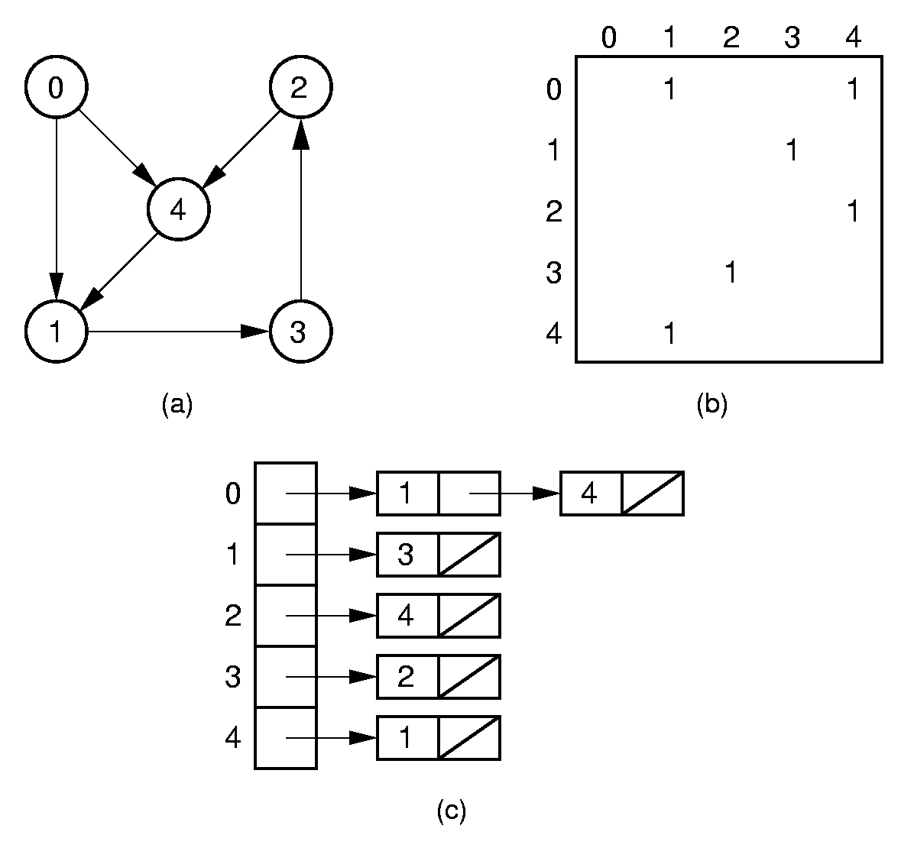
Directed Representation

Slide 50
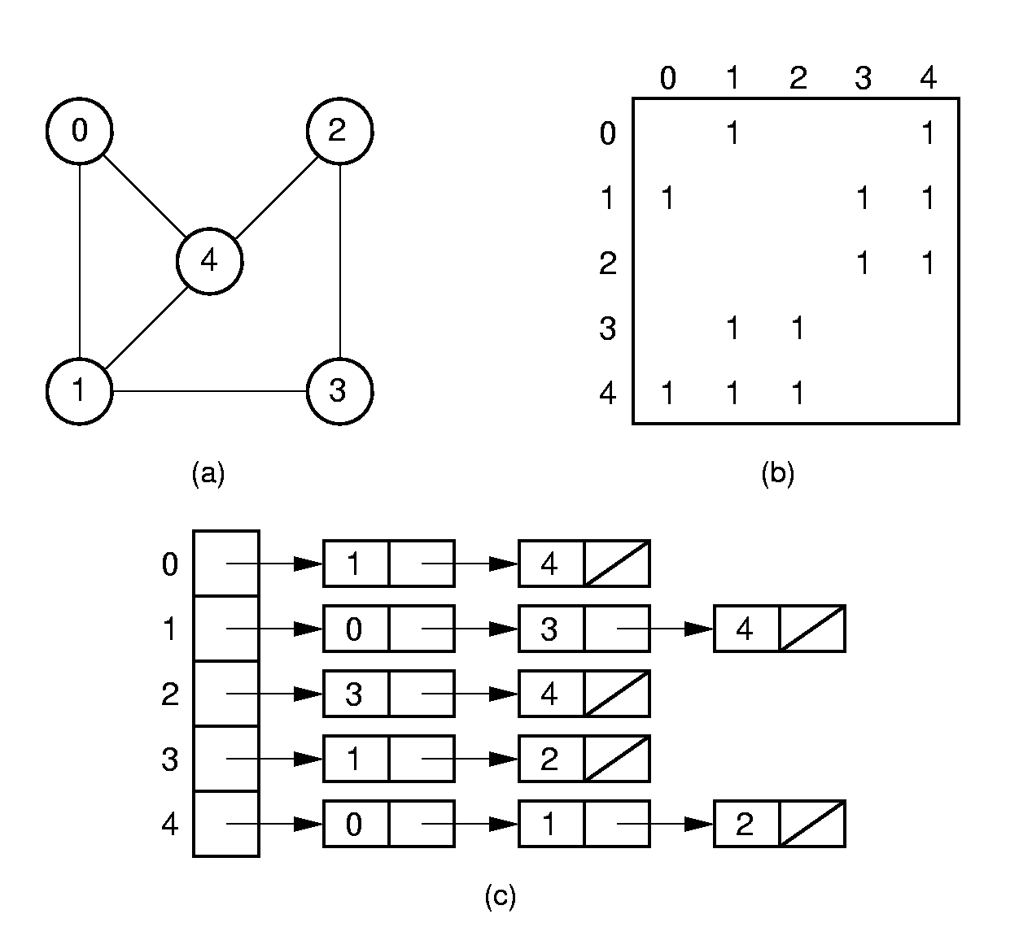
Undirected Representation

Slide 51
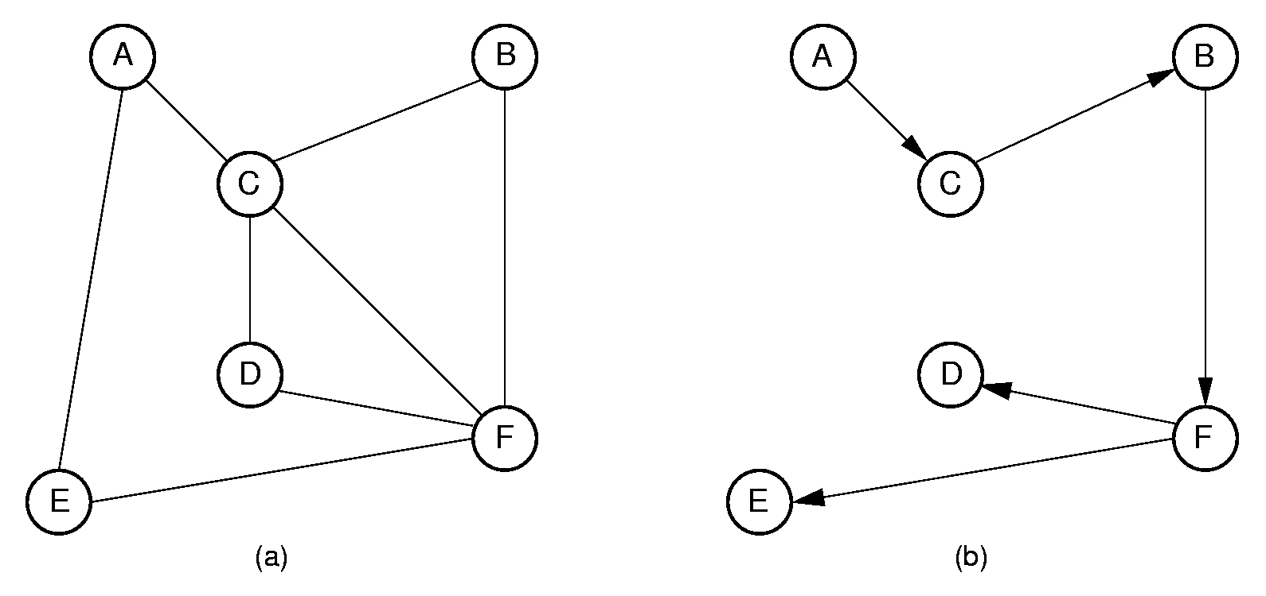
Depth First Search (2)
Order that nodes are processed: ACBFDE

Slide 52
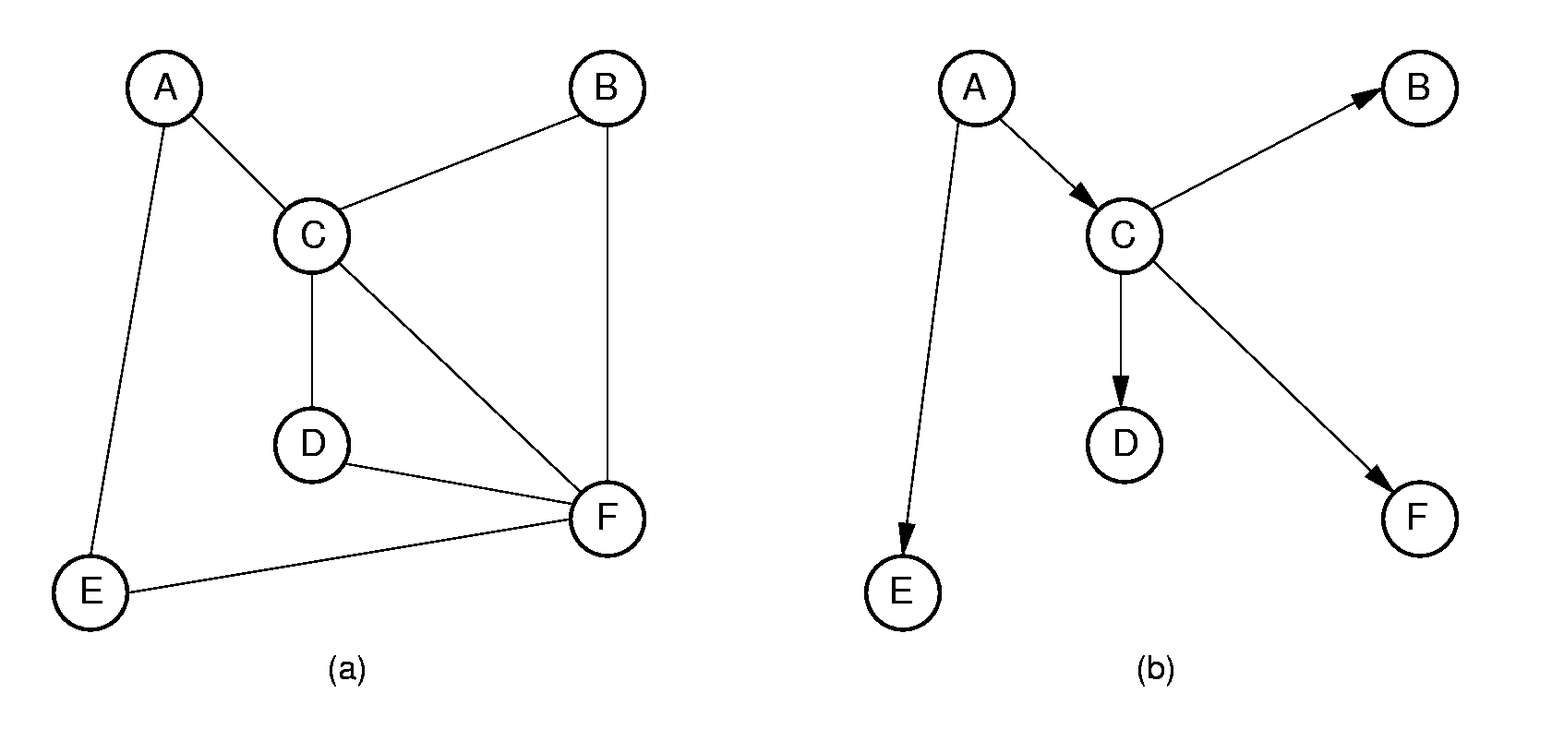
Breadth First Search (2)
Order that nodes are processed: ACEBDF

Slide 53
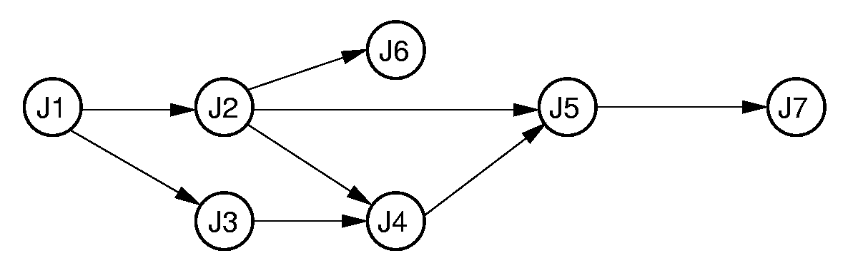
Topological Sort (3)
Prints in reverse order:
J7,J5,J4,J6,J2,J3,J1

Slide 54
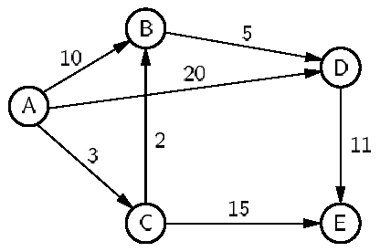
Dijkstra’s Algorithm Example
 | A | B | C | D | E
Initial | 0 | ∞ | ∞ | ∞ | ∞
Process A | 0 | 10 | 3 | 20 | ∞
Process C | 0 | 5 | 3 | 20 | 18
Process B | 0 | 5 | 3 | 10 | 18
Process D | 0 | 5 | 3 | 10 | 18
Process E | 0 | 5 | 3 | 10 | 18

Slide 55
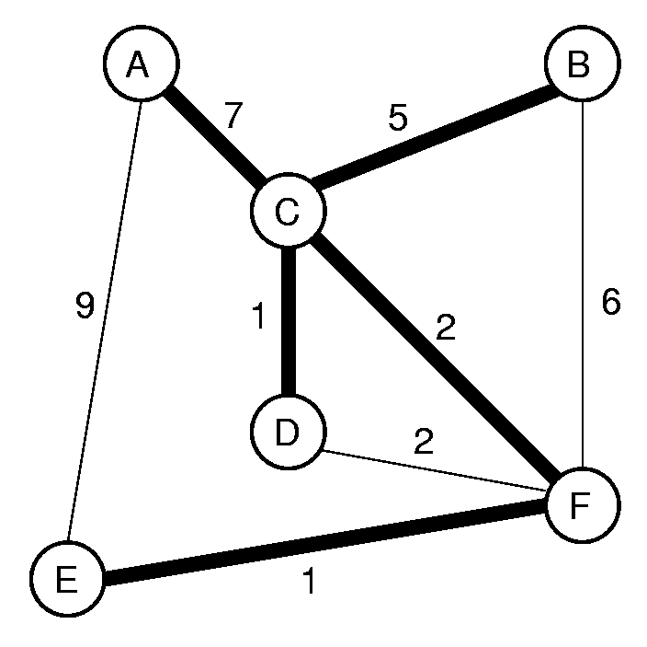
Prim

Slide 56
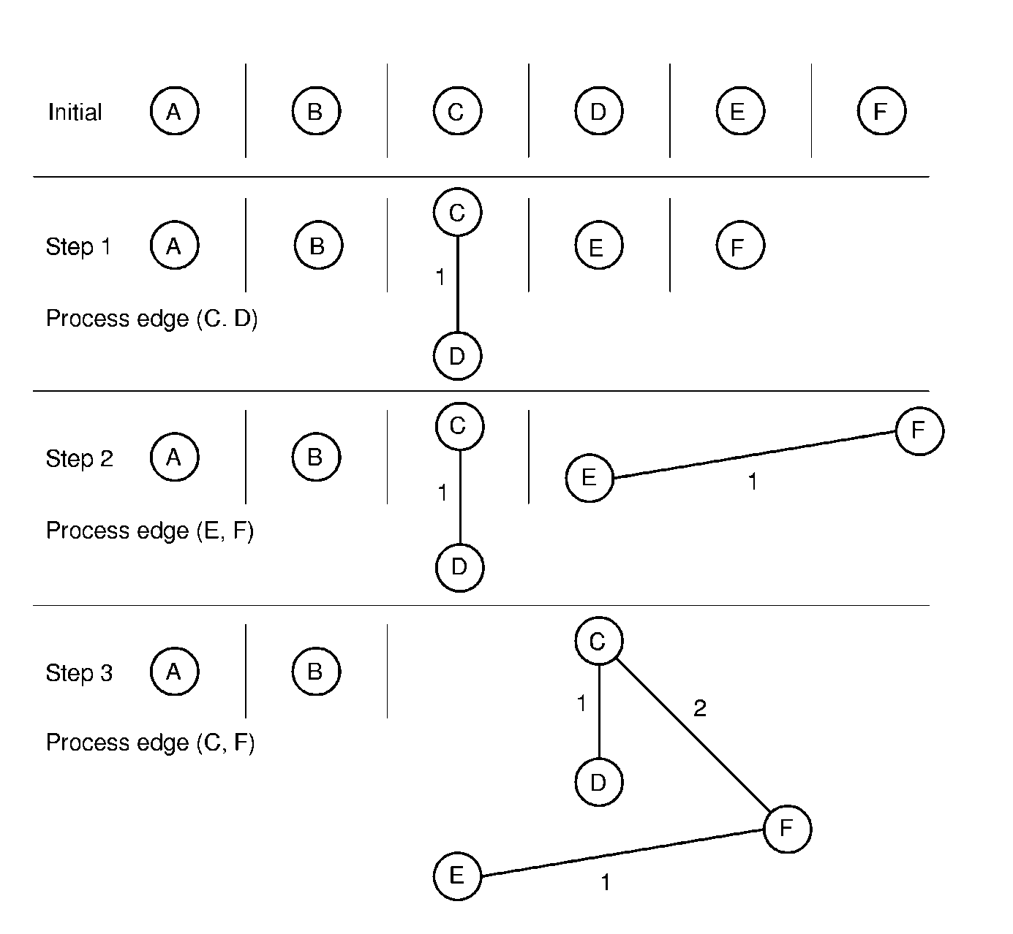
Kruskal’s MST Algorithm (2)

