Slide 1
Computer Organization & Architecture
Chapter 9 – Arithmetic
Junying Chen 陈俊颖

Slide 2
Content of this lecture
1.4 Integer Representation
9.1 Addition and Subtraction of Signed Numbers
9.2 Design of Fast Adders
9.3 Multiplication of Unsigned Numbers
9.4 Multiplication of Signed Numbers
9.6 Integer Division
9.7 Floating-point Numbers and Operation
9.10 Solved Problems
Summary

Slide 3
Integer Representation (1)
Unsigned Representation
  Implies that the representation does not have a separate bit to represent the sign bit of the number.
  Note that numbers can be either positive or negative in some unsigned representation.
Unsigned Integer
  Unsigned Non-Negative Representation
  Unsigned Two’s Complement Representation

Slide 4
Integer Representation (2)
Unsigned Non-Negative Representation
  Treats every number as either zero or a positive value.
  This representation can only represent non-negative numbers.
  A n-bit number can have a value ranging from 0 to 2^{n}-1.
  Example: An 8-bit word could be used to represent the numbers from 0 to 255
    10000000 = 128
    11111111 = 255

Slide 5
Integer Representation (3)
Unsigned Two’s Complement Representation
  This representation can represent both positive and negative numbers.
  A positive number (or zero) is represented exactly the same as in non-negative representation.
  A negative number is represented as the bitwise complement of its absolute value +1.

Slide 6
Integer Representation (4)
Unsigned Two’s Complement Representation (ctd.)
  Bitwise Complement (One’s Complement)
    Take the Boolean complement of each bit of the number. That is , set each 1 to 0 and each 0 to 1.
  Example –5 10
    5 10= 0101 2
    Bitwise complement of 0101 is 1010
    1010 + 1 = 1011

Slide 7
Integer Representation (5)
Unsigned Two’s Complement Representation (ctd.)
  Positive numbers (and zero) have a 0 as the leading bit and negative numbers have a 1 as the most significant bit
  A n-bit number can have a value ranging from -2^{n} ^{–1} to 2^{n –1} – 1.

Slide 8
Integer Representation (6)
Signed Integer
  Sign and Magnitude Representation
  Signed Two’s Complement Representation
  Signed One’s Complement Representation
Sign and Magnitude Representation
  Rule
    The sign part is a 1-bit value that is 0 for positive numbers, and 1 for negative numbers.
    The magnitude part is an n-bit value that holds the absolute value of the number in the same format of unsigned non-negative numbers.

Slide 9
Integer Representation (7)
Sign and Magnitude Representation (ctd.)
  B = b_{n}…b₁b₀
    b_{n} = 0, B is a positive number.
    b_{n}= 1, B is a negative number.
  Example
    +18 10 = 00010010
    －18 10 = 10010010
    + 0 10 = 00000000
    － 0 10 = 10000000
Sign
Magnitude
b_{n}
…
b₁
b₀

Slide 10
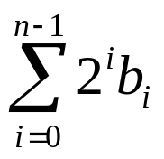
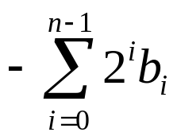
Integer Representation (8)
Signed and Magnitude Representation (ctd.)
  In general, if an (n+1)-bit sequence of binary digits bnbn-1…b1b0 is interpreted as an signed integer B, its value is
    －(2^{n}－1)≤ V (B) ≤ 2^{n}－1
if b_{n} = 0
V (B) =
if b_{n} = 1

Slide 11
Integer Representation (9)
Sign and Magnitude Representation (ctd.)
  Drawbacks
    Addition and subtraction require a consideration of both the signs of the numbers and their relative magnitudes to carry out the required operation.
    There are two representations of 0 .
      ＋0 = 00000000
      －0 = 10000000

Slide 12
Integer Representation (10)
Signed Two’s Complement Representation
  Rule
    The sign part is a 1-bit value that is 0 for positive numbers, and 1 for negative numbers.
    The magnitude part is an n-bit value that is equivalent to a unsigned two’s complement number.
  Example
    +18 = 00010010
    －18 = 11101110
    + 0 = 00000000
    －0 = 00000000

Slide 13

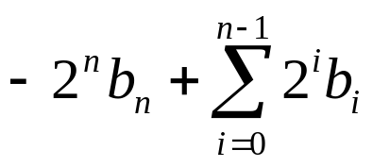
Integer Representation (11)
Signed Two’s Complement Representation (ctd.)
  The general case B= bnbn-1…b1b0
    －2^{n}≤ V (B) ≤ 2^{n}－1
B≥ 0
V (B) =
B < 0
=
(for both positive and negative numbers)

Slide 14
Integer Representation (12)
Signed One’s Complement Representation
  Rule
    The sign part is a 1-bit value that is 0 for positive numbers, and 1 for negative numbers.
    The magnitude part is an n-bit value that complementing each bit of the absolute of the integer.
  Example
    +18 = 00010010
    －18 = 11101101
    + 0 = 00000000
    －0 = 11111111

Slide 15
11…1
10…01
10…0
00…0
00…01
01…1
-(2^{n}-1)
-1
0
+1
+(2^{n}-1)
sign and magnitude
10…0
11…10
11…1
00…0
00…01
01…1
-(2^{n}-1)
-1
0
+1
+(2^{n}-1)
signed one’s complement
10…0
10…01
11…1
00…0
00…01
01…1
-2^{n}
-(2^{n}-1)
-1
0
+1
+(2^{n}-1)
signed two’s complement

Slide 16
Integer Representation (13)
Conclusions
  In all three systems, the leftmost bit is 0 for positive numbers and 1 for negative numbers.
  Positive values have identical representations in all systems, but negative values have different representations.
  The 2’s-complement of a number is obtained by adding 1 to the 1’s-complement of that number.
  The Sign and Magnitude system is the simplest representation, but it is also the most awkward for addition and subtraction operations.
  The 2’s-complement system is the most efficient method for performing addition and subtraction operations.

Slide 17
Integer Representation (14)
Converting between Different Bit Lengths
  Sign and Magnitude Numbers
    Move the sign bit to the new left-most position and fill in with zeros.
    Example
      ＋18 = 00010010 ( 8 bits)
      ＋18 = 0000000000010010 (16 bits)
      －18 = 10010010 ( 8 bits)
      －18 = 1000000000010010 (16 bits)

Slide 18
Integer Representation (15)
Converting between Different Bit Lengths (ctd.)
  Signed Two’s Complement Numbers
    Example
      ＋18 = 00010010 ( 8 bits)
      ＋18 = 0000000000010010 (16 bits)
      －18 = 11101110 ( 8 bits)
      －32568 = 1000000001101110 (16 bits)
    Sign Extension
      Move the sign bit to the new left-most position and fill in with copies of the sign bit. For positive numbers, fill in with zeros, and for negative numbers, fill in with ones.

Slide 19
Integer Representation (16)
Converting between Different Bit Lengths (ctd.)
  Example
      －18 = 11101110 ( 8 bits)
      －18 = 1111111111101110 (16 bits)

Slide 20
Addition and Subtraction of Signed Numbers (1)
Addition of 1-bit Positive Numbers
0
+ 0
1
+ 0
0
+ 1
1
+ 1
0
1
1
1 0
Carry-out

Slide 21
Addition and Subtraction of Signed Numbers (2)
Addition of n-bit Signed Numbers
  Rule1 (In Signed Two’s Complement Form)
    To add two numbers, add their n-bit representations, treating the sign bit as the most significant bit (MSB), ignoring the carry-out signal from the MSB position.
    The sum will be algebraically correct value in the two’s-complement representation as long as the answer is in the range －2^{n –1} through +2^{n –1}－1.

Slide 22
Addition and Subtraction of Signed Numbers (3)
Addition of n-bit Signed Numbers (ctd.)
  Example
    Textbook P14(a)-(d)
    (+5) + (+4)
    (-6) + (-7)
0 1 0 1
+0 1 0 0
1 0 0 1
overflow
1 0 0 1
+1 0 1 0
1 0 0 1 1
overflow

Slide 23
Addition and Subtraction of Signed Numbers (4)
Addition of n-bit Signed Numbers (ctd.)
  Arithmetic Overflow
    The result of an arithmetic operation is outside the representable range.
    If two numbers are added, and they have the same sign, then overflow occurs if and only if the result has the opposite sign to both summands.
    The carry-out signal from the sign-bit position is not a sufficient indicator of overflow when adding signed numbers. Overflow can occur whether or not there is a carry-out.

Slide 24
Addition and Subtraction of Signed Numbers (5)
Subtraction of n-bit Signed Numbers
  Rule2 (In Signed Two’s Complement Form)
    To subtract two numbers X and Y, that is, to perform X－Y, form the 2’s-complement of Y and then add it to X, as in rule1.
    The result will be the algebraically correct value in the two’s-complement representation system if the answer is in the range －2^{n-1} through +2^{n –1}－1.
    Essence of Rule2 X－Y= X + (－Y)

Slide 25
Addition and Subtraction of Signed Numbers (6)
Subtraction of n-bit Signed Numbers (ctd.)
  Twos Complement Operation (Negation)
    Take the boolean complement of each bit of the integer (including the sign bit). That is ,set each 1 to 0 and each 0 to 1.
    Treating the result as an unsigned binary integer, add 1.
  Example
    Textbook P14 (e)-(j)

Slide 26
Addition and Subtraction of Signed Numbers (7)
Subtraction of n-bit Signed Numbers (ctd.)
  Example (ctd.)
    M = 7, S = -7 , M – S = ?
      M = 7 = 0111
      S = -7 = 1001
      - S = 0111
0 1 1 1
+0 1 1 1
1 1 1 0
overflow

Slide 27
Addition and Subtraction of Signed Numbers (8)
Subtraction of n-bit Signed Numbers (ctd.)
  Conclusions
    The examples in Figure 1.6 (P14) show that two, n-bit, signed numbers can be added using n-bit binary addition, treating the sign bit the same as the other bit.
    In other words, a logic circuit that is designed to add unsigned binary numbers can also be used to add signed numbers in 2’s-complement.

Slide 28
Addition and Subtraction of Signed Numbers (9)
1-bit Full Adder
  Example: X= 7, Y=6, X+Y = ?
X
+ Y
7
+ 6
0 1 1 1
+ 0 0 1 1 1 1 0 0 0
1 1 0 1
=
=
Z
13

Slide 29
Addition and Subtraction of Signed Numbers (10)
1-bit Full Adder
  Full Adder
    A full adder circuit takes three bits of input, and produces a two-bit output consisting of a sum and a carry out.
y_{i}
x_{i}
x_{i}
Full Adder
(FA)
c_{i+1}
y_{i}
c_{i}
c_{i+1}
c_{i}
s_{i}
s_{i}

Slide 30
Addition and Subtraction of Signed Numbers (11)
1-bit Full Adder (ctd.)
  Logic Truth Table
xi | yi | ci | si | ci+1
0 | 0 | 0 | 0 | 0
0 | 0 | 1 | 1 | 0
0 | 1 | 0 | 1 | 0
0 | 1 | 1 | 0 | 1
1 | 0 | 0 | 1 | 0
1 | 0 | 1 | 0 | 1
1 | 1 | 0 | 0 | 1
1 | 1 | 1 | 1 | 1

Slide 31

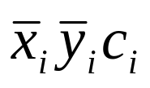
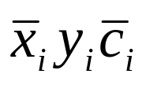
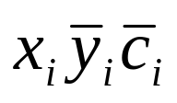

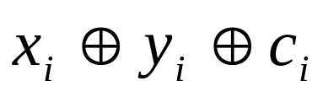
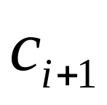



Addition and Subtraction of Signed Numbers (12)
1-bit Full Adder (ctd.)
  Logic Expressions
=
+
+
+
=
=
+
+
y
x
i
i
c
i
y
s
x
i
i
i
c
c
i
+
1
c
i
i
x
i
y
i

Slide 32
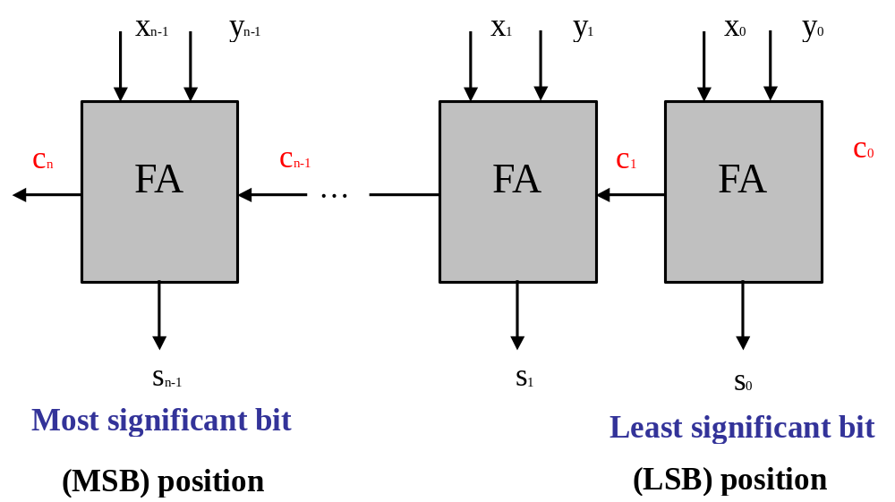
Addition and Subtraction of Signed Numbers (13)
n-bit Ripple-Carry Adder

Slide 33
Addition and Subtraction of Signed Numbers (14)
n-bit Ripple-Carry Adder (ctd.)
  Overflow Detect
xn-1 | yn-1 | sn-1 | Overflow
0 | 0 | 0 | 0
0 | 0 | 1 | 1
0 | 1 | 0 | 0
0 | 1 | 1 | 0
1 | 0 | 0 | 0
1 | 0 | 1 | 0
1 | 1 | 0 | 1
1 | 1 | 1 | 0

Slide 34
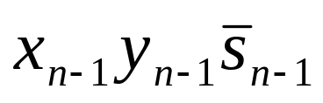
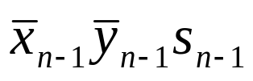
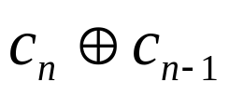
Addition and Subtraction of Signed Numbers (15)
n-bit Ripple-Carry Adder (ctd.)
  Overflow Detect (ctd.)
    Overflow =
    Or overflow =
Gate Delays
  Every gate takes some small fraction of a second between the time inputs are presented and the time the correct answer appears on the outputs. This little fraction of a second is called a gate delay.
+

Slide 35

Addition and Subtraction of Signed Numbers (16)
Gate Delays (ctd.)
  There are actually detailed ways of calculating gate delays that can get quite complicated, but for this class, let’s just assume that there’s some small constant delay that’s the same for all gates.
  We can use a timing diagram to show gate delays graphically.
1
x
x’
0
gate delays

Slide 36
Addition and Subtraction of Signed Numbers (17)
Delays in the Ripple Carry Adder
  The delay through a network of logic gates depends on the integrated circuit electronic technology used in fabricating the network and on the number of gates in the paths from inputs to outputs.
  The delay through any combinational logic network constructed from gates in a particular technology is determined by adding up the number of logic-gate delays along the longest signal propagation path through the network.
  In the case of the n-bit ripple-carry adder, the longest path is from inputs x₀,y₀ and c₀ at the LSB position to outputs c_{n} and s_{n-1} at the MSB position.

Slide 37
Addition and Subtraction of Signed Numbers (18)
Delays in the Ripple Carry Adder (ctd.)
  Assume that the gate delay of an AND gate or an OR gate or a XOR gate is T.
y
i
c
x
i
i
x
i
y
s
c
c
i
i
i
i
+
1
c
i
x
y
x
i
i
i
y
i
Full adder
c_{i+1}
2T
c
i
+
1
c
i
(F
A)
si
T
s
i
(a) Logic f
or a single stage

Slide 38
Addition and Subtraction of Signed Numbers (19)
Delays in the Ripple Carry Adder (ctd.)
c_{n-1}
2(n-1)T
s_{n-1}
2(n-1)T+T=(2n-1)T
c_{n}
2(n-1)T+2T=(2n)T

Slide 39
Addition and Subtraction of Signed Numbers (20)
Hierarchical Adder Design
  kn-bit adder
xkn-1
ykn-1
x2n-1
y2n-1
xn
yn
xn-1
yn-1
x0
y0
…
…
…
n-bit adder
n-bit adder
n-bit adder
ckn
cn
c0
…
…
…
…
skn-1
s(k-1)n
s2n-1
sn
sn-1
s0

Slide 40

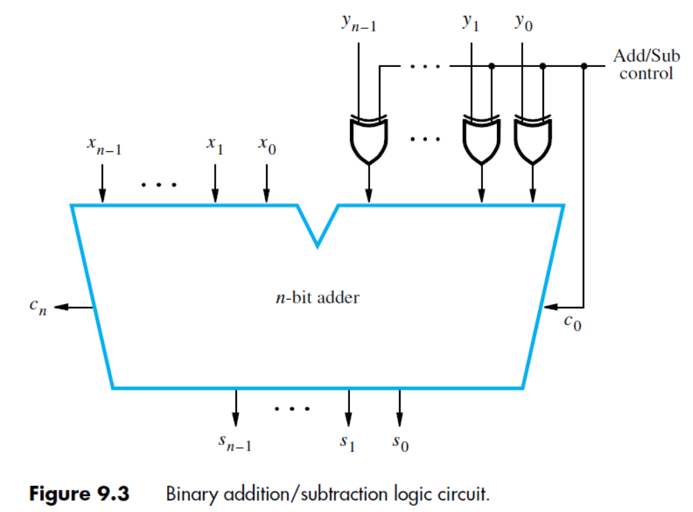
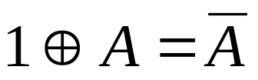
Addition and Subtraction of Signed Numbers (21)
Addition/Subtraction Logic Unit
Control=0 c0=0
Perform addition
Control=1 c0=1
Perform subtraction

Slide 41
Addition and Subtraction of Signed Numbers (22)
Addition/Subtraction Logic Unit (ctd.)
  An XOR gate can be added to detect the overflow.
  All sum bits are available in 2n gate delays, including the delay through the XOR gate on the Y input.

Slide 42
Design of Fast Adders (1)
Drawback of n-bit ripple-carry adder
  It may have too much delay in developing its outputs, s₀ through s_{n-1} and c_{n}.
    s_{n-1} (2n-1)T
    c_{n} (2n)T
  Solutions
    Use the fastest possible electronic technology in implementing the ripple-carry logic design or variations of it.
    Use an augmented logic gate network structure

Slide 43
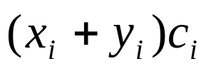
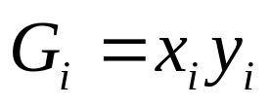
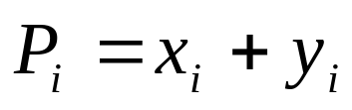
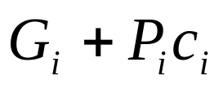
Design of Fast Adders (2)
Carry-Lookahead Addition
=
=
+
+
=
+
(generate function for stage i)
(propagate function for stage i)
=
Notes:
讲到这里—2018.9.6

Slide 44
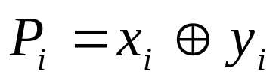
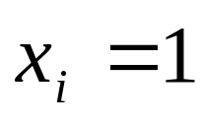
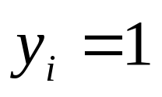
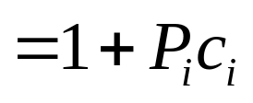
Design of Fast Adders (3)
Carry-Lookahead Addition (ctd.)
x_{i} | y_{i} | x_{i}+y_{i} | x_{i}⊕ y_{i}
0 | 0 | 0 | 0
0 | 1 | 1 | 1
1 | 0 | 1 | 1
1 | 1 | 1 | 0
if
and
=
=1

Slide 45
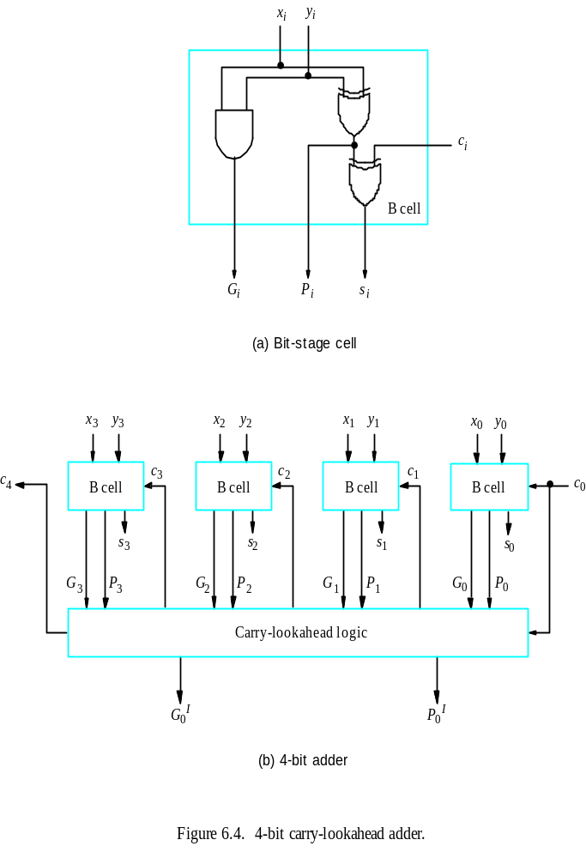
Design of Fast Adders (4)
Carry-Lookahead Addition (ctd.)
  A simpler circuit of bit stage

Slide 46
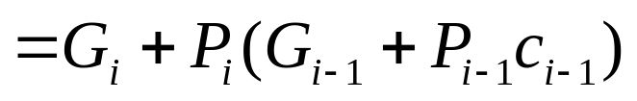
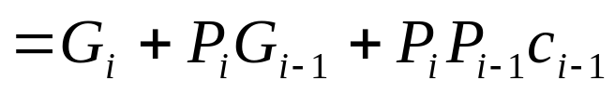
Design of Fast Adders (5)
Carry-Lookahead Addition (ctd.)
=
=
…

Slide 47
Design of Fast Adders (6)
Carry-Lookahead Addition (ctd.)
  Delays of n-bit CLA
    All carries can be obtained 3 gate delays after the input signal X, Y and c0 are applied.
    All sum bits are available 4 gate delays after the input signal X, Y and c0 are applied.
  CLA Summary
    Provide supplemental logic circuits that form a carry signal into each adder stage
      To accelerate the propagation of carries
      Carry propagation becomes concurrent instead of sequential

Slide 48


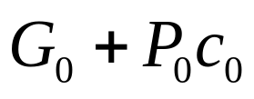
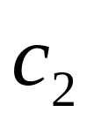
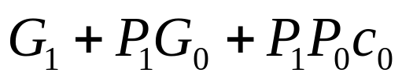

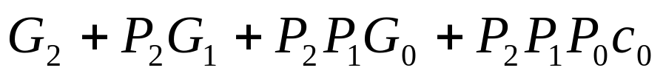
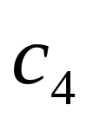
Design of Fast Adders (7)
4-bit Carry-Lookahead Adder
=
=
=
=
=

Slide 49
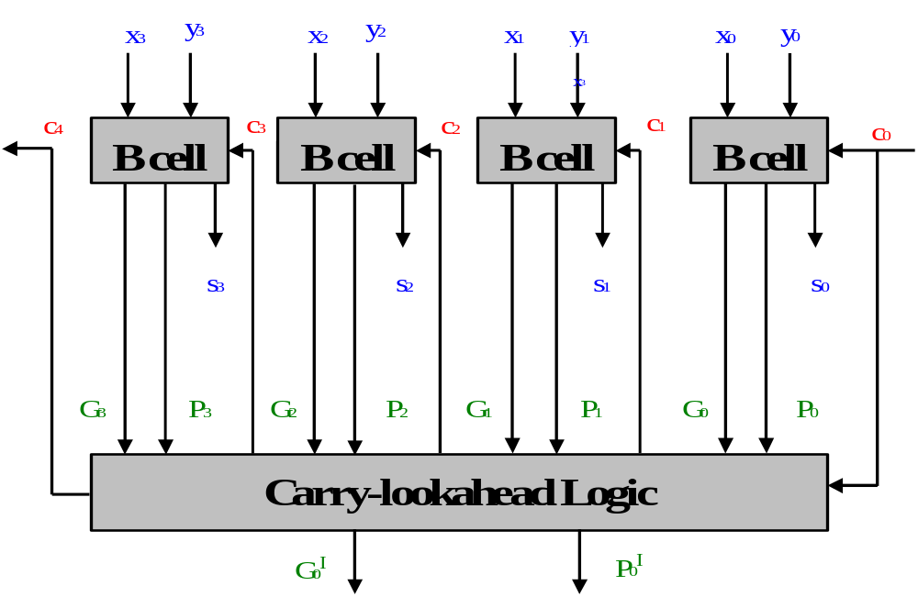
Design of Fast Adders (8)
4-bit carry-lookahead adder

Slide 50



Design of Fast Adders (9)
4-bit Carry-Lookahead Adder (ctd.)
  Delay Comparison
    4-bit CLA
      3T
      4T
    4-bit ripple carry adder
      8T
      7T

Slide 51
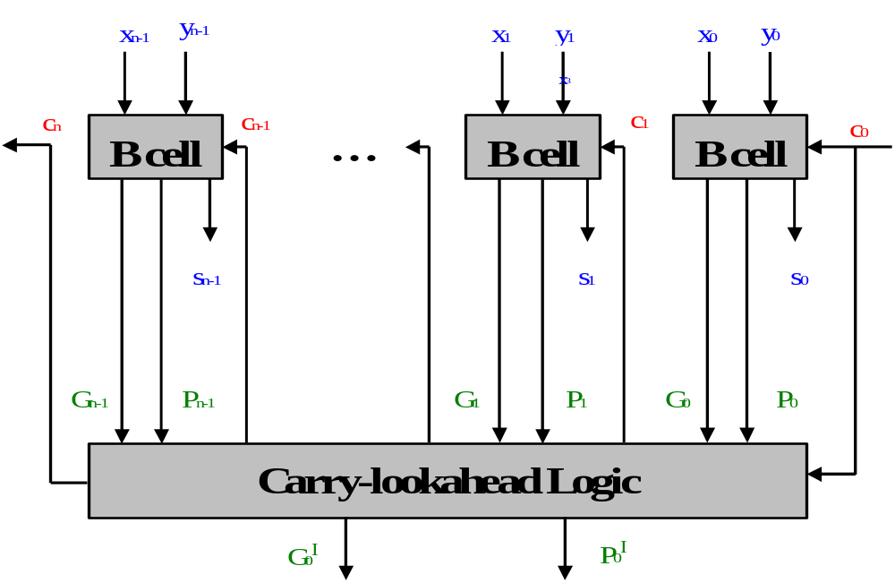
Design of Fast Adders (10)
Extension to Longer Adders
  The 4-bit ripple-carry adder design cannot be directly extended to longer operand sizes.

Slide 52
Design of Fast Adders (11)
Extension to Longer Adders(ctd.)
  Fan-In Constraints
    Fan-In
      The number of inputs to a logic gate is called its fan-in.
    Fan-Out
      The number of gate inputs that the output of a logic gate drives is called its fan-out.
    Practical circuits do not allow large fan-in and fan-out because they both have an adverse effect on the propagation delay and hence the speed of the circuit.
    Example: Fan-In of the last AND gate is i + 2

Slide 53
Design of Fast Adders (12)
Extension to Longer Adders(ctd.)
  Build 32-bit Adders with 4-bit Adders
    Cascade of 8 4-bit Carry-Lookahead Adders
x31
y31
x28
y28
x7
y7
x4
y4
x3
y3
x0
y0
…
…
…
4-bit adder
4-bit adder
4-bit adder
c32
c28
c4
c0
…
…
…
…
s31
s28
s7
s4
s3
s0

Slide 54

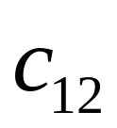
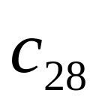
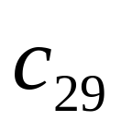
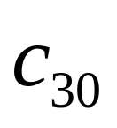
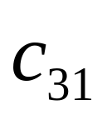
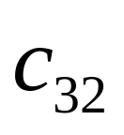
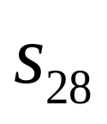
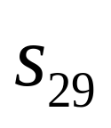
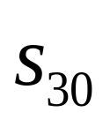
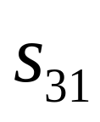
Design of Fast Adders (13)
Extension to Longer Adders(ctd.)
  Build 32-bit Adders with 4-bit Adders (ctd.)
    Cascade of 8 4-bit Carry-Lookahead Adders (ctd.)
      Calculate the delays in generating sum bits s₂₈ , s₂₉ , s₃₀ s₃₁, and c₃₂ in the high-order 4-bit adder.
3T
3T+2T=5T
5T+2T
…
(6×2)T+3T=15T
15T+2T=17T
17T+T=18T

Slide 55
Multiplication of Unsigned Numbers (1)
Manual Multiplication Algorithm (unsigned & positive signed)
  Example: M= 1101, Q= 1011, calculate P= M×Q
1 1 0 1
Multiplicand
× 1 0 1 1
Multiplier
1 1 0 1
1 1 0 1
Partial Products
0 0 0 0
1 1 0 1
1 0 0 0 1 1 1 1
Product
Notes:
讲到这里—2018.9.11

Slide 56
Multiplication of Unsigned Numbers (2)
Manual Multiplication Algorithm (unsigned & positive signed) (ctd.)
  Multiplication of the multiplicand by one bit of the multiplier
    If the multiplier bit is 1, the multiplicand is entered in the appropriate position to be added to the partial product. If the multiplier bit is 0, then 0s are entered.
  Note
    The multiplication product of two n-bit binary integers results in a product of up to 2n bits in length.

Slide 57
Multiplication of Unsigned Numbers (3)
Array Multiplier
  M = m₃m₂m₁m₀ Q = q₃q₂q₁q₀
  P = M×Q = p₇p₆p₅p₄p₃p₂p₁p₀
m₃ m₂ m₁ m₀
× q₃ q₂ q₁ q₀
m₃q₀ m₂q₀ m₁q₀ m₀q₀
m₃q₁ m₂q₁ m₁q₁ m₀q₁
m₃q₂ m₂q₂ m₁q₂ m₀q₂
m₃q₃ m₂q₃ m₁q₃ m₀q₃
p₇
p₆
p₅
p₄
p₃
p₂
p₁
p₀

Slide 58
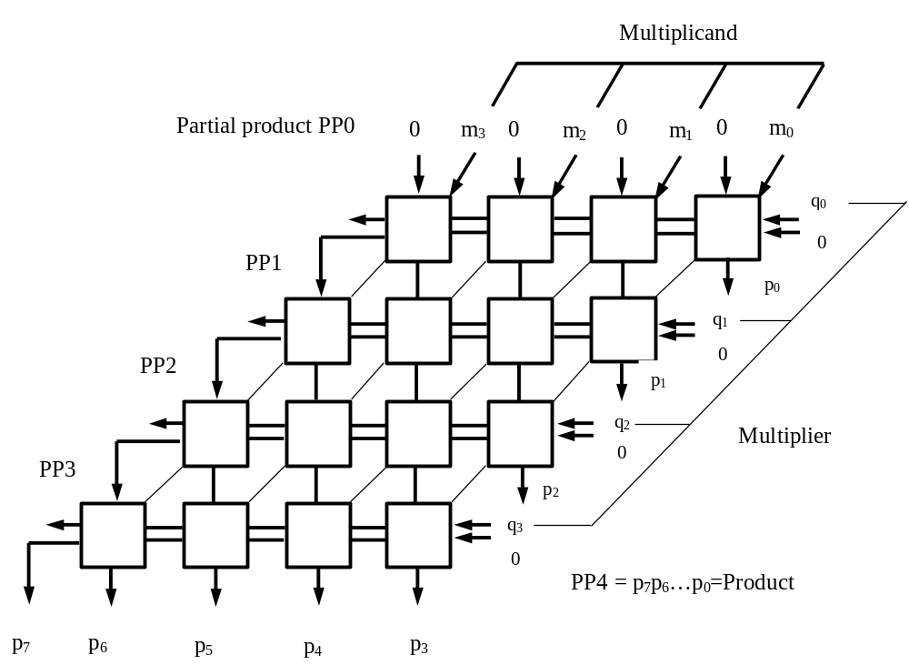

Slide 59
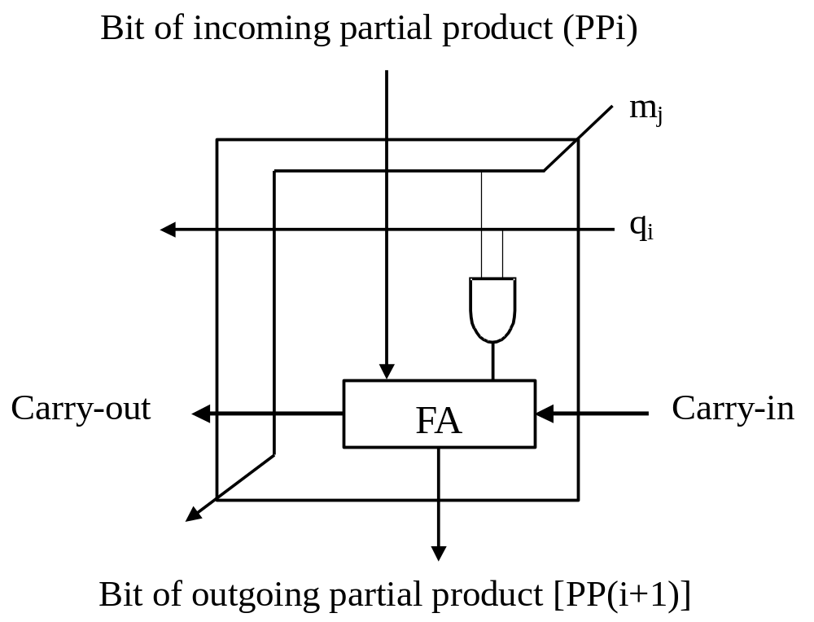

Slide 60
Multiplication of Unsigned Numbers (4)
Array Multiplier (ctd.)
  Q: When calculating P = M × Q (M and Q are all n bit unsigned binary numbers) , how many FAs and AND gates do we need (using n × n array multiplier)?
A:
FAs : n(n-1)
AND gates : n²
n= 32, 992 FAs, 1024 AND gates
n= 64, 4032 FAs, 4096 AND gates

Slide 61
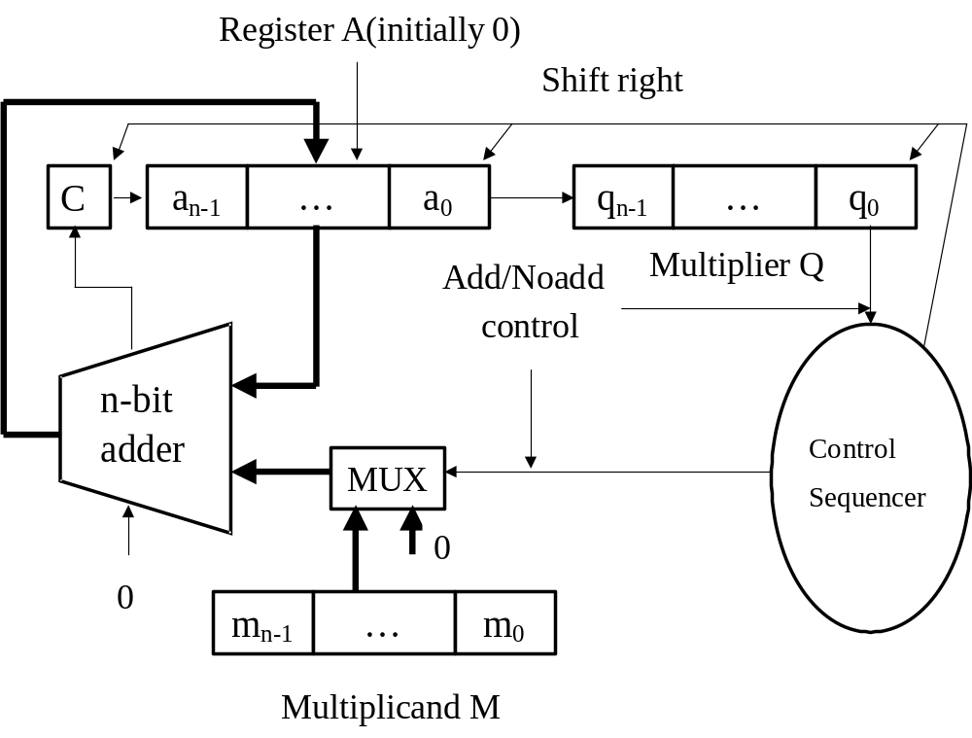
Multiplication of Unsigned Numbers (5)
Sequential Circuit Multiplier

Slide 62
Start
C, A=0
M=Multiplicand
Q=Multiplier
Count=n
No
Q₀=1?
Yes
C, A= A+M
Shift C, A, Q
Count= Count －1
No
Yes
Count=0?
End

Slide 63
Example:M= 1101, Q= 1011, calculate P= M×Q
M
1 1 0 1
Initial Configuration
0
0 0 0 0
1 0 1 1
C
A
Q
0 1 1 0 1 1 0 1 1
Add
First Cycle
0 0 1 1 0 1 1 0 1
Shift
1 0 0 1 1 1 1 0 1
Add
Second Cycle
0 1 0 0 1 1 1 1 0
Shift
0 1 0 0 1 1 1 1 0
No add
Third Cycle
0 0 1 0 0 1 1 1 1
Shift
1 0 0 0 1 1 1 1 1
Add
Fourth Cycle
0 1 0 0 0 1 1 1 1
Shift

Slide 64
Multiplication of Signed Numbers (1)
How do we handle signed numbers ?
  Convert to unsigned, multiply, then convert back to signed
    Works but is slow and a bit cumbersome
  Directly handle the multiplication with the signed numbers
    Booth algorithm recodes the bits to allow for such a computation.
    Works with 2’s complement numbers directly

Slide 65
Signed-Operand Multiplication (2)
If the multiplier is negative, how should we do multiplication straightly?
  Straightforward multiplication will not work in the case of a positive multiplier and a negative multiplicand.
    Example: M = 1001, Q = 0011, calculate P = M×Q
      P = 00011011
      If M, Q, and P are unsigned non-negative numbers, then: M = 9, Q = 3, P=27
      If M, Q, and P are signed 2’s complement numbers, then: M = -7, Q = 3, P = 27

Slide 66
Signed-Operand Multiplication (3)
If the multiplier is negative, how should we do multiplication straightly? (ctd.)
  Case 1: a positive multiplier and a negative multiplicand (ctd.)
    Example: M = 1001, Q =0011, calculate P = M×Q
1 0 0 1
× 0 0 1 1
1 1 1 1
1 0 0 1
1 1 1
1 0 0 1
0 0
0 0 0 0
0
0 0 0 0
1 1 1 0 1 0 1 1
= - 21

Slide 67
Signed-Operand Multiplication (4)
If the multiplier is negative, how should we do multiplication straightly? (ctd.)
  Case 2: a negative multiplier and a negative multiplicand
    Example: M = 1101, Q = 1011, calculate P = M×Q
      Straightforward multiplication P = 10001111
      If M, Q, and P are unsigned non-negative numbers, then: M = 13, Q = 11, P = 143
      If M, Q, and P are signed 2’s complement numbers, then: M = - 3, Q = -5, P = - 113

Slide 68
Signed-Operand Multiplication (5)
If the multiplier is negative, how should we do multiplication straightly? (ctd.)
  Case 2: a negative multiplier and a negative multiplicand (ctd.)
    Example: M = 1101, Q = 1011, calculate P = M×Q
      M = 0011, 2’s complement of M
      N = 0101, 2’s complement of N
0 0 1 1
× 0 1 0 1
0 0 0 0 0 0 1 1
0 0 0 0 0 0 0
0 0 0 0 1 1
0 0 0 0 0
0 0 0 0 1 1 1 1
=15

Slide 69
Signed-Operand Multiplication (6)
Booth Algorithm
  Reducing number of partial products
  Fewer partial products generated for groups of consecutive 0’s and 1’s
    Group of consecutive 0’s in multiplier - no new partial product - only shift partial product right one bit position for every 0
    Group of m consecutive 1's in multiplier - less than m partial products generated
      Example: 0011110 = 0100000 – 0000010 (decimal notation: 30 = 32 – 2)

Slide 70
Signed-Operand Multiplication (7)
Booth Algorithm (ctd.)
  Recoding of a multiplier
Multiplier |  | Version of Multiplicand Selected by bit i
Bit i | Bit i-1
0 | 0 | 0×M
0 | 1 | +1×M
1 | 0 | - 1×M
1 | 1 | 0×M

Slide 71
Signed-Operand Multiplication (8)
Booth Algorithm (ctd.)
  Recoding of a multiplier (ctd.)
    Example
      0 0 1 0 1 1 0 0 1 1 1 0 1 0 1 1 0 0
      0+1 -1+1 0-1 0+1 0 0-1+1-1+1 0 -1 0 0
    Example
0 1 1 0 1 (+13)
× 1 1 0 1 0 (-6)

Slide 72
Signed-Operand Multiplication (9)
Booth Algorithm (ctd.)
  Recoding of a multiplier (ctd.)
    Example (ctd.)
0 1 1 0 1
0 -1 +1 –1 0
0 0 0 0 0 0 0 0 0 0
1 1 1 1 1 0 0 1 1
0 0 0 0 1 1 0 1
1 1 1 0 0 1 1
0 0 0 0 0 0
1 1 1 0 1 1 0 0 1 0
Notes:
讲到这里—2018.9.13

Slide 73
Signed-Operand Multiplication (10)
Booth Algorithm (ctd.)
  Advantages
    Handle both positive and negative multipliers uniformly.
    Achieve some efficiency in the number of additions required when the multiplier has a few large blocks of 1s.
Good
multiplier
0 0 0 0 1 1 1 1 1 0 0 0 0 1 1 1
0 0 0 +1 0 0 0 0 –1 0 0 0 +1 0 0 –1
Ordinary
multiplier
1 1 0 0 0 1 0 1 1 0 1 1 1 1 0 0
0 –1 0 0 +1 –1 +1 0 – 1 +1 0 0 0 –1 0 0

Slide 74
Signed-Operand Multiplication (11)
Booth Algorithm (ctd.)
  Advantages
    On average, the speed of doing multiplication with the Booth algorithm is the same as with the normal algorithm.
Worst-case
multiplier
0 1 0 1 0 1 0 1 0 1 0 1 0 1 0 1
+1 –1 +1 –1 +1 –1 +1 –1 +1 –1 +1 –1 +1 –1 +1 –1

Slide 75
Integer Division (1)
Manual Algorithm
  Example
0
0
0
0
1
0
1
0
1
Quotient
Divisor
1 1 0 1
1 0 0 0 1 0 0 1 0
Dividend
1 1 0 1
Partial
Remainders
1 0 0
0
0
1 1 0 1
1 1
1
0
1 1 0 1
1
Remainder

Slide 76
Integer Division (2)
Manual Algorithm (ctd.)
  Process Description
    The bits of the dividend are examined from left to right, until the set of bits examined represents a number greater than or equal to the divisor. Until this event occurs, 0s are placed in the quotient from left to right.
    If the event occurs, a 1 is placed in the quotient and the divisor is subtracted from the partial dividend.
    From this point on, the division follows a cyclic pattern. At each cycle, additional bits from the dividend are appended to the partial remainder until the result is greater than or equal to the divisor. The divisor is subtracted from this number to produce a new partial remainder.
    Continue until all the bits of the dividend are exhausted.

Slide 77
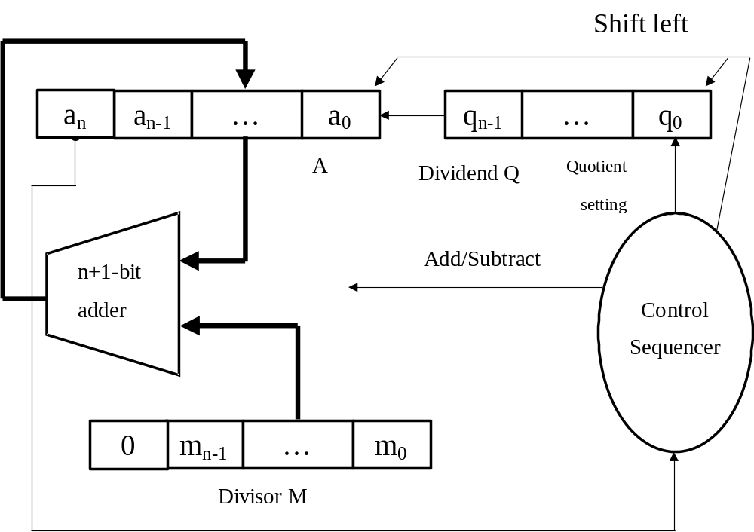
Integer Division (3)
Restoring Division
  Hardware

Slide 78
Start
A= 0 M=Divisor Q=Dividend Count=n
Shift Left A, Q
A= A - M
No
Yes
A < 0?
Q₀ = 1
Q₀ = 0 , A = A+ M
Count = Count - 1
Quotient in Q
Remainder in A
No
Yes
Count = 0?
End

Slide 79
Integer Division (4)
Restoring Division (ctd.)
  Example
M
Initially
0 0 0 1 1
1 0
0 0 0 0 0
1 0 0 0
1 1
1 0 0 0
A
Q
1 1
Shift
0 0 0 0 1
0 0 0
1 0
Subtract
1 1 1 0 1
First Cycle
Set q₀
1 1 1 1 0
Restore
0 0 0 1 1
0 0 0 0 1
0 0 0 0

Slide 80
Integer Division (5)
Restoring Division (ctd.)
  Example (ctd.)
Shift
0 0 0 1 0
0 0 0
Subtract
1 1 1 0 1
Set q₀
1 1 1 1 1
Second Cycle
Restore
0 0 0 1 1
0 0 0 1 0
0 0 0 0
Shift
0 0 1 0 0
0 0 0
Subtract
1 1 1 0 1
Third Cycle
Set q₀
0 0 0 0 1
0 0 0 1

Slide 81
Integer Division (6)
Restoring Division (ctd.)
  Example (ctd.)
Shift
0 0 0 1 0
0 0 1
Subtract
1 1 1 0 1
Set q₀
1 1 1 1 1
Fourth Cycle
Restore
0 0 0 1 1
0 0 0 1 0
0 0 1 0
Remainder
Quotient

Slide 82
Integer Division (7)
Non-Restoring Division
  In restoring division
    (i – 1) step, R_{i} _{–1}
    i step, R_{i}’= 2R_{i} _{–1} – M
      R_{i}’ > 0, Q₀ = 1, R_{i} = R_{i}’
      R_{i}’ < 0, Q₀ = 0, R_{i} = R_{i}’ + M
    (i + 1) step, R_{i+1}’= 2R_{i} – M
      R_{i} = R_{i}’, R_{i+1}’ = 2R_{i}’ – M →
      R_{i} = R_{i}’ + M, R_{i+1}’ = 2(R_{i}’ + M) – M= 2R_{i}’ + M
A= 2A – M
A= 2A + M
Notes:
这里标记的Ri-1和A指的是slide78上没有shift left之前的A；因为shift left相当于乘以2，所以这里用2Ri-1和2A来表示。基于这个原理，设计了non-restoring division算法。

Slide 83
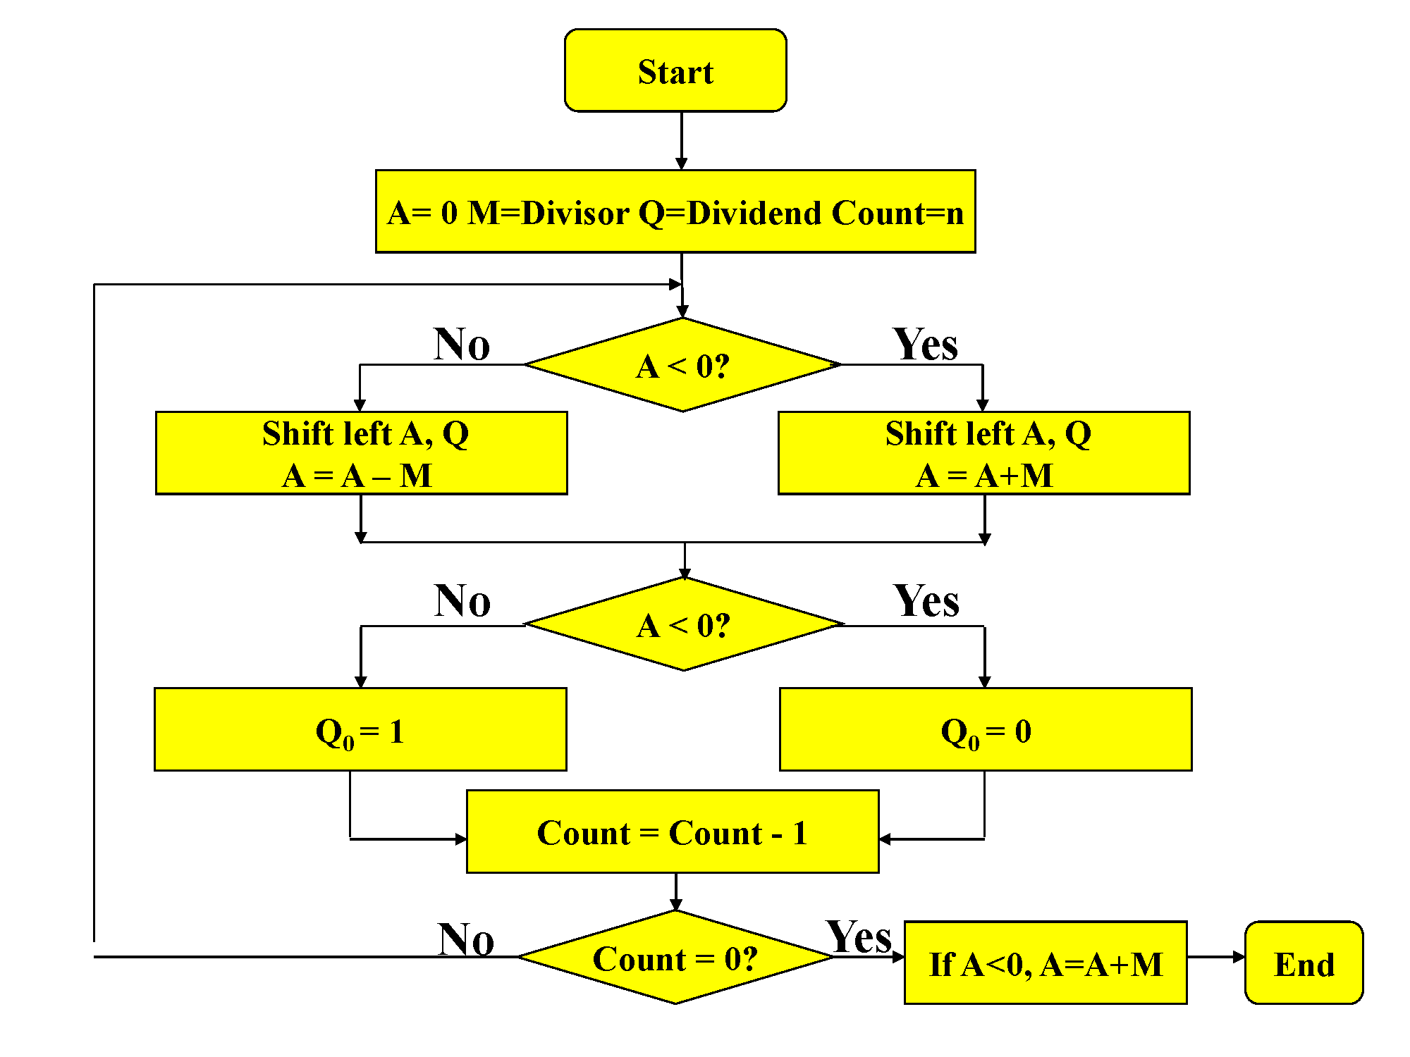
Notes:
最后A+M是用于restore remainder。

Slide 84
Integer Division (8)
Non-Restoring Division (ctd.)
  Example
M
1 0
Initially
0 0 0 1 1
1 1
1 0 0 0
0 0 0 0 0
1 0 0 0
A
Q
1 1
Shift
0 0 0 0 1
0 0 0
1 0
First Cycle
Subtract
1 1 1 0 1
Set q₀
1 1 1 1 0
0 0 0 0
Shift
1 1 1 0 0
0 0 0
Add
0 0 0 1 1
Second Cycle
Set q₀
1 1 1 1 1
0 0 0 0

Slide 85
Integer Division (9)
Non-Restoring Division (ctd.)
  Example (ctd.)
Shift
1 1 1 1 0
0 0 0
Third Cycle
Add
0 0 0 1 1
Set q₀
0 0 0 0 1
0 0 0 1
Shift
0 0 0 1 0
0 0 1
Subtract
1 1 1 0 1
Fourth Cycle
Set q₀
1 1 1 1 1
0 0 1 0
Quotient

Slide 86
Integer Division (10)
Non-Restoring Division (ctd.)
  Example (ctd.)
Add
1 1 1 1 1
Restoring
Remainder
0 0 0 1 1
0 0 0 1 0
Remainder

Slide 87
Integer Division (11)
Non-Restoring Division (ctd.)
  Note
    There are no simple algorithms for directly performing division on signed operands that are comparable to the algorithms for signed multiplication.
    In division, the operands can be processed to transform them into positive values.
    After using one of the algorithms (restoring division or nonrestoring division), the results are transformed to the correct signed values, as necessary.

Slide 88
Floating-point Numbers and Operations (1)
What can be represented in n bits?
  Unsigned: 0 to 2^{n}-1
  2’s complement: -2^{n} ^{–1} to 2^{n –1} – 1
  But, what about?
    Very large numbers? 9,349,398,989,787,762,244,859,087,678
    Very small number? 0.0000000000000000000000045691
    Fractional values? 0.35
    Mixed numbers? 10.28
    Irrationals(无理数)? π

Slide 89

Floating-point Numbers and Operations (2)
Floating point ‡ Real numbers
  Floating point numbers in a computer do not behave like their conceptual counterparts, the real numbers:
    limited space to represent the numbers
    finite length encoding (e.g., 1/3 = 0.333333333…..)
    limited resolution: can only represent exactly values of the form x ×
    Numbers like 1/10 cannot be represented precisely
  Floating point is a major source of errors and bugs in programs.

Slide 90
Floating-point Numbers and Operations (3)
Number Format
  According to whether the position of binary point is fixed, there are two number formats:
    Fixed-point numbers
      E.g., integers, have an implied binary point at the right end of them.
    Floating-point numbers

Slide 91
Floating-point Numbers and Operations (4)
Fixed-point Representation
  A fixed-point notation is any number in which the number of bits to the right of the binary point does not change.
    Unsigned integers: with no bits to the right of the binary point
    Signed integers: with no bits to the right of the binary point.
    Signed fractions:the binary point is to the right of the sign bit.

Slide 92
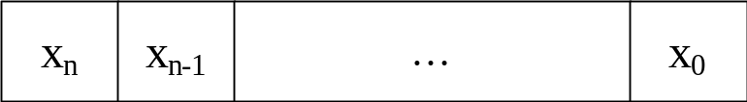
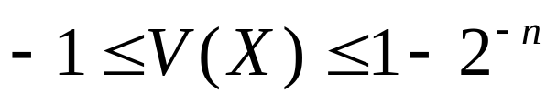
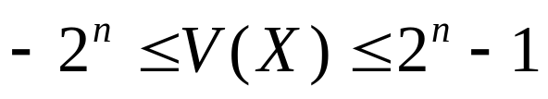
Floating-point Numbers and Operations (5)
Fixed-point Representation (ctd.)
  Let X = x_{n}…x₀ be a fixed-point number
    If X is a pure fraction
      The binary point is between x_{n} and x_{n-1}
      Range:
    If X is an integer
      The binary point is to the right of x₀
      Range:
sign
magnitude

Slide 93


Floating-point Numbers and Operations (6)
Fixed-point Representation (ctd.)
  Limitation
    Very large integers can not be represented, nor can very small fractions.
    Example: Consider the range of values representable in a 32-bit, signed, fixed-point format.
      Interpreted as integers
      Interpreted as fractions

Slide 94
Floating-point Numbers and Operations (7)
Fixed-point Representation (ctd.)
  Limitation
    Example: Consider the range of values representable in a 32-bit, signed, fixed-point format.
      In scientific calculations
      Avogadro’s constant 6.0247 ×10²³ mol ^{– 1} =
      0.60247 ×10²⁴ mol ^{– 1}
      Planck’s constant 6.6254 ×10 ^{– 27}erg.s =
      0.66254 ×10 ^{– 26}erg.s

Slide 95

Floating-point Numbers and Operations (8)
Floating-point Numbers in Computers
  Numerical Form
    (–1)^{S} M 2e
      Sign bit S determines whether number is negative or positive
      Mantissa M, a fraction in sign-magnitude or 2’s complement representation, containing the significant digits
      Exponent E, in 2’s complement or biased notation, the power of base
  Encoding
sign
exponent
mantissa

Slide 96
Floating-point Numbers and Operations (9)
Floating-point Numbers in Computers
  Excess or Biased Notation
    A negative exponent in 2’s complement looks like a large exponent.
    A fixed value is subtracted from the exponent field to get the true exponent.
    E = e + (2^{k} ^{– 1} – 1)
      e is the actual exponent
      k is the number of bits in the exponent
    Note
      When the bits of a biased representation are treated as unsigned integers, the relative magnitudes of the numbers do not change.

Slide 97


Slide 98


Slide 99


Floating-point Numbers and Operations (10)
Floating-point Numbers in Computers (ctd.)
  Normalization
    A number in scientific notation that has no leading 0 is called a “normalized” number
      1.0× (√ ) à Normalized scientific notation
      0.1× ( X )
  Normalizing means
    Shifting the decimal point until we have the right number of digits to its left (normally one)
    Adding or subtracting from the exponent to reflect the shift
  In normalized binary, the first bit of the mantissa should always be a 1.
    Example: normalize 0 000010 000110101
    0 111111 110101000

Slide 100
Floating-point Numbers and Operations (11)
IEEE 754 Standard
  Institute of Electrical and Electronics Engineers
  Most common standard for representing floating point numbers.
  Established in 1985 as uniform standard for floating point arithmetic
  This standard was developed to facilitate the portability of programs from one processor to another and encourage the development of sophisticated, numerically oriented programs.
  Supported by all major CPUs

Slide 101

Floating-point Numbers and Operations (12)
IEEE 754 Standard (ctd.)
  Single Precision

Slide 102

Floating-point Numbers and Operations (13)
IEEE 754 Standard (ctd.)
  Double Precision

Slide 103
Floating-point Numbers and Operations (14)
IEEE 754 Standard (ctd.)
  A computer must provide at least single-precision representation to conform to the IEEE standard.
  Double-precision representation is optional.
  Extended single-precision (more than 32 bits) /Extended double-precision (more than 64 bits)
    Help to reduce the size of the accumulated round-off error in a sequence of calculations.
    Enhance the accuracy of evaluation of elementary functions such as sine, cosine, and so on.
  Trade-off between “accuracy” and “range”
    Increasing the size of mantissa enhances accuracy.
    Increasing the size of exponent increases the range.

Slide 104
Floating-point Numbers and Operations (15)
IEEE 754 Standard (ctd.)
  Special Values
    Zero
      S = 0/1, E = 0, M = 0 (0.M) Value = ± 0
      An exponent field of zero is special; it indicates that there is no implicit leading 1 on the mantissa.
    Infinity
      Operation that overflows
        E.g., 1.0/0.0 = 1.0/0.0 = +infinity
      S = 0/1, E = 255 or 2047, M = 0 Value = ±infinity
    NaN (Not a Number)
      Represents case when no numeric value can be determined
        E.g., sqrt(–1),  
      S = 0/1, E = 255 or 2047, M ≠ 0 Value = NaN
Notes:
讲到这里—2018.9.18
注意解释0是特殊情况，1的表达是不一样的。

Slide 105
Floating-point Numbers and Operations (16)
IEEE 754 Standard (ctd.)
  Special Values (ctd.)
    Denormal Numbers
      There is no implied 1 to the left of the binary point.
      All denormalized numbers are assumed to have an exponent field of 1 – bias.
      Numbers very close to 0.0
      Note that we cannot normalize this value.
      Zero is effectively a denormal number.
      Lose precision as get smaller
      “Gradual underflow”
      S = 0/1, E = 0, M ≠ 0
        Value = ± 0.M ×2⁻¹²⁶
        Value = ± 0.M ×2⁻¹⁰²²

Slide 106
Floating-point Numbers and Operations (17)
Arithmetic Operations on FP
  Addition and Subtraction
    Alignment
      If their exponents differ, it is necessary to manipulate the two summands so that the two exponents are equal.
      Example: Decimal addition (123 × 10⁰)+(456 × 10⁻²)
      (123 × 10⁰)+(456 × 10⁻²) = (123 × 10⁰)+(4.56 × 10⁰)
      The alignment is achieved by shifting the magnitude portion of the mantissa right 1 digit and incrementing the exponent until the two exponents are equal.

Slide 107
Floating-point Numbers and Operations (18)
Arithmetic Operations on FP
  Add/Subtract Rule (for IEEE single precision)
    ① Choose the number with the smaller exponent and shift its mantissa right a number of steps equal to the difference in exponents.
    ② Set the exponent of the result equal to the larger exponent.
    ③ Perform addition/subtraction on the mantissas and determine the sign of the result.
    ④ Normalize the resulting value, if necessary.

Slide 108
Floating-point Numbers and Operations (19)
Arithmetic Operations on FP
  Multiplication and Division
    Multiply Rule (for IEEE single precision)
      ① Add the exponents and subtract 127.
      ② Multiply the mantissas and determine the sign of the result.
      ③ Normalize the resulting value, if necessary.
    Divide Rule (for IEEE single precision)
      ① Subtract the exponents and add 127.
      ② Divide the mantissas and determine the sign of the result.
      ③ Normalize the resulting value, if necessary.

Slide 109
Floating-point Numbers and Operations (20)
Problems Considerable in FP Arithmetic
  Guard bits
    The additional bits retained in the mantissa are referred to as guard bits.
    The guard bits are used to pad out the right end of the mantissa with 0s.
    It is important to retain guard bits during the intermediate steps. This yields maximum accuracy in the final results.
    Example: X= 1.00…00 × 2¹ , Y= 1.11…11 × 2⁰ ( X and Y are all in IEEE single precision format). Calculate Z= X – Y.

Slide 110
Floating-point Numbers and Operations (21)
Problems Considerable in FP Arithmetic
  Guard bits (ctd.)
    Example (ctd.)
      Without guard bits
      With guard bits
X = 1.000…00 × 2¹
– Y = 0.111…11 × 2¹
Z = 0.000…01 × 2¹
= 1.000…00 × 2⁻²²
X = 1.000…00 0 × 2¹
– Y = 0.111…11 1 × 2¹
Z = 0.000…00 1 × 2¹
= 1.000…00 0× 2⁻²³
Notes:
讲到这里—2018.9.20

Slide 111
Floating-point Numbers and Operations (22)
Problems Considerable in FP Arithmetic
  Truncation
    Chopping
      Remove the guard bits and make no changes in the retained bits.
      Example: Truncate 0.b_{– 1}b_{– 2}b_{– 3} 010 to three bits.
        0.b_{– 1}b_{– 2}b_{– 3} 010 0.b_{– 1}b_{– 2}b_{– 3}
        Actually, all fractions in the range 0.b_{– 1}b_{– 2}b_{– 3} 000 to 0.b_{– 1}b_{– 2}b_{– 3} 111 are truncated to 0.b_{– 1}b_{– 2}b_{– 3}.
        The error range in the 3-bit result is from 0 to 0.000111.
      Error Range
        The error range in chopping is from 0 to almost 1 in the least significant position of the retained bits.

Slide 112
Floating-point Numbers and Operations (23)
Problems Considerable in FP Arithmetic
  Truncation (ctd.)
    Von Neumann Rounding
      ① If the bits to be removed are all 0s, they are simply dropped, with no changes to the retained bits.
      ② If any of the bits to be removed are 1, the least significant bit of the retained bits is set to 1.
      Example: Truncate 0.b_{– 1}b_{– 2}b_{– 3} 000 – 0.b_{– 1}b_{– 2}b_{– 3} 111 to three bits.
        ① 0.b_{– 1}b_{– 2}b_{– 3} 000 0.b_{– 1}b_{– 2}b_{– 3}
        ② 0.b_{– 1}b_{– 2}b_{– 3} 001 – 0.b_{– 1}b_{– 2}b_{– 3} 111 0.b_{– 1}b_{– 2}1
      Error Range
        The error range in Von Neumann rounding is between – 1 and +1 in the LSB position of the retained bits.

Slide 113
Floating-point Numbers and Operations (24)
Problems Considerable in FP Arithmetic
  Truncation (ctd.)
    Rounding
      A 1 is added to the LSB position of the bits to be retained if there is a 1 in the MSB position of the bits being removed.
      Example: Truncate 0.b_{– 1}b_{– 2}b_{– 3} 000 – 0.b_{– 1}b_{– 2}b_{– 3} 111 to three bits.
        ① 0.b_{– 1}b_{– 2}b_{– 3} 000 – 0.b_{– 1}b_{– 2}b_{– 3} 011 0.b_{– 1}b_{– 2}b_{– 3}
        ② 0.b_{– 1}b_{– 2}b_{– 3} 101 – 0.b_{– 1}b_{– 2}b_{– 3} 111 0.b_{– 1}b_{– 2}b_{– 3}+0.001

Slide 114
Floating-point Numbers and Operations (25)
Problems Considerable in FP Arithmetic
  Truncation (ctd.)
    Rounding (ctd.)
      Example: Truncate 0.b_{– 1}b_{– 2}b_{– 3} 000 – 0.b_{– 1}b_{– 2}b_{– 3} 111 to three bits.
        ③ 0.b_{– 1}b_{– 2}b_{– 3} 100(tie situation) : Choose the retained bits to be nearest even number.
        0.b_{– 1}b_{– 2}0100 0.b_{– 1}b_{– 2}0
        0.b_{– 1}b_{– 2}1100 0.b_{– 1}b_{– 2}1 + 0.001
      Error Range
        The error range is – ½ to + ½ in the LSB position of the retained bits.
      Rounding achieves the closest approximation to the number being truncated and is an unbiased technique.
      Rounding is the default mode for truncation specified in the IEEE floating-point standard.

Slide 115
Floating-point Numbers and Operations (26)
Problems Considerable in FP Arithmetic
  Normalization
    If a number is not normalized, it can always be put in normalized form by shifting the mantissa and adjusting the exponent.
    Example
      Value =+0.0010110… ×2 ⁹
      Value =+1.0110… ×2 ⁶

Slide 116
Floating-point Numbers and Operations (27)
Problems Considerable in FP Arithmetic
  Overflow
    As computation proceed, a number that does not fall in the representable range of normal numbers might be generated.
    Exponent Overflow
      A positive exponent exceeds the maximum possible exponent value.
      Example: In IEEE single precision, e > 127
      In some systems, it may be designated as plus infinity or minus infinity.
    Exponent Underflow
      A negative exponent is less than the minimum possible exponent value.
      Example: In IEEE single precision, e < – 126
      This means that the number is too small to be represented, it may be reported as 0.

Slide 117
Floating-point Numbers and Operations (28)
Problems Considerable in FP Arithmetic
  Overflow(ctd.)
    Mantissa Overflow
      The addition of two mantissas of the same sign may result in a carry out of the most significant bit.
      If so, the mantissa of the result is shifted right and the exponent is incremented.
    Mantissa Underflow
      In the process of aligning mantissas, digits may flow off the right end of the mantissa.
      This can be resolved by using guard bits and some method of truncation.

Slide 118
Floating-point Numbers and Operations (29)
Implementing Floating-Point Operations
  Implementation Methods
    Software Routines
    Hardware Circuits
      Computers will provide machine instructions for floating-point operations.
    Note
      In either case, the computer must be able to convert input and output from and to the use’s decimal representation of numbers.
  Example of Hardware Implementation
    32-bit operands , {A: S_{A}, E_{A}’, M_{A}}, {B: S_{B}, E_{B}’, M_{B}}

Slide 119

E ’
E ’

Slide 120
Summary (1)
Integer Representation
  unsigned integer
    non-negative
    2’s-complement
  signed integer
    signed-magnitude
    1’s-complement
    2’s-complement
Converting between different bit lengths
  signed-magnitude numbers
  signed 2’s-complement number
Rules of Addition and subtraction of signed numbers (2 ’s-complement form)
  Addition
  Subtraction

Slide 121
Summary (2)
Arithmetic overflow (2 ’s-complement form)
1-bit Full-adder
n-bit ripple-carry adder
Propagation delay of n-bit ripple-carry adder
Carry-lookahead addition
Sequential multiplication (Positive multiplication)
Booth algorithm (Signed-operand multiplication)
non-restoring division or restoring division
IEEE 754 FP number
Addition, subtraction, multiplication, and division of FP
Guard bits, truncation, normalization, overflow of FP

