Slide 1
Computer Organization & Architecture
Chapter 8 – The Memory System - 1
Junying Chen 陈俊颖

Slide 2
Content of this lecture
The Memory System Overview
  Internal Memory and External Memory
  2.1 Memory Locations and Addresses
  8.1 Memory Operations
  Characteristics of Memory Systems
8.2 Semiconductor RAM Memories
  SRAM
  DRAM
  Structure of Larger Memory

Slide 3
The Memory System Overview (1)
Internal Memory and External Memory
  The typical computer system is equipped with a hierarchy of memory subsystems.
  Internal Memory (Primary Storage)
    Internal to the system, directly accessible by the processor.
    Example: Main Memory, Cache, Processor Registers
  External Memory (Secondary Storage)
    External to the system, accessible by the processor via an I/O module.

Slide 4
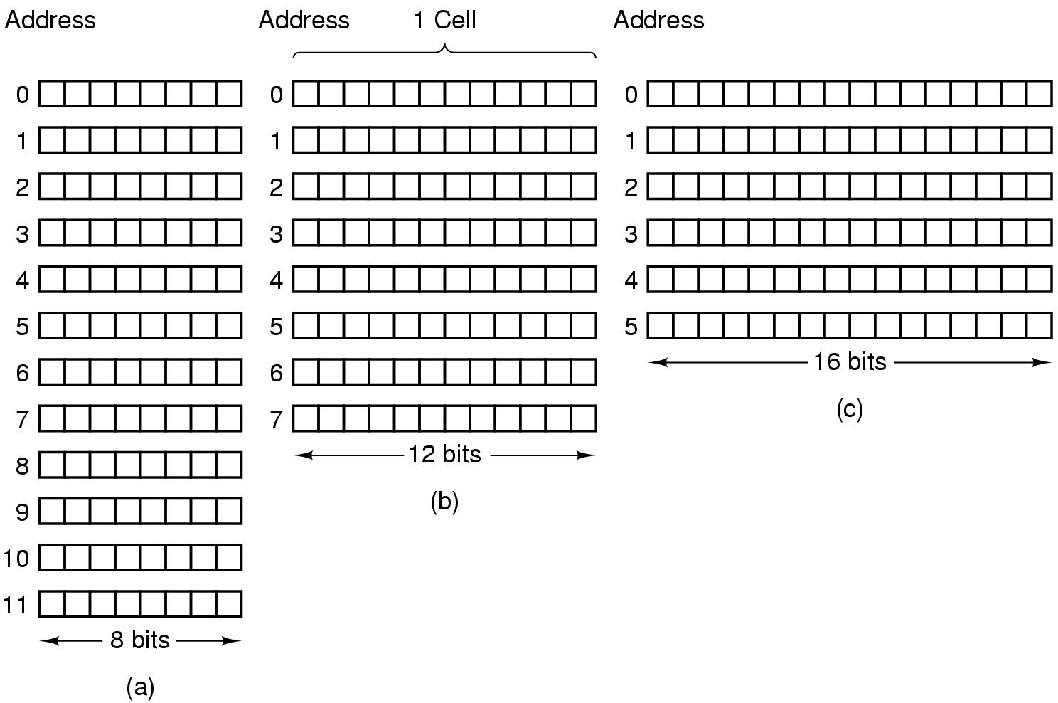
The Memory System Overview (2)
Memory Locations and Addresses
  How the memory is organized?
    Example: Three ways of organizing a 96-bit memory

Slide 5
The Memory System Overview (3)
Memory Locations and Addresses (ctd.)
  How the memory is organized? (ctd.)
    The memory consists of many millions of storage cells, each of which can store a bit of information having the value 0 or 1.
    The memory is organized so that a group of fixed size of bits can be stored or retrieved in a single, basic memory operation.
    Word: Each group of fixed size of bits is referred to as a word.
    Word length: The number of bits in each word is referred to as word length. It typically ranges from 16 to 64 bits.

Slide 6
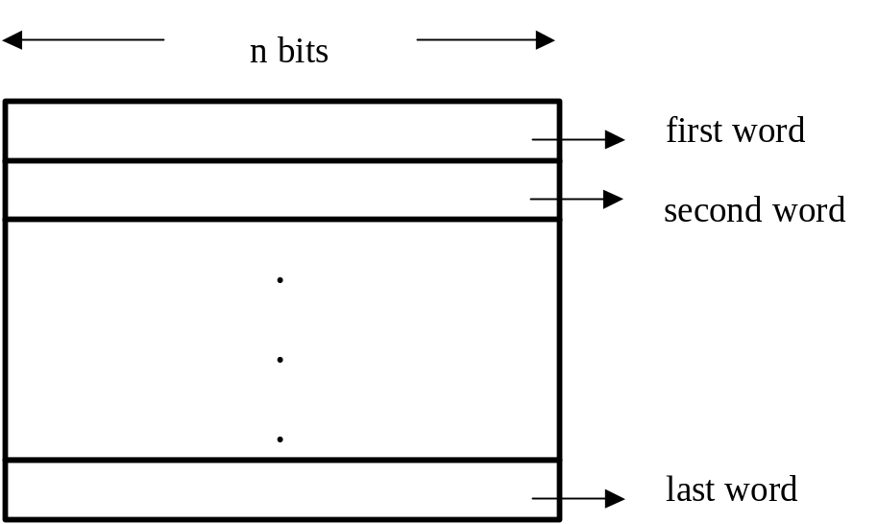
The Memory System Overview (4)
Memory Locations and Addresses (ctd.)
  How the memory is organized? (ctd.)
    The memory of a computer can be schematically represented as a collection of words.

Slide 7
The Memory System Overview (5)
Memory Locations and Addresses (ctd.)
  Address and Address Space
    Addresses are numbers that identify memory locations.
    It is customary to use numbers from 0 through 2^{k} – 1, for some suitable value of k, as the addresses of successive locations in the memory.
    The 2^{k} addresses constitute the address space of the computer, and the memory can have up to 2^{k} addressable locations.

Slide 8
The Memory System Overview (6)
Memory Locations and Addresses (ctd.)
  Byte-addressable Memory
    The most practical assignment is to have successive addresses refer to successive byte locations in the memory.
  Big-endian Assignment
    In this assignment, the lower byte addresses are used for the more significant bytes (the leftmost bytes) of the word.
    Example: Big-endian assignment for 32-bit word-length byte-addressable memory.

Slide 9
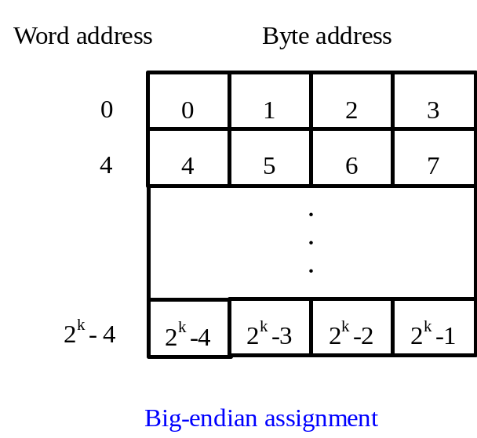
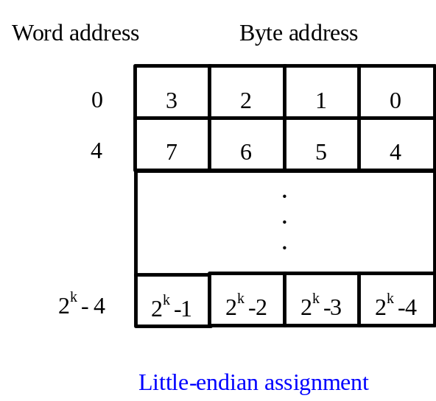
The Memory System Overview (7)
Memory Locations and Addresses (ctd.)
  Little-endian Assignment
    In this assignment, the lower byte addresses are used for the less significant bytes (the rightmost bytes) of the word.
    Example: Little-endian assignment

Slide 10
The Memory System Overview (8)
Memory Locations and Addresses (ctd.)
  Little-endian Assignment (ctd.)
    Note: In both cases, byte addresses 0, 4, 8, …, are taken as the addresses of successive words in the memory and are the addresses used when specifying memory operations for words.
Notes:
0xa7

Slide 11
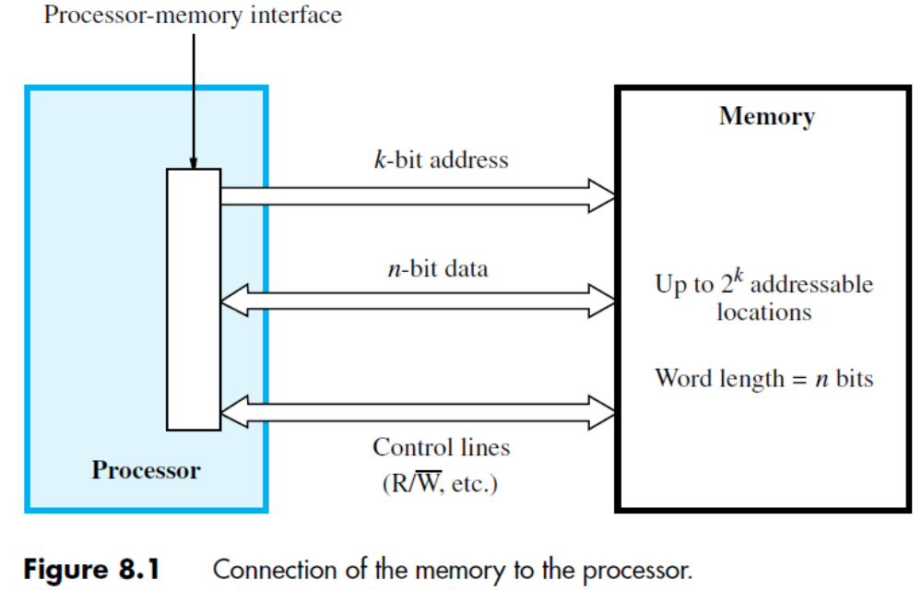
The Memory System Overview (9)
Memory Operations
Notes:
讲到这里—2018.9.25

Slide 12
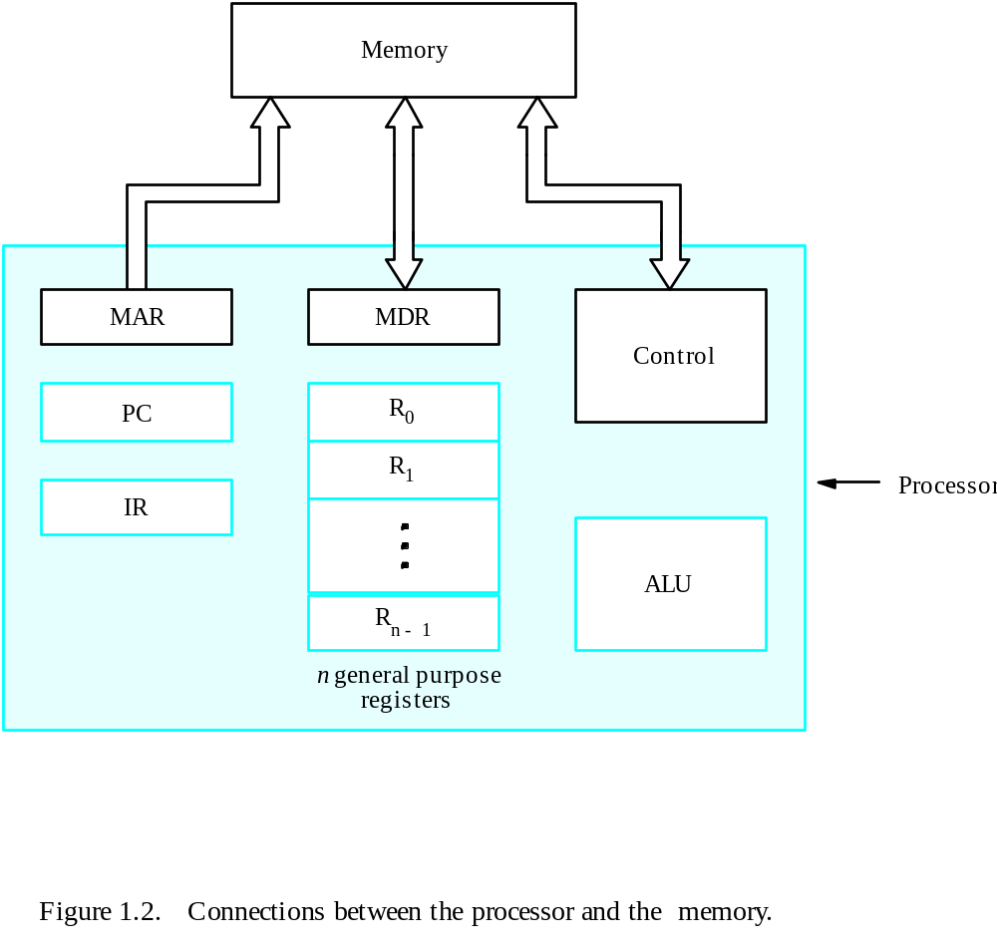
The Memory System Overview (10)
Memory Operations (ctd.)

Slide 13
The Memory System Overview (11)
Memory Operations (ctd.)
  Read (Load) Operation
    Transfers a copy of the contents of a specific memory location to the processor.
    Processor: Load the address of the required memory location into the MAR register and set the R/W line to 1.
    Memory: Place the data from the addressed location onto the data lines and confirm this action by asserting the MFC signal.
    Processor: Upon receipt of the MFC signal, the processor loads the data on the data lines into the MDR register.

Slide 14
The Memory System Overview (12)
Memory Operations (ctd.)
  Write (Store) Operation
    Transfer an item of information from the processor to a specific location, destroying the former contents of that location.
    Processor: Load the address of the specific location into MAR and load the data into MDR register. It also set the R/W line to 0.
    Memory: When the data have been written, it responses processor with MFC signal.

Slide 15
The Memory System Overview (13)
Characteristics of Memory Systems
  Capacity
    Word size: # of bits in natural unit of organization
      Usually related to length of an instruction or the number of bits used to represent an integer number
    Internal memory: usually expressed in terms of numbers of bytes or words.
    External memory: usually expressed in terms of numbers of bytes.
  Unit of Transfer
    Number of bits read from, or written into memory at a time.
    Internal memory: usually equal to the number of data lines into and out of the memory module.
      It is often equal to the number of the word length, but it may not be.
    External memory: data are often transferred in much larger units than a word, and these are referred to as blocks.

Slide 16
The Memory System Overview (14)
Characteristics of Memory Systems (ctd.)
  Access Mode
    Sequential Access
      Memory is organized into units of data, called records.
      Access must be made in a specific linear sequence.
      The time to access an arbitrary record is highly variable.
      Example: Magnetic Tape
start
first location
read to here
location of interest

Slide 17
The Memory System Overview (15)
Characteristics of Memory Systems (ctd.)
  Access Mode (ctd.)
    Random Access
      Any memory location can be selected at random and directly addressed and accessed.
      The time to access a given location is independent of the location’s address and is constant.
      Example: RAM
. . .
read here

Slide 18
The Memory System Overview (16)
Characteristics of Memory Systems (ctd.)
  Mode of Accessing (ctd.)
    Direct Access
      Individual blocks or records have a unique address based on physical location.
      Access is accomplished by direct access to reach a general vicinity plus sequential searching, counting or waiting to reach the final location.
      Access time is variable.
      Example: Magnetic Disk
. . .
jump to here
block i
read to here

Slide 19
The Memory System Overview (17)
Characteristics of Memory Systems (ctd.)
  Addressable Unit
    Smallest location which can be uniquely addressed
    Internal memory: word or byte
    External memory: device dependent e.g. a disk “cluster”

Slide 20
The Memory System Overview (18)
Characteristics of Memory Systems (ctd.)
  Performance (Speed)
    Access Time
      Time between presenting the address and getting the valid data (memory or other storage)
      Random-access memory: The time it takes to perform a read or write operation.
      Non-random-access memory: The time it takes to position the read-write mechanism at the desired location.

Slide 21
The Memory System Overview (19)
Characteristics of Memory Systems (ctd.)
  Performance (Speed) (ctd.)
    Memory Cycle Time (for random access memory)
      Time from a memory access to the next memory access
      It consists of the access time plus any additional time required before a second access can commence.
      Memory Cycle Time = Access Time + Recovery Time
      Access time and memory cycle time are all measures of the speed of memory units.

Slide 22
The Memory System Overview (20)
Characteristics of Memory Systems (ctd.)
  Physical Types
    Semiconductor
      Example: Main Memory
    Magnetic Surface
      Example: Magnetic disk and Magnetic tape
    Optical
      Example: CD, CD-R, CD-RW, DVD, Blu-Ray
  Physical Characteristic
    Volatile/Nonvolatile
      Volatile: Information decays naturally or is lost when electrical power is switched off.
      Nonvolatile: Information once recorded remains without deterioration until deliberately changed. No electrical power is needed to retain information.

Slide 23
The Memory System Overview (21)
Characteristics of Memory Systems (ctd.)
  Physical Characteristic (ctd.)
    Volatile/Nonvolatile (ctd.)
      Example:Magnetic surface memories are nonvolatile. Semiconductor memory may be either volatile or nonvolatile.
    Erasable/Non-erasable
      Erasable: The contents of the memory can be altered.
      Non-erasable: The contents of the memory can not be altered, except by destroying the storage unit.

Slide 24

Semiconductor RAM Memories (1)
Semiconductor RAM Memory
  The most common type of semiconductor memory is referred to as random-access memory (RAM).
  Characteristic
    It is possible both to read data from the memory and to write new data into the memory easily and rapidly
    It is volatile.
    Access time is of just a few nanoseconds ( seconds).

Slide 25
Semiconductor RAM Memories (2)
Main Memory Storage Technology
  Dynamic RAM (DRAM)
    Made with cells that store data as charge on capacitors.
    Highest densities
    Optimized for cost/bit ->main memory
  Static RAM (SRAM)
    Binary values are stored using traditional flip-flop logic-gate configurations.
    Densities ¼ to 1/8 of DRAM
    Speeds 8-16x faster than DRAM
    Cost 8-16x more per bit
    Optimized for speed ->caches
  Note
    Both static RAMs and dynamic RAMs are volatile.

Slide 26
Semiconductor RAM Memories (3)
Static RAM (SRAM)
  Implementation of a SRAM Cell
b
b
′
T
1
X
Y
T
2
Word line
Bit lines
Figure 8.4. A static RAM cell.

Slide 27
Semiconductor RAM Memories (4)
Static RAM (SRAM) (ctd.)
  Implementation of a SRAM Cell (ctd.)
    Assume that the cell is in state 1 if the logic value at point X is 1 and at point Y is 0.
    Read Operation
      The word line is at high level.
      Read “1”: The signal on the bit line b is high and the signal on the bit line b’ is low.
      Read “0”: The signal on the bit line b is low and the signal on the bit line b’ is high.
      Note: Sense/write circuits at the end of the bit lines monitor the state of b and b’ and set the output accordingly.

Slide 28
Semiconductor RAM Memories (5)
Static RAM (SRAM) (ctd.)
  Implementation of a SRAM Cell (ctd.)
    Write Operation
      The word line is at high level.
      Write “1” : Place high level signal on bit line b and place low level signal on bit line b’.
      Write “0” : Place high level signal on bit line b and place low level signal on bit line b’.
      Note: The required signals on the bit lines are generated by the Sense/Write circuit.
    Maintain State
      The word line is at ground level.

Slide 29
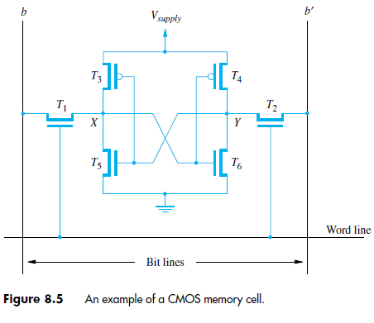
Semiconductor RAM Memories (6)
Static RAM (SRAM) (ctd.)
  CMOS Realization of a SRAM Cell
    MOS IC
      NMOS
      PMOS
      CMOS: Complementary Metal-Oxide Semiconductor (互补金属氧化物半导体)

Slide 30
Semiconductor RAM Memories (7)
Static RAM (SRAM) (ctd.)
  CMOS Realization of a SRAM Cell (ctd.)
    Note: If power is interrupted and then it is restored, the latch will settle into a stable state, but it will not necessarily be the same state the cell was in before the interruption.
    The power supply voltage is 5V in older CMOS SRAMs or 3.3V in new low-voltage versions.
    CMOS SRAMs’ power consumption is very low.
  Advantage and Disadvantage of Static RAM
    Fast
    Low density
    High cost

Slide 31
Semiconductor RAM Memories (8)
Internal Organization of Static RAM Chips
  Organization of 128 Bit Cells (16 × 8 )
b
7
b
′
7
b
1
b
′
b
b
′
1
0
0
W
•
•
•
0
•
•
•
FF
FF
A
0
W
1
A
1
Address
Memory
decoder
•
•
•
•
•
•
•
•
•
•
•
•
•
•
•
•
•
•
cells
A
2
A
3
W
•
•
•
15
Sense / Write
Sense / Write
Sense / Write
R
/
W
circuit
circuit
circuit
CS
Data input
/output lines:
b
7
b
1
b
0
Figure 8.2. Organization of bit cells in a memory chip.

Slide 32
Semiconductor RAM Memories (9)
Internal Organization of Static RAM Chips (ctd.)
  Organization of 128 Bit Cells (ctd.)
    Internal Organization
      Word line: driven by the address decoder.
      Bit lines
      Sense/Write circuits
    External Connections
      Address lines( Input ): A₀ – A₃
      Data lines( Input/Output ): b₀ – b₇
      Control lines( Input )
        R/W (Read/Write): Specify the required Read or Write operation.
        CS( Chip Select): Select a given chip in a multi-chip memory system.

Slide 33
Semiconductor RAM Memories (10)
Internal Organization of Static RAM Chips (ctd.)
  Organization of 128 Bit Cells (ctd.)
    External Connections (ctd.)
      Power Supply line
      Ground line
      Total Connections = 4 + 8 + 2 + 1 + 1 = 16
Notes:
讲到这里—2018.9.27

Slide 34
Semiconductor RAM Memories (11)
Internal Organization of Static RAM Chips (ctd.)
  Organization of 1024 (1K) Bit Cells
    128 × 8 Organization
      External Connections
        Address lines( Input ): A₀ – A₆
        Data lines( Input/Output ): b₀ – b₇
        Control lines( Input ): R/W, CS
        Power supply line
        Ground line
        Total Connections = 7 + 8 + 2 + 1 + 1 = 19

Slide 35
Semiconductor RAM Memories (12)
Internal Organization of Static RAM Chips (ctd.)
  Organization of 1024 (1K) Bit Cells (ctd.)
    1K × 1 Organization
5-bit row
address
W
0
W
1
5-bit
32
×
32
decoder
memory cell
array
W
31
Sense
/
Write
circuitry
10-bit
address
32-to-1
output multiplexer
R
/
W
and
CS
input demultiplexer
5-bit column
address
Data
input/output

Slide 36
Semiconductor RAM Memories (13)
Internal Organization of Static RAM Chips (ctd.)
  Organization of 1024 (1K) Bit Cells (ctd.)
    1K × 1 Organization (ctd.)
      External Connections
        Address lines( Input ): A₀ – A₉
        Data lines( Input/Output ): b₀
        Control lines( Input ): R/W, CS
        Power supply line
        Ground line
        Total Connections= 10 + 1 + 2 + 1 + 1 = 15
      Large chips have essentially the same organization as Figure 5.3 but use a larger memory cell array and have more external connections.

Slide 37
Semiconductor RAM Memories (14)
Dynamic RAM
  Example of a DRAM cell
Bit line
Word line
T
C
Ground

Slide 38
Semiconductor RAM Memories (15)
Dynamic RAM (ctd.)
  Example of a DRAM cell (ctd.)
    Read Operation
      Pre-charge bit line to Vcc/2.
      Take the word line HIGH.
      Detect whether current flows into or out of the cell.
      Note: cell contents are destroyed by the read!
      Must write the bit value back after reading.

Slide 39
Semiconductor RAM Memories (16)
Dynamic RAM (ctd.)
  Example of a DRAM cell (ctd.)
    Write Operation
      Take the word line HIGH.
      Set the bit line LOW or HIGH to store 0 or 1.
      Take the word line LOW.
      Note: The stored charge for a 1 will eventually leak off.
    Maintain State
      The word line is low.
    Disadvantages
      Longer memory access time
      Leaky, needs to be refreshed
      Cannot be easily integrated with CMOS

Slide 40
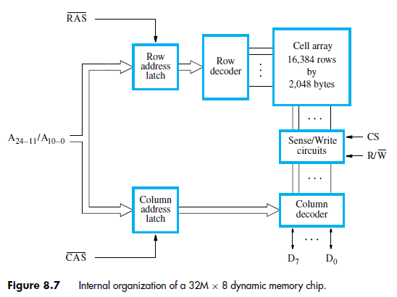
Semiconductor RAM Memories (17)
Dynamic RAM (ctd.)
  Internal Organization of an Asynchronous DRAM Chip
    Example

Slide 41
Semiconductor RAM Memories (18)
Dynamic RAM (ctd.)
  Internal Organization of an Asynchronous DRAM Chip (ctd.)
    Example (ctd.)
      14 bit address bits are needed to select a row.
      Another 11 bits are needed to specify a group of 8 bits in the selected row.
      Total: 25-bit address
      To reduce the number of pins needed for external connections, the row and column addresses are multiplexed on 14 pins.
      Row Address Strobe (RAS)
      Column Address Strobe (CAS)

Slide 42
Semiconductor RAM Memories (19)
Dynamic RAM (ctd.)
  DRAM Refresh
    Leaky storage
    Periodic refresh across DRAM rows
    Un-accessible when refreshing
    Read, and write the same data back
    Example: 4K rows in a DRAM, 100ns read cycle, Decay in 64ms
      4096*100ns = 410μs to refresh once
      410μs / 64ms = 0.64% unavailability

Slide 43
Semiconductor RAM Memories (20)
Asynchronous DRAM
  The memory is not synchronized to the system clock. A memory access is begun, and a certain period of time later the memory value appears on the bus. The signals are not coordinated with the system clock at all.
  The timing of the memory is controlled asynchronously.
    Normal: Responds to RAS and CAS signals (no clock)
    A specialized memory controller circuit provides the necessary control signals, RAS and CAS that govern the timing.

Slide 44
Semiconductor RAM Memories (21)
Asynchronous DRAM
  Question: How to access the other bytes in the same row of a DRAM chip?
  Fast Page Mode (FPM)
    Row remains open after RAS for multiple CAS commands
    It allows transferring a block of data at a much faster rate than can be achieved for transfers involving random addresses.

Slide 45
Semiconductor RAM Memories (22)
Enhanced DRAMs
  Obsolete Technologies
    Fast page mode DRAM (FPM DRAM): Allowed re-use of row-addresses
    Extended data out DRAM (EDO DRAM): Enhanced FPM DRAM with more closely spaced CAS signals.
    Video RAM (VRAM): Dual ported FPM DRAM with a second, concurrent, serial interface
    Extra functionality DRAMS (CDRAM, GDRAM): Added SRAM (CDRAM) and support for graphics operations (GDRAM)

Slide 46
Semiconductor RAM Memories (23)
Enhanced DRAMs (ctd.)
  DRAM Cores with better interface logic and faster I/O
    Synchronous DRAM (SDRAM):Uses a conventional clock signal instead of asynchronous control
    Double Data Rate Synchronous DRAM (DDR SDRAM): Double edge clocking sends two bits per cycle per pin
    Rambus™ DRAM (RDRAM):Uses faster signalling over fewer wires (source directed clocking) with a transaction oriented interface protocol

Slide 47
Semiconductor RAM Memories (24)
Synchronous DRAMs (SDRAMs)
  Their operation is directly synchronized with a clock signal.
  Structure of a SDRAM Chip
Refresh
counter
Row
Ro
w
address
decoder
Cell array
latch
Row/Column
address
Column
Co
lumn
Read/Write
address
decoder
circuits & latches
counter
Clock
R
A
S
Mode register
C
A
S
and
Data input
Data output
R
/
W
timing control
register
register
C
S
Data

Slide 48
Semiconductor RAM Memories (25)
Synchronous DRAMs (SDRAMs) (ctd.)
  Structure of a SDRAM Chip (ctd.)
    If an access is made for refreshing purpose only, it will merely refresh the contents of the cells, not changing the contents of the latches.
    It is not necessary to provide externally generated pulses on the CAS line to select successive columns. The necessary control signals are provided internally using a column counter and the clock signal.
    SDRAMs have built-in refresh circuitry. A refresh counter is a part of built-in refresh circuitry.

Slide 49
Semiconductor RAM Memories (26)
Synchronous DRAMs (SDRAMs) (ctd.)
  Burst Operation
    Example: Burst read of length 4 in an SDRAM
Clock
R
/
W
R
A
S
C
A
S
Address
Row
Col
Data
D0
D1
D2
D3

Slide 50
Semiconductor RAM Memories (27)
Synchronous DRAMs (SDRAMs) (ctd.)
  Speed of SDRAM
    The speed of SDRAM is rated in MHz rather than in nanoseconds (ns).
    Advantage
      This makes it easier to compare the bus speed and the SDRAM chip speed.
    Example
      Intel has defined PC100 and PC133 bus specifications in which the system bus is controlled by a 100 or 133 MHz clock respectively. Therefore, major manufacturers of memory chips produce 100 and 133 MHz SDRAM chips.
    Note
      Convert the SDRAM clock speed to nanoseconds by dividing the chip speed into 1 billion ns.

Slide 51
Semiconductor RAM Memories (28)
Synchronous DRAMs (SDRAMs) (ctd.)
  Latency and Bandwidth
    Latency and Bandwidth are two parameters indicating the performance of a memory system.
    Latency
      Refers to the amount of time it takes to transfer a word of data to or from the memory.
      Note
        In block transfers, latency is used to denote the time it takes to transfer the first word of data.
        When buying DRAM, the latency rating that you see most often is the memory access time.

Slide 52
Semiconductor RAM Memories (29)
Synchronous DRAMs (SDRAMs) (ctd.)
  Latency and Bandwidth (ctd.)
    Latency (ctd.)
      Example: The first word of data is transferred 5 clock cycles later.The latency is 5 clock cycles.
Clock
R
/
W
R
A
S
C
A
S
Address
Row
Col
Data
D0
D1
D2
D3
Figure 8.9. Burst read of length 4 in an SDRAM.

Slide 53
Semiconductor RAM Memories (30)
Synchronous DRAMs (SDRAMs) (ctd.)
  Latency and Bandwidth (ctd.)
    Bandwidth
      The number of bits or bytes that can be transferred in one second is referred to as bandwidth.
      Unit :bit per second or byte per second
      The bandwidth of a memory unit depends on the speed of access to the stored data and on the number of bits that can be accessed in parallel.
      The effective bandwidth also depends on the transfer capability of the links that connect the memory and the processor, typically the speed of the bus.
      Effective Bandwidth = Bus Speed × Bus Width
Notes:
讲到这里—2018.10.9

Slide 54
Semiconductor RAM Memories (31)
Synchronous DRAMs (SDRAMs) (ctd.)
  DDR SDRAM
    DDR: double data rate
    在原有的SDRAM的架构基础上加以较小的改进(可复用原有生产线)
    The latency of these devices is the same as for standard SDRAMs.
    Uses both rising (positive edge) and falling (negative) edge of clock for data transfer. (typical 100MHz clock with 200 MHz transfer). (bandwidth ×2) (SDRAM only carries information on the rising edge of a signal)
    DDR SDRAM also consumes less power, which makes it ideal for notebook computers.
    SDRAM和DDR均为开放标准(JEDEC)Important !!

Slide 55
Semiconductor RAM Memories (32)
Synchronous DRAMs (SDRAMs) (ctd.)
  DDR SDRAM (ctd.)
    DDR Terminology (ctd.)
Name | Clock Freq. | Data Rate Module Name
DDR200 | 100 MHz | 200 MHz PC1600
DDR266 | 133 MHz | 266 MHz PC2100
DDR333 | 167 MHz | 333 MHz PC2700
DDR400 | 200 MHz | 400 MHz PC3200

Slide 56
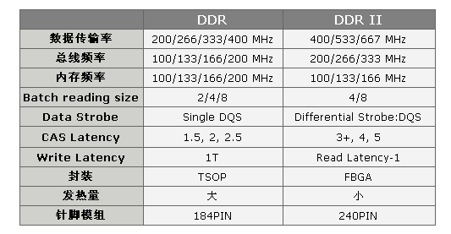
Semiconductor RAM Memories (33)
Synchronous DRAMs (SDRAMs) (ctd.)
  DDR2 SDRAM
    基于DDR技术，并在关键领域有所提升
      FBGA package (更为良好的电气性能与散热性), 1.8V
      4-bit prefetch buffer, burst length = 4
      Higher latency

Slide 57
Semiconductor RAM Memories (34)
Synchronous DRAMs (SDRAMs) (ctd.)
  DDR3 SDRAM
    Comes with a promise of a power consumption reduction of 30%, 1.5V
    "Dual-gate" transistors to reduce leakage of current.
    8 bit pre-fetch buffer, burst length = 8
Name | Clock Freq. | Data Rate | Module Name
DDR3-800 | 100 MHz | 800 MHz | PC3-6400
DDR3-1066 | 133 MHz | 1066 MHz | PC3-8500
DDR3-1333 | 166 MHz | 1333 MHz | PC3-10600
DDR3-1600 | 200 MHz | 1600 MHz | PC3-12800

Slide 58

Semiconductor RAM Memories (35)
Structure of Larger Memories
  Static Memory Systems
    由若干存储器芯片组成所要求的主存。
    位扩展法
      芯片每个存储单元的位数小于存储器字长，需进行位扩展。
      例 ：用1M×1位存储芯片组成1M×8位（1MB）的RAM，每片存储同一位权的一位数据（片的I/O端接D_{i}），访问芯片需20位地址码：A₁₉~A₀
：写读控制信号

Slide 59
Semiconductor RAM Memories (36)
Structure of Larger Memories (ctd.)
  Static Memory Systems (ctd.)
    位扩展法 (ctd.)
8
I/O
7
I/O
6
I/O
5
I/O
中 央
处理器
(CPU)
4
I/O
3
I/O
地址总线
2
I/O
A₀
1
1Mⅹ1
I/O
……
A₁₉
WE
D₀
数据总线
D₇

Slide 60
Semiconductor RAM Memories (37)
Structure of Larger Memories (ctd.)
  Static Memory Systems (ctd.)
    字扩展法
      芯片每个存储单元的位数等于存储器字长，但容量(字数)不够，需进行字扩展。
      例：用256K×8位芯片组成1MB的RAM
        1MB容量需20位地址码(A₁₉~A₀)
        256KB芯片需18位片内地址码(A₁₇ ~A₀)
        用高二位地址A₁₉A₁₈ 经2:4译码器（74139）选择芯片读/写
        每片8条I/O线分别接D₇ ~D₀

Slide 61

Semiconductor RAM Memories (38)
Structure of Larger Memories (ctd.)
  Static Memory Systems (ctd.)
    字扩展法 (ctd.)
2:4
译
码
器
3
A₁₉
2
1
A₁₈
0
CPU
A₀
_{256Kⅹ8}
_{256Kⅹ8}
_{256Kⅹ8}
_{256Kⅹ8}
CE
CE
CE
CE
A₁₇
1
2
3
4
D₀~D₇

Slide 62
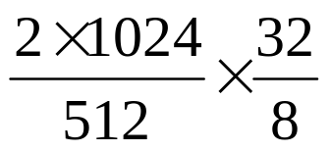

Semiconductor RAM Memories (39)
Structure of Larger Memories (ctd.)
  Static Memory Systems (ctd.)
    字位同时扩展法
      单片芯片的字数和位数均小于主存的容量要求，需进行字、位的扩展。
      Example: Using 512K × 8 static memory chips to implement a memory of 2M × 32 .
      Total chips = =16
      Figure see next page
    Conclusion
      Assume that the capacity of a memory unit is M × N bit, if constituted of using l × k bit chips, the number of total chips needed is (M/l) × (N/k).

Slide 63
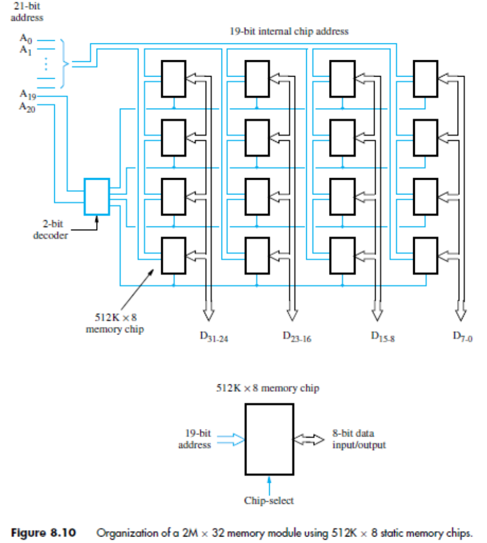

Slide 64


Semiconductor RAM Memories (40)
Structure of Larger Memories (ctd.)
  Static Memory Systems (ctd.)
    例：（补充） CPU的地址总线16根（A₁₅~A₀，A₀为低位），双向数据总线8根（D₇ ~ D₀），控制总线中与主存有关的信号有 （允许访存，低电平有效）， （高电平为读命令，低电平为写命令）。
    主存地址空间分配如下：0000_{H}—3FFF_{H}为系统程序区，由只读存储芯片组成；4000_{H}－4FFF_{H}为系统程序工作区，由SRAM组成；6000_{H}—9FFF_{H}为用户程序区，也由SRAM组成。按字节编址。现有如下存储器芯片：
EPROM：8K×8位（控制端仅有 CS ）
SRAM：16K×1位，2K×8位，4K×8位，8K×8位
请从上述芯片中选择适当芯片设计该计算机主存储器，画出主存储器逻辑框图，注意画出选片逻辑（可选用门电路及3:8译码器74LS138）与CPU的连接，说明选哪些存储器芯片及选多少片。

Slide 65
Semiconductor RAM Memories (41)
Structure of Larger Memories (ctd.)
  Static Memory Systems (ctd.)
    例：(ctd.)
0000_{H}
16KB(EPROM)
～
3FFF_{H}
【解】主存地址空间分布:
～
4000_{H}
4KB(SRAM)
4FFF_{H}
4KB(空)
6000_{H}
16KB(SRAM)
～
9FFF_{H}
A000_{H}
24KB(空)
～
FFFF_{H}

Slide 66
D
0
...
...
D
...
...
...
...
...
7
D
D
D
D
D
D
D
D
D
D
CS
7
0
CS
7
0
CS
7
0
CS
7
0
CS
7
0
CPU
EPROM
EPROM
SRAM
SRAM
SRAM
8
8
KB
8KB
8
KB
4
KB
R/W
KB
R/W
A
0
A
12
A
0
A
12
A
0
A
₁₂
A
0
A
12
A
0
A
11
R/W
A
0
...
A
10
A
11
A
12
A
13
A
14
A
15
G
2A
Y
0
Y
1
Y
2
Y
3
Y
4
Y
5
Y
6
Y
7
MREQ
G
2B
A
B
C
74LS138

Slide 67
Semiconductor RAM Memories (42)
Structure of Larger Memories (ctd.)
  Dynamic Memory Systems
    The organization of large dynamic memory systems is essentially the same as the above static memory system.
    SIMM ( Single In-line Memory Modules)
      A SIMM is a basic DRAM packaging type that fits most older systems.
      Single-sided: RAM chips on one side only
      Double-sided: RAM chips on both sides
      30-pin SIMM: 256KB,1MB,4MB,16MB;8 bits;plus 1bit for parity;single-sided
      72-pin SIMM: 1MB, 4MB, 16MB (single-sided); 2MB, 8MB, 32MB (double-sided); 32 bits, plus 4 bits for parity/ECC.
Notes:
SIMM：单列直插式内存组件

Slide 68
Semiconductor RAM Memories (43)
Structure of Larger Memories (ctd.)
  Dynamic Memory Systems (ctd.)
    DIMM ( Double In-line Memory Modules)
      At present, DIMMs are the standard way for memory to be packaged.
      A DIMM is capable of delivering 64 data bits at once.
      Differences between SIMM and DIMM
        DIMMs have separate electrical contacts on each side of the module, while the contacts on SIMMs on both sides are redundant.
        Standard SIMMs have a 32-bit data path, while standard DIMMs have a 64-bit data path.

Slide 69
Semiconductor RAM Memories (44)
Structure of Larger Memories (ctd.)
  Dynamic Memory Systems (ctd.)
    DIMM ( ctd.)
      Most common types of DIMMs
        72-pin SO-DIMM (Small Outline DIMM), used for FPM DRAM and EDO DRAM
        100-pin DIMM, used for printer SDRAM
        144-pin SO-DIMM, used for SDR SDRAM
        168-pin DIMM, used for SDR SDRAM (less frequently for FPM/EDO DRAM in workstations/servers)
        200-pin SO-DIMM, used for DDR SDRAM and DDR2 SDRAM
        204-pin SO-DIMM, used for DDR3 SDRAM
        184-pin DIMMs, used for DDR SDRAM
        240-pin DIMMs, used for DDR2 SDRAM, DDR3 SDRAM (have a different key notch location )

