Slide 1
Computer Organization & Architecture
Chapter 8 – The Memory System - 2
Junying Chen 陈俊颖

Slide 2
Content of this lecture
8.5 Memory Hierarchy
  Why have a memory hierarchy?
  What is a memory hierarchy?
  Why do memory hierarchies work?
8.6 Cache Memories
  Mapping Scheme
  Replacement Algorithm
  Write Policy

Slide 3
Memory Hierarchy (1)
Why Have a Memory Hierarchy?
  Ideally
    Infinite storage
    Fast
    Cheap
    Compact
    Cold
    Non-volatile
  Can’t have everything
    Bigger → slower
    Faster → denser
    Faster → more expensive
Notes:
non-volatile：非易失性的

Slide 4
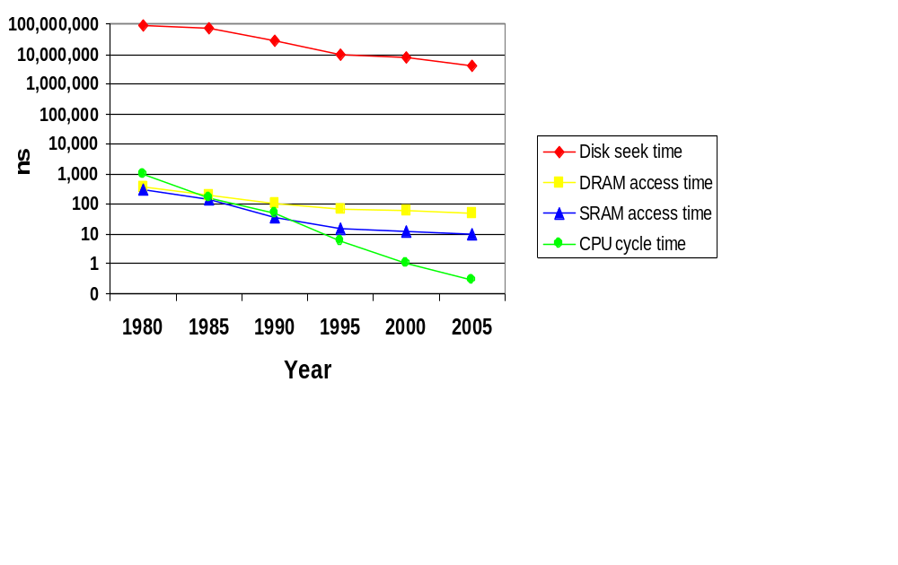
Memory Hierarchy (2)
Why Have a Memory Hierarchy? (ctd.)
  The CPU-Memory Gap
    The gap widens between DRAM, disk, and CPU speeds.
Notes:
Disk seek time：磁盘查找时间

Slide 5
Memory Hierarchy (3)
How can We Achieve the Ideal?
  Fact: Large memories are slow, fast memories are small
  How do we create a memory that gives the illusion of being large, cheap and fast (most of the time)?
by taking advantage of
  The Principle of Locality(局部性原理):Programs access a relatively small portion of the address space at any instant of time.
Probability
of reference
0
Address Space
2^{n} - 1

Slide 6
Memory Hierarchy (4)
How can We Achieve the Ideal? (ctd.)
  The Principle of Locality (ctd.)
    Temporal Locality – locality in time (时间局部性)
      If item was referenced recently, it will likely be referenced again soon.
    Spatial locality – locality in space (空间局部性)
      If an item is referenced, items near it might be referenced soon
      80/20 rule – 80% of the time is spent executing 20% of the code

Slide 7
Memory Hierarchy (5)
What is the Memory Hierarchy?
  Some fundamental and enduring properties of hardware and software:
    Fast storage technologies cost more per byte and have less capacity.
    The gap between CPU and main memory speed is widening.
    Well-written programs tend to exhibit good locality.
  These fundamental properties complement each other beautifully.
  They suggest an approach for organizing memory and storage systems known as a memory hierarchy.
Notes:
学好体系结构的重要性：写软件程序能经可能地充分利用局部性原理，尽可能地节省数据访问时间。

Slide 8
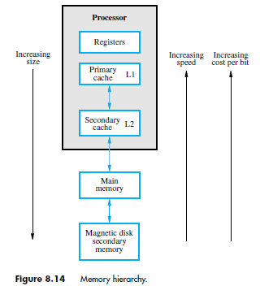
Memory Hierarchy (6)
What is the Memory Hierarchy? (ctd.)

Slide 9
Memory Hierarchy (7)
How is the Hierarchy Managed?
  Registers <-> Memory
    By compiler (programmer?)
  Cache <-> Main memory
    By the hardware
  Main Memory <-> Disks
    By the hardware and operating system (virtual memory)
    By the programmer (files)

Slide 10
Memory Hierarchy (8)
Four Questions for Memory Hierarchy Designers
  Q1: Where can a block be placed in the upper level? (Block placement)
  Q2: How is a block found if it is in the upper level?
  (Block identification)
  Q3: Which block should be replaced on a miss?
  (Block replacement)
  Q4: What happens on a write?
  (Write strategy)

Slide 11
Cache Memories (1)
CPU-DRAM Gap
  1980: no cache in µproc; 1995 2-level cache on chip (1989 first Intel µproc with a cache on chip)
1000
µProc
60%/yr.
CPU
“Moore’s Law”
100
Processor-Memory
Performance Gap:
(grows 50% / year)
Performance
10
DRAM
7%/yr.
DRAM
1
1980
1981
1982
1983
1984
1985
1986
1987
1988
1989
1990
1991
1992
1993
1994
1995
1996
1997
1998
1999
2000

Slide 12

Cache Memories (2)
Placement of Cache in a Computer System
  Cache memories are small, fast SRAM-based memories managed automatically in hardware.
  Serves as a buffer between CPU and main memory
  Hold frequently accessed blocks of main memory

Slide 13
Cache Memories (3)
Purpose of Cache Memory
  Give main memory speed approaching that of the fastest memories available.
  At the same time, provide a large memory size at the price of less expensive types of semiconductor memories.
Structure of Cache/Memory System
  Figure see next page

Slide 14
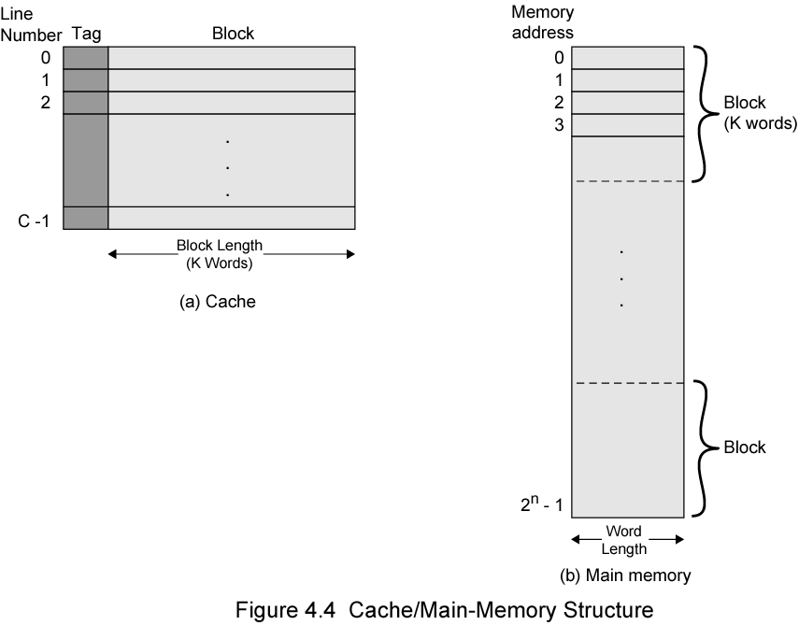

Slide 15
Cache Memories (4)
Structure of Cache/Memory System (ctd.)
  Each entry contains a block from main memory.
    Copy of contents of several consecutive bytes in main memory
    Tag is also stored with each block-identifies addresses of these bytes
  When one byte from a block is needed
    If block not already in cache, entire block loaded
  Block stayed in cache until entry must be reused

Slide 16
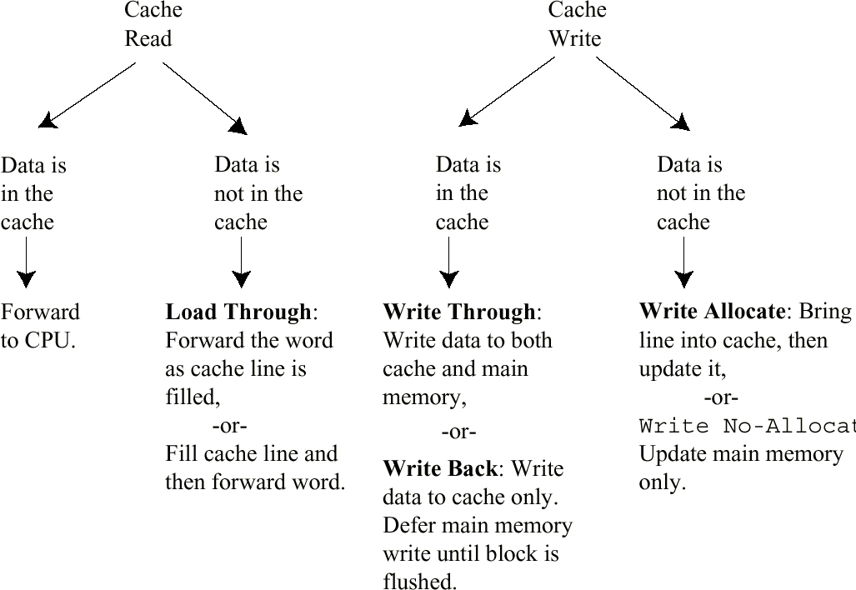
Cache Memories (5)
Cache Read and Write Policies

Slide 17
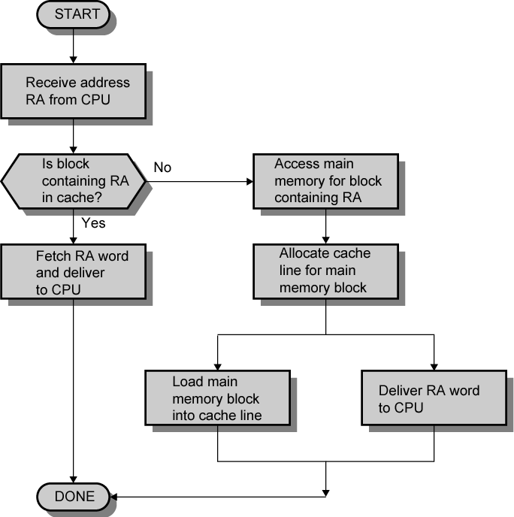
Cache Memories (6)
Cache Read Flowchart

Slide 18
Cache Memories (7)
Cache Design Issues
  Where can a block be placed in a cache? Mapping Scheme
  How is a block found if it is in a cache? Block Identification
  Which block should be evicted on a cache miss? Replacement Algorithm
  What happens on write hit? What happens on write miss? Write Policy

Slide 19
Cache Memories (8)
Mapping Scheme
  If the CPU generates an address for a particular word in main memory, and that data happens to be in the cache, the same main memory address cannot be used to access the cache.
  Hence a mapping scheme is required that converts the generated main memory address into a cache location.
  Mapping scheme also determines where the block will placed when it originally copied into the cache.

Slide 20
Cache Memories (9)
Mapping Scheme (ctd.)
  Address Conversion To Cache Location
    Address conversion is done by giving special significance to the bits of the main memory address.
    The address is split into distinct groups called fields.
    The group fields are a way to find:
      Which cache location?
      Which word in the block?
      Whether it is the right data are looking for? Some kind of unique identifier

Slide 21
Cache Memories (10)
Mapping Scheme (ctd.)
  Three Schemes
    Direct Mapping
    Associative Mapping
    Set Associative Mapping
  Assume that
    Cache line L_{i} i = 0, 1, …, m – 1 m = 2^{r}
    Memory block B_{j} j = 0, 1, …, n – 1 n = 2^{s}
    Each line or block consists of k = 2^{w} consecutive words
Notes:
直接映射，相联映射，组相联映射

Slide 22
Cache Memories (11)
Direct Mapping
  Each block of main memory maps to only one cache line
    i.e. if a block is in cache, it must be in one specific place
  i = j modulo m, where
    i = cache line number
    j = main memory block number
    m = number of lines in the cache

Slide 23
Cache Memories (12)
Direct Mapping (ctd.)
  Cache Line Table
Cache line | Main Memory blocks assigned
0 | 0, m, 2m, …, 2^{s}- m
1 | 1, m + 1, 2m +1, …, 2^{s}- m+1
… | …
m – 1 | m-1, 2m-1, 3m-1, …, 2^{s}-1

Slide 24
Cache Memories (13)
Direct Mapping (ctd.)
  Address Structure
    Least Significant w bits identify unique word
    Most Significant s bits specify one memory block
    The MSBs are split into a cache line field r and a tag of s-r (most significant)
  Access Cache (see next page)
Tag s-r
Line or Slot r
Word w

Slide 25
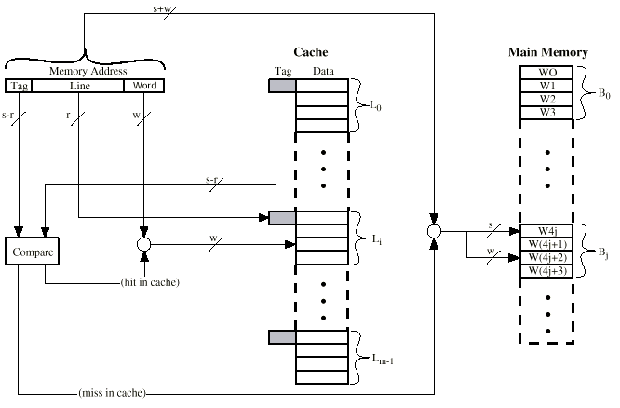
Cache Memories (14)
Direct Mapping (ctd.)

Slide 26
Cache Memories (15)
Direct Mapping (ctd.)
  Example: Consider a cache consisting of 128 lines of 16 words each. The main memory has 64K words. Assume that :
    The main memory is addressable by a 16-bit address.
    Consecutive addresses refer to consecutive words. Thus,
      Total Main Memory Blocks =64K/16= 4K
      i = j modulo 128

Slide 27
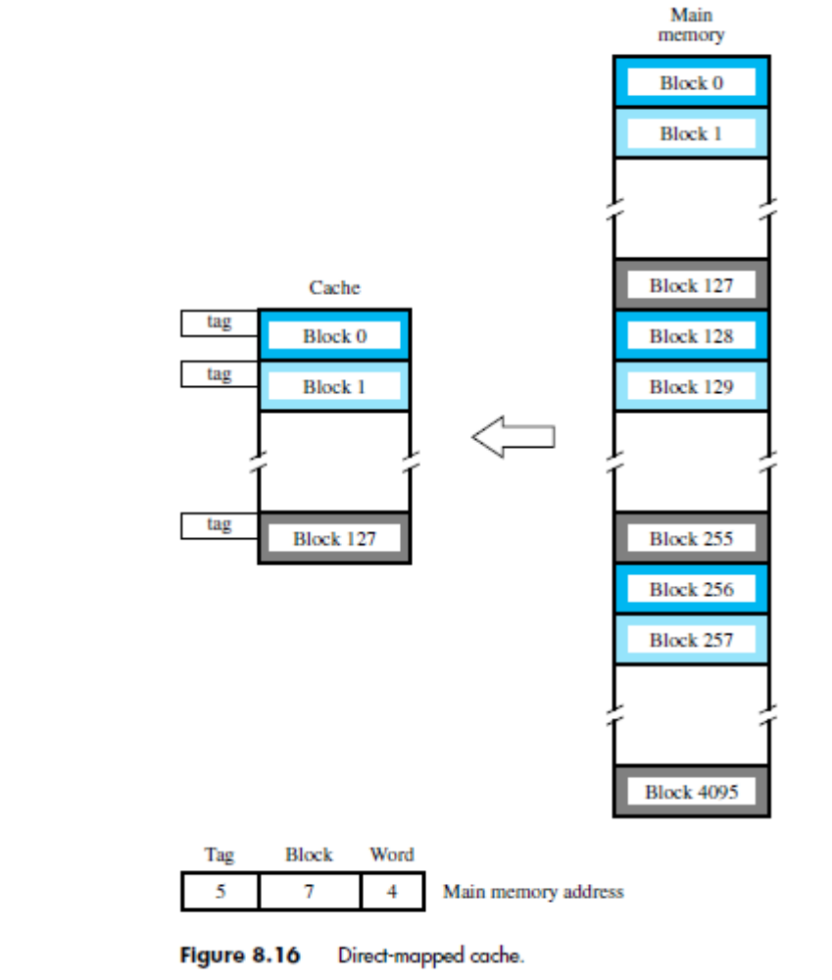
Cache Memories (16)
Direct Mapping (ctd.)
  Example (ctd.)

Slide 28
Cache Memories (17)
Direct Mapping (ctd.)
  Advantages
    Simple, easy to implement
    Inexpensive
  Disadvantage
    Fixed location for given block
      If a program accesses 2 blocks that map to the same line repeatedly, cache misses are very high

Slide 29
Cache Memories (18)
Associative Mapping
  A main memory block can load into any line of cache
  Address Structure
    Memory address is interpreted as tag and word
    Tag uniquely identifies block of memory
  Every line’s tag is examined for a match
  Cache searching gets expensive
  Access Cache (see next page)
Word
w bit
Tag s bit
Notes:
讲到这里—2018.10.11

Slide 30

Cache Memories (19)
Associative Mapping (ctd.)

Slide 31
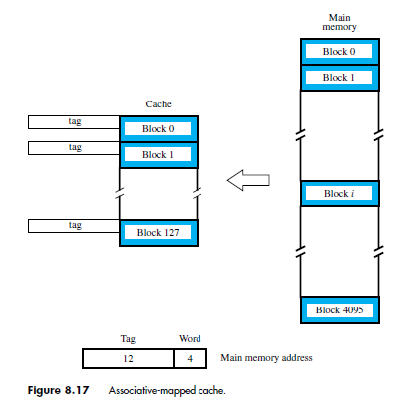
Cache Memories (20)
Associative Mapping (ctd.)
  Example

Slide 32
Cache Memories (21)
Associative Mapping (ctd.)
  Advantage
    It gives complete freedom in choosing the cache location in which to place the memory blocks.
  Disadvantage
    Complex circuitry required to examine the tags of all cache blocks in parallel.

Slide 33
Cache Memories (22)
Set Associative Mapping
  A combination of the direct- and associative-mapping techniques.
  Cache is divided into a number of sets
  Each set contains a number of lines
  A given block maps to any line in a given set
    e.g. Block Bj can be in any line of set i
    e.g. 2 lines per set
      2 way set associative mapping
      A given block can be in one of 2 lines in only one set
Notes:
2 way set associative mapping：双路组相联映射

Slide 34
Cache Memories (23)
Set Associative Mapping (ctd.)
  The cache is divided into v ( =2^{d} ) sets, each of which consists of k lines. ( k-way set associative mapping)
    m = v × k
    i = j modulo v, where
      i = cache set number
      j = main memory block number
      v = number of sets in the cache
    Special Cases
      v = m, k =1 Direct mapping
      v = 1, k = m Fully Associative mapping
      v = m/2, k = 2 2-way Set associative mapping
      v = m/4, k = 4 4-way Set associative mapping

Slide 35
Cache Memories (24)
Set Associative Mapping (ctd.)
  Address Structure
    Set Field
      Determine which set of the cache might contain the desired block.
  Access Cache (see next page)
Word
w bit
Tag (s-d) bit
Set d bit

Slide 36
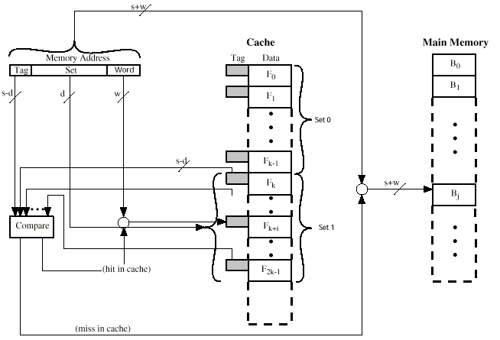
Cache Memories (25)
Set Associative Mapping (ctd.)

Slide 37
Cache Memories (26)
memory
Block 0
Set Associative Mapping (ctd.)
  Example
    i = j modulo 64
Block 1
Cache
tag
Block 0
Set 0
Block 63
tag
Block 64
tag
Block 64
Set 1
Block 1
tag
Block 65
Block 65
tag
Block 127
Set 63
Block 63
tag
Block 128
Block 127
Block 129
Block 4095
T
ag
Set
W
ord
6
6
4
Main memory address

Slide 38
Cache Memories (27)
Set Associative Mapping (ctd.)
  Advantages
    The contention problem of the direct method is eased by having a few choices for block replacement.
    The hardware cost is reduced by decreasing the size of the associative search.
  Disadvantages
    Tags of each block in a set need to be matched (in parallel) to figure out whether the data is present in cache. Need k comparators.
    Although, the hardware cost for matching is less than fully associative (need n comparators, where n = #blocks), but it is more than direct mapped (need only one comparator)

Slide 39
Cache Memories (28)
Tag & Valid Bit
  To find data stored in the cache, we need to add tags to distinguish between different memory locations that map to the same cache block.
  We include a single valid bit per block to distinguish full and empty blocks.
    0 – not valid, 1 – valid
    All blocks at start up would be not valid
    If data from main memory is got into cache for a particular block, then valid bit for that field is set
    Valid bit will contribute to the cache size

Slide 40
Cache Memories (29)
Hit & Miss in Cache
  Hit means that we actually found data in the cache
    A hit occurs when valid bit = 1 AND tag in the cache matches the tag field of the address
  Miss
    If both conditions don’t hold then we did not find the data in cache.
    On a miss, the data is brought from main memory into the cache, and the valid bit is set.

Slide 41
Cache Memories (30)
Replacement Algorithms
  Direct Mapped Cache
    No choice
    Each block only maps to one line
    Replace that line
  Associative and Set Associative Mapped Cache
    Hardware implemented algorithm (speed)
    LRU (Least Recently Used)
      Replace block not accessed for longest time
    FIFO (First In First Out)
      Push block onto queue when accessed
      Choose block to replace by popping queue
    Random
      Replace block chosen at random

Slide 42
Cache Memories (31)
Example of Mapping Technique
  Assume that
    The processor has separate instruction and data caches.
    The data cache has space for only 8 blocks of data.
    Each block consists of only one 16-bit word of data and the memory is word-addressable with 16-bit addresses.
    The LRU replacement algorithm is used for block replacement in the cache.
  Examine the changes in the data cache entries caused by running the following applications:
    A 4×10 array of numbers, each occupying one word, is stored in memory locations 7A00 through 7A27.
    The elements of this array,A, are stored in column order.

Slide 43
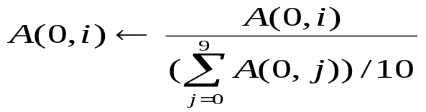
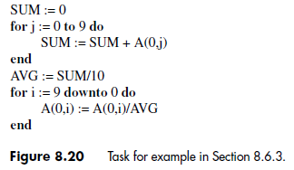
Cache Memories (32)
Example of Mapping Technique (ctd.)
  Examine the changes in the data cache entries caused by running the following applications: (ctd.)
    The application normalizes the elements of the first row of A with respect to the average value of the elements in the row. That is ,
for i=0,1,…,9

Slide 44
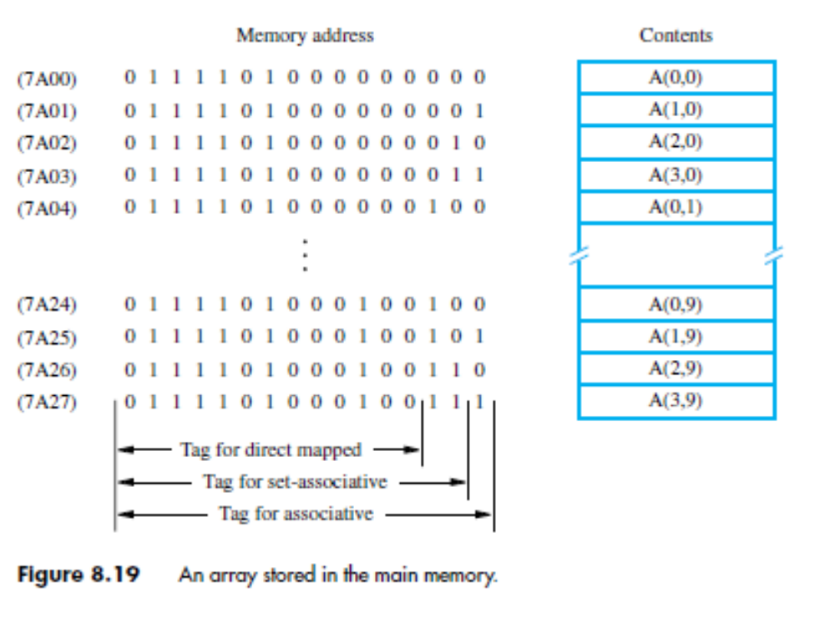
Cache Memories (33)
Example of Mapping Technique (ctd.)

Slide 45
Cache Memories (34)
Example of Mapping Technique (ctd.)
  Direct Mapped Cache
Eight elements are replaced while the second loop is executed.
T
ag
Block
13
3
Main memory address
Contents of data cache after pass:
Block
j
=
1
j
=
3
j
=
5
j
=
7
j
=
9
i
=
6
i
=
4
i
=
2
i
=
0
position
0
A(0,0)
A(0,2)
A(0,4)
A(0,6)
A(0,8)
A(0,6)
A(0,4)
A(0,2)
A(0,0)
1
2
3
4
A(0,1)
A(0,3)
A(0,5)
A(0,7)
A(0,9)
A(0,7)
A(0,5)
A(0,3)
A(0,1)
5
6
7
Figure 8.21. Contents of a direct-mapped data cache

Slide 46
Cache Memories (35)
Example of Mapping Technique (ctd.)
  Associative Mapped Cache
T
ag
16
Main memory address
Two elements are replaced while the second loop is executed.
Contents of data cache after pass:
Block
j
=
7
j
=
8
j
=
9
i
=
1
i
=
0
position
0
A(0,0)
A(0,8)
A(0,8)
A(0,8)
A(0,0)
1
A(0,1)
A(0,1)
A(0,9)
A(0,1)
A(0,1)
2
A(0,2)
A(0,2)
A(0,2)
A(0,2)
A(0,2)
3
A(0,3)
A(0,3)
A(0,3)
A(0,3)
A(0,3)
4
A(0,4)
A(0,4)
A(0,4)
A(0,4)
A(0,4)
5
A(0,5)
A(0,5)
A(0,5)
A(0,5)
A(0,5)
6
A(0,6)
A(0,6)
A(0,6)
A(0,6)
A(0,6)
7
A(0,7)
A(0,7)
A(0,7)
A(0,7)
A(0,7)
Figure 8.22. Contents of an associative-mapped data cache in

Slide 47
Cache Memories (36)
Example of Mapping Technique (ctd.)
  Set Associative Mapped Cache
T
ag
Set
Six elements must be reloaded during execution of the second loop.
15
1
Main memory address
Contents of data cache after pass:
j
=
3
j
=
7
j
=
9
i
=
4
i
=
2
i
=
0
A(0,0)
A(0,4)
A(0,8)
A(0,4)
A(0,4)
A(0,0)
A(0,1)
A(0,5)
A(0,9)
A(0,5)
A(0,5)
A(0,1)
Set 0
A(0,2)
A(0,6)
A(0,6)
A(0,6)
A(0,2)
A(0,2)
A(0,3)
A(0,7)
A(0,7)
A(0,7)
A(0,3)
A(0,3)
Set 1
Figure 8.23. Contents of a set-associative-mapped data cache

Slide 48
Cache Memories (37)
Write Policy
  Write Hit: Update the data in the cache, but what about the main memory?
    Write Through
      The cache location and the main memory location are updated simultaneously.
      Advantage
        Keeps cache main memory consistent at the same time.
      Disadvantages
        All writes require main memory access (bus transaction).
        Slows down the system - If there is another read request for main memory due to miss in cache, the read request has to wait until the earlier write was serviced.

Slide 49
Cache Memories (38)
Write Policy (ctd.)
  Write Hit (ctd.)
    Write Back
      Update only the cache location and to mark it as updated with an associated flag bit (dirty or modified bit).
      When the block containing the marked word is to be removed from the cache, update the main memory location of the word.
      Advantages
        Faster than write-through, time is not spent accessing main memory.
        Writes to multiple words within a block require only one write to the main-memory.

Slide 50
Cache Memories (39)
Write Policy (ctd.)
  Write Hit (ctd.)
    Write Back (ctd.)
      Disadvantages
        Portions of main memory are invalid, and hence accesses by I/O modules can be allowed only through the cache.
        Need extra bit in cache to indicate which block has been modified. 0 – Not Dirty, 1 – Dirty (modified). Adds to size of the cache.

Slide 51
Cache Memories (40)
Write Policy (ctd.)
  Write Miss
    No-Write Allocate
      Write-through cache: The information is written directly into the main memory and not loaded into the cache.
    Write Allocate
      Write-back cache: The block containing the addressed word is first brought into the cache, and then the desired word in the cache is overwritten with the new information.

Slide 52
Cache Memories (41)
Hit Rate and Miss Penalty (see 8.7.1)
  Hit Rate
    Hit: A successful access to data in a cache is called a hit.
    Hit Rate: The number of hits stated as a fraction of all attempted accesses is called the hit rate.
    High hit rates, well over 0.9, are essential for high-performance computers.
  Miss Penalty
    Miss Rate: The number of misses stated as a fraction of attempted accesses.
    Miss Penalty: The total access time seen by the processor when a miss occurs as the miss penalty.
    The miss penalty consists almost entirely of the time to access a block of data in the main memory, in a system with one level of cache.

Slide 53
Cache Memories (42)
Hit Rate and Miss Penalty (ctd.)
  Impact of the cache on the overall performance of the computer
    The average access time experienced by the processor
    tavg=hC+(1 – h)M
      h: hit rate
      C: the time to access information in the cache
      M: miss penalty

Slide 54
Cache Memories (43)
Hit Rate and Miss Penalty (ctd.)
  Example 8.1: Consider a computer that has the following parameters. Access times to the cache and the main memory are τ and 10τ , respectively. When a cache miss occurs, a block of 8 words is transferred from the main memory to the cache. It takes 10τ to transfer the first word of the block, and the remaining 7 words are transferred at the rate of one word every τ seconds. The miss penalty also includes a delay of τ for the initial access to the cache, which misses, and another delay of τ to transfer the word to the processor after the block is loaded into the cache (assuming no load-through). Thus, the miss penalty in this computer is given by: M= τ + 10τ +7 τ+ τ=19 τ

Slide 55
Cache Memories (44)
Hit Rate and Miss Penalty (ctd.)
  Example 8.1 (ctd.) Assume that 30 percent of the instructions in a typical program perform a Read or a Write operation, which means that there are 130 memory accesses for every 100 instructions executed. Assume that the hit rates in the cache are 0.95 for instructions and 0.9 for data. Assume further that the miss penalty is the same for both read and write accesses. Then, a rough estimate of the improvement in memory performance that results from using the cache can be obtained as follows:

Slide 56
Cache Memories (45)
Hit Rate and Miss Penalty (ctd.)
  Example 8.1: An estimate of the increase in memory access time caused by misses in the cache is given by:

Slide 57
Cache Memories (46)
Multi-level Cache
  Most of today’s systems employ multilevel cache hierarchies.
  The levels of cache form their own small memory hierarchy.
  Current day processor uses
    Level-1 cache (8KB to 128KB) is situated on the processor.—Access time is typically about 4ns.
    Level-2 cache (256KB to several MB) located internal or external to the processor. –Access time is usually around 15-20ns.

Slide 58
Cache Memories (47)
Instruction and Data Caches
  A unified or integrated cache is one where both instructions and data are cached.
    Causing excessive cache misses
  Many modern systems employ separate caches for data and instructions. This is called a Harvard cache.
  Advantages
    Allows accesses to be less random and more clustered.
    Less access time than unified cache (typically larger).

Slide 59
Cache Memories (48)
Caches on the Processor Chip (see 8.7.2)
  Most processor chips include at least one L1 cache. Often there are two separate L1 caches, one for instructions and another for data.
  In high-performance processors, two levels of caches are normally used, separate L1 caches for instructions and data and a larger L2 cache.

Slide 60
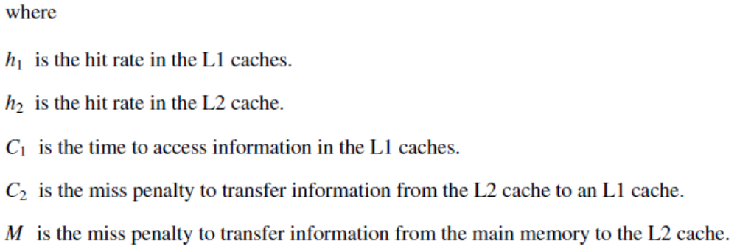
Cache Memories (49)
Caches on the Processor Chip (ctd.)
  The average access time experienced by the processor in such a system is:

