Slide 1
Computer Organization & Architecture
Chapter 8 – The Memory System - 3
Junying Chen 陈俊颖

Slide 2
Content of this lecture
8.8 Virtual Memory
  What is Virtual Memory
  Benefits of Virtual Memory
  Implementation of Virtual Memory
8.10 Secondary Storage
  Magnetic Hard Disks
  Optical Disks
8.12 Solved Problems

Slide 3
Virtual Memory (1)
What is Virtual Memory
  If you think it’s there, and it’s there…it’s real.
  If you think it’s not there, and it’s there…it’s transparent.
  If you think it’s there, and it’s not there…it’s imaginary.
  If you think it’s not there, and it’s not there…it’s nonexistent.
  Virtual memory is imaginary memory: it gives you the illusion of a memory arrangement that’s not physically there.

Slide 4
Virtual Memory (2)
Motivations for Virtual Memory
  Use physical DRAM as cache for the disk
    Address space of a process can exceed physical memory size
    Sum of address spaces of multiple processes can exceed physical memory (more common modern case)
  Simplify memory management
    Multiple processes resident in main memory
      Each with its own address space
    Only “active” code and data is actually in memory
      Allocate more memory to process as needed
  Provide protection
    One process can’t interfere with another
      Because they operate in different address spaces
    User process cannot access privileged information
      Different sections of address spaces have different permissions

Slide 5
Virtual Memory (3)
Terminology
  Physical memory – memory as seen by the processor
  Logical memory – memory as seen by the process
  Physical Address – real location in physical memory; identifies actual storage
  Virtual Address – conventional addressing used by a program which the OS must translate into a physical address
Notes:
讲到这里—2018.10.16

Slide 6
Virtual Memory (4)
What is Virtual Memory?
  Not a physical device but an abstract concept.
  It’s just another level in the cache/memory hierarchies.
  Virtual memory is the name of the technique that allows us to view main memory as a cache of a larger memory space (on disk).
    Automatic storage allocation
cpu
$
cacheing
cache
cacheing
memory
virtual memory
disk

Slide 7
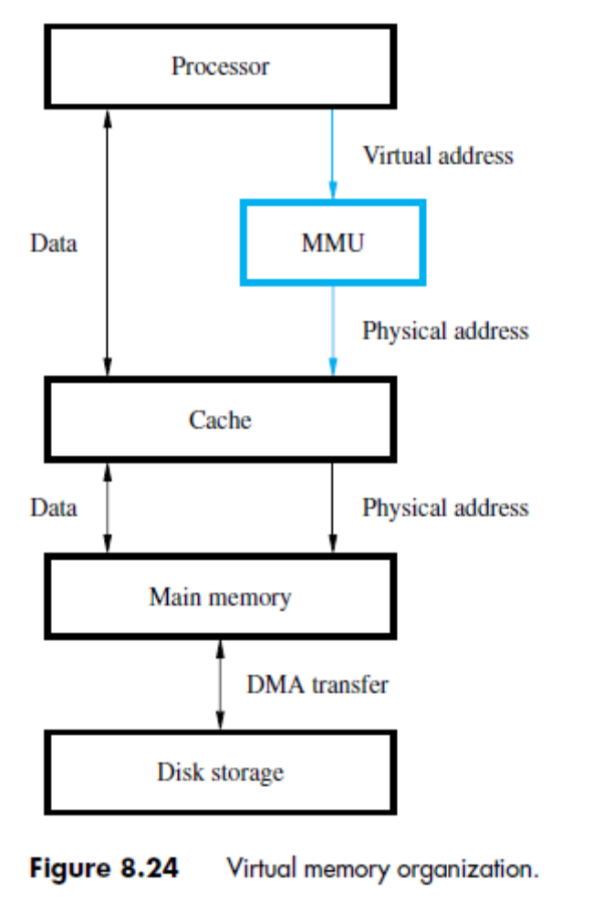
Virtual Memory (5)
Typical Organization of VM
  MMU
    Memory Management Unit
  OS
    Control MMU
  Address Translation
    The hardware converts virtual addresses into physical addresses via an OS-managed lookup table (page table)

Slide 8
Virtual Memory (6)
Benefits of VM
  Large address space: Virtual address to Physical Address mapping
  Simplify relocation: the same program can run in any location in the physical memory
  Reduce time to start a program: not all code and data need to be in the physical memory before a program can start
  Relieve programmers from burden of overlays: VM automatically manages the two levels of memory hierarchy represented by main memory and secondary storage

Slide 9
Virtual Memory (7)
Implementation of VM
  Paging
  Segmentation
  Segmentation with Paging

Slide 10
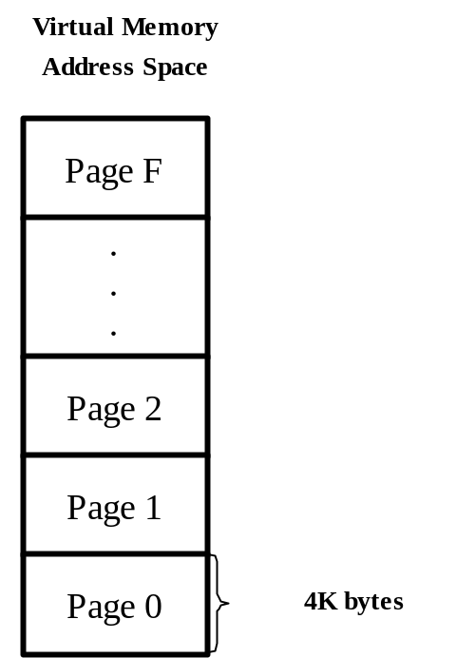
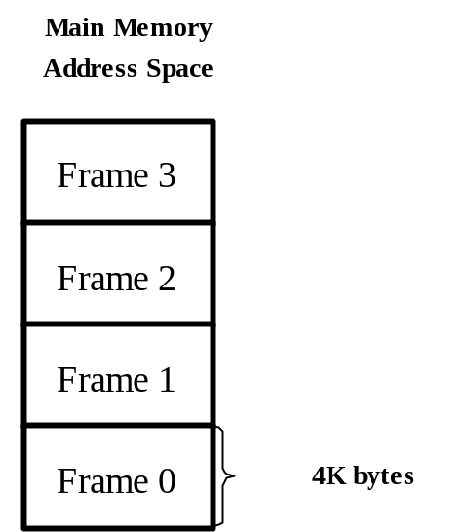
Virtual Memory (8)
Paging
  Organization of Virtual Memory and Main Memory
    Page: a block of consecutive words
    Page Frame: an area in the main memory that can hold one page

Slide 11
Virtual Memory (9)
Paging (ctd.)
  Organization of Virtual Memory and Main Memory (ctd.)
    Note
      Pages constitute the basic unit of information that is moved between the main memory and the disk.
      Pages commonly range from 2K to 16K bytes in length.
      Pages should not be too small or too large.
  Address Structure
    Virtual Address (2 fields)
      Virtual page number (high-order bits)
      Offset (low-order bits)
        Specify the location of a particular byte(or word) within a page.
    Physical Address (2 fields)
      Physical page number (high-order bits)
      Offset

Slide 12
Virtual Memory (10)
Paging (ctd.)
  Page Table
    A page table is an array of page table entries (PTEs) that maps virtual pages to physical pages.
      Kernel data structure in DRAM
  Page Table Entry
    Access Control Bit
      Read, Write, Execute, etc
    Present Bit (Valid Bit)
      present in main memory (or not)

Slide 13
Virtual Memory (11)
Paging (ctd.)
  Page Table Entry (ctd.)
    Dirty Bit
      If the page has been modified
    Use Bit
      Recently used?
    Page Number
      physical page number OR pointer to secondary storage
Access
Present
Dirty
Use
Page Number

Slide 14
Virtual Memory (12)
Virtual address from processor
Page table base register
Paging (ctd.)
  Address Translation
Page table address
Virtual page number
Offset
+
PAGE TABLE
Control
Page frame
bits
in memory
Page frame
Offset
Figure 8.25. Virtual-memory address translation.

Slide 15
Virtual Memory (13)
Paging (ctd.)
  Page Hit
    A page hit is a reference to a VM word that is in physical (main) memory.
  Page Fault (Similar to “Cache Miss”)
    A page fault is caused by a reference to a VM word that is not in physical (main) memory.
    Example: A instruction references a word contained in VP 3, a miss that triggers a page fault exception
    What if an object is on disk rather than in memory?
      Page table indicates that the virtual address is not in memory
      OS trap handler is invoked, moving data from disk into memory
        Current process suspends, others can resume
        OS has full control over placement, etc.

Slide 16
Virtual Memory (14)
Paging (ctd.)
  Servicing a Page Fault
    Make space in memory by writing physical page to disk
      Page Frames
      Replacement policy?
    Load page
      Loading pages could waste processor time, use DMA
      DMA allows processor to do something else
    OS updates the process's page table
      Desired data is in memory for process to resume

Slide 17
Virtual Memory (15)
Paging (ctd.)
  Translation Lookaside Buffer (TLB)
    Disadvantage of Page Table
      Every memory access by a program can take at least twice as long: one memory access to obtain the physical address and a second access to get the data.
    TLB
      A small cache which is incorporated in MMU consists of a small portion of the page table.
      The contents of the TLB must be coherent with the contents of page tables in the main memory.

Slide 18
Virtual Memory (16)
Virtual address from processor
Paging (ctd.)
  TLB (ctd.)
    Address Translation with TLB
Virtual page number
Offset
TLB
Virtual page
Control
Page frame
number
bits
in memory
No
=?
Yes
Miss
Hit
Page frame
Offset
Figure 8.26. Use of an associative-mapped TLB.

Slide 19
Virtual Memory (17)
Paging (ctd.)
  TLB (ctd.)
    Design Issues
      Accessed Frequently: Speed is important
      Minimize TLB Miss
        Can be fully-associative, set-associative, or direct mapped
        Often fully associative, can be set associative
        Sized to maximize hits, but make timing
        Usually not more than 128, 256 entries (associativity)

Slide 20
Virtual Memory (18)
Paging (ctd.)
  Page Replacement
    LRU (needs use bits)
    FIFO
    Software (OS) implementation
  Write Policy
    Write back
    Write through is not suitable for virtual memory.
  Disadvantage
    Internal Fragmentation
      Last page is unlikely to be full

Slide 21
Virtual Memory (19)
Paging (ctd.)
  Disadvantage (ctd.)
    Example: If the program and data need 26000 bytes on a machine with 4096 bytes per page, the first 6 page will be full, totaling 6×4096=24576 bytes, and the last page will contain 26000－24576=1424 bytes. So 2672 bytes will be wasted.
    Conclusion
      If the page size is n bytes, the average amount of space wasted in the last page of a program by internal fragmentation will be n/2 bytes.

Slide 22
Virtual Memory (20)
Paging (ctd.)
  Selecting Page Size
    Choosing a page size is a question of balancing forces that favor a larger page size versus those favoring a smaller size.
    Advantages of Choosing Large Page Size
      The size of the page table is inversely proportional to the page size: Memory can therefore be saved by making the pages bigger
      Transferring larger pages to or from secondary storage, possibly over a network, is more efficient than transferring smaller pages.

Slide 23
Virtual Memory (21)
Paging (ctd.)
  Selecting Page Size (ctd.)
    Advantage of Choosing Smaller Page Size
      The main reason for choosing smaller page is conserving storage. A small page size will result in less wasted storage when a contiguous region of virtual memory is not equal in size to a multiple of the page size.

Slide 24
Virtual Memory(22)
Segmentation
  For many problems, having two or more separate virtual address spaces may be much better than having only one.
  Example: A compiler might have many tables that are built up as compilation proceeds, including (1) The symbol table(2) The source text being saved for the printed listing (3) A table containing all the integer and floating-point constants used(4) The parse tree(5) The stack used for procedure calls within the compiler. Consider what happens if a program has an exceptionally large number of variables.

Slide 25
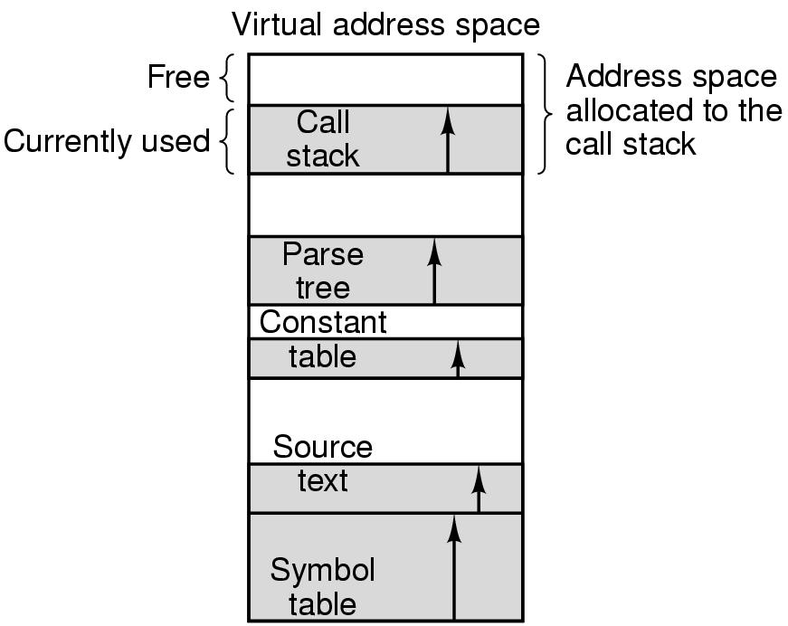
Virtual Memory (23)
Segmentation (ctd.)
  Example

Slide 26
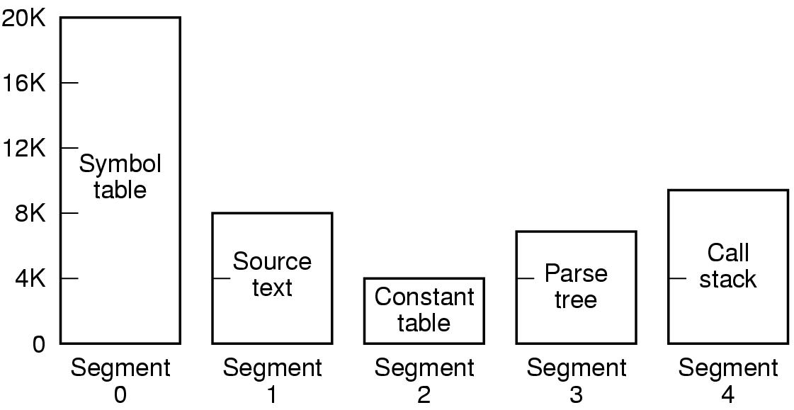
Virtual Memory (24)
Segmentation (ctd.)
  Solution: Provide many completely independent address spaces.

Slide 27
Virtual Memory (25)
Segmentation (ctd.)
  Memory-management scheme that supports user view of memory.
  Pages are fixed in size, segments are variable sized.
  A program is a collection of segments. A segment is a logical unit such as:
    Main program
    Procedure
    Function
    Symbol table
    Stack
    …

Slide 28
Virtual Memory (26)
Segmentation (ctd.)
  Segment
    A self-contained unit, which consists of a linear sequence of address from 0 to some maximum.
  Note
    A segment usually does not contain a mixture of different type.
    The length of each segment can vary in size, from 0 to the maximum allowed.
    Segment lengths may change during execution without affecting each other.
    A segment is a logical entity, which the programmer is aware of and uses as a single logical entity.

Slide 29
Virtual Memory (27)
Segmentation (ctd.)
  Address Structure
    Virtual Address
      Virtual Segment Number
      Offset
  Address Translation
    Segment table: maps two-dimensional physical addresses; each table entry has:
      base – contains the starting physical address where the segments reside in memory
      limit – specifies the length of the segment
    Segment Table Base Register (STBR): points to the segment table’s location in memory
    Segment Table Length Register (STLR)

Slide 30

Virtual Memory (28)
Segmentation (ctd.)
  Address Translation (ctd.)

Slide 31
Virtual Memory (29)
Segmentation (ctd.)
  Address Translation (ctd.)
    The offset is compared to the segment size. If the offset is greater than or equal to the segment size, indicating that the location is not a part of the segment, an error is generated.
    A segmented MMU can also have a TLB to speed up the generation of segment start addresses and sizes.

Slide 32

Virtual Memory (30)
Segmentation (ctd.)
  Example of Segmentation

Slide 33
Virtual Memory (31)
Segmentation (ctd.)
  Advantages
    Resolve internal fragmentation problem.
    Simplify the handling of data structures that are shrinking or growing.
    The linking up of procedures compiled separately is greatly simplified.
    Facilitate sharing procedures or data between several programs.
    Different segments can have different kinds of protection.

Slide 34
Virtual Memory (32)
Segmentation (ctd.)
  Disadvantages
    Programmer must be aware of the memory model in use (at the assembly level, anyway)
    The start address is added to the offset, a process much more time consuming than concatenation.
    Segments may be too large to fit in physical memory.
    Segmentation has a problem called external fragmentation.
    External Fragmentation (next page)

Slide 35
Virtual Memory (33)
Segmentation with Paging
  Take advantage of the best features of both by assigning fixed-size pages within variable-sized segments.
  Address Structure
    Segment number
    Page number
    Offset within page
  Address Translation
    Each segment has a page table
Segment #
Page #
Offset within page

Slide 36
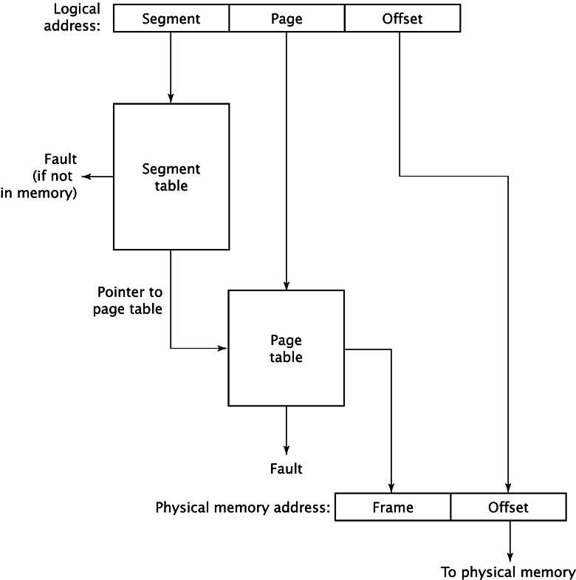
Virtual Memory (34)

Slide 37
Virtual Memory (35)
Segmentation with Paging (ctd.)
  Advantages (compared to Segmentation)
    The allocation of segments to physical memory is simpler.
    It is no longer necessary to explicitly store the size of the segment in the segment table.
    When the frame number is generated explicitly, it is no longer necessary to add the offset to a generated value.
  Disadvantages
    Internal fragmentation problem.
    The time cost of a second level of table lookup.

Slide 38
Secondary Storage (1)
Types of Secondary Storage
  Magnetic Disk
    Hard Disk
    Floppy Disk
  Optical
    CD
    CD-ROM
    CD-Recordable (CD-R)
    CD-R/W
    DVD
    Blu-ray
  Magnetic Tape

Slide 39
Secondary Storage (2)
Magnetic Disk
  Metal or plastic disk coated with magnetizable material (iron oxide…rust)
  Range of packaging
    Floppy
    Winchester hard disk
    Removable hard disk

Slide 40
Secondary Storage (3)
Magnetic Hard Disk
  Mechanical Structure
    Overall Structure
      One or more disks (double-sided/single-sided) mounted on a common spindle.
      A disk is a circular platter constructed of metal or of plastic coated with a magnetizable material.
      The disks are placed in a rotary drive and they rotate at a uniform speed.

Slide 41
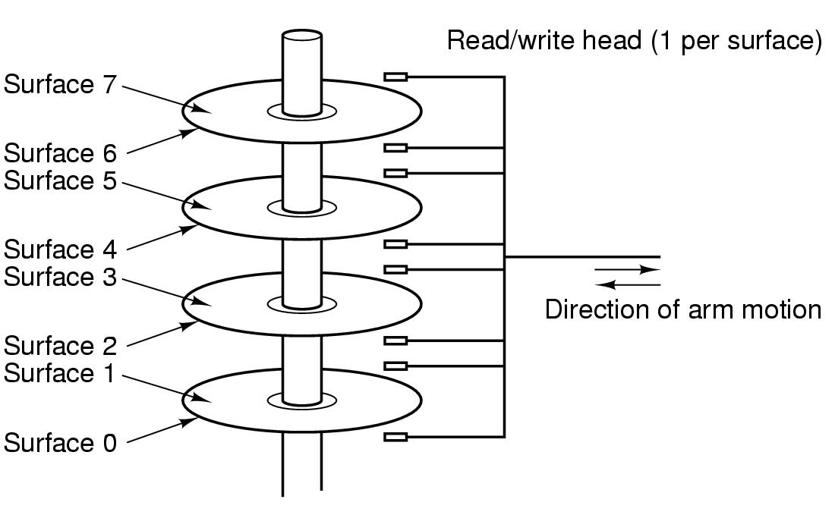
Secondary Storage (4)
Magnetic Hard Disk (ctd.)
  Mechanical Structure (ctd.)
    Overall Structure (ctd.)
Rotary drive shaft
arm

Slide 42
Secondary Storage (5)
Magnetic Hard Disk (ctd.)
  Read/Write Head
    Fixed Head
      One read/write head per track
      Heads mounted on fixed ridged arm
      Expensive, no longer production
    Movable Head
      One read/write head per side
      Mounted on a movable arm
    Detail (next page)
      Each head consist of a magnetic yoke and a magnetizing coil.
      Read/Write must be maintained at a very small distance from the moving disk surfaces.

Slide 43
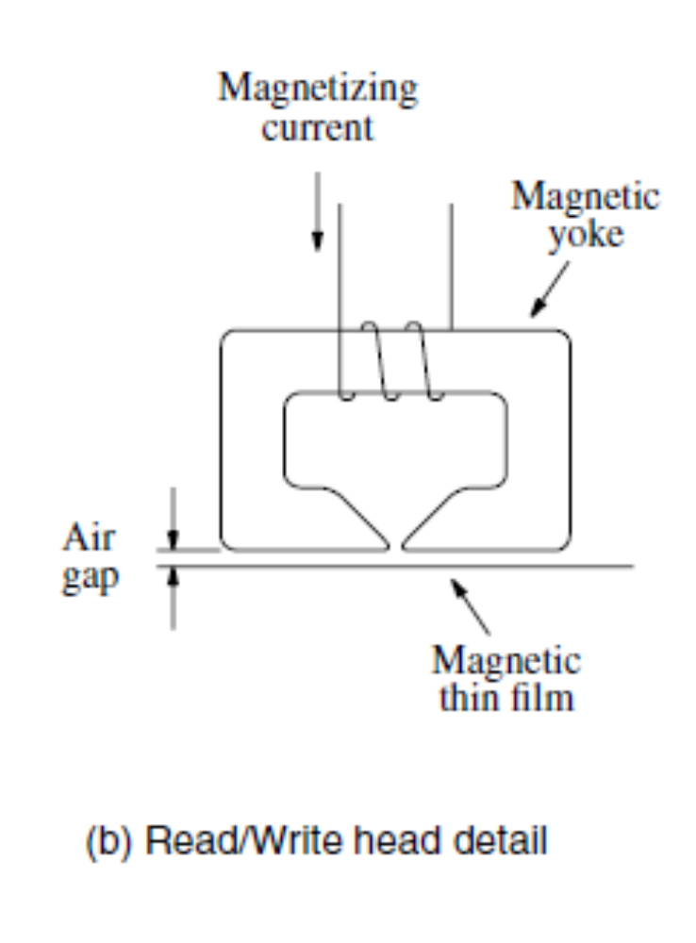
Secondary Storage (6)
Magnetic Hard Disk (ctd.)
  Read/Write Head (ctd.)

Slide 44
Secondary Storage (7)
Magnetic Hard Disk (ctd.)
  Winchester Hard Disk
    Developed by IBM in Winchester (USA)
    Sealed unit
    One or more platters (disks)
    Heads fly on boundary layer of air as disk spins (crash into disk!)
    Very small head to disk gap
    Getting more robust
    Universal
    Cheap
    Fastest external storage
    Getting larger all the time
      Multiple Gigabyte now usual

Slide 45
Secondary Storage (8)
Magnetic Hard Disk (ctd.)
  Data Organization
    Each surface is divided into concentric tracks, and each track is divided into sectors.
Sector 3, track
n
Sector 0, track 1
Sector 0, track 0
Figure 8.28. Organization of one surface of a disk.

Slide 46
Secondary Storage (9)
Magnetic Hard Disk (ctd.)
  Data Organization (ctd.)
    Each track has the same number of sectors.
    Outer tracks have more sectors. (Applied in large disks)
    Tracks usually
      500 – 2000 tracks per surface
    Sectors usually
      Typically 512K bytes
      10 – 100 sectors per track
    Disk address: (surface number, track number, sector number)

Slide 47
Secondary Storage (10)
Magnetic Hard Disk (ctd.)
  Cylinders
    A cylinder is the set of tracks at a given radius of a disk pack.
      i.e. a cylinder is the set of tracks that can be accessed without moving the disk arm.
    All the information on a cylinder can be accessed without moving the read/write arm.
cylinder k
surface 0
platter 0
surface 1
surface 2
platter 1
surface 3
surface 4
platter 2
surface 5
spindle

Slide 48
Secondary Storage (11)
Magnetic Hard Disk (ctd.)
  Track Organization
    Sector Header
      Contains identification (addressing) information used to find the desired sector on the selected track.
    ECC (Error-correcting Code) bits
      Detect and correct errors that may have occurred in writing or reading of the 512 data bytes.
    Intersector Gap
      Distinguish between two consecutive sectors easily

Slide 49
Secondary Storage (12)
Magnetic Hard Disk (ctd.)
  Disk Format
    Divide the disk into tracks and sectors.
    The formatting process may discover some defective sectors or even whole tracks.
    The formatting information accounts for about 15 percent of the total information that can be stored on a disk.

Slide 50
Secondary Storage (13)
Magnetic Hard Disk (ctd.)
  Disk Capacity
    Capacity: maximum number of bits that can be stored.
    Vendors express capacity in units of gigabytes (GB), where 1 GB = 10⁹ Bytes).
    Capacity is determined by these technology factors:
      Recording density (bits/in): number of bits that can be squeezed into a 1 inch segment of a track.
      Track density (tracks/in): number of tracks that can be squeezed into a 1 inch radial segment. (tpi)
      Areal density (bits/in²): product of recording and track density.

Slide 51
Secondary Storage (14)
Magnetic Hard Disk (ctd.)
  Disk Capacity (ctd.)
    Capacity = (# bytes/sector) x (avg. # sectors/track) x (# tracks/surface) x (# surfaces/platter) x (# platters/disk)
    Example
      512 bytes/sector
      300 sectors/track (on average)
      20,000 tracks/surface
      2 surfaces/platter
      5 platters/disk
      Capacity = 512 x 300 x 20000 x 2 x 5 = 30,720,000,000 = 30.72 GB

Slide 52
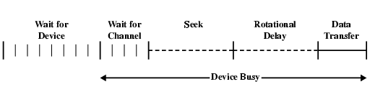
Secondary Storage (15)
Magnetic Hard Disk (ctd.)
  Disk Access Time
    The time to access a sector in a track on a surface is divided into 3 components:
      Seek time: Time to move the read/write arm to the correct cylinder (5-15ms)
      Rotational delay (or latency): Time it takes for the disk to rotate so that the desired sector is under the read/write head (4-8ms)
      Transfer time: Once the read/write head is positioned over the data, this is the time it takes for transferring data (25-100us)

Slide 53
Secondary Storage (16)
Magnetic Hard Disk (ctd.)
  Main Functions of Disk Controller (from the disk drive’s viewpoint)
    Seek: causes the disk drive to move the read/write head from its current position to the desired track.
    Read: initiates a Read operation, starting at the address specified in the disk address register.
    Write
    Error checking: computes the ECC value for the data read from a given sector and compares it with the corresponding ECC value read from the disk.

Slide 54
Secondary Storage (17)
Optical Disks
  Brief History
    1980: The first Compact Disk player is produced by Sony/Phillips.
    1985: Sony/Philips announce the standard for compact disc storage of computer data, the CD-ROM.
    1987: Video CD format is designed.
    1991: CD-R (Compact Disk Recordable) technology is introduced as a new storage technology.
    1996: Digital Versatile Disk (DVD) technology is introduced.
    1998: DVD Recordable systems invented and begin to enter the market.

Slide 55
Secondary Storage (18)
Optical Disks
  CD Technology
    CD (Compact Disk) (IS 10149, the Red Book)
      All CDs are 120mm across and 1.2mm thick, with a 15-mm diameter hole in the middle.
      The disk is formed from a resin（树脂）, such as polycarbonate（聚碳酸酯） and coated with a highly reflective surface, usually aluminum.
Pit’s wideness
Aluminum
Acrylic
Label
0.5 microns
Pit’s length
Pit
Land
Polycarbonate plastic
0.8 to 3 microns
(a) Cross-section

Slide 56
Secondary Storage (19)
Optical Disks (ctd.)
  CD Technology (ctd.)
    Read CD
      The laser source and the photodetector are positioned below the polycarbonate plastic.
      The emmitted beam travels through this plastic, reflects off the aluminum layer, and travels back toward the photodetector.
Pit
Land
Reflection
Reflection
No reflection
Source
Detector
Source
Detector
Source
Detector
(b) Transition from pit to land

Slide 57
Secondary Storage (20)
Optical Disks (ctd.)
  CD Technology (ctd.)
    Read CD (ctd.)
      When the light reflects solely from the pit, or solely from the land, the detector will see the reflected beam as a bright spot.
      At the pit-land and land-pit transitions the detector will not see a reflected beam and will detect a dark spot.
      Each transition is taken to denote the binary value 1, and the flat portions represent 0s.
0
1
0
0
1
0
0
0
0
1
0
0
0
1
0
0
1
0
0
1
0
(c) Stored binary pattern

Slide 58
Secondary Storage (21)
Optical Disks (ctd.)
  CD Technology (ctd.)
    Encoding Scheme
      Complex
      Each byte of data is represented by a 14-bit code.
    Data Organization
      The pits and lands are written in a single continuous spiral starting near the hole and working out a distance of 32mm toward the edge.
      The spiral makes 22,188 revolutions around the disk (about 600 per mm). If unwounded, the spiral would be 5 km long.

Slide 59
Secondary Storage (22)
Optical Disks (ctd.)
  CD-ROM (Compact Disk-Read Only Memory) (the Yellow Book)
    Problem of CD
      Ensure the integrity of stored data
    Data Organization (Mode 1)
      Encode every byte in a 14-bit symbol.
      A group of 42 consecutive symbols forms a 588-bit frame.
      Group 98 frames into a CD-ROM sector.

Slide 60
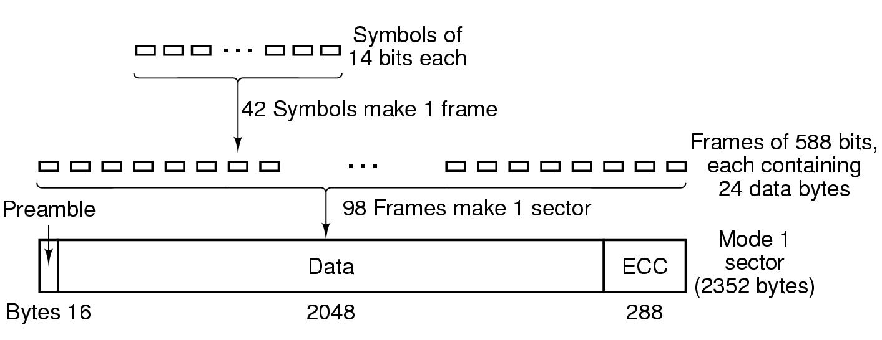
Secondary Storage (23)
Optical Disks (ctd.)
  CD-ROM (ctd.)
    Data Organization (Mode 1) (ctd.)

Slide 61
Secondary Storage (24)
Optical Disks (ctd.)
  CD-ROM (ctd.)
    Data Organization (Mode 1) (ctd.)
      Every sector begins with a 16-byte preamble.
        The first 12 bytes: 00FF FFFF FFFF FFFF FFFF FF00
        The next 3 bytes : the sector number
        The last byte: Mode
      Three separate error-correcting schemes are used
        Symbol level: single-bit errors
        Frame level: short burst errors
        Sector level: any residual errors

Slide 62
Secondary Storage (25)
Optical Disks (ctd.)
  CD-ROM (ctd.)
    CD-ROM Drive’s Rotational Speed
      Basic speed:1X, 75 sectors/s; Data rate: 153,600 bytes/s (Mode 1 Format)
      High speed CD-ROM are identified in relation to the basic speed.
    Advantages
      Small physical size, low cost, ease of handling as a removable and transportable mass-storage medium.
    Disadvantage
      Lower data transfer rate

Slide 63
Secondary Storage (26)
Optical Disks (ctd.)
  CD-ROM (ctd.)
    CD-ROM Drive’s Rotational Speed (ctd.)
Speed
------------
1x
2x
4x
6x
8x
12x
16x
24x
32x
40x
Data Rate
------------------------
153,600 bytes per second
307,200 bytes per second
614,400 bytes per second
921,600 bytes per second
1,228,800 bytes per second
1,843,200 bytes per second
2,457,600 bytes per second
3,688,400 bytes per second 4,915,200 bytes per second
6,144,000 bytes per second
Approximation
------------
150 KB/s
300 KB/s
600 KB/s
900 KB/s
1.2 MB/s
1.8 MB/s
2.4 MB/s
3.6 MB/s
4.8 MB/s
6 MB/s

Slide 64
Secondary Storage (27)
Optical Disks (ctd.)
  CD-R (CD-Recordable) (the Orange Book)
    Write once, read many (WORM)
    CD-Rs start with 120-mm polycarbonate blanks that are like CD-ROMs
    Also contain a 0.6-mm wide groove to guide the laser for writing
    Creation
      No master disc or mold
      Reflective layer → gold
      No physical pits → simulated pits
      Using a high-power laser beam
        Dark spot in the dye (染料) to simulate a pit

Slide 65
Secondary Storage (28)
Optical Disks (ctd.)
  CD-RW (CD-ReWritable)
    Creation
      Instead of dye → uses an alloy (合金) of silver(银), indium(铟), antimony (锑), and tellurium(碲).
      Two states
        Amorphous (非结晶态): pit
        Crystalline (结晶态(可穿透)): land
      CD-RW drive uses different laser power
        The highest power is used to record the pits.
        The middle power is erase power.
        The lowest power is used to read the stored information.

Slide 66
Secondary Storage (29)
Optical Disks (ctd.)
  DVD (Digital Versatile Disk)
    Differences between DVD and CD-ROM
      DVD: The pits are smaller (0.4 microns versus 0.8 microns for CDs)
      DVD: The tracker are closer (0.74 microns between tracks versus 1.6 microns for CDs)
      DVD: The beam is red laser (at 0.65 microns versus 0.78 microns for CDs).
      DVD: uses one to two recording layers
        Single-sided or Double-sided

Slide 67
Secondary Storage (30)
Optical Disks (ctd.)
  DVD (Digital Versatile Disk) (ctd.)
    DVD uses MPEG for compression
    A single-sided single-layer DVD
      133 minutes of video at high resolution
Feature
---------------------------------
single-sided, single-layer
single-sided, dual-layer
double-sided, single-layer
double-sided, dual-layer
Capacity
------------
4.7 GB
8.5 GB
9.4 GB
17 GB

Slide 68
Summary (1)
Basic Concepts
  Word: Each group of fixed size of bits is referred to as a word.
  Word length: The number of bits in each word is referred to as word length.
  Memory address: Addresses are numbers that identify memory locations.
  Big-endian: the lower byte addresses are used for the more significant bytes (the leftmost bytes) of the word.
  Little-endian: the lower byte addresses are used for the less significant bytes (the rightmost bytes) of the word.
  Accessing method: Sequential Access, Direct Access, Random Access
  Volatile/Non-volatile
  Erasable/Non-erasable

Slide 69
Summary (2)
Read/Write principle of static RAM
Internal organization of static RAM chips (16 × 8 , 1K × 1 )
Read/Write principle of dynamic RAM
Internal Organization of an Asynchronous DRAM Chip(2M × 8 )
Principle of burst operation mode (SDRAM)
Memory Latency
  Refers to the amount of time it takes to transfer a word of data to or from the memory.
Memory Bandwidth
  The number of bits or bytes that can be transferred in one second is referred to as bandwidth.
Use small memory chips to constitute large memory (draw the figure)

Slide 70
Summary (3)
Memory Hierarchy
Principle of cache locality of reference
Mapping functions of cache
Example of mapping techniques
LRU Replacement Algorithm
  Replace the block that has been in the cache longest with no reference to it.
Write Policy
  Write-Through
  Write-Back

Slide 71
Summary (4)
Paging Method
Segmentation Method
Magnetic Hard Disk
  Capacity
  Data Organization
  Access Time

