Slide 1
Computer Organization & Architecture
Chapter 5 – Basic Processing Unit
Junying Chen 陈俊颖

Slide 2
Content of this lecture
5.1 Some Fundamental Concepts
5.2 Instruction Execution
5.3 Hardware Components
5.4 Instruction Fetch and Execution Steps
5.5 Control Signals
5.6 Hardwired Control
5.7 CISC-Style Processors
5.9 Solved Problem
Summary

Slide 3
Some Fundamental Concepts (1)
Processing Unit
  Instruction Set Processor or Central Processing Unit (CPU)
  A processor is responsible for reading program instructions from the computer’s memory and executing them.
    It fetches one instruction at a time.
    It decodes (interprets) the instruction.
    Then, it carries out the actions specified.

Slide 4
Some Fundamental Concepts (2)
Functions of Processing Unit
  Control program sequences
  Control instruction operations
  Control timing
  Data processing

Slide 5
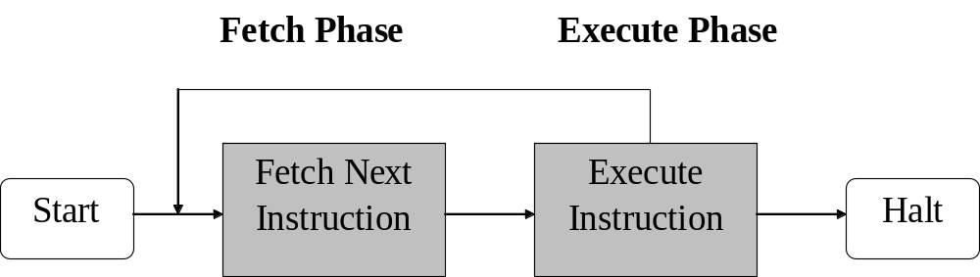
Some Fundamental Concepts(3)
Instruction Execution
  To execute an instruction, the processor has to perform the following steps:
    1. Fetch the contents of the memory location pointed to by the PC. The contents of this location are loaded into the IR. IR ← [[PC]]

Slide 6
Some Fundamental Concepts(4)
Instruction Execution (ctd.)
  To execute an instruction, the processor has to perform the following steps:
    2. Increment the contents of the PC by 4. PC ← [PC] + 4
      Assuming that the memory is byte addressable, and each instruction comprises 4 bytes.
    3. Carry out the actions specified by the instruction in the IR.
    Note
      If an instruction occupies more than one memory word, steps1 and 2 must be repeated as many times as necessary to fetch the complete instruction.

Slide 7
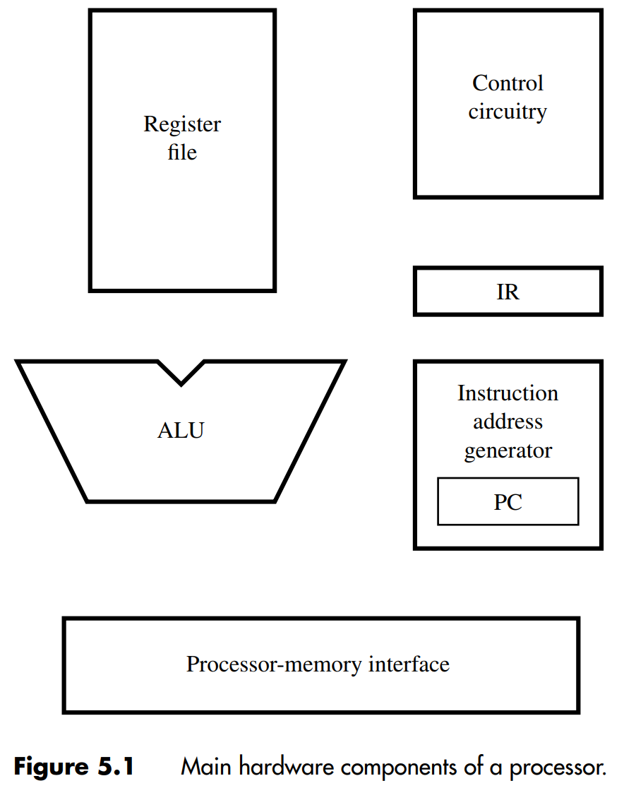
Some Fundamental Concepts(5)
Processor’s Building Blocks

Slide 8
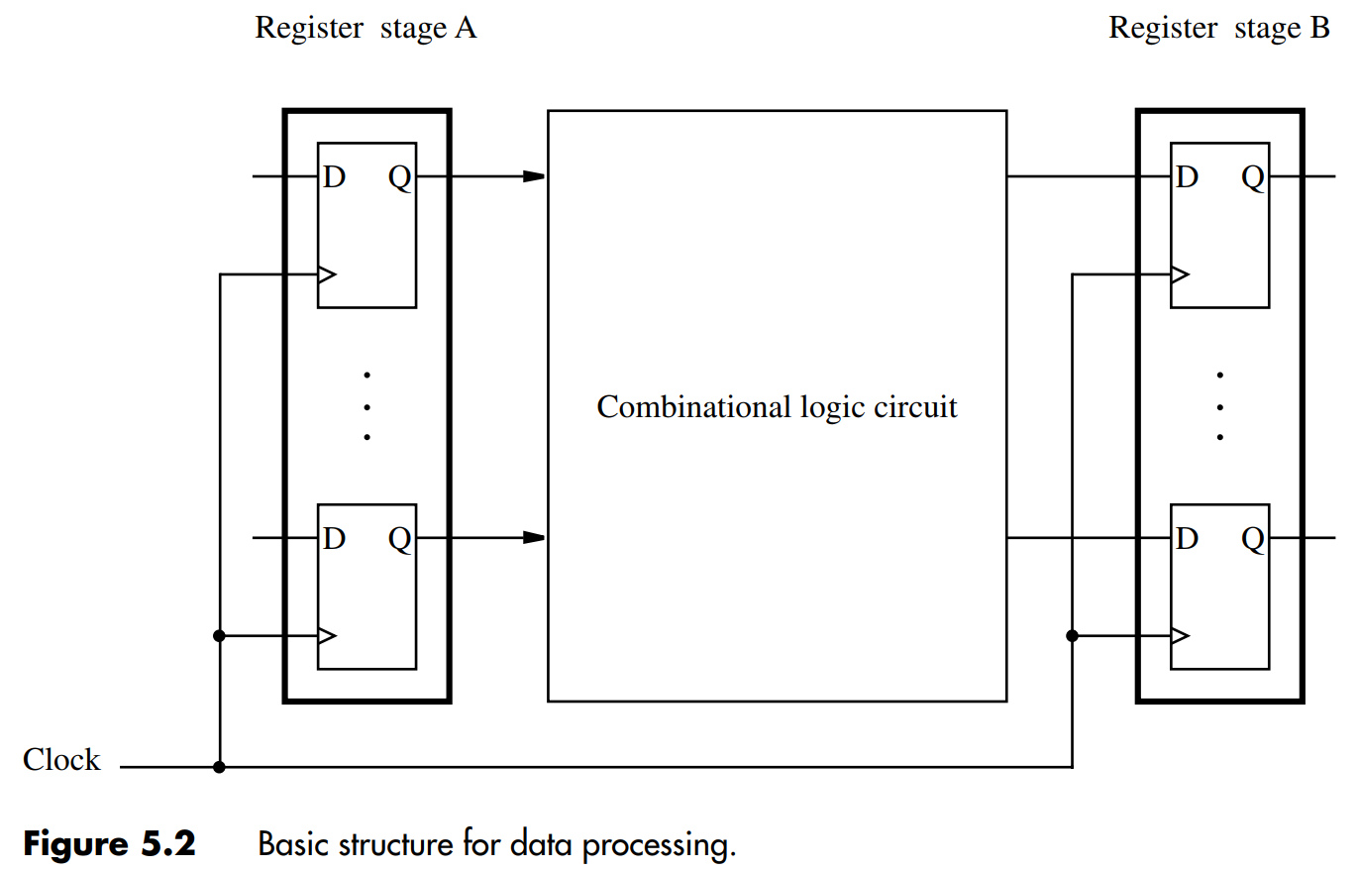
Some Fundamental Concepts(6)
A Digital Processing System
  Contents of register A are processed and deposited in register B.

Slide 9
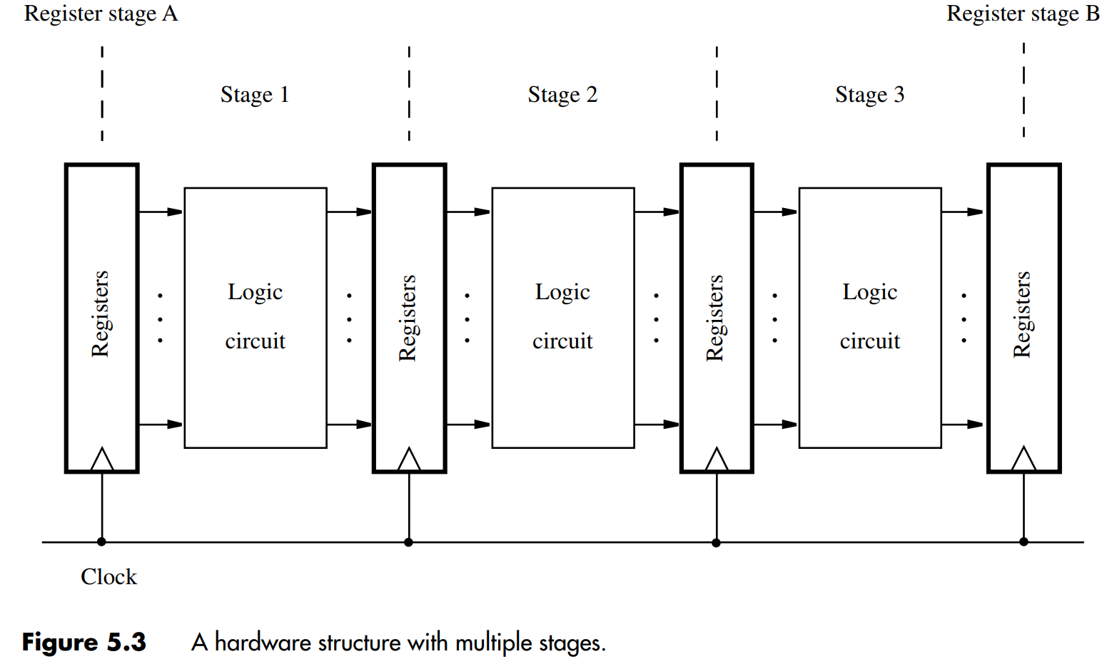
Some Fundamental Concepts(7)
A Multi-Stage Digital Processing System

Slide 10
Some Fundamental Concepts(8)
A Multi-Stage Digital Processing System (ctd.)
  Why Multi-Stage?
    Processing moves from one stage to the next in each clock cycle.
    Such a multi-stage system is known as a pipeline.
    High-performance processors have a pipelined organization.
    Pipelining enables the execution of successive instructions to be overlapped.
    Pipelining will be discussed later.

Slide 11
Instruction Execution (1)
Instruction Execution
  Pipelined organization is most effective if all instructions can be executed in the same number of steps.
  Each step is carried out in a separate hardware stage.
  Processor design will be illustrated using five hardware stages.
  How can instruction execution be divided into five steps?

Slide 12
Instruction Execution (2)
Load Instruction: Load R5,X(R7)
  Actions required for execution of the instruction
    Fetch the instruction from the memory.
    Increment the program counter.
    Decode the instruction to determine the operation to be performed.
    Read register R7.
    Add the immediate value X to the contents of R7.
    Use the sum X+[R7] as the effective address of the source operand, and read the contents of that location in the memory.
    Load the data received from the memory into the destination register, R5.

Slide 13
Instruction Execution (3)
Load Instruction: Load R5,X(R7) (ctd.)
  Depending on how the hardware is organized, some of these actions can be performed at the same time.
    1. Fetch the instruction and increment the program counter.
    2. Decode the instruction and read the contents of register R7 in the register file.
    3. Compute the effective address.
    4. Read the memory source operand.
    5. Load the operand into the destination register, R5.

Slide 14
Instruction Execution (4)
Arithmetic and Logic Instructions
  Differ from the Load instruction
    Two source operand
    No access to memory operand
  Example Add R3, R4, R5
    1. Fetch the instruction and increment the program counter.
    2. Decode the instruction and read the contents of source registers R4 and R5.
    3. Compute the sum [R4] + [R5].
    4. No action.
    5. Load the result into the destination register, R3.
    Stage 4 (memory access) is not involved in this instruction.

Slide 15
Instruction Execution (5)
Store Instruction: Store R6, X(R8)
  1. Fetch the instruction and increment the program counter.
  2. Decode the instruction and read registers R6 and R8.
  3. Compute the effective address X + [R8].
  4. Store the contents of register R6 into memory location X + [R8].
  5. No action.

Slide 16
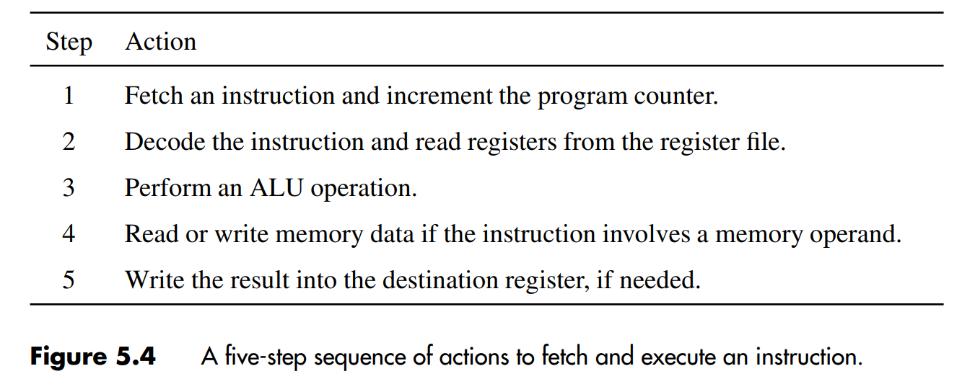
Instruction Execution (6)
Five-Step Sequence of Actions for RISC
  This sequence determines the hardware stages needed.

Slide 17
Instruction Execution (7)
Five-Step Sequence of Actions for RISC (ctd.)
  The five-step sequence is suitable for all instructions in a RISC-style instruction set.
  Instructions that perform computations use data that are either stored in general-purpose registers or given as immediate data in the instruction.
  The five-step sequence is suitable for all Load and Store instructions, because the addressing modes that can be used in these instructions are special cases of the Index mode.
    R0 as index register

Slide 18
Hardware Components (1)
Register File
  General-purpose registers are implemented in the form of a register file.
  Register File: a small and fast memory block
  Port: The inputs and outputs of any memory unit are often called input and output ports.
  A 2-port register file is needed to read the two
  source registers at the same time.
  A memory unit that has two output ports is said to be dual-ported.
  It may be implemented using a 2-port memory.
  Or using two single-ported memory blocks.

Slide 19
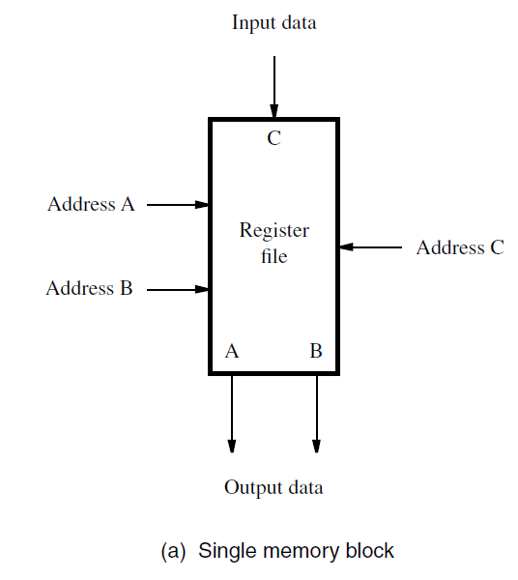
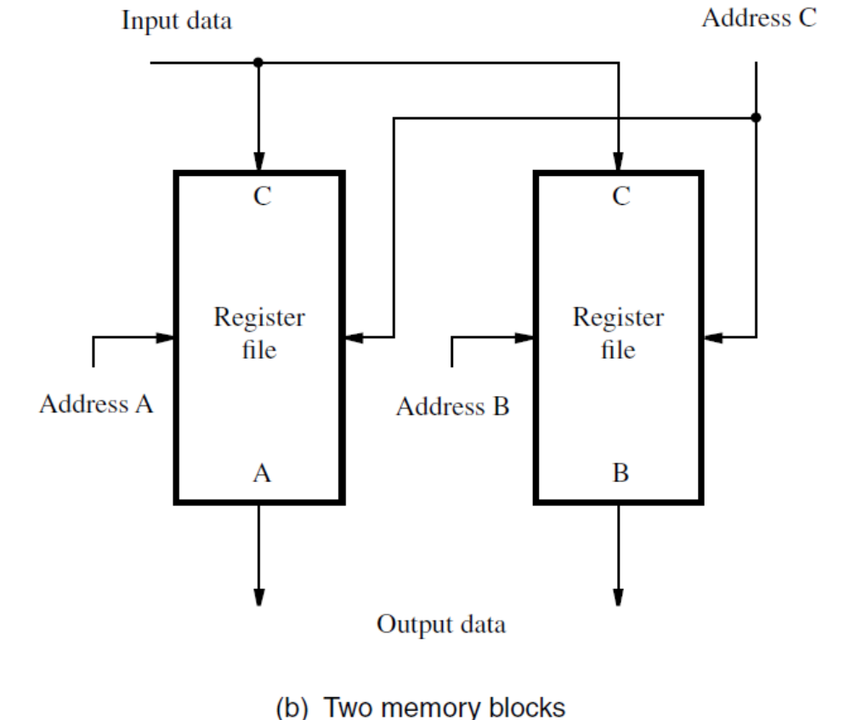
Hardware Components (2)
Register File (ctd.)

Slide 20
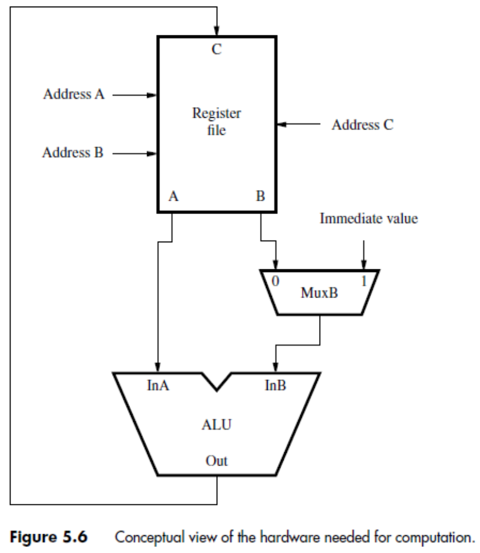
Hardware Components (3)
ALU

Slide 21
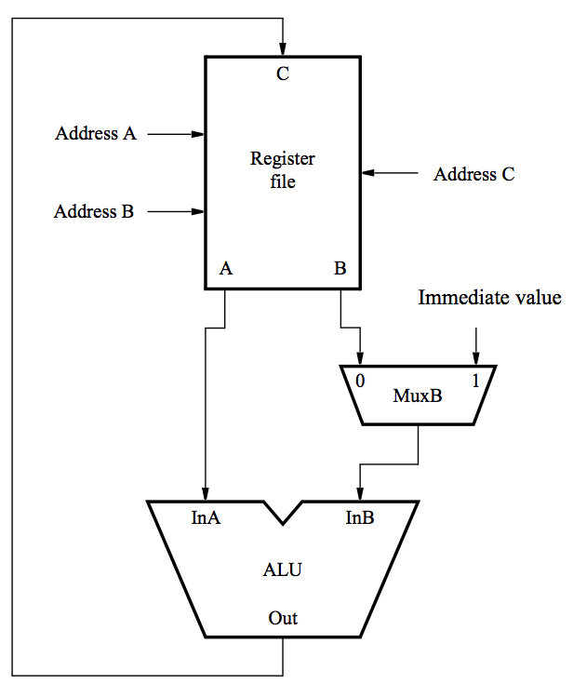
Hardware Components (4)
ALU (ctd.)
  A conceptual view
  of computational
  instructions:
  Both source operands
  and the destination
  location are in the
  register file.
[RA]

Slide 22
Hardware Components (5)
ALU (ctd.)
  A conceptual view
  of immediate
  instructions:
  One of the source
  operands is the
  immediate value
  in the IR.

Slide 23
Hardware Components (6)
Datapath
  Two Phase of Instruction Processing
    Fetch Phase
    Execution Phase
  Divide the processor hardware into two corresponding sections:
    Fetch Section: fetching instruction, decoding instruction, generating control signals
    Execution Section: reading operands, performing computation, storing results
  A datapath is a collection of functional units, such as arithmetic logic units or multipliers, that perform data processing operations.

Slide 24
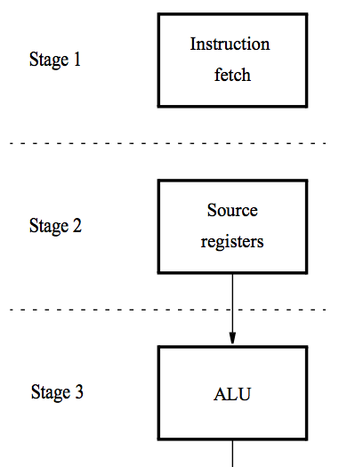
Hardware Components (7)
Datapath (ctd.)
  A Five-Stage Organization
    Instruction processing moves from each stage to the next in every clock cycle.
    The instruction is decoded and the source registers are read in stage 2.
    Computation takes place in the ALU in stage 3.

Slide 25
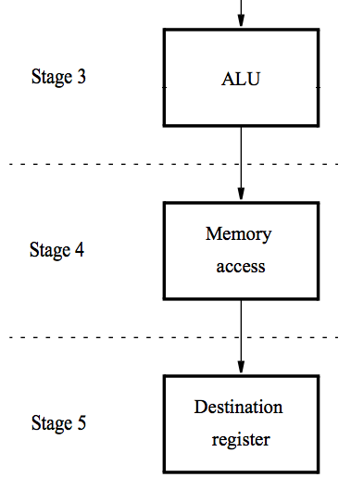
Hardware Components (8)
Datapath (ctd.)
  A Five-Stage Organization (ctd.)
    If a memory operation is involved, it takes place in stage 4.
    The result of the instruction is stored in the destination register in stage 5.

Slide 26
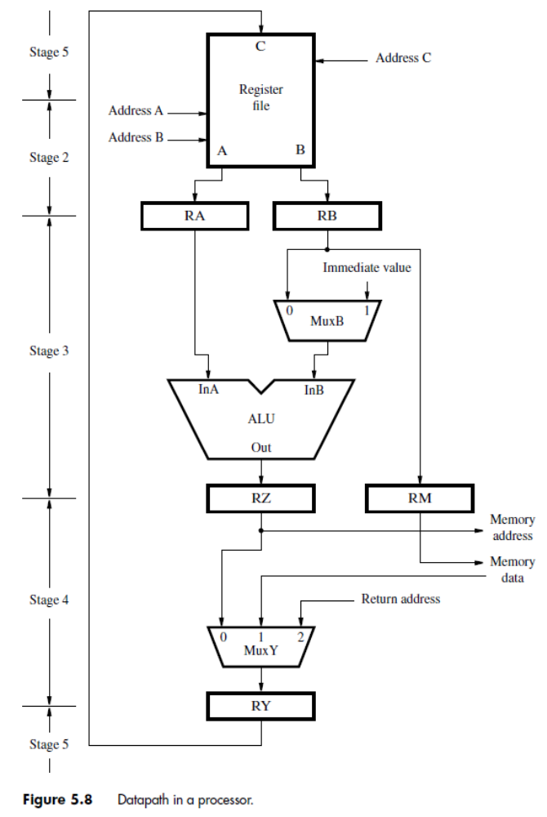
Hardware Components (9)
The Datapath-Stages 2 to 5
  Register file
  Inter-stage registers needed to carry data from one stage to the next.
  ALU stage
  Memory stage
  Back to the register file

Slide 27
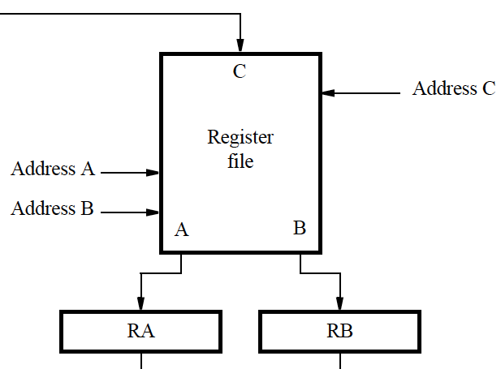
Hardware Components (10)
Register File-Stages 2&5
  Address inputs connected to corresponding fields in IR.
  Source registers are read and their contents stored in RA and RB.
  The result of the instruction is stored in the destination register selected by address C.

Slide 28
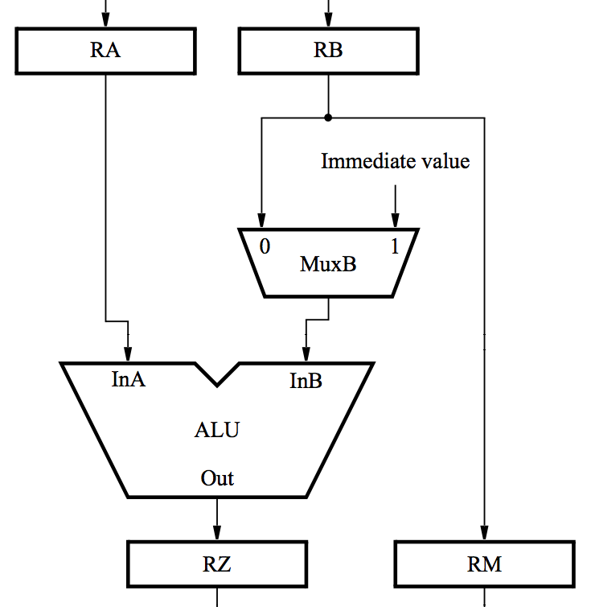
Hardware Components (11)
ALU Stage
  ALU performs calculation specified by the instruction.
  Multiplexer MuxB selects either RB or the Immediate field of IR.
  Results stored in RZ.
  Data to be written in the memory are transferred from RB to RM.

Slide 29
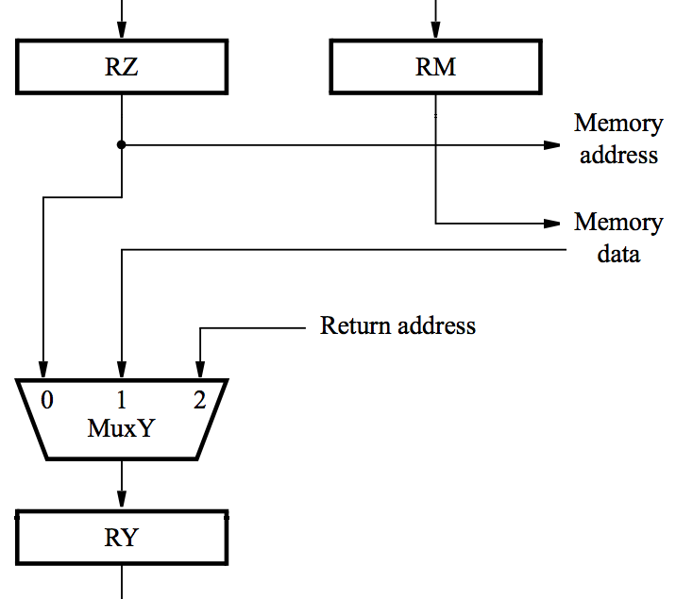
Hardware Components (12)
Memory Stage
  For a memory instruction, RZ provides memory address, and MuxY selects data read to be placed in RY.
  RM provides data for a memory write operation.
  For a calculation instruction, MuxY selects [RZ] to be placed in RY.
  Input 2 of MuxY is used in subroutine calls.

Slide 30
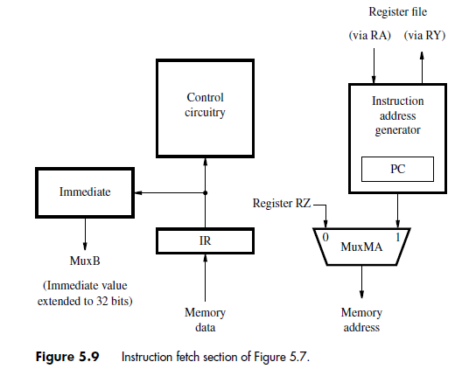
Hardware Components (13)
Instruction Fetch Section

Slide 31
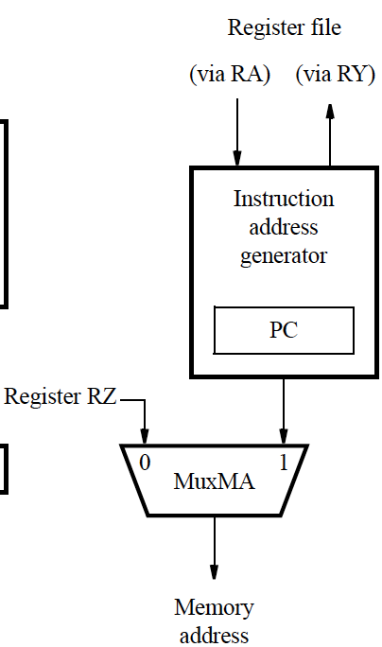
Hardware Components (14)
Memory Address Generation
  MuxMA selects the PC when fetching instructions.
  The Instruction address generator increments the PC after fetching an instruction.
  It also generates branch and subroutine addresses.
  MuxMA selects RZ when reading or writing data operands.

Slide 32
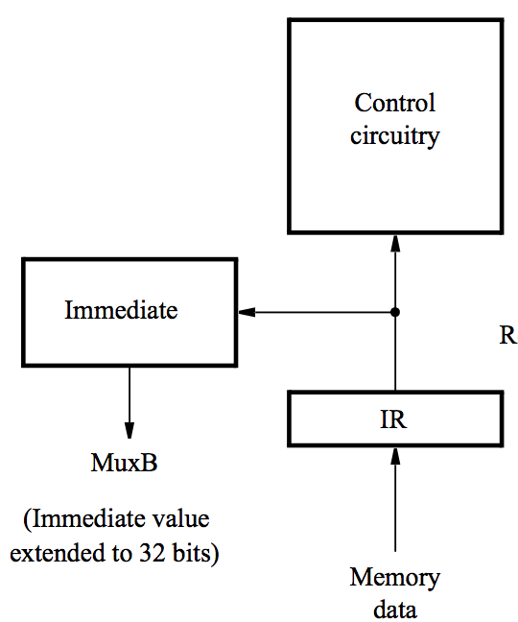
Hardware Components (15)
Processor Control Section
  When an instruction is read, it is placed in IR.
  The control circuitry decodes the instruction.
  It generates the control signals that drive all units.
  The Immediate block extends the immediate operand to 32 bits as specified in the instruction.

Slide 33
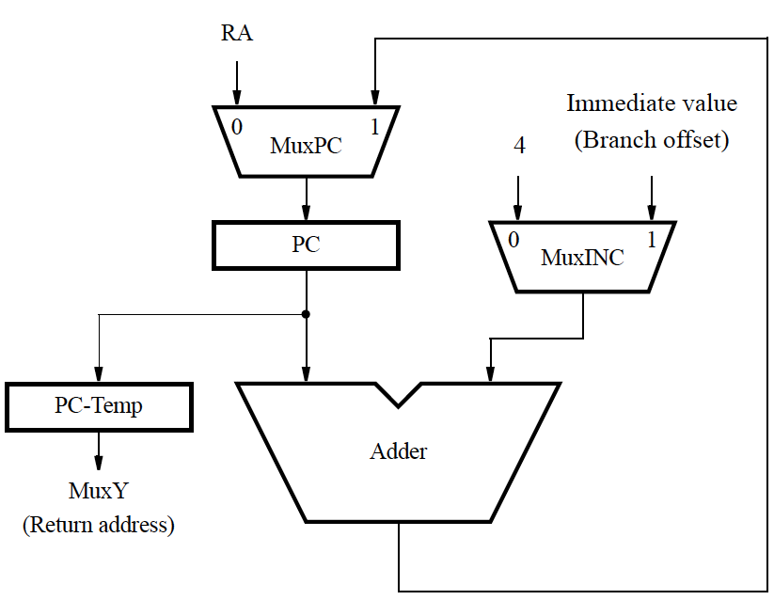
Hardware Components (16)
Instruction Address Generator
  Connections to RY and RA are used for subroutine call and return.
  The branch offset is given in the immediate field of the IR

Slide 34
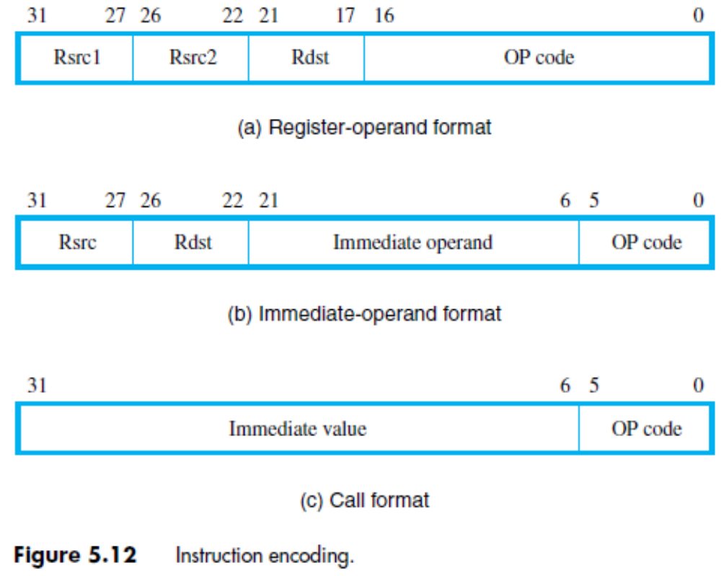
Instruction Fetch and Execution Steps (1)
Example: Add R3, R4, R5
  Instruction Encoding

Slide 35
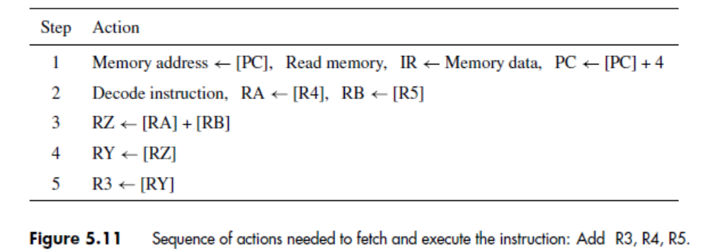
Instruction Fetch and Execution Steps (2)
Example: Add R3, R4, R5 (ctd.)
  Sequence of Actions

Slide 36
Instruction Fetch and Execution Steps (3)
Example: Add R3, R4, R5 (ctd.)

Slide 37
Instruction Fetch and Execution Steps (4)
Example: Add R3, R4, R5 (ctd.)

Slide 38
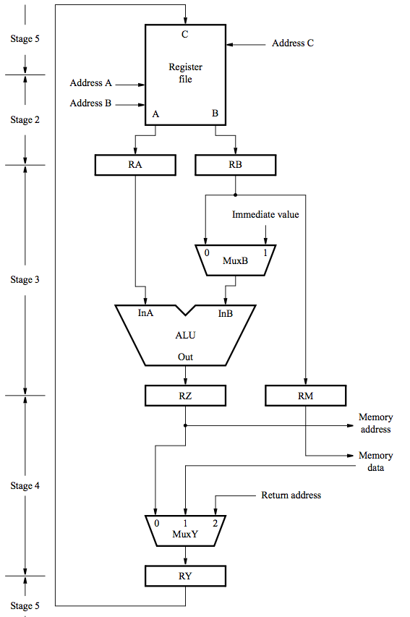




Instruction Fetch and Execution Steps (5)

Slide 39
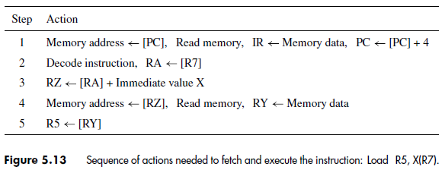
Instruction Fetch and Execution Steps (6)
Example: Load R5, X(R7)
  Sequence of Actions

Slide 40




Instruction Fetch and Execution Steps (7)

Slide 41
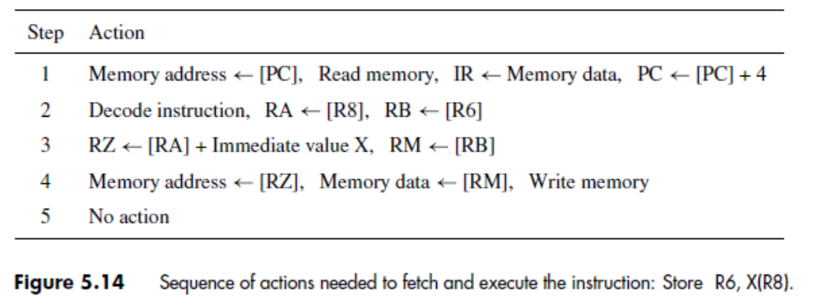
Instruction Fetch and Execution Steps (8)
Example: Store R6, X(R8)
  Sequence of Actions

Slide 42




Instruction Fetch and Execution Steps (9)

Slide 43
Instruction Fetch and Execution Steps (10)
Some Observations
  Memory Read and Write operations can be completed in one clock cycle?
    A memory Read or Write operation can be completed in one clock cycle when the data involved are available in the cache
  We assume that the processor reads the source registers of the instruction in step 2, while it is still decoding the OP code of the instruction that has just been loaded into the IR. Can these two tasks be completed in the same step? How can the control hardware know which registers to read before it completes decoding the instruction?
    Source register addresses are specified using the same bit positions in all instructions.
Notes:
讲到这里—2018.11.6

Slide 44
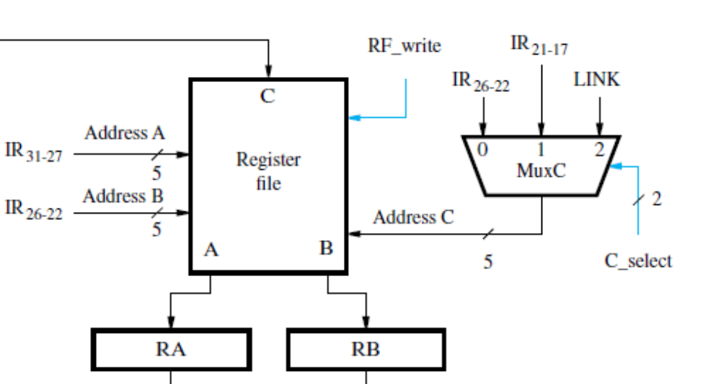
Instruction Fetch and Execution Steps (11)
Some Observations (ctd.)

Slide 45
Instruction Fetch and Execution Steps (12)
Branching
  Straight-line Program Execution
    PC<-[PC]+4
  Branch Instructions
    A branch offset given as an immediate value in the instruction is added to the current contents of the PC.
    The range of addresses that can be reached by a branch instruction is limited.
  Subroutine Call Instructions
    Subroutine call instructions can reach a larger range of addresses.
    Most RISC-style computers have Jump and Call instructions that use a general-purpose register to specify a full 32-bit address.

Slide 46
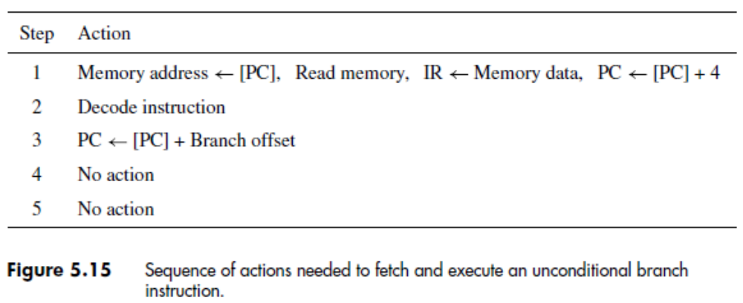
Instruction Fetch and Execution Steps (13)
Branch Instructions
  Unconditional Branch Instructions

Slide 47
Instruction Fetch and Execution Steps (14)
Branch Instructions (ctd.)
  Unconditional Branch Instructions (ctd.)

Slide 48
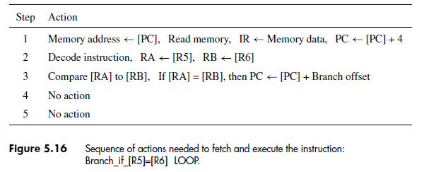
Instruction Fetch and Execution Steps (15)
Branch Instructions (ctd.)
  Conditional Branch Instructions
    Example: Branch_if_[R5]=[R6] LOOP

Slide 49
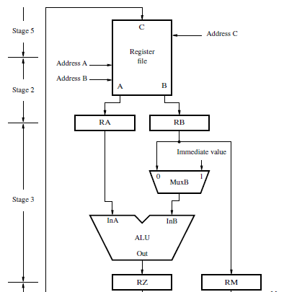

Instruction Fetch and Execution Steps (16)
Branch Instructions (ctd.)
  Conditional Branch Instructions (ctd.)
    Example (ctd.)
      Comparison can be done by [R5] – [R6] in the ALU

Slide 50
Instruction Fetch and Execution Steps (17)
Branch Instructions (ctd.)
  Conditional Branch Instructions (ctd.)
    Example (ctd.)
      A subtraction operation in the ALU is time consuming, and is not needed in this case.
      A simpler and faster comparator circuit ( a part of ALU) can examine the contents of registers RA and RB and produce the required condition signals.

Slide 51
Instruction Fetch and Execution Steps (18)
Branch Instructions (ctd.)
  Conditional Branch Instructions (ctd.)
    Example 5.3 (P186) : Derive the logic expressions for a circuit that compares two unsigned numbers:
    X = x2x1x0 and Y = y2y1y0 and generates three outputs: XGY, XEY, and XLY . One of these outputs is set to 1 to indicate that X is greater than, equal to, or less than Y , respectively.

Slide 52
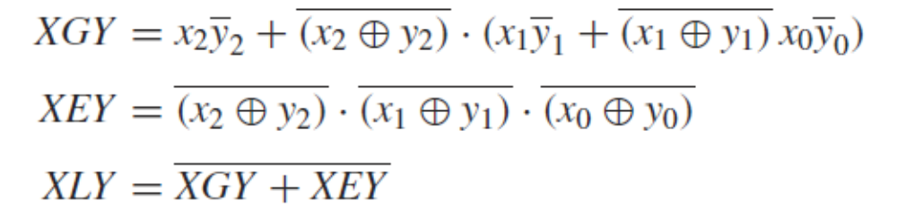
Instruction Fetch and Execution Steps (19)
Branch Instructions (ctd.)
  Conditional Branch Instructions (ctd.)
    Solution: To compare two unsigned numbers, we need to compare individual bit locations, starting with the most significant bit. If x2 = 1 and y2 = 0, then X is greater than Y. If x2 = y2, then we need to compare the next lower bit location, and so on. Thus, the logic expressions for the three outputs may be written as follows:

Slide 53
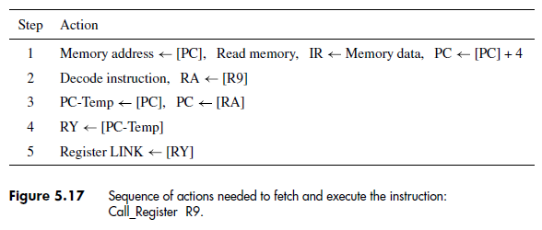
Instruction Fetch and Execution Steps (20)
Subroutine Call Instructions
  Example: Call_Register R9

Slide 54
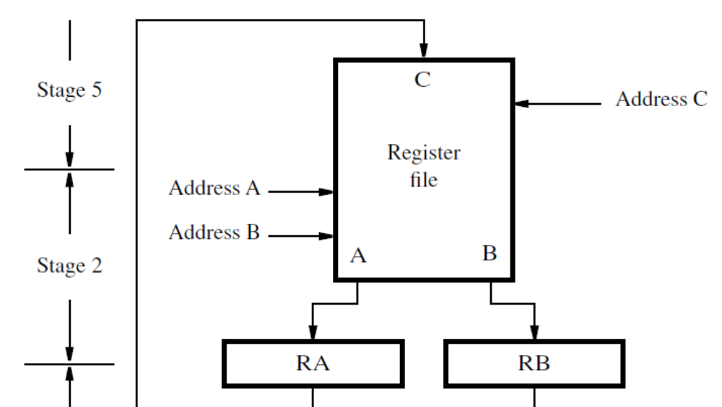

Instruction Fetch and Execution Steps (21)
Subroutine Call Instructions (ctd.)
  Example: Call_Register R9 (ctd.)

Slide 55


Instruction Fetch and Execution Steps (22)
Subroutine Call Instructions (ctd.)
  Example: Call_Register R9 (ctd.)

Slide 56
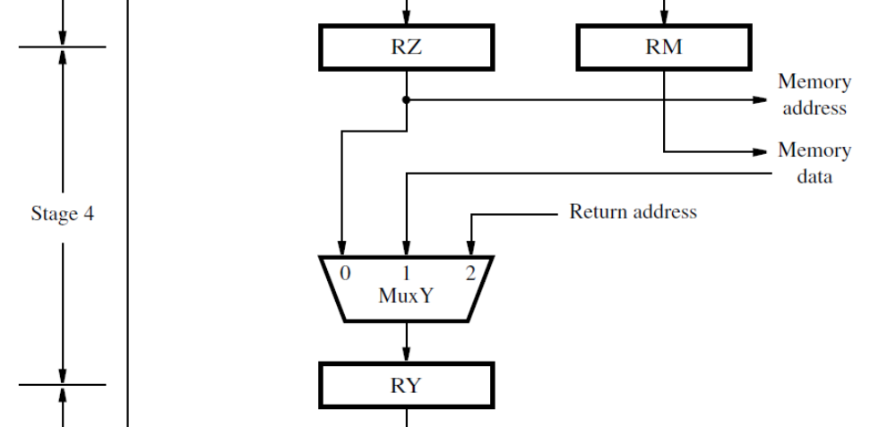
Instruction Fetch and Execution Steps (23)
Subroutine Call Instructions (ctd.)
  Example: Call_Register R9 (ctd.)

Slide 57
Instruction Fetch and Execution Steps (24)
Waiting For Memory
  Cache memory described earlier as faster and smaller storage that is an adjunct to the larger and slower main memory.
  When data are found in the cache, access to memory can be completed in one clock cycle.
  Otherwise, read and write operations may require several clock cycles to load data from main memory into the cache.

Slide 58
Instruction Fetch and Execution Steps (25)
Waiting For Memory (ctd.)
  A control signal is needed to indicate that memory function has been completed (MFC).
  E.g., for step 1 :
  Memory address ← [PC], Read memory, Wait for MFC, IR ← Memory data, PC ←[PC] + 4
  E.g., for step 4 of Load instruction
  Memory address ← [RZ], Read memory, Wait for MFC, RY ← Memory data
  E.g., for step 4 of Store instruction
  Memory address ← [RZ], Memory data ←[RM], Write memory, Wait for MFC

Slide 59
Control Signals (1)
Inter-stage Registers: RA, RB, RZ, RY, RM, and PC-Temp
  Since data are transferred from one stage to the next in every clock cycle, inter-stage registers are always enabled.
PC, IR, and the Register File
  Must be enabled when new data are loaded in.
MuxB, MuxY
  To simplify the required control circuit, the same selection can be maintained in all execution steps.
MuxMA
  Must change its selection in different execution steps.
  In Step1:Select PC
  In Step 4 of Load and Store: Select RZ

Slide 60
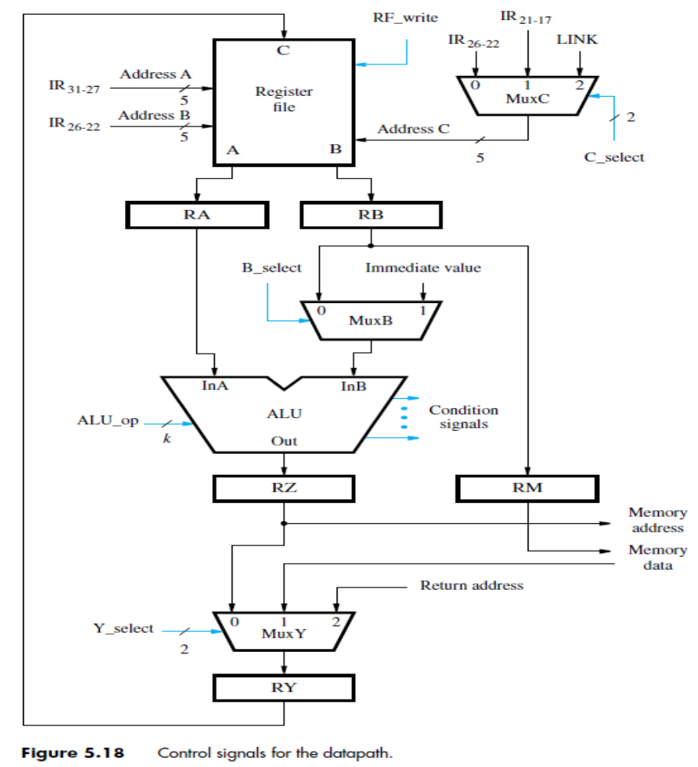
Control Signals (2)
Control Signals for The Datapath

Slide 61
Control Signals (3)
Recall Instruction Encoding

Slide 62
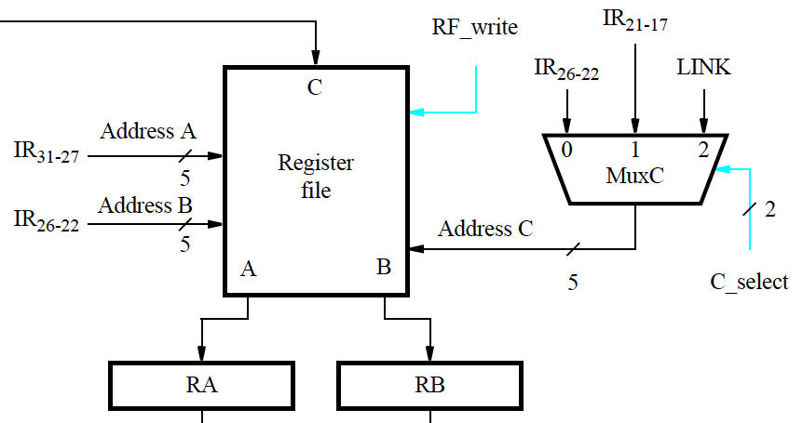
Control Signals (4)
Register File Control Signals

Slide 63
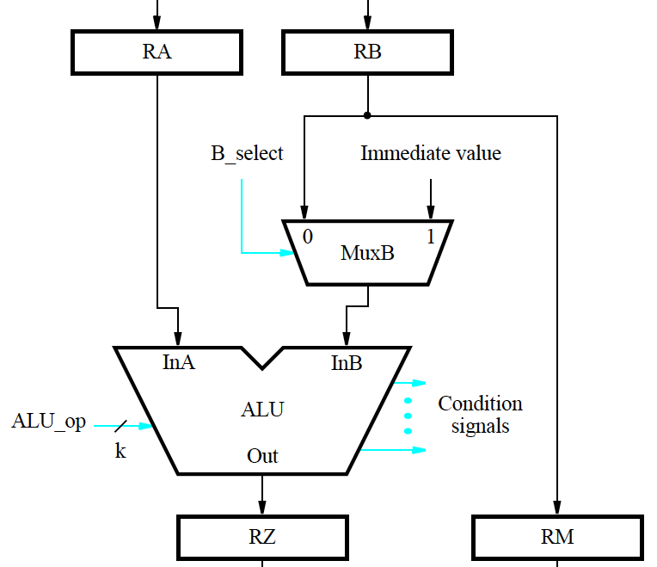
Control Signals (5)
ALU Control Signals
Branch_if_[R5]=[R6] LOOP

Slide 64
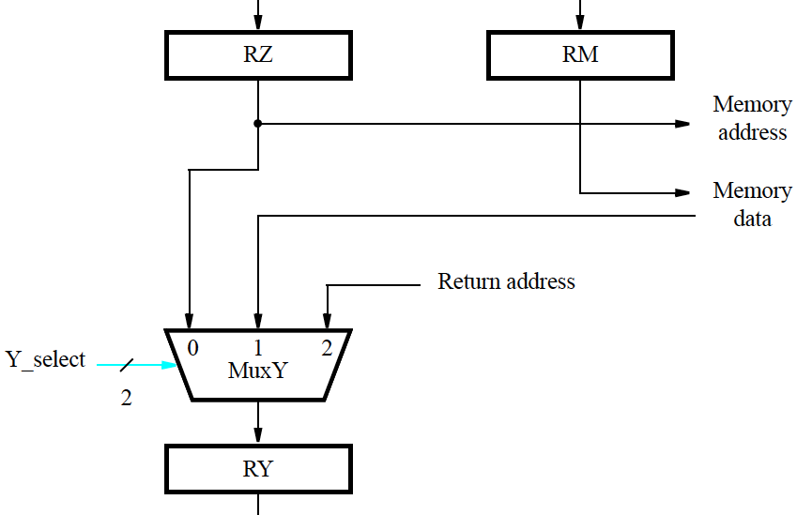
Control Signals (6)
Result Selection Control Signals

Slide 65
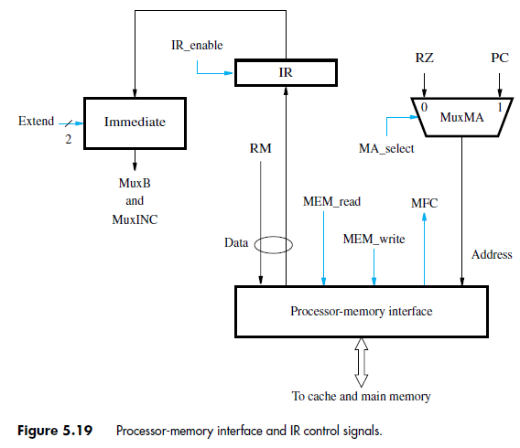
Control Signals (7)
Processor-Memory Interface and IR Control Signals
During a fetch step, IR_enable must be activated only after the MFC signal
is asserted.
MEM_read and
MEM_write are used to initiate a memory Read or a memory Write operation.

Slide 66
Control Signals (8)
Processor-Memory Interface and IR Control Signals (ctd.)
immediate value : be extended to a 32-bit value. Assume
that the immediate value is used in three different ways:
(a) A 16-bit value is sign-extended for use in arithmetic operations.
(b) A 16-bit value is padded with zeros to the left for use in logic operations.
(c)A26-bit value is padded with 2 zeros to the right and the 4 high-order bits of the PC are
appended to the left for use in subroutine-call instructions.

Slide 67
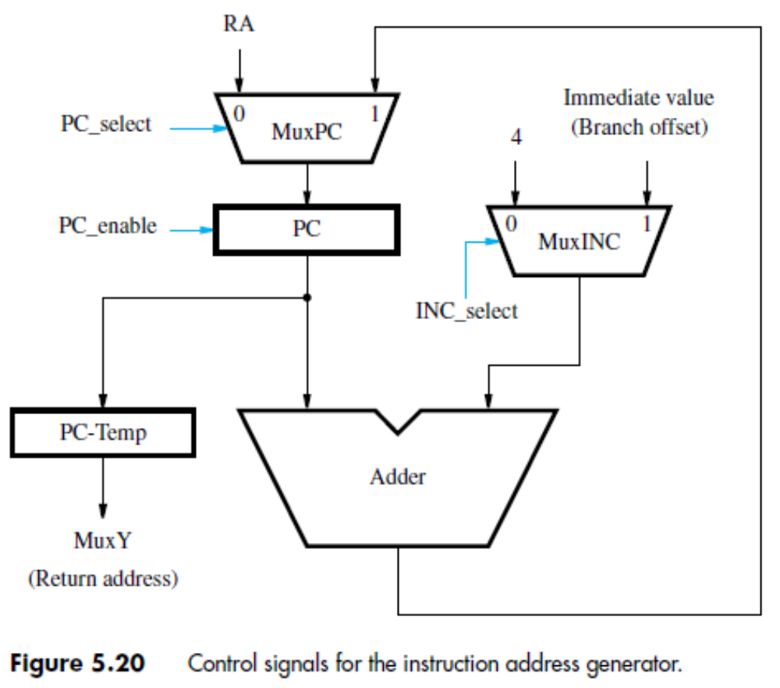
Control Signals (9)
Control Signals for the Instruction Address Generator

Slide 68
Control Signals (10)
Problem: Give the sequence of actions for a Return-from-subroutine instruction in a RISC processor. Assume that the address LINK of the general-purpose register in which the subroutine return address is stored is given in the instruction field connected to address A of the register file (IR31−27).

Slide 69
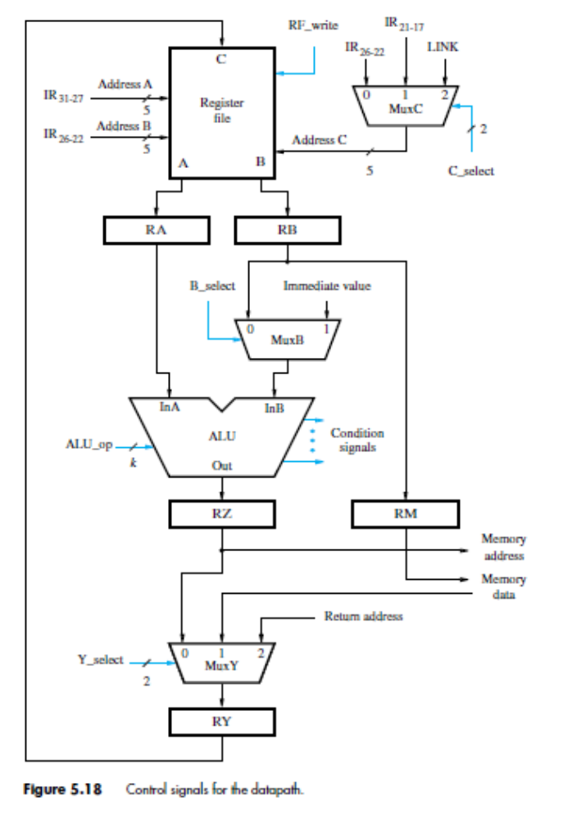
Control Signals (11)

Slide 70
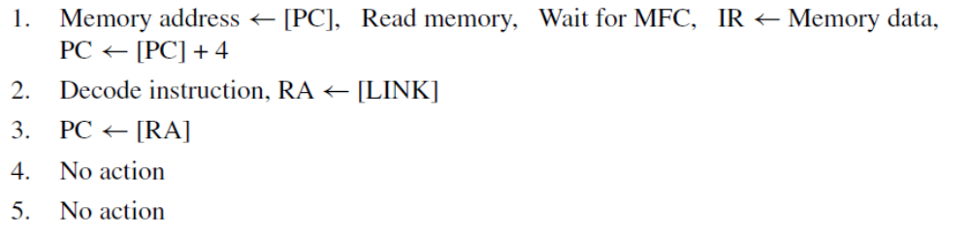
Control Signals (12)
Solution: Whenever an instruction is loaded into the IR, the contents of the general-purpose register whose address is given in bits IR31−27 are read and placed into register RA (see Figure 5.18). Hence, a Return-from-subroutine instruction will cause the contents of register LINK to be read and placed in register RA. Execution proceeds as follows:

Slide 71
Hardwired Control (1)
Control Signal Generation
  Circuitry must be implemented to generate control signals so actions take place in correct sequence and at correct time.
  There are two basic approaches
    Hardwired Control
      The control unit is essentially a combinational circuit. Its input logic signals are transformed into a set of output logic signals, which are the control signals.
    Microprogrammed Control
      The control signals are generated by a microprogram.

Slide 72
Hardwired Control (2)
Control Signal Generation
  Contents of the step counter
  Contents of the instruction register
  The result of a computation or a comparison operation
  External input signals, such as interrupt requests

Slide 73
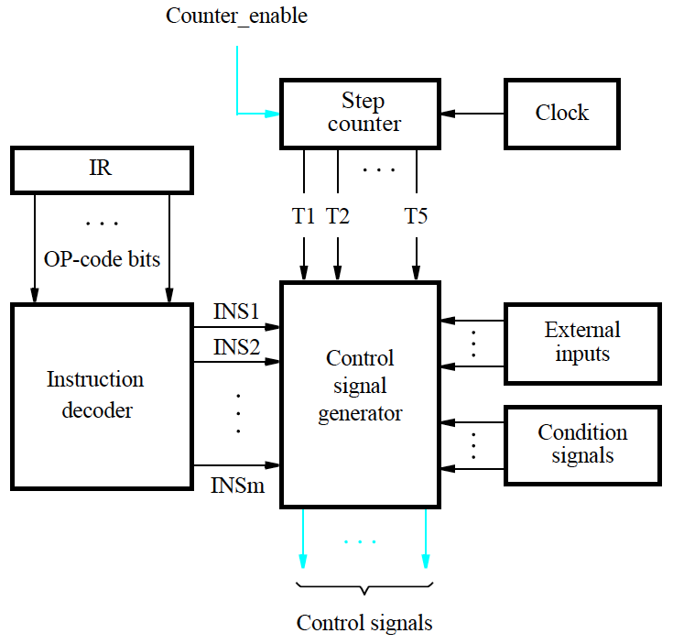
Hardwired Control (3)
Control Signal Generation (ctd.)

Slide 74
Hardwired Control (4)
Instruction Fetch Control Signals
  Step1 (instruction fetch):
  T1=1,
  MA_select=1,
  MEM_read, WMFC, IR_enable
  INC_select=0, PC_select=1, PC_enable=1

Slide 75
Hardwired Control (5)
Instruction Fetch Control Signals (ctd.)

Slide 76
Hardwired Control (6)
Instruction Fetch Control Signals (ctd.)

Slide 77
Hardwired Control (7)
Datapath Control Signals

Slide 78
Hardwired Control (8)
Datapath Control Signals
  Inter-stage registers RA, RB, RZ, RM, and RY are always enabled. This means that data flow automatically from one datapath stage to the next on every active edge of the clock signal.
  The desired setting of various control signals can be determined by examining the actions taken in each execution step of every instruction.
    RF_write = T5 ・ (ALU + Load + Call)
    B_select = Immediate
      Immediate stands for all instructions that use an immediate value in the IR

Slide 79
Hardwired Control (9)
Datapath Control Signals (ctd.)
  Recall: Add R3, R4, R5 (ctd.)
    Sequence of Actions

Slide 80
Hardwired Control (10)
Datapath Control Signals (ctd.)
  Recall: Load R5, X(R7)
    Sequence of Actions

Slide 81
Hardwired Control (11)
Datapath Control Signals (ctd.)
  Example: Call_Register R9

Slide 82
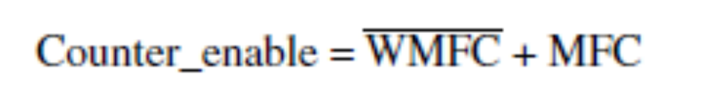
Hardwired Control (12)
Dealing With Memory Delay
  To extend the duration of an execution step to more than one clock cycle, we need to disable the step counter.
  Assume that the counter is incremented when enabled by a control signal called Counter_enable.
  Let the need to wait for a memory operation to be completed be indicated by a control signal called WMFC, which is activated during any execution step in which the Wait for MFC command is issued.
Notes:
讲到这里—2018.11.8

Slide 83
Hardwired Control (13)
Dealing With Memory Delay (ctd.)
  We must ensure that the PC is incremented only once when an execution step is extended for more than one clock cycle.
    PC_enable = T1 ・ MFC + T3 ・ BR

Slide 84
CISC-Style Processors (1)
CISC-style processors have more complex instructions.
The full collection of instructions cannot all be implemented in a fixed number of steps.
Execution steps for different instructions do not all follow a prescribed sequence of actions.
Hardware organization should therefore enable a flexible flow of data and actions to accommodate CISC.

Slide 85
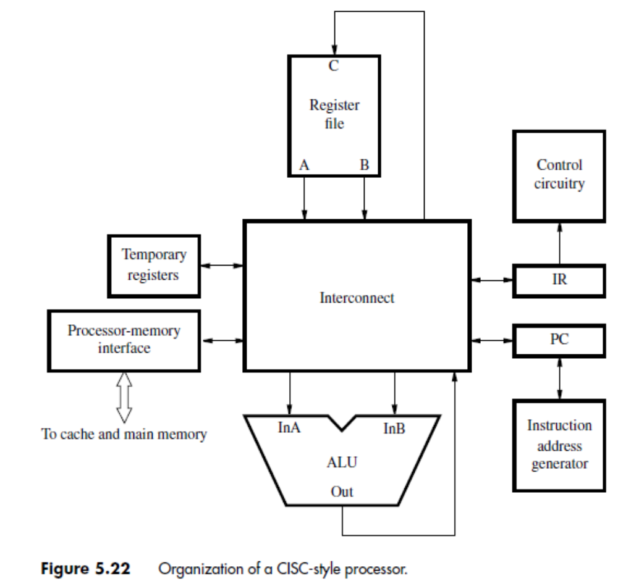
CISC-Style Processors (2)
Hardware Organization of A CISC-Style Processor

Slide 86
CISC-Style Processors (3)
Hardware Organization of A CISC-Style Processor (ctd.)
  Interconnect Block
    Provide interconnections among other blocks
    It does not prescribe any particular structure or pattern of data flow
    It provides paths that make it possible to transfer data between any two components, as needed to implement instructions.
  Temporary Registers Block
    No inter-stage registers
    Two temporary registers hold intermediate results during instruction execution
      Temp1 and Temp2

Slide 87
CISC-Style Processors (4)
Traditional Implementation of the Interconnect: Bus
A bus consists of a set of lines to which several devices may be connected, enabling data to be transferred from any one device to any other.
A logic gate that sends a signal over a bus line is called a bus driver.
When functional units are connected to a common bus, tri-state drivers are needed.

Slide 88
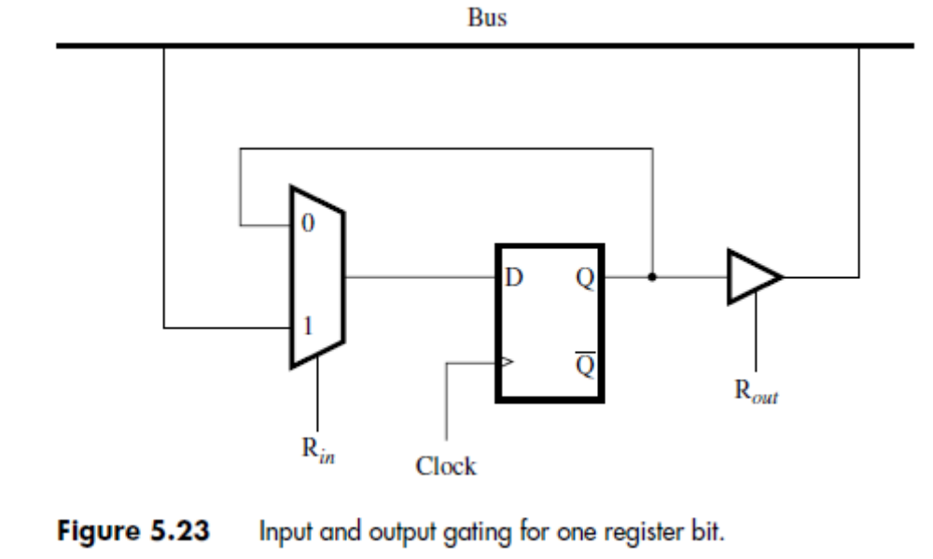
CISC-Style Processors (5)
How a flip-flop that forms one bit of a data register can be connected to a bus line
  Rin
  Rout

Slide 89
CISC-Style Processors (6)
An Interconnect Using Three Buses
  All registers are assumed to be edge-triggered
    When a register is enabled, data are loaded into it on the active edge of the clock at the end of the clock period.
  Addresses for the three ports of the register file are provided by the Control block.
  These connections are not shown to keep the figure simple.
  Also not shown is the Immediate block through which the IR is connected to bus B.

Slide 90
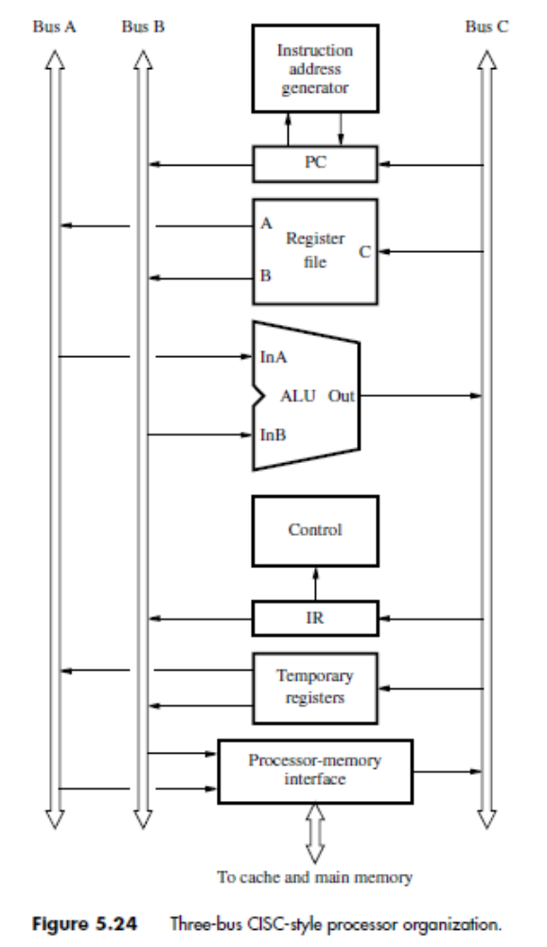
CISC-Style Processors (7)
An Interconnect Using Three Buses (ctd.)

Slide 91
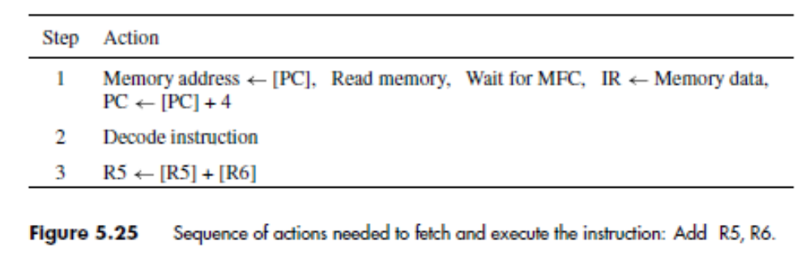
CISC-Style Processors (8)
An Interconnect Using Three Buses (ctd.)
  Example: Add R5, R6

Slide 92
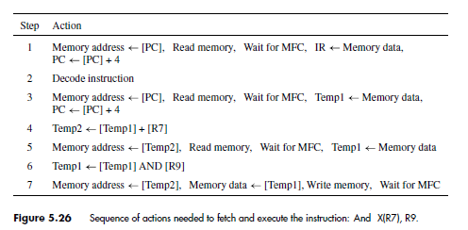
CISC-Style Processors (9)
An Interconnect Using Three Buses (ctd.)
  Example: And X(R7), R9

Slide 93
CISC-Style Processors (10)
Microprogrammed Control
  It is possible to use a “software" approach, in which the desired setting of the control signals in each step is determined by a program stored in a special memory.
  Control Word (Microinstruction)
    Suppose that n control signals are needed. Let each control signal be represented by a bit in an n-bit word, which is often referred to as a control word or a microinstruction.
  Microroutine (Microprogram )
    A sequence of CWs corresponding to the control sequence of a machine instruction constitute the microroutine for that instruction.
Notes:
讲到这里—2018.11.13

Slide 94
CISC-Style Processors (11)
Microprogrammed Control (ctd.)
  Microprogram Memory or Control Store
    The microprogram is stored on the processor chip in a small and fast memory called the microprogram memory or the control store.
  A processor instruction is implemented by a sequence of microinstructions that are placed in a control store.

Slide 95
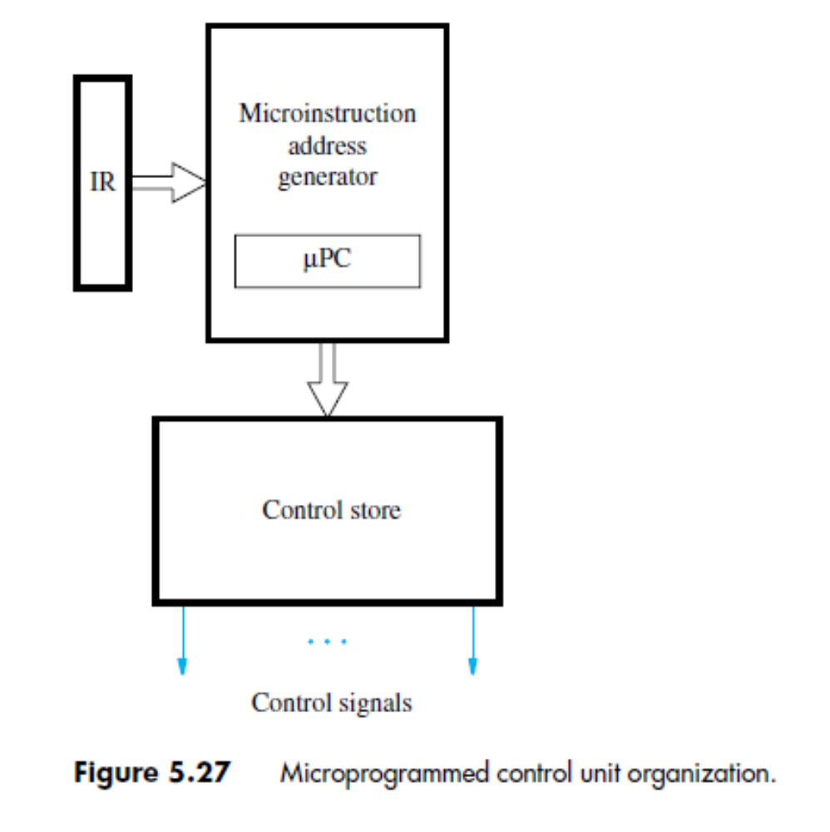
CISC-Style Processors (12)
Microprogrammed Control (ctd.)

Slide 96
Summary
Execution steps of an instruction
Principle of hard-wired control unit
Principle of microprogram control
Terminologies
  Control word : A control word is a word whose individual bits represent the various
  Microprogram: A sequence of CWs corresponding to the control sequence of a machine instruction constitute the microroutine for that instruction.
  Control store: The microinstruction for all instructions in the instruction set of a computer are stored in a special memory called control store.

