Slide 1
Computer Organization & Architecture
Chapter 6 – Pipelining
Junying Chen 陈俊颖

Slide 2
Content of this lecture
6.1 Basic Concept
6.2 Pipeline Organization
6.3 Pipeline Issues
6.4 Data Dependencies
6.5 Memory Delays
6.6 Branch Delays
6.7 Resource Limitations
6.12 Examples of Solved Problems
Summary

Slide 3
Basic Concept (1)
Making the Execution of Programs Faster
  Use faster circuit technology to build the processor and the main memory.
  Arrange the hardware so that more than one operation can be performed at the same time.
  In the latter way, the number of operations performed per second is increased even though the elapsed time needed to perform any one operation is not changed.

Slide 4
Basic Concept (2)
1 nanosecond = 10^-9 second
1 picosecond = 10^-12 second
Pipelining a Digital System
  Key idea: break big computation up into pieces
  Separate each piece with a pipeline register
1ns
200ps
200ps
200ps
200ps
200ps
Pipeline
Register

Slide 5
Basic Concept (3)
Pipelining a Digital System (ctd.)
  Why do this? Because it's faster for repeated computations
Non-pipelined:
1 operation finishes
every 1ns
1ns
Pipelined:
1 operation finishes
every 200ps
200ps
200ps
200ps
200ps
200ps

Slide 6
Basic Concept (4)
Pipelining a Digital System (ctd.)
  Comments about pipelining
    Pipelining increases throughput, but not latency
      Answer available every 200ps, BUT
      A single computation still takes 1ns
    Limitations
      Computations must be divisible into stage size
      Pipeline registers add overhead

Slide 7
Basic Concept (5)
Pipelining a Processor
  Recall the 5 steps in instruction execution: Figure 5.7
  1. Instruction Fetch
  2. Instruction Decode and Register Read
  3. Execution operation or calculate address
  4. Memory access
  Write result into register
  Review: Figure 5.8

Slide 8
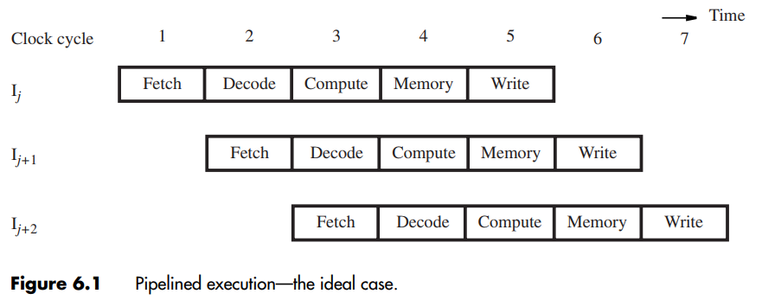
Basic Concept (6)
Pipelining a Processor (ctd.)

Slide 9
Basic Concept (7)
What is Pipelining
  A way of speeding up execution of instructions
Key Idea
  Overlap execution of multiple instructions

Slide 10
Pipeline Organization (1)
Use program counter (PC) to fetch instructions
A new instruction enters pipeline every cycle
Carry along instruction-specific information as instructions flow through the different stages
  Use inter-stage buffers to hold this information
  These buffers incorporate RA, RB, RM, RY, RZ, IR, and PC-Temp registers from Chapter 5
  The buffers also hold control signal settings

Slide 11
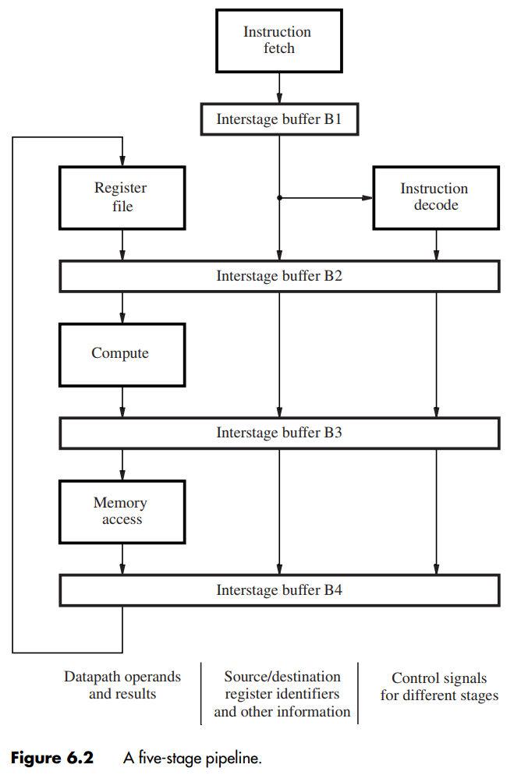
Pipeline Organization (2)
A Five-Stage Pipeline
  B1 holds a newly-fetched instruction.
  B2 holds
    Two operands read from the register file,
    Source/destination register identifiers
    Immediate value derived from the instruction,
    Incremented PC value used as the return address for a subroutine call
    Settings of control signals determined by the instruction decoder.

Slide 12
Pipeline Organization (3)
A Five-Stage Pipeline (ctd.)
  B3 holds
    Result of ALU operation: data or address
    Incremented PC value used as the return address for a subroutine call
  B4 holds a value to be written into the register

Slide 13
Pipeline Issues (1)
Any condition that causes a pipeline to stall is called a hazard.
Three Types of Hazard
  Data hazard – any condition in which either the source or the destination operands of an instruction are not available at the time expected in the pipeline. So some operation has to be delayed, and the pipeline stalls.
  Instruction (control) hazard – a delay in the availability of an instruction causes the pipeline to stall.
  Structural hazard – the situation when two instructions require the use of a given hardware resource at the same time.

Slide 14
Pipeline Issues (2)
An Example of Data Hazard
  Consider two successive instructions I_{j} and I_{j+1}
  Assume that the destination register of I_{j} matches one of the source registers of I_{j+1}
  Result of I_{j} is written to destination in cycle 5
  But I_{j+1} reads old value of register in cycle 3
  Due to pipelining, I_{j+1} computation is incorrect
  So stall (delay) I_{j+1} until I_{j} writes the new value

Slide 15
Data Dependencies (1)
A Specific Data Hazard Example
Add R2, R3, #100
Subtract R9, R2, #30
  Destination R2 of Add is a source for Subtract
  There is a data dependency between them because R2 carries data from Add to Subtract
  On non-pipelined datapath, result is available
  in R2 because Add completes before Subtract

Slide 16
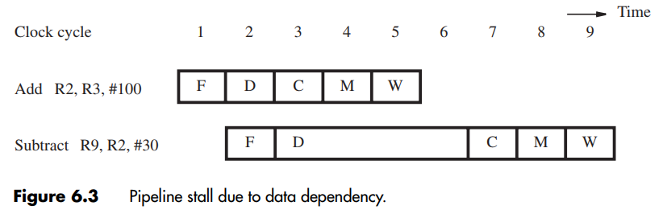
Data Dependencies (2)
Stalling the Pipeline
  With pipelined execution, old value is still in register R2 when Subtract is in Decode stage
  So stall Subtract for 3 cycles in Decode stage
  New value of R2 is then available in cycle 6

Slide 17
Data Dependencies (3)
Details for Stalling the Pipeline
  Control circuitry must recognize dependency while Subtract is being decoded in cycle 3
  Interstage buffers carry register identifiers for source(s) and destination of instructions
  In cycle 3, compare destination identifier in Compute stage against source(s) in Decode
  R2 matches, so Subtract kept in Decode
  while Add allowed to continue normally

Slide 18
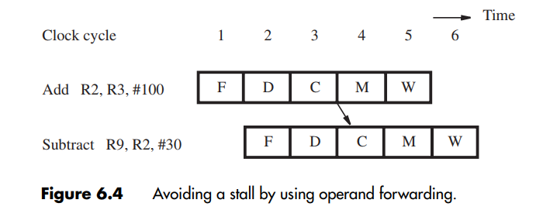
Data Dependencies (4)
Operand Forwarding
  Operand forwarding handles dependencies without the penalty of stalling the pipeline
  For the preceding sequence of instructions, new value for R2 is available at end of cycle 3
  Forward value to where it is needed in cycle 4

Slide 19
Data Dependencies (5)
Details For Operand Forwarding
  Introduce multiplexers before ALU inputs to use contents of register RZ as forwarded value
  Control circuitry now recognizes dependency in cycle 4 when Subtract is in Compute stage
  Interstage buffers still carry register identifiers
  Compare destination of Add in Memory stage with source(s) of Subtract in Compute stage
  Set multiplexer control based on comparison

Slide 20
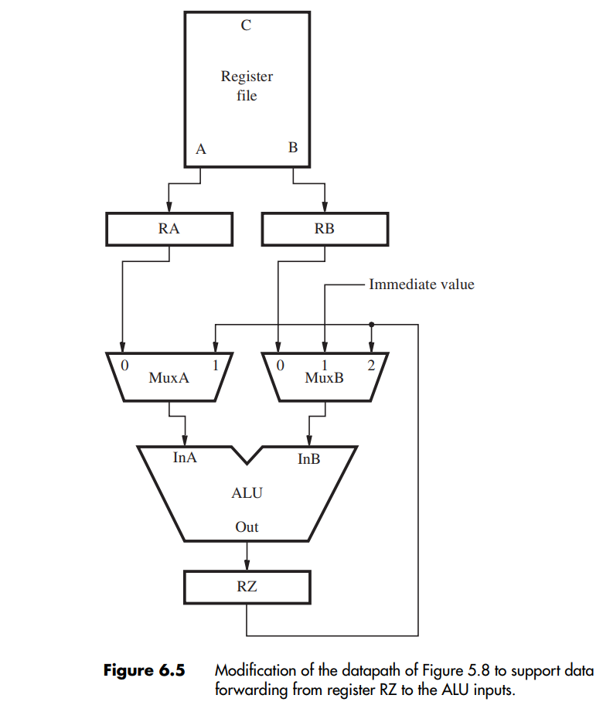
Data Dependencies (6)
Details For Operand Forwarding

Slide 21
Data Dependencies (7)
Extension of Operand Forwarding
  Forwarding can also be extended to a result in register RY in Figure 5.8.
  This would handle a data dependency such as the one involving register R2 in the following sequence of instructions:
      Add R2, R3, #100
      Or R4, R5, R6
      Subtract R9, R2, #30

Slide 22
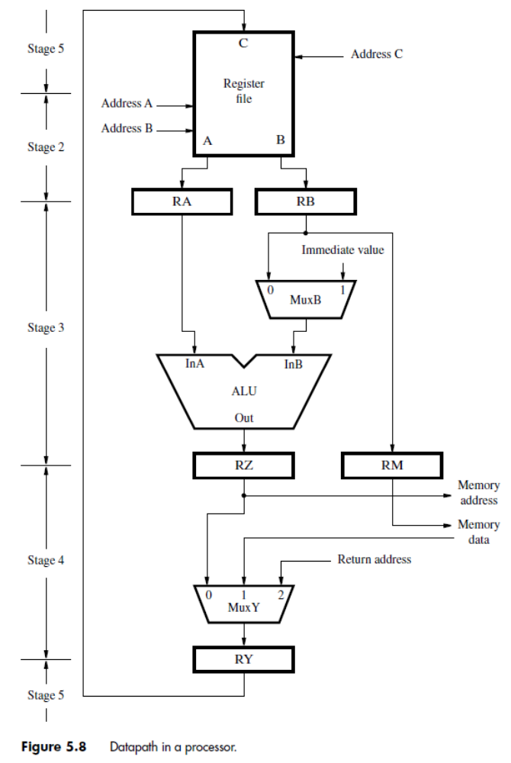
Data Dependencies (8)
Extension of Operand Forwarding (ctd.)

Slide 23
Data Dependencies (9)
Software Handling of Dependencies
  Compiler can generate & analyze instructions
  Data dependencies are evident from registers
  Compiler puts three explicit NOP instructions between instructions having a dependency
  Delay ensures new value available in register but causes total execution time to increase
  Compiler can optimize by moving instructions into NOP slots (if data dependencies permit)
Notes:
NOP: no operation

Slide 24
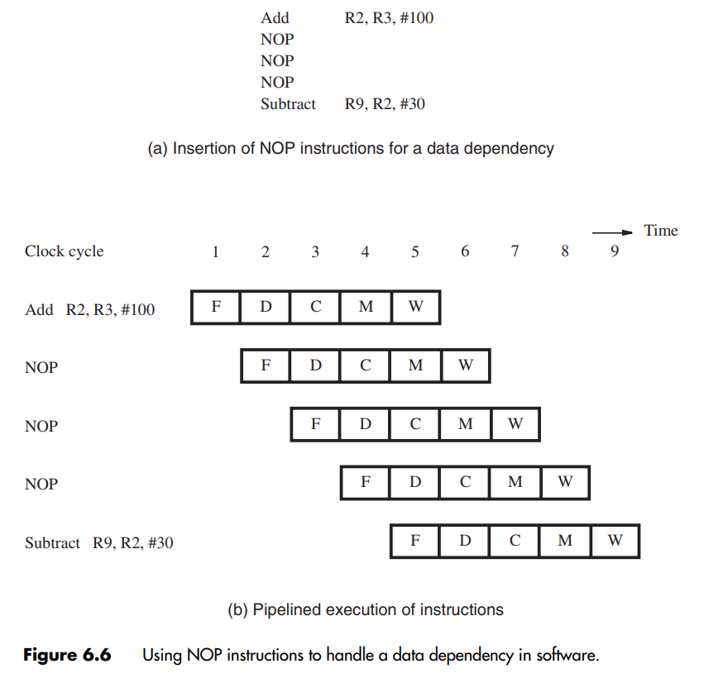
Data Dependencies (10)
Software Handling of Dependencies (ctd.)

Slide 25
Memory Delays (1)
Memory delays can also cause pipeline stalls
A cache memory holds instructions and data from the main memory, but is faster to access
With a cache, typical access time is one cycle
But a cache miss requires accessing slower main memory with a much longer delay
In pipeline, memory delay for one instruction causes subsequent instructions to be delayed

Slide 26
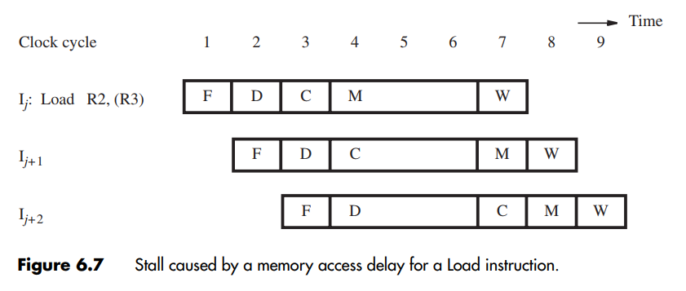
Memory Delays (2)
Memory Delay for a Load Instruction

Slide 27
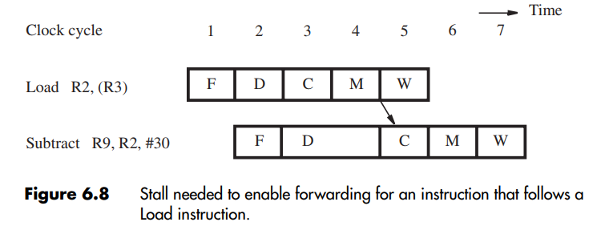
Memory Delays (3)
Even with a cache hit, a Load instruction may cause a short delay due to a data dependency
One-cycle stall required for correct value to be forwarded to instruction needing that value
The compiler can eliminate the one-cycle stall. Optimize with useful instruction to fill delay

Slide 28
Branch Delays (1)
Ideal pipelining: fetch each new instruction while previous instruction is being decoded
Instruction (control) hazard – a delay in the availability of an instruction causes the pipeline to stall.
Branch instructions alter execution sequence, but they must be processed to know the effect
Any delay for determining branch outcome leads to an increase in total execution time
Techniques to mitigate this effect are desired
Understand branch behaviour to find solutions

Slide 29
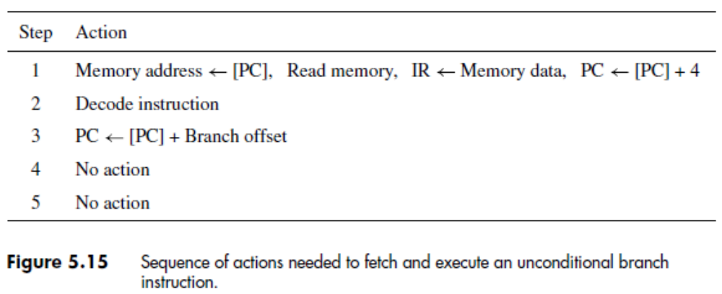
Branch Delays (2)
Unconditional Branches
  Consider instructions I_{j} , I_{j+1} , I_{j+2} in sequence
  I_{j} is an unconditional branch with target I_{k}
  In Chapter 5, the Compute stage determined the target address using offset and PC+4 value

Slide 30
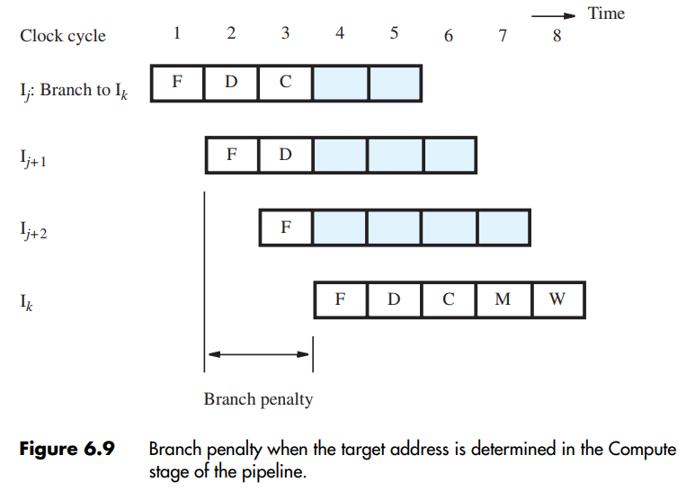
Branch Delays (3)
Unconditional Branches (ctd.)
  In pipeline, target I_{k} is known for I_{j} in cycle 4, but instructions I_{j+1} , I_{j+2} fetched in cycles 2 & 3
  Target I_{k} should have followed I_{j} immediately, so discard I_{j+1} , I_{j+2} and incur two-cycle penalty

Slide 31
Branch Delays (4)
Reducing the Branch Penalty
  In pipeline, adder for PC is used every cycle, so it cannot calculate the branch target address
  So introduce a second adder just for branches
  Place this second adder in the Decode stage to enable earlier determination of target address
  For previous example, now only I_{j+1} is fetched
  Only one instruction needs to be discarded
  The branch penalty is reduced to one cycle

Slide 32
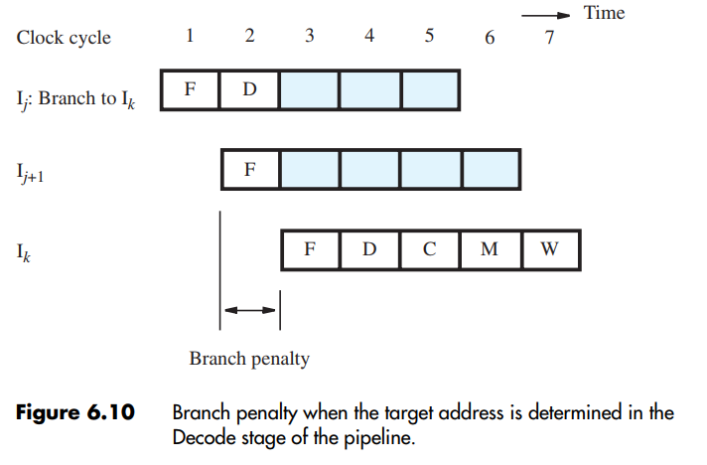
Branch Delays (5)
Reducing the Branch Penalty (ctd.)

Slide 33
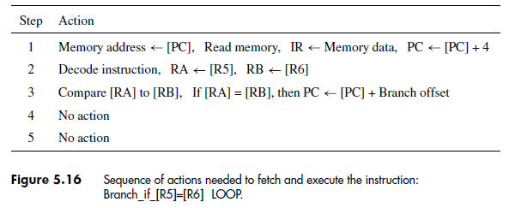
Branch Delays (6)
Conditional Branches
  Consider a conditional branch instruction:
  Branch_if_[R5]=[R6] LOOP
  Requires not only target address calculation, but also requires comparison for condition
  In Chapter 5, ALU performed the comparison

Slide 34
Branch Delays (7)
Conditional Branches (ctd.)
  To maintain one-cycle penalty, we introduce a comparator just for branches in Decode stage
  Target address now calculated in Decode stage

Slide 35
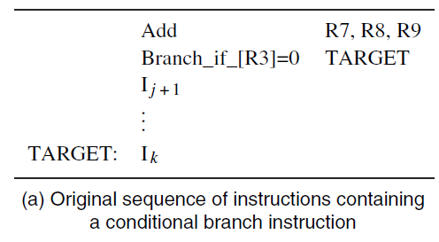
Branch Delays (8)
The Branch Delay Slot
  Let both branch decision and target address be determined in Decode stage of pipeline.
Notes:
讲到这里—2018.11.15

Slide 36
Branch Delays (9)
The Branch Delay Slot (ctd.)
  Branch not taken, no branch penalty
Add
F
D
C
M
W
F
D
Branch
F
D
C
M
W
I j+1

Slide 37
Branch Delays (10)
The Branch Delay Slot (ctd.)
  Branch taken, one cycle of branch penalty
Add
F
D
C
M
W
F
D
Branch
F
I j+1
F
D
C
M
W
I k

Slide 38
Branch Delays (11)
The Branch Delay Slot (ctd.)
  Instruction immediately following a branch is always fetched, regardless of branch decision
  That next instruction is discarded with penalty, except when conditional branch is not taken
  The location immediately following the branch is called the branch delay slot

Slide 39
Branch Delays (12)
The Branch Delay Slot (ctd.)
  Instead of conditionally discarding instruction in delay slot, always let it complete execution
  Let compiler find an instruction before branch to move into slot, if data dependencies permit
  Called delayed branching due to reordering
  If useful instruction put in slot, penalty is zero
  If not possible, insert explicit NOP in delay slot for one-cycle penalty, whether or not taken

Slide 40
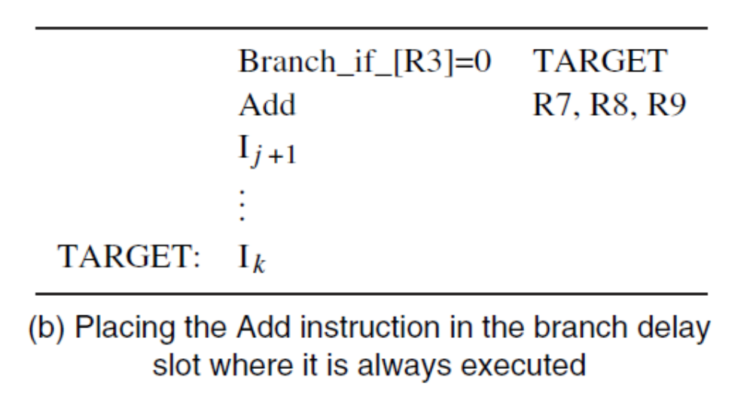
Branch Delays (13)
The Branch Delay Slot (ctd.)

Slide 41
Branch Delays (15)
Branch Prediction
  A branch is decided in Decode stage (cycle 2) while following instruction is always fetched
  Following instruction may require discarding (or with delayed branching, it may be a NOP)
  Instead of discarding the following instruction, can we anticipate the actual next instruction?
  Two aims: (a) predict the branch decision
  (b) use prediction earlier in cycle 1

Slide 42
Resource Limitations (1)
Structural Hazards
  Resource conflicts when hardware cannot support all possible combinations of instructions simultaneously in overlapped execution.
  Can be prevented by providing additional hardware.
Reasons for structural hazards
  Some functional units not fully pipelined
  Some resources not duplicated enough
Pipeline stalls when there are insufficient hardware resources to permit all actions to proceed concurrently.

Slide 43
Resource Limitations (2)
Example: Assume a processor with only one memory port
Load
F
D
C
M
W
I+1
F
D
C
M
W
I+2
F
D
C
M
W
F
D
C
M
W
I+3

Slide 44
Resource Limitations (3)
Example: Assume a processor with only one memory port (ctd.)
Load
F
D
C
M
W
I+1
F
D
C
M
W
I+2
F
D
C
M
W
Stall
F
D
C
M
I+3

Slide 45
Examples of Solved Problems (1)
Example 6.1 Problem: Consider the pipelined execution of the following sequence of instructions:
  Add R4, R3, R2
  Or R7, R6, R5
  Subtract R8, R7, R4
Initially, registers R2 and R3 contain 4 and 8, respectively. Registers R5 and R6 contain 128 and 2, respectively. Assume that the pipeline provides forwarding paths to the ALU from registers RY and RZ in Figure 5.8. The first instruction is fetched in cycle 1, and the remaining instructions are fetched in successive cycles. Draw a diagram similar to Figure 6.1 to show the pipelined execution of these instructions assuming that the processor uses operand forwarding. Then, with reference to Figure 5.8, describe the contents of registers RY and RZ during cycles 4 to 7.

Slide 46
Examples of Solved Problems (2)
Example 6.1 Solution: There are data dependencies involving registers R4 and R7. The Subtract instruction
needs the new values for these registers before they are written to the register file. Hence, those values need to be forwarded to the ALU inputs when the Subtract instruction is in the Compute stage of the pipeline. Figure 6.15 shows the execution with forwarding. One arrow represents the new value of register R7 being forwarded from register RZ, and the other arrow represents the new value of register R4 being forwarded from register RY.

Slide 47
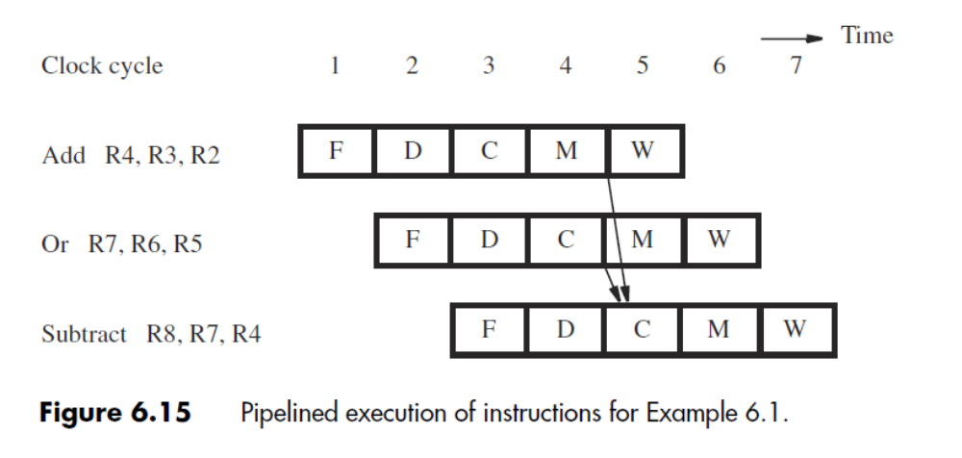
Examples of Solved Problems (3)
Example 6.1 Solution (ctd.):

Slide 48
Examples of Solved Problems (4)
Example 6.1 Solution (ctd.):

Slide 49
Examples of Solved Problems (5)
Example 6.1 Solution (ctd.):As for the contents of registersRYandRZduring cycles 4 to 7, the following description provides the answer.
  Using the initial values for registers R2 and R3, theAdd instruction generates the result of 12 in cycle 3. That result is available in register RZ during cycle 4. The value in register RY during cycle 4 is the result for the unspecified instruction preceding the Add instruction.
  In cycle 4, the Or instruction generates the result of 130. That result is placed in register RZ to be available during cycle 5. The result of 12 for the Add instruction is in register RY during cycle 5.

Slide 50
Examples of Solved Problems (6)
Example 6.1 Solution (ctd.):
  In cycle 5, the Subtract instruction is in the Compute stage. To generate a correct result, forwarding is used to provide the value of 130 in register RY and the value of12 in register RZ. The result from theALU is 130 − 12 = 118. This result is available in register RZ during cycle 6. The result of the Or instruction, 130, is in register RY during in cycle 6.
  In cycle 6, the Subtract instruction is in the Memory stage. The unspecified instruction following the Subtract instruction is generating a result in the Compute stage. In cycle 7, the result of the unspecified instruction is in register RZ, and the result of the Subtract instruction is in register RY.

Slide 51
Summary
Principle of pipeline
Pipeline Hazards
  Data hazard
    Operand forwarding
  Control hazard
    Delay slot
    Static prediction
  Structural hazard

